Slide 1
I CAN DO IT
ALL BY MYSELF – part III.
Exploring new roles for libraries and mediating technologies in addressing the DIY mindset of library patrons
Jason Clark
Head of Digital Access & Web Services
Montana State University Library
American Library Association Annual Conference, Anaheim, CA. 2012

Slide 2
pinboard.in tag for links
  pinboard.in/u:jasonclark/t:ala2012-diy

Slide 3
New Paradigm
  What about users that don’t come into the building?
    Libraries are passive
    Users are active
  Building engaging tools and online experiences

Slide 4
Traditional library services are designed to solve information scarcity by mediation.

Slide 5
Disintermediation
In economics, disintermediation is the removal of intermediaries in a supply chain: "cutting out the middleman".
  en.wikipedia.org/wiki/Disintermediation

Slide 6
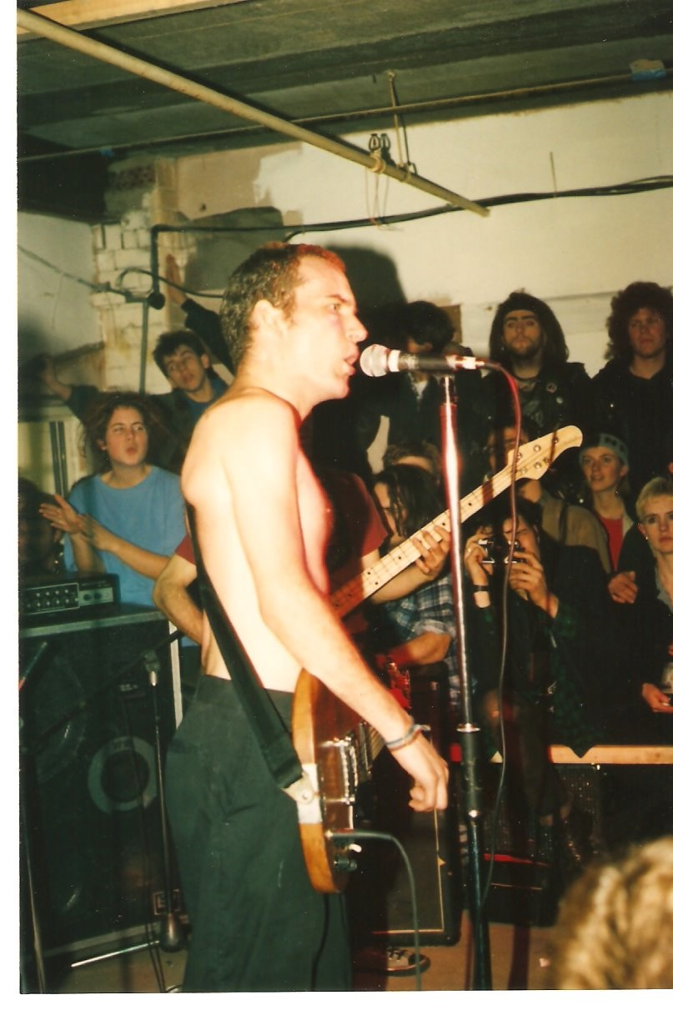
DIY – “Do It Yourself”
Ian MacKaye, Punk Rocker and DIY Patron Saint

Slide 7
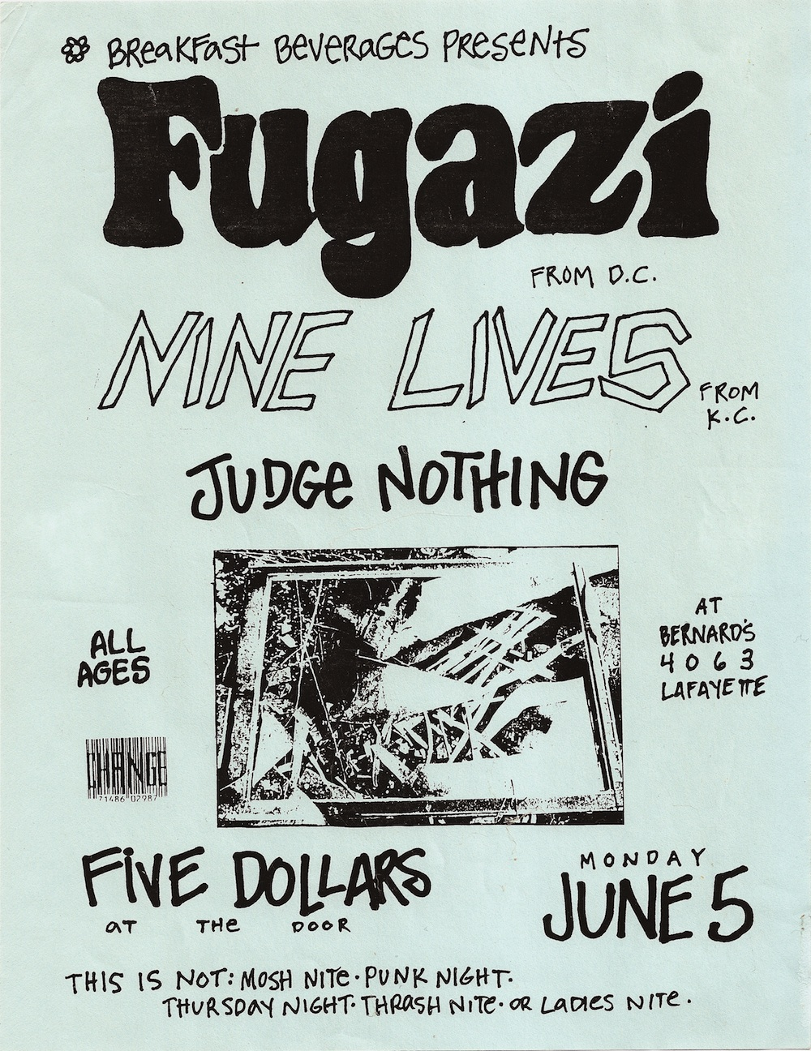
DIY – “Do It Yourself”

Slide 8
DIY – “Do It Yourself”
“…recorded their own music, produced albums and merchandise, distributed their works and often performed basement shows in residential homes rather than at traditional venues to secure freedom in performance.”
  en.wikipedia.org/wiki/DIY_ethic

Slide 9
DIY and the Internet
  DIY as part of Internet Culture
    Make Magazine
      makezine.com
    Skillshare
      www.skillshare.com
  We work in a medium that facilitates DIY

Slide 10
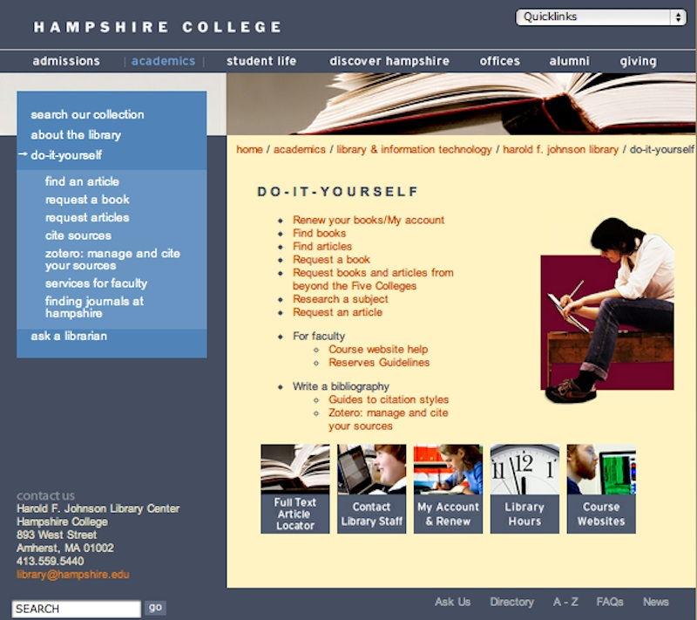
DIY Libraries

Slide 11
What about apps and tools that create and support DIY behavior?

Slide 12
Crowdsourcing
  WikiAnswers
    wiki.answers.com
  Direct Me NYC: 1940
    directme.nypl.org
  What's on the Menu?
    menus.nypl.org
  Patron Driven Acquisition
    scholarlykitchen.sspnet.org/2011/05/31/what-patron-driven-acquisition-pda-does-and-doesnt-mean-an-faq

Slide 13
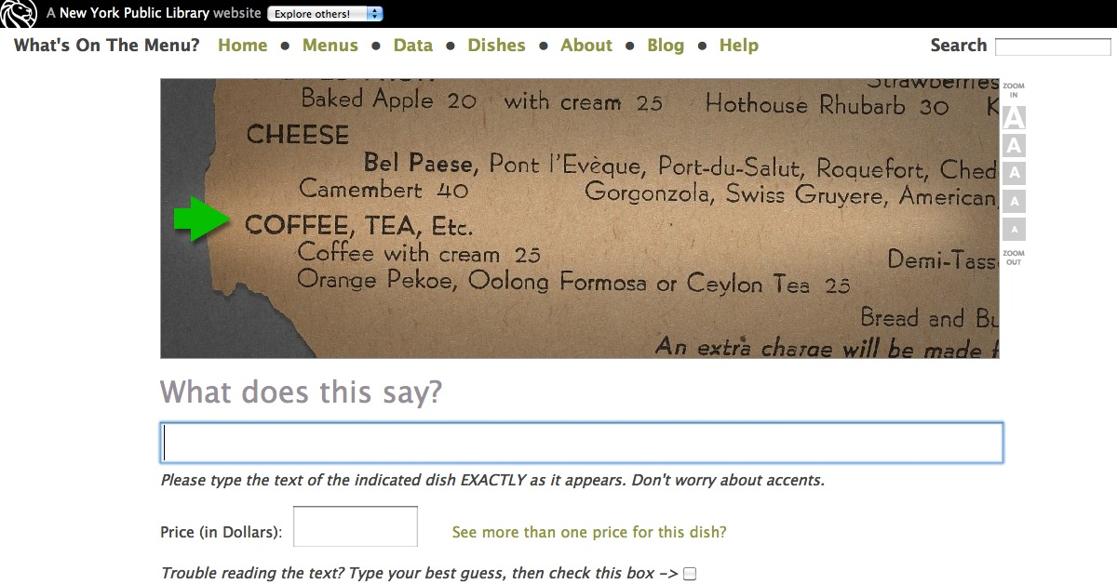
Crowdsourcing

Slide 14
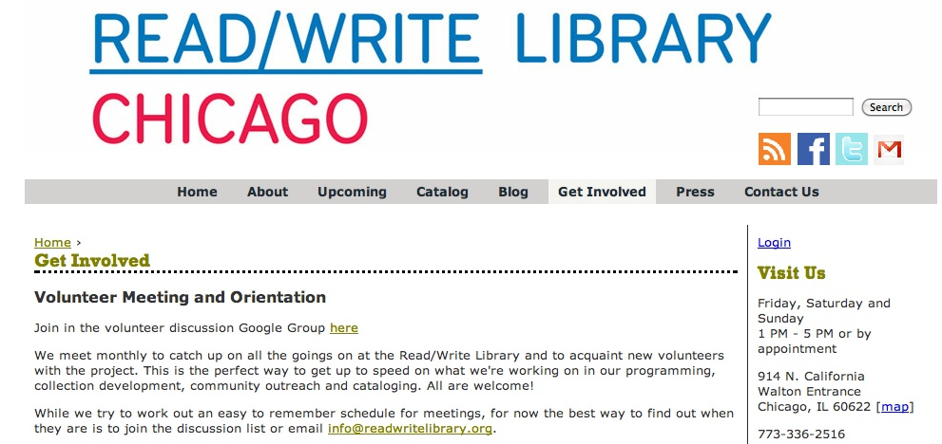
Crowdsourcing

Slide 15
Research & Citation Management
  The Student Research Pad (draft)
    www.stephenfrancoeur.com/digitalreference/2012/04/02/the-student-research-pad/
  Surfacing scholarly community activity
    www.lib.montana.edu/resources/popular.php
    realtime.easybib.com
  Mendeley, Academia.edu, Zotero, scholr.ly

Slide 16
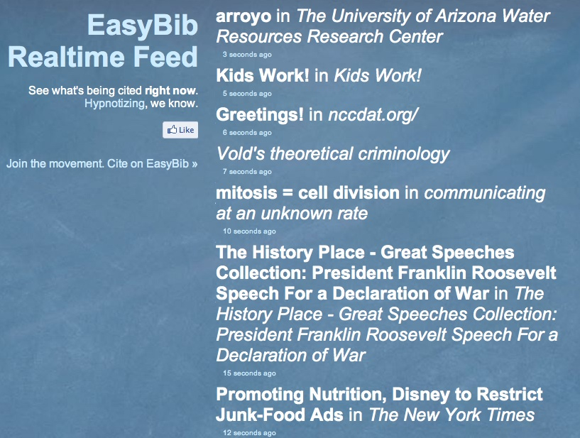
Research & Citation Management

Slide 17
Extending Search
  University of Michigan Library Bookmarklets
    www.lib.umich.edu/mlibrary-labs
  LibX toolbar
    libx.org
  NCSU QuickSearch (metasearch results)
    www.lib.ncsu.edu/search/?q=laser
    www.lib.ncsu.edu/search/about.html

Slide 18
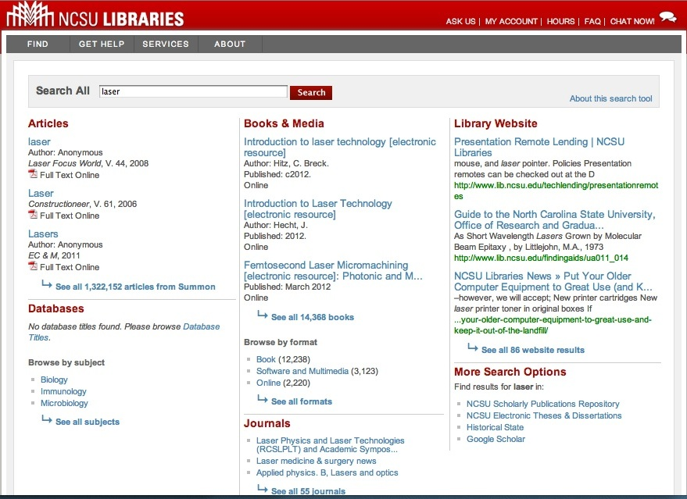
Extending Search

Slide 19
Converting traditional services?
What are the new "app" opportunities?

Slide 20
(new) Ready Reference
  twitterbots, chatbots, statbots
    Chatbot - University of Nebraska Library
      dx.doi.org/10.1108/07378831211213238
    Statbot - Florida State University Library
      journal.code4lib.org/articles/85

Slide 21
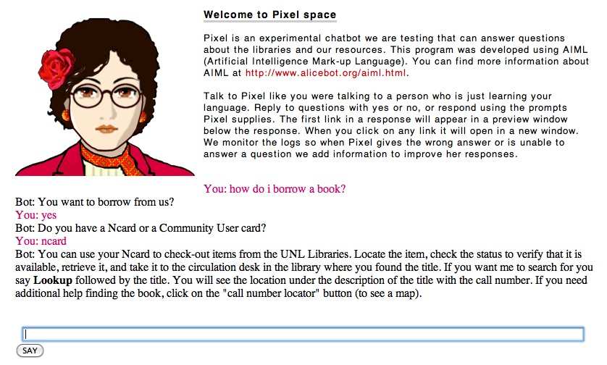
(new) Ready Reference

Slide 22
(new) Reader’s Advisory
  Gimme (Scottsdale Public Library)
    gimme.scottsdalelibrary.org
  BookMeUp
    www.lib.montana.edu/beta/bookme

Slide 23
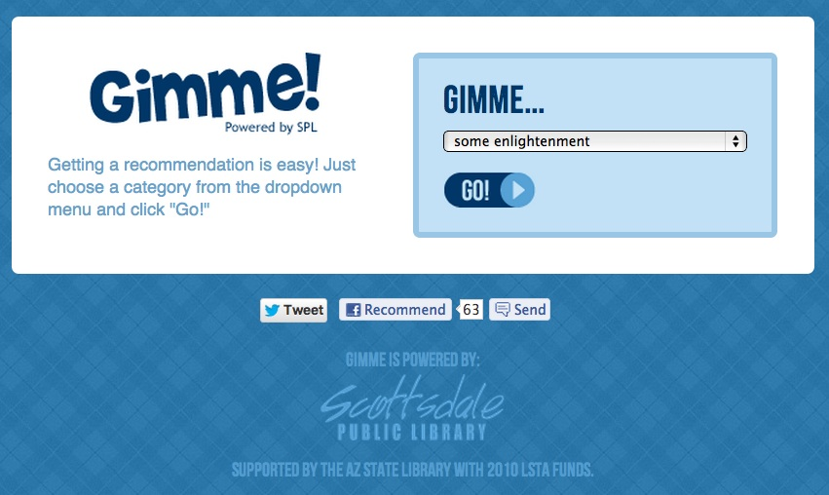
(new) Reader’s Advisory

Slide 24
(new) Outreach
  Data mining social media
    andyburkhardt.com/2010/02/12/ambient-awareness-in-twitter-for-reference
    andyburkhardt.com/2012/04/25/puppies-in-the-library-and-social-media

Slide 25
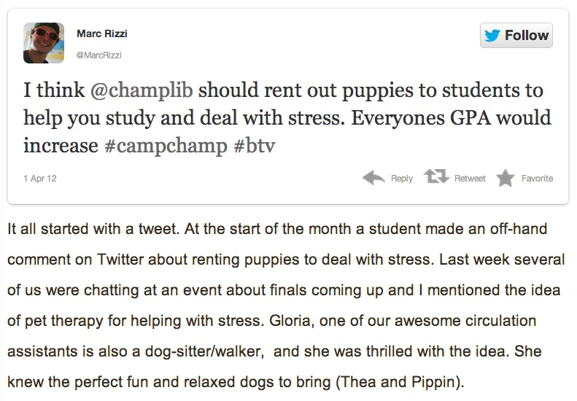
(new) Outreach

Slide 26
(new) Digital Collections
  Range Science Information System (RSIS)
    rangescience.info
  Experts creating a digital "bookshelf"

Slide 27
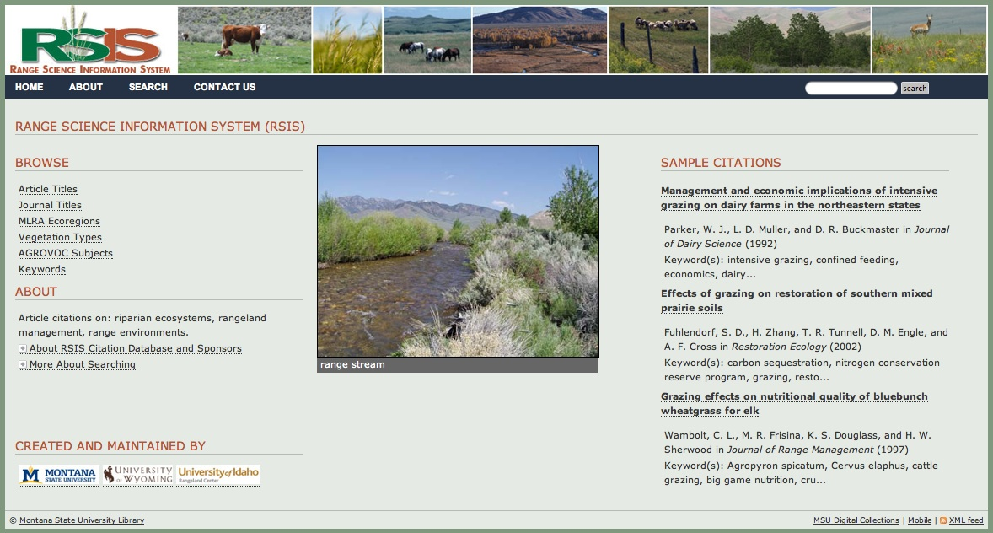
(new) Digital Collections

Slide 28
(new) Collection Development
  Patron Driven Acquisition
    scholarlykitchen.sspnet.org/2011/05/31/what-patron-driven-acquisition-pda-does-and-doesnt-mean-an-faq

Slide 29
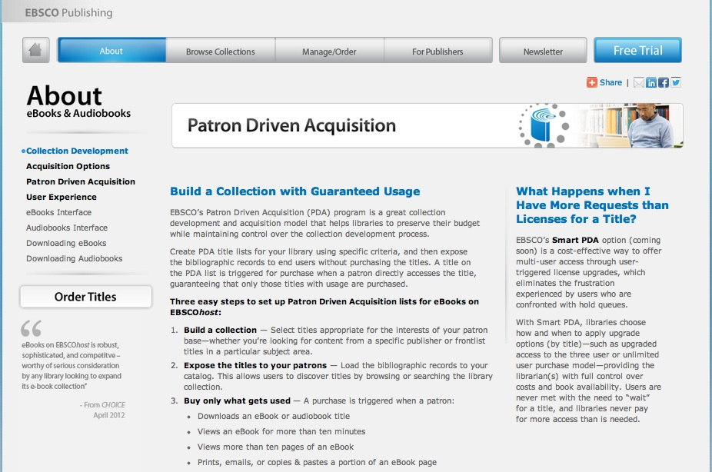
(new) Collection Development

Slide 30
(new) Content Selection
  Sorting databases based on popularity (clickthrough analytics)
    www.lib.montana.edu/resources/popular.php

Slide 31
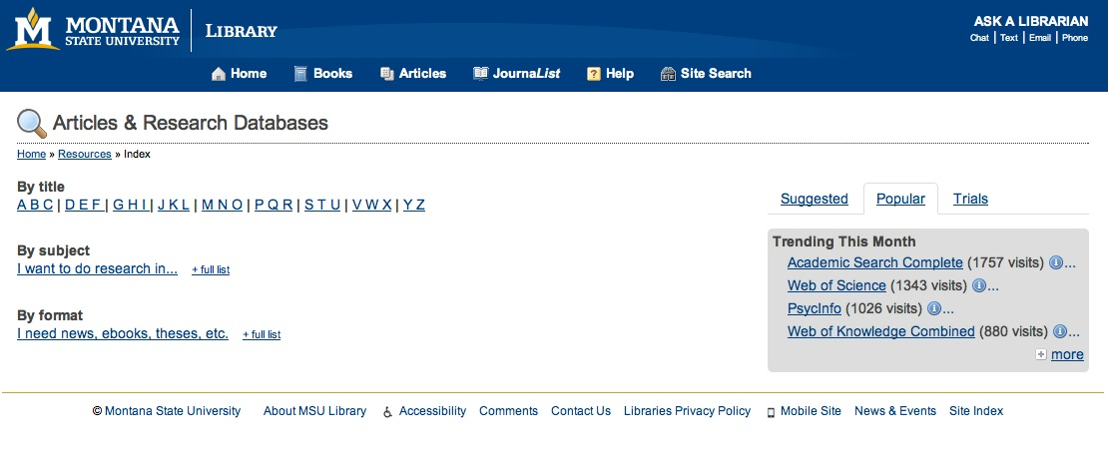
(new) Content Selection

Slide 32
(new) Instruction
  Real-time Instruction
    bit.ly/zA9DCf
    americanlibrariesmagazine.org/columns/practice/guide-side
  "Guide on the Side", a tutorial created for JSTOR by University of Arizona librarians

Slide 33
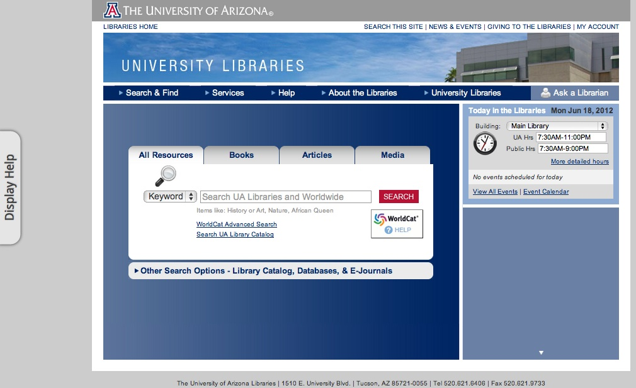
(new) Instruction

Slide 34
Takeaways & Next Steps
  New job duties, New staffing models
  Realignment of personnel
  Look for public service + tech service collaborations
  This is a great opportunity!
  We all have some role to play; it just might be a new role.

Slide 35
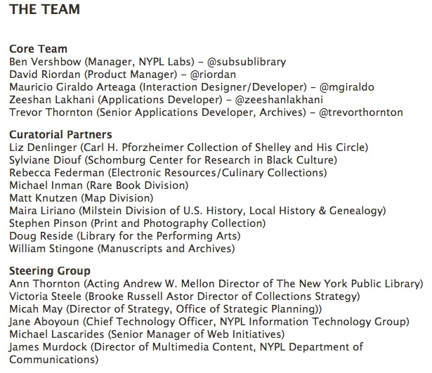
Takeaways & Next Steps

Slide 36
Code Samples
  Bookmarklets
    www.lib.montana.edu/~jason/files/bookmarklets
  AskREF
    www.lib.montana.edu/~jason/files/question-point
  BookMeUp
    www.lib.montana.edu/~jason/files.php

Slide 37
Questions?
  Twitter Hashtag
  #diy

