Slide 1
Beyond Description:
Using Schema.org to describe networks and actions in book, people, and discovery settings
American Library Association, Annual Meeting
“Understanding Schema.org” Session
Sponsors: ALCTS/LITA Metadata Standards Committee
June 29, 2014
Jason Clark
Head of Library Informatics & Computing
Montana State University Library

Slide 2
Abstract
At its core Schema.org is about creating machine-actionable descriptions of content. Librarians, especially cataloging librarians, have a unique understanding of the benefits of description at scale. What may be newer to our field are the additional expressions being brought into the Schema.org standard such as actions, roles, and linked data sameAs equivalencies. With the introduction of these expressions, opportunities for a more nuanced expression of identity and relationships in addition to basic description have been enabled. In this session, we’ll look at some particular projects at Montana State University Library – an online web book (arc.lib.montana.edu/book/home-cooking-history-409/), a people directory application (www.lib.montana.edu/people/), and a digital collections search application (arc.lib.montana.edu/digital-collections/) – that are beginning to apply some of these additional Schema.org expressions to define relationships and linked data sources inside of web applications and web pages.

Slide 3
pinboard.in tag
pinboard.in/u:jasonclark/t:ala-schema/

Slide 4
twitter as channel (#hashtag)
#schema
@jaclark

Slide 6
Overview
Emerging markup practices
Show some examples in production
Reason for these markup practices
Getting started
Questions

Slide 7
Introducing Semantic Markup
HTML5 semantic tags and schema.org vocabularies that help classify page types and identify content on the page
“If Google understands the content on your pages, we can create rich snippets—detailed information intended to help users with specific queries.”
https://support.google.com/webmasters/answer/99170?hl=en&ref_topic=1088472

Slide 8
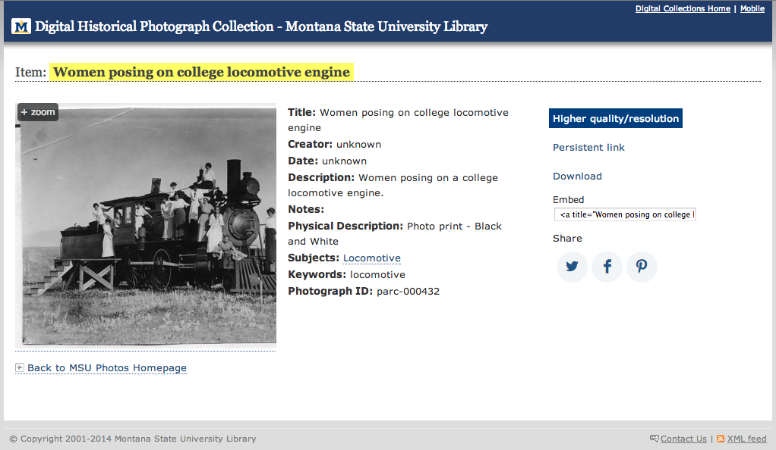
Before Schema.org markup

Slide 9
After Schema.org markup

Slide 10
<dl>
<dt>Title</dt>
<dd>A River Runs Through It and Other Stories</dd>
<dt>Author</dt>
<dd>Norman Maclean</dd>
<dt>Publication date</dt>
<dd>October 1, 2001</dd>
<dt>ID</dt>
<dd>0226500667</dd>
</dl>

Slide 11
<dl itemscope itemtype="http://schema.org/Book">
<dt>Title</dt>
<dd itemprop="title">A River Runs Through It and Other Stories</dd>
<dt>Author</dt>
<dd itemprop="author">Norman Maclean</dd>
<dt>Publication date</dt>
<dd itemprop="pubdate">October 1, 2001</dd>
<dt>ID</dt>
<dd itemprop="isbn">0226500667</dd>
</dl>

Slide 12
sameAs - Schema.org
“URL of a reference Web page that unambiguously indicates the item's identity.”
http://schema.org/Thing
has property
http://schema.org/sameAs
Notes:
Property inherited from most generic type of item: Thing

Slide 13
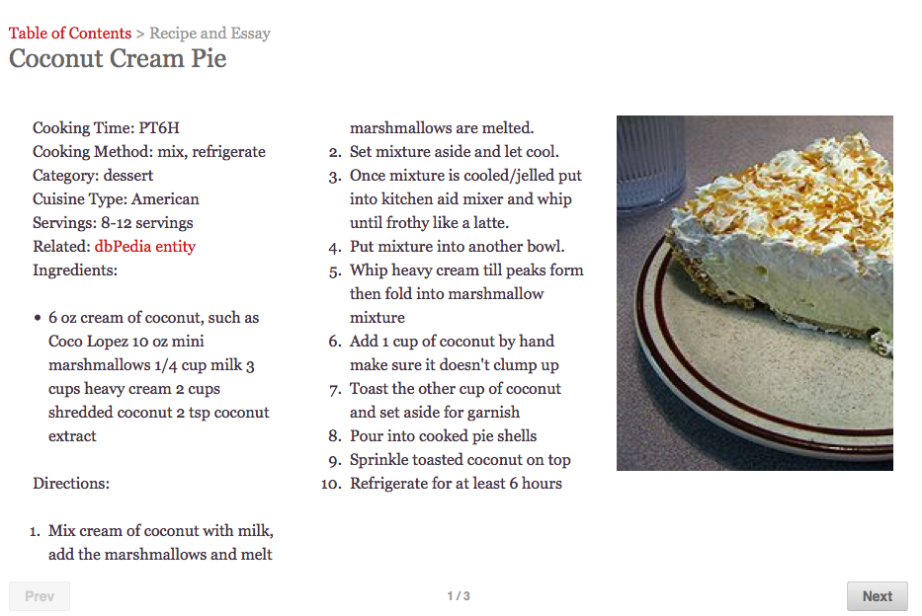
arc.lib.montana.edu/book/home-cooking-history-409/item-13

Slide 14
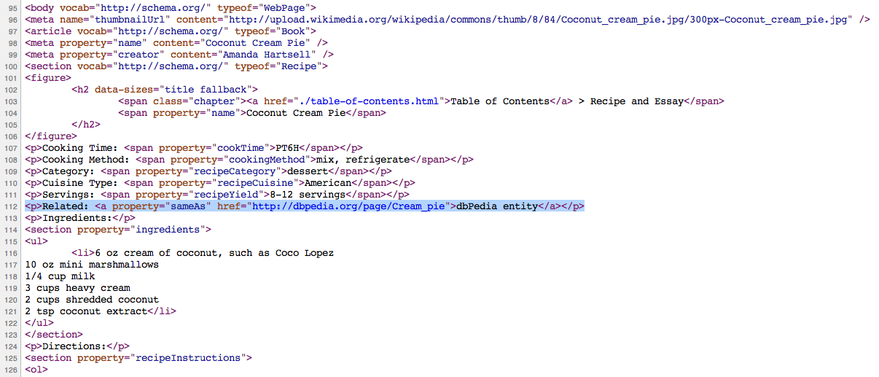
arc.lib.montana.edu/book/home-cooking-history-409/item-13

Slide 15
Role - Schema.org
“Represents additional information about a relationship or property. For example, a Role can be used to say that a Person's 'actor' role in a Movie was for some particular characterName.”
http://schema.org/Thing
has property
https://schema.org/Role
Notes:
Property inherited from most generic type of item: Thing

Slide 16
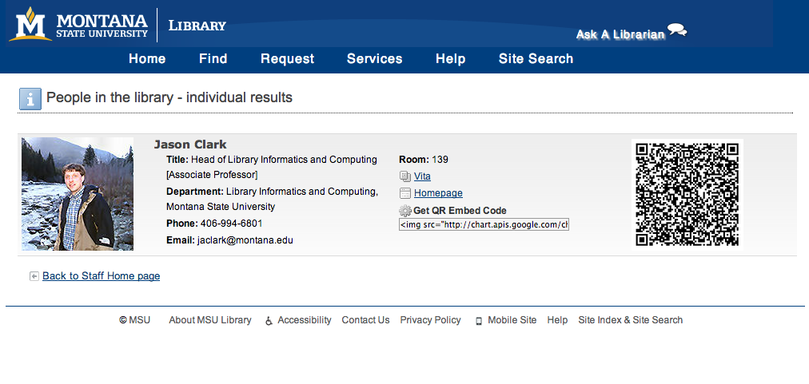
www.lib.montana.edu/people/about?id=23

Slide 17
www.lib.montana.edu/people/about?id=23

Slide 18
Action - Schema.org
“An action performed by a direct agent and indirect participants upon a direct object.”
http://schema.org/Thing
has property
https://schema.org/Action
or
https://schema.org/potentialAction
Notes:
Property inherited from most generic type of item: Thing

Slide 19
<script type="application/ld+json">
{
"@context": "http://schema.org",
"@type": "Organization",
"name": "Montana State University (MSU) Library",
"sameAs": "http://www.freebase.com/m/0j3y9r1",
"potentialAction": {
"@type": "ViewAction",
"target": [
"http://www.lib.montana.edu",
{
"@type": "EntryPoint",
"urlTemplate": "http://www.lib.montana.edu",
"contentType": "text/html"
}
]
}
}
</script>
Notes:
Wait, what happened to HTML? This is JSON-LD another format for encoding schema props
Not limited here… Jenn Riley wrote a book about McGill University Digital Libraries

Slide 20
Why Schema.org?
Libraries as publishers in Web of Data
Machines understanding our data = Significance
Can improve findability in search engines (search engine optimization)
Can create efficiencies in our own indexing (e.g., digital collections search)

Slide 21
What is Linked Open Data?
Practice of publishing structured, machine actionable data with an open license for sharing and reuse.

Slide 22
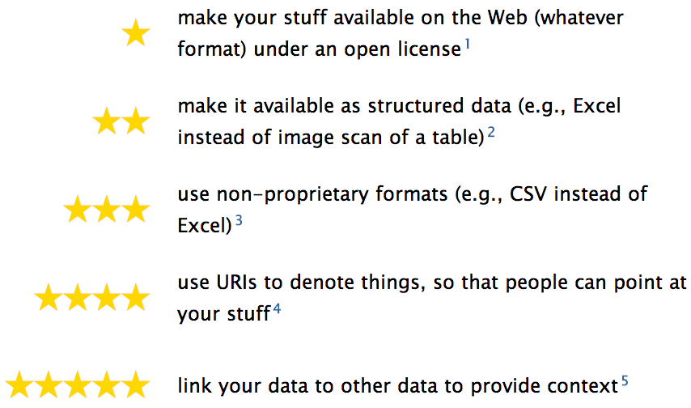
5 Star Linked Open Data
http://5stardata.info/

Slide 23
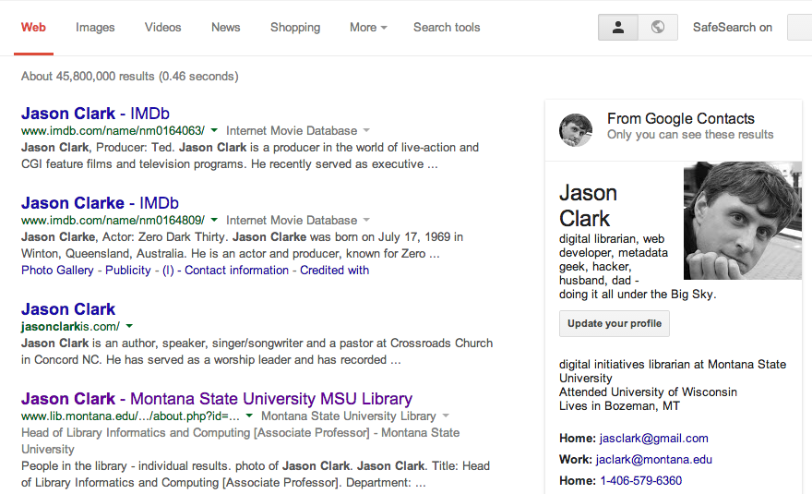
*Tentative results for SEO - This is a personal result set.

Slide 24
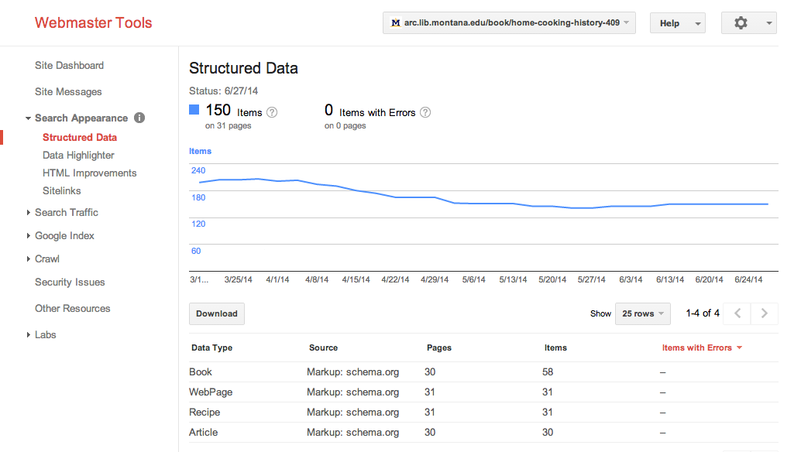
Structured Data in Your Index
www.google.com/webmasters/tools/
Notes:
Using a local data store, an about page, and a sitemap

Slide 25
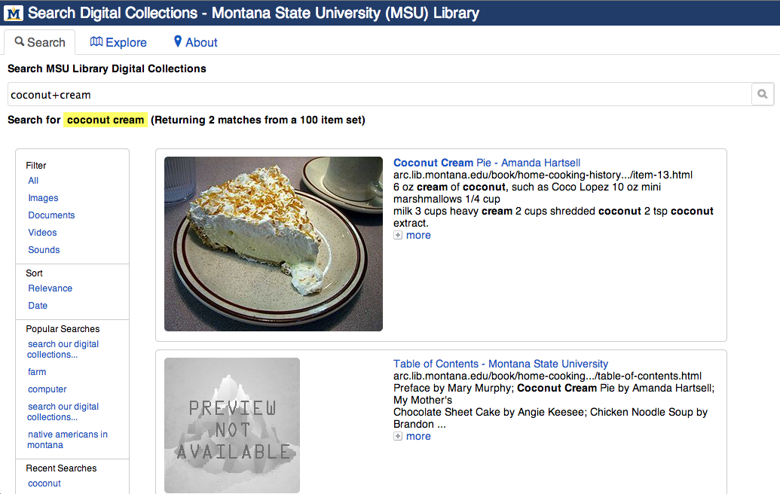
arc.lib.montana.edu/digital-collections/index.php?q=coconut+cream

Slide 26
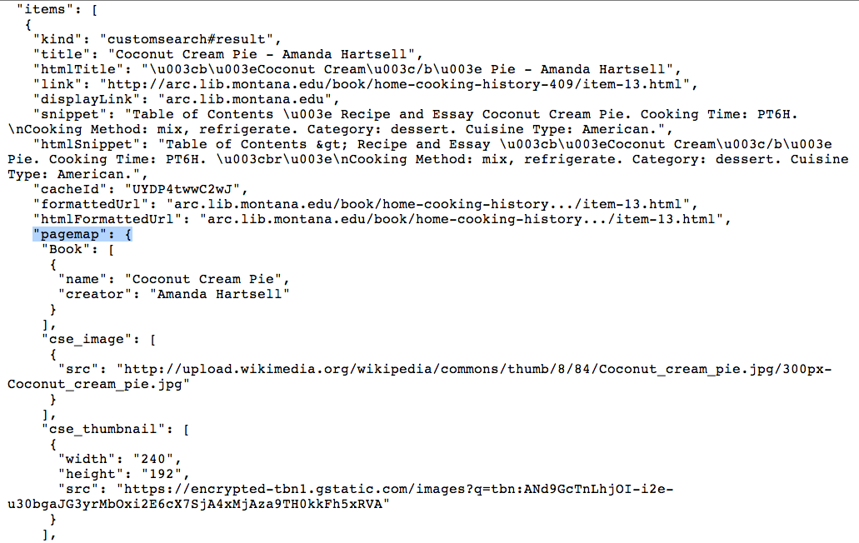
Google Custom Search Engine JSON API Result

Slide 27
Getting Started
Think about entities you want to surface - type of web page, organization, person, etc.
Find those entities in schema.org vocabulary
Draft your new markup
Use Google Structure Data Markup Helper Tool
Test your markup in Google Structured Data Testing Tool
Publish it on the web.

Slide 28
Schema.org in Libraries
NCSU Libraries, Jason Ronallo
http://journal.code4lib.org/articles/6400
Duke Libraries, Sean Aery
http://www.cni.org/topics/information-access-retrieval/discovery-turned-inside-out-using-schema-org-and-google-site-search-with-library-digital-collections-2/
RDFa and Schema.org, Dan Scott
http://coffeecode.net/archives/271-RDFa-and-schema.org-all-the-library-things.html

Slide 29
A Research Team Effort
Scott Young: Digital Initiatives Librarian at Montana State University. Scott works to make information more open and accessible through front-end web development, semantic web development, user experience research, and social media. Catch up with him on Twitter @hello_scott_.
Jason Clark: Head of Digital Access and Web Services at Montana State University Library
Patrick O’Brien: Semantic Web Research Director at Montana State University Library.
Kenning Arlitsch: Dean of the Library at Montana State University. His book, co-authored with Patrick OBrien is titled Improving the Visibility and Use of Digital Repositories through SEO, and was published in February 2013. He occasionally tweets from @kenning_msu.

Slide 30
Questions?
twitter.com/jaclark
www.lib.montana.edu/~jason/talks.php

