Slide 1
Implementing Linked Data & Discovery:
Liberating Library Data & Empowering Users
Jason A. Clark
Associate Professor
Head of Library Informatics & Computing
Montana State University (MSU) Library
ALA Annual Conference
ProQuest Exhibitor Session
June 27, 2015

Slide 2
pinboard.in tag
pinboard.in/u:jasonclark/t:lod/

Slide 3
twitter as channel (#hashtag)
@jaclark #lod

Slide 4
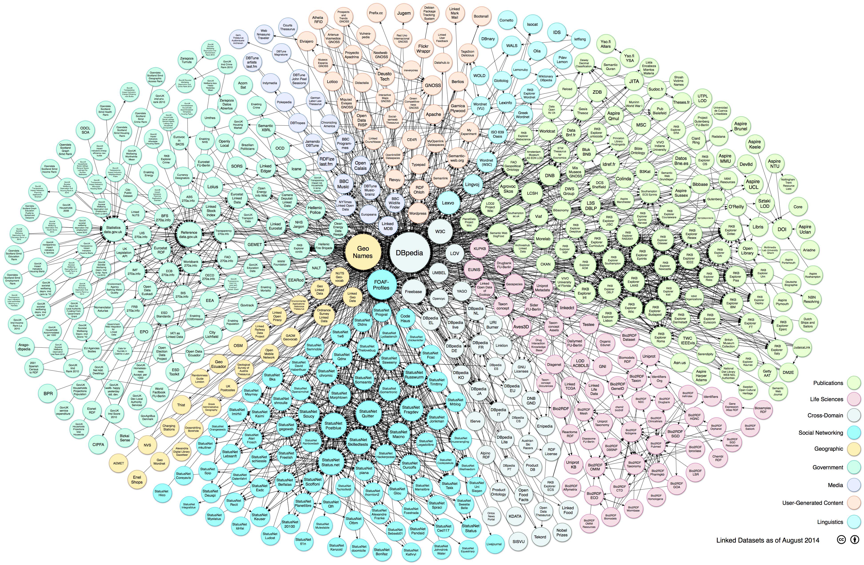
Linking Open Data cloud diagram 2014, by Max Schmachtenberg, Christian Bizer, Anja Jentzsch and Richard Cyganiak. http://lod-cloud.net/

Slide 5
LOD in Libraries
UNLV Linked Data Project
http://www.library.unlv.edu/linked-data
Worldcat
http://www.oclc.org/data.en.html
Europeana Linked Open Data
http://labs.europeana.eu/api/linked-open-data/introduction/

Slide 6
LOD in Libraries
iiiff
http://iiif.io/
DPLA
http://dp.la/info/developers/codex/responses/field-reference/
Vivo
http://vivoweb.org

Slide 7
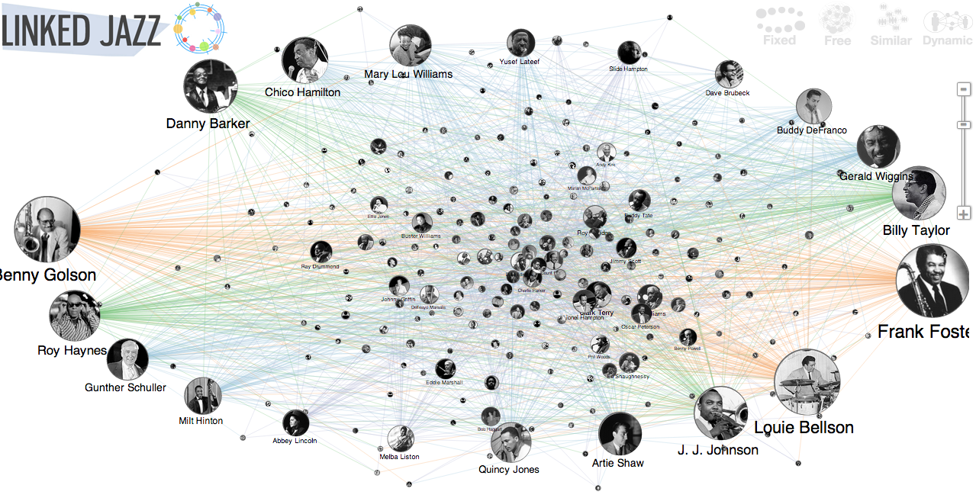
http://linkedjazz.org/

Slide 8
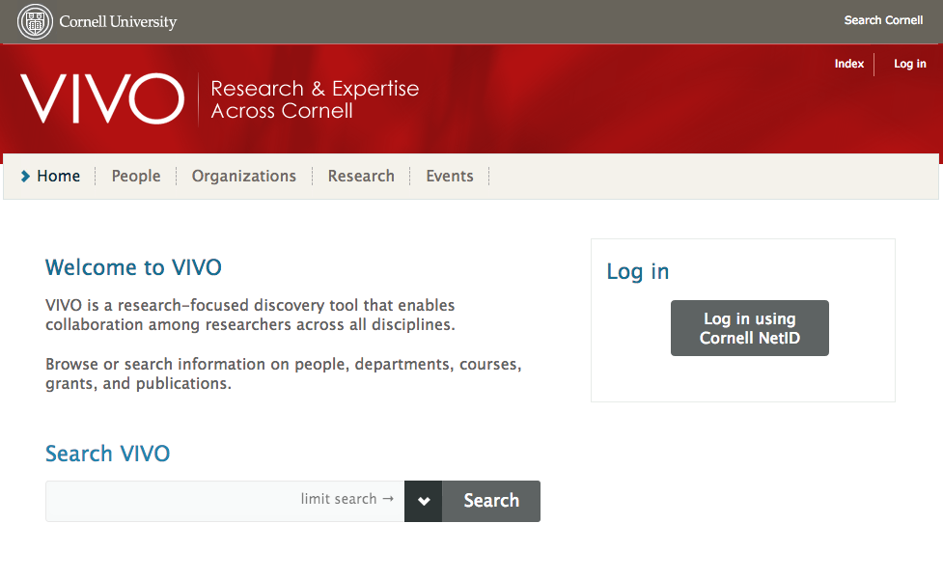

Slide 10
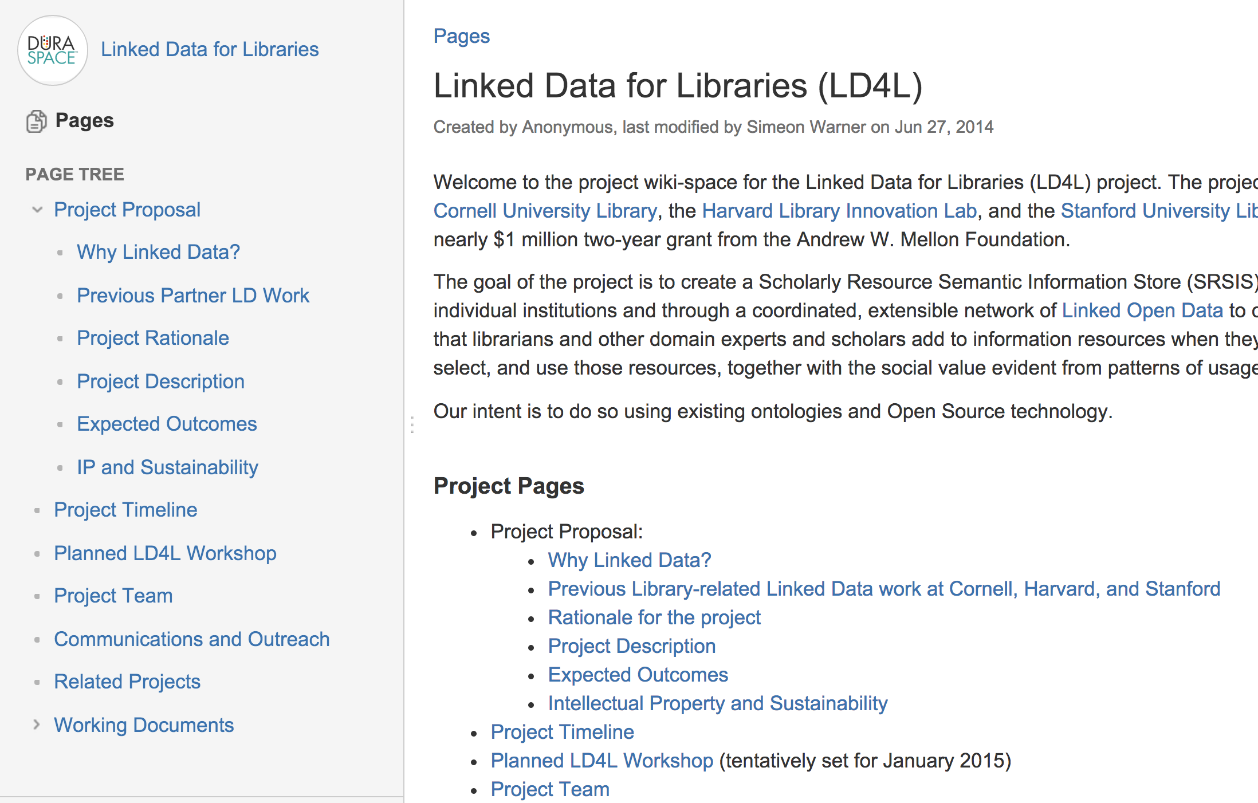

Slide 11
Overview
Why Linked Open Data (LOD)?
Truths about LOD
LOD in Practice at MSU
Questions

Slide 12
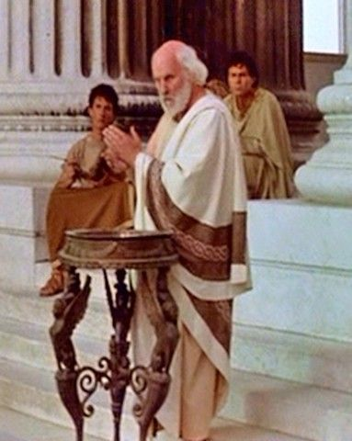
Defining Terms and Truths

Slide 13
What is Linked Open Data?
Practice of publishing structured, machine actionable data with an open license for sharing and reuse.

Slide 14
Truths about Linked Data

Slide 15
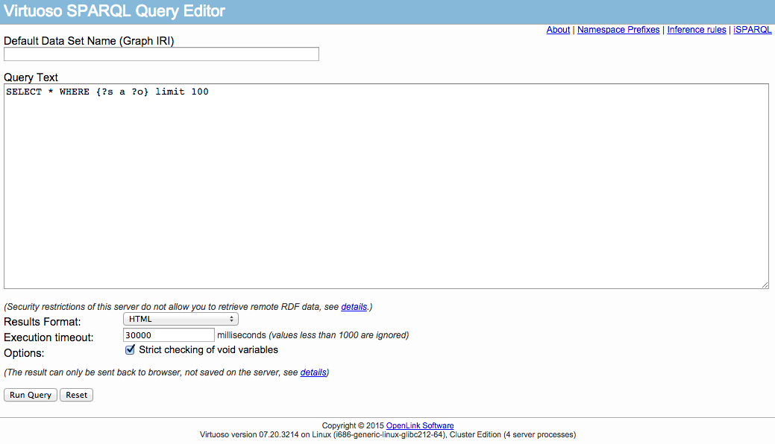

Slide 16
Limited Interfaces

Slide 17
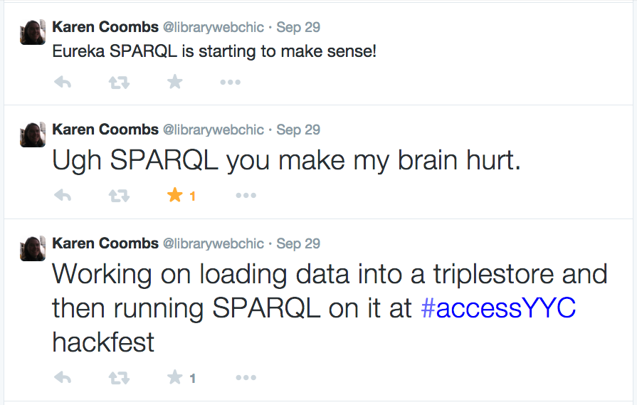
Notes:
Goals of project: discovery, machine readability, serendipitous browsing/visualization

Slide 18
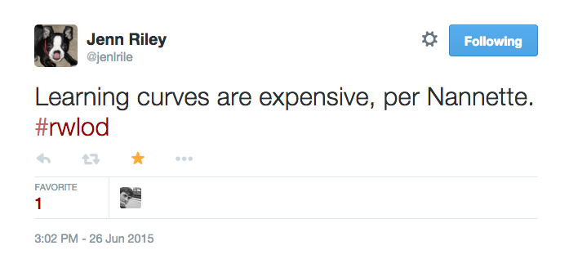
Notes:
Goals of project: discovery, machine readability, serendipitous browsing/visualization

Slide 19
Learning Curves

Slide 20
A Research Team Effort
Scott Young: Digital Initiatives Librarian at Montana State University @hei_scott
Jason Clark: Head, Library Informatics & Computing at Montana State University @jaclark
Patrick O’Brien: Semantic Web Research Director at Montana State University Library
Kenning Arlitsch: Dean of the Library at Montana State University @kenning_msu
Doralyn Rossmann: Head, Collection Development at Montana State University Library @doralyn

Slide 21
Need Staffing + Interest

Slide 22
Why LOD?
Libraries as publishers in Web of Data
Reuse of our data = Significance
Can improve findability in search engines (search engine optimization)
Levels of description in LOD enable entirely new applications

Slide 23
Why LOD at MSU?
Semantic Publishing
Machine Definitions
Discovery

Slide 24
Principles of Publishing LOD
Use URIs for description
Make structured data available on WWW
Allow for machine-actionability and sharing through common ontologies
* machine-actionable is a term used by Karen Coyle to mean readable and interpretable by computers or software agents. See her Library Technology Report on Understanding the Semantic Web at http://www.metapress.com/content/g212v1783607/

Slide 25
LOD Ontologies & Vocabularies
URIs link to:
Reputable machine-readable endpoints
E.g., Worldcat, VIAF, or DbPedia
Open Ontologies & Vocabularies
E.g., Dublin Core Terms, Library of Congress Subject Headings
* See Linked Open Vocabularies (LOV) for a list of possible ontologies and vocabularies.
http://lov.okfn.org/dataset/lov/

Slide 26
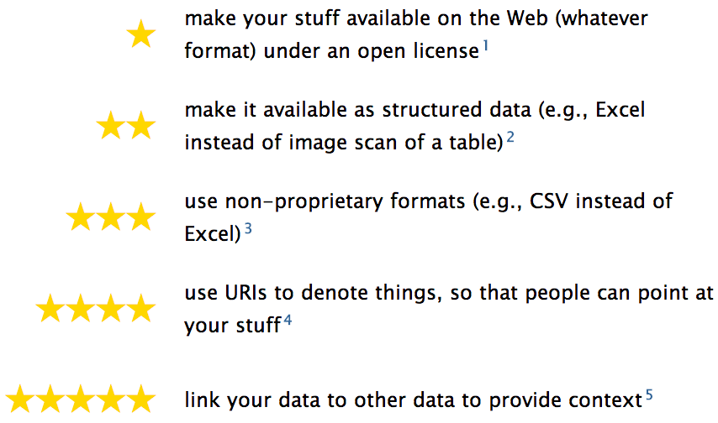
5 Star Linked Open Data
http://5stardata.info/

Slide 27
LOD at Montana State University (MSU)

Slide 28
Case Studies
Book as Linked Data Platform
Linked People
Web Scale Cataloging

Slide 29
Semantic Publishing Book as Linked Data Platform

Slide 30
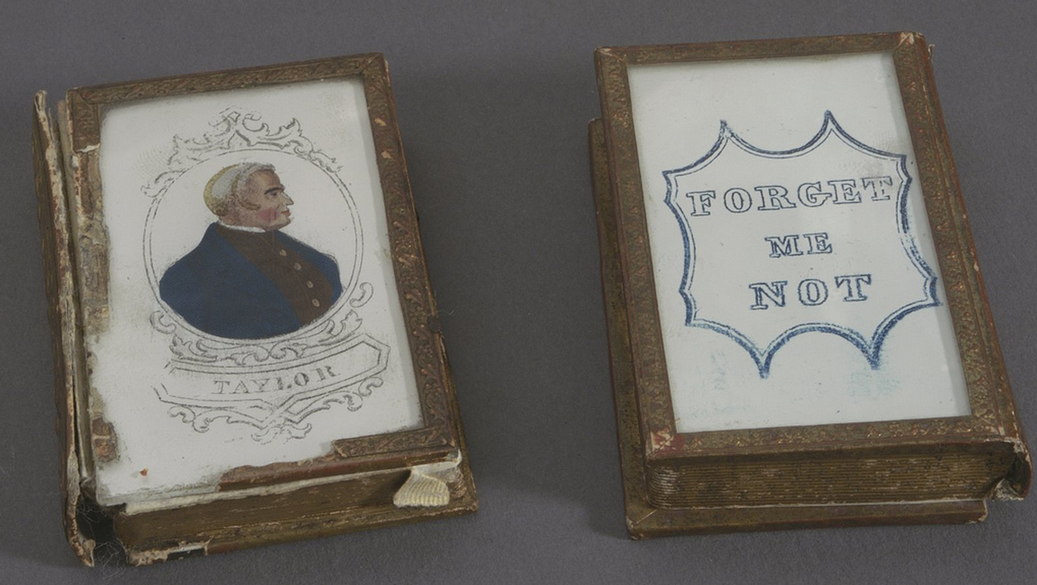
Notes:
http://library24.library.cornell.edu:8280/luna/servlet/detail/CORNELL~9~1~78423~3615

Slide 33
The Research
Institute of Museum and Library Services
Sparks Ignition Grant

Slide 34
Book 1
demo: arc.lib.montana.edu/book/home-cooking-history-409
code: github.com/jasonclark/bib-template
Book 2
demo: arc.lib.montana.edu/book/opsis
code: github.com/msulibrary/bib-template-fiction
* Additional prototypes in development for textbook and an academic journal

Slide 35
Every Book its [machine] Reader
Apologies to Ranganathan
Notes:
It’s as easy to access a book page as it is a web page

Slide 36
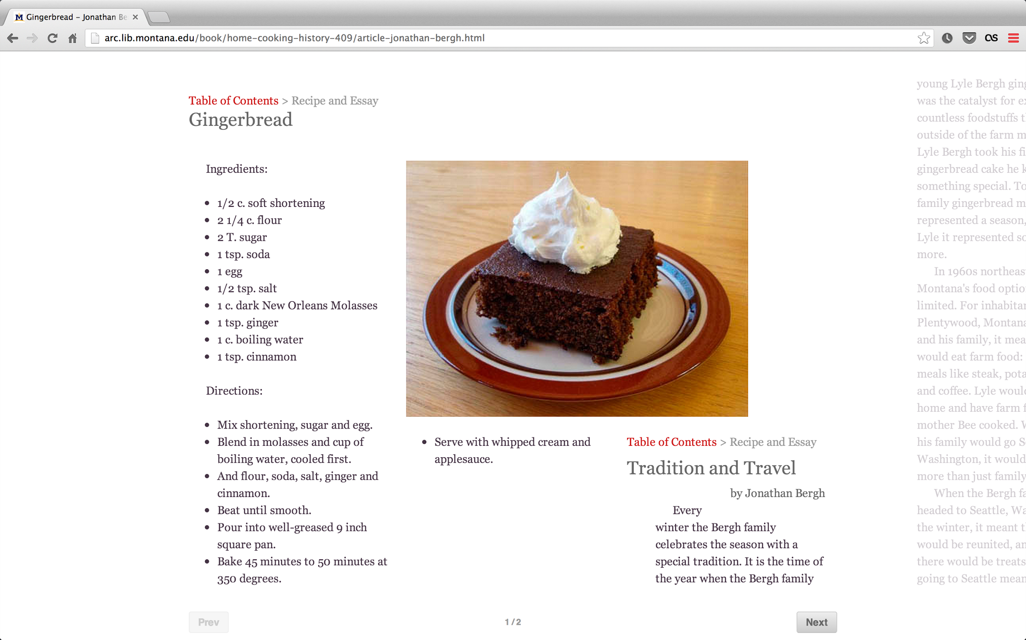

Slide 38
Structured Data
Data Model + Machine Readability

Slide 39
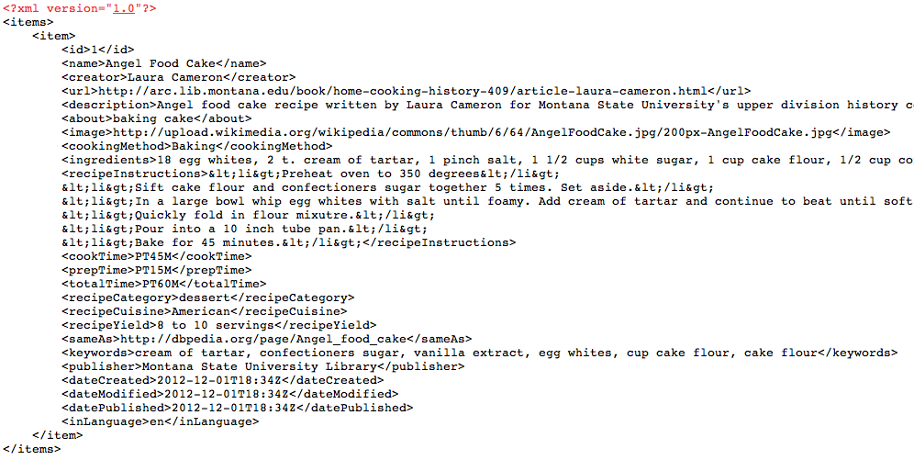
XML, JSON
/home-cooking-history-409/api.php?type=recipe&id=1&num=1&format=xml
...api?id=1&format=xml
...api?type=search&q=poetry&format=json
Notes:
http://shelf.lib.montana.edu/home-cooking-history-409/api.php?type=book&id=1&num=1&format=json
http://shelf.lib.montana.edu/home-cooking-history-409/api.php?type=recipe&id=1&num=1&format=xml
http://shelf.lib.montana.edu/home-cooking-history-409/api.php?type=search&q=lauren&num=10

Slide 40
Schema.org
Controlled Vocabulary

Slide 41
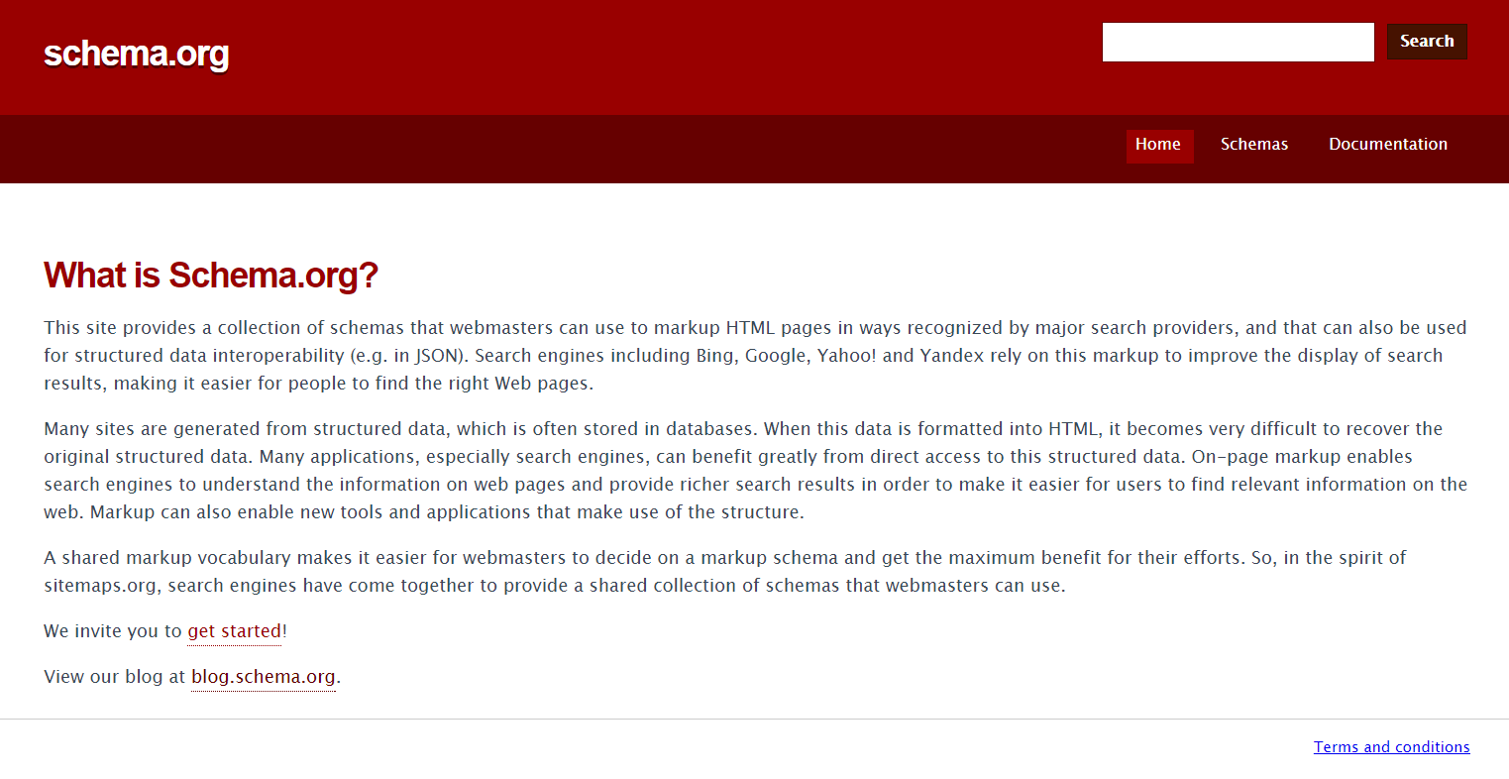

Slide 42
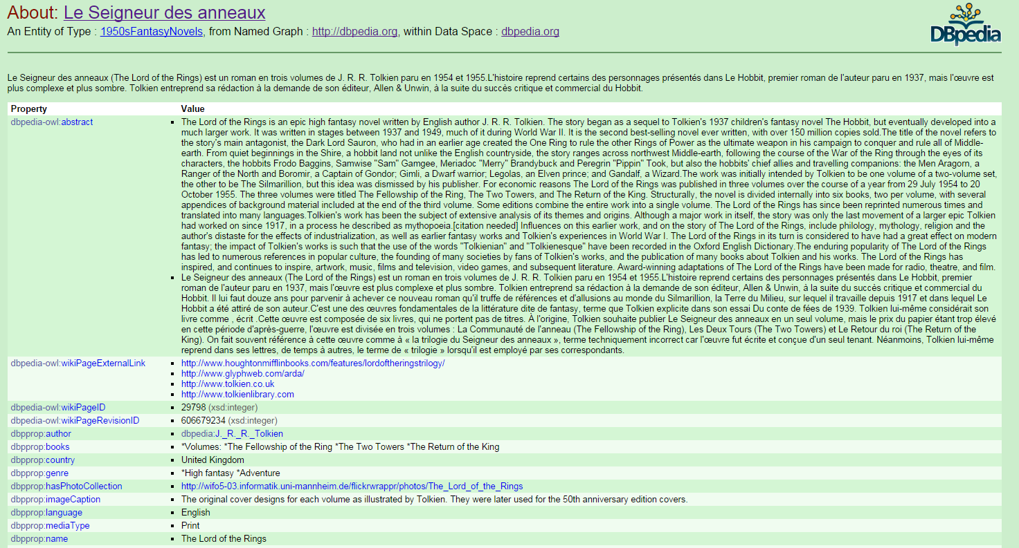

Slide 43
What if?
Books were machine indexed
for semantic discovery
Journal articles were semantically tagged at the page level
Notes:
It’s as easy to access a book page as it is a web page

Slide 44
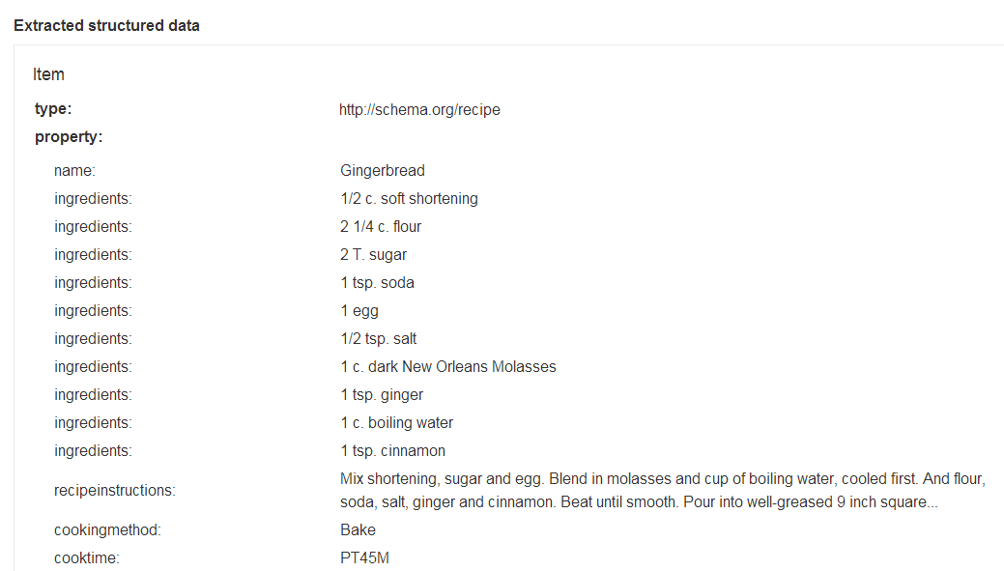

Slide 46
Behavioral Metadata

Slide 47
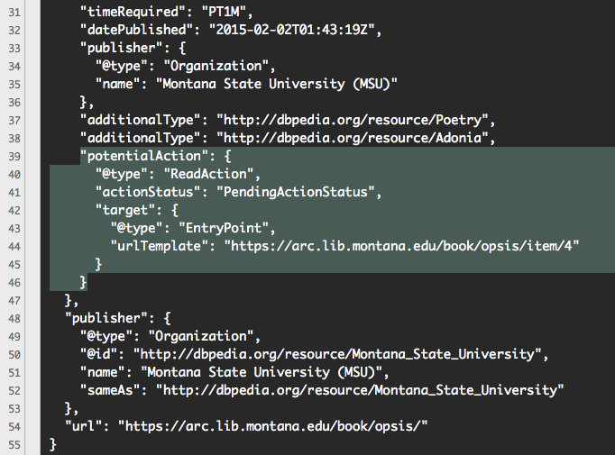
https://arc.lib.montana.edu/book/opsis/item.json?id=4

Slide 48
Machine Definitions Linked People www.lib.montana.edu/people

Slide 49
Linked Data is People
Using Linked Data to Reshape
the Library Staff Directory

Slide 50
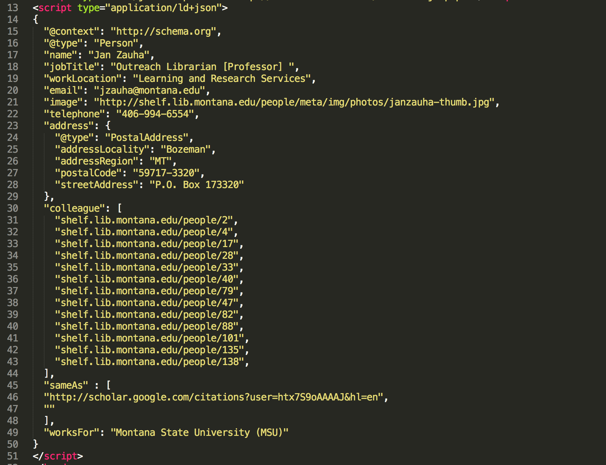

Slide 51
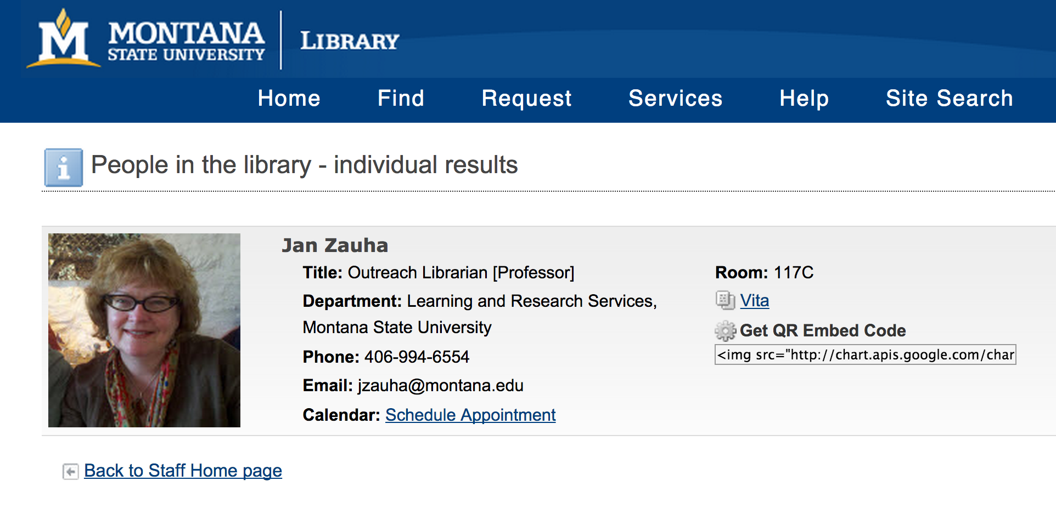

Slide 52
How are people and data understood?
By machines and by humans
Notes:
Goals of project: discovery, machine readability, serendipitous browsing/visualization
Modeling a library staff directory
Creating RDF-inspired relationship expressions
Producing database-driven recommendations for faculty and topics
Finding meaningful web-ready visualization
Challenges in describing a person (active) versus a book (passive)

Slide 53
Create distributed, linked, flexible data systems.
Add context and dimension to data.
Demonstrate relationships among data based on standardized and reusable vocabulary
Networked data is smarter data.

Slide 54
Applying the concept of linked data for our local community
Finding a real-world use-case for graph modeling using open source tools
What if our people could be discovered and understood?
Notes:
To make our people more meaningful to our users
Network visualization breaths life into a dataset
Recommendation brings value for users
When the dataset is comprised of people and their interests, this is even more relevant
SEO results

Slide 55
Where are your people?
Where are your concepts?

Slide 56
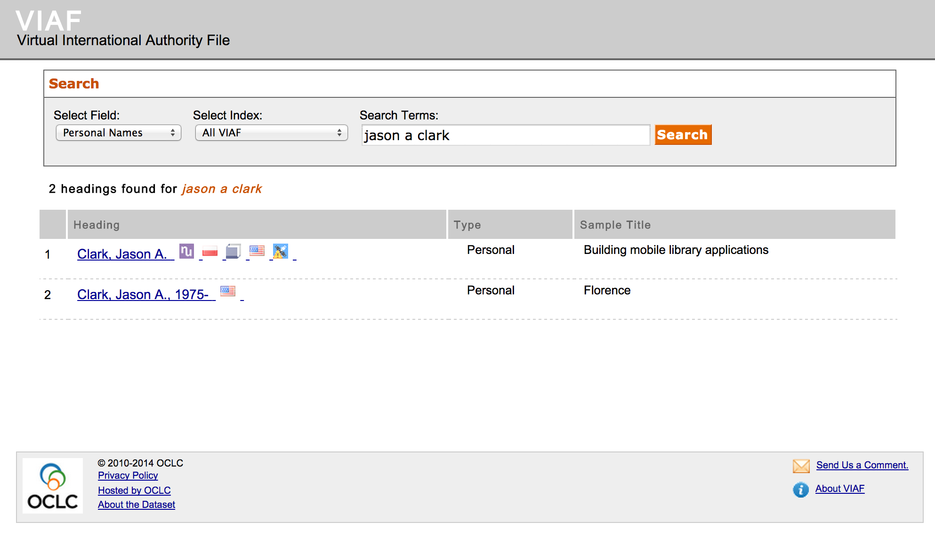

Slide 57
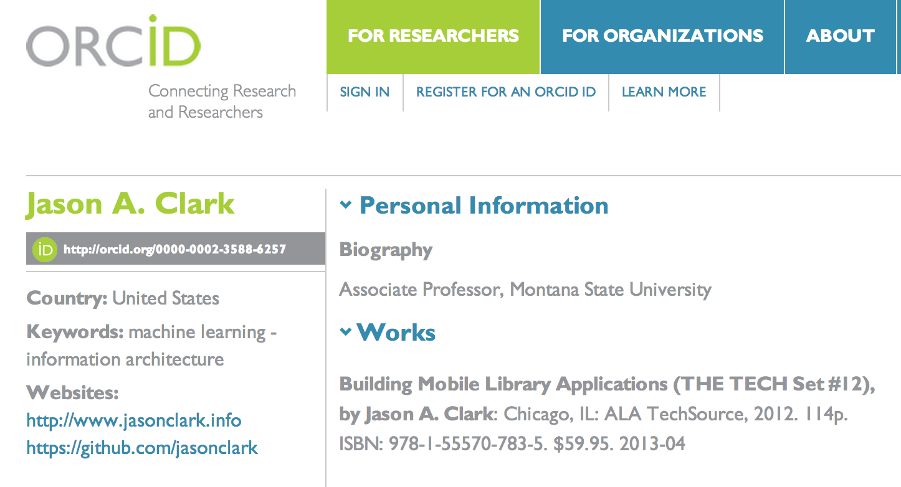

Slide 58
An Ontology

Slide 59
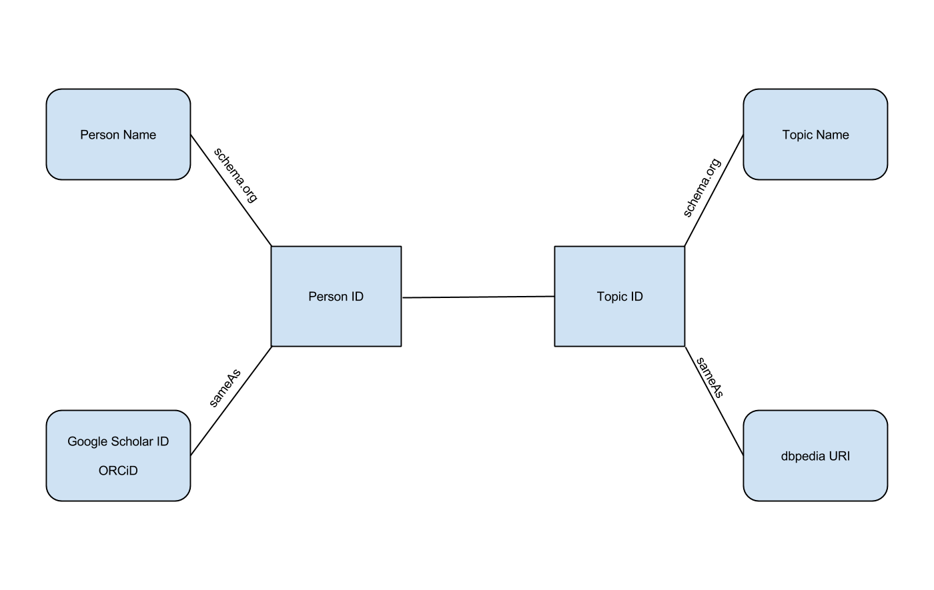

Slide 61
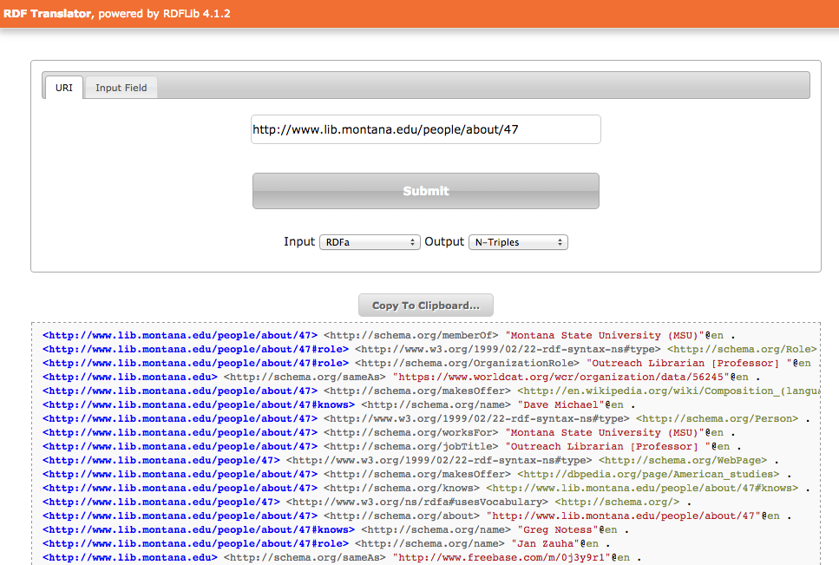
JJan Zauha is defined/understood as an entity

Slide 62
Discovery Web Scale Cataloging

Slide 63
SEO + Semantic Understanding

Slide 64
Designing Your Collections for Web Scale Search
James Willard Schultz
http://arc.lib.montana.edu/schultz-0010/

Slide 65
Introducing Semantic Markup
HTML5 semantic tags and RDFa that help classify page types and define the types of content on the page
“If Google understands the content on your pages, we can create rich snippets—detailed information intended to help users with specific queries.” https://support.google.com/webmasters/answer/99170?hl=en&ref_topic=1088472

Slide 66
Before RDFa

Slide 67
After RDFa

Slide 68
External Enumerations
"We define here some specific integration points through which selected externally maintained vocabulary can be published as part of schema.org markup"
www.w3.org/wiki/WebSchemas/ExternalEnumerations

Slide 69
additionalTypes, specialty
https://schema.org/additionalType, http://schema.org/specialty

Slide 70
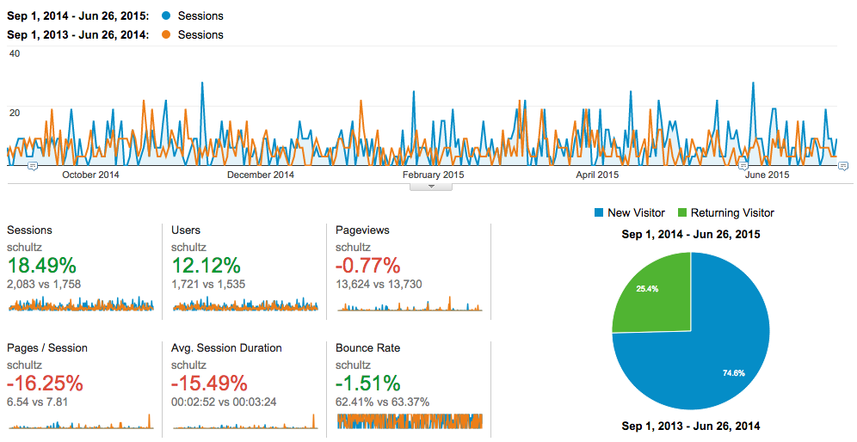
Improved Metrics? Research in progress…

Slide 71
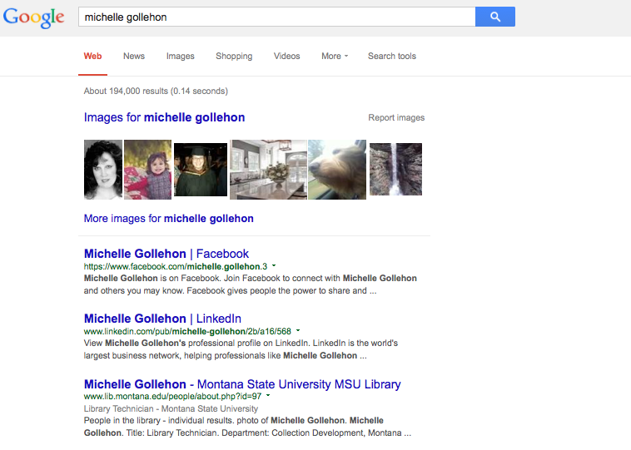
Notes:
4/25/2014

Slide 72
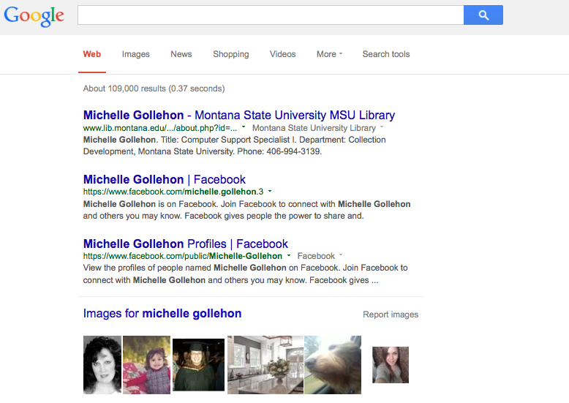
Notes:
9/18/2014 Google understands Michelle better - Machine Readability...

Slide 73
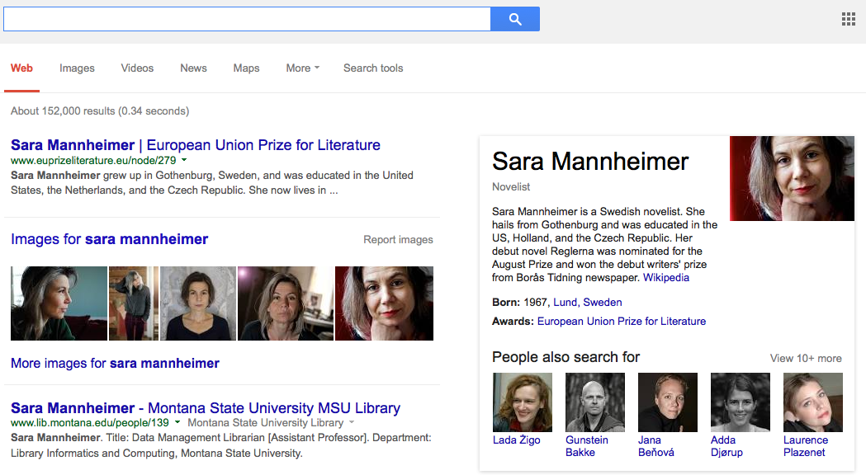

Slide 74
New Search and Browse

Slide 75
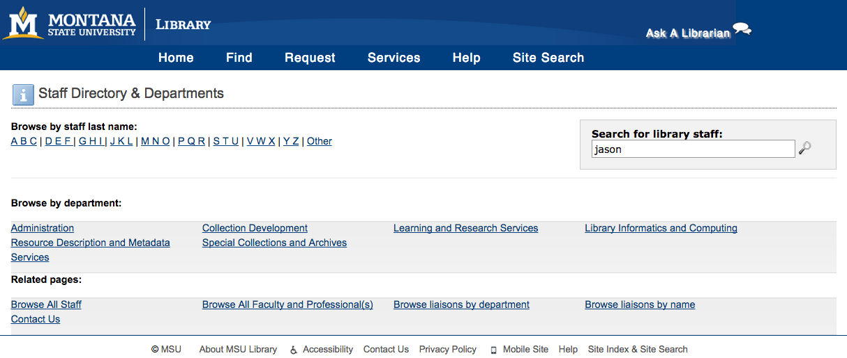

Slide 76
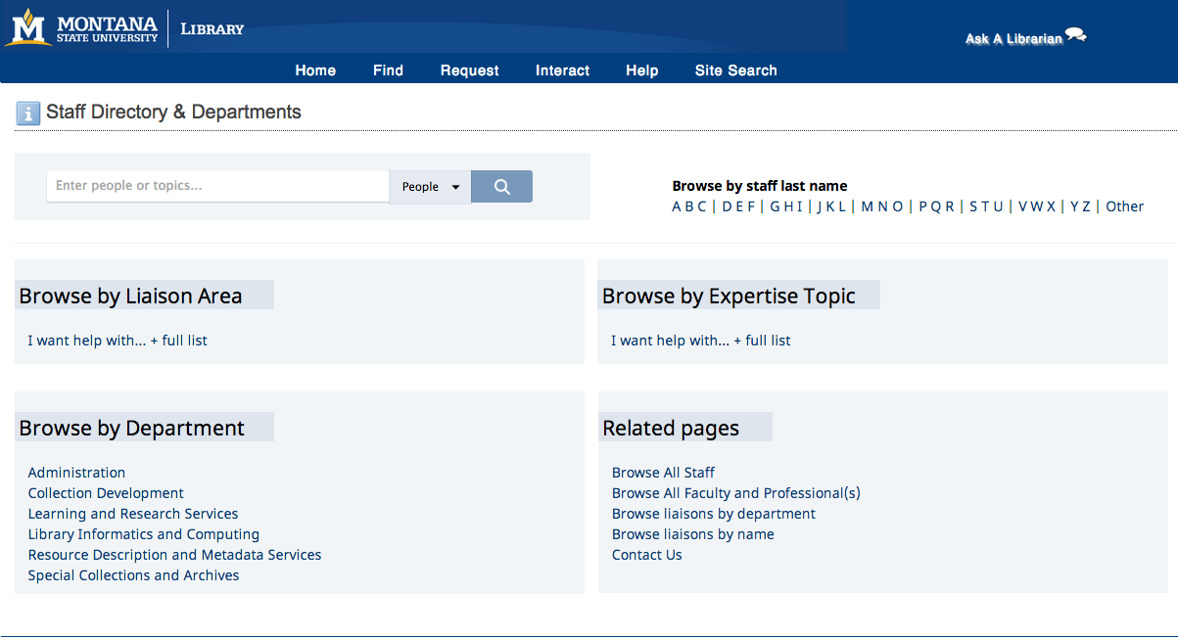

Slide 77
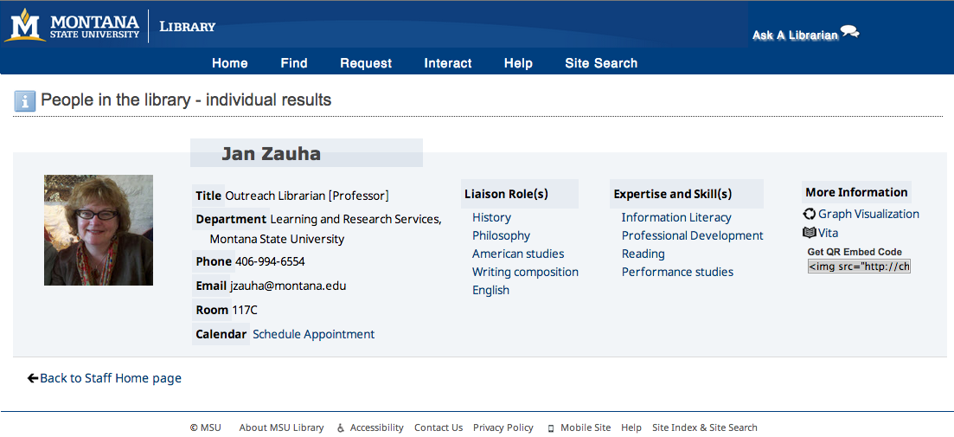

Slide 78
Linked Data Tools

Slide 79
RDF Search Engines

Slide 80
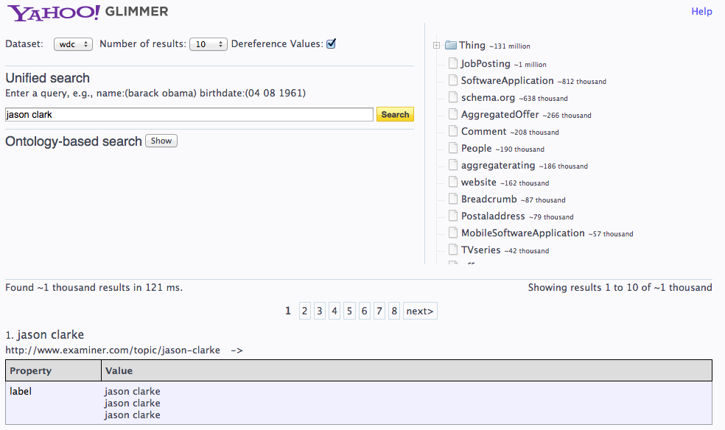

Slide 81
Semantic Classifiction Tools

Slide 82
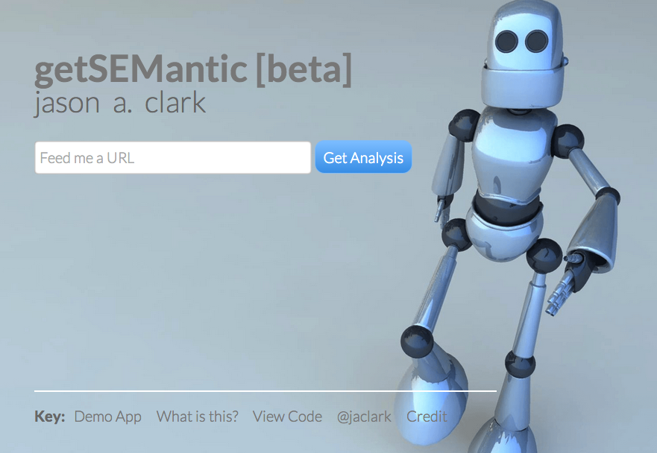
github.com/jasonclark/getsemantic

Slide 83
Linked Data Creation Tools

Slide 84
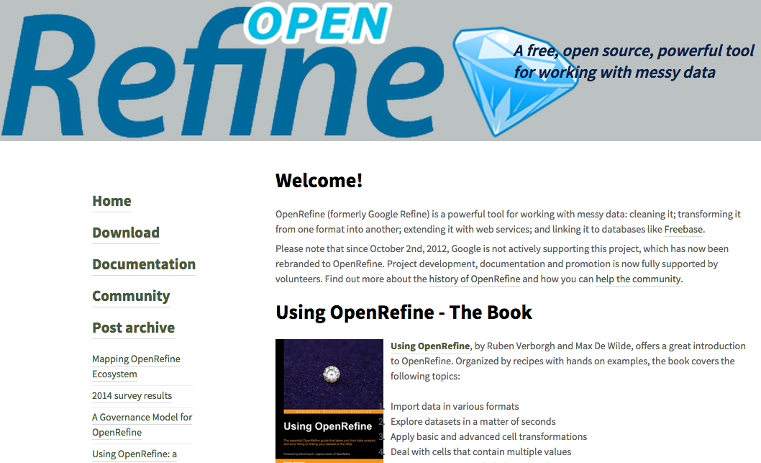

Slide 85
Crosswalking Tools

Slide 86
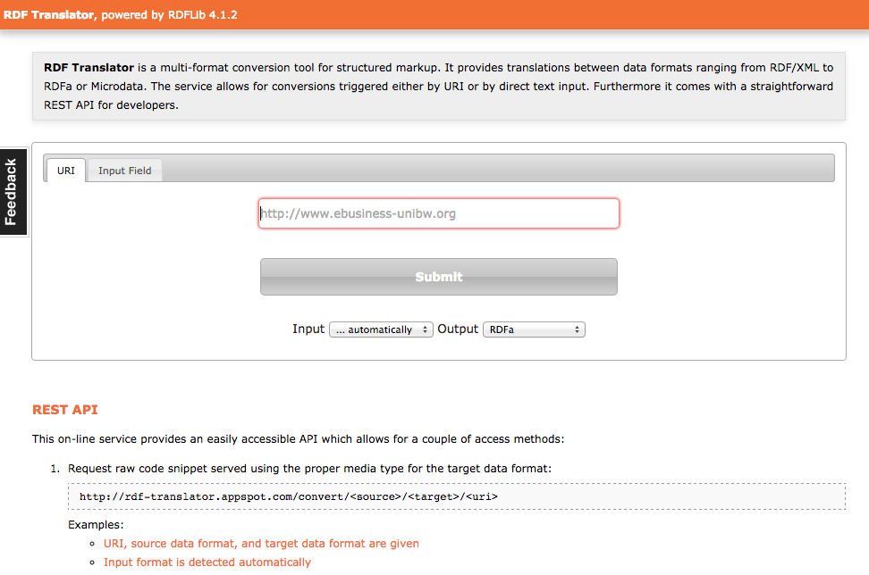
http://rdf-translator.appspot.com

Slide 87
Your Website is Your API

Slide 88
JJan Zauha is defined/understood as an entity

Slide 89
The Linked Data Audience

Slide 91
Notes:
Make web pages for users https://support.google.com/webmasters/answer/35769?hl=en&ref_topic=1724121#3
but ensure bots can crawl and machines can understand
http://starwars.wikia.com/wiki/File:R2d2.jpg
https://en.wikipedia.org/wiki/R2-D2

Slide 92
Humans + Bots

Slide 93
Why LOD?
Libraries as publishers in Web of Data
Reuse of our data = Significance
Can improve findability in search engines (search engine optimization)
Levels of description in LOD enable entirely new applications

Slide 94
Resources
Harper, Corey. Library linked data: tuning library metadata for the semantic web. An ALCTS webcast, March 16. 2011. (open access) http://www.ala.org/alcts/confevents/upcoming/webinar/cat/031611
Berners-Lee, Tim. The next web. A TED talk, February 2009. (open access) http://www.ted.com/talks/tim_berners_lee_on_the_next_web
Koster, Lukas (2011) Brief Introduction to Linked Data (open access) https://docs.google.com/document/d/1W6UOCLgxTyM0BlPfd5hs58dh4k6CUdLW354AjjtnJfk/edit
*See also LODLAM - Linked Open Data in Libraries, Archives &amp; Museums at http://lodlam.net/

Slide 95
Acknowledgements
I would like to thank Alison Hitchens for her excellent work in explaining and teaching these linked data concepts and definitions.
http://www.accessola2.com/olita/insideolita/wordpress/?p=60029
She was also gracious enough to distribute her work under the Attribution-Noncommercial-Share Alike 3.0 Unported license. And I am doing the same.

Slide 96
Questions?
twitter.com/jaclark
github.com/jasonclark
www.lib.montana.edu/~jason/talks.php

