Slide 1
Building a Simple Mobile-optimized Web App/Site Using the jQuery Mobile Framework

Slide 2
pinboard.in tag
  http://pinboard.in/u:jasonclark/t:amigos-jquery-mobile/

Slide 3
Agenda
Learn what a mobile framework is.
Understand the various technologies (HTML, CSS, JavaScript) and how they work together to build mobile Web apps/sites.
Recognize the differences between native and web apps/sites.
Explore jQuery Mobile basics.
Acquire best practices in mobile Web development.
Create an opportunity to continue to work with us after the webinar to demonstrate what you learned.
Gain access after the webinar to a free Web server so you can see your mobile Web app/site live.

Slide 4
Mobile-optimized Website
Native App (iOS, Android etc.)
Nothing yet, but considering an app
Nothing yet, but considering a website.
No plans; it is too expensive/complex!
Quick Poll
Does your library have:

Slide 5
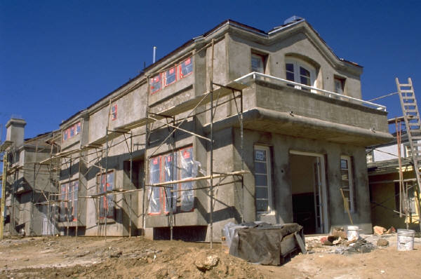
A framework resembles scaffolding. It is a temporary platform used as a supportive guide to help build something. Mobile frameworks work similarly in that they provide libraries etc. that allow
one to build something quickly.

Slide 6
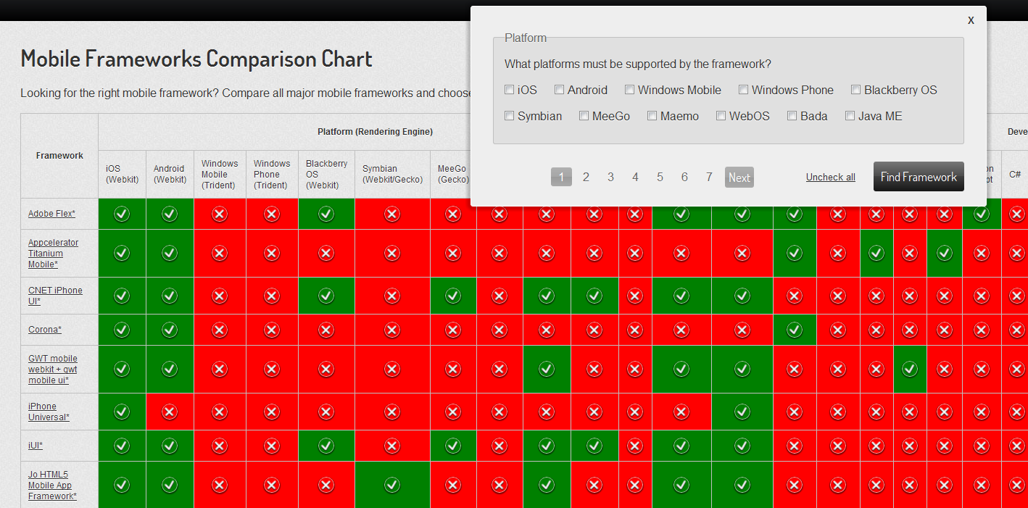
Source: http://http://goo.gl/y8CFb

Slide 7
Native Apps vs. Web/Browser Apps
Issues | Native apps | Web apps
Internet access | Not required | Required, except for apps written in HTML5 (offline capabilities)
Shareable content (Twitter etc.) | Only if it is built in to the app | Web links can be shared. Social API’s allow 1-click posting
Access to hardware sensors | Yes: camera, gyroscope, microphone, compass, accelerometer, GPS | Access thru browser is limited. Geolocation works!
Development | Build app for target platform (Android, iOS [Objective-C] etc.) | Write/publish once using standard Web technologies, view it anywhere with URL. Speedy debugging and development.
Distribution | Most app stores require approval. | No hassles.
Source: http://goo.gl/zSeDU

Slide 8
jQuery Mobile is …
a unified, HTML5-based user interface system for all popular mobile device platforms.
Source: http://jquerymobile.com/

Slide 9
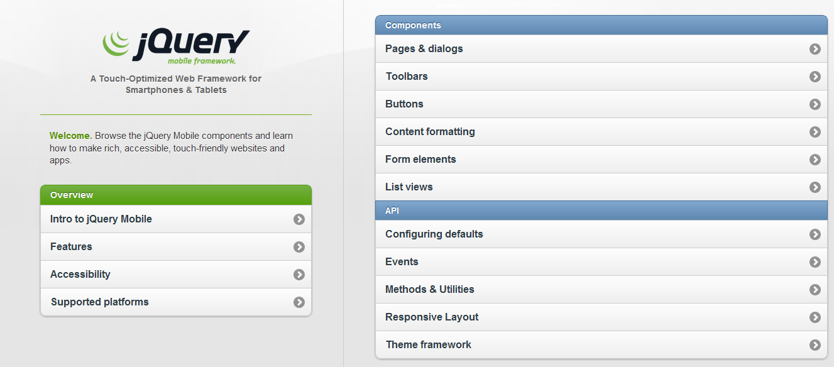
jQuery Mobile is well-documented and there are great demos to get you started

Slide 10
Getting Started!
Let’s build something.
Handout: http://goo.gl/Mg1cm

Slide 11
Your Live Site
To test your work use this URL, but include your last name.
Example: http://marcomponline.com/chadtest/Class/a_Morris/touch-jquery/index.html

Slide 12
Mobile Development - Demos
Demos:
Responsive Design Template (custom)
www.lib.montana.edu/~jason/files/responsive-design/
Mobile Template (jQuery Mobile)
www.lib.montana.edu/~jason/files/touch-jquery/
Code Samples and Downloads:
www.lib.montana.edu/~jason/files.php

Slide 13
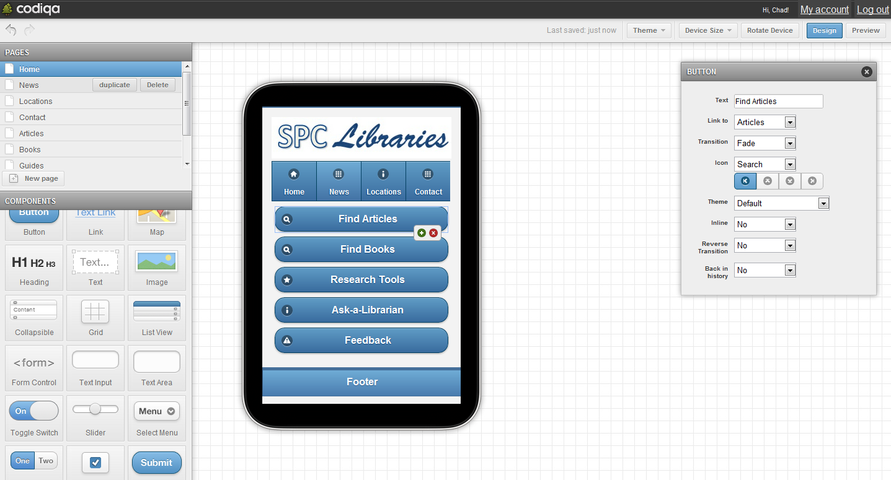
Rapid Prototyping for jQuery Mobile
Try it at http://codiqa.com/

Slide 14
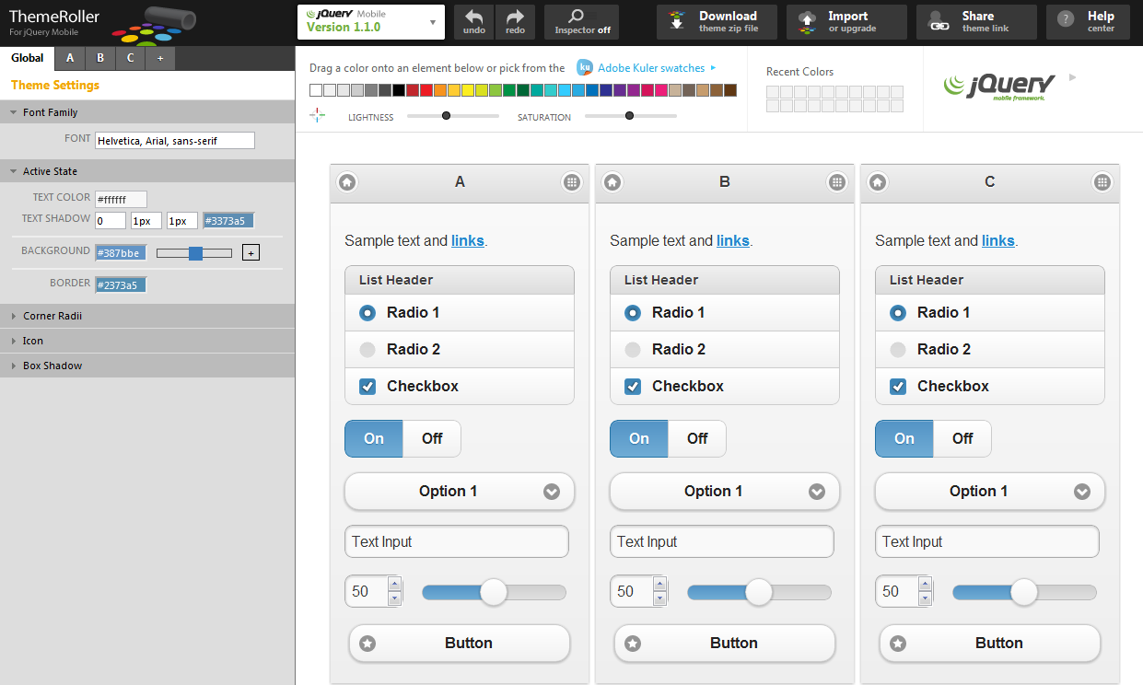
Try it at http://jquerymobile.com/themeroller/

Slide 15
Assignment 1
  Finish your jquery mobile web app
  Create new theme with jQuery ThemeRoller
  Add new theme to your web app
  Ask questions in the class forum.

Slide 16
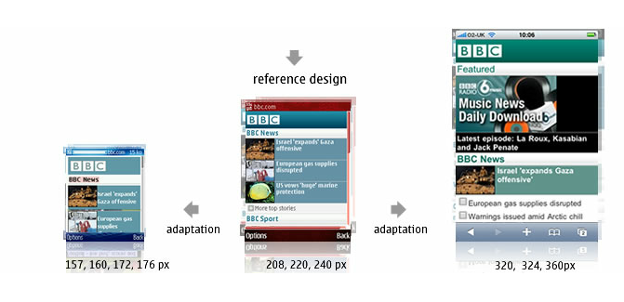
Mobile Screen Resolutions
  Android (Motorola Droid) 480x854
  Android (MyTouch) 320x480
  Android (Nexus One) 480x800
  Apple iPhone 320x480
  Apple iPad 1024x768
  Palm Pre 320 x 480
Source: http://goo.gl/zEDoi

Slide 17
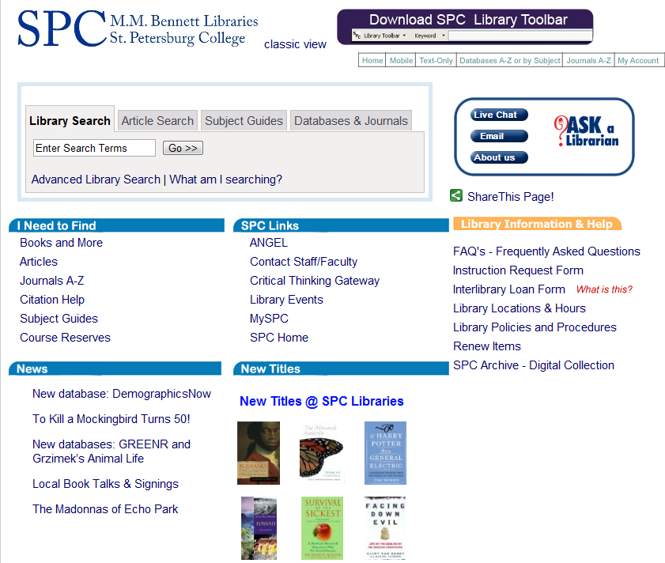
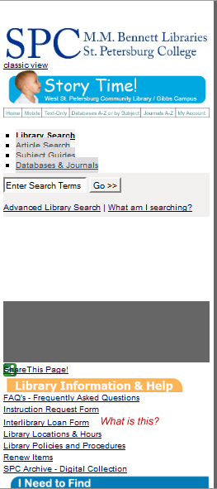
Small Screen Rendering (260 px) using the
Web Developer add-on in Firefox
Desktop
Small Screen

Slide 18
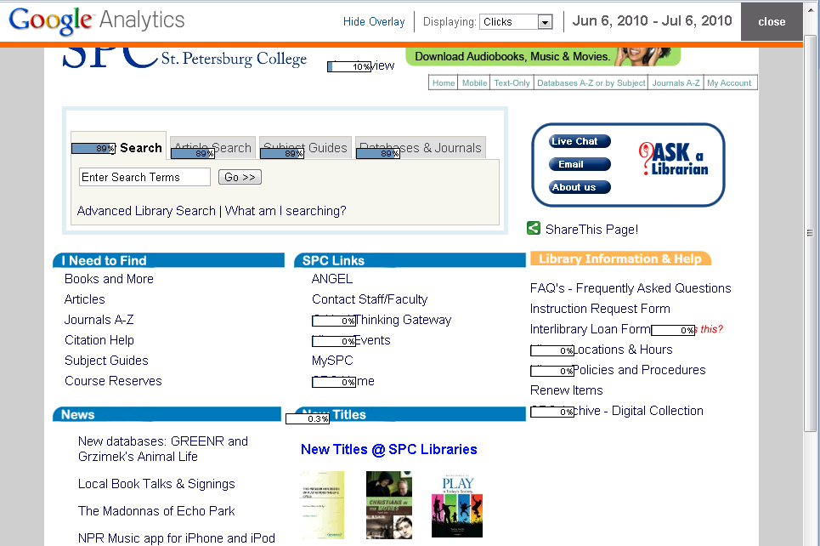
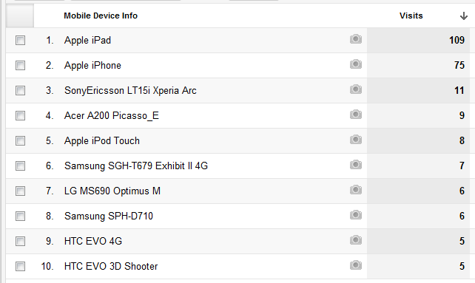
In-page Analytics
Note: you can determine how your user’s are accessing your Web site (e.g., mobile devices, carriers, browsers , OS’s, screen resolution etc.)

Slide 19
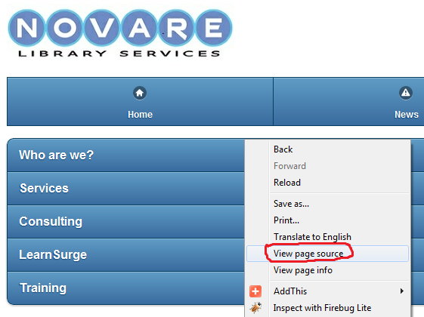
Learn and borrow from sites you like.
http://m.novarelibrary.com/

Slide 20
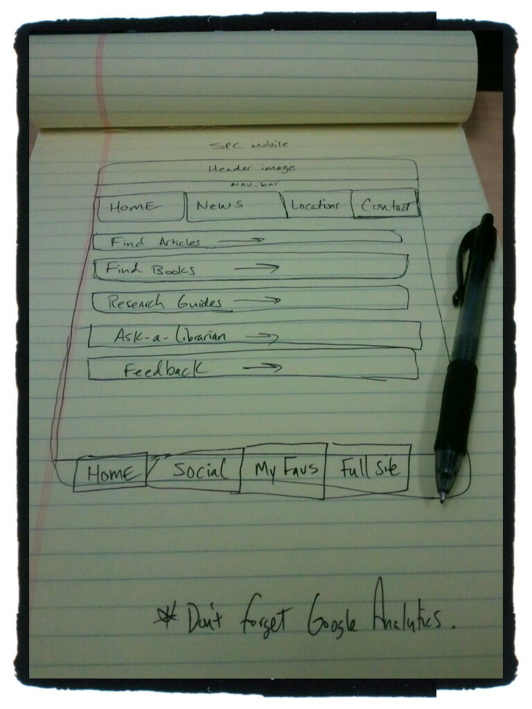
Sketch ideas

Slide 21
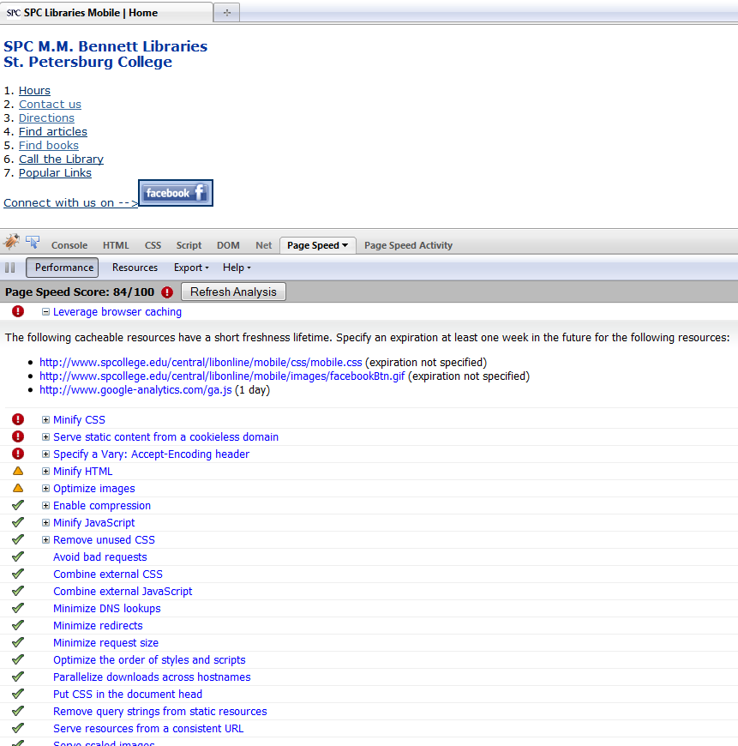

Testing and validation
Test Page Speed in Firebug
http://getfirebug.com/

Slide 22
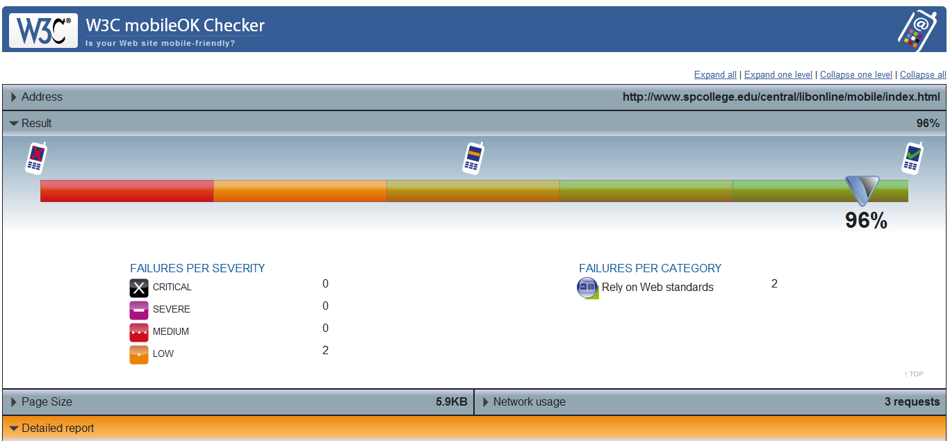
W3C mobileOK Checker http://validator.w3.org/mobile/

Slide 23
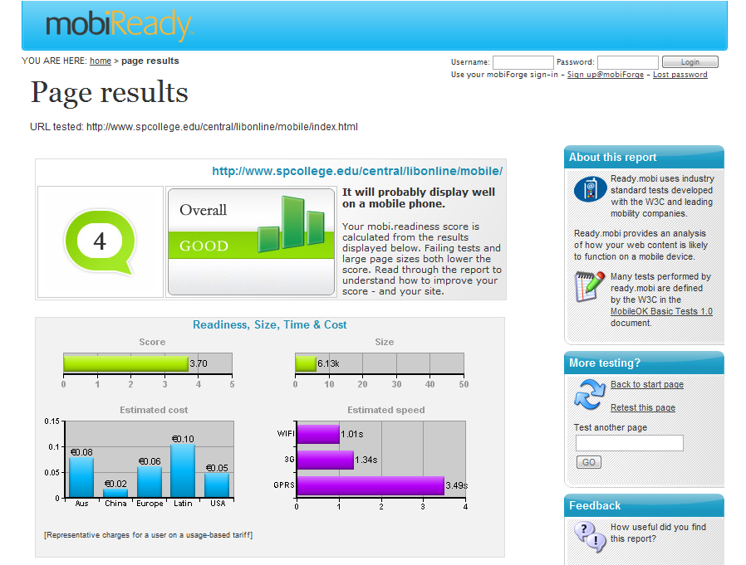
http://ready.mobi

Slide 24
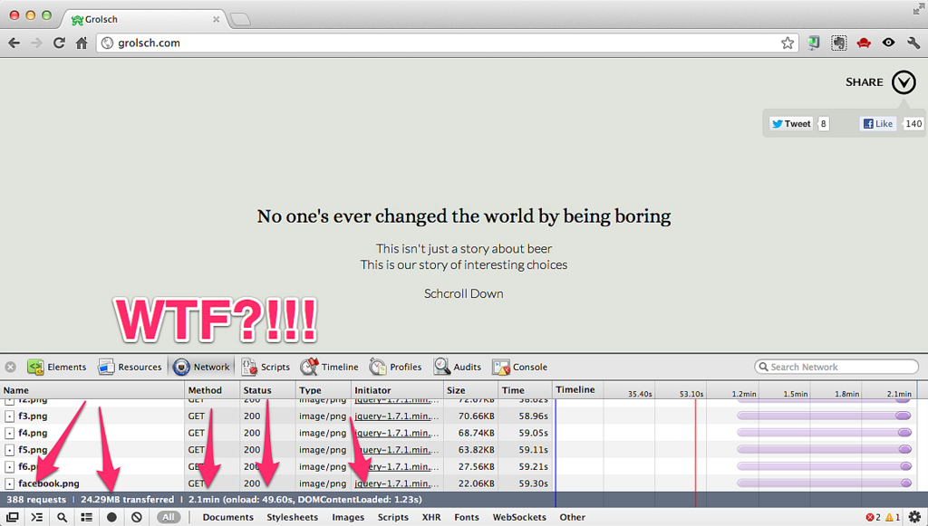
"All sizes | Enough of this silliness | Flickr - Photo Sharing!." Last modified 10/15/2012 12:45:55. http://www.flickr.com/photos/philhawksworth/7562460356/sizes/l/in/photostream/ (accessed 10/15/2012).

Slide 25
Mobile Optimization
  Minify scripts, html, css …
  Reduce HTTP requests
  Compress files with gzip
  Cache static resources
  “Speed matters.”
  https://developers.google.com/speed/pagespeed/insights

Slide 26
Mobile Analytics
  Web metrics and statistics
  Mobile search logs
  “Data is your friend. Take out the guesswork.”

Slide 27
Editors and Tools
You can use a simple text editor (e.g., Notepad) or a more sophisticated application (e.g., Dreamweaver).
Adobe Device Central is part of Adobe’s CS.
iUI: http://code.google.com/p/iui/ for iPhone.
MIT Mobile Web Open Source Project http://sourceforge.net/projects/mitmobileweb/
Device detection? http://detectmobilebrowsers.mobi/
To see your browser's HTTP Headers. Works on mobile browsers. http://rabin.mobi/http
Web Developer Toolbar in Firefox: Select Miscellaneous >>> Small Screen Rendering (260 px) >>> the layout will be reformatted to simulate rendering by a mobile browser.

Slide 28









Other mobile development tools/frameworks

Slide 29
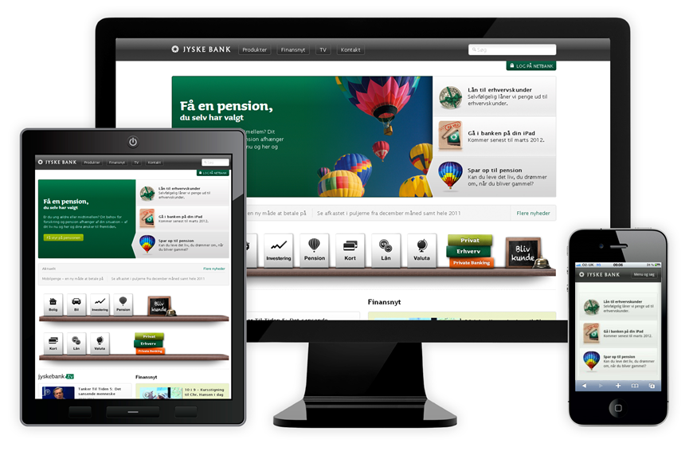
The Future of Mobile Web App/Site Development? Responsive Web Design?

Slide 30
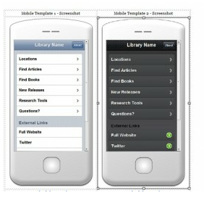
jQuery Mobile Templates at:
http://goo.gl/1FdO0
Handout: http://goo.gl/Mg1cm

Slide 31

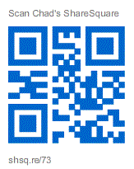

Want to Hangout?
gplus.to/chadmairn

Slide 32

Jason Clark
Head of Digital Access & Web Services
Associate Professor
Montana State University Library
@jaclark - twitter.com/jaclark
jaclark@montana.edu

