Slide 1
Building a Simple Mobile-optimized Web App/Site Using the jQuery Mobile Framework (part 2)

Slide 2
pinboard.in tag
http://pinboard.in/u:jasonclark/t:amigos-jquery-mobile/

Slide 3
Agenda
Open questions on jQuery Mobile template and Assignment 1
Acquire Best Practices for Mobile Design & Development.
Learn about Tips and Tools for Mobile Design & Development.
Discussion of Next Steps and Assignment 2.

Slide 4
Mobile Development - Demos
Demos:
Responsive Design Template (custom)
www.lib.montana.edu/~jason/files/responsive-design/
Mobile Template (jQuery Mobile)
www.lib.montana.edu/~jason/files/touch-jquery/
Code Samples and Downloads:
www.lib.montana.edu/~jason/files.php

Slide 5
Your Live Site
To test your work use this URL, but change it to your user number.
Example: http://marcomponline.com/chadtest/Class/lastname/touch-jquery/index.html

Slide 6
Making the Move to Mobile...
“My goal was initially just to make a mobile companion for the facebook.com mothership, but once I got comfortable with the platform I became convinced it was possible to create a version of Facebook that was actually better than the website.”
Joe Hewitt, lead developer for touch.facebook.com
Source: http://joehewitt.com/post/ipad/

Slide 7
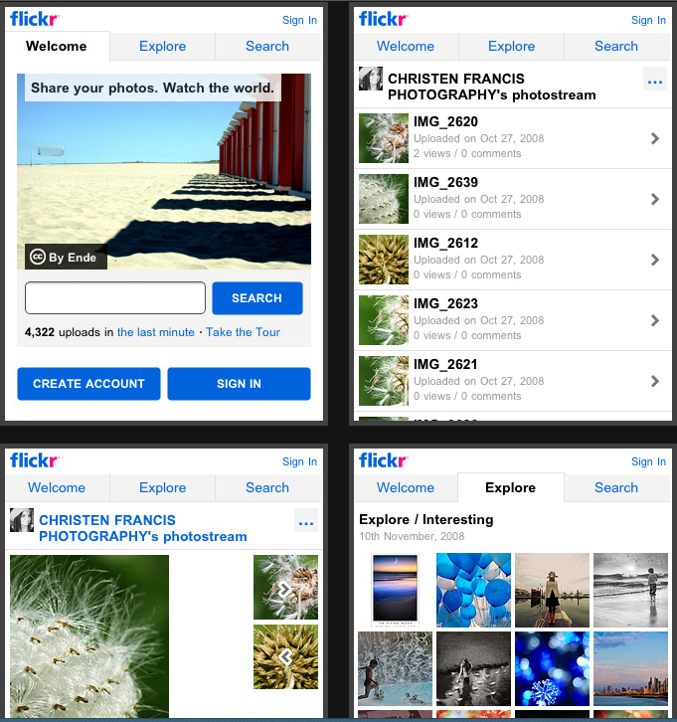
http://m.flickr.com

Slide 8
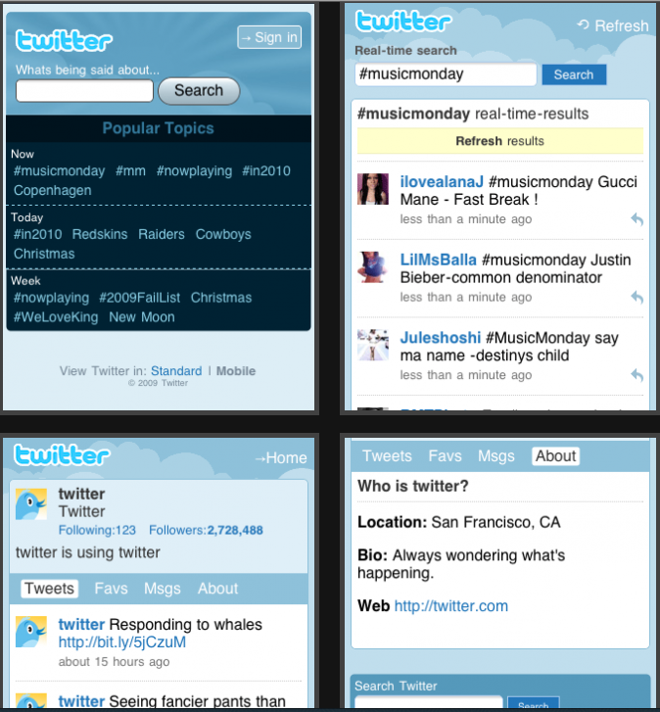
http://mobile.twitter.com

Slide 9
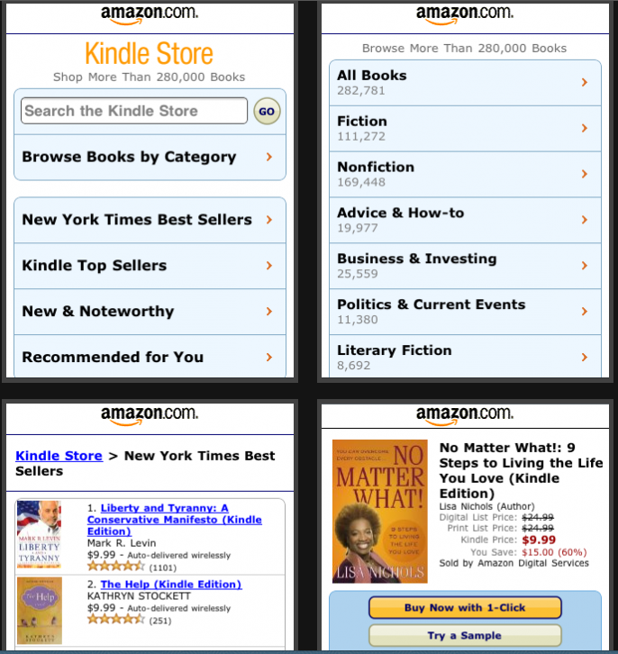
http://www.amazon.com/gp/aw/kindle/storefront/

Slide 10
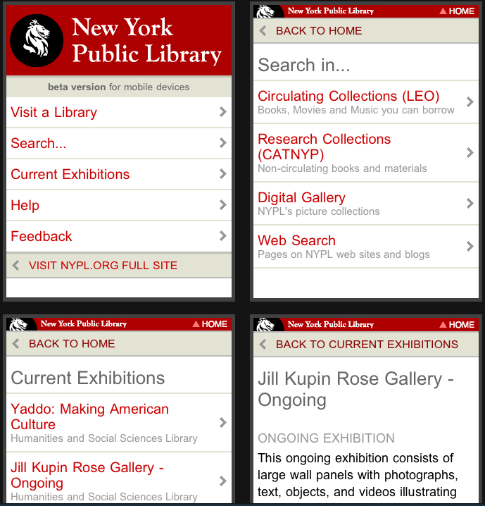
http://m.nypl.org

Slide 11
Exercise
Pick a web site
Define primary mobile actions
Choose mobile entry points (links)
What do library patrons want to do with library services in the mobile setting?

Slide 13
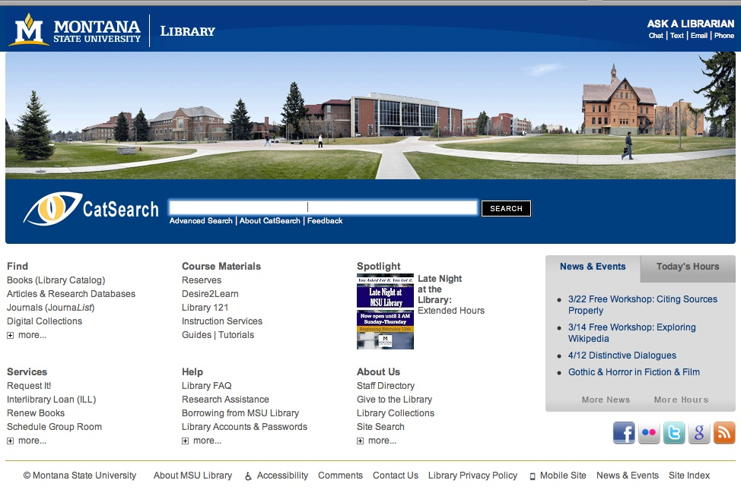

Slide 14
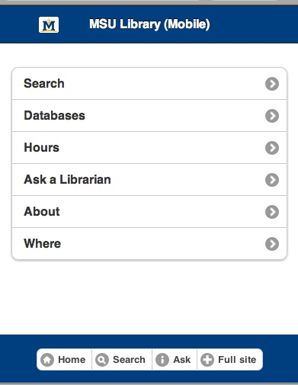

Slide 15
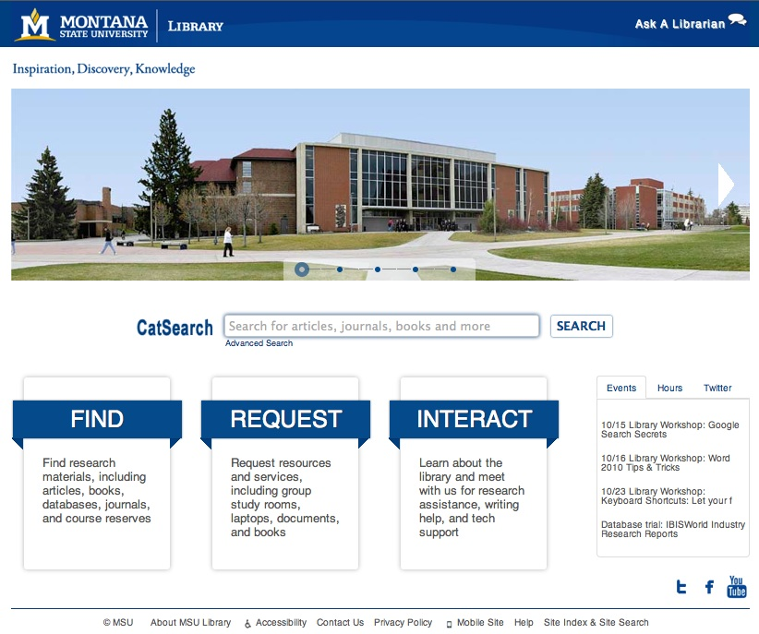

Slide 16
Some Best Practices
Follow the "m" convention (m.novarelibrary.com OR lifeonterra.com/m/)
Keep categories (directories) short. Remember that you are creating a page that people touch without much typing
Limit image and markup sizes
Limit HTML pages to 25KB to allow for caching
"Minify" your scripts and CSS (JSLint, CleanCSS)
Link to Full Site
Sniff for User Agent – Detection (allow the user to decide where to go)
One Column Layout with some whitespace
Mobile refers to the user!

Slide 17
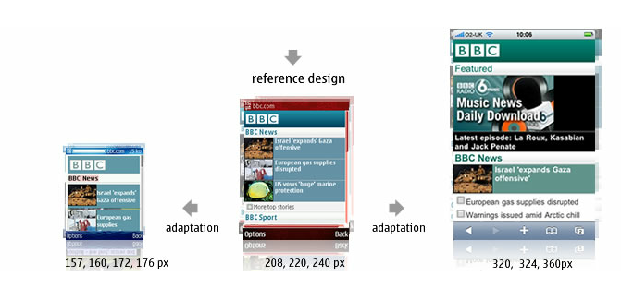
Mobile Screen Resolutions
Android (Motorola Droid) 480x854
Android (MyTouch) 320x480
Android (Nexus One) 480x800
Apple iPhone 320x480
Apple iPad 1024x768
Palm Pre 320 x 480
Source: http://goo.gl/zEDoi

Slide 18
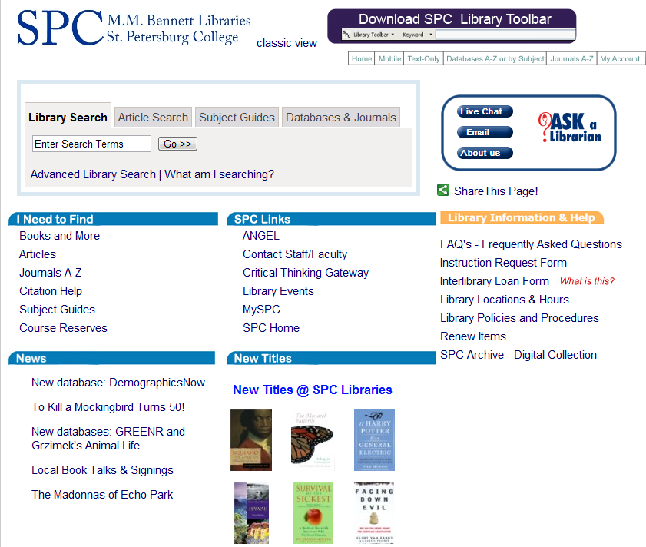
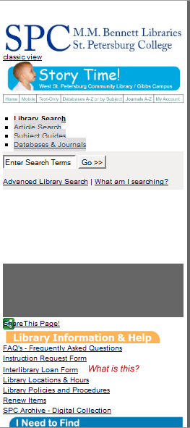
Small Screen Rendering (260 px) using the Web Developer add-on in Firefox
Desktop
Small Screen

Slide 19
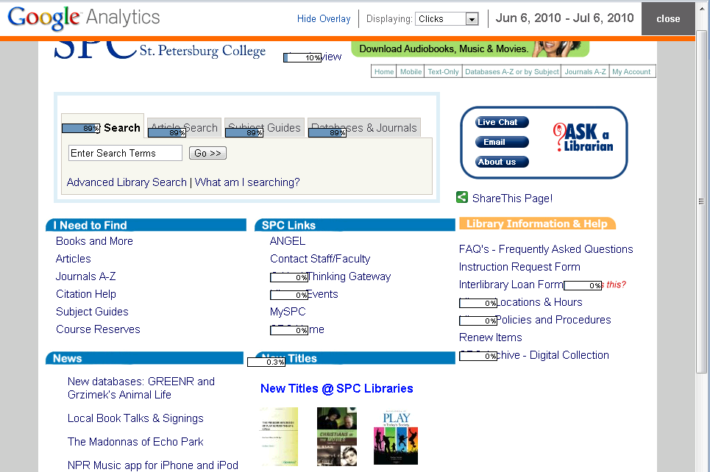
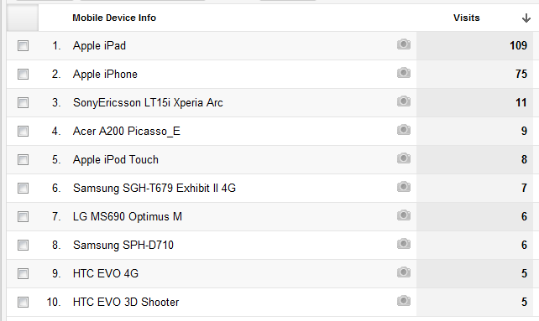
In-page Analytics
Note: you can determine how your user’s are accessing your Web site (e.g., mobile devices, carriers, browsers , OS’s, screen resolution etc.)

Slide 20
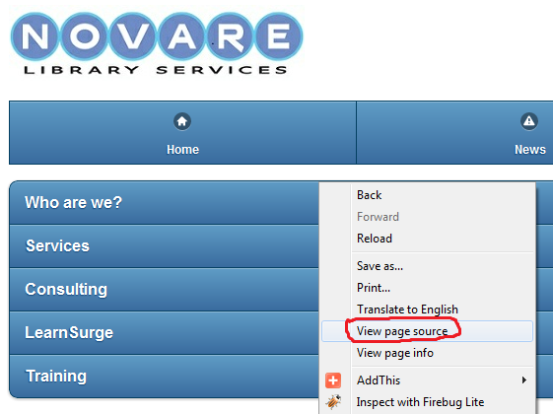
Learn and borrow from sites you like.
http://m.novarelibrary.com/

Slide 21
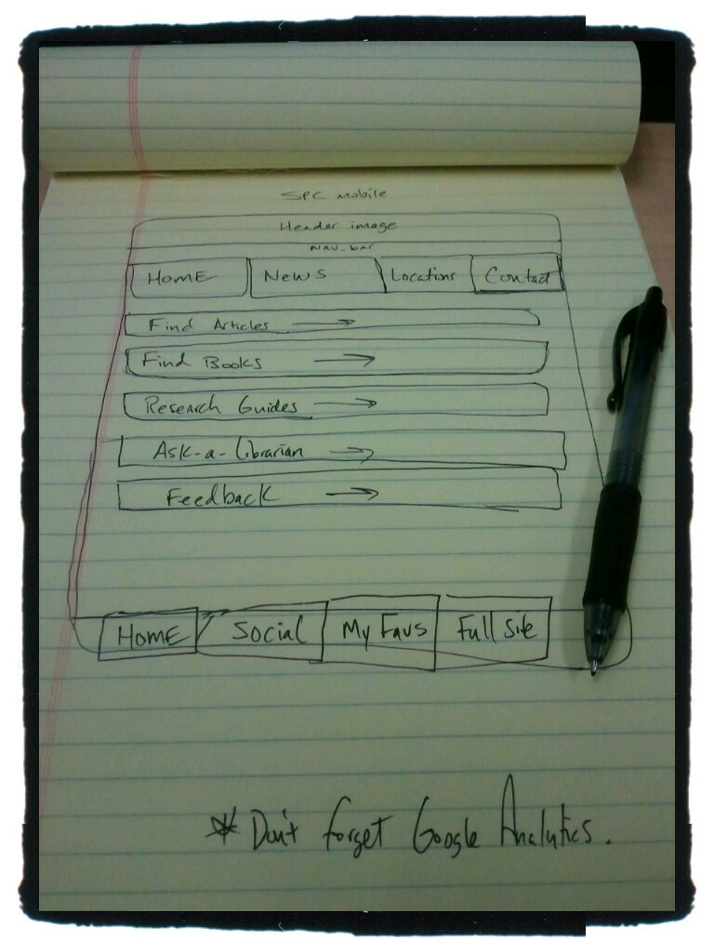
Sketch ideas

Slide 22
Testing and validation
Test Page Speed in Firebug
http://getfirebug.com/

Slide 23
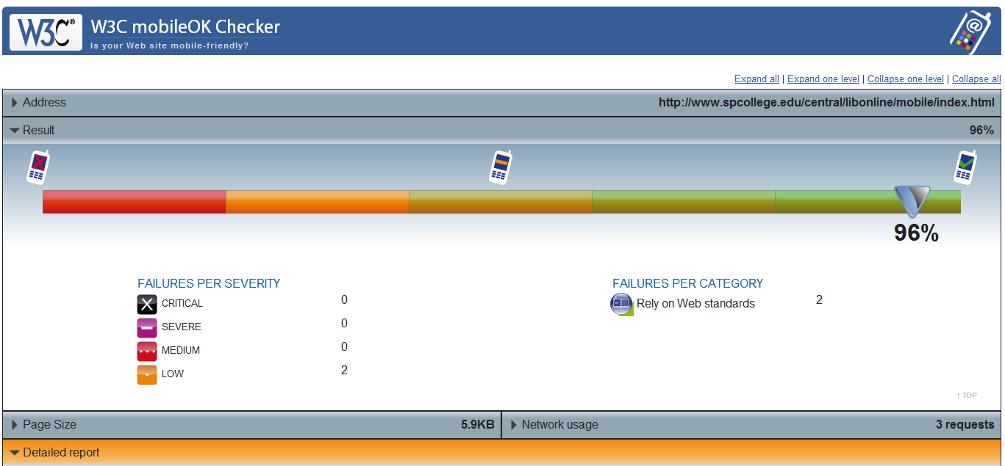
W3C mobileOK Checker http://validator.w3.org/mobile/

Slide 24
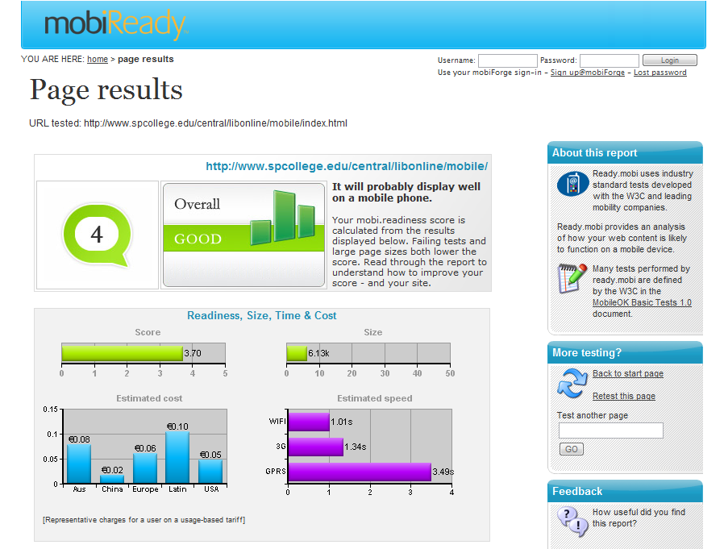
http://ready.mobi

Slide 25
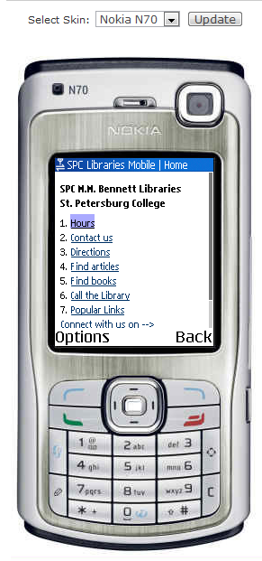
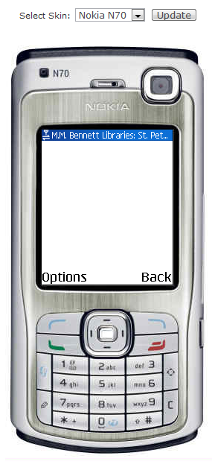
Take an emulated look at your desktop site.
Mobile Site
Desktop Site

Slide 26
Emulators/Simulators:
Cowemo Mobile Emulator: http://www.mobilephoneemulator.com/
dotMobi Emulator - http://mtld.mobi/emulator.php
Opera Mini Simulator - http://www.opera.com/mobile/demo/
Mimic - emulates European and Japanese models: N400i and N505i. http://pukupi.com/post/2059
Android Emulator - http://developer.android.com/guide/developing/tools/emulator.html
BlackBerry Device Simulators - https://www.blackberry.com/Downloads/entry.do?code=060AD92489947D410D897474079C1477
iPhone Dev Center: http://developer.apple.com/iphone/
Palm Pre - http://developer.palm.com/
Windows Mobile - http://msdn.microsoft.com/en-us/windowsmobile/default.aspx
JAVA ME - Java Platform Micro Edition was termed J2ME. It is considered one of the most ubiquitous application platform for mobile devices. http://java.sun.com/javame/reference/apis.jsp

Slide 27
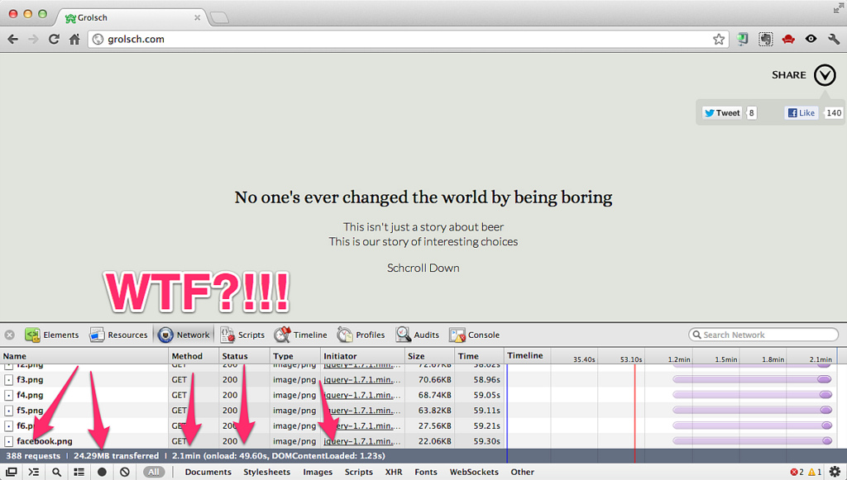
"All sizes | Enough of this silliness | Flickr - Photo Sharing!." Last modified 10/15/2012 12:45:55. http://www.flickr.com/photos/philhawksworth/7562460356/sizes/l/in/photostream/ (accessed 10/15/2012).

Slide 28
Mobile Optimization
Minify scripts, html, css …
Reduce HTTP requests
Compress files with gzip
Cache static resources
“Speed matters.”
https://developers.google.com/speed/pagespeed/insights

Slide 29
Mobile Analytics
Web metrics and statistics
Mobile search logs
“Data is your friend. Take out the guesswork.”

Slide 30
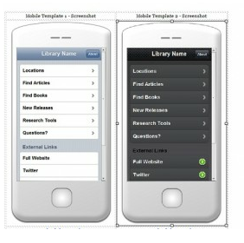
jQuery Mobile Templates at:
http://goo.gl/1FdO0
Handout: http://goo.gl/GIzWJ

Slide 31
Other mobile development tools/frameworks

Slide 32
The Future of Mobile Web App/Site Development? Responsive Web Design?

Slide 33
Mobile First as Strategy
“Google programmers are doing work on mobile applications first, because they are better apps and that's what top programmers want to develop.”
- Eric Schmidt, Google CEO
http://www.eweek.com/c/a/Midmarket/Google-CEO-Eric-Schmidt-at-MWC-Mobile-First-694942/

Slide 34
Assignment 2
Validate your jQuery Mobile App
Make one optimization and tell us what it is
Add Google Analytics to your template
When all tasks are complete, upload index.html to Assignment 2.
Ask us questions in the class forum

Slide 35
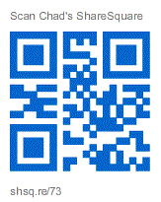
Want to Hangout?
gplus.to/chadmairn

Slide 36
Jason Clark
Head of Digital Access & Web Services
Associate Professor
Montana State University Library
@jaclark - twitter.com/jaclark
jaclark@montana.edu

