Slide 1
Book as Platform:
Linking Data to Build a Better Book
#arcs2015
Jason A. Clark
@jaclark
Scott Young
@hei_scott
Notes:
We are from Montana State

Slide 3
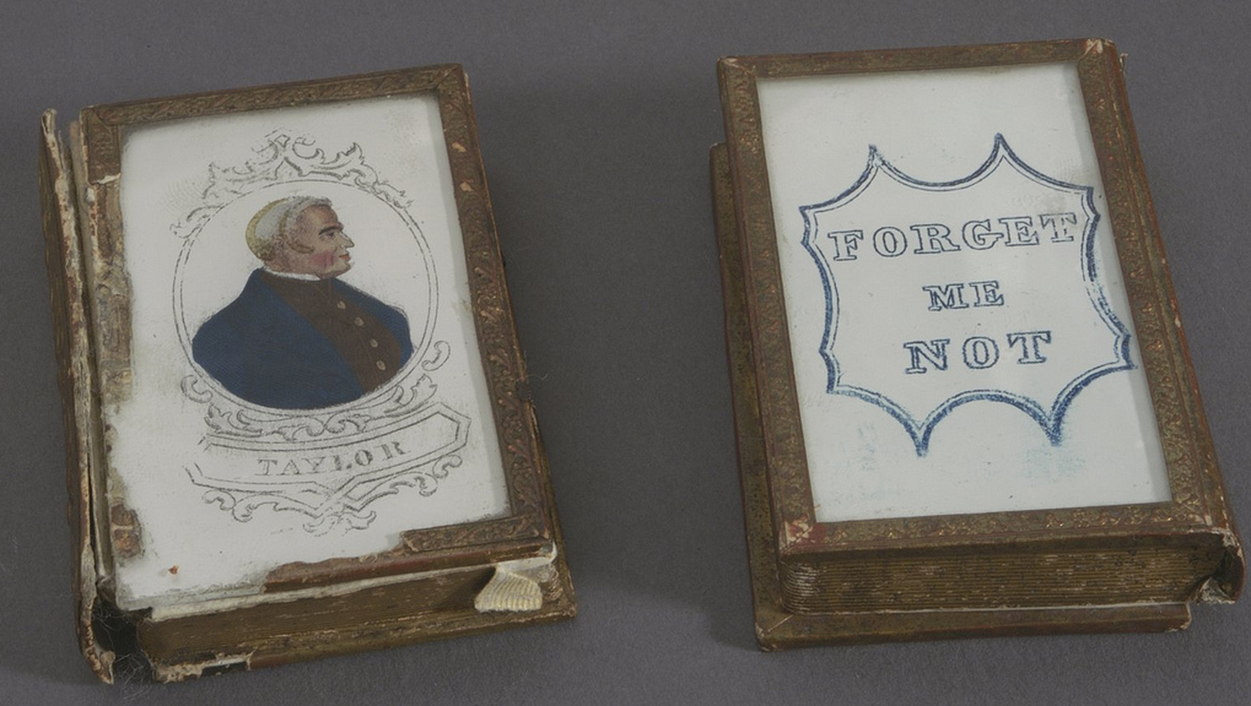
Notes:
http://library24.library.cornell.edu:8280/luna/servlet/detail/CORNELL~9~1~78423~3615

Slide 6
Every Book its [machine] Reader
Apologies to Ranganathan
Notes:
It’s as easy to access a book page as it is a web page

Slide 7
What if?
Books were machine indexed
for semantic discovery
Journal articles were semantically tagged
at the page level
Notes:
It’s as easy to access a book page as it is a web page

Slide 8
A “Book” in a Browser
Atomizable, Analyzable, Linkable, Reusable

Slide 9
Book as Software
Software Development
Data Storage and Archiving
Metadata
Discovery and Analytics
API Access

Slide 10
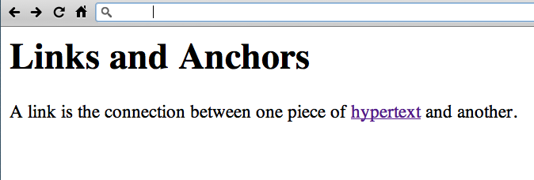
www.w3.org/History/19921103-hypertext/hypertext/WWW/Link.html

Slide 11
The Research
Institute of Museum and Library Services
Sparks Ignition Grant

Slide 12
Web Book Prototyping

Slide 13
Book 1
demo: arc.lib.montana.edu/book/home-cooking-history-409
code: github.com/jasonclark/bib-template
Book 2
demo: arc.lib.montana.edu/book/opsis
code: github.com/msulibrary/bib-template-fiction

Slide 14
Our Initial Project
Digital Book for History Class
MS Word -> Static HTML -> Dynamic HTML
API driven and Linked Data

Slide 15
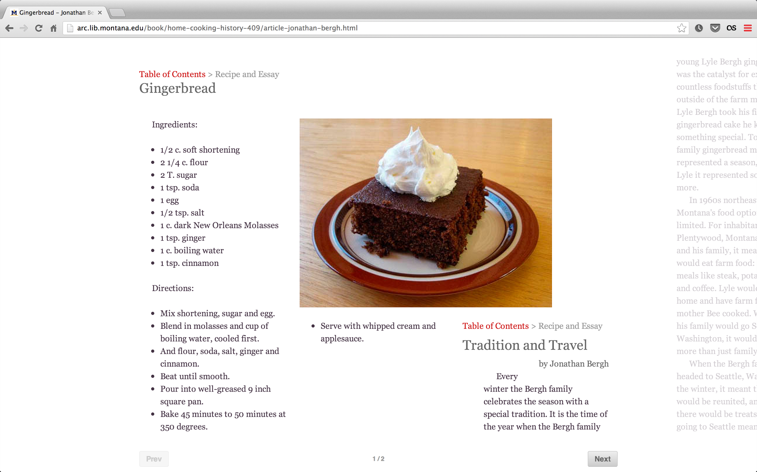

Slide 16
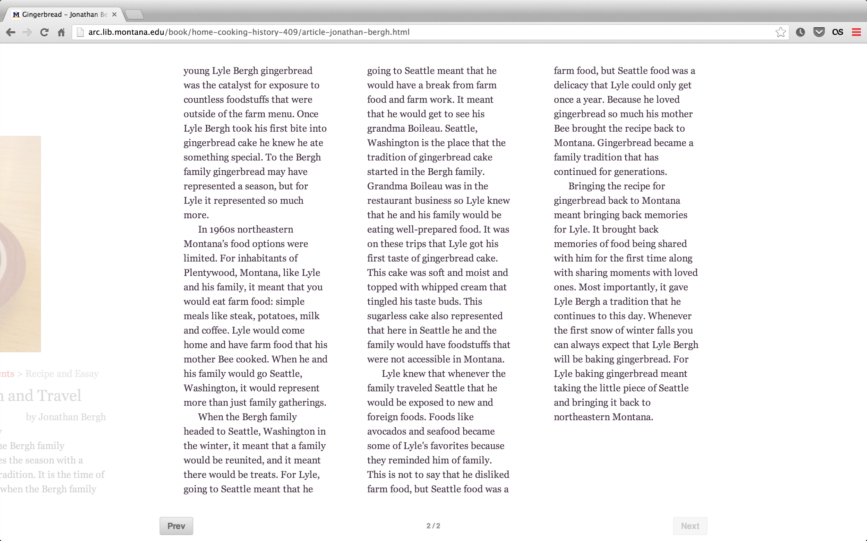

Slide 17
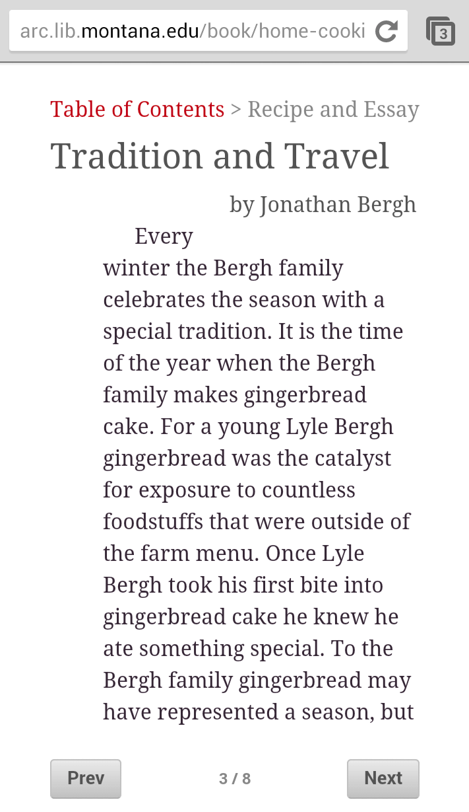

Slide 18
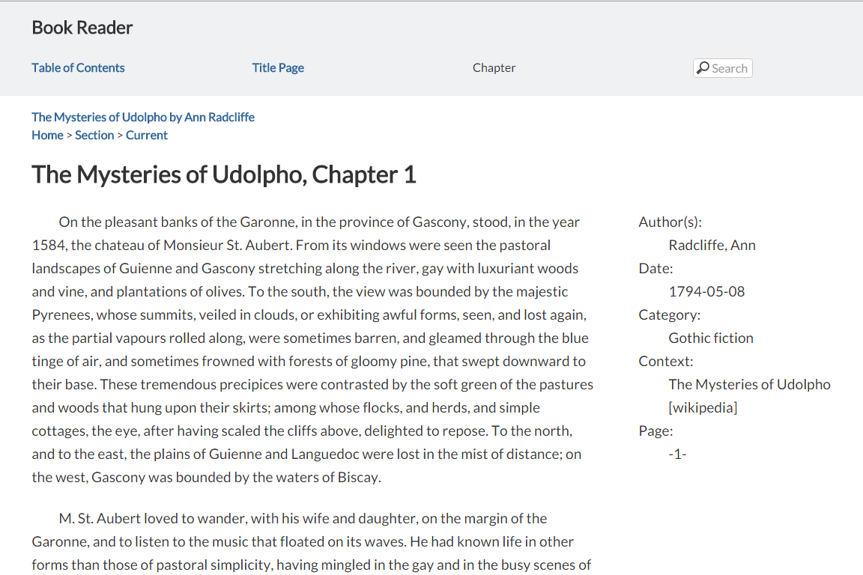

Slide 19
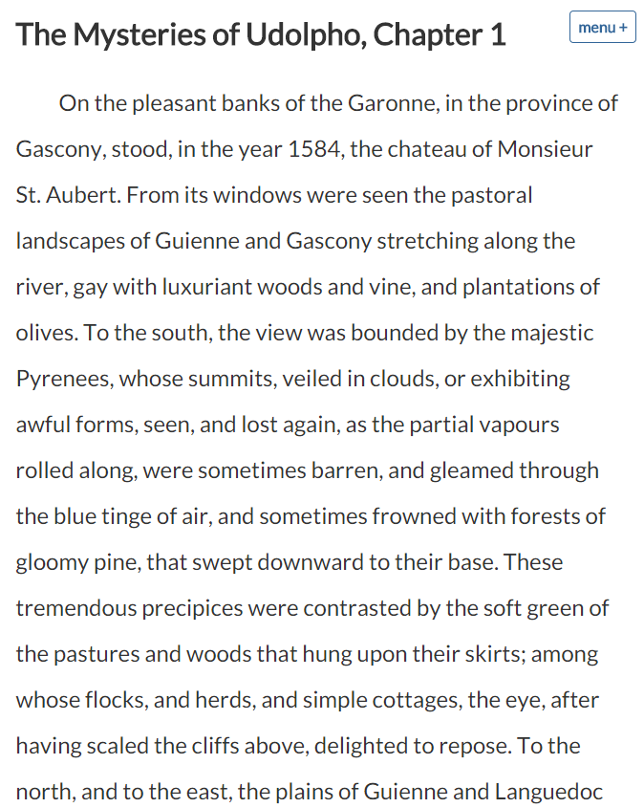

Slide 20
Web Book Dev Stack
HTML
CSS
(Javascript)
MySQL
PHP
schema.org
RDFa

Slide 21
Disruption?
New Roles for Publisher

Slide 22
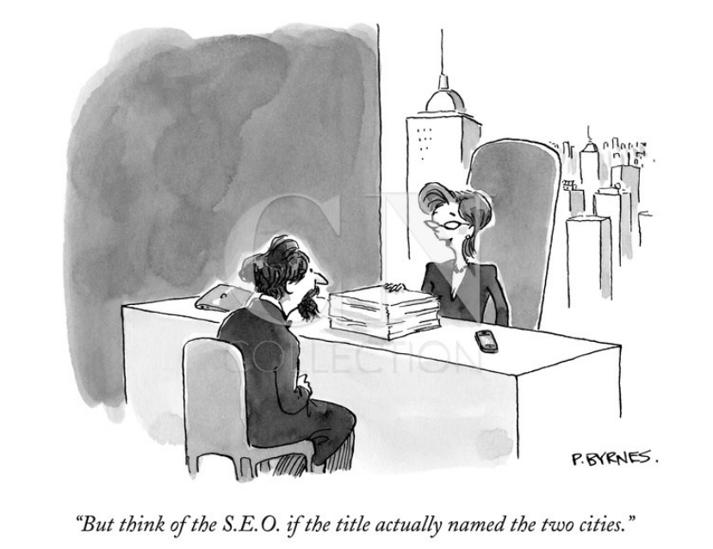

Slide 23
Old Roles
Validating
Editing
Typesetting
Promotion
Sales

Slide 24
New Roles
Archiving
Metadata [structured]
Discovery
Analytics + Metrics
Sharing + Reuse

Slide 25
Structured Data
Data Model + Machine Readability

Slide 26
Schema.org
controlled vocabulary

Slide 27
CREATE TABLE IF NOT EXISTS `bodymatter` (
`id` int(11) NOT NULL AUTO_INCREMENT,
`name` varchar(255) DEFAULT NULL,
`creator` varchar(255) DEFAULT NULL,
`url` varchar(255) DEFAULT NULL,
`description` text,
`about` text,
`image` varchar(140) DEFAULT NULL,
`articleBody` text COMMENT 'http://schema.org/Article',
`articleSection` text COMMENT 'http://schema.org/Article',
`publicationType` varchar(255) NOT NULL COMMENT 'http://schema.org/MedicalScholarlyArticle',
`additionalType` varchar(255) DEFAULT NULL,
`additionalType2` varchar(255) DEFAULT NULL,
`isbn` varchar(40) DEFAULT NULL,
`genre` varchar(140) DEFAULT NULL,
`keywords` varchar(255) DEFAULT NULL,
`publisher` varchar(255) DEFAULT NULL,
`dateCreated` varchar(255) DEFAULT NULL,
`dateModified` timestamp NULL DEFAULT CURRENT_TIMESTAMP ON UPDATE CURRENT_TIMESTAMP,
`datePublished` varchar(255) DEFAULT NULL,
`version` varchar(140) DEFAULT NULL,
`learningResourceType` varchar(140) DEFAULT NULL,
`inLanguage` varchar(5) DEFAULT NULL,
PRIMARY KEY (`id`),
FULLTEXT KEY `search` (`name`,`creator`,`description`,`genre`,`keywords`,`dateCreated`)
) ENGINE=MyISAM DEFAULT CHARSET=utf8;

Slide 28
epub:type
semantic divisions...

Slide 29
<html …
xmlns:epub="http://www.idpf.org/2007/ops">
…
<section epub:type="bodymatter">
…
</section>
…
</html>

Slide 31
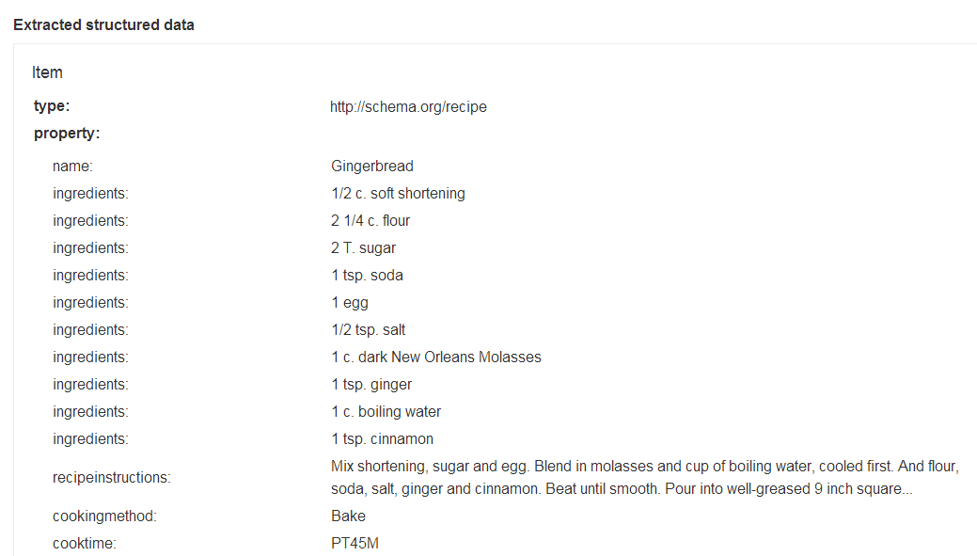

Slide 32
Discovery
RDFa
JSON-LD
Linked Data Topics
Notes:
https://developers.google.com/webmasters/structured-data/testing-tool/

Slide 34
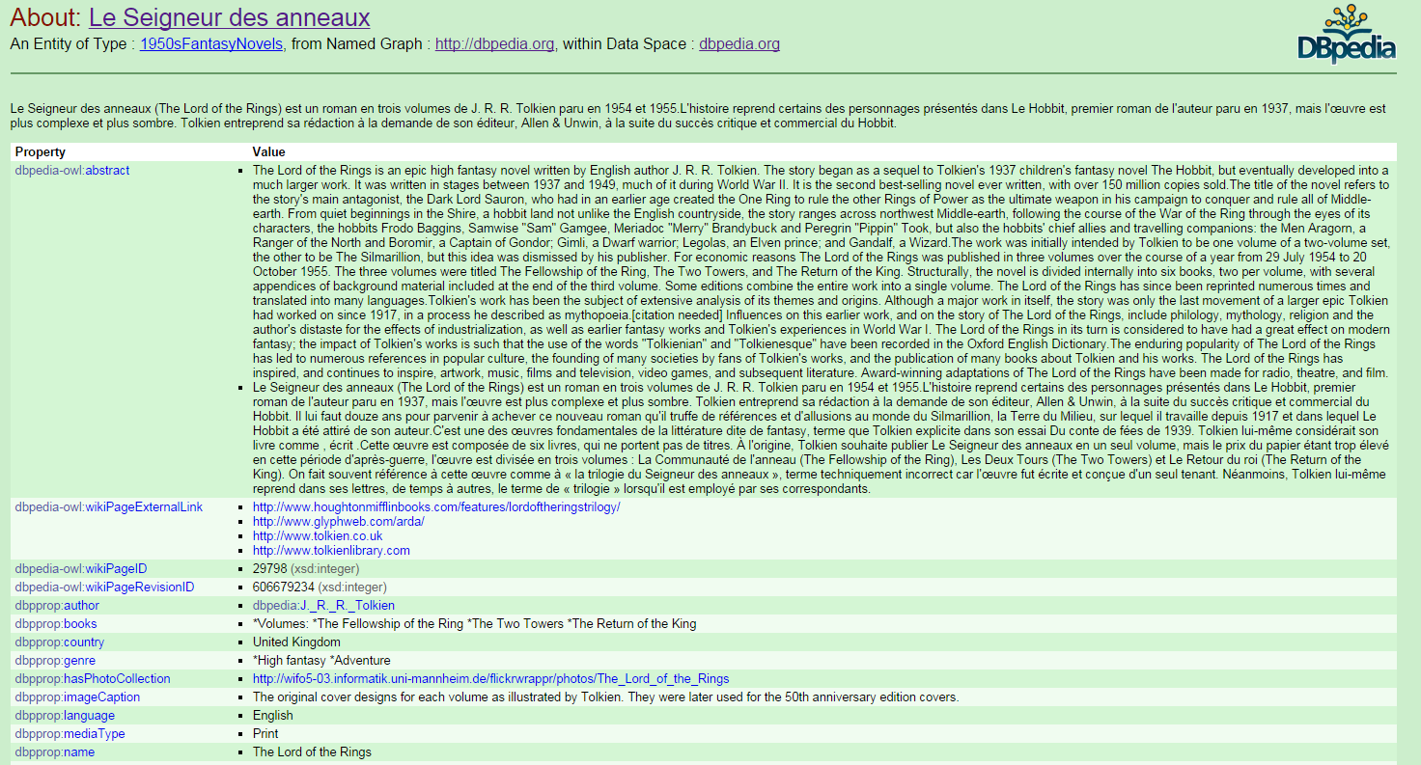

Slide 35
<script type="application/ld+json">
{
"@context" : "http://schema.org",
"@type": "CreativeWork",
"name": "Opsis: Literary Arts Journal at Montana State University (MSU)",
"description": "Opsis is the literature and arts magazine of Montana State University",
"image": "http://arc.lib.montana.edu/book/opsis/meta/img/opsis.png",
"datePublished": "2015-02-02T01:43:19Z",
"inLanguage" : "en",
"genre" : "Journals (Publications)",
"learningResourceType" : "Student literary journal",
"creator": {
"@type": "Person",
"name": "Multiple Authors"
},
"Article": {
"@type": "Article",
"name": "The Shore As She",
"author": {
"@type": "Person",
"name": "Leslie Staven"
},
"articleBody": "The sand softens shifts ...",
"url": "http://arc.lib.montana.edu/book/opsis/item/7",
"datePublished": "2015-02-02T01:43:19Z",
"publisher": {
"@type": "Organization",
"name": "Montana State University (MSU)"
},
"additionalType": "http://dbpedia.org/resource/Poetry",
"additionalType": "http://dbpedia.org/resource/Memory"
},
...

Slide 36
Analytics + Metrics
Web Analytics, UX

Slide 37
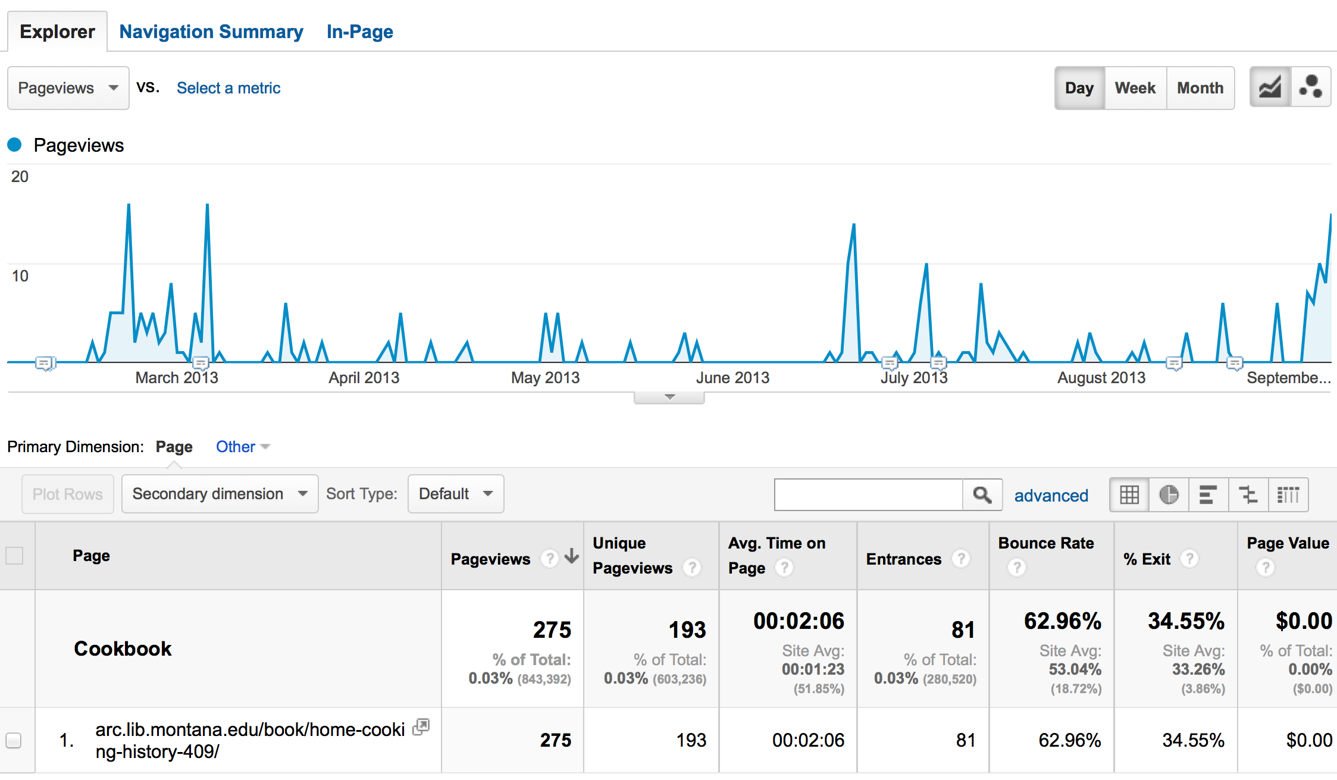

Slide 38
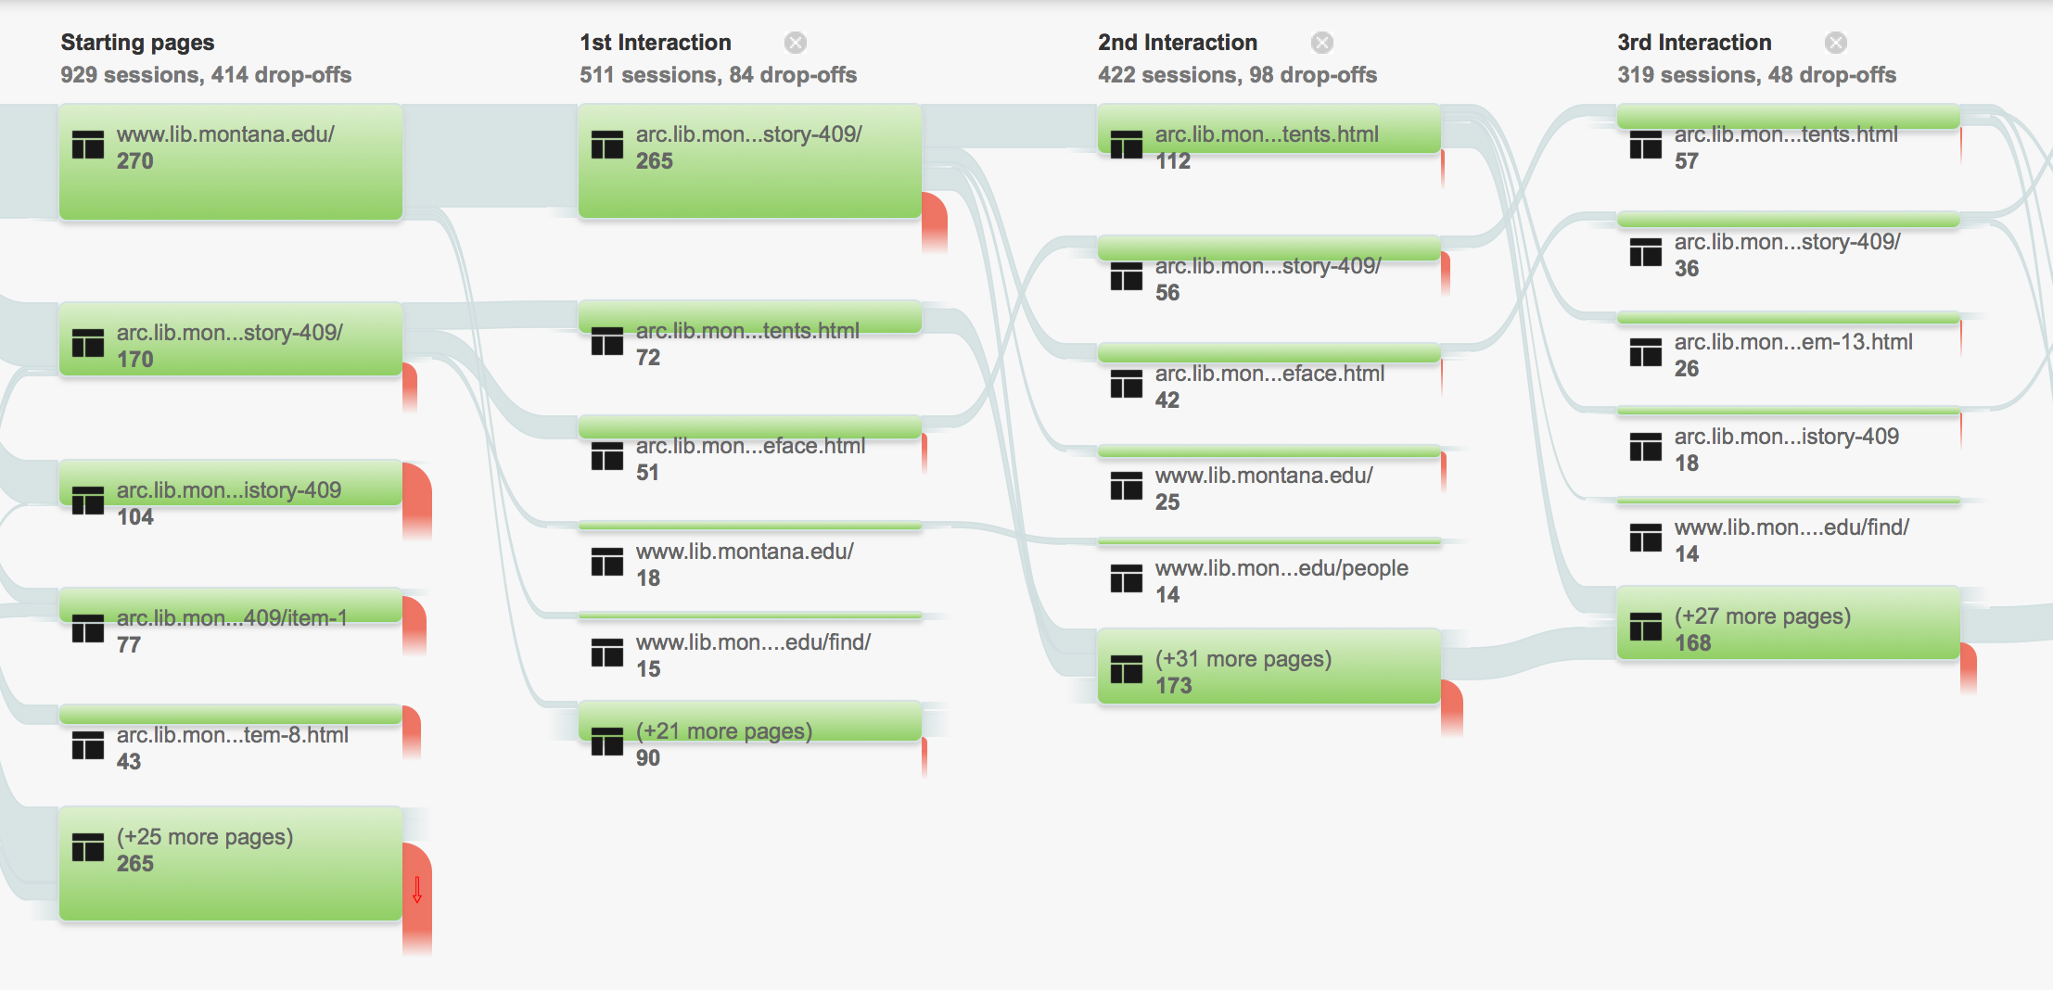
Notes:
- GA allows us to see how people are moving through the book
- we can see how they interact with each page

Slide 39
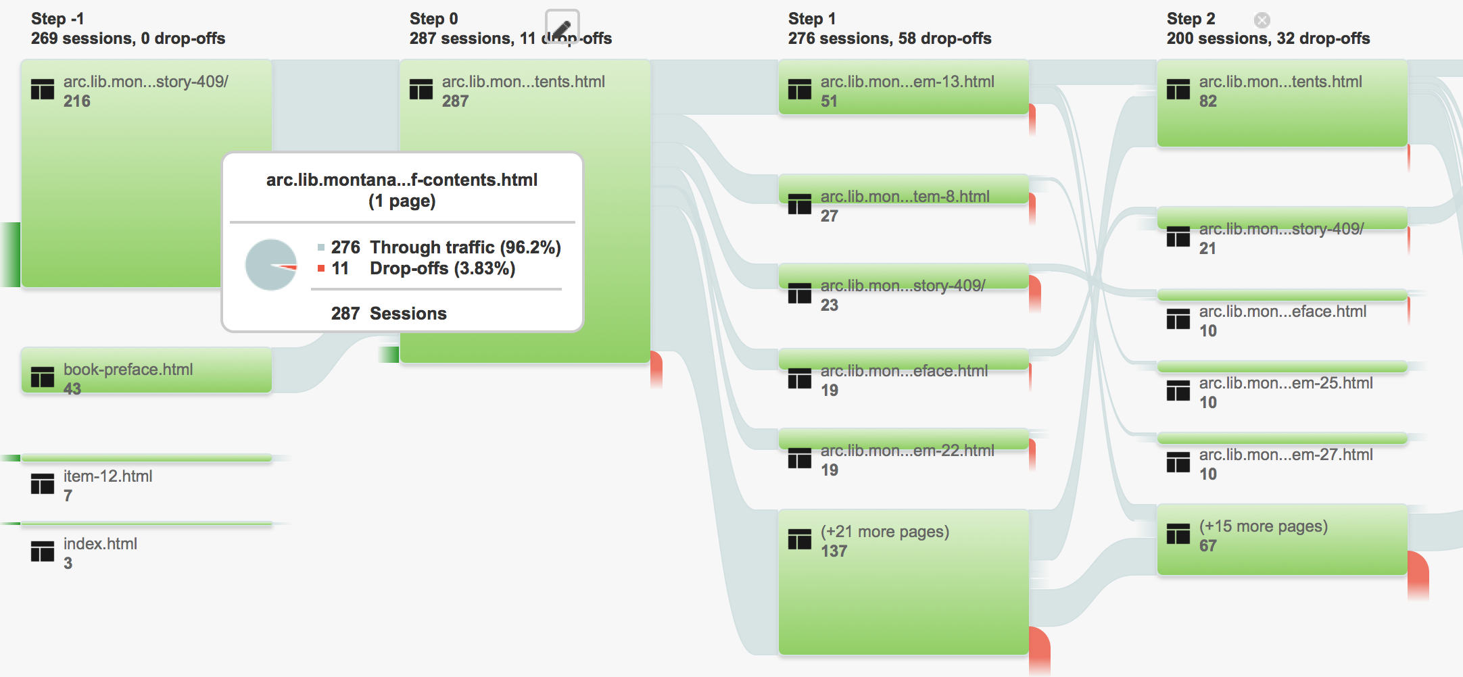

Slide 40
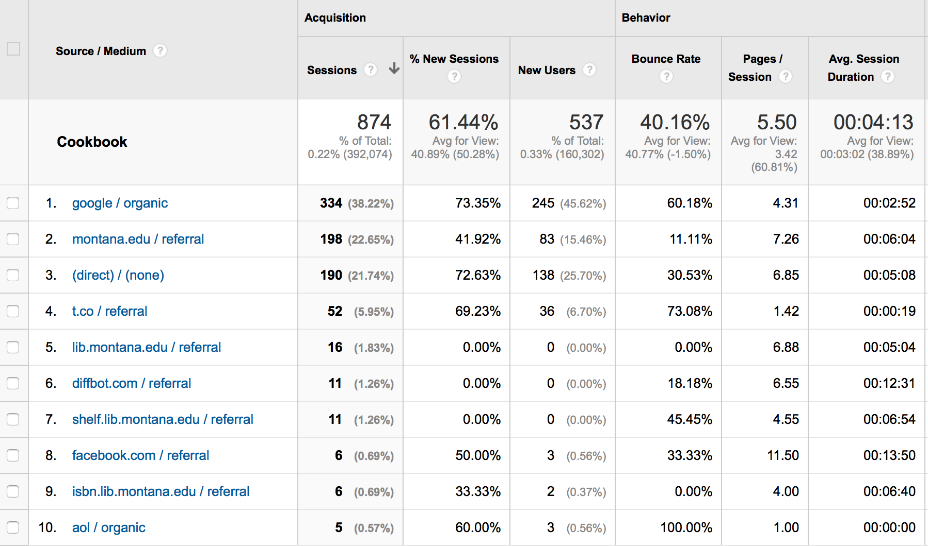

Slide 41
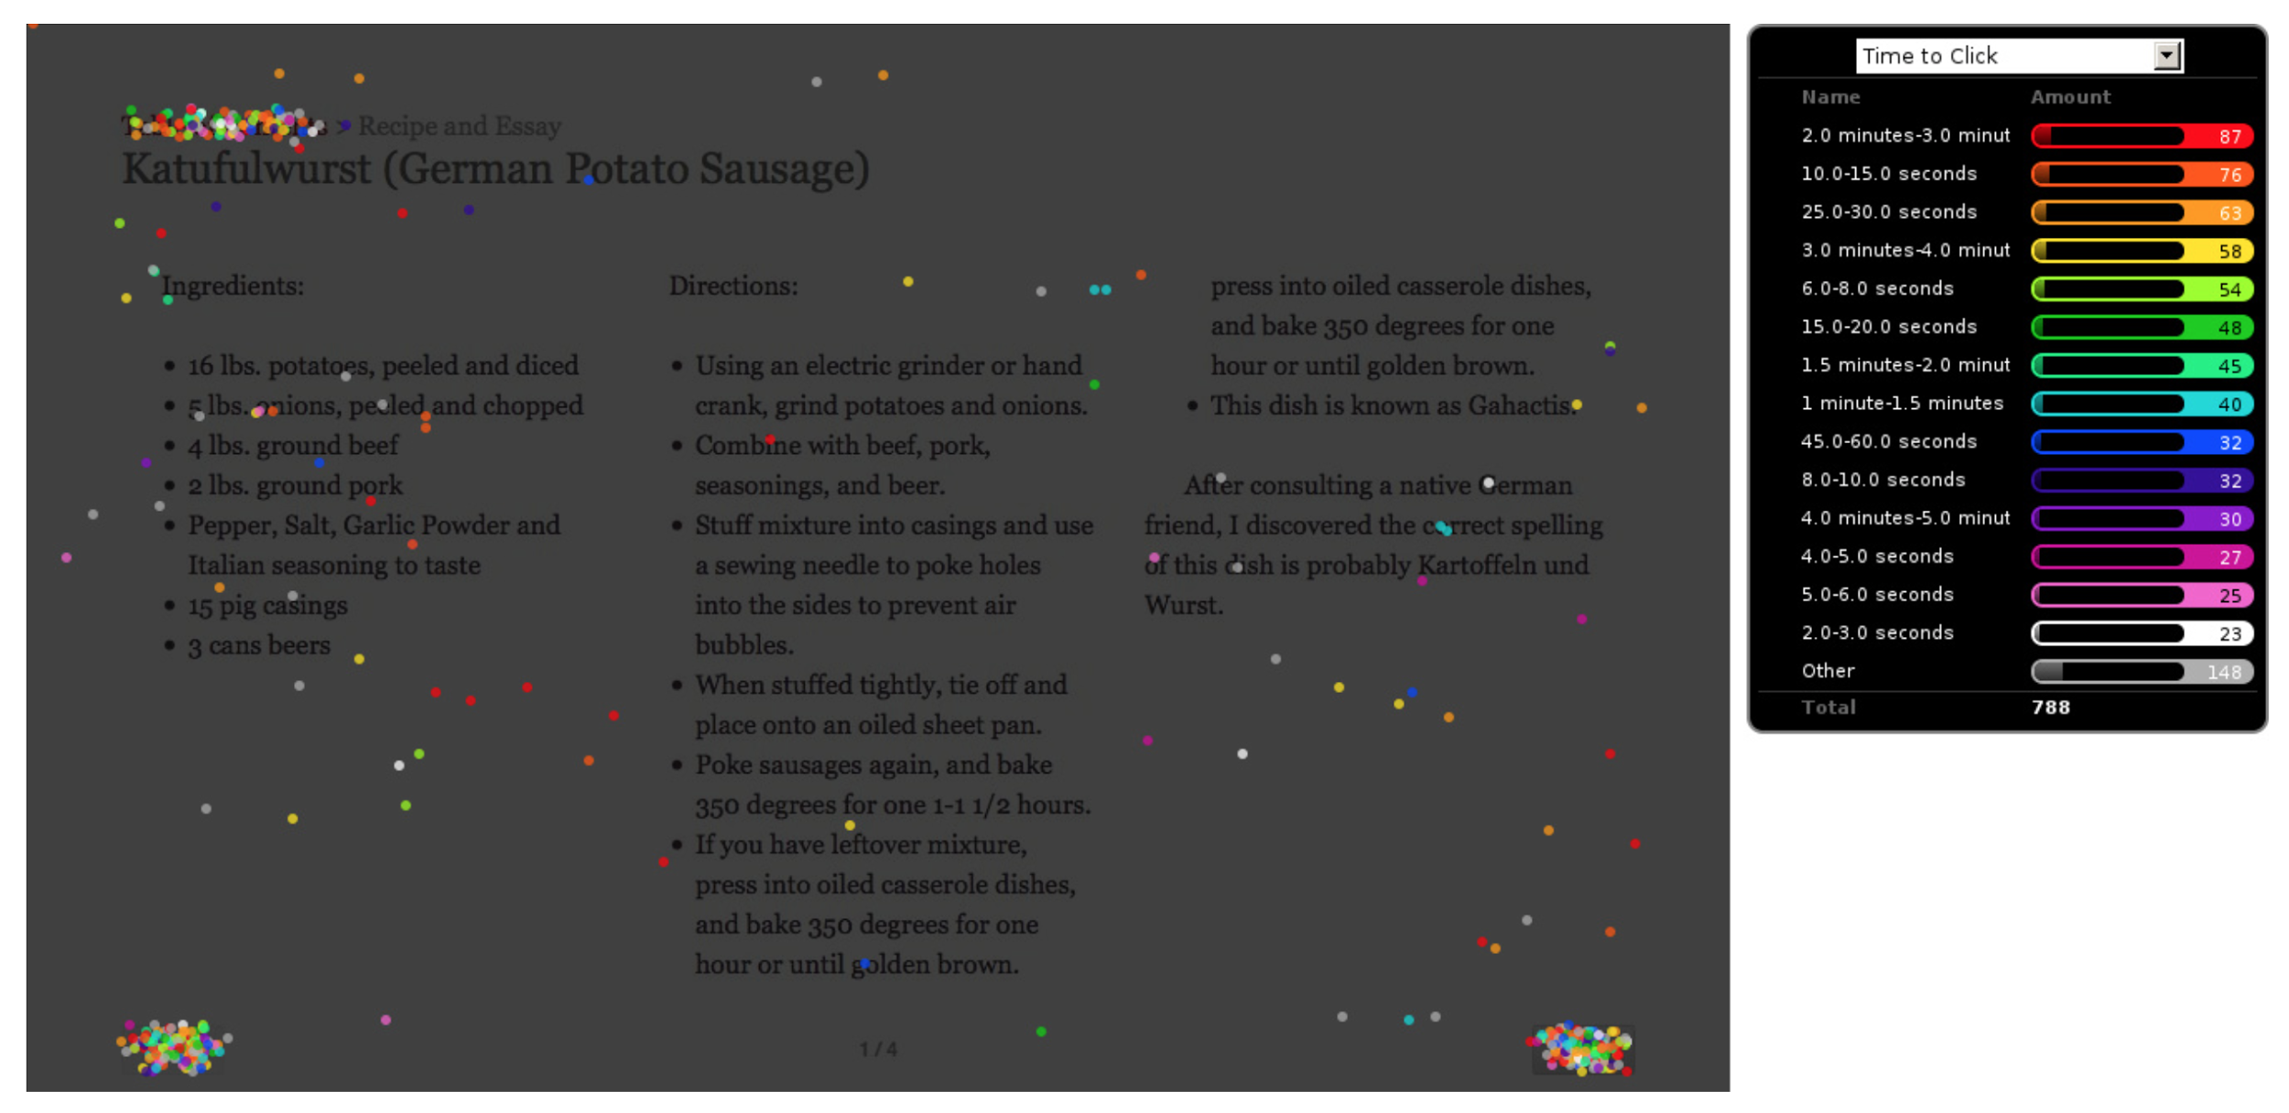

Slide 42
Sharing + Reuse
Web Services + API
Social Sharing
Deep Linking

Slide 43
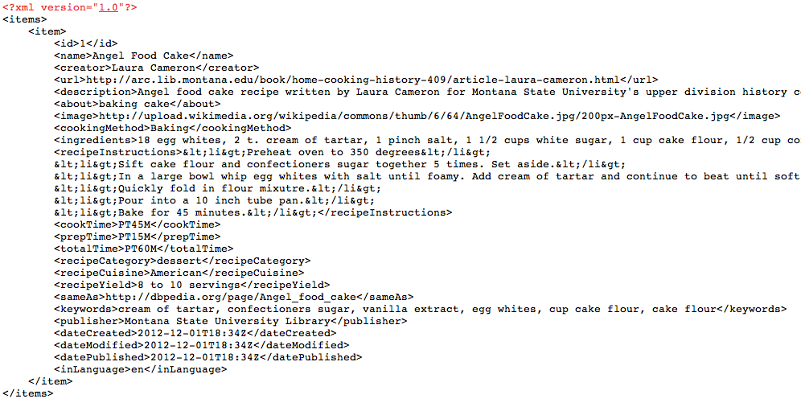
XML, JSON
/home-cooking-history-409/api.php?type=recipe&id=1&num=1&format=xml
...api?id=1&format=xml
...api?type=search&q=poetry&format=json
Notes:
http://shelf.lib.montana.edu/home-cooking-history-409/api.php?type=book&id=1&num=1&format=json
http://shelf.lib.montana.edu/home-cooking-history-409/api.php?type=recipe&id=1&num=1&format=xml
http://shelf.lib.montana.edu/home-cooking-history-409/api.php?type=search&q=lauren&num=10

Slide 44
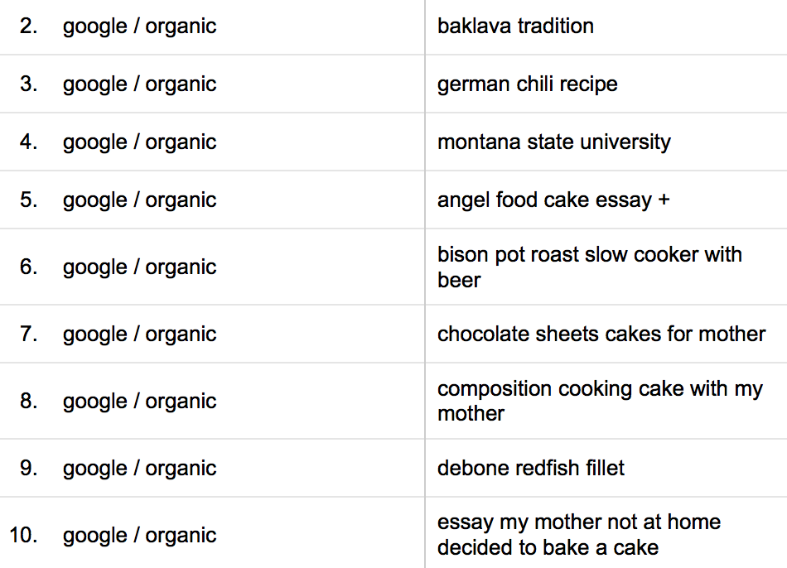

Slide 45
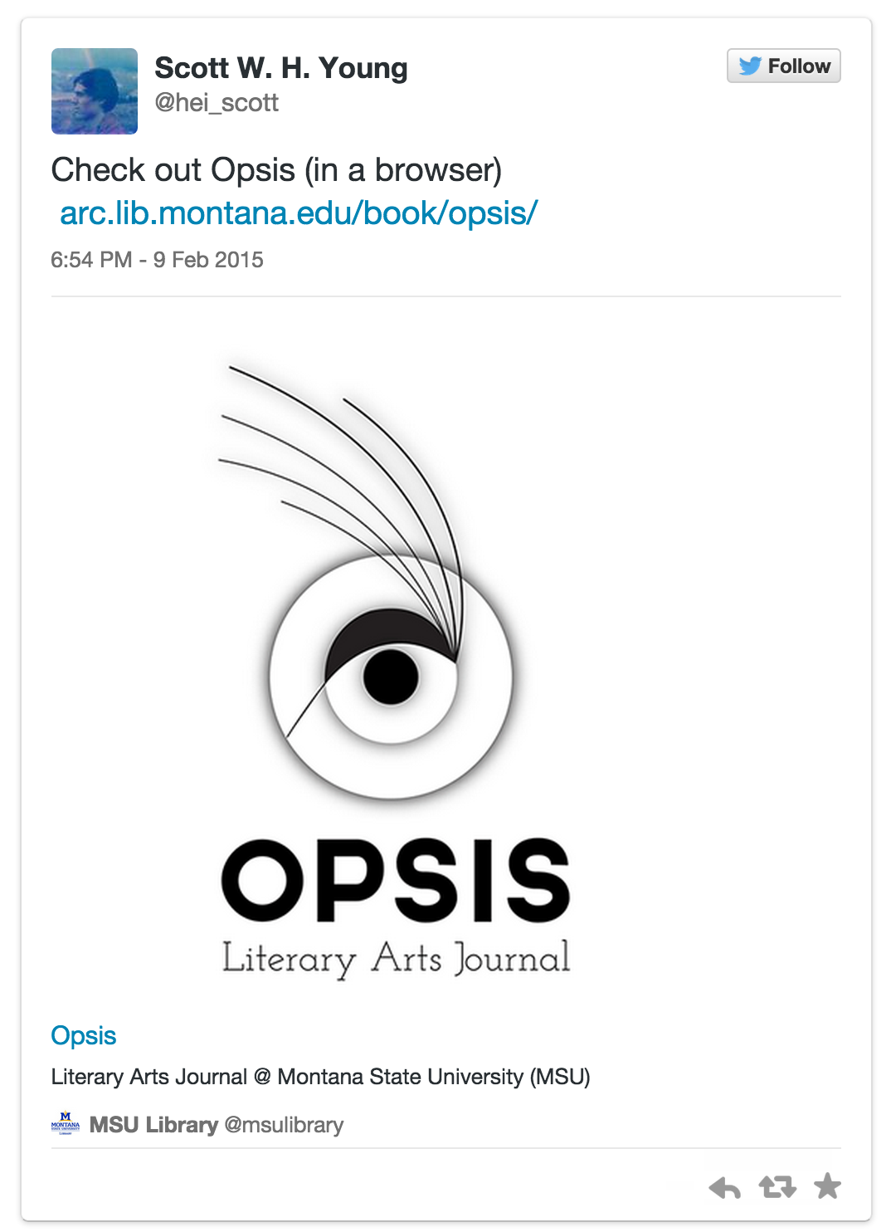

Slide 46
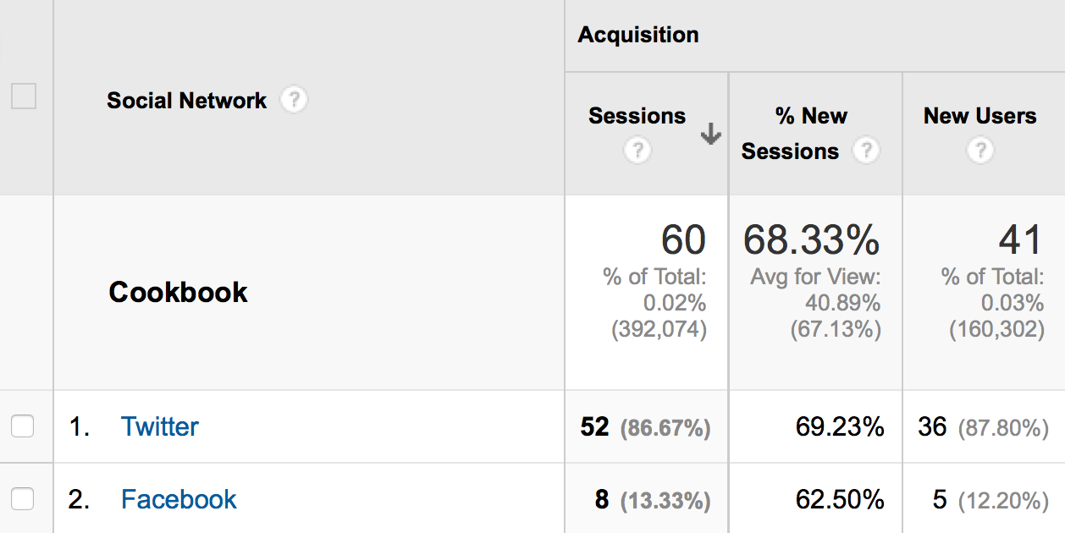

Slide 47
Deep-linking the book
HTTP + URL
Notes:
- harness the HTTP and the URL: one of the design purposes of the Web is to allow authors to link to any published document on another site
- share individual pages

Slide 48
http://arc.lib.montana.edu/book/opsis/item/21
http://arc.lib.montana.edu/book/opsis/table-of-contents.html
Notes:
The book in a browser is networked and therefore findable and shareable

Slide 49
Ongoing Research
Data Modeling and Transformation
Genres - textbook, journal
UX of Reading
Real-time Analytics
Annotations

Slide 50
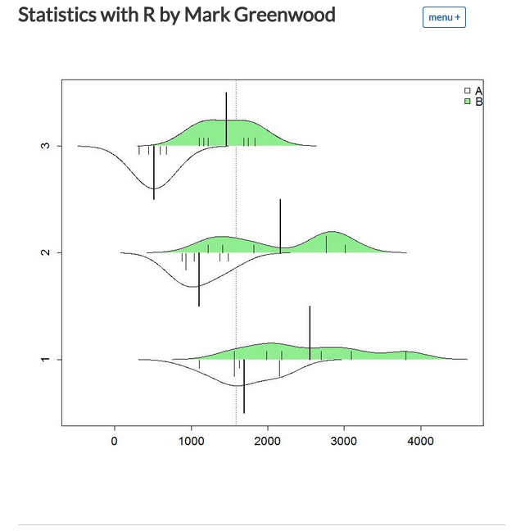

Slide 51
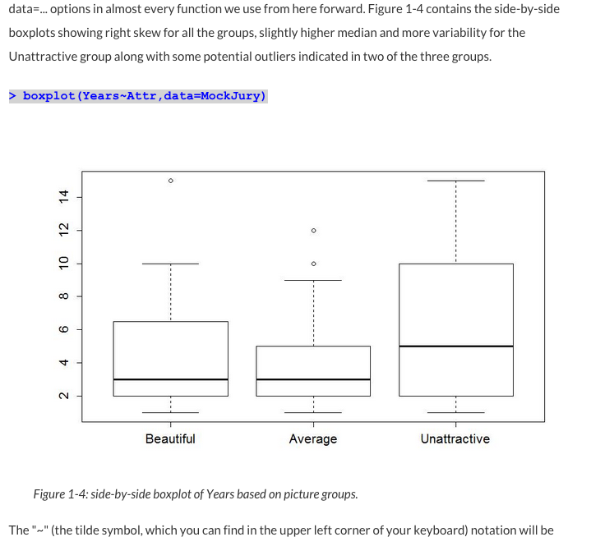

Slide 52
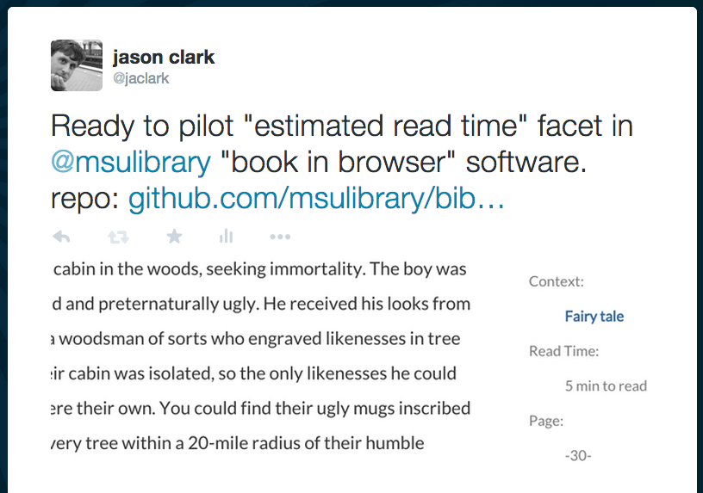

Slide 53
The “Book” in a Network
http://arc.lib.montana.edu/book/
Designed for the bot’s experience
Designed for the reader’s experience
Notes:
Connected, Shareable

Slide 54
Survey of the Field
HTMLBook
https://github.com/oreillymedia/HTMLBook
Leanpub
https://leanpub.com/
GitBook
https://www.gitbook.com/
Penflip
https://www.penflip.com/
gitenberg
https://gitenberg.github.io/
Book in Browser Conference
http://booksinbrowsers.org/
Library Publishing Coalition
http://www.librarypublishing.org/
Notes:
http://www.kickstarter.com/projects/1371597318/the-peoples-e-book

Slide 55
A Research Team Effort
Patrick O’Brien: Semantic Web Research Director at Montana State University Library.
Scott Young: Digital Initiatives Librarian at Montana State University.
Jason Clark: Head of Library Informatics and Computing at Montana State University Library
Kenning Arlitsch: Dean of the Library at Montana State University. His book, co-authored with Patrick OBrien, is titled Improving the Visibility and Use of Digital Repositories through SEO, and was published in February 2013.

Slide 56
Thanks!
Jason A. Clark
Head, Library Informatics & Computing
Montana State University Library
@jaclark
Scott Young
Digital Initiatives Librarian
Montana State University Library
@hei_scott

