Slide 1
Finding the Machine [processes]:
Applying the Open Data Project to Research Services
Charleston Conference 2015
(Session with Kamran Naim and Robin Champieux)
Jason A. Clark
Associate Professor
Head of Library Informatics & Computing
Montana State University (MSU) Library
www.jasonclark.info

Slide 2
pinboard.in tag
pinboard.in/u:jasonclark/t:open-machines/

Slide 3
twitter as channel (#hashtag)
@jaclark #chs15

Slide 4
Open has Consequences

Slide 5
Almost always good ones...

Slide 6
Overview
Why Open?
“Open” and Research Signals
Machine Processes + Tools
Questions

Slide 7
What do you mean by “open”?
An open work must satisfy requirements around open licenses, open access, and open formats.

Slide 8
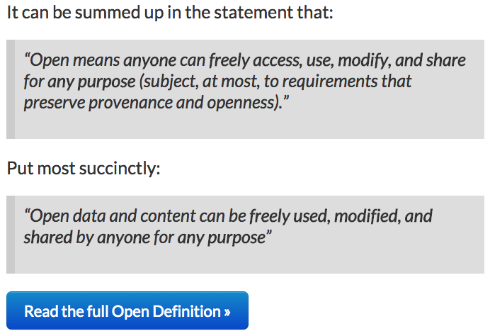
http://opendefinition.org/od/

Slide 9
“A piece of data or content is open if anyone is free to use, reuse, and redistribute it - subject only, at most, to the requirement to attribute and/or share-alike.”
http://opendefinition.org/

Slide 10
Open Data + Research Signals? Part of a Library Continuum

Slide 11
Machine Harvesting

Slide 12
HTML

Slide 13
Application: Web Harvesting of PubMed
www.lib.montana.edu/~jason/files/crawler/
www.lib.montana.edu/~jason/files/crawler/index.txt

Slide 14
Given web page, return article titles and article URLs

Slide 15
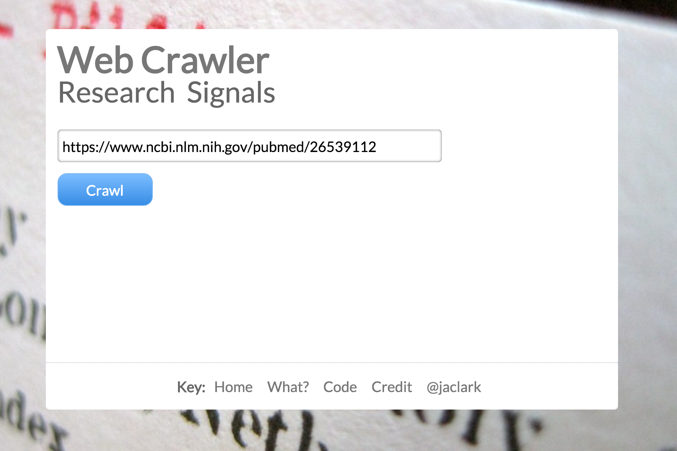
*App Screenshot and URL*

Slide 16
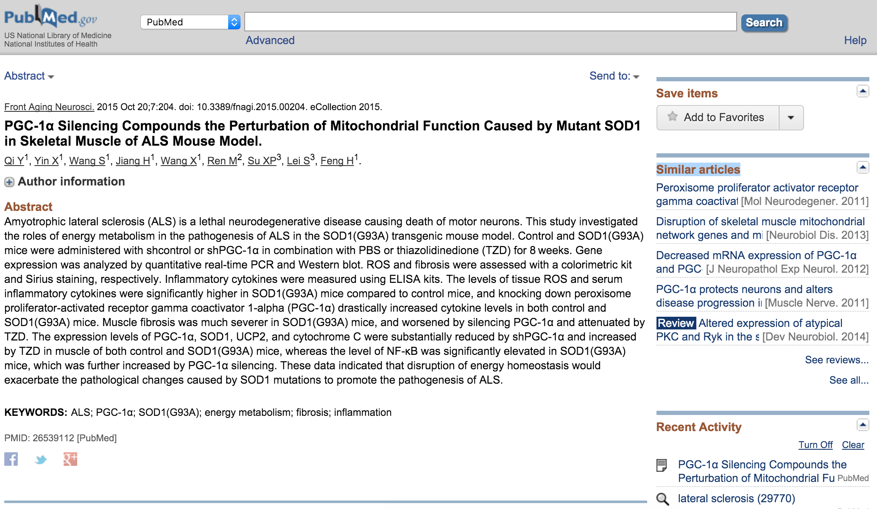

Slide 17
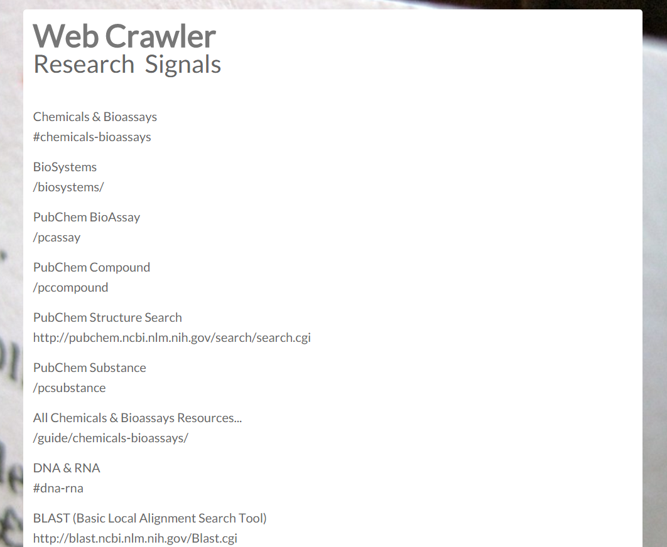

Slide 18
Linked Data Assignments

Slide 19
Linked Pages + Resources

Slide 20
Application: GetSemantic
www.lib.montana.edu/~jason/files/getsemantic/
github.com/jasonclark/getsemantic

Slide 21
Given a linked resource, return linked data entities + keywords

Slide 22
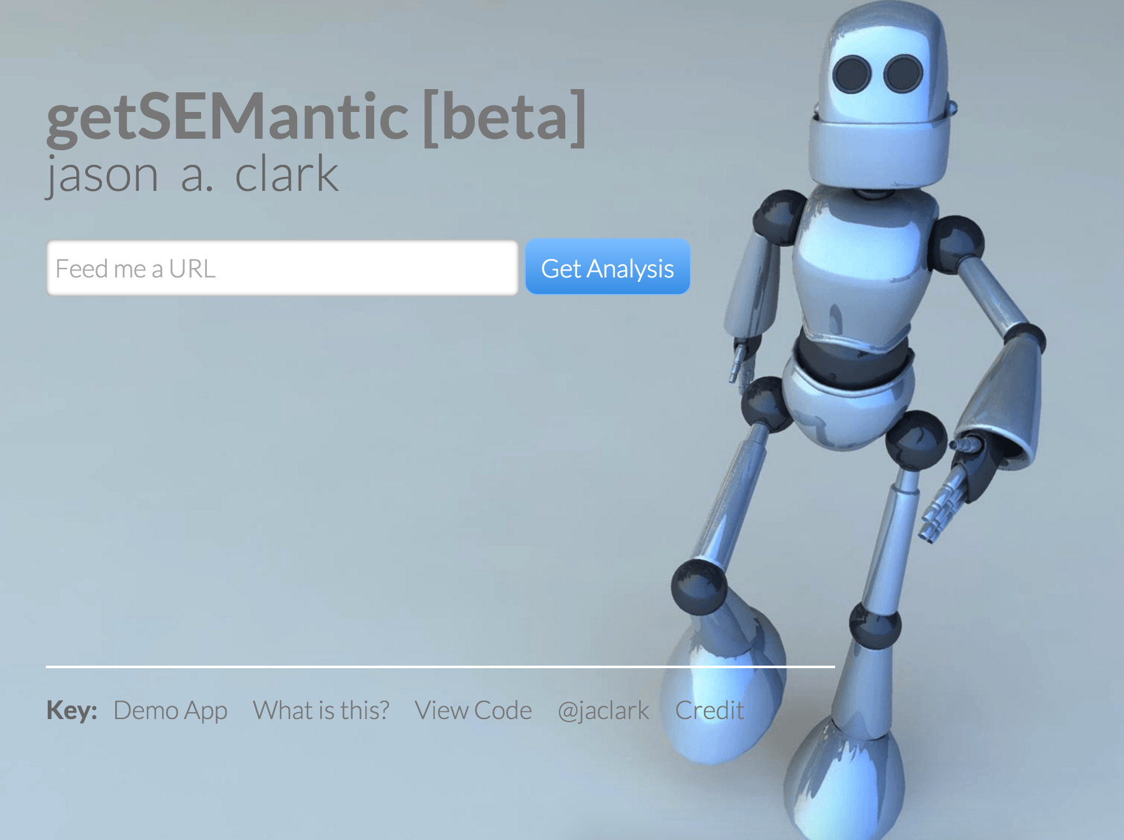

Slide 25
Understanding the Sharing Economy

Slide 26
API

Slide 27
Application: Watching Reuse in Social Networks
www.lib.montana.edu/~jason/files/social-signal/
www.lib.montana.edu/~jason/files/social-signal/index.txt

Slide 28
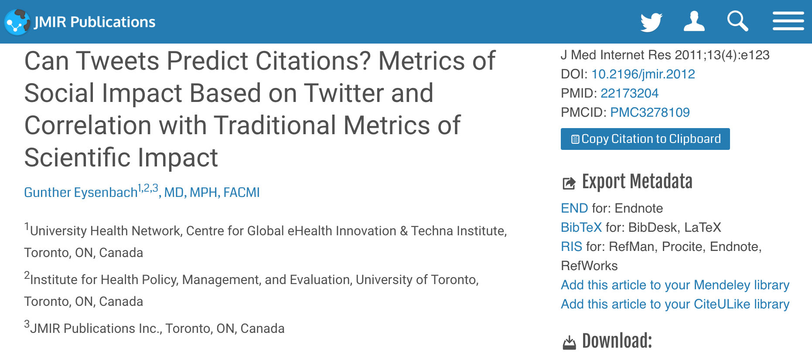
Eysenbach G. Can Tweets Predict Citations? Metrics of Social Impact Based on Twitter and Correlation with Traditional Metrics of Scientific Impact. J Med Internet Res 2011;13(4):e123m DOI: 10.2196/jmir.2012

Slide 29
Given a linked resource, return Altmetrics references (“citations”)

Slide 30
Twitter or Facebook APIs
ImpactStory
Plum Analytics
Altmetric

Slide 34
Filtering Research

Slide 35
API

Slide 36
Application: MSU Research Citations
arc.lib.montana.edu/msu-research-citations/
github.com/msulibrary/msu-research-citations

Slide 37
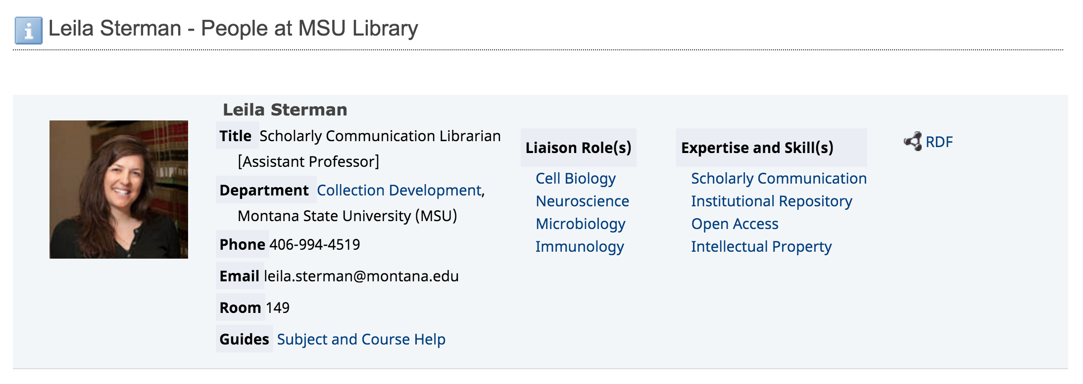

Slide 38
Monitor scholarship, collect/curate to understand and analyze scholarly output

Slide 39
Using the Google Feed API and Data Feeds from Publishers and Aggregators

Slide 40
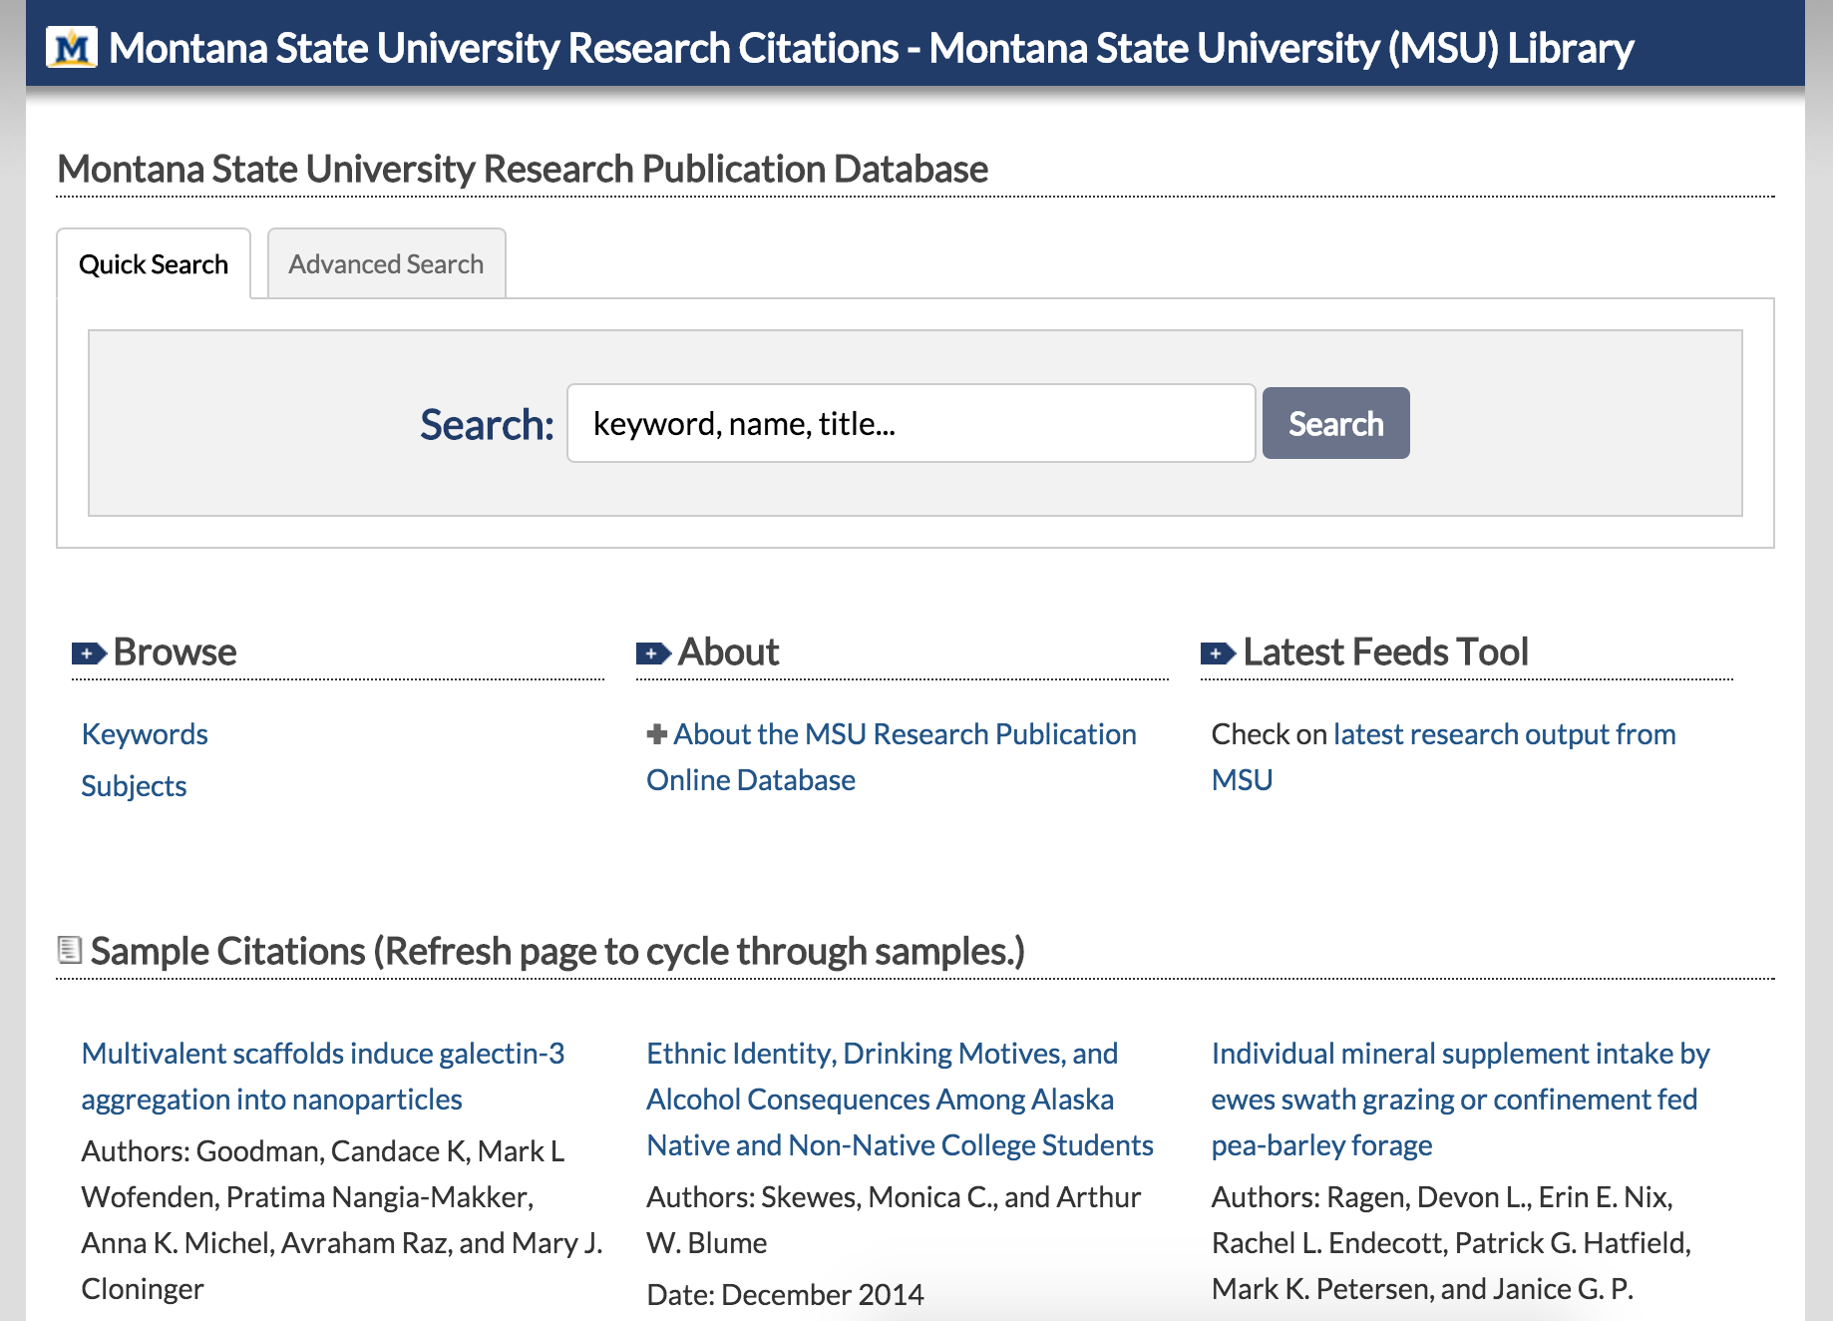

Slide 41
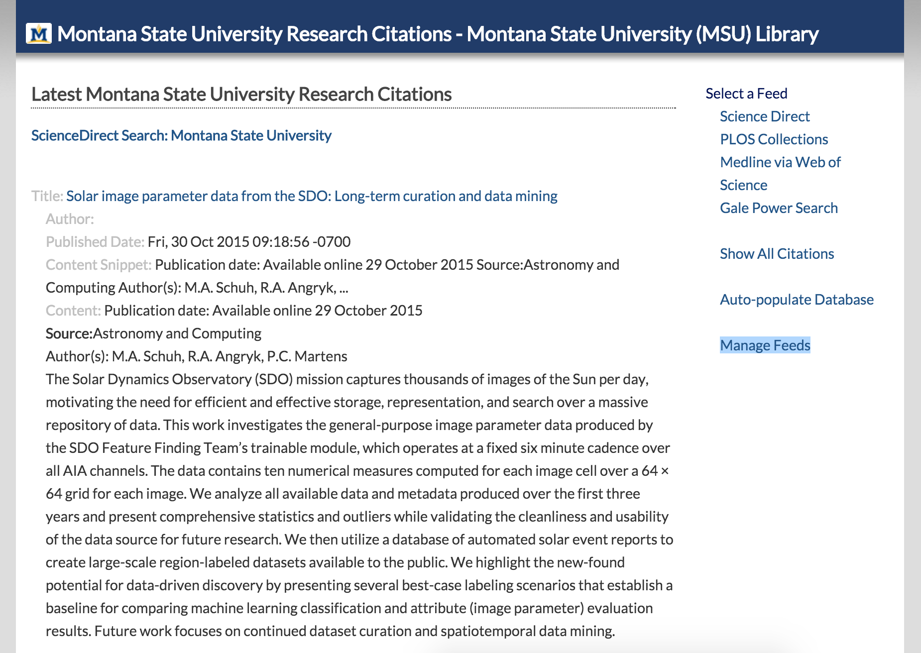

Slide 42
Open, Networked Research Signals
New Research Services

Slide 43
Questions?
twitter.com/jaclark
www.lib.montana.edu/~jason/talks.php

Slide 44
Acknowledgements
I would like to thank Montana State University and my excellent colleagues at MSU Library for supporting my research.
In particular, I would like to thank Leila Sterman and James Espeland for their work in conceiving and building the MSU Research Citations Application.
I am distributing this work under the Attribution-Noncommercial-Share Alike 3.0 Unported license.

