Slide 1
Building a Simple Mobile-optimized Web App/Site Using the jQuery Mobile Framework

Slide 2
pinboard.in tag
  http://pinboard.in/u:jasonclark/t:cil2013-mobile/

Slide 3
Agenda
Learn what a mobile framework is.
Understand the various technologies (HTML, CSS, JavaScript) and how they work together to build mobile Web apps/sites.
Recognize the differences between native and web apps/sites.
Explore jQuery Mobile basics.
Acquire best practices in mobile Web development.
Create an opportunity to continue to work with us after the webinar to demonstrate what you learned.
Gain access after the webinar to a free Web server so you can see your mobile Web app/site live.

Slide 4

Mobile-optimized Website
Native App (iOS, Android etc.)
Nothing yet, but considering an app
Nothing yet, but considering a website.
No plans; it is too expensive/complex!
Quick PollDoes your library have:

Slide 5
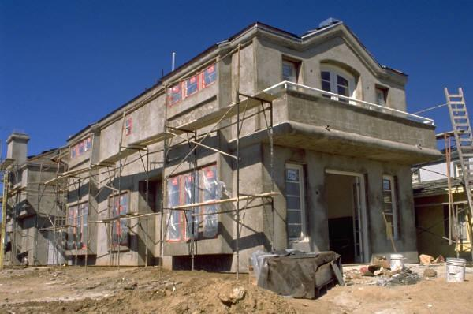
A framework resembles scaffolding. It is a temporary platform used as a supportive guide to help build something. Mobile frameworks work similarly in that they provide libraries etc. that allow
one to build something quickly.

Slide 6
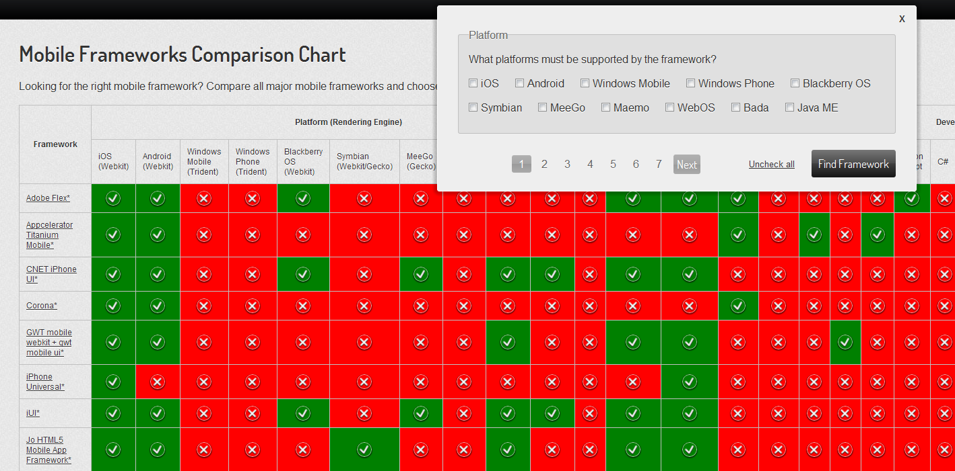
Source: http://http://goo.gl/y8CFb

Slide 7
Native Apps vs. Web/Browser Apps
Issues | Native apps | Web apps
Internet access | Not required | Required, except for apps written in HTML5 (offline capabilities)
Shareable content (Twitter etc.) | Only if it is built in to the app | Web links can be shared. Social API’s allow 1-click posting
Access to hardware sensors | Yes: camera, gyroscope, microphone, compass, accelerometer, GPS | Access thru browser is limited. Geolocation works!
Development | Build app for target platform (Android, iOS [Objective-C] etc.) | Write/publish once using standard Web technologies, view it anywhere with URL. Speedy debugging and development.
Distribution | Most app stores require approval. | No hassles.
Source: http://goo.gl/zSeDU

Slide 8
jQuery Mobile is …a unified, HTML5-based user interface system for all popular mobile device platforms.
Source: http://jquerymobile.com/

Slide 9
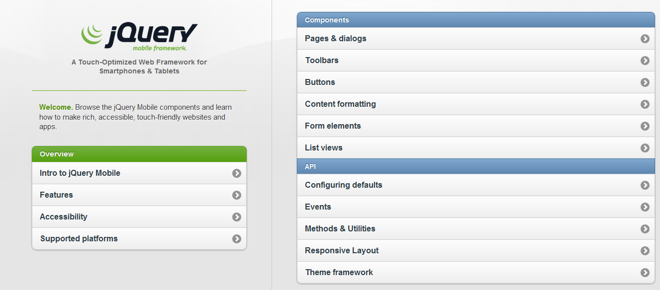
jQuery Mobile is well-documented and there are great demos to get you started

Slide 10
Mobile Development - Demos
Demos:
Responsive Design Template (custom)
www.lib.montana.edu/~jason/files/responsive-design/
Mobile Template (jQuery Mobile)
www.lib.montana.edu/~jason/files/touch-jquery/
Code Samples and Downloads:
www.lib.montana.edu/~jason/files.php

Slide 11
Your Live Site
To test your work use this URL, but change it to your user number.
Example: http://marcomponline.com/chadtest/Class/cil1/jquery-mobile-template/index.html

Slide 12
Getting Started!
Let’s build something.
Handout: http://goo.gl/xMGp0

Slide 13
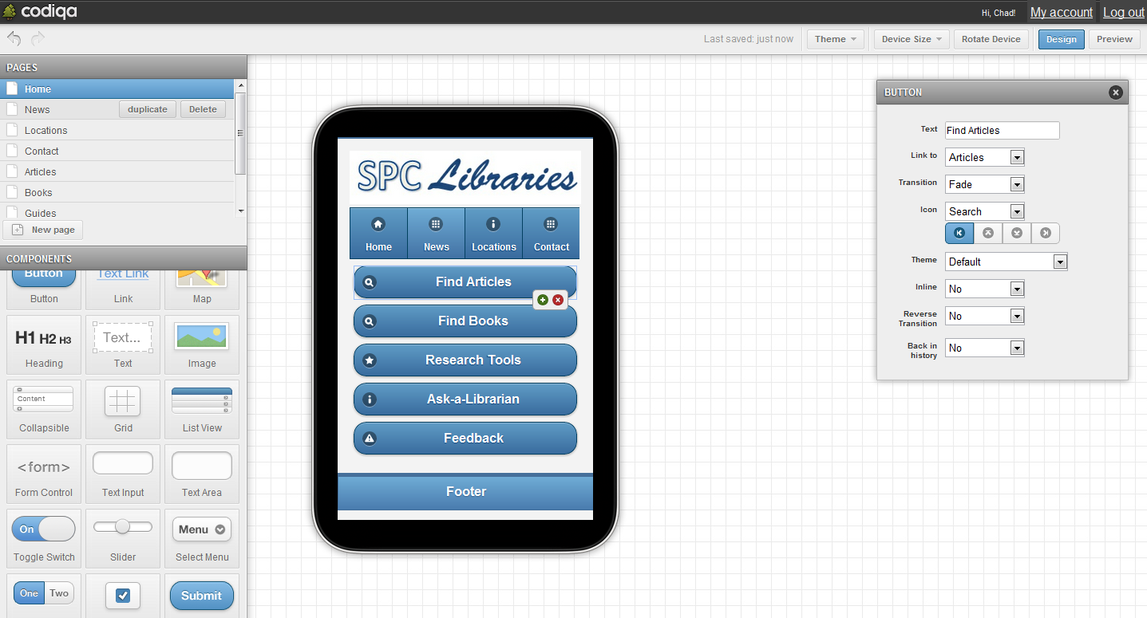
Rapid Prototyping for jQuery Mobile
Try it at http://codiqa.com/

Slide 14
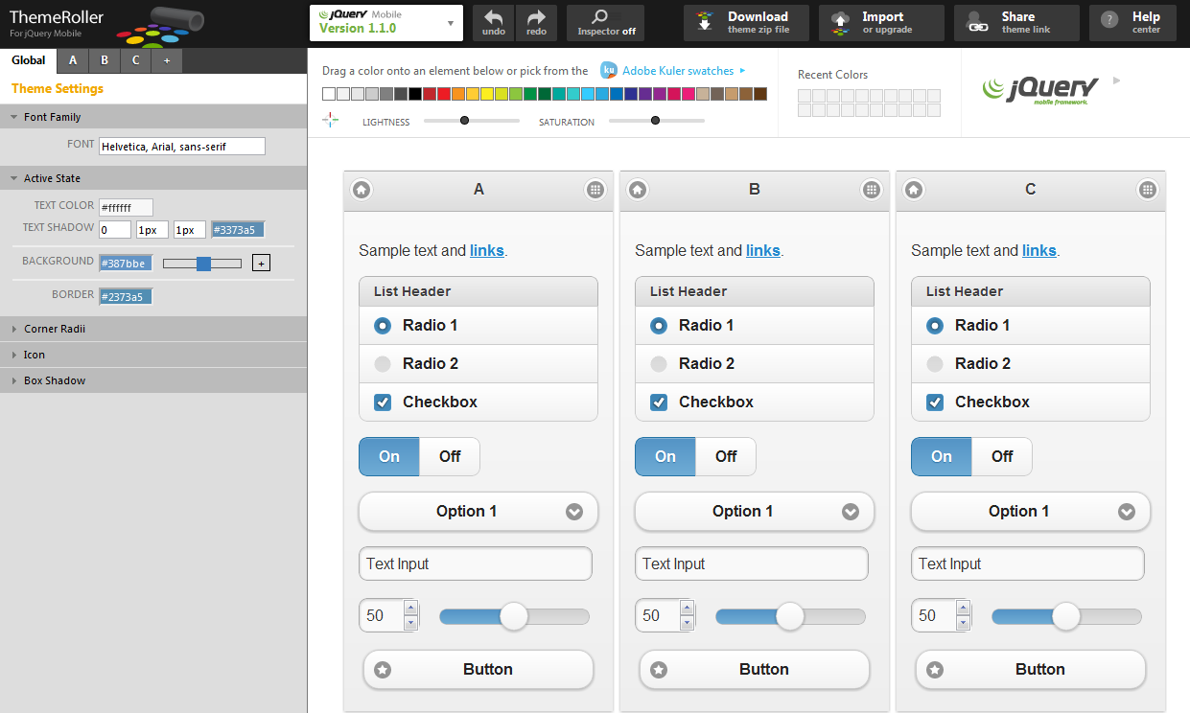
Try it at http://jquerymobile.com/themeroller/

Slide 15
Exercise
  Pick a web site
  Define primary mobile actions
  Choose mobile entry points (links)
  What do library patrons want to do with library services in the mobile setting?

Slide 16


Slide 17
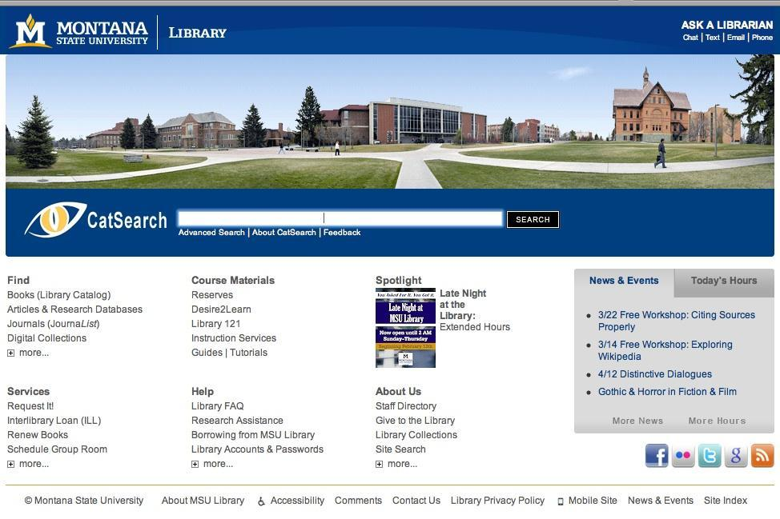

Slide 18
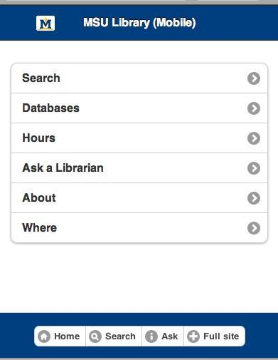

Slide 19
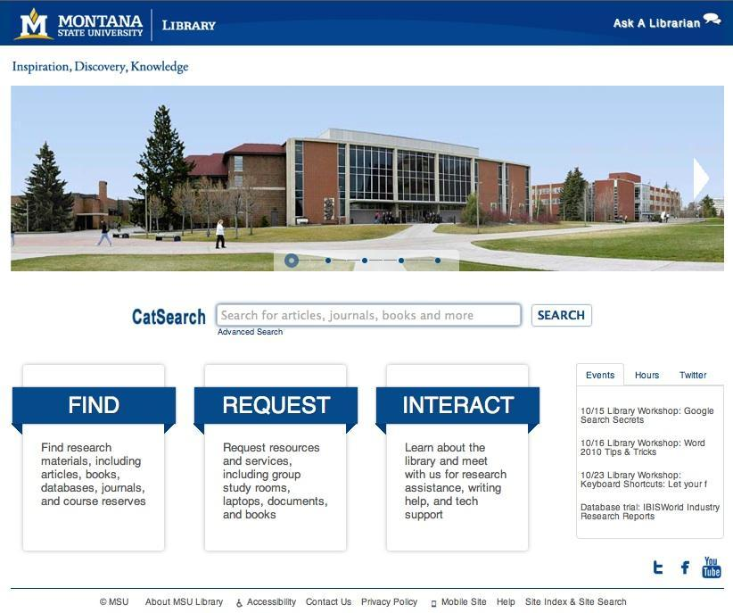

Slide 20
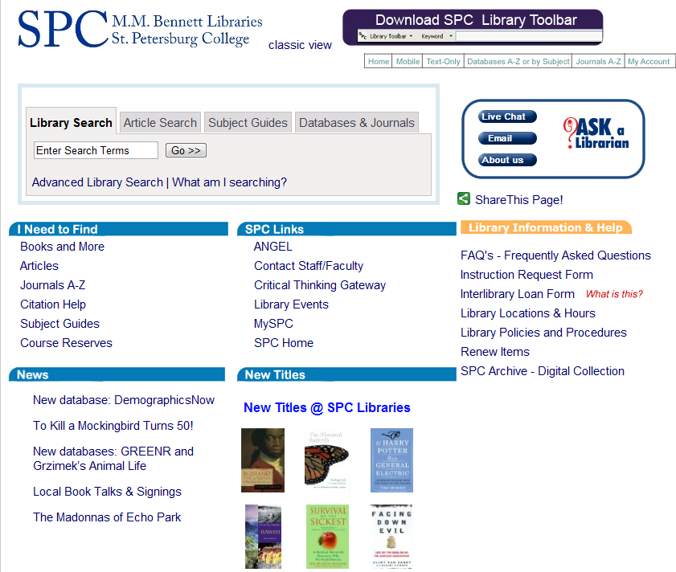
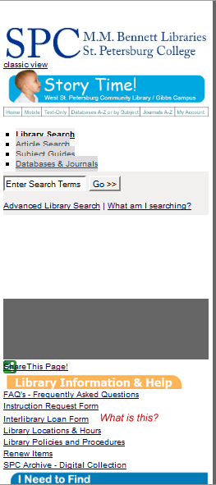
Small Screen Rendering (260 px) using the
Web Developer add-on in Firefox
Desktop
Small Screen

Slide 21
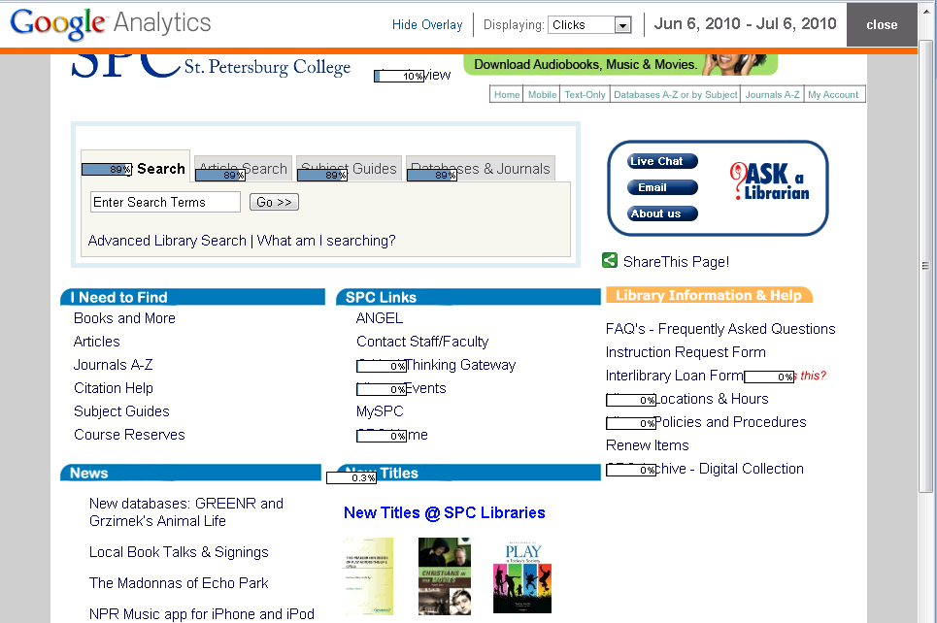
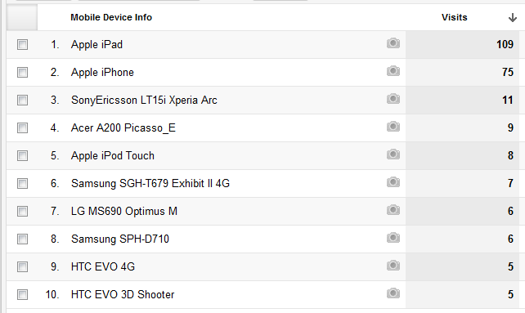
In-page Analytics
Note: you can determine how your user’s are accessing your Web site (e.g., mobile devices, carriers, browsers , OS’s, screen resolution etc.)

Slide 22
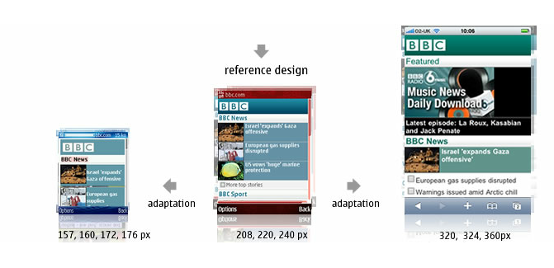
Mobile Screen Resolutions
  Android (Motorola Droid) 480x854
  Android (MyTouch) 320x480
  Android (Nexus One) 480x800
  Apple iPhone 320x480
  Apple iPad 1024x768
  Palm Pre 320 x 480
Source: http://goo.gl/zEDoi

Slide 23
Some Best Practices
  Follow the "m" convention (m.novarelibrary.com OR lifeonterra.com/m/)
  Keep categories (directories) short. Remember that you are creating a page that people touch without much typing
  Limit image and markup sizes
  Limit HTML pages to 25KB to allow for caching
  "Minify" your scripts and CSS (JSLint, CleanCSS)
  Link to Full Site
  Sniff for User Agent – Detection (allow the user to decide where to go)
  One Column Layout with some whitespace
  Mobile refers to the user!

Slide 24
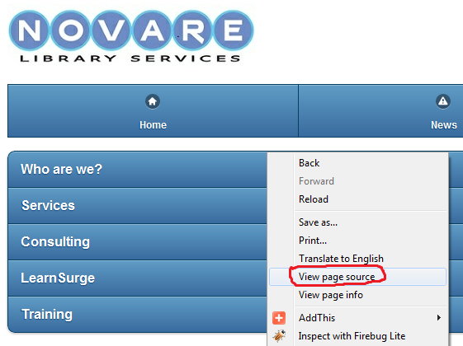
Learn and borrow from sites you like.
http://m.novarelibrary.com/

Slide 25
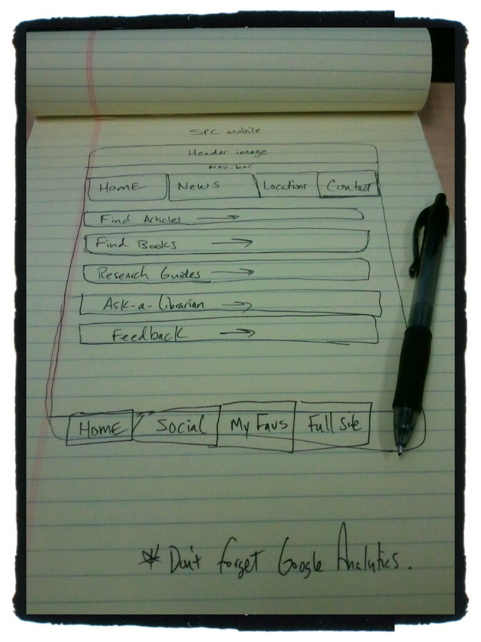
Sketch ideas

Slide 26
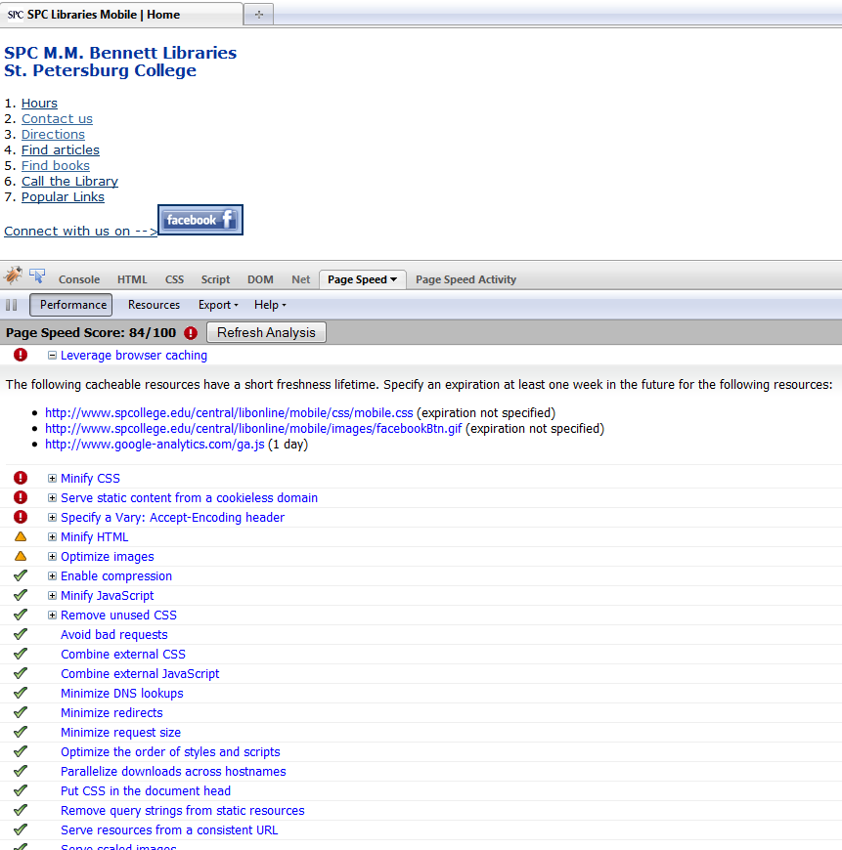

Testing and validation
Test Page Speed in Firebug
http://getfirebug.com/

Slide 27
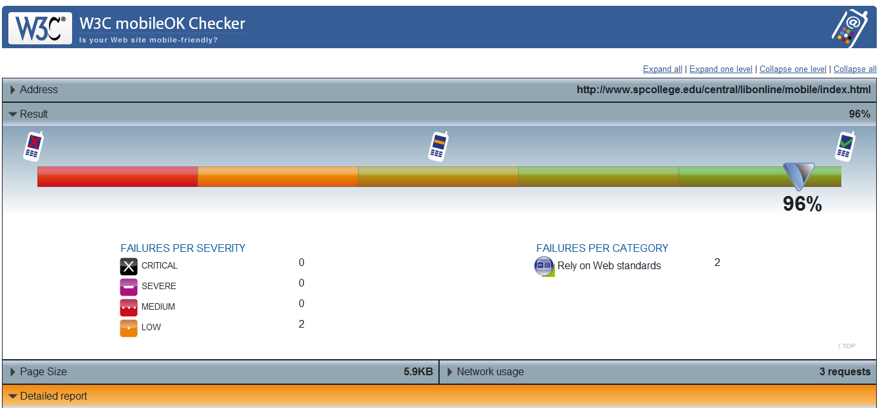
W3C mobileOK Checker http://validator.w3.org/mobile/

Slide 28
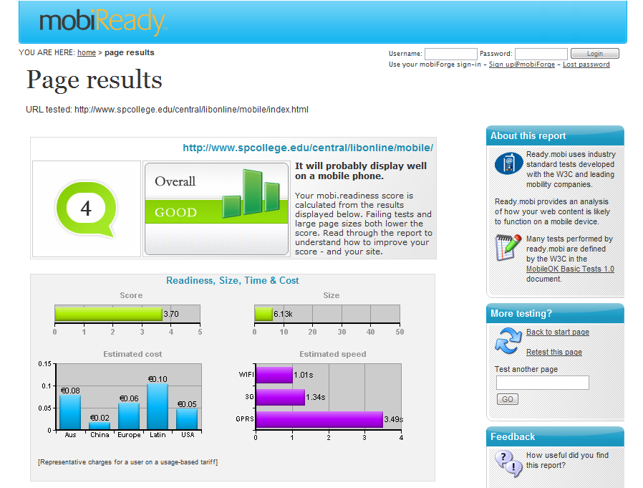
http://ready.mobi

Slide 29
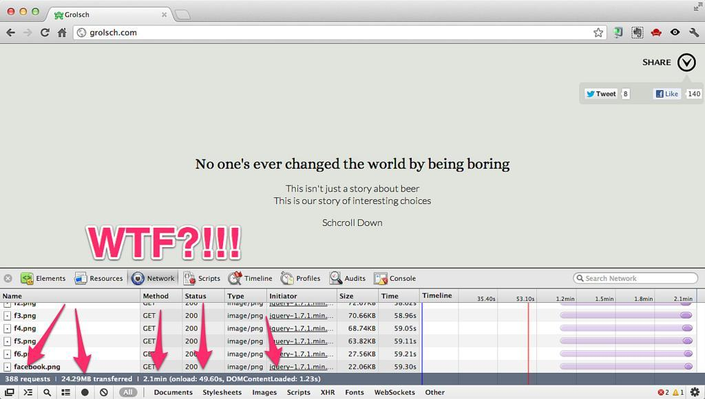
"All sizes | Enough of this silliness | Flickr - Photo Sharing!." Last modified 10/15/2012 12:45:55. http://www.flickr.com/photos/philhawksworth/7562460356/sizes/l/in/photostream/ (accessed 10/15/2012).

Slide 30
Mobile Optimization
  Minify scripts, html, css …
  Reduce HTTP requests
  Compress files with gzip
  Cache static resources
  “Speed matters.”
  https://developers.google.com/speed/pagespeed/insights

Slide 31
Mobile Analytics
  Web metrics and statistics
  Mobile search logs
  “Data is your friend. Take out the guesswork.”

Slide 32
Editors and Tools
You can use a simple text editor (e.g., Notepad) or a more sophisticated application (e.g., Dreamweaver).
Adobe Device Central is part of Adobe’s CS.
iUI: http://code.google.com/p/iui/ for iPhone.
MIT Mobile Web Open Source Project http://sourceforge.net/projects/mitmobileweb/
Device detection? http://detectmobilebrowsers.mobi/
To see your browser's HTTP Headers. Works on mobile browsers. http://rabin.mobi/http
Web Developer Toolbar in Firefox: Select Miscellaneous >>> Small Screen Rendering (260 px) >>> the layout will be reformatted to simulate rendering by a mobile browser.

Slide 33
Emulators/Simulators:
Cowemo Mobile Emulator: http://www.mobilephoneemulator.com/
dotMobi Emulator - http://mtld.mobi/emulator.php
Opera Mini Simulator - http://www.opera.com/mobile/demo/
Mimic - emulates European and Japanese models: N400i and N505i. http://pukupi.com/post/2059
Android Emulator - http://developer.android.com/guide/developing/tools/emulator.html
BlackBerry Device Simulators - https://www.blackberry.com/Downloads/entry.do?code=060AD92489947D410D897474079C1477
iPhone Dev Center: http://developer.apple.com/iphone/
Palm Pre - http://developer.palm.com/
Windows Mobile - http://msdn.microsoft.com/en-us/windowsmobile/default.aspx
JAVA ME - Java Platform Micro Edition was termed J2ME. It is considered one of the most ubiquitous application platform for mobile devices. http://java.sun.com/javame/reference/apis.jsp

Slide 34
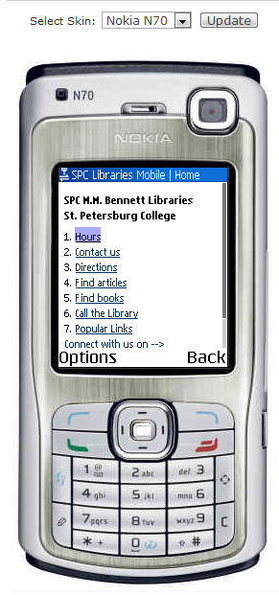
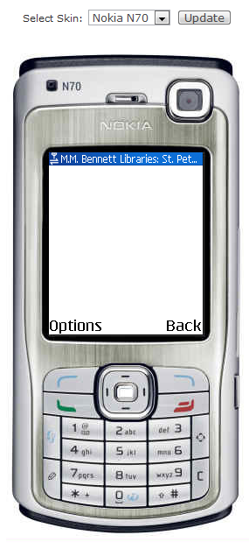
Take an emulated look at your desktop site.
Mobile Site
Desktop Site

Slide 35









Other mobile development tools/frameworks

Slide 36
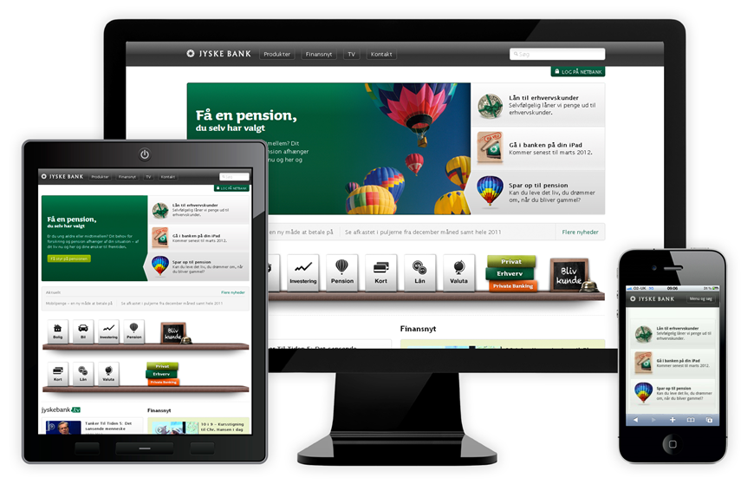
The Future of Mobile Web App/Site Development? Responsive Web Design?

Slide 37
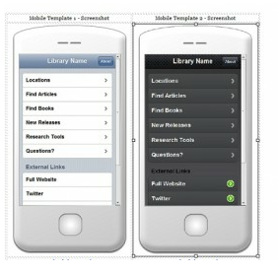
jQuery Mobile Templates at:
http://goo.gl/1FdO0
Handout: http://goo.gl/xMGp0

Slide 38

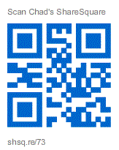

Want to Hangout?
gplus.to/chadmairn

Slide 39

Jason Clark
Head of Digital Access & Web Services
Associate Professor
Montana State University Library
@jaclark - twitter.com/jaclark
jaclark@montana.edu

