Slide 1
Web Services Bootcamp
Jason A. Clark
Head of Digital Access and Web Services
Montana State University Library
Amanda Hollister
Systems Librarian
Broome Community College

Slide 2
A quick look ahead…
  An overview of the different web services protocols
  Wading through the acronym soup and major terms associated with web services
  Walkthrough of the code that makes it happen
  Code lab

Slide 3
Questions?
  Ask anytime during the presentation
  This can be heady stuff

Slide 4
Getting to know you
About us
About you
  Who knows XML?
  Who knows javascript and DOM?
  Who knows PHP?
  Goals for workshop?

Slide 5
What is a mashup?
A web application that uses and/or combines data from multiple sources within a single tool

Slide 6
Why use Mashups?
Access to content/data stores you could not otherwise provide (zip codes, news, pictures, reviews, etc.)
Enhance site with a service that is not
feasible for you to provide (maps, search, products, etc.)
Combine these services into a seamless
service you provide (mash-ups)

Slide 7
Mashup Examples
www.housingmaps.com/
www.lib.montana.edu/beta/bookme/
www.DistancesCalculator.com

Slide 8
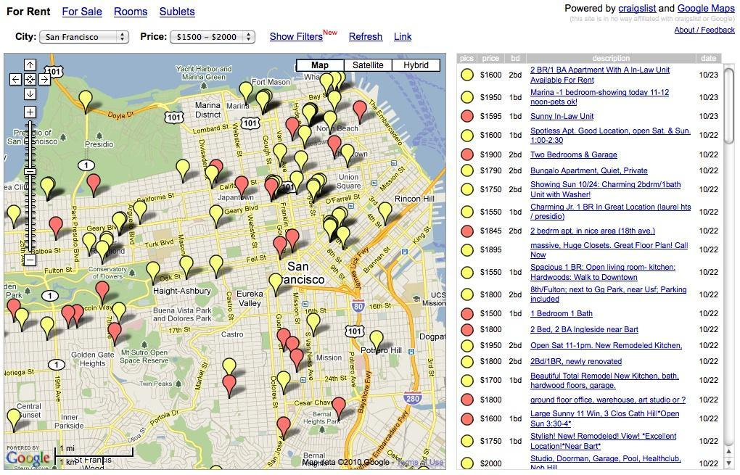

Slide 9
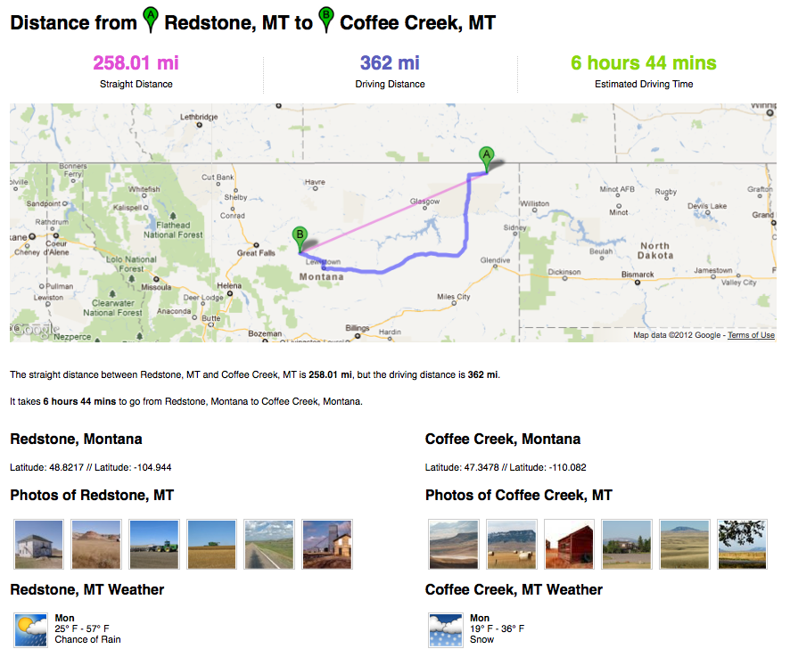

Slide 10
Available Web Services
Google
Yahoo!
Amazon
eBay
Flickr
del.icio.us?
AllCDCovers.com
ISBNdb.com
OpenDOAR
arXiv.org
Freebase
Google Book Search APIs
LibraryThing APIs
WorldCat Search API
Open Library API

Slide 11
Possible Types Of Data
Bibliographic Data
Book Covers
Digital Library metadata and objects
Reviews
Ratings
Library Information
Map Data

Slide 12
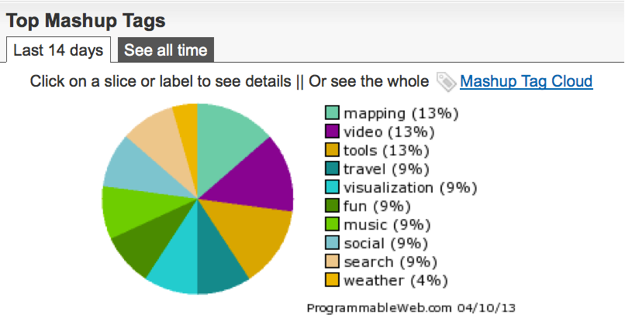
Top Mashup Types - recent

Slide 13
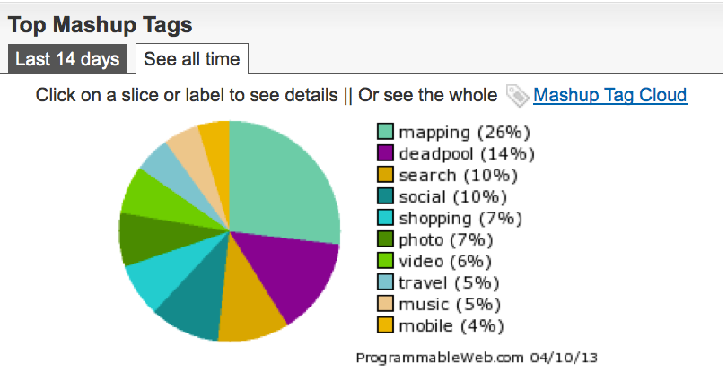
Top Mashup Types

Slide 14
How Do Mashups Work?
Retrieve data from another source(s) typically via a web service
Mix these datasets together and integrate them into your website

Slide 15
BASIC CONCEPTS
API
Web Service
GET and POST
Structured Data

Slide 16
Terms: API
An application programming interface (or API) is a way for developers to access parts of a remote web site and integrate it with their own site.

Slide 17
Terms: Web Service
Provides access to data and/or procedures (API)
On a remote/external system (usually)
Use structured data for data exchange (often XML)
Come in 3 flavors : RPC, SOAP, REST

Slide 18
Demo Time!
http://www.lib.montana.edu/~jason/files/api/lofi/

Slide 19
Terms: POST and GET
Two primary verbs for web services actions:
  GET data from a web service
  POST data to a web service
  Read and Write actions

Slide 20
Terms: Structured Data
Structured data = XML and JSON
  Extensible Mark-up Language and Javascript Object Notation
  Flexible mark-up languages
  Lightweight and easy to parse
  Allow communication between disparate systems

Slide 21
Putting it all together
Data access = Web Services (REST, SOAP, XML-RPC)
Data typically formatted in XML or JSON
Data display = one or more scripting languages (javascript, PHP, python, etc)

Slide 22
What is REST?
  The greatest thing since sliced...
  Representational State Transfer
  Unique data resources with addresses

Slide 23
Theory of REST
Focus on diversity of resources (nouns), not actions (verbs)
Every resource is uniquely addressable
All resources share the same constrained interface for transfer of state (actions)
Must be stateless, cacheable, and layered

Slide 24
REST = Web Protocol
Web As Prime Example
  URLs uniquely address resources
  HTTP methods (GET, POST, HEAD, etc.) and content types provide a constrained interface
  All transactions are atomic
  HTTP provides cache control

Slide 25
REST: Final Thoughts
  Similarity to web - easy to understand
  URL is the method
  Most popular type of web service

Slide 26
Basic Concepts
Variables
Conditions
Loops
Functions
http://docs.webplatform.org/wiki/concepts/programming/programming_basics

Slide 27
Demo Time!
Yahoo Pipes

Slide 28
Yahoo Pipes
Drag and drop UI for creating mashups
It’s a way to play with basic programming concepts
Lots of examples - clone them!
Variety of inputs and outputs

Slide 29
Yahoo Pipes
Inputs: RSS feeds, search queries, HTML pages, flickr photos, csv files (Google Spreadsheets), build your own input...
Outputs: Javascript, RSS, JSON, PHP

Slide 30
Yahoo Pipes Demo
Use ‘Fetch Feed’ to fetch 2 rss feeds (drupal.org, wordpress.org)
Use ‘filter’ to limit to two keywords (security, update)
http://pipes.yahoo.com/pipes/pipe.edit?_id=b49ae422dcfc463ccd414f6e16ab6152

Slide 31
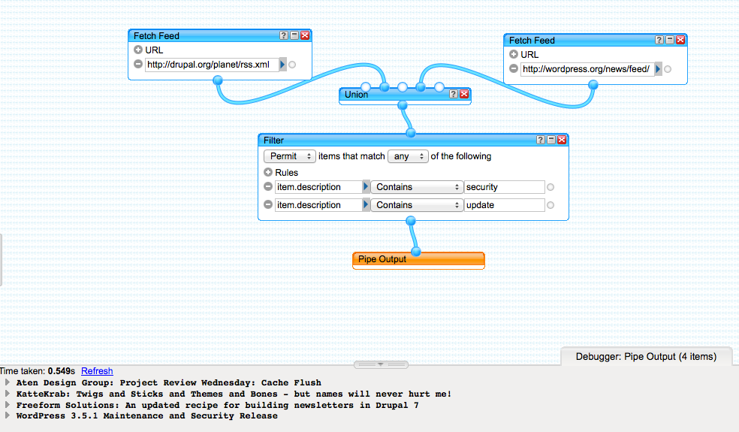
Yahoo Pipes Demo

Slide 32
Debugging
Browser Tools
  Firebug (Firefox) or Firebug lite (chrome)
  Advanced Rest Client (chrome)
  Chrome Developer view

Slide 33
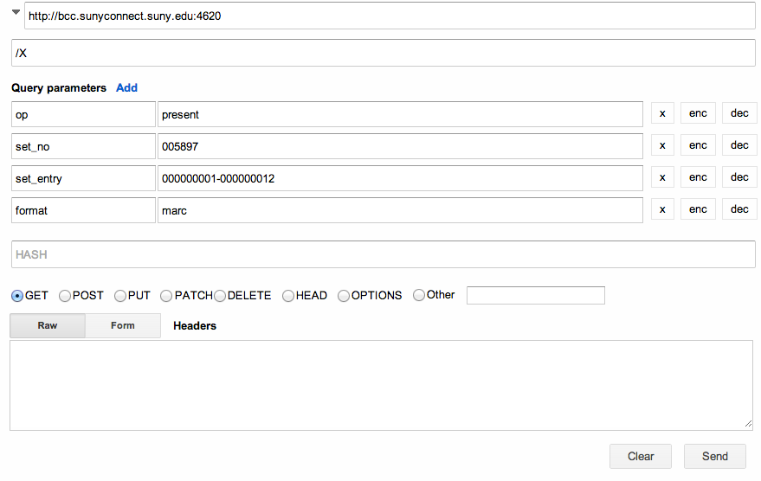

Slide 34
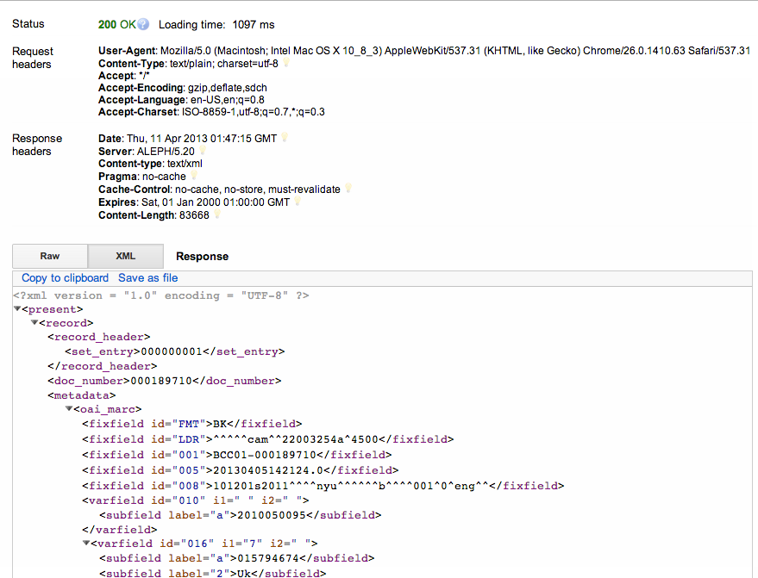

Slide 35
Debugging - advanced
Turn error reporting on in php.ini
Apache Log files

Slide 36
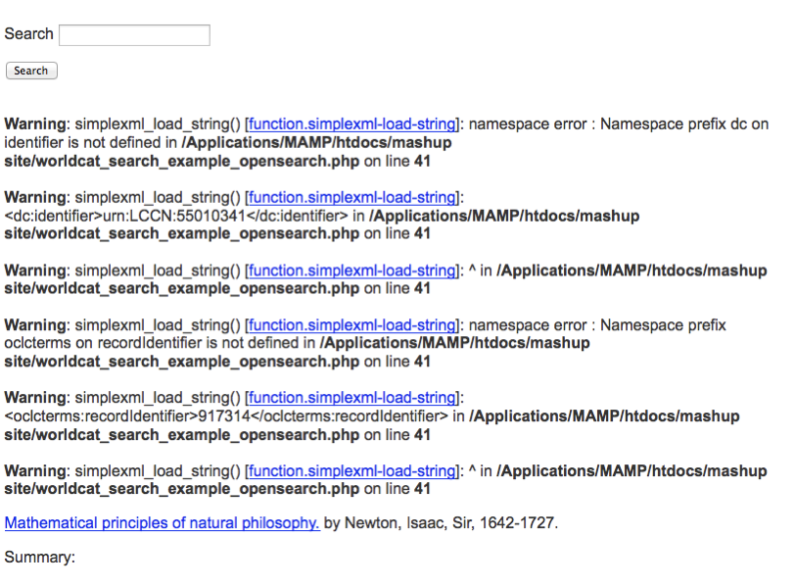

Slide 37
Things to Do
Get data by constructing a query url
Parse and display the raw data as html (code samples)
Try a mashup tool

Slide 38
Step1:
Construct a url
New York Times API Tool
Wikipedia API sandbox

Slide 39
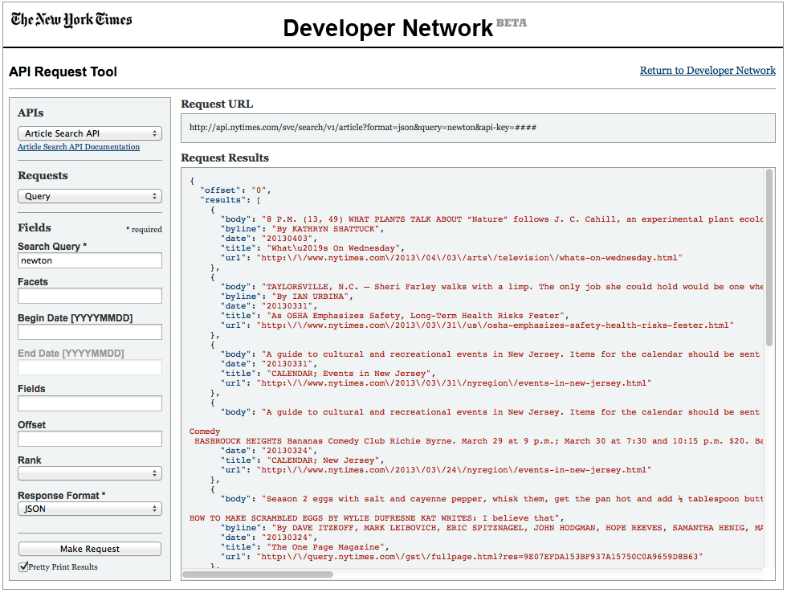

Slide 40
Step 2
Work with code samples
Parse and display the raw data as html
Workshop Demo Files: http://librarydev.com/mashupdemos.zip or usb key
Extract the demo code

Slide 41
Walk Throughs
Flickr API example
Lifestream
Google spreadsheet to HTML
Google Maps API example

Slide 42
Flickr
Code Demo: using the Flickr API

Slide 43
Lifestream Demo
Social Media Lifestream (jQuery) - http://www.lib.montana.edu/~jason/files/web-services/lifestream-jquery-json.html
lifestream-jquery-json.html file in the mashup demo folder

Slide 44
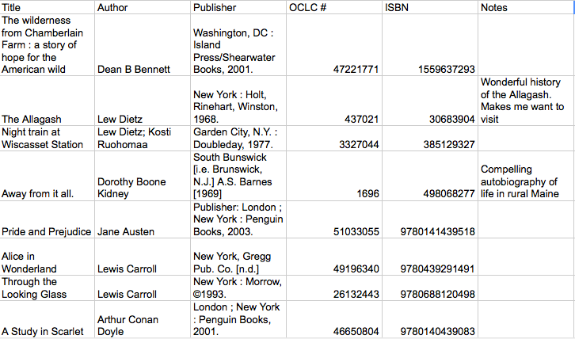
Google spreadsheet

Slide 45
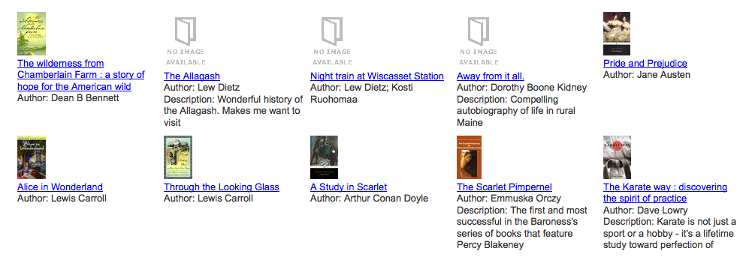

Slide 46
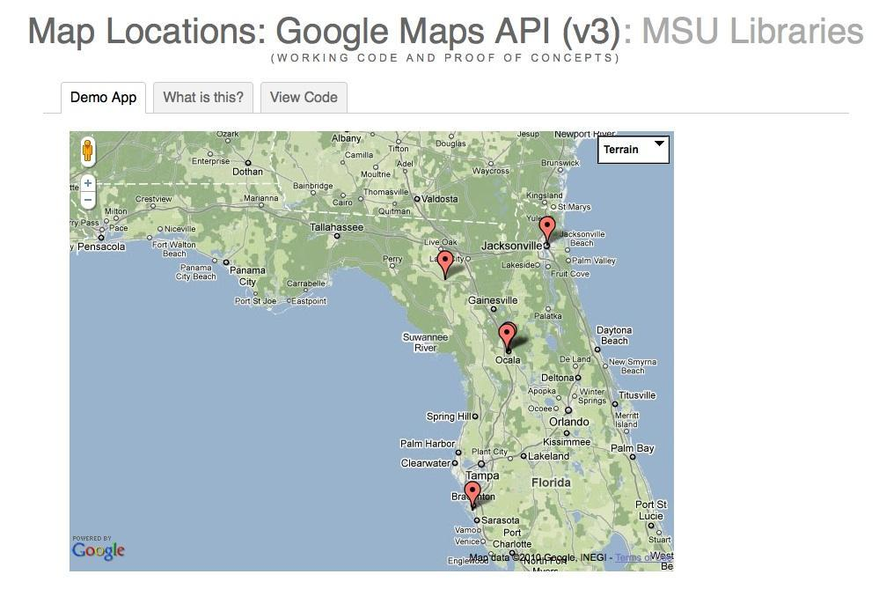

Slide 47
Step 3: Try a
Mashup Tool
  Yahoo Pipes
  Google Code Playground
  jsFiddle: http://jsfiddle.net/

Slide 48
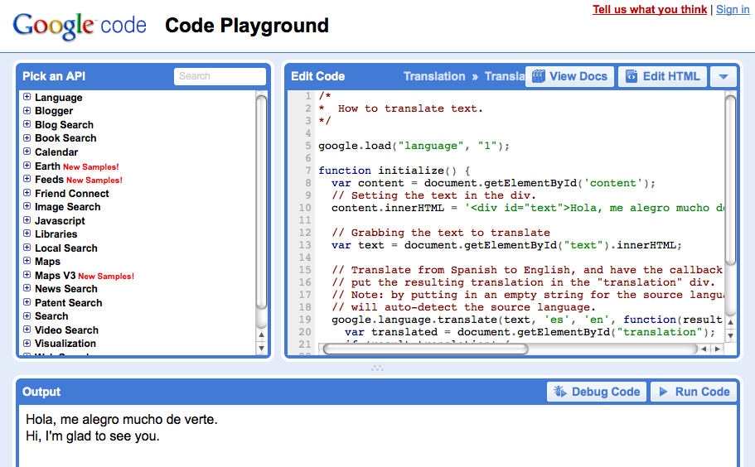
Google Code Playground

Slide 49
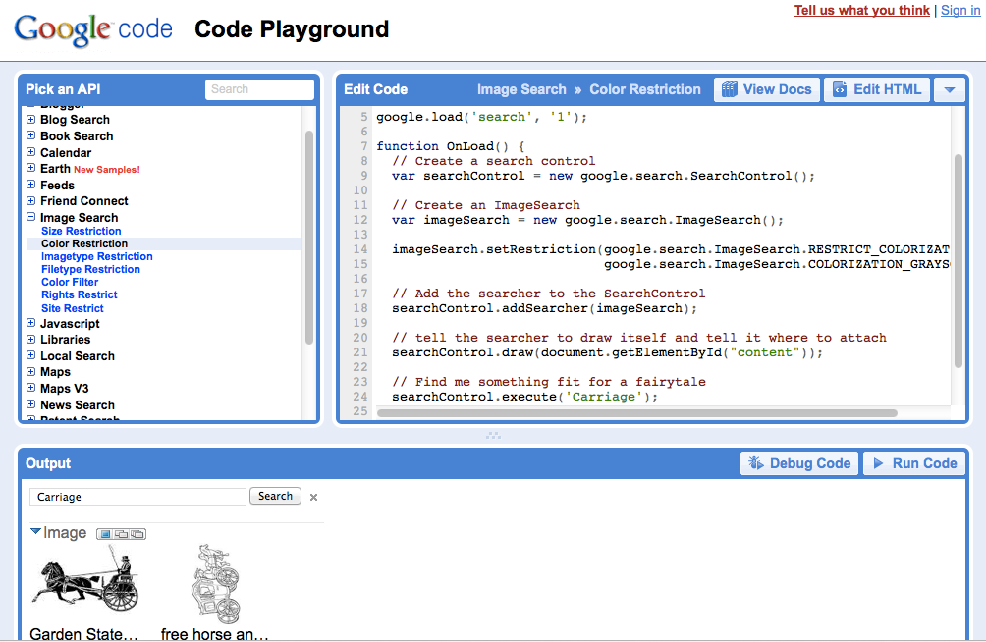

Slide 50
jsFiddle
Can edit javascript and jquery scripts without a web server
Can share code examples
http://jsfiddle.net/libdevel/4HbhB/7/

Slide 51
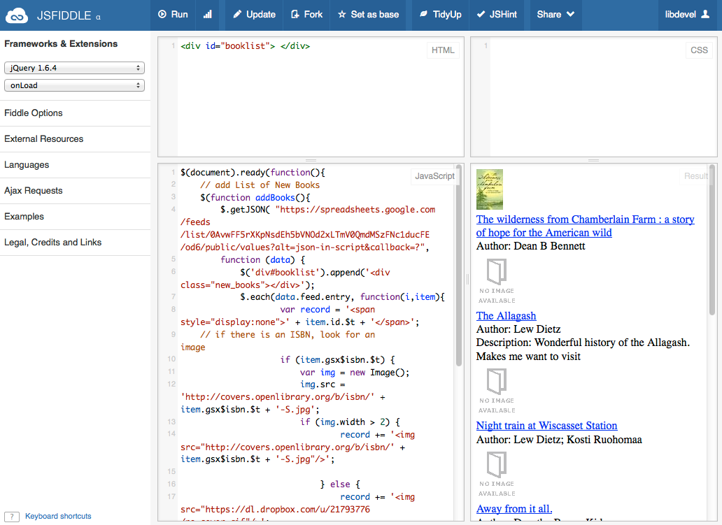

Slide 52
What we've Learned
  Web services are closed source software
  Documentation and online support is vital
  Debugging can be hard
  Similarities to common protocols are important
  Practice and finding your development kit is essential

Slide 53
Contact Information
Jason A. Clark
Head of Digital Access and Web Services
Montana State University Library
jaclark@montana.eduwww.jasonclark.info406-994-6801
Amanda Hollisterlibdevel@gmail.com

