Slide 1
Open SESMO: Innovations in Surfacing Paid Content to Today’s Learners
CNI Spring Meeting 2016
Jason A. Clark and Doralyn Rossmann
Montana State University

Slide 2
@jaclark
@doralyn

Slide 3
Outline
How Libraries Generally Present Their Paid Resources
How Researchers Look for Information
Open SESMO
How to Apply Open SESMO
Results - Google Analytics & Twitter Analytics

Slide 4
"Search engines continue to dominate, topping the list of electronic sources most used to find online content (93%), followed closely by Wikipedia (88%). The key difference in usage between search engines and Wikipedia is the frequency - 75% of students who use search engines do so daily, compared to 20% of those who use Wikipedia."
Perceptions of Libraries, 2010: Context and Community: a Report to the OCLC Membership. OCLC, 2011.
http://www.oclc.org/content/dam/oclc/reports/2010perceptions/2010perceptions_all_singlepage.pdf
http://www.oclc.org/content/dam/oclc/reports/2010perceptions/collegestudents.pdf

Slide 5
"The library is not the starting point."
"The campus is not the work location."
"The proxy server is not the answer."
Meeting Researchers Where They Start: Streamlining Access to Scholarly Resources. Ithaka S+R and Roger C. Schoenfeld, 2015.
http://www.sr.ithaka.org/publications/meeting-researchers-where-they-start-streamlining-access-to-scholarly-resources/

Slide 6
Unique vs. Purchased Resources
Digitized collections: Royal treatment with markup
Purchased collections: Royal treatment with funds
Notes:
Doralyn

Slide 7
Finding Information
Teach
Browse
Search
Notes:
Doralyn

Slide 8
Meeting Users in the Search
Notes:
Doralyn “a revision to the teaching moment”

Slide 9
Designing Your Digital Collections for Web-Scale Search

Slide 10
Designing Your Library Collections for Web-Scale Search

Slide 11
The Open SESMO Project

Slide 12
Search Engine Optimization

Slide 13
Social Media Optimization
Notes:
Got it - I have stuff to say here

Slide 14
Linked Data
Notes:
Links to external vocabularies that provide definitions to the content of the page

Slide 15
Modeling best practices for library collections markup
Creating metadata routines for web-scale external vocabularies
Measuring the impact of applying optimizations and metadata to library collections

Slide 16
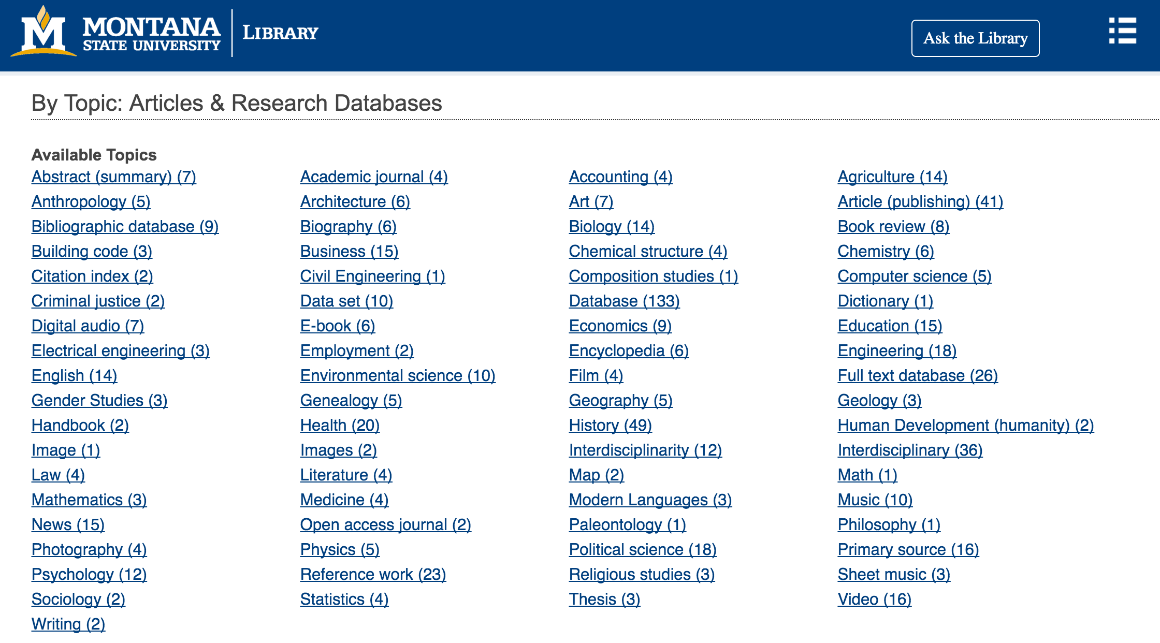

Slide 17
The Experiment
Same collection
Apply optimizations in stages
Compare analytics over time
Goal: increased traffic and more nuanced, semantic understanding of content by search engines
www.lib.montana.edu/resources
Notes:
Doralyn last slide of first part

Slide 18
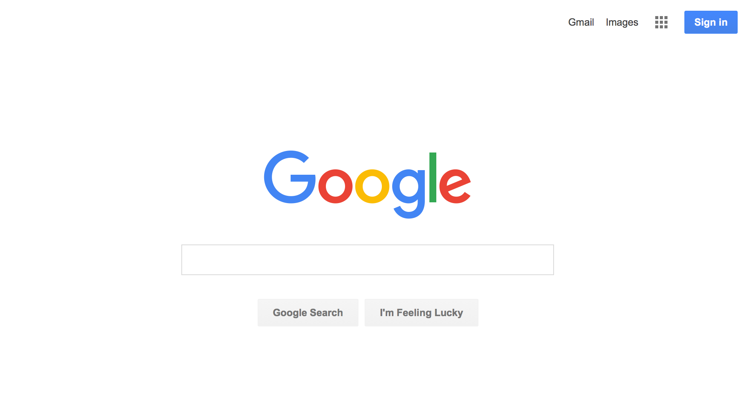

Slide 19
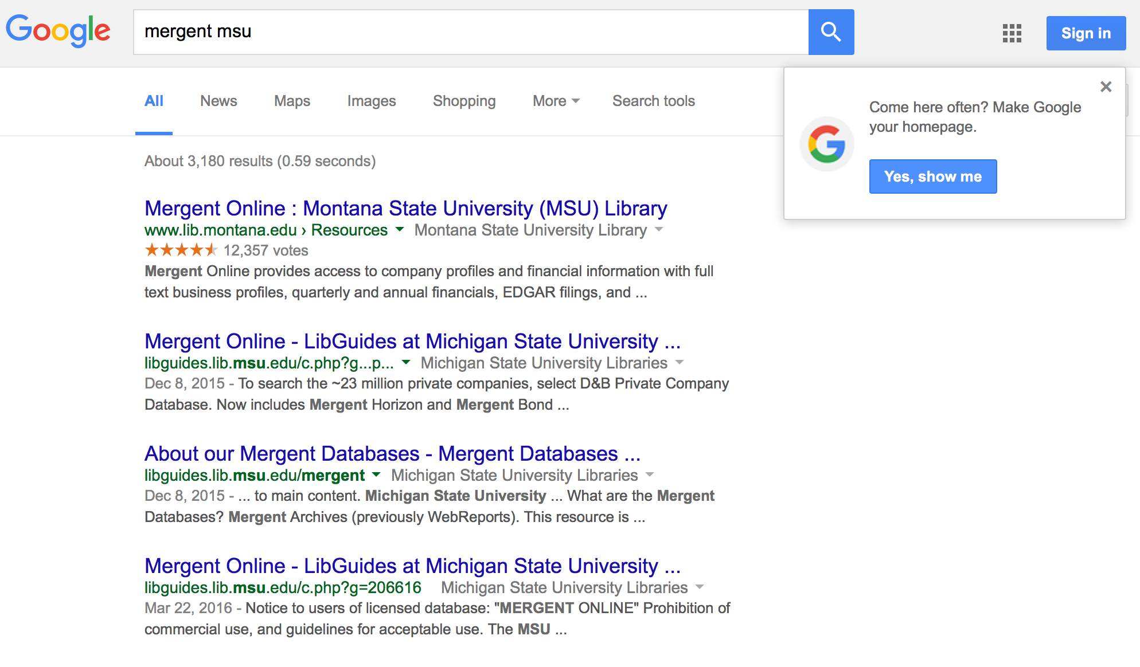

Slide 20
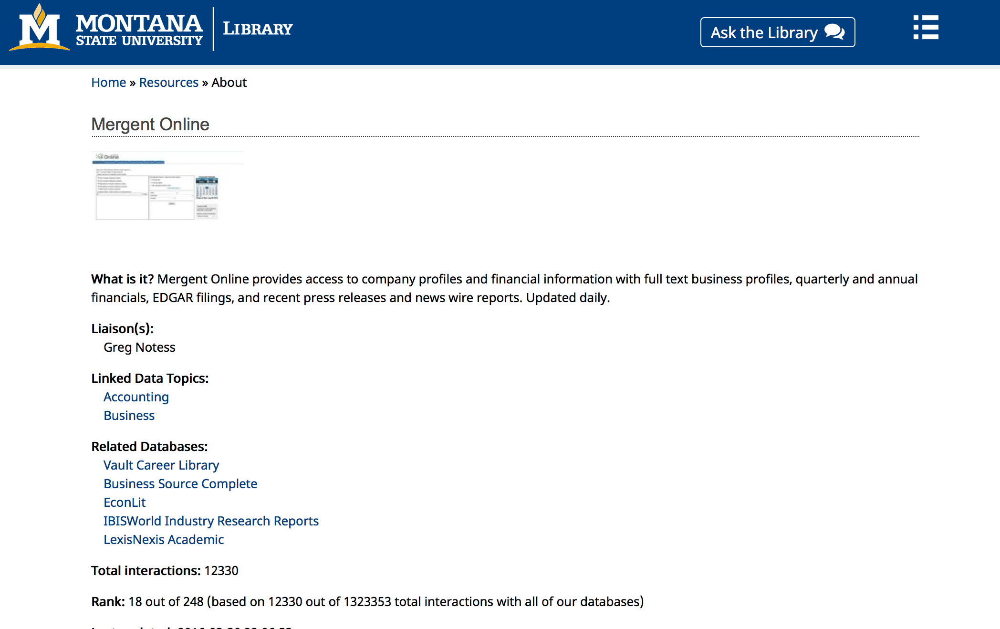

Slide 21
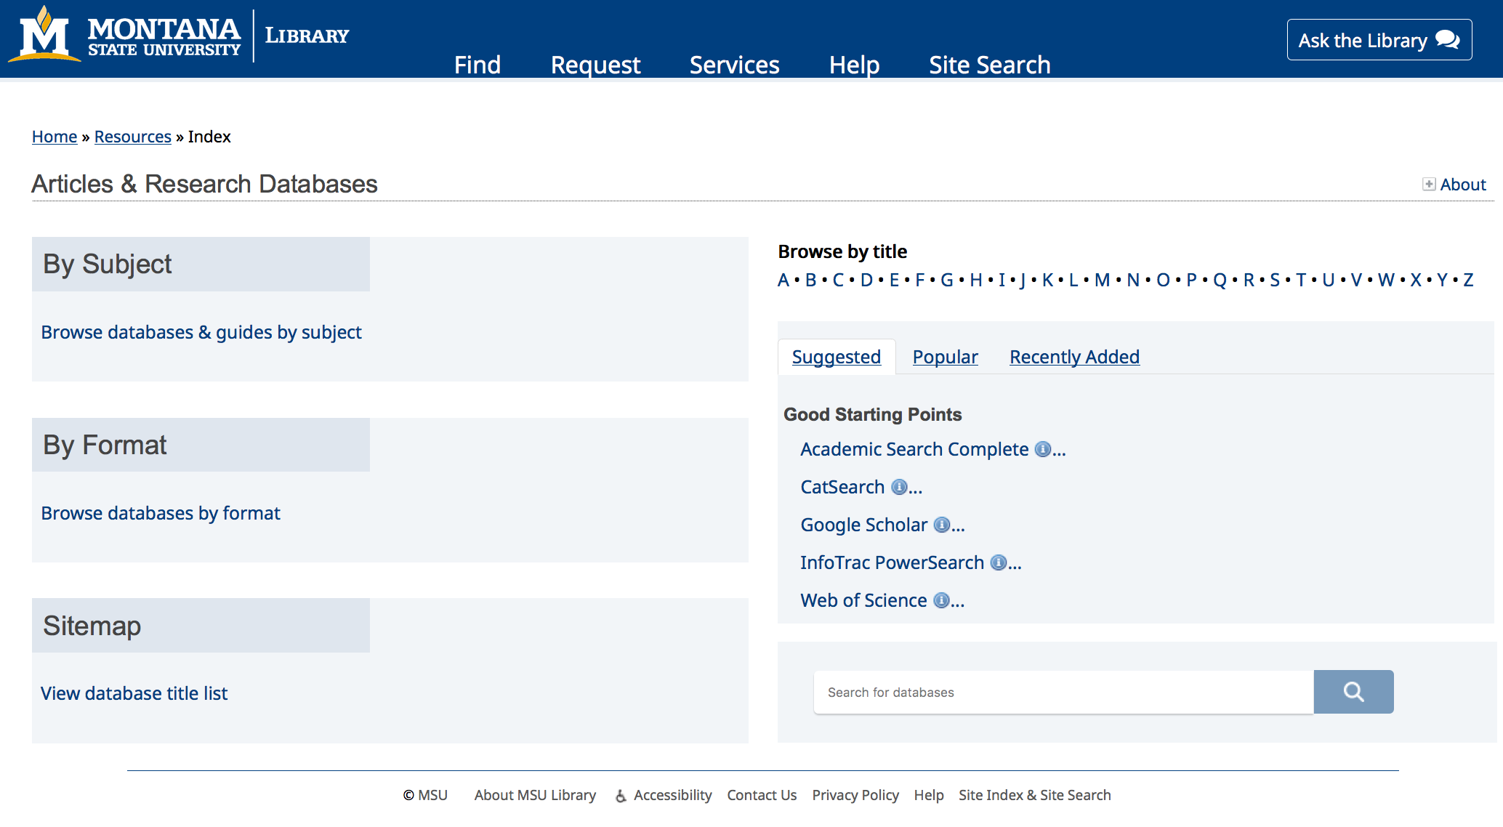

Slide 22
Wait, what… how?

Slide 23
A Revised Website Architecture
Collection Page [home page]
www.lib.montana.edu/resources/
About Pages [about page, topics page]
www.lib.montana.edu/resources/about.php
www.lib.montana.edu/resources/topics.php
Item Pages [individual record page]
www.lib.montana.edu/resources/about/31
Sitemap and rel=canonical work
www.lib.montana.edu/resources/sitemap.xml

Slide 24
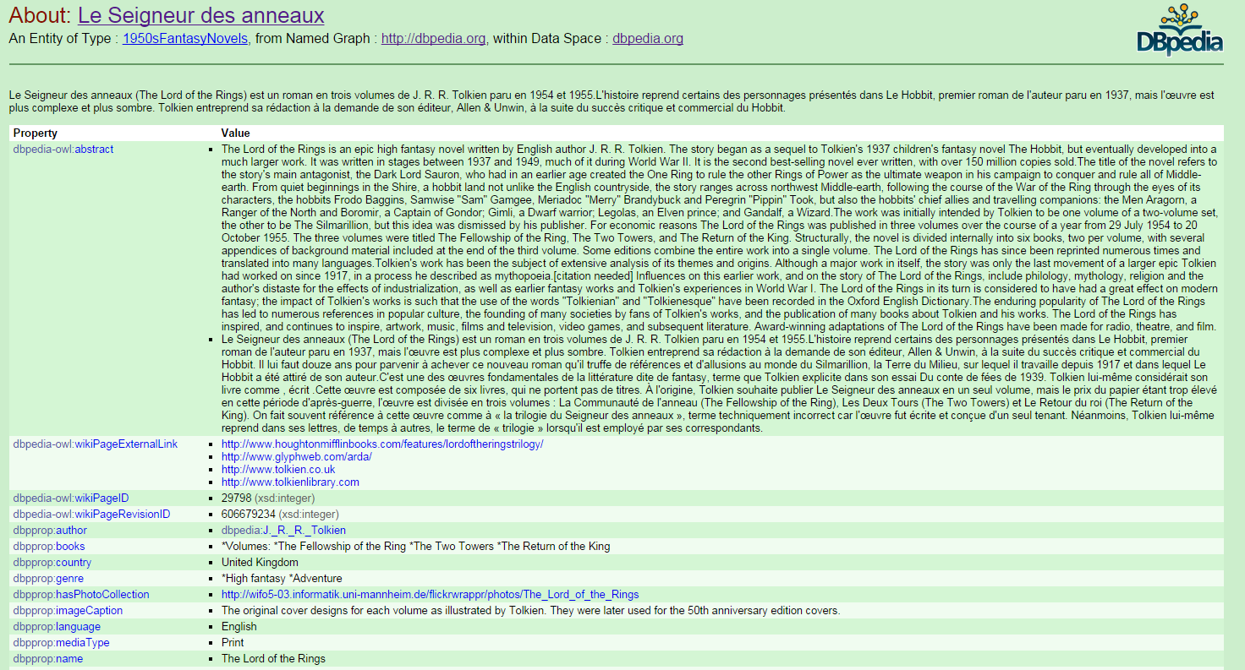

Slide 25
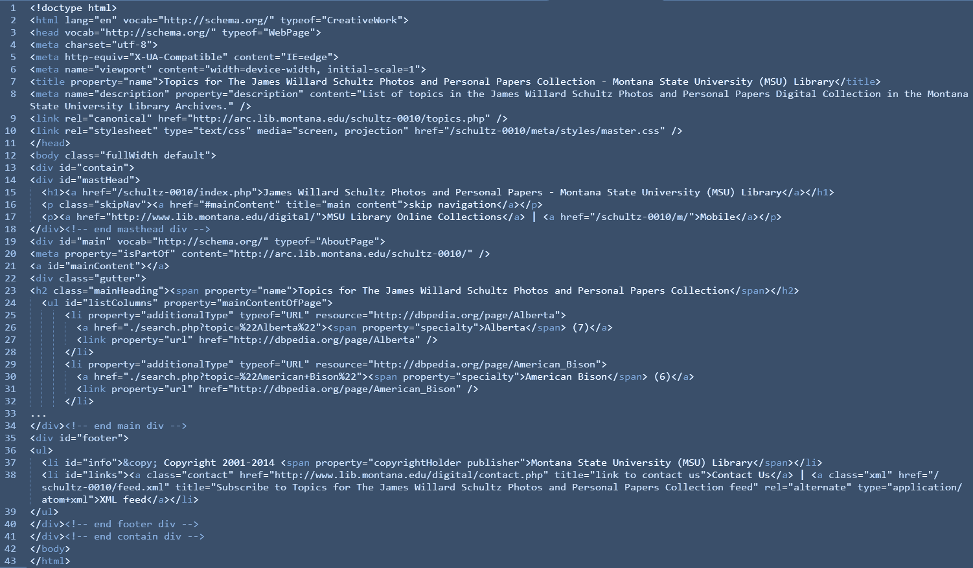

Slide 27
CollectionPage
https://schema.org/CollectionPage, http://schema.org/AboutPage, https://schema.org/ItemPage

Slide 28
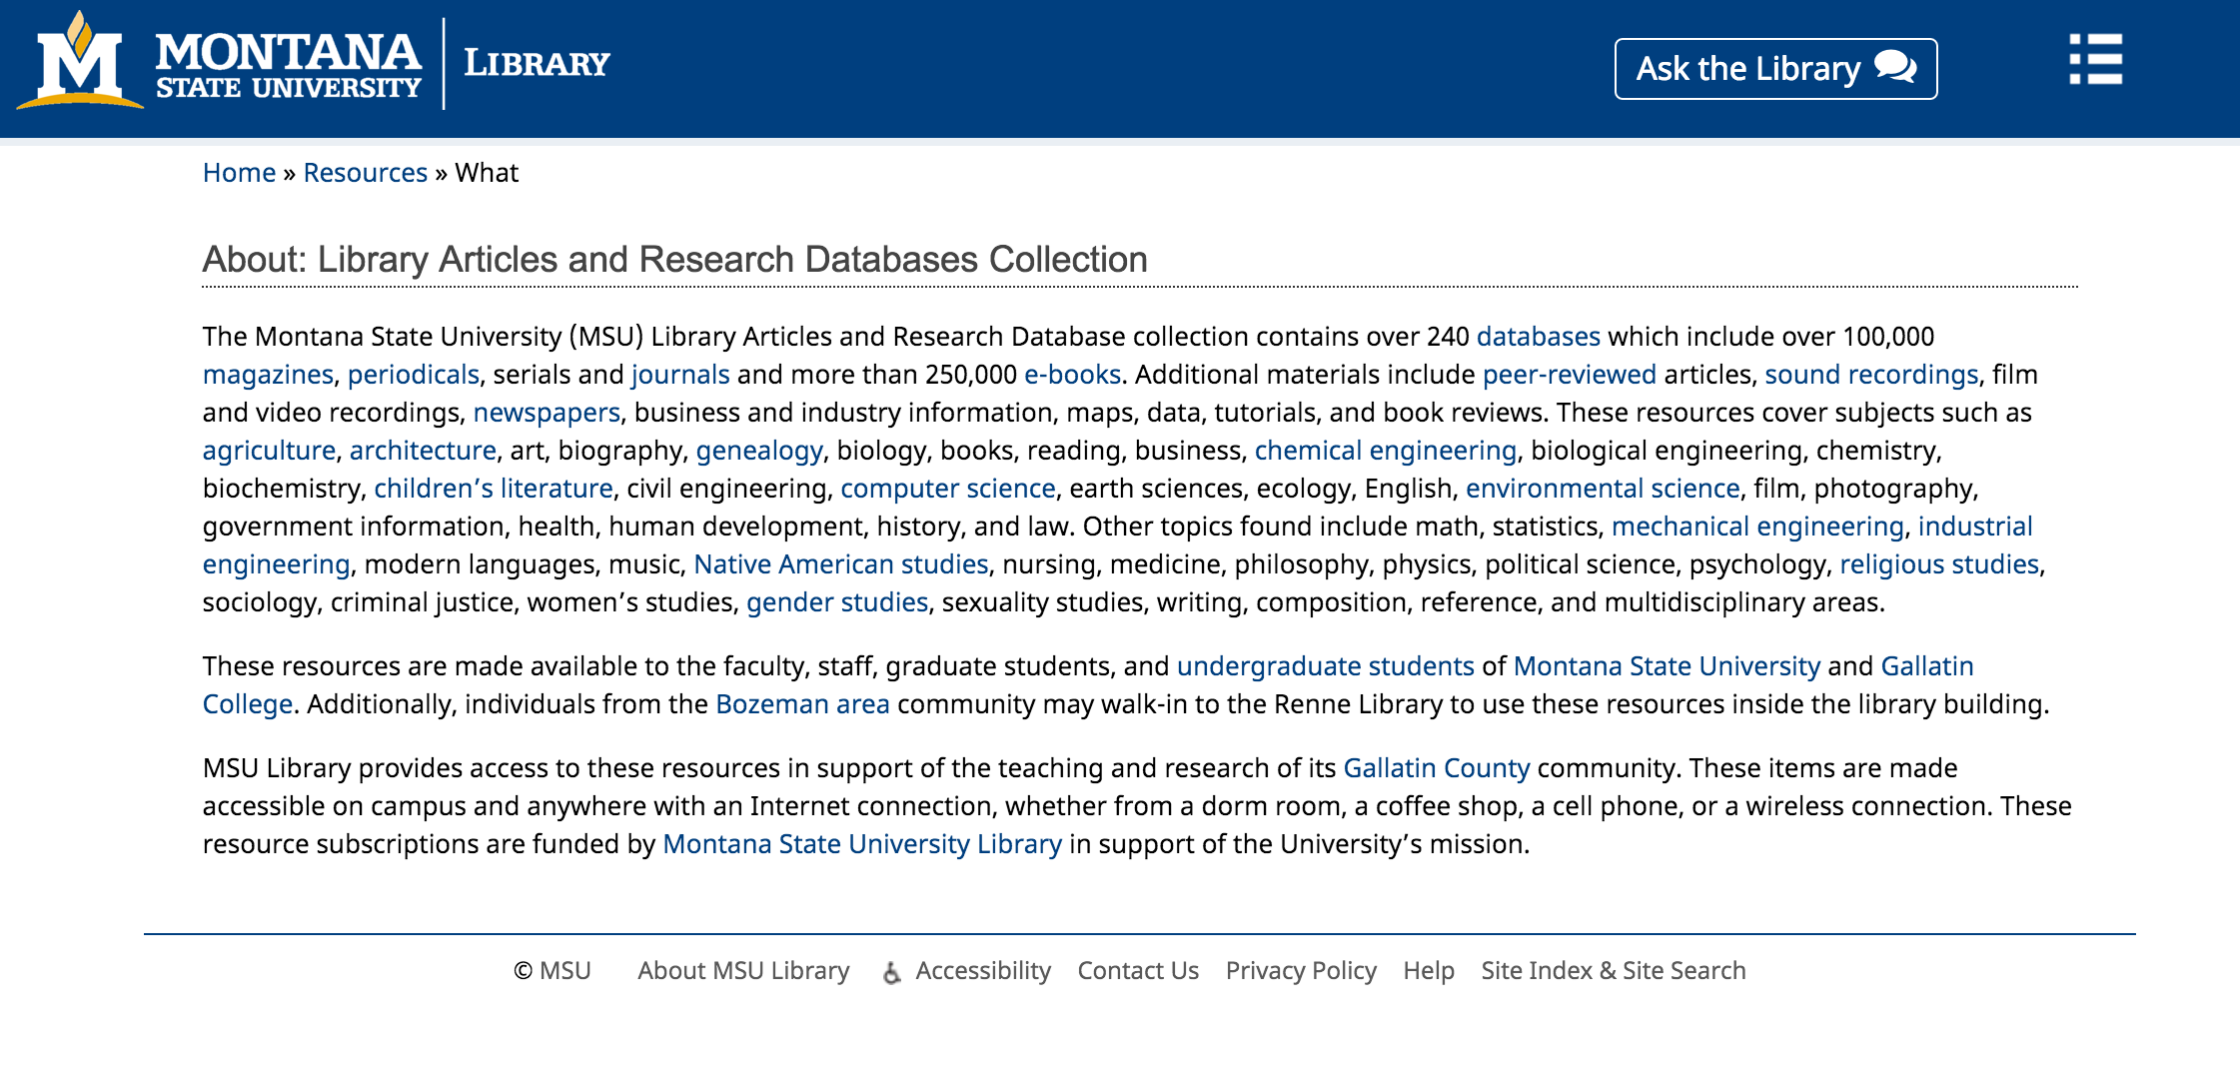

Slide 29
AboutPage
https://schema.org/CollectionPage, http://schema.org/AboutPage, https://schema.org/ItemPage

Slide 31
ItemPage
https://schema.org/CollectionPage, http://schema.org/AboutPage, https://schema.org/ItemPage

Slide 32
ItemPage -> Product
https://www.lib.montana.edu/resources/about/238

Slide 33
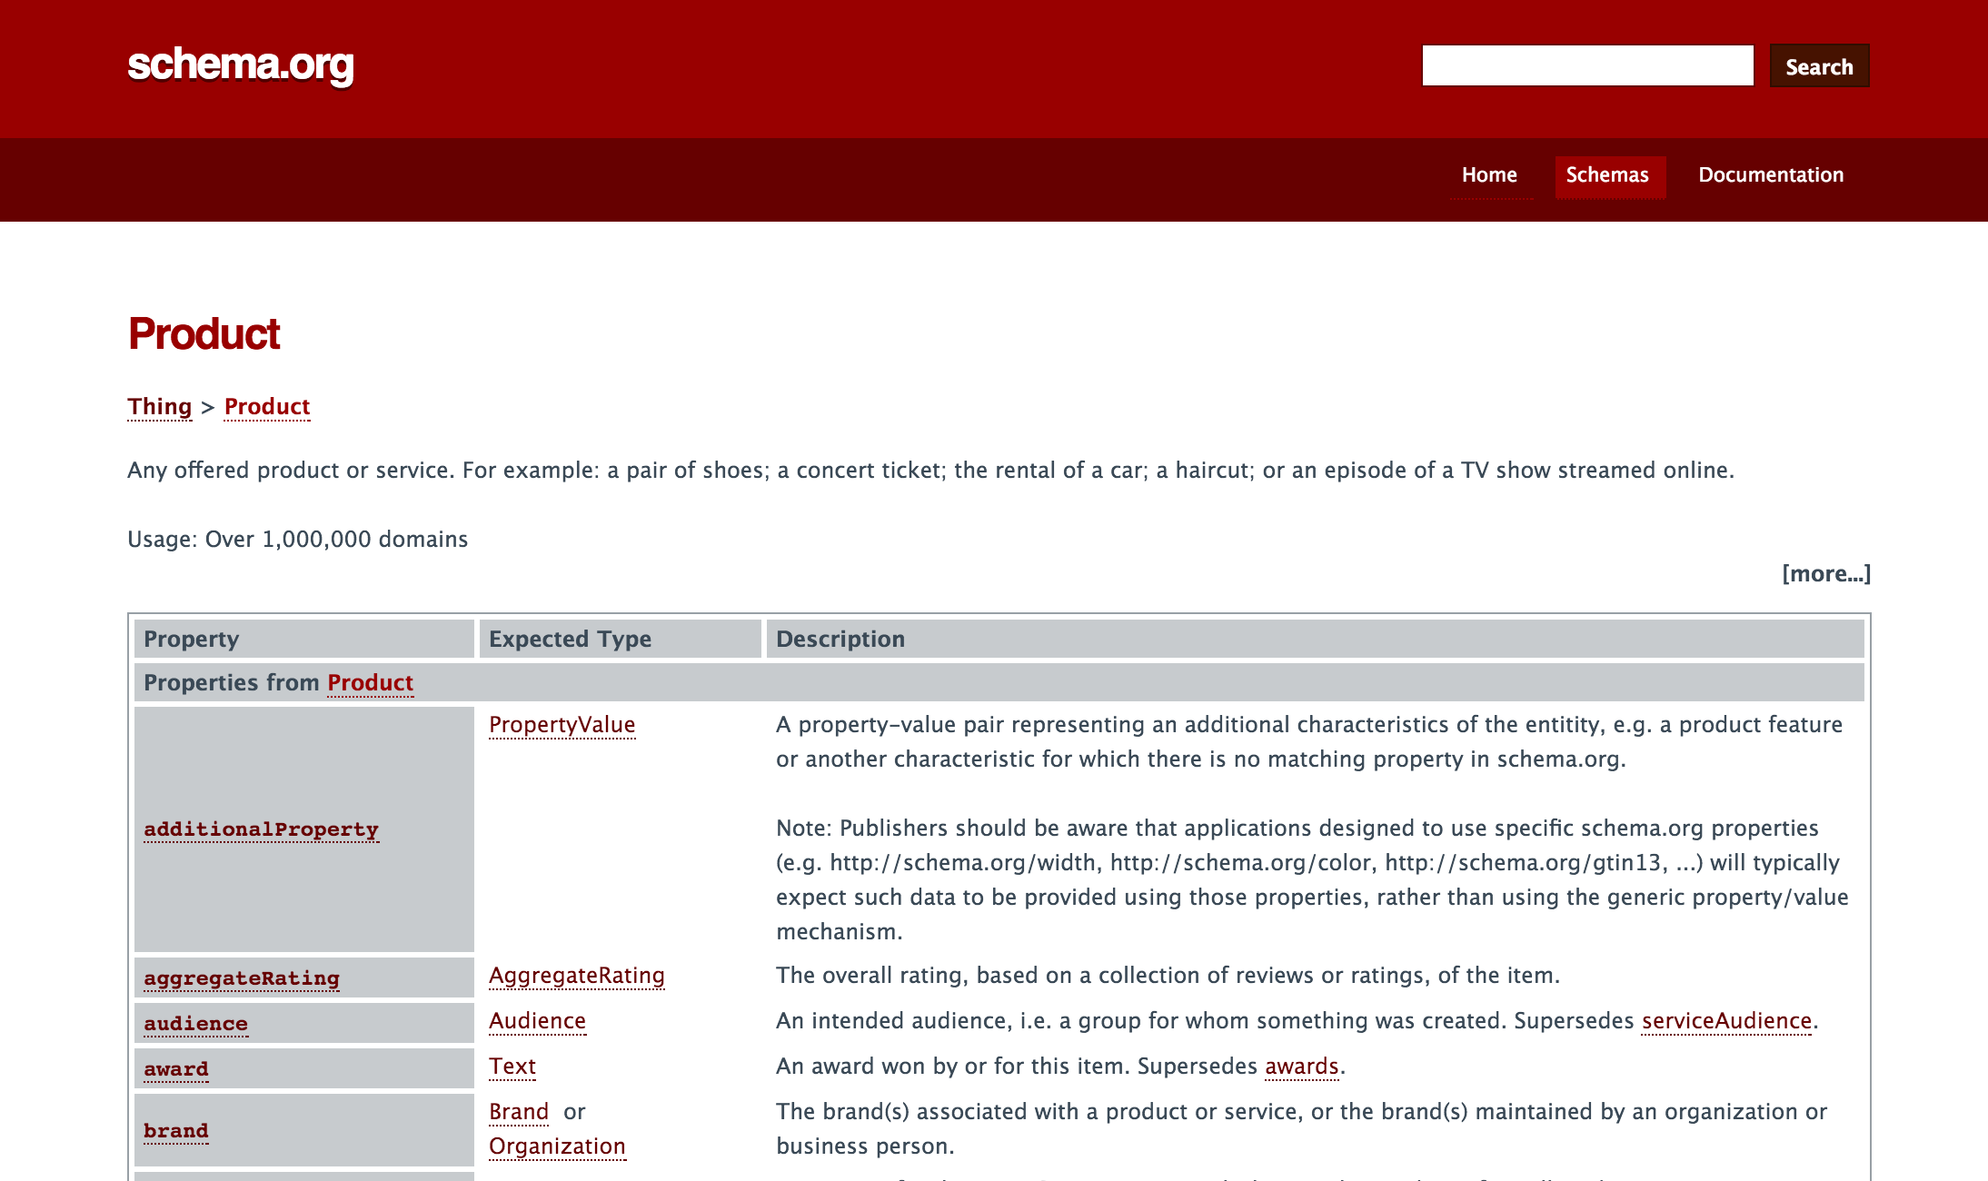

Slide 34
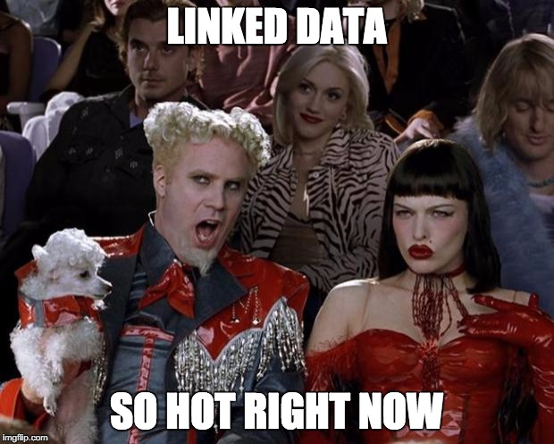
HT @ruthbrarian
Ruth Kitchin Tillman
ruthtillman.com

Slide 35
External Enumerations
"We define here some specific integration points through which selected externally maintained vocabulary can be published as part of schema.org markup"
www.w3.org/wiki/WebSchemas/ExternalEnumerations

Slide 36
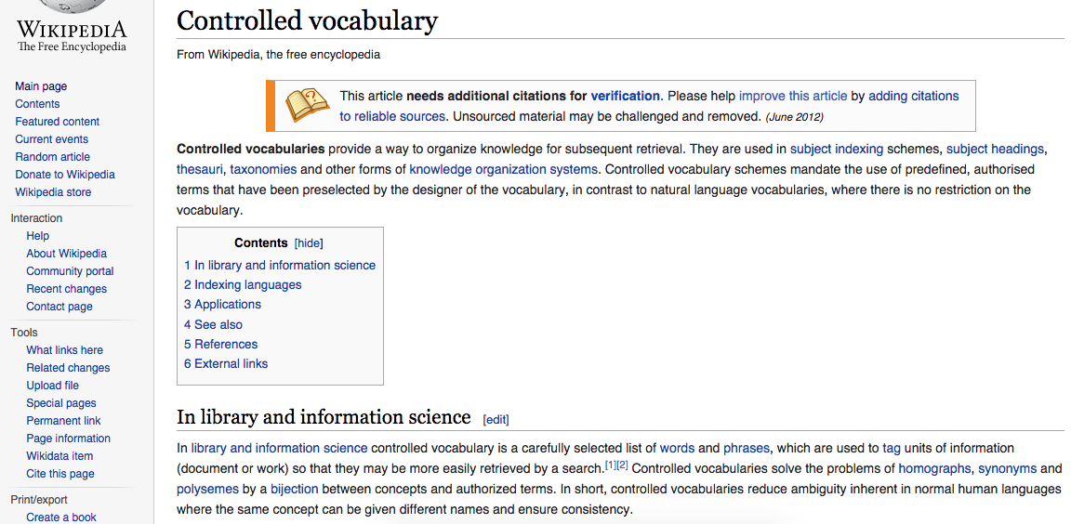
Wikipedia (DBpedia) as a Controlled Vocabulary

Slide 37
additionalTypes, category
https://schema.org/additionalType, http://schema.org/specialty

Slide 38
Results

Slide 39
Search Engine Result Pages
Notes:
Doralyn

Slide 41
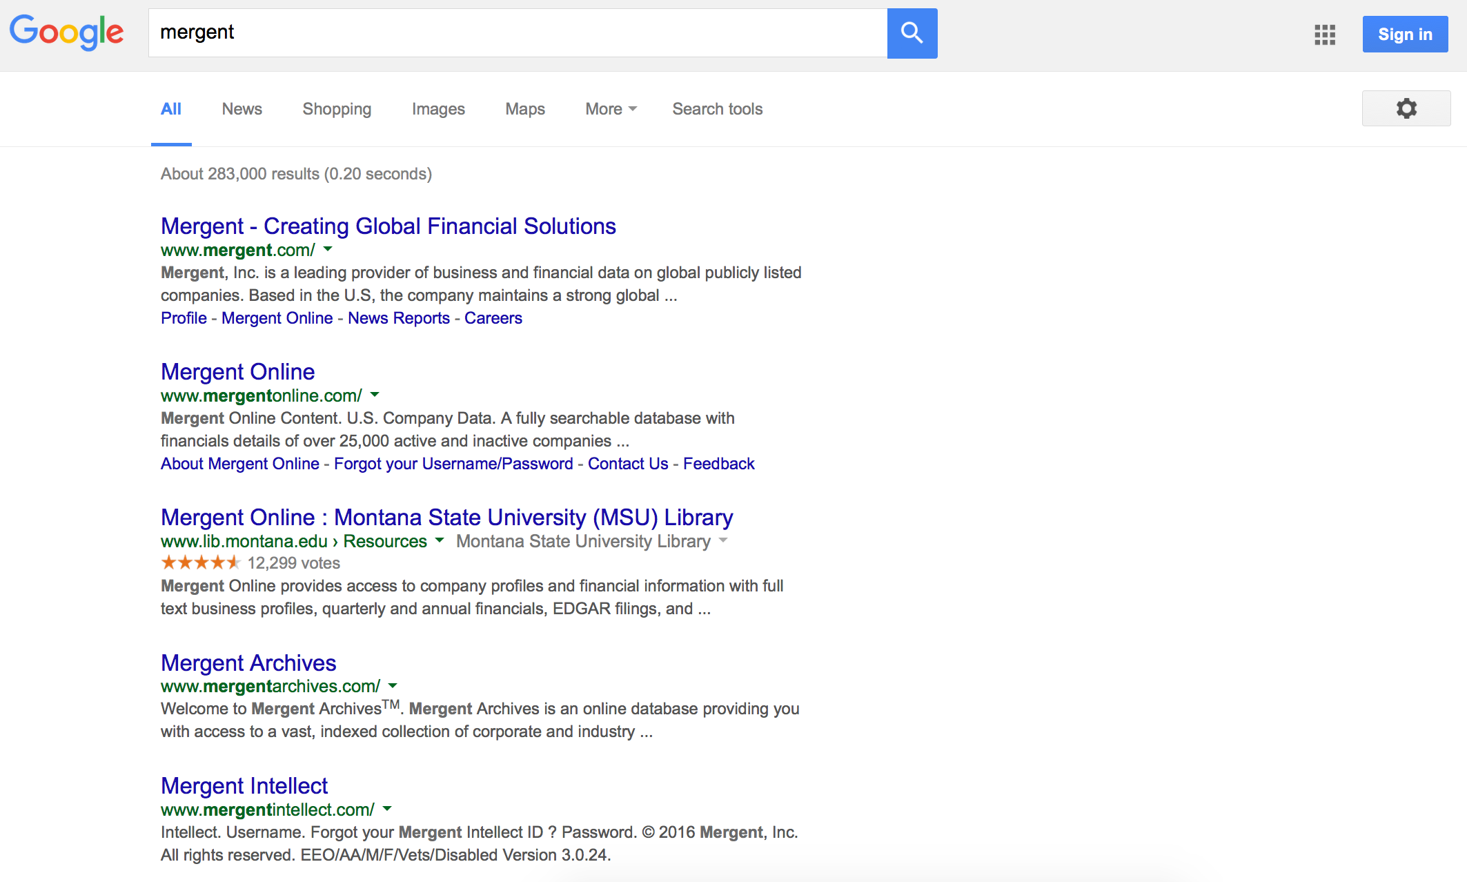

Slide 42
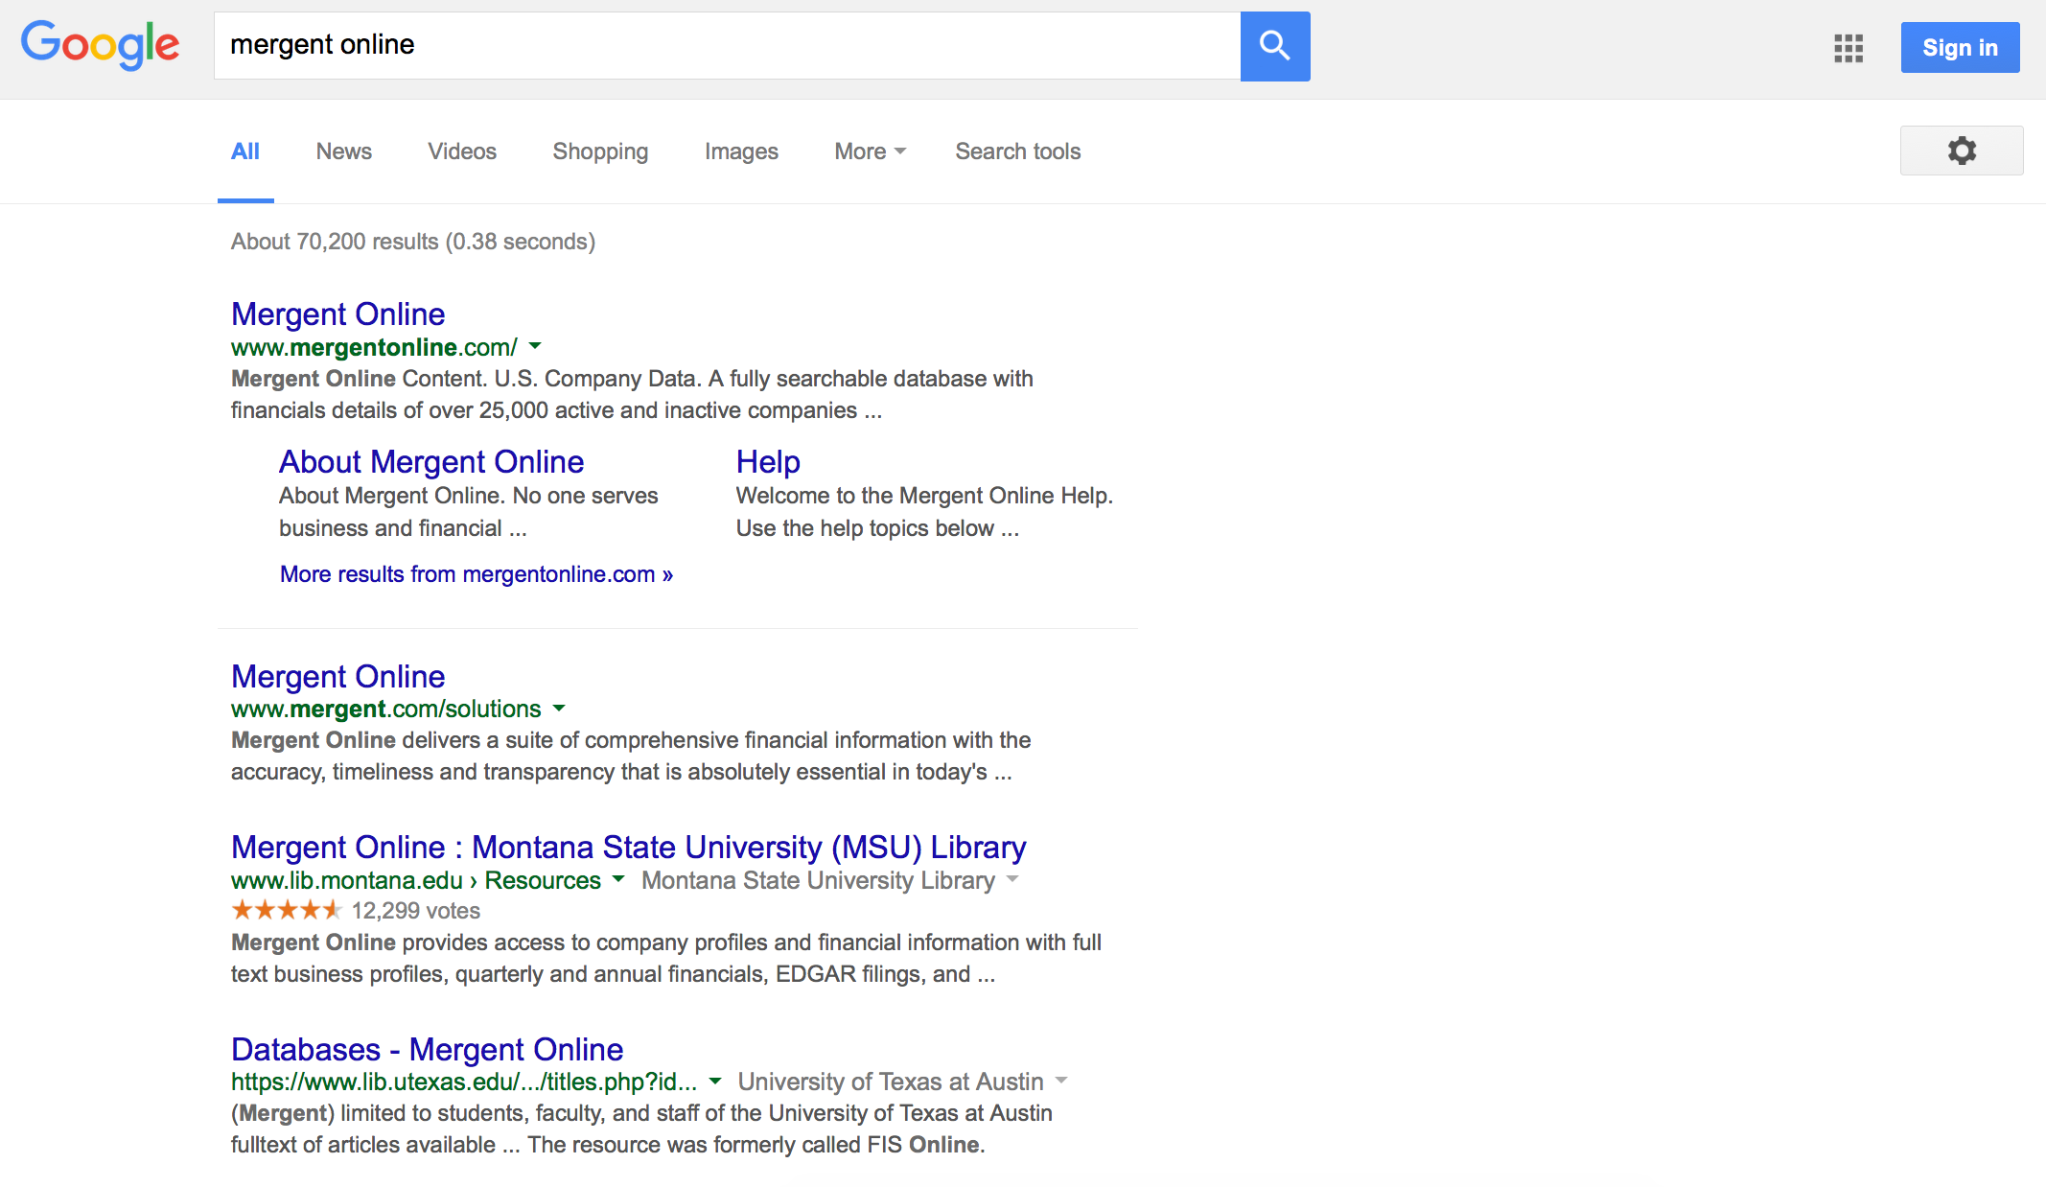

Slide 43
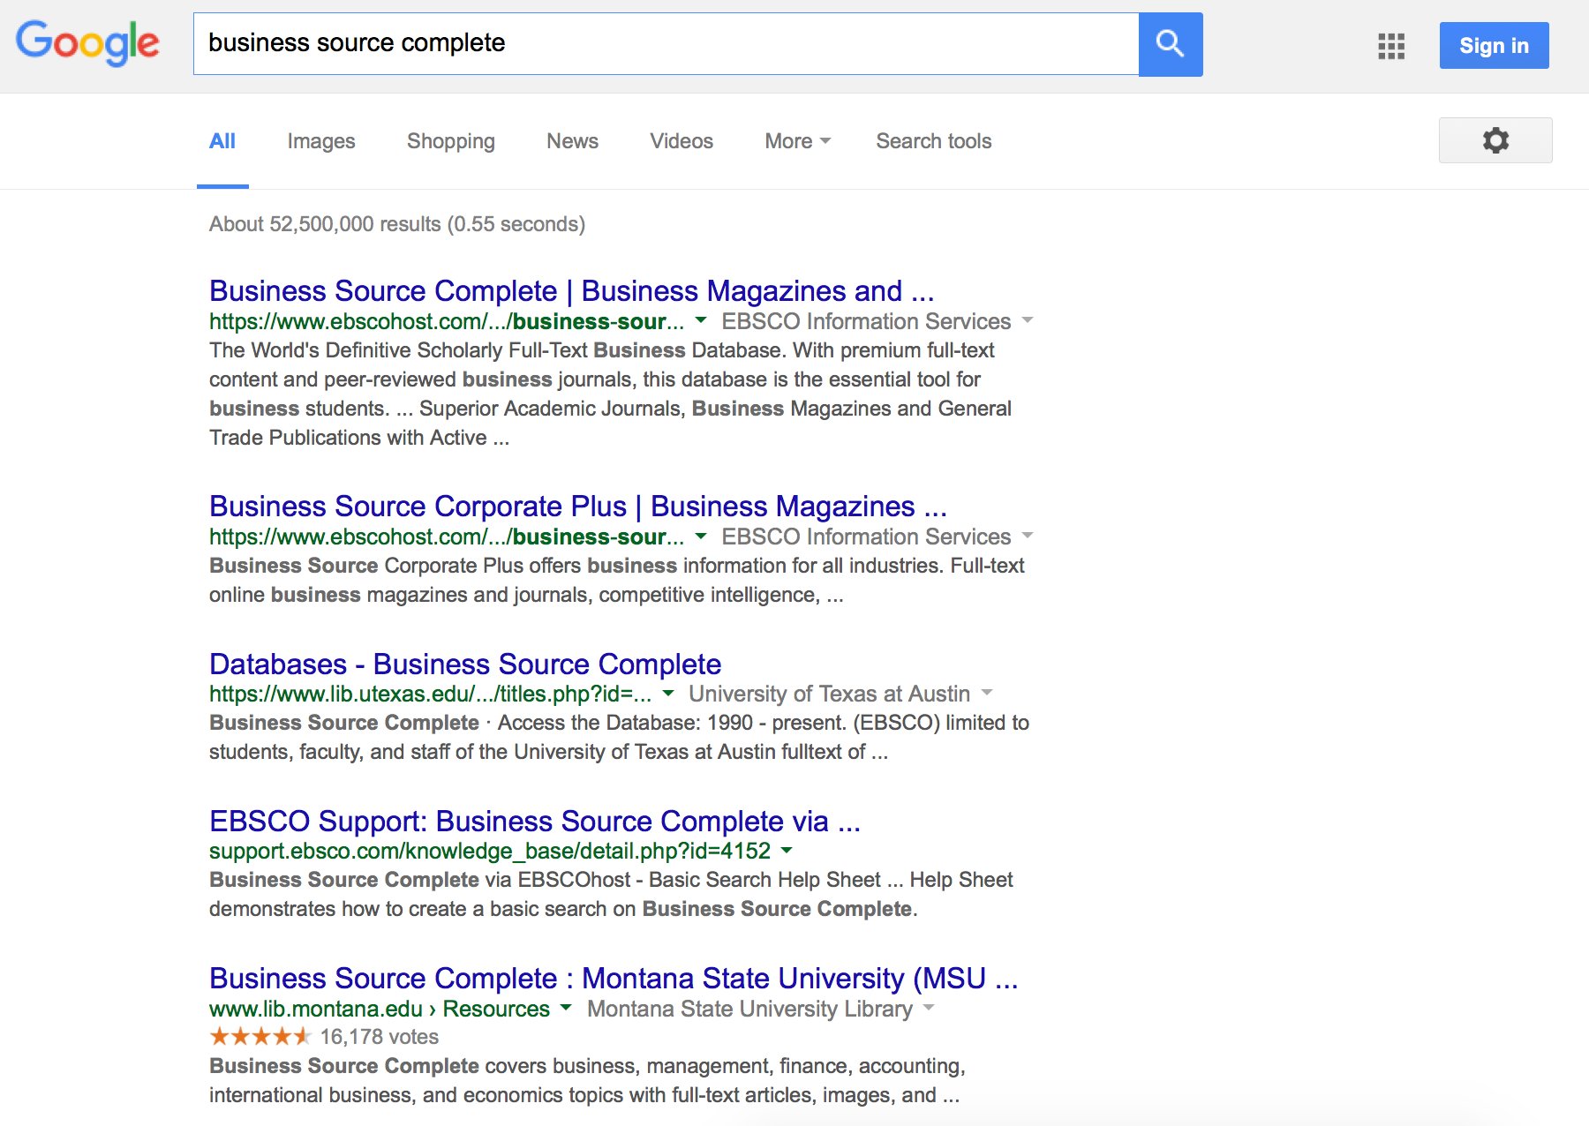

Slide 44
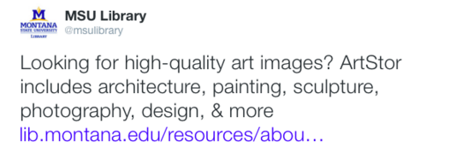

Slide 45
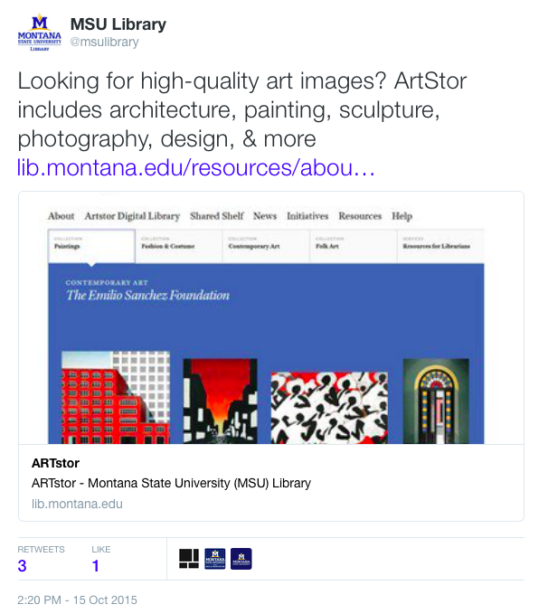

Slide 46
Twitter Card and Facebook Open Graph Tagging
<!--Begin social media tags and metadata-->
<meta name="twitter:title" content="Art Abstracts">
<meta name="twitter:description" content="Art Abstracts - Montana State University (MSU) Library">
<meta name="twitter:image:src" content="http://www.lib.montana.edu/resources/meta/img/screenshots/14.jpg">
<meta name="twitter:url" content="http://www.lib.montana.edu/resources/about/14">
<meta name="twitter:card" content="summary_large_image">
<meta name="twitter:site" content="@msulibrary">
<meta name="twitter:creator" content="@msulibrary">
<meta property="og:title" content="Art Abstracts">
<meta property="og:description" content="Art Abstracts - Montana State University (MSU) Library">
<meta property="og:image" content="http://www.lib.montana.edu/resources/meta/img/screenshots/14.jpg">
<meta property="og:url" content="http://www.lib.montana.edu/resources/about/14">
<meta property="og:type" content="website" />
<meta property="og:site_name" content="Art Abstracts - Montana State University (MSU) Library"/>
<!-- End social media tags and metadata -->

Slide 47
Twitter Analytics
Notes:
Doralyn
Yes, Doralyn will add here

Slide 48
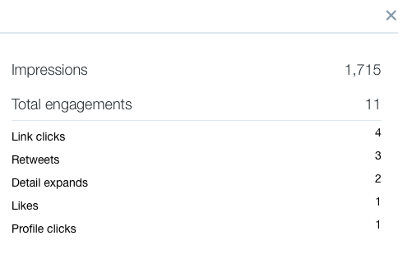

Slide 49
Organic Search Statistics
Notes:
Jason

Slide 50
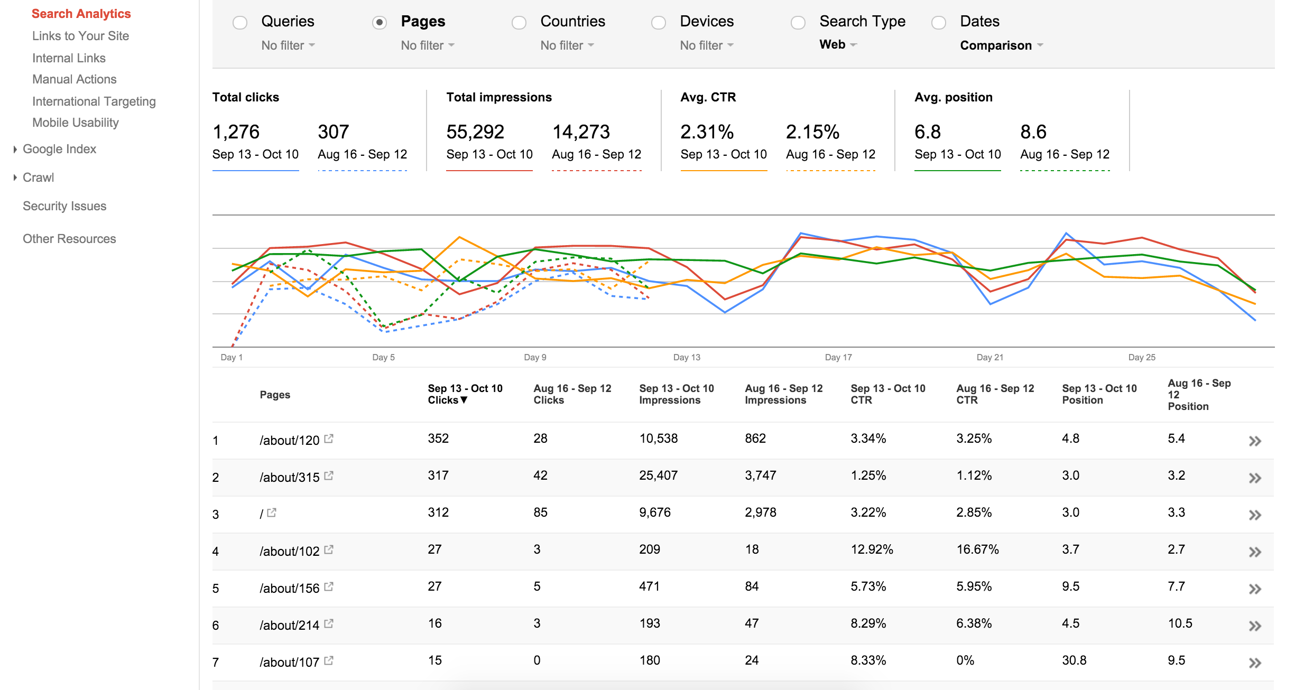

Slide 51
Initial snapshot
August 16, 2015 to September 12, 2015
15,000 total impressions
to
55,000 total impressions
Notes:
Jason

Slide 52
Initial snapshot
August 16, 2015 to September 12, 2015
“Clickthrough Rates” and “Search Position” show growth
Notes:
Jason

Slide 53
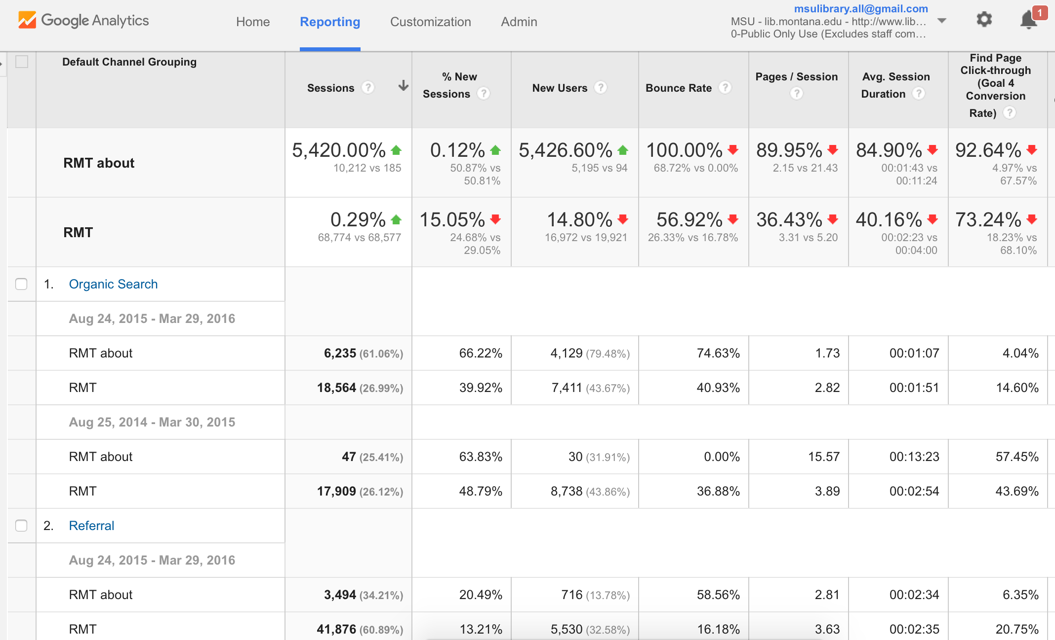

Slide 54
Organic Search Growth
August 24, 2015 to March 29, 2016
68,742 sessions
to
78,986 sessions
Notes:
Jason

Slide 55
Overall Page Metrics

Slide 56
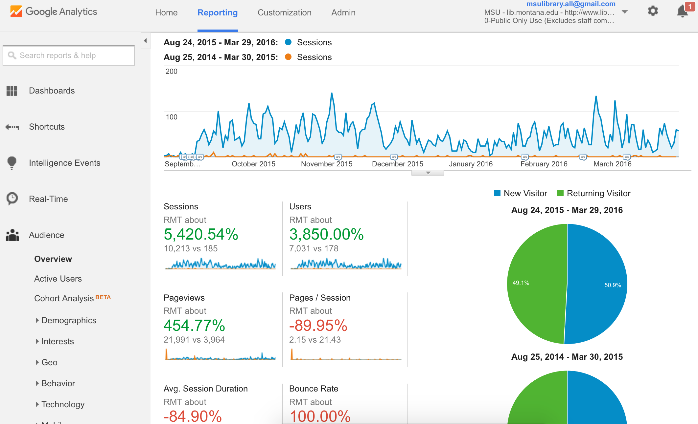

Slide 57
About Pages
August 24, 2015 to March 29, 2016
(compared to previous year)
185 total impressions
to
10,200 total impressions
Notes:
Jason

Slide 58
About Pages
August 24, 2015 to March 29, 2016
(compared to previous year)
3,964 total pageviews
to
21,991 pageviews
Notes:
Jason

Slide 59
About Pages - Bounce Rates
August 24, 2015 to March 29, 2016
(compared to previous year)
Pages per/session decrease
and
100% bounce rate
Notes:
Jason

Slide 60
Semantic Understandings

Slide 61
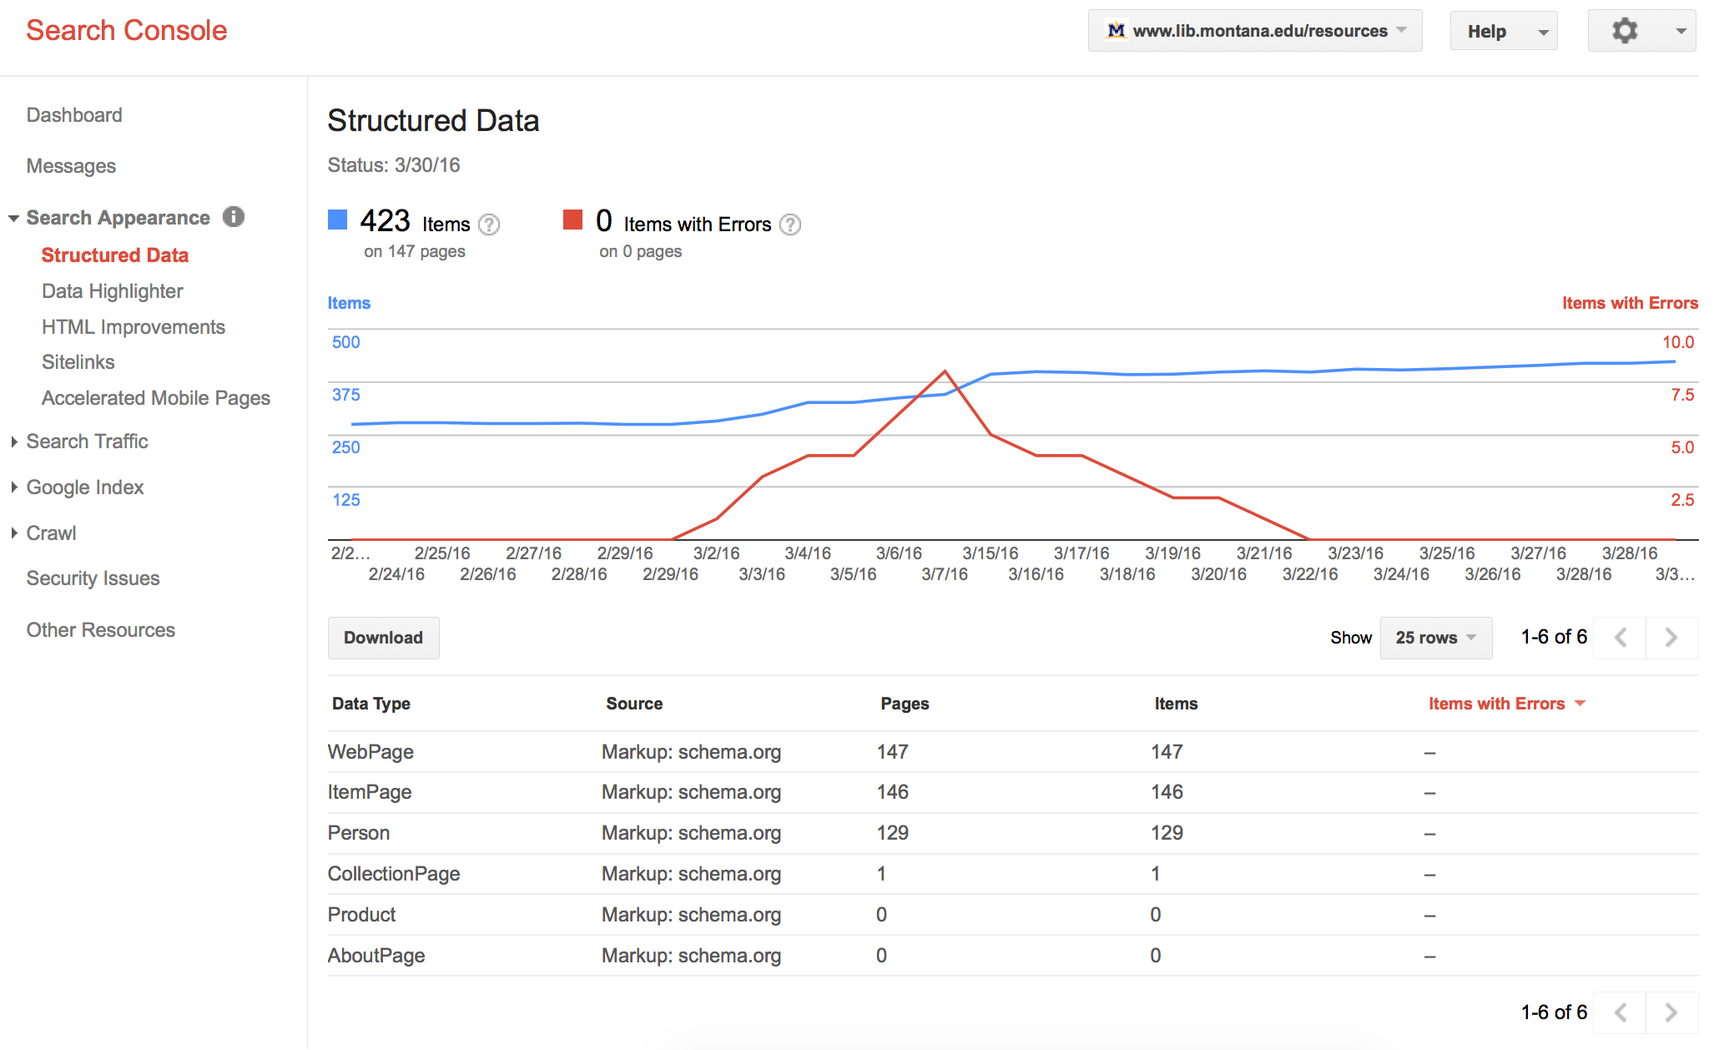

Slide 62
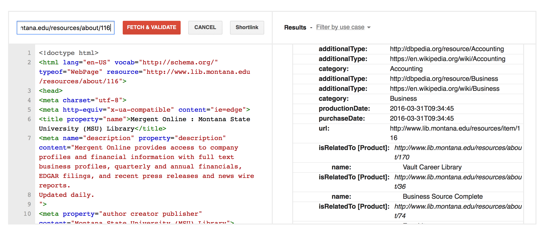

Slide 63
Linking Resources to People

Slide 65
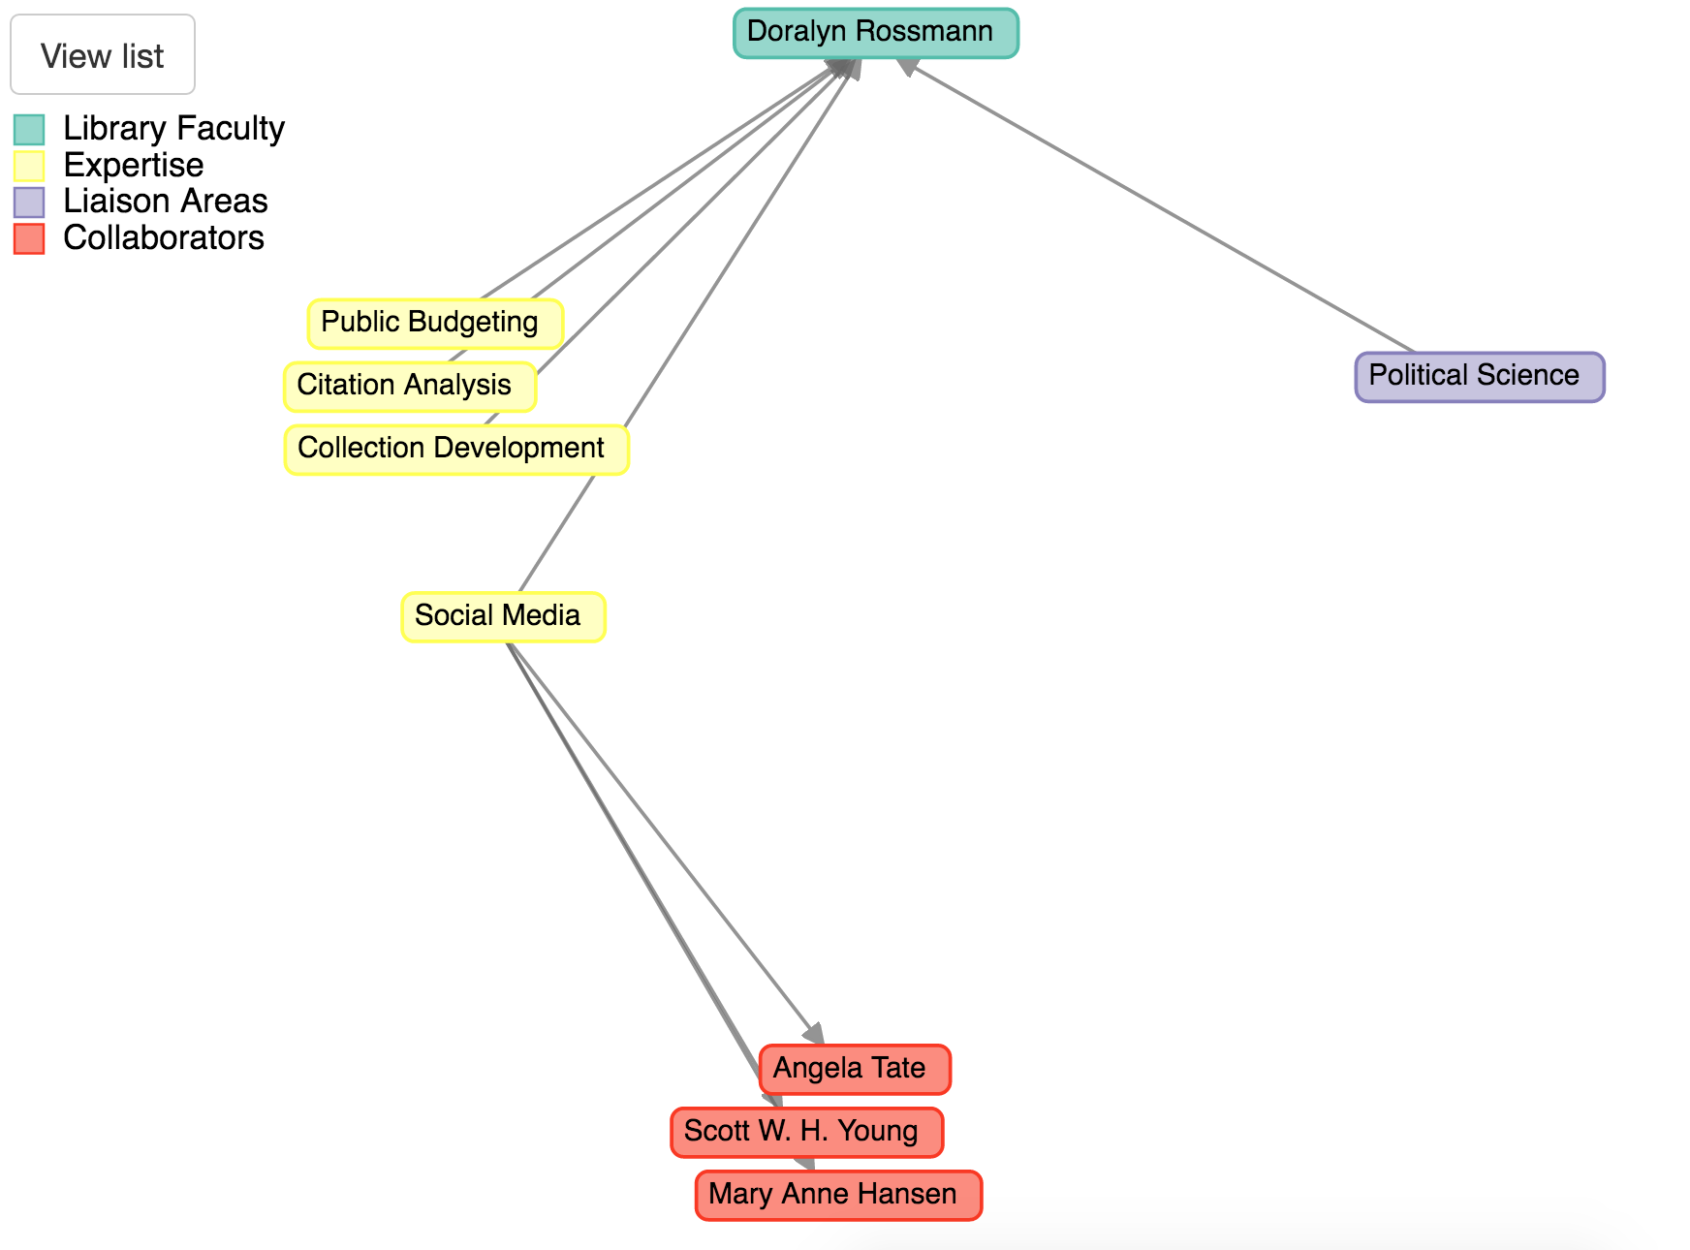

Slide 66
Database Recommendations

Slide 68
Future Research
Notes:
Doralyn and Jason?

Slide 69
Finish library knowledge graph
Remove the proxy using Accelerated Mobile Pages (AMP) markup
Understand and optimize for Local SEO
Encourage standard use of Twitter and OpenGraph
Reproducible results and guide for implementation
Explore adaptability to LibGuides
Collaboration with vendors
Notes:
Doralyn and Jason?

Slide 70
Think about the new
“teaching moment”
Notes:
Doralyn “a revision to the teaching moment”

Slide 71
Questions?
Notes:
Doralyn

Slide 72
Thanks!
Jason A. Clark
Head, Library Informatics & Computing
Montana State University Library
@jaclark
Doralyn Rossmann
Administrative Director, Data Infrastructure and Scholarly Communication & Head, Collection Development
Montana State University Library
@doralyn
Notes:
Doralyn

