Slide 1
Machine Learning, Text Summarization, and Optimizing Scholarship for Citizen Audiences and Discovery
Leila Sterman
Jason A. Clark
Justin Shanks Daniel Laden
Montana State University
Coalition for Networked Information, Spring 2o22

Slide 2
What’s Ahead
Research Motivation
Survey - How do scholars think about outreach and translation?
Summarizing and restructuring scholarship - Optimizing Scholarship for Citizen Audiences and Discovery - Challenges and Opportunities
Research Implications - Interdisciplinary communication
Notes:
Research Motivation - "Last Mile" metaphor (5 minutes, All) - Upgoer5 text editor - https://splasho.com/upgoer5/
How do scholars think about promotion of their idea? (10 minutes, Leila) - Practices for summarizing for different audiences - Survey and Assessment - Initial Findings
Summarizing and restructuring scholarship (10 minutes, Jason) - Programming practices – NLP, Text Summarization - Markup practices – nanopublications? - Optimizing Scholarship for Citizen Audiences and Discovery - Challenges and Opportunities
Research Implications (5 minutes, All) - Interdisciplinary communication

Slide 3
Research
Motivation
Notes:
Clear communication outside of disciplinary niches is rarely taught or emphasized in higher education. In fact, we train students in complex jargon as part of their indoctrination into a field.
At the same time, interdisciplinary research is a sought after interaction that research offices (& etc.) believe will increase innovation, productivity, and access to funding.
Journal articles and book chapters are standard, efficient means of communicating within one’s field, and yet the format, disciplinary jargon, and presumed audience may inhibit some of the most common measures of success for those outputs (Q9.). Measures like high citations rates successful grant applications, broad readership, and acknowledgment of research are contingent on articles that attract and encourage readership from broad audiences

Slide 4
Research Motivation - Access
Access is essential to understanding.
Notes:
We talk a great deal about the physical access to materials, about open access through licensing and yet understanding can be a secondary barrier once the document is in hand. If researchers want to have large scale impact Doing the work is not enough, translation a is needed further step – there is a reason some folks get quoted in national news outlets more than others—they have done the work to be accessible.

Slide 5
Research Motivation - Access
Translation takes effort.
Notes:
one barrier that limits researcher's potential to be collaborative is understanding concepts enough to make those leaps between niches. The barrier is enforced by a lack of generally understandable language in abstracts, summaries, and other research outputs. We are not arguing that scholarship should be "dumbed down" or simplified at an detriment to innovation or to be misconstrued, but that secondary outputs can greatly help the broad reach and impact of knowledge. This is not a totally new concept & Libraries are well situated to engage in this type of service.

Slide 6
Survey development
First, we wanted to understand the current practices and motivations.
Survey questions
Survey responses
Notes:
So, to get baseline data of the current practices of faculty at MSU we developed a survey with a gift card incentive to recognize that this was, as one historian put it, a very challenging survey.

Slide 7
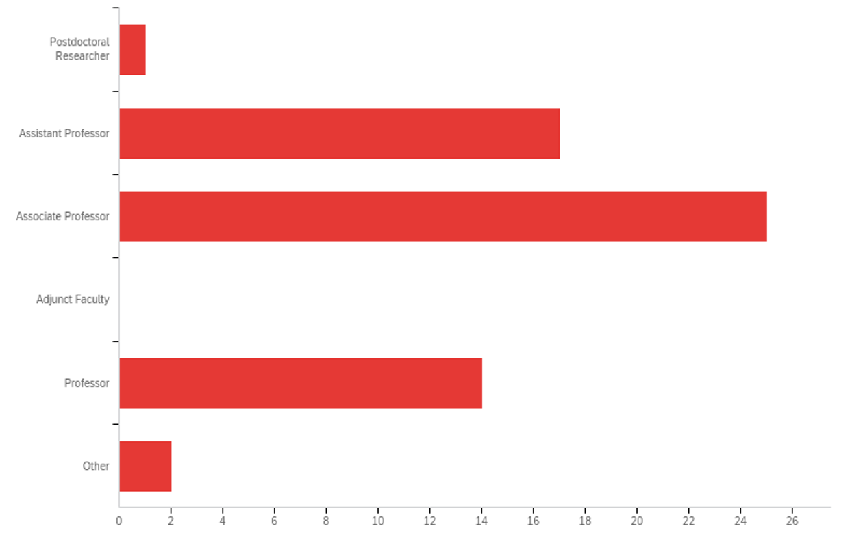
Survey
Notes:
We aimed to build an understanding of both what scholars felt was important and where they currently spent their time so that we could develop an automated process to decrease the time and effort involved in this "extra" step, to encourage better communication across disciplines (& outside of academia).
Our 59 respondents (out of105 invitations ~60%) were 42% associate profs, and then about 25% each asistant and full profs.
We invited 2-3 faculty members from each tenure-home department on campus

Slide 8
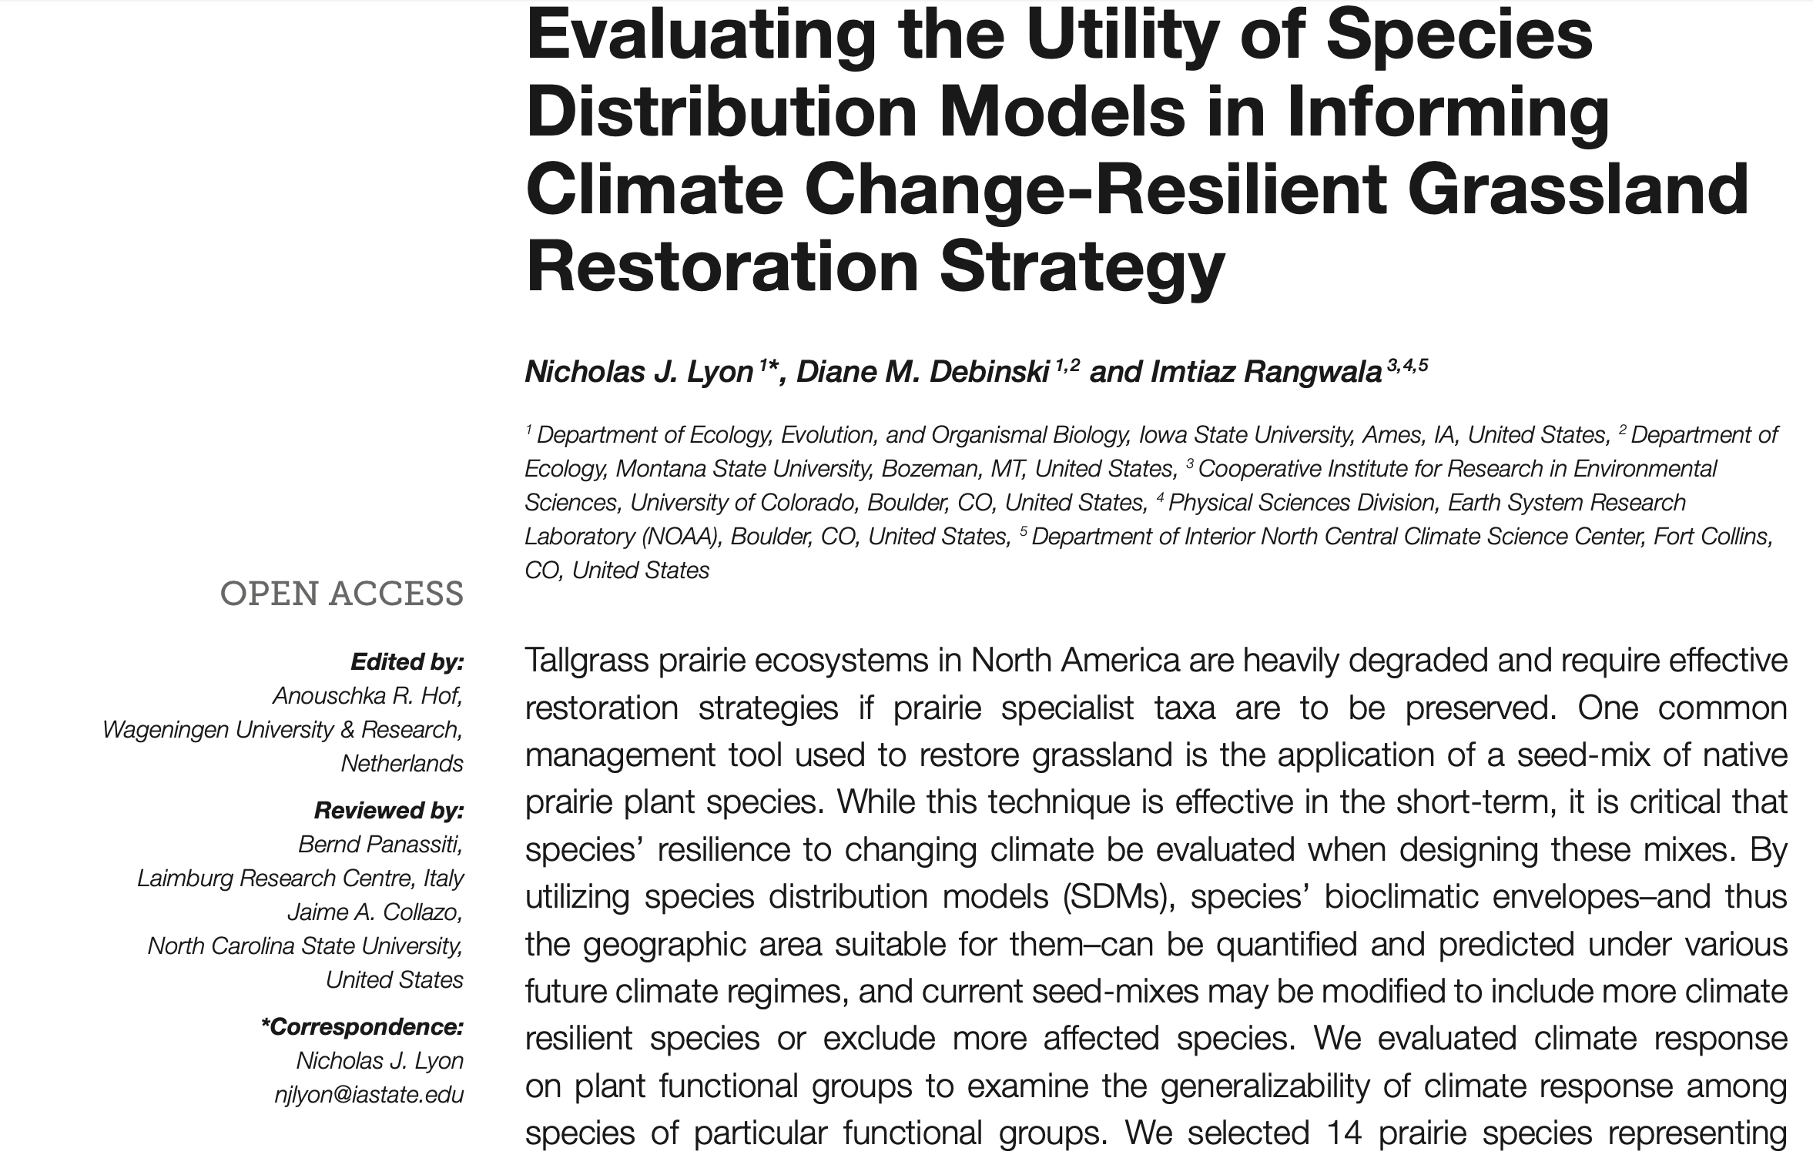
Survey
Notes:
Scholars value a broad range of outputs, with the journal article, books, presentations, invited lectures, book chapters, posters and proceedings unsurprisingly rising to the top.
When asked about measures of success:
Asst profs universally said publications, citations, and grant dollars were the measure of success.
P& T drive their work
Asoc profs-- The number of PhD and MS students that go on to have careers in science. Expand to include recognition, impact,
Full—add undergraduate success, teaching, and a few more mentions of broad impacts.
If we break down intrinsic motivations: a sense of personal satisfaction, a positive impact on people’s lives, being sought out as a mentor, or the feeling of making a difference. One respondent notes that while there are many answers to this question, Montana State values “the number of journal articles, book chapters + grant dollars” and they value making a difference.
while individuals may have varied motivation, the spectre of tenure and promotion continues to be a central driving factor in dissemination of research. This also drives the venues and objectives of that research dissemination.
These outputs are aimed at disciplinary peers,

Slide 9
"How do you target your intended audience?"
"I just expect researchers to find my papers"
"I probably don't do as good a job of targeting the uptake audience because my job counts productivity as scientific articles + grant dollars"
Notes:
Instead of just trusting that publishing in a reputable journal will do the work for you....

Slide 10
Research Motivation - Access
Understanding requires translation.
Notes:
….we advocate for translation
We should treat scholarship as a conversation, (ACRL info lit framework) its important to be speaking the same language.
An opportunity for libraries to help with this work and provide Wider access to ideas for the benefit of the research and the public.

Slide 11
"Which audience would you like to reach and do not currently?"
"... there are so many publications it is even difficult to keep up with ... one field, so articles/podcasts, or other media outlets that highlight our research efforts help it gain more visibility"
Notes:
Lack of translation inhibits both outreach and discovery

Slide 12
Research Motivation - Access
Interdisciplinarity takes effort.
Notes:
Many survey respondents believe that their research has impact or should have impact and they desire to reach a specific audience, yet describe no more effort than “choosing the appropriate journal”.
An opportunity for libraries to help with this work.

Slide 13
"What impact do you think your research has?"
"On a scholarly level, builds new knowledge within specific niches; cross-fertilizes between fields, opens up new avenues of discussion; reveals the historical roots of current issues (e.g., refugee crises); preserves historical materials for future generations; brings "hidden stories" to public light; educates the public; contributes to peace and reconciliations processes in post-trauma societies."
"it moves ideas around within whatever academic field it lands in"
Notes:
What impact do you think your research has?
Clearly this is an area of need.

Slide 14
The ideal Reality
"Often our peer-reviewed research is then crafted into a policy brief that is disseminated to the government officials and policymakers. Additionally, our communication administrator crafts new articles highlighting the topic. Lastly, economists present their work to the public."
"I publish in reputable journals"
Notes:
How can we help researchers without the ideal team obtain some of the benefits of translation?

Slide 15
Research Motivation - Access
How might we create a “snapshot” of a scholarly article - a concise and readable summarization of the thesis, methods, findings, major figures of an article - for a broad, reading audience.
Notes:
We aim to create a tool that allows entre into the scholarly conversation—it doesn’t replace the scholarship but increases visibility and accessibility across disciplines.

Slide 16
Research Motivation - Access
There are a number of tools in this area:
Scholarcy
GROBID
ScienceBeam
CERMINE
ContentMine
The up-goer text editor
Notes:
We are not working in a vacuum--These tools attempt to help scholars translate, text mine, parse metadata from PDFs, and summarize research. A few are still maintained. All work to enhance the possibilities of the static PDF for human and machine readabilty

Slide 17
Applying the Survey
Notes:
Researchers responded that they were most interested in "An abstract that has been translated to provide an accessible and readable summary of your work for the general public". This is no easy task, Jason and Daniel will explain how we got started:

Slide 18
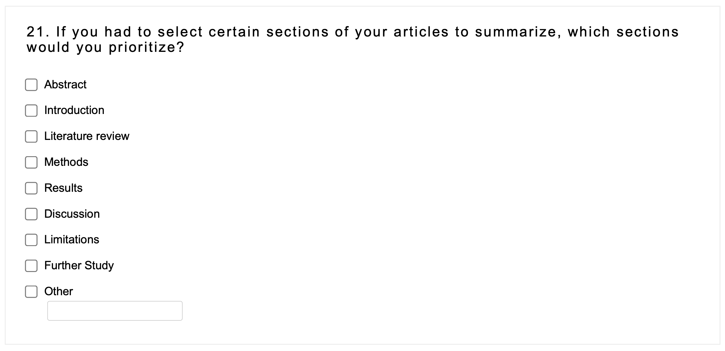
Summarizing Research – Original Article
Notes:
There are barriers to intradisciplinary work that limit our potential to be productive. One of those barriers is understanding concepts enough to make those leaps between niches. The barrier is enforced by a lack of generally understandable language in abstracts, summaries, and other research outputs. We are not arguing that scholarship should be "dumbed down" or simplified at an detriment to innovation, but that secondary outputs can greatly help the broad reach and impact of knowledge. This is not a new concept. Our hope is that we can use information from a survey of MSU scholars to inform the habits and tactics of folks who are active translators and then use generative computing models to translate academic language into more accessible reading levels using similar pathways.

Slide 19
New forms for Scholarship

Slide 20
Summarizing Research – Original Article
Notes:
There are barriers to intradisciplinary work that limit our potential to be productive. One of those barriers is understanding concepts enough to make those leaps between niches. The barrier is enforced by a lack of generally understandable language in abstracts, summaries, and other research outputs. We are not arguing that scholarship should be "dumbed down" or simplified at an detriment to innovation, but that secondary outputs can greatly help the broad reach and impact of knowledge. This is not a new concept. Our hope is that we can use information from a survey of MSU scholars to inform the habits and tactics of folks who are active translators and then use generative computing models to translate academic language into more accessible reading levels using similar pathways.

Slide 21
Summarizing Research – Machine Processes
Minimum Viable Unit for Expressing Scholarship
Notes:
There are barriers to intradisciplinary work that limit our potential to be productive. One of those barriers is understanding concepts enough to make those leaps between niches. The barrier is enforced by a lack of generally understandable language in abstracts, summaries, and other research outputs. We are not arguing that scholarship should be "dumbed down" or simplified at an detriment to innovation, but that secondary outputs can greatly help the broad reach and impact of knowledge. This is not a new concept. Our hope is that we can use information from a survey of MSU scholars to inform the habits and tactics of folks who are active translators and then use generative computing models to translate academic language into more accessible reading levels using similar pathways.

Slide 22
Summarizing Research – Creating a "snapshot" article
Notes:
There are barriers to intradisciplinary work that limit our potential to be productive. One of those barriers is understanding concepts enough to make those leaps between niches. The barrier is enforced by a lack of generally understandable language in abstracts, summaries, and other research outputs. We are not arguing that scholarship should be "dumbed down" or simplified at an detriment to innovation, but that secondary outputs can greatly help the broad reach and impact of knowledge. This is not a new concept. Our hope is that we can use information from a survey of MSU scholars to inform the habits and tactics of folks who are active translators and then use generative computing models to translate academic language into more accessible reading levels using similar pathways.

Slide 23
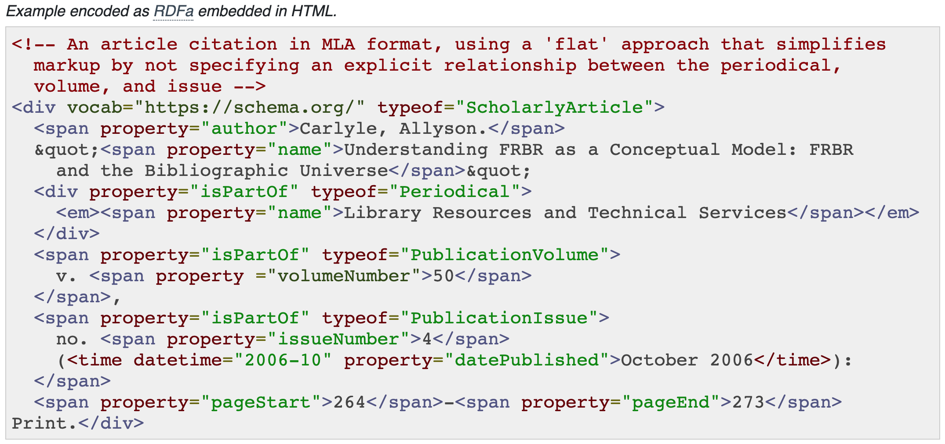
Summarizing Research – Creating a "snapshot" article
Notes:
There are barriers to intradisciplinary work that limit our potential to be productive. One of those barriers is understanding concepts enough to make those leaps between niches. The barrier is enforced by a lack of generally understandable language in abstracts, summaries, and other research outputs. We are not arguing that scholarship should be "dumbed down" or simplified at an detriment to innovation, but that secondary outputs can greatly help the broad reach and impact of knowledge. This is not a new concept. Our hope is that we can use information from a survey of MSU scholars to inform the habits and tactics of folks who are active translators and then use generative computing models to translate academic language into more accessible reading levels using similar pathways.

Slide 24
Summarizing Research – Machine Processes
Scripting and Programming Summarization
Notes:
There are barriers to intradisciplinary work that limit our potential to be productive. One of those barriers is understanding concepts enough to make those leaps between niches. The barrier is enforced by a lack of generally understandable language in abstracts, summaries, and other research outputs. We are not arguing that scholarship should be "dumbed down" or simplified at an detriment to innovation, but that secondary outputs can greatly help the broad reach and impact of knowledge. This is not a new concept. Our hope is that we can use information from a survey of MSU scholars to inform the habits and tactics of folks who are active translators and then use generative computing models to translate academic language into more accessible reading levels using similar pathways.

Slide 25
Summarizing Research – Machine Processes
Data Mining
Harvesting
+
Normalizing
---------------------------------
Corpus for analysis
- PubMed (STEM)
- Web of Science (STEM)
- IEEE Xplore (STEM)
- Academic Search Complete (Social Sciences, Humanities)
- JSTOR (Social Sciences, Humanities)

Slide 26
Summarizing Research – Machine Processes (Code)
Data Mining
Harvesting
+
Normalizing
---------------------------------
CERMINE Java Library
scripts/Cermine-Cleanup.py

Slide 27
Summarizing Research – Machine Processes
Text Processing + Analysis
Natural Language Processing
+
Evaluating Language Accessibility
---------------------------------
Snapshot article

Slide 28
Summarizing Research – Machine Processes (Code)
Text Processing + Analysis
Natural Language Processing
+
POS tagging, Vectors for ranking sentences
---------------------------------
Python Natural Language Toolkit
(NLTK)
/scripts/Sumzor.py

Slide 29
Summarizing Research – Creating a "snapshot" article
Machine processes +
Schema.org markup.
ScholarlyArticle, NewsArticle
Notes:
There are barriers to intradisciplinary work that limit our potential to be productive. One of those barriers is understanding concepts enough to make those leaps between niches. The barrier is enforced by a lack of generally understandable language in abstracts, summaries, and other research outputs. We are not arguing that scholarship should be "dumbed down" or simplified at an detriment to innovation, but that secondary outputs can greatly help the broad reach and impact of knowledge. This is not a new concept. Our hope is that we can use information from a survey of MSU scholars to inform the habits and tactics of folks who are active translators and then use generative computing models to translate academic language into more accessible reading levels using similar pathways.

Slide 30
Summarizing Research – Creating a "snapshot" article
Notes:
There are barriers to intradisciplinary work that limit our potential to be productive. One of those barriers is understanding concepts enough to make those leaps between niches. The barrier is enforced by a lack of generally understandable language in abstracts, summaries, and other research outputs. We are not arguing that scholarship should be "dumbed down" or simplified at an detriment to innovation, but that secondary outputs can greatly help the broad reach and impact of knowledge. This is not a new concept. Our hope is that we can use information from a survey of MSU scholars to inform the habits and tactics of folks who are active translators and then use generative computing models to translate academic language into more accessible reading levels using similar pathways.

Slide 31
Optimizing Scholarship for Citizen Audiences and Discovery
2 to 3 Sentence Summary
Readability Score of 60
Search Engine Optimization
Notes:
There are barriers to intradisciplinary work that limit our potential to be productive. One of those barriers is understanding concepts enough to make those leaps between niches. The barrier is enforced by a lack of generally understandable language in abstracts, summaries, and other research outputs. We are not arguing that scholarship should be "dumbed down" or simplified at an detriment to innovation, but that secondary outputs can greatly help the broad reach and impact of knowledge. This is not a new concept. Our hope is that we can use information from a survey of MSU scholars to inform the habits and tactics of folks who are active translators and then use generative computing models to translate academic language into more accessible reading levels using similar pathways.

Slide 32
Summarizing Research – Original Article
Notes:
There are barriers to intradisciplinary work that limit our potential to be productive. One of those barriers is understanding concepts enough to make those leaps between niches. The barrier is enforced by a lack of generally understandable language in abstracts, summaries, and other research outputs. We are not arguing that scholarship should be "dumbed down" or simplified at an detriment to innovation, but that secondary outputs can greatly help the broad reach and impact of knowledge. This is not a new concept. Our hope is that we can use information from a survey of MSU scholars to inform the habits and tactics of folks who are active translators and then use generative computing models to translate academic language into more accessible reading levels using similar pathways.

Slide 33
Research in Practice – Template Article
Notes:
There are barriers to intradisciplinary work that limit our potential to be productive. One of those barriers is understanding concepts enough to make those leaps between niches. The barrier is enforced by a lack of generally understandable language in abstracts, summaries, and other research outputs. We are not arguing that scholarship should be "dumbed down" or simplified at an detriment to innovation, but that secondary outputs can greatly help the broad reach and impact of knowledge. This is not a new concept. Our hope is that we can use information from a survey of MSU scholars to inform the habits and tactics of folks who are active translators and then use generative computing models to translate academic language into more accessible reading levels using similar pathways.

Slide 34
Optimizing Scholarship for Citizen Audiences and Discovery
Accessible Research
Translating Concepts
Findable Research

Slide 35
Challenges + Opportunities

Slide 36
Challenges + Opportunities
Challenges...
Data sources for articles
Evaluating the NLP model
Are the summarizations correct?
Is it finding important sentences?
Can we adjust reading levels?

Slide 37
Challenges + Opportunities
Opportunities...
New partnerships
Applying summarization and markup model to MSU Research News
Benchmarking the snapshot article
Impacts and reach
Referrals to original research

Slide 38
Research Implications

Slide 39
Research Implications + Next Steps
Implications...
Changing how the library is viewed or integrated into the research enterprise.
Understanding how or why scholars summarize their work.
Creating interdisciplinary communication through simplifying research expression.

Slide 40
Research Implication
Positioning the library as a partner throughout the research process—acknowledging that scholarship is an ongoing conversation.
Notes:
Positioning the library as a partner throughout the research process—acknowledging that scholarship is an ongoing conversation. Have to speak the same language at some point :)

Slide 41
**Thank you**
Jason A. Clark
Leila Sterman Daniel Laden

Slide 42
References and Follow-up Resources
MSU Researchers - Article Summarization Practices and Preferences
Survey questions
Survey responses
MSU Article Summarization - Working Code and Supporting Documents
https://github.com/msulibrary/msu-article-summarization
T. Xie, Y. Zhen, T. Li, C. Li and Y. Ge, "Self-supervised extractive text summarization for biomedical literatures," 2021 IEEE 9th International Conference on Healthcare Informatics (ICHI), 2021, pp. 503-504, doi: 10.1109/ICHI52183.2021.00091.
Rahul, S. Adhikari and Monika, "NLP based Machine Learning Approaches for Text Summarization," 2020 Fourth International Conference on Computing Methodologies and Communication (ICCMC), 2020, pp. 535-538, doi: 10.1109/ICCMC48092.2020.ICCMC-00099.

Slide 43
Article Summarization Development - Tools and Getting Started
Nanopublications
https://nanopub.org/wordpress/
Readability Testing
https://www.online-utility.org/english/readability_test_and_improve.jsp
Understand Text Summarization and Create Your own Summarizer in Python
https://towardsdatascience.com/understand-text-summarization-and-create-your-own-summarizer-in-python-b26a9f09fc70

