Slide 1
Green Digital Libraries: Progressive Web Apps, Sustainable Design, and Coding for the Greener Good
Jason A. Clark @jaclark
Montana State University
Code4Lib 2021

Slide 2
What’s Ahead
Research Motivation
The Energy Problem Statement
Sustainable Software Design
Sample Application
Research Implications

Slide 3
Research
Motivation

Slide 4
Research Motivation - Environmental Media Studies
“Corporate responsibility is going to be a central concern across industries in the coming decades, with carbon transparency and de-intensification being specific and easily articulated actions and missions through which companies can demonstrate this accountability.”
Hunter Vaughan, Environmental Media Scholar-in-Residence in CMCI’s Department of Media Studies, University of Colorado

Slide 5
Research Motivation - Environmental Media Studies
“A Materiality of the Virtual”
Hunter Vaughan, Environmental Media Scholar-in-Residence in CMCI’s Department of Media Studies, University of Colorado

Slide 6
Research Motivation - Web Performance
“To the user, speed matters... In this paper, I discuss the web performance of 129 library websites, and detail a step-by-step performance enhancement plan.”
Scott W. H. Young (2016)
https://doi.org/10.3998/weave.12535642.0001.401

Slide 7
What’s the Problem?

Slide 8
Problem Statement
“If the Internet was a country, it would be the 7th largest polluter.”
Source: Total ICT emissions from How to stop data centres from gobbling up the world’s electricity compared with Carbon emission by country.

Slide 9
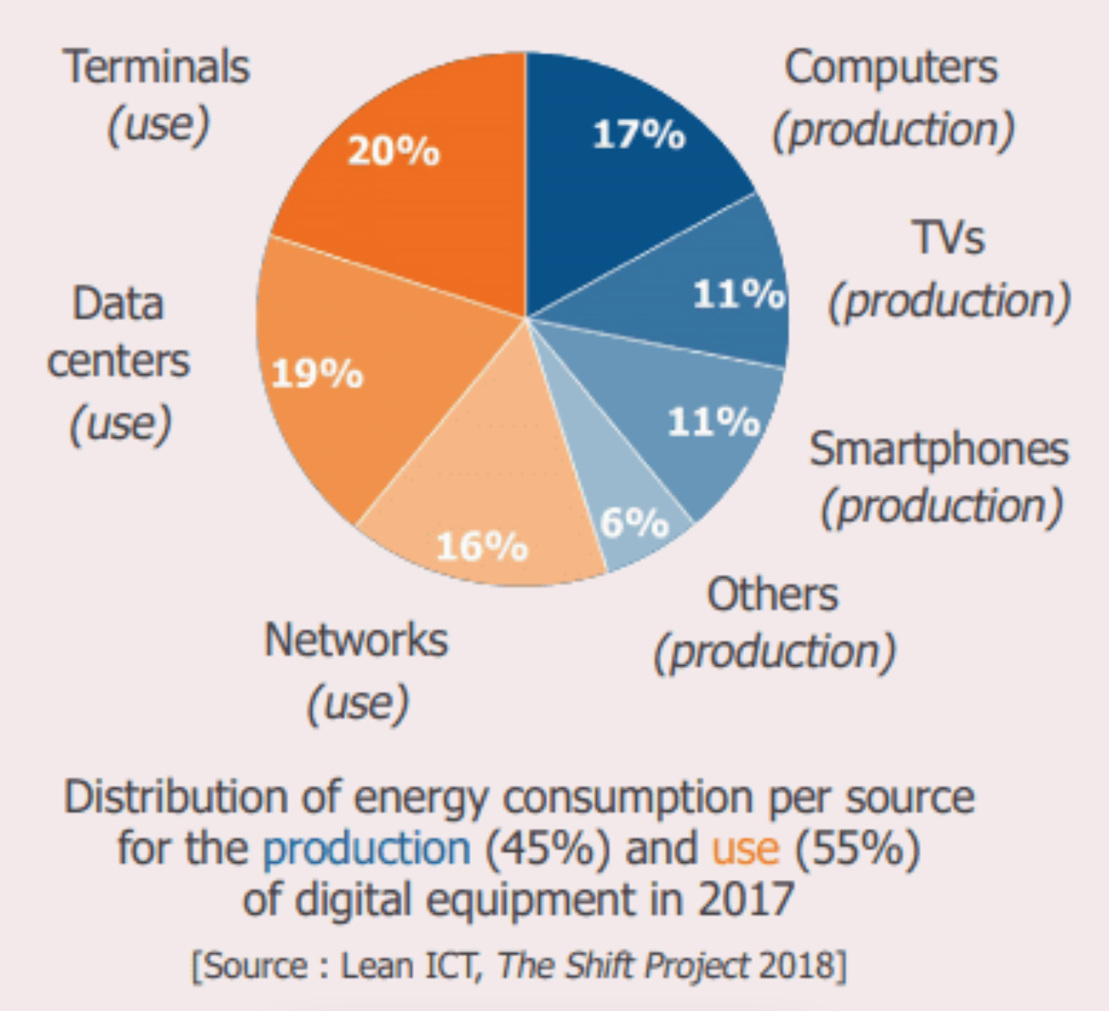
Problem Statement - Energy Consumption
[Source: The Shift Project]
Notes:
In this chart, the Shift Project shows that the energy consumption can be divided in two factors:
45% of the total emissions is dedicated to the production of digital equipment. To reduce the carbon footprint, it is important to keep a computer or a smartphone as long as possible. However, the average lifespan of a computer is estimated around 2 years. As developers, we can have an influence on the lifespan of our users' devices by making sure our applications are not too slow on old devices. Indeed, when you need 30 seconds to open most websites, your first thought usually is: "I really need to change my phone"!
55% of the emissions come from the usage of the equipment. We can have an impact on this energy consumption by designing sober and low-consuming applications.

Slide 10
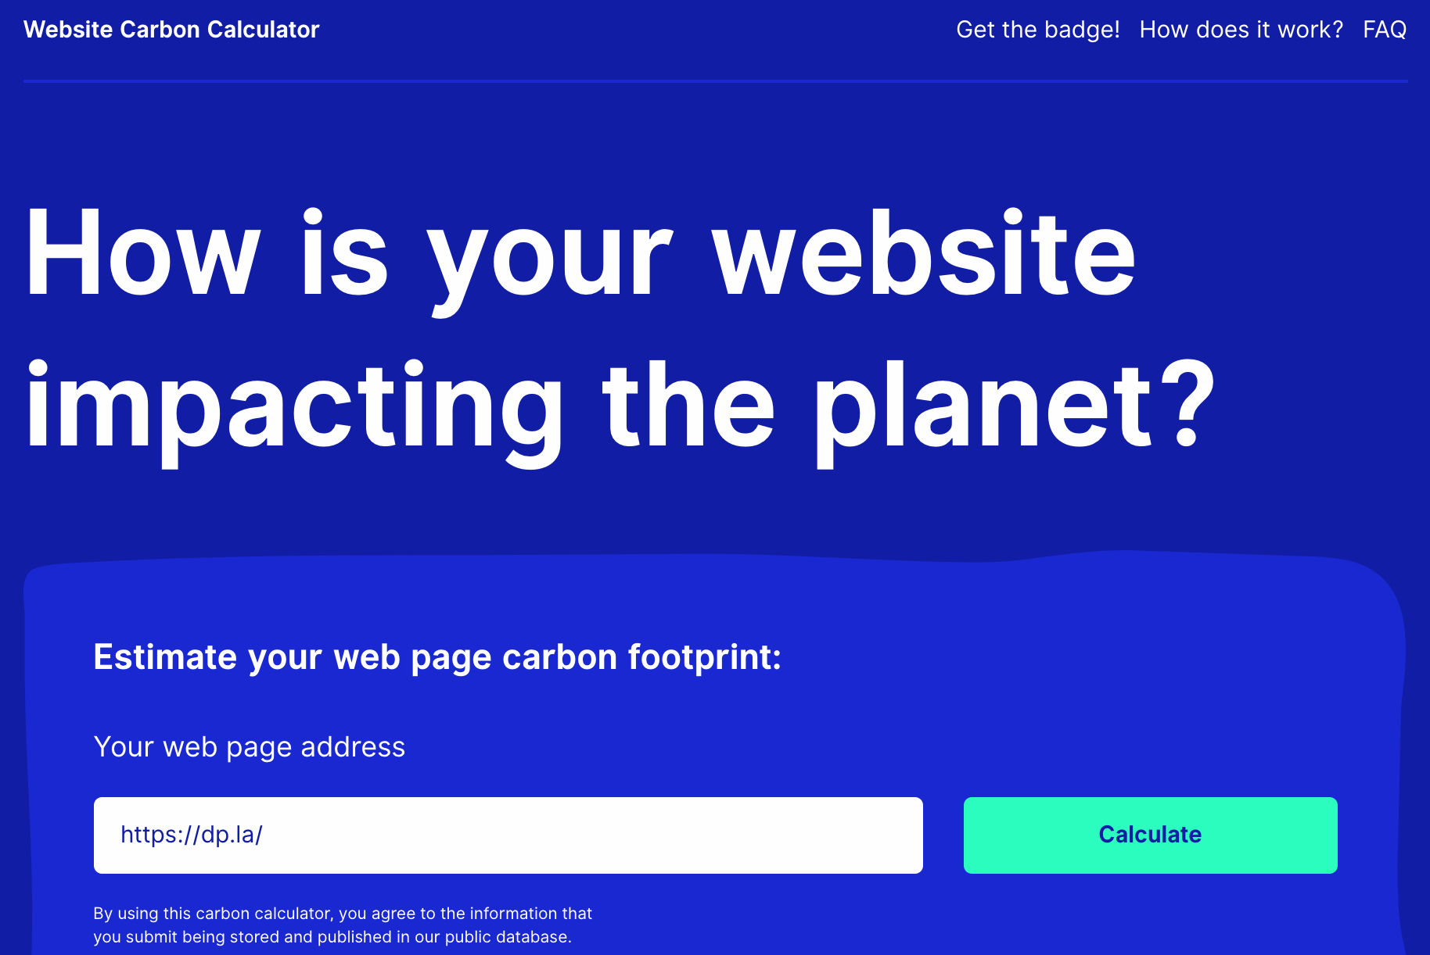
Energy Consumption in Digital Libraries
www.websitecarbon.com
Notes:
Ignored By Big Telecom, Detroit's Marginalized Communities Are Building Their Own Internet - 40 percent of Detroit residents don't have any access to internet at all. https://motherboard.vice.com/en_us/article/kz3xyz/detroit-mesh-network

Slide 11
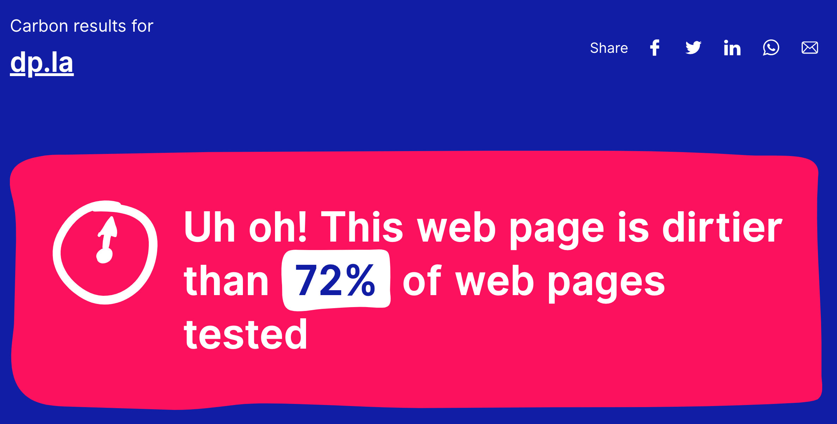
Energy Consumption in Digital Libraries

Slide 12
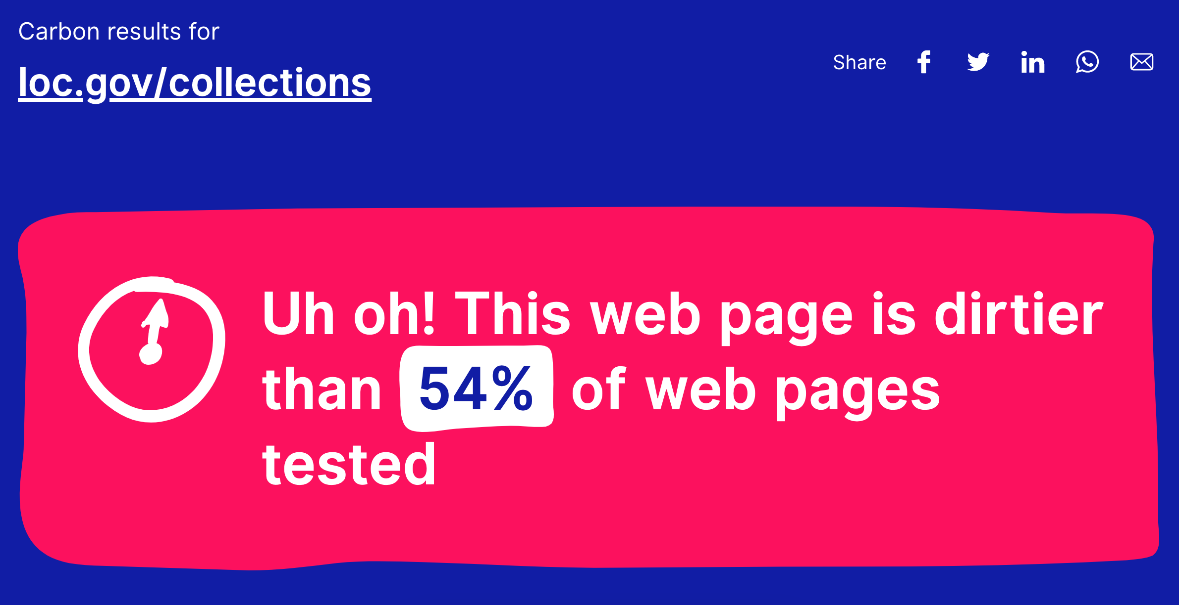
Energy Consumption in Digital Libraries

Slide 13
Opportunity for Impact
“Shaving off a single kilobyte in a file that is being loaded on 2 million websites reduces CO₂ emissions by an estimated 2950 kg per month.”
Source: Danny Van Kooten and Pihkola, H., Hongisto, M., Apilo, O., & Lasanen, M. (2018). Evaluating the energy consumption of mobile data transfer-from technology development to consumer behaviour and life cycle thinking. https://doi.org/10.3390/su10072494

Slide 14
Opportunity for Impact
“That is the same amount of CO₂ saved each month as 5 flights from Amsterdam to New York (679 kg CO₂ per flight).”
Source: Danny Van Kooten and Pihkola, H., Hongisto, M., Apilo, O., & Lasanen, M. (2018). Evaluating the energy consumption of mobile data transfer-from technology development to consumer behaviour and life cycle thinking. https://doi.org/10.3390/su10072494

Slide 15
Environment as User
Notes:
Speed Matters = Green Matters

Slide 16
Sustainable Development Techniques?
Systems
Resources
Code

Slide 17
Systems:
routines + architecture

Slide 18
Compression
A sysadmin practice of setting up your infrastructure
Compression algorithms
+
Evaluating network bandwidth
---------------------------------
Minimizing filesize and network use

Slide 19
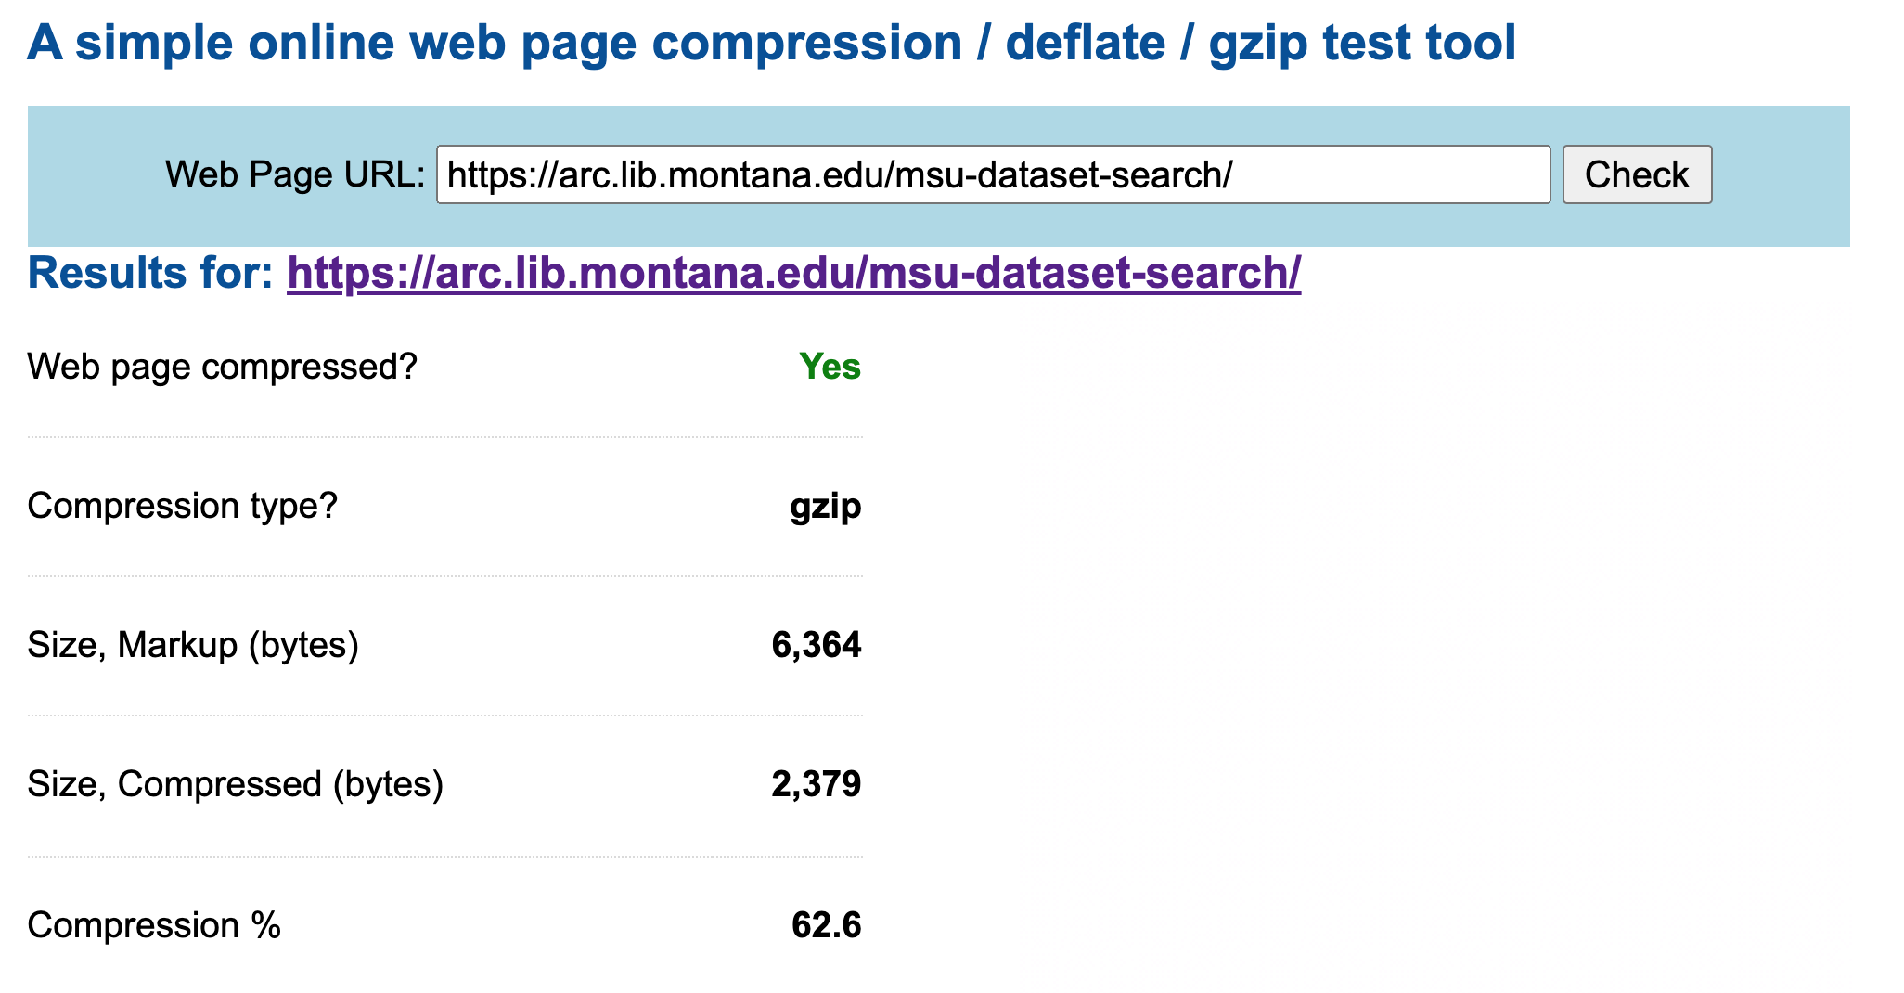
Compression (Server-side)

Slide 20
Caching
A sysadmin practice of setting up your infrastructure
Content Delivery Networks
+
Evaluating User Need for a File
---------------------------------
Minimizing network and power use

Slide 21
Hosting
A sysadmin practice of setting up your infrastructure
Placement of Data Centers
+
Investment in Green Energy Sources
---------------------------------
Minimizing network and power use
See Green Web Foundation

Slide 22
Sunsetting
A sysadmin practice of setting up your infrastructure
Using Analytics
+
Applying Local Time
-----------------------
Powering down software during times of limited use

Slide 23
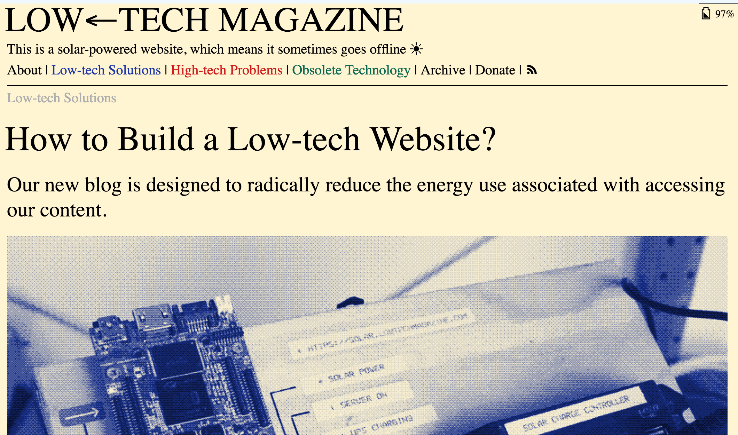
Sunsetting for Local Time and Use
[Source: LOW←TECH MAGAZINE]
Notes:
Thanks to a low-tech web design, we managed to decrease the average page size of the blog by a factor of five compared to the old design – all while making the website visually more attractive. Secondly, our new website runs 100% on solar power, not just in words, but in reality: it has its own energy storage and will go off-line during longer periods of cloudy weather.

Slide 24
Resources:
media + materials optimization

Slide 25
Optimization
A software deployment practice
Packaging Fonts
Compressing Videos
Optimizing Images

Slide 26
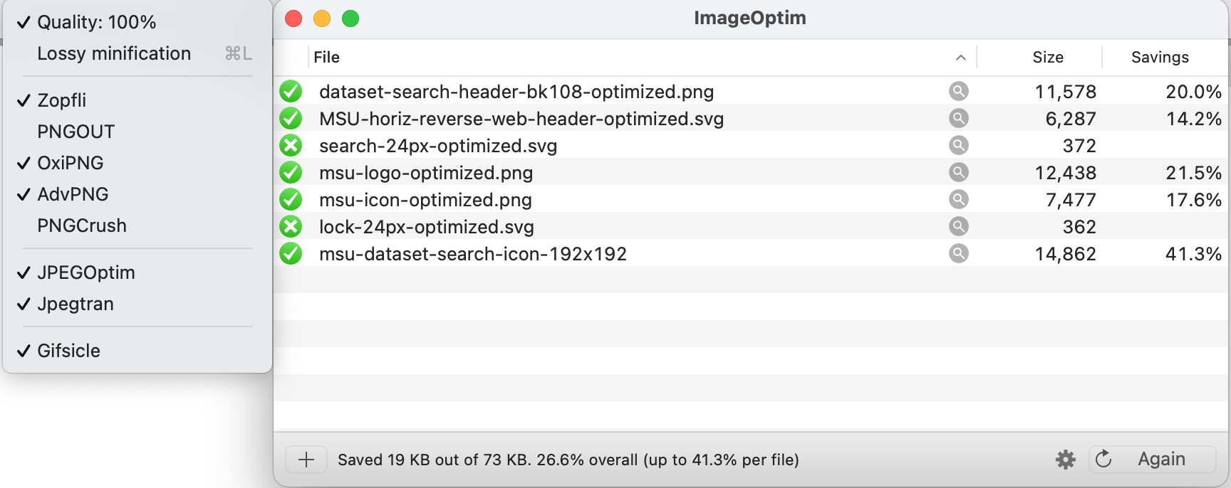
Optimization for Media (Images and Videos)

Slide 27
Minification
A software deployment practice
Removing all unnecessary characters from source code without changing functionality.
Packaging software releases
Compressing HTML, CSS, Scripts
<!DOCTYPE html><html lang="en" vocab="http://schema.org/" typeof="WebPage"><head><meta charset="UTF-8"/><meta name="viewport" content="width=device-width, initial-scale=1.0"/><meta http-equiv="X-UA-Compatible" content="ie=edge"/><title>MSU Dataset Search - Montana State University (MSU) Library</title>...

Slide 28
Technical Search Engine Optimization (SEO)
A software deployment practice
Technical SEO
Crawling, Indexing, robots.txt
Structured data
<meta name="description" content ="..." />

Slide 29
Code:
smarter routines + defensive programming

Slide 30
Smarter programming routines - Memory
if (navigator.deviceMemory > 1) {
await import('./costly-module.js');
}

Slide 31
Smarter programming routines - CPUs and Processing
if (navigator.hardwareConcurrency > 4) {
await import('./costly-module.js');
}

Slide 32
Smarter programming routines - Battery and Local Device Power
const {level, charging} = await navigator.getBattery();
// If the device is currently charging
// Or the battery level is more than 20%
if (charging || level > 0.2) {
await import('./costly-module.js');
}

Slide 33
Smarter programming routines - Dark Mode with CSS
@media (prefers-color-scheme: dark) {
.day.dark-scheme
{background:#333;color:white;}
.night.dark-scheme
{background:black;color:#ddd;}
}
Notes:
OLED screen panels can display black pixels with almost no energy cost. So it follows that using apps with more black would save your battery. “...Showing dramatic power saving when using Dark Mode in Google’s official apps on an OLED screen. At 50% brightness, the new Dark Mode interface in the YouTube app saves a little under 15% screen energy when using blacks and muted grays over a flat white background. At 100% screen brightness, the dark interface is saving a whopping 60% of screen energy.”
https://www.howtogeek.com/fyi/google-wants-more-battery-saving-dark-mode-options-in-its-apps/
https://www.howtogeek.com/397982/how-dark-mode-can-extend-battery-life-on-oled-phones/

Slide 34
Lazy Loading
A software development practice
Intersection Observer API
Lazy Loading HTML attribute
<img src="image.jpg" alt="..." loading="lazy">

Slide 35
What is a PWA?
A software development practice
over HTTPS
manifest.json (installable)
Javascript to cache files for offline
Static data stores (json)

Slide 36
Progressive Web Apps (PWA)
Manifest File
Service Worker
Offline + Installable

Slide 37
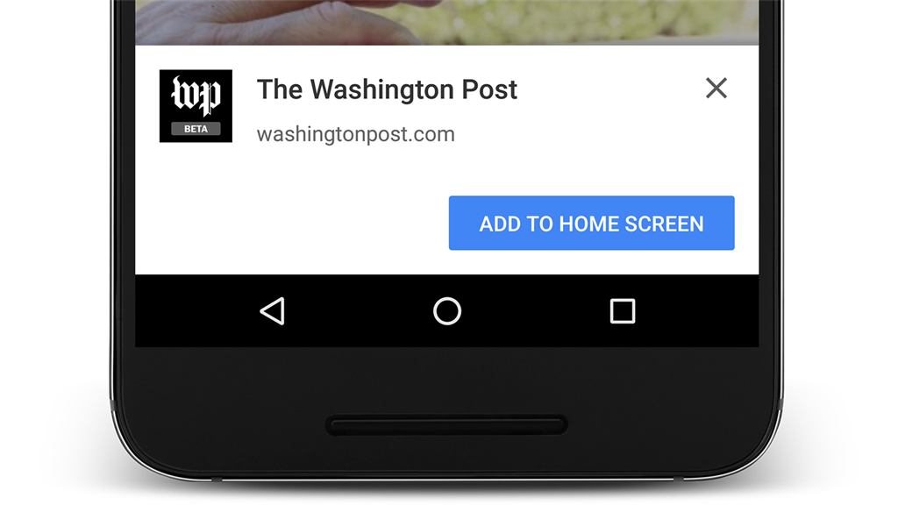
Install the Web?

Slide 38
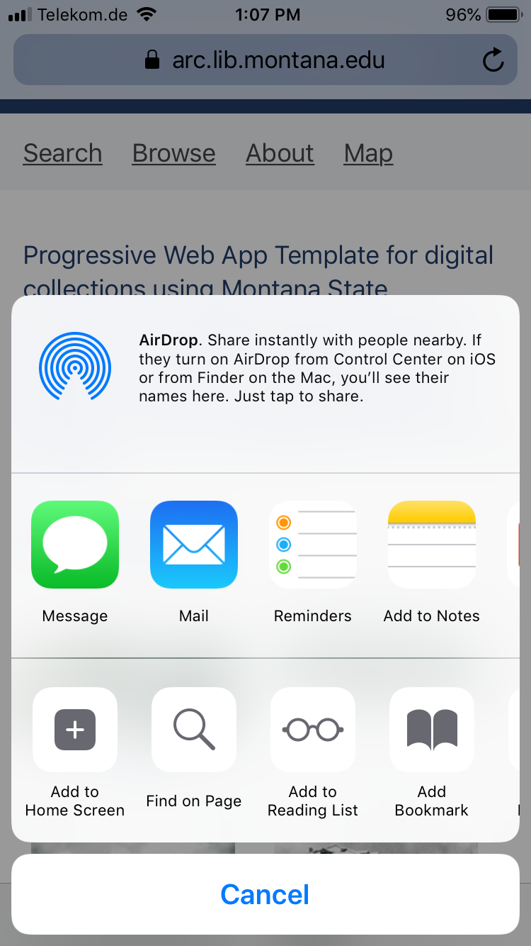
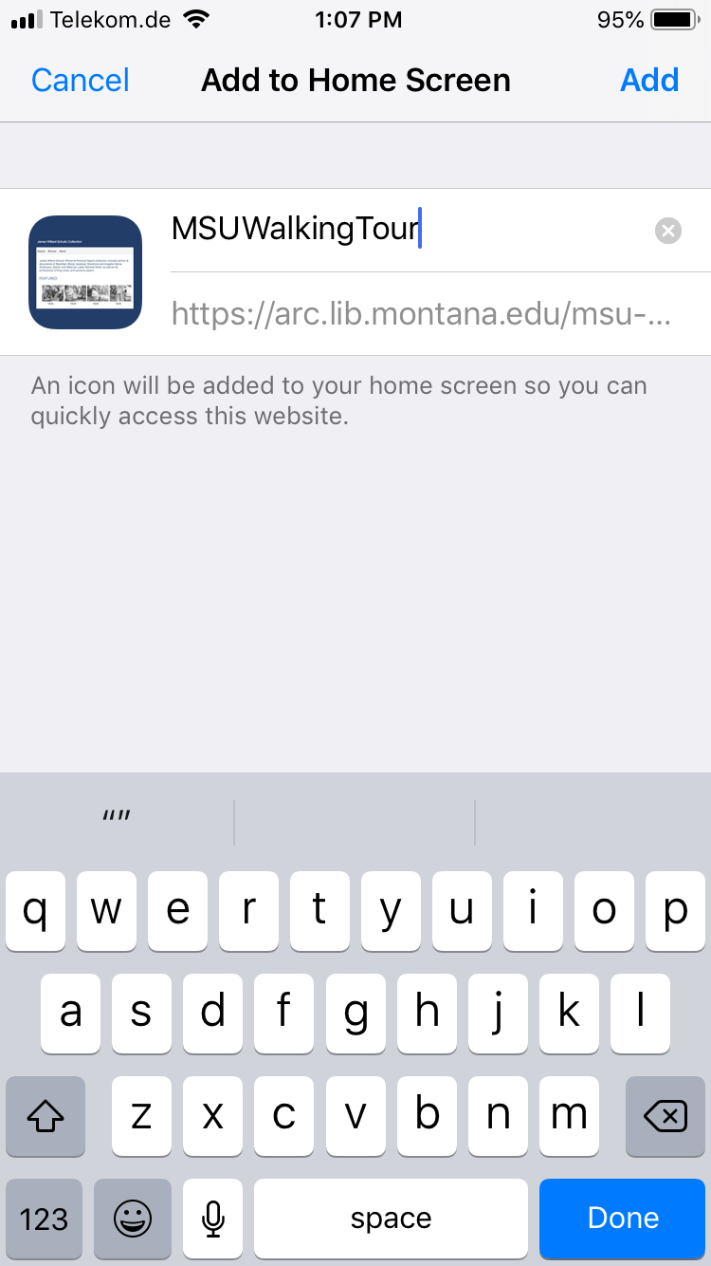
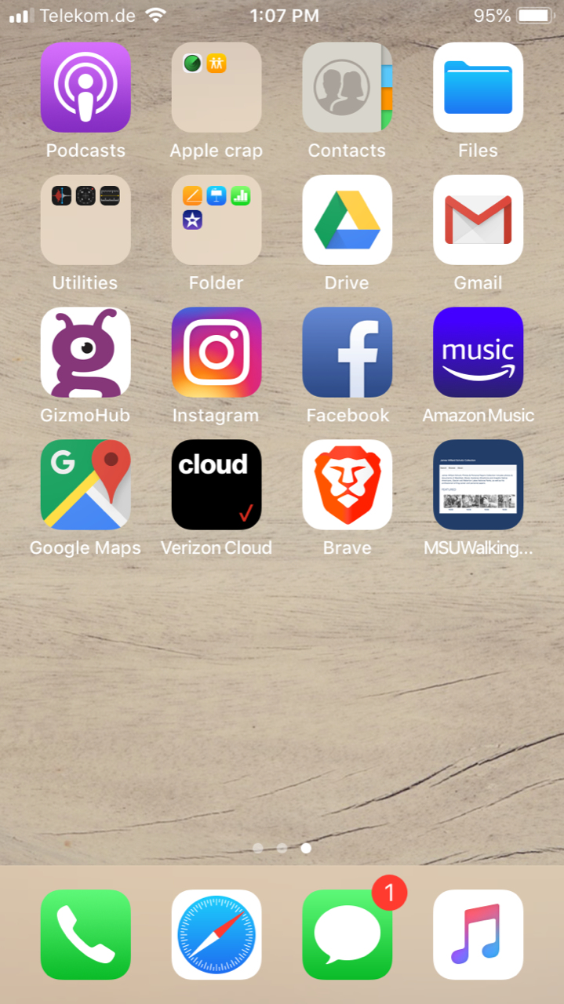
Installability

Slide 39
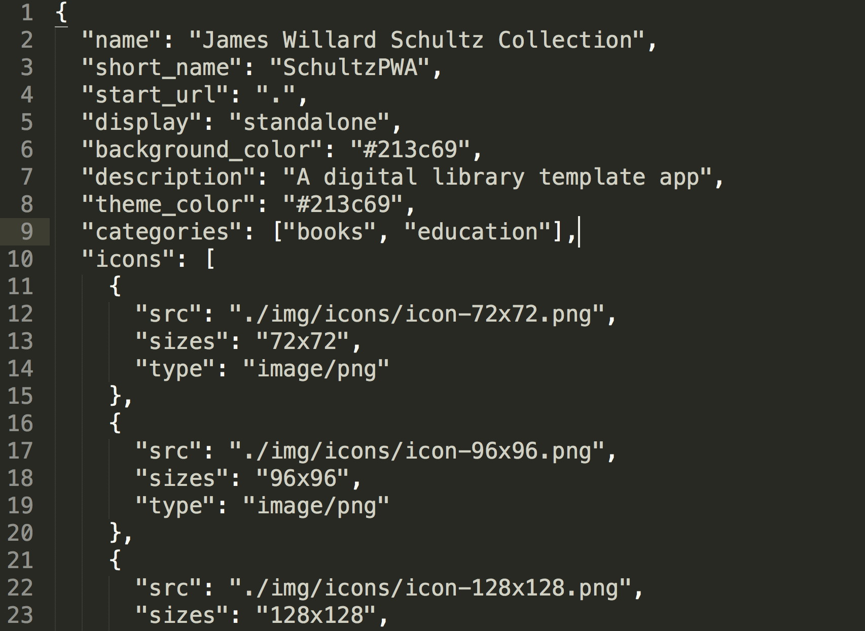
Manifest (.json)

Slide 40
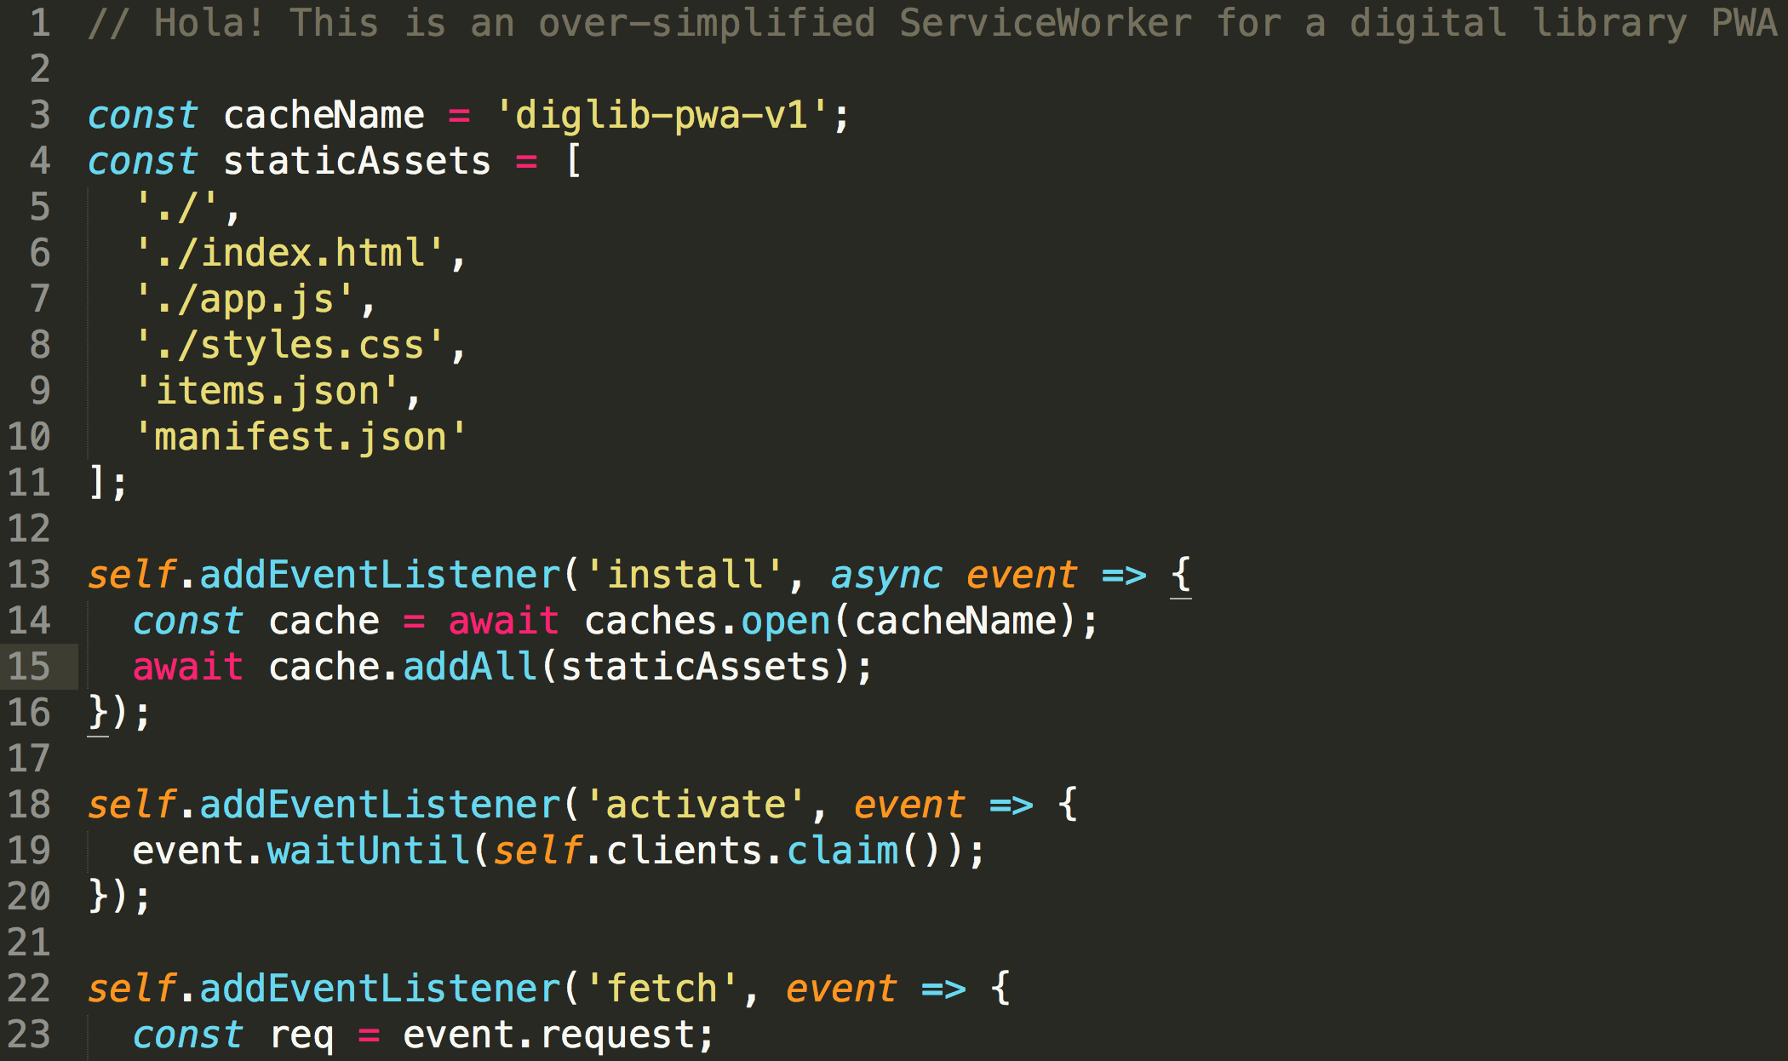
Service Worker (.js)

Slide 41
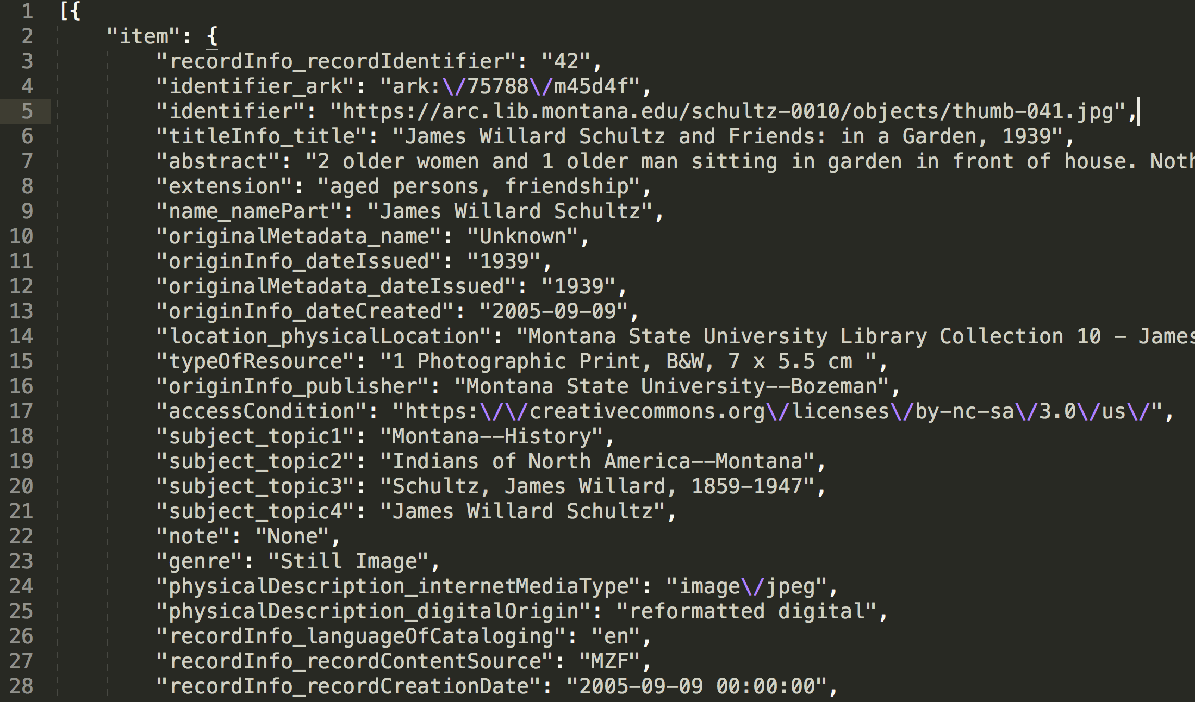
items (.json)

Slide 42
Why PWA?
Benefits
Discoverable
Linkable
Installable
Write Once, Publish Everywhere

Slide 43
Sample
Application

Slide 44
Sample Application
MSU Dataset Search

Slide 45
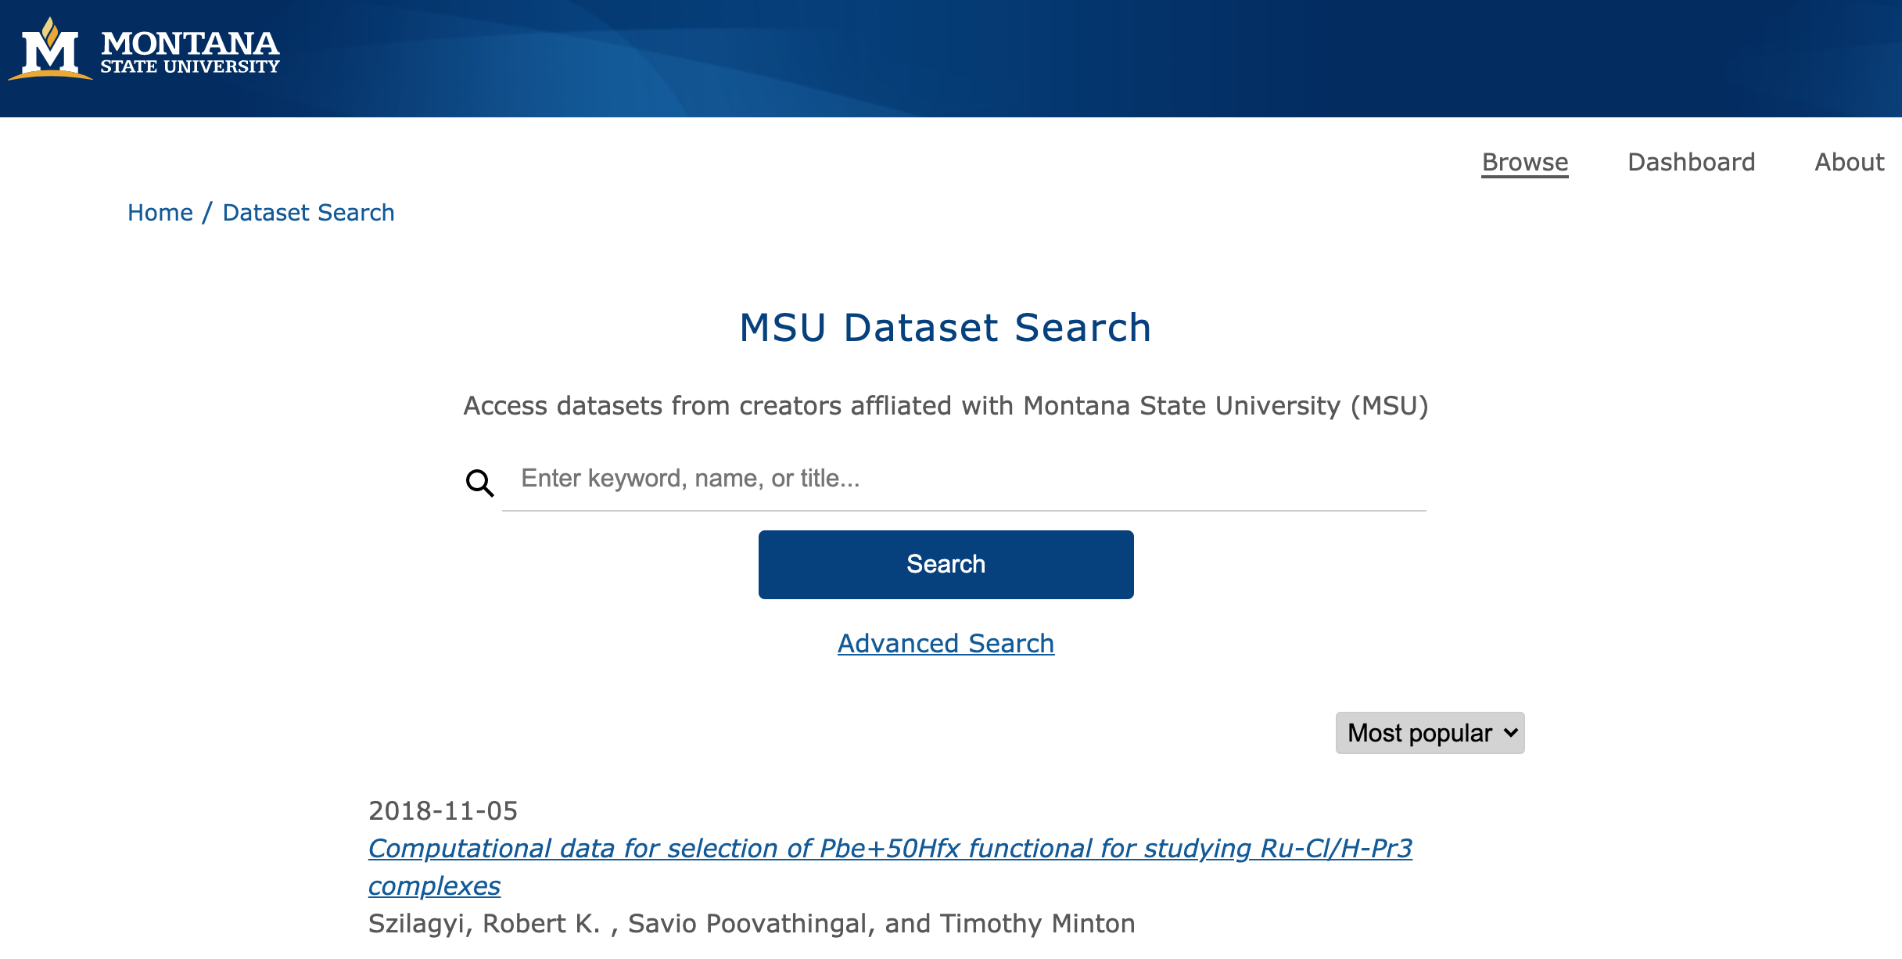
Research Implication - energy-efficient, sustainable design

Slide 46
Sample Application
optimized source code + media
lean HTML/CSS, structured data
systems with compression + caching
serviceworker.js
items.json (static “database”)
Green Software Architectures

Slide 47
Research
Implications

Slide 48
Research Implication - energy-efficient, sustainable design

Slide 49
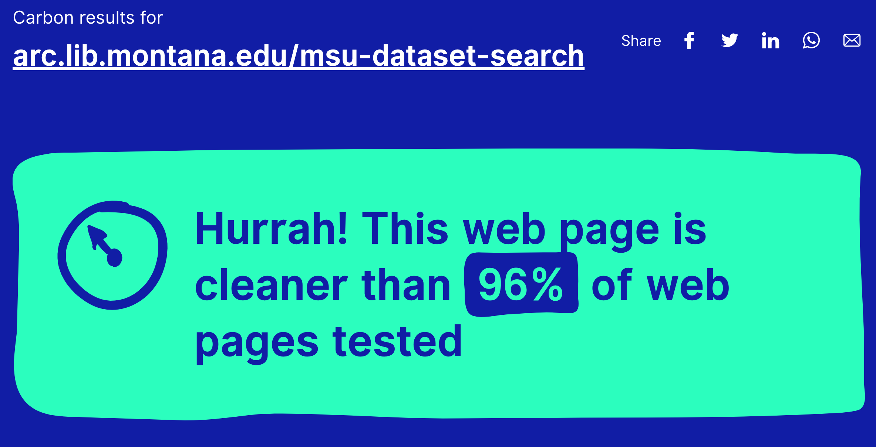
Research Implication - energy-efficient, sustainable design

Slide 50
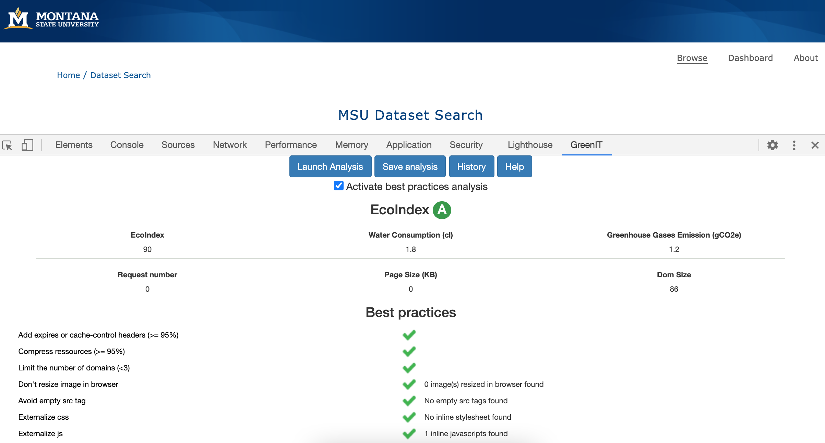
Research Implication - energy-efficient, sustainable design

Slide 51
Implications and Recommended Practices
Empathetic DevOps
Coding + Social Good

Slide 52
Research Implication
Digital libraries for Everyone.
- lightweight computing practices
- “Green” digital libraries that consume less energy
- discoverable + accessible to any user on limited device

Slide 53
**Thank you**
Jason A. Clark
@jaclark

Slide 54
Green Software Development - Tools and Getting Started
Eco Design Checklist
collectif.greenit.fr/ecoconception-web
PWA Universal Builder
github.com/lukeed/pwa
Ecometer Design + Development Rules
www.ecometer.org/rules
Website Carbon Calculator
www.websitecarbon.com
EcoIndex Tool
www.ecoindex.fr, GreenIT-Analysis extension

Slide 55
Green Software Development - Code Samples
Digital Library PWA Template
github.com/jasonclark/digital-library-pwa
Montana State University Dataset Search
github.com/msulibrary/dataset-search

Slide 56
References and Follow-up Resources
Progressive Web Apps - Mozilla Developer Network
https://developer.mozilla.org/en-US/docs/Web/Apps/Progressive
Sustainable Web Design
Tom Greenwood
(Book published in February 2021)
https://abookapart.com/products/sustainable-web-design
Measure the server-side impact of your application with PowerAPI
Cyrielle Willerval
2020-05-14
https://blog.theodo.com/2020/05/greenit-measure-server-energy-consumption-powerapi/
Speed Matters: Performance Enhancements for Library Websites
Scott W. H. Young
Weave: Journal of Library User Experience
Volume 1, Issue 4, 2016
https://doi.org/10.3998/weave.12535642.0001.401
Materiality of the Virtual - Digital Technology and the Climate Crisis?
Hunter Vaughan
Public lecture, Media Studies in the College of Media, Communication, & Information, University of Colorado Boulder
2020-02-26
Webcast | Presentation Slides

Slide 57
Research Inspiration - Minimal Computing
Notes:
The size of the average web page (defined as the average page size of the 500,000 most popular domains) increased from 0.45 megabytes (MB) in 2010 to 1.7 megabytes in June 2018.

Slide 58
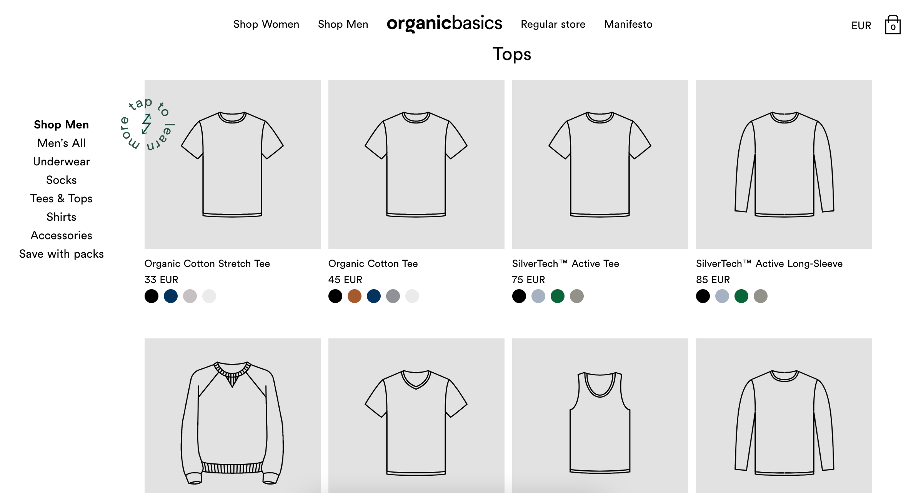
Proof of Concept Websites - OrganicBasics

Slide 59
Proof of Concept Websites - OrganicBasics

