Slide 1
Is there a Ghost in the [Search] Machine?
Improving Search UX using Query Analysis and Machine Cues
Jason A. Clark
Associate Professor
Head, Library Informatics & Computing
Montana State University (MSU) Library
Digital Library Federation Forum
Vancouver, Canada
October 26, 2015

Slide 2
pinboard.in tag
pinboard.in/u:jasonclark/t:search-ux/

Slide 3
twitter as channel (#hashtag)
@jaclark #DLFforum

Slide 4
Overview
What are the “ghosts” of the search act?
Applying context and intention to Search UX
Anticipatory Design in a search prototype
Questions

Slide 5
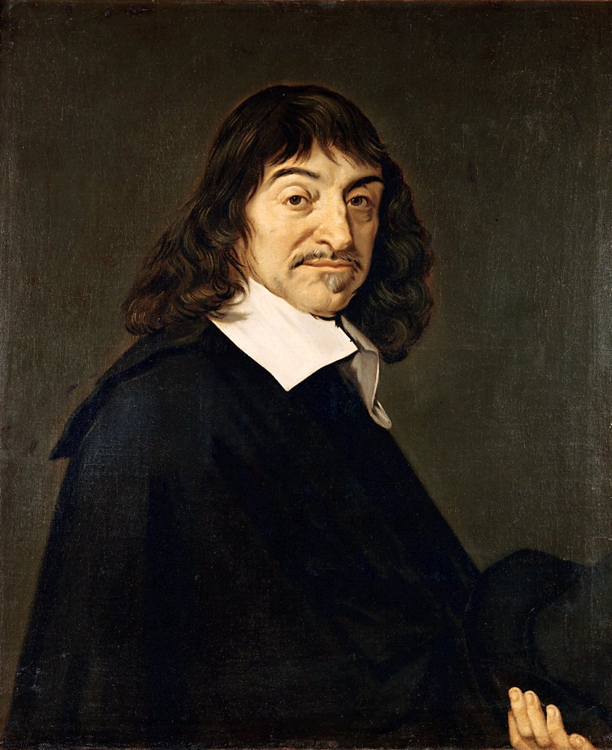

Slide 6
MIND | BODY

Slide 8
“Such in outline is the official theory. I shall often speak of it, with deliberate abusiveness, as "the dogma of the Ghost in the Machine." I hope to prove that it is entirely false, and false not in detail but in principle. It is not merely an assemblage of particular mistakes. It is one big mistake and a mistake of a special kind. It is, namely, a category mistake.”
Ryle, Gilbert, "Descartes' Myth," in The Concept of Mind, Hutchinson, London, 1949

Slide 9
Search Act | Context + Intention

Slide 10
Search Act => Context + Intention

Slide 11
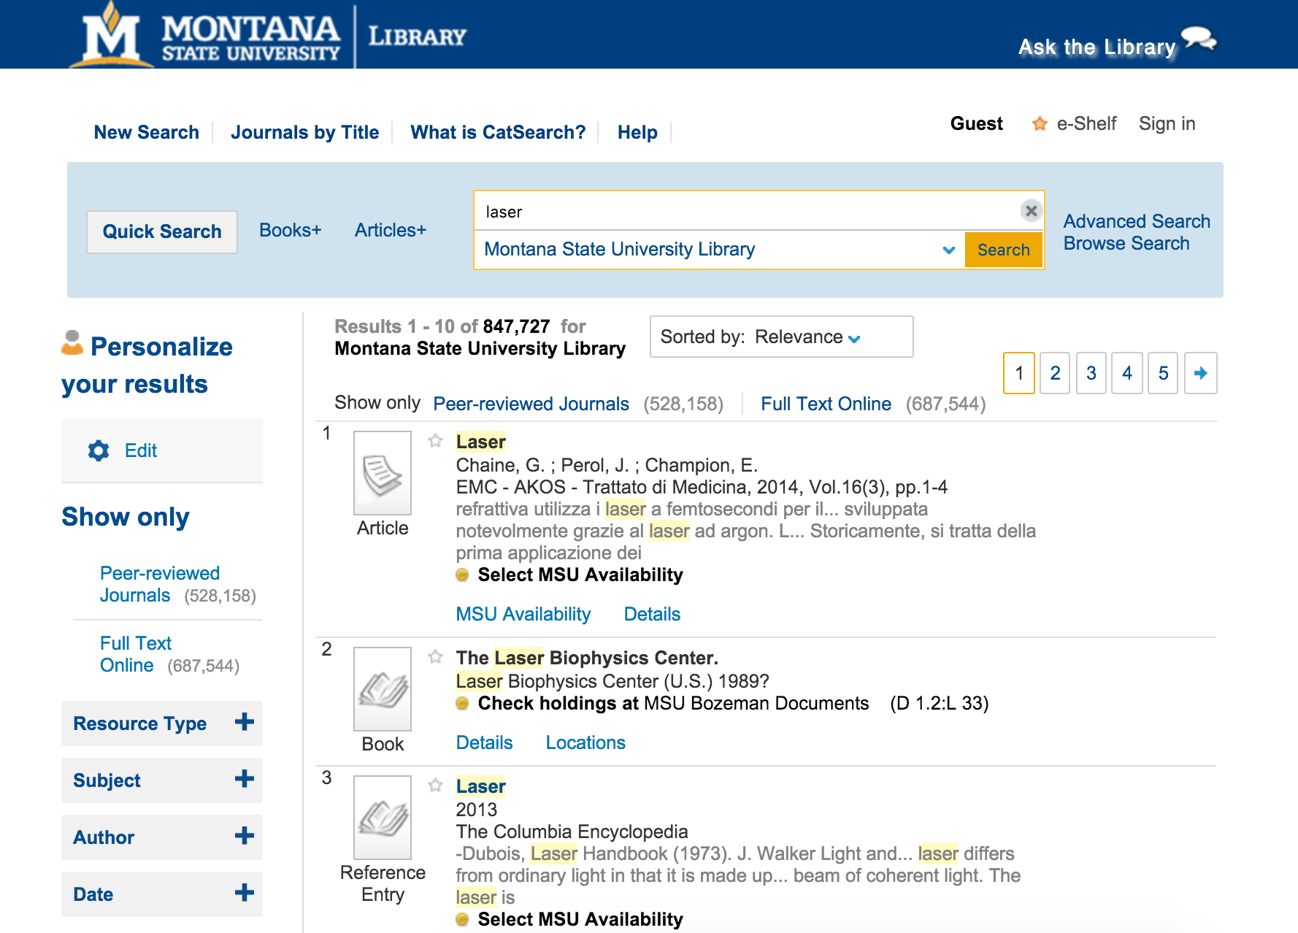

Slide 12
Notes:
http://libereurope.eu/blog/2012/09/04/thinking-the-unthinkable-a-library-without-a-catalogue-reconsidering-the-future-of-discovery-tools-for-utrecht-university-library/

Slide 13
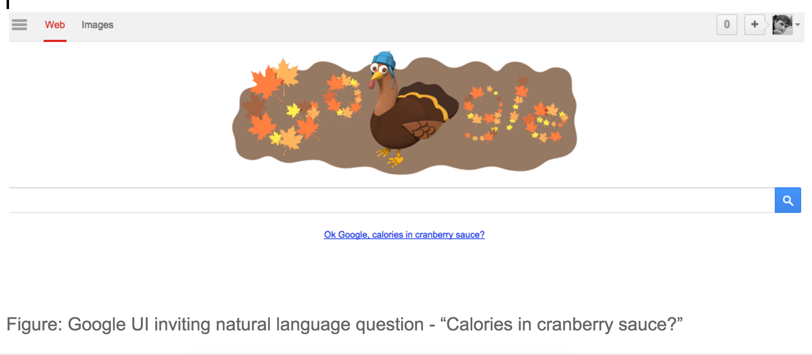

Slide 14
What are the Ghosts in the Search Act?

Slide 15
search query =
literal aspect + inferred aspect

Slide 16
“yellowstone national park”
[search query]
“yellowstone national park”
[literal aspect]
iPhone user, on MT highway [tacit, inferred aspect]

Slide 17
This is anticipatory design.
www.smashingmagazine.com/2015/09/anticipatory-design/

Slide 18
Cues from the “live” Query

Slide 19
$cueWords = array( "about", "above", "across", "after", "afterwards", "again", "against", "all", "almost", "alone", "became", "because", "become", "becomes", "becoming", "been", "before", "beforehand", "behind", "being", "below", "beside", "besides", "between", "beyond", "by", "call", "can", "cannot", "cant", "could", "couldnt", "cry", "describe", "do", "either", "except", "few", "fill", "find", "found", "from", "front", "full", "further", "get", "give", "go", "had", "has", "hasnt", "have", "how", "however", "hundred", "if", "in", "indeed", "interest", "into", "is", "keep", "might", "mine", "more", "moreover", "most", "mostly", "move", "much", "must", "my", "myself", "name", "never", "nevertheless", "nor", "not", "nothing", "now", "nowhere", "of", "off", "often", "on", "once", "one", "only", "onto", "or", "other", "others", "otherwise", "our", "ours", "ourselves", "out", "over", "own", "part", "per", "perhaps", "please", "put", "rather", "see", "seem", "seemed", "seeming", "seems", "should", "show", "side", "since", "so", "some", "somehow", "someone", "something", "sometime", "sometimes", "somewhere", "still", "such", "system", "take", “temp”, “temperature”, "than", "that", "the", "their", "them", "themselves", "then", "thence", "there", "thereafter", "thereby", "therefore", "therein", "thereupon", "these", "they", "this", "those", "though", "three", "through", "throughout", "thru", "thus", "to", "together", "too", "top", "toward", "towards", "under", "until", "up", "upon", "us", "very", "time", "were", “weather”, "what", "whatever", "when", "whence", "whenever", "where", "whereafter", "whereas", "whereby", "wherein", "whereupon", "wherever", "whether", "which", "while", "whither", "who", "whoever", "whole", "whom", "whose", "why", "will", "with", "within", "without", "would", "yet", "you", "your", "yours", "yourself", "yourselves");

Slide 20
cueWords = ["about", "above", ... , "can", ...]
query = 'Can I get research help?';
if (in_array(strtolower($query), $cueWords)) {
echo "Here are some people to talk to: ";
}
OR
# python example
cueWords = ["about", "above", ... , "can", ...]
query = 'Can I get research help?'
query.lower()
if query in cueWords:
print Here are some people to talk to:

Slide 21
Cues from the Machine

Slide 22
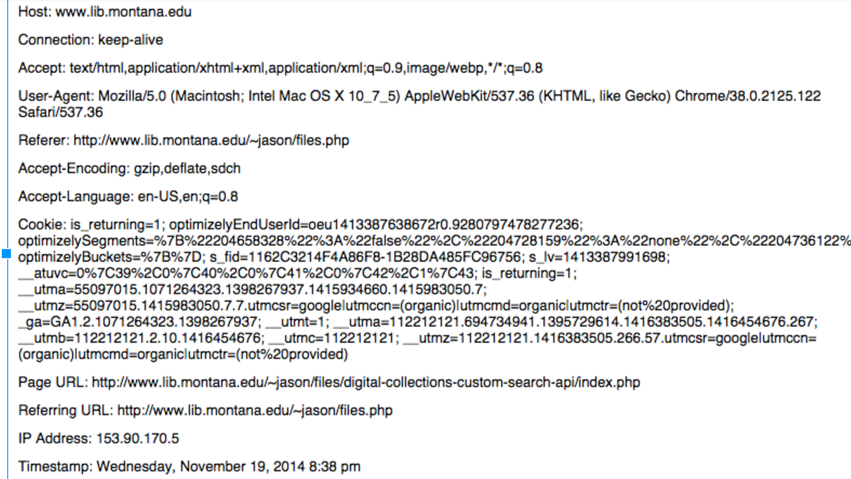
a

Slide 23
HTTP Headers
+
Global Server Variables
en.wikipedia.org/wiki/List_of_HTTP_header_fields

Slide 24
Location from the Browser or Network Info

Slide 25
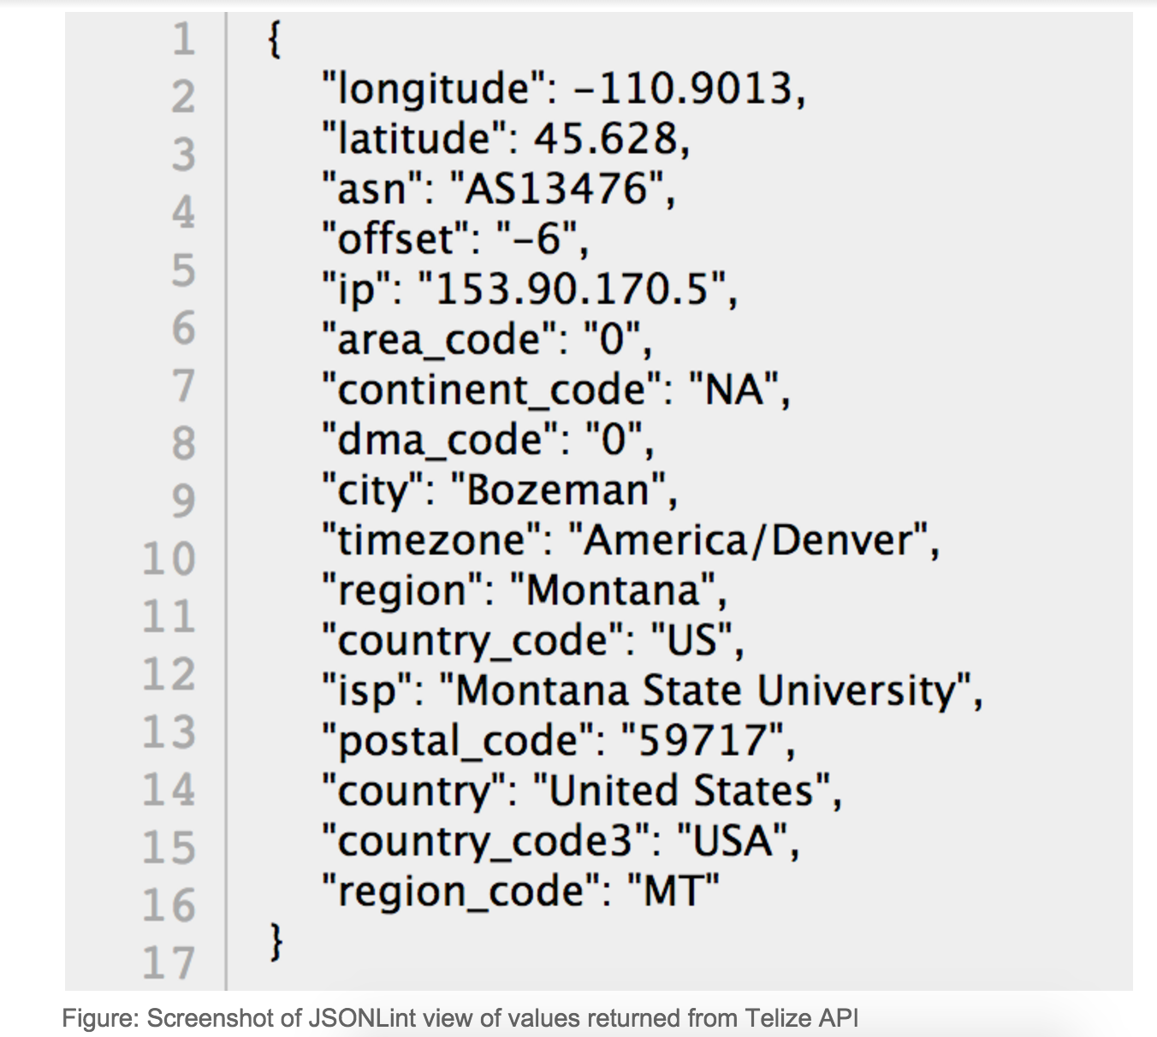

Slide 26
Cues from Analytics Logs

Slide 27
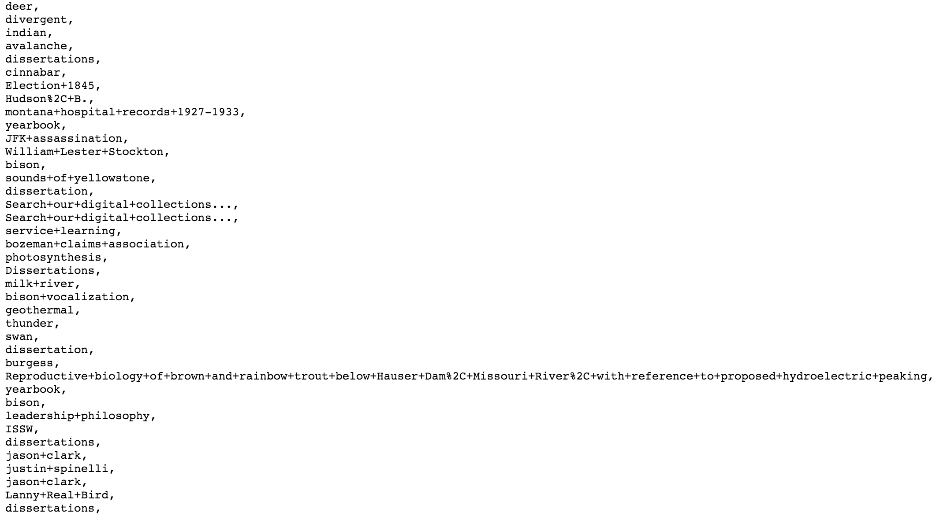
arc.lib.montana.edu/digital-collections/search-log.txt

Slide 28
Applying Contextual and Intentional Cues

Slide 29
Use these cues to show different parts of search index and additional context

Slide 30
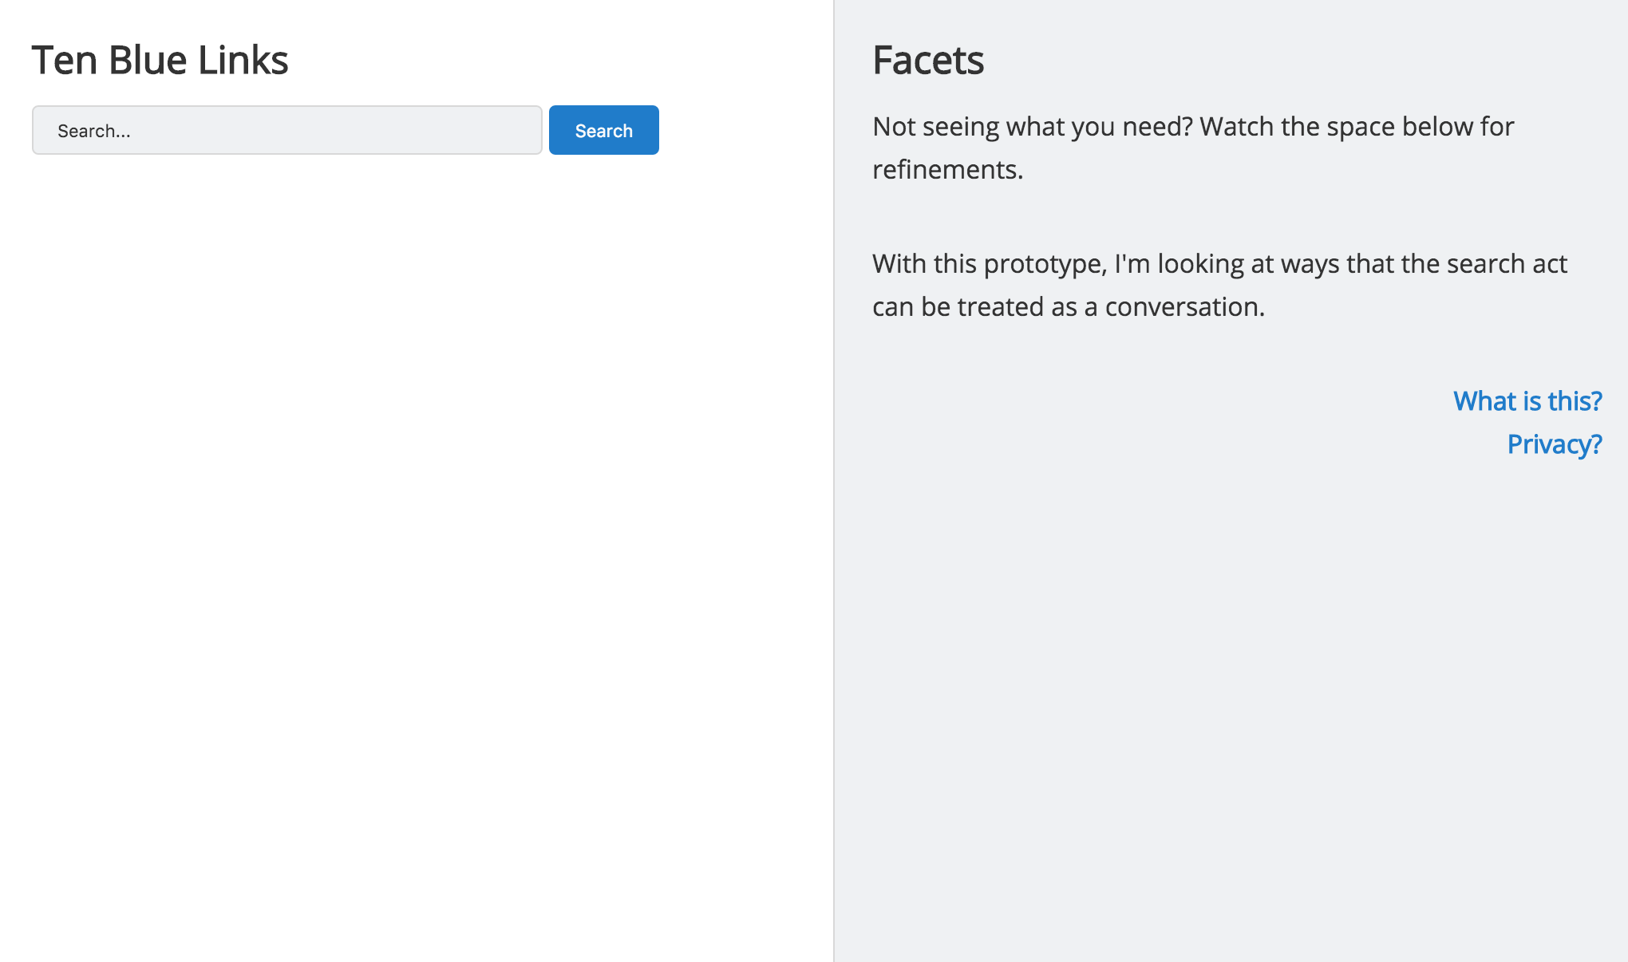
www.lib.montana.edu/~jason/files/search-ux/
github.com/jasonclark/search-ux

Slide 31
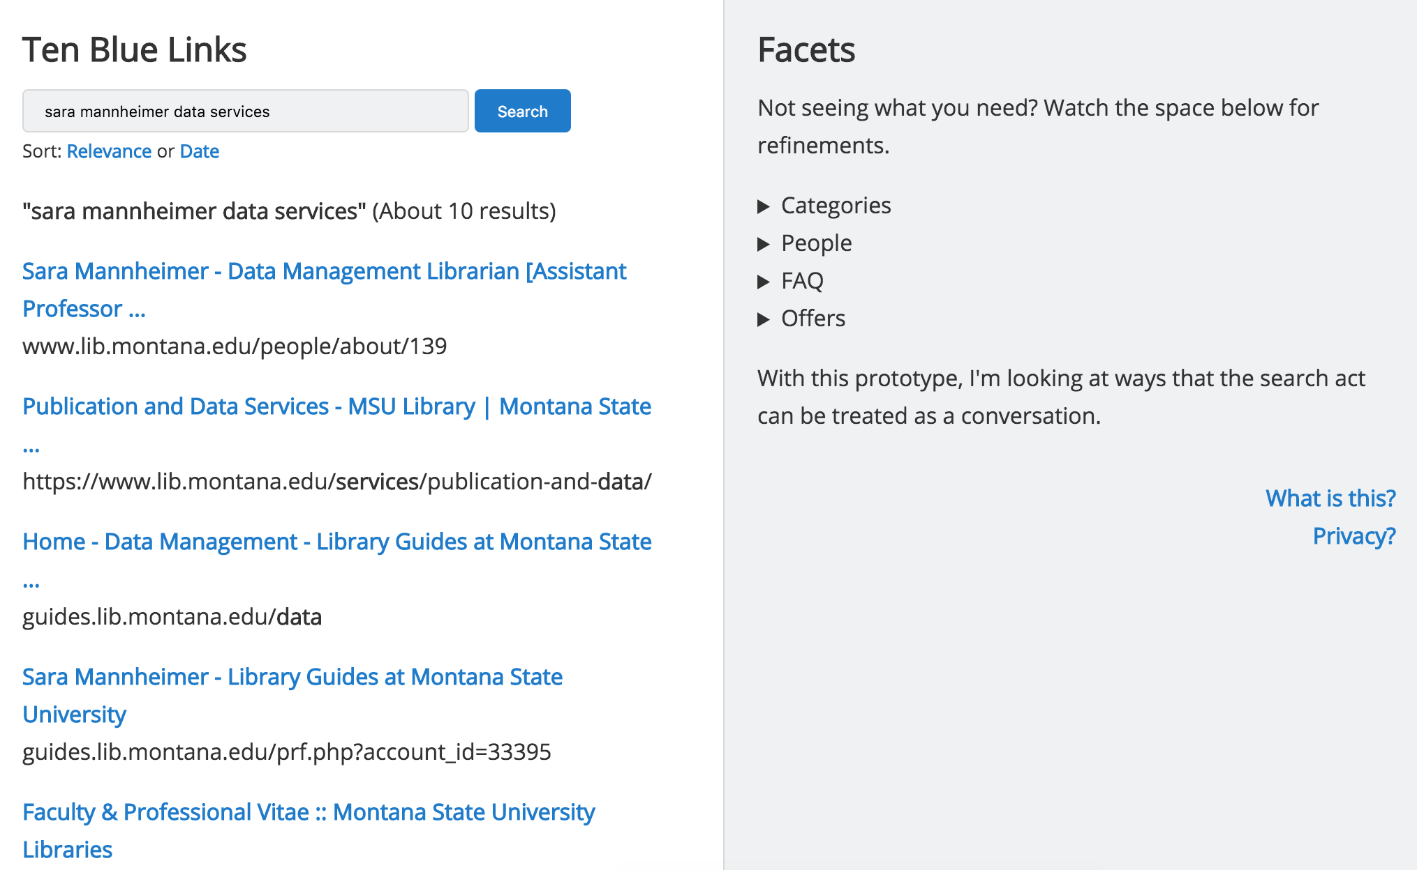
Small Result Set ( < 30 results)

Slide 32
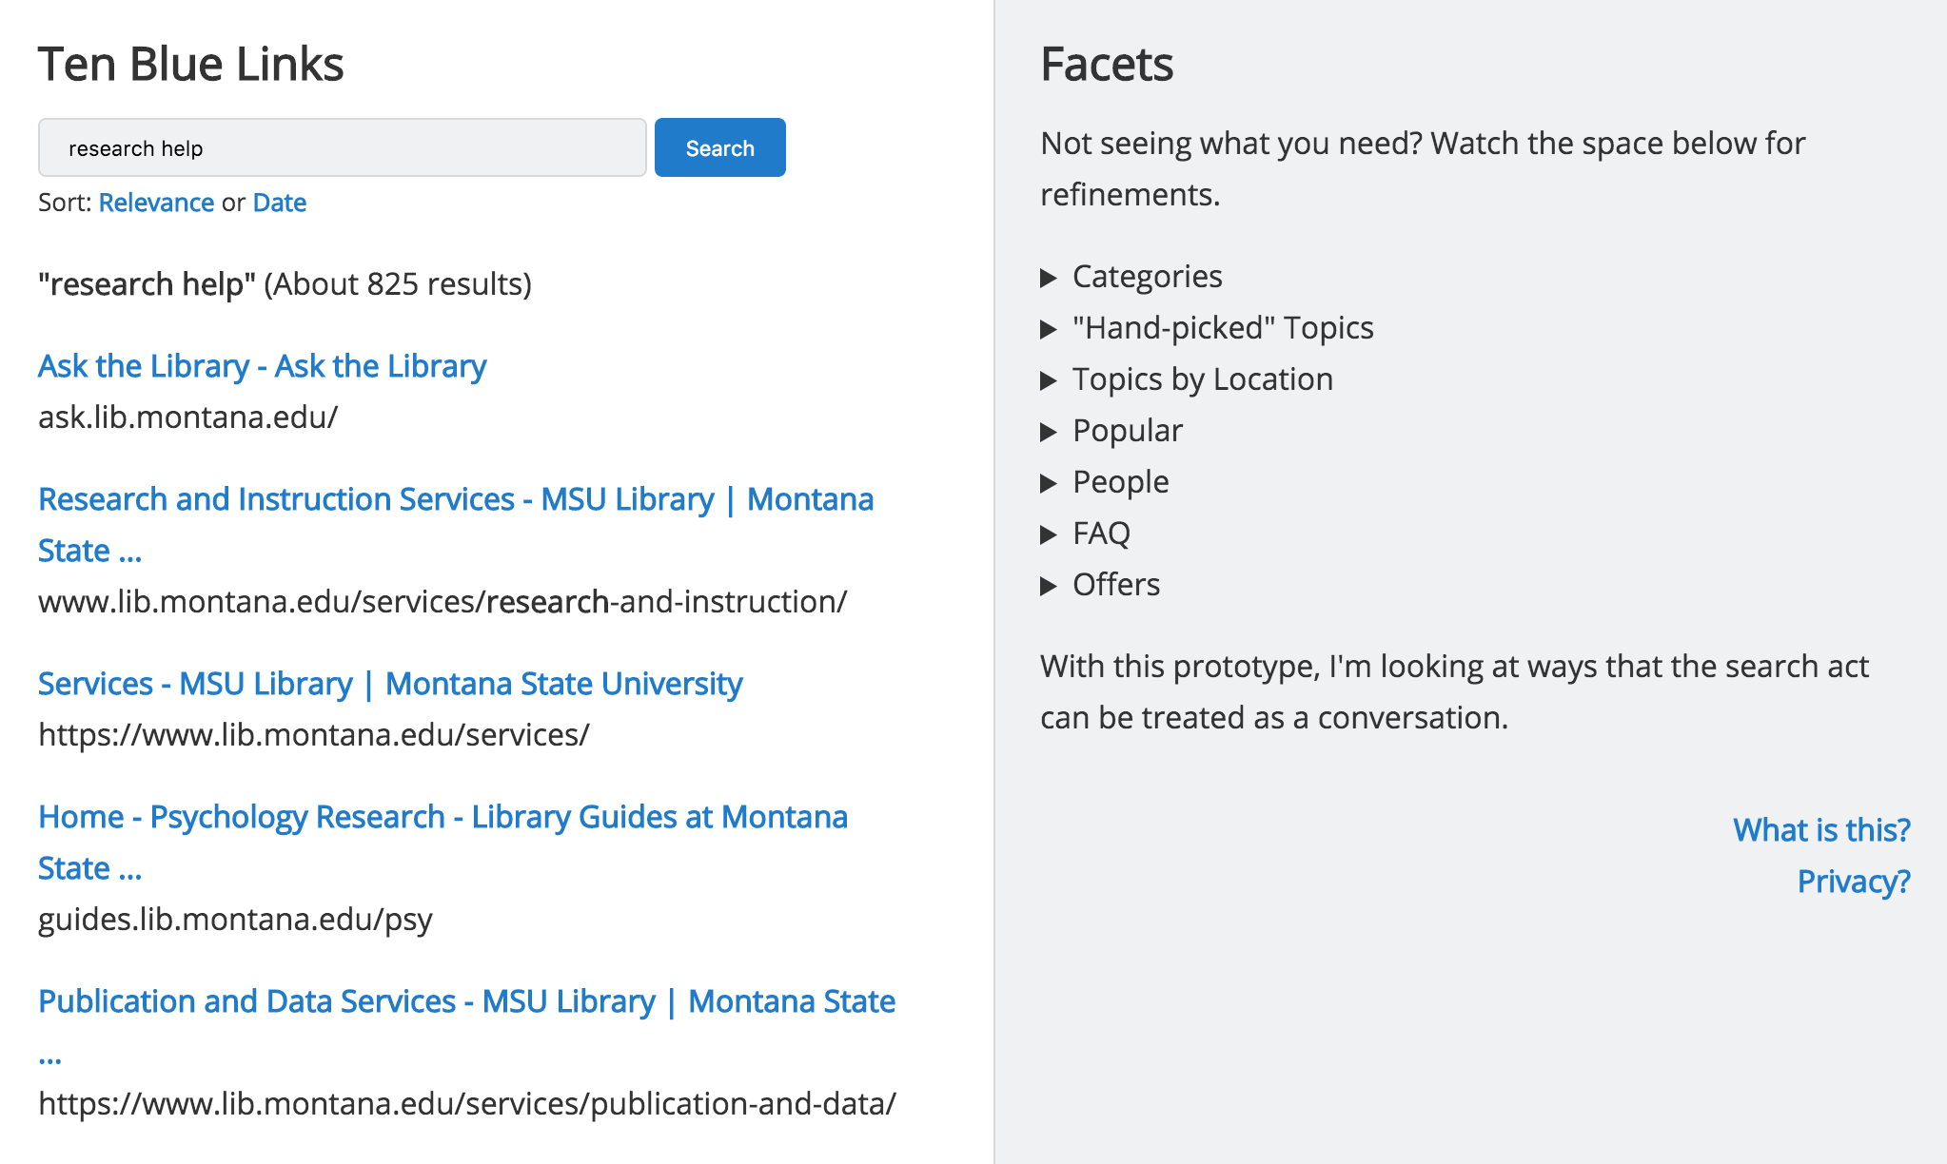
Large Result Set ( > 30 results)

Slide 33
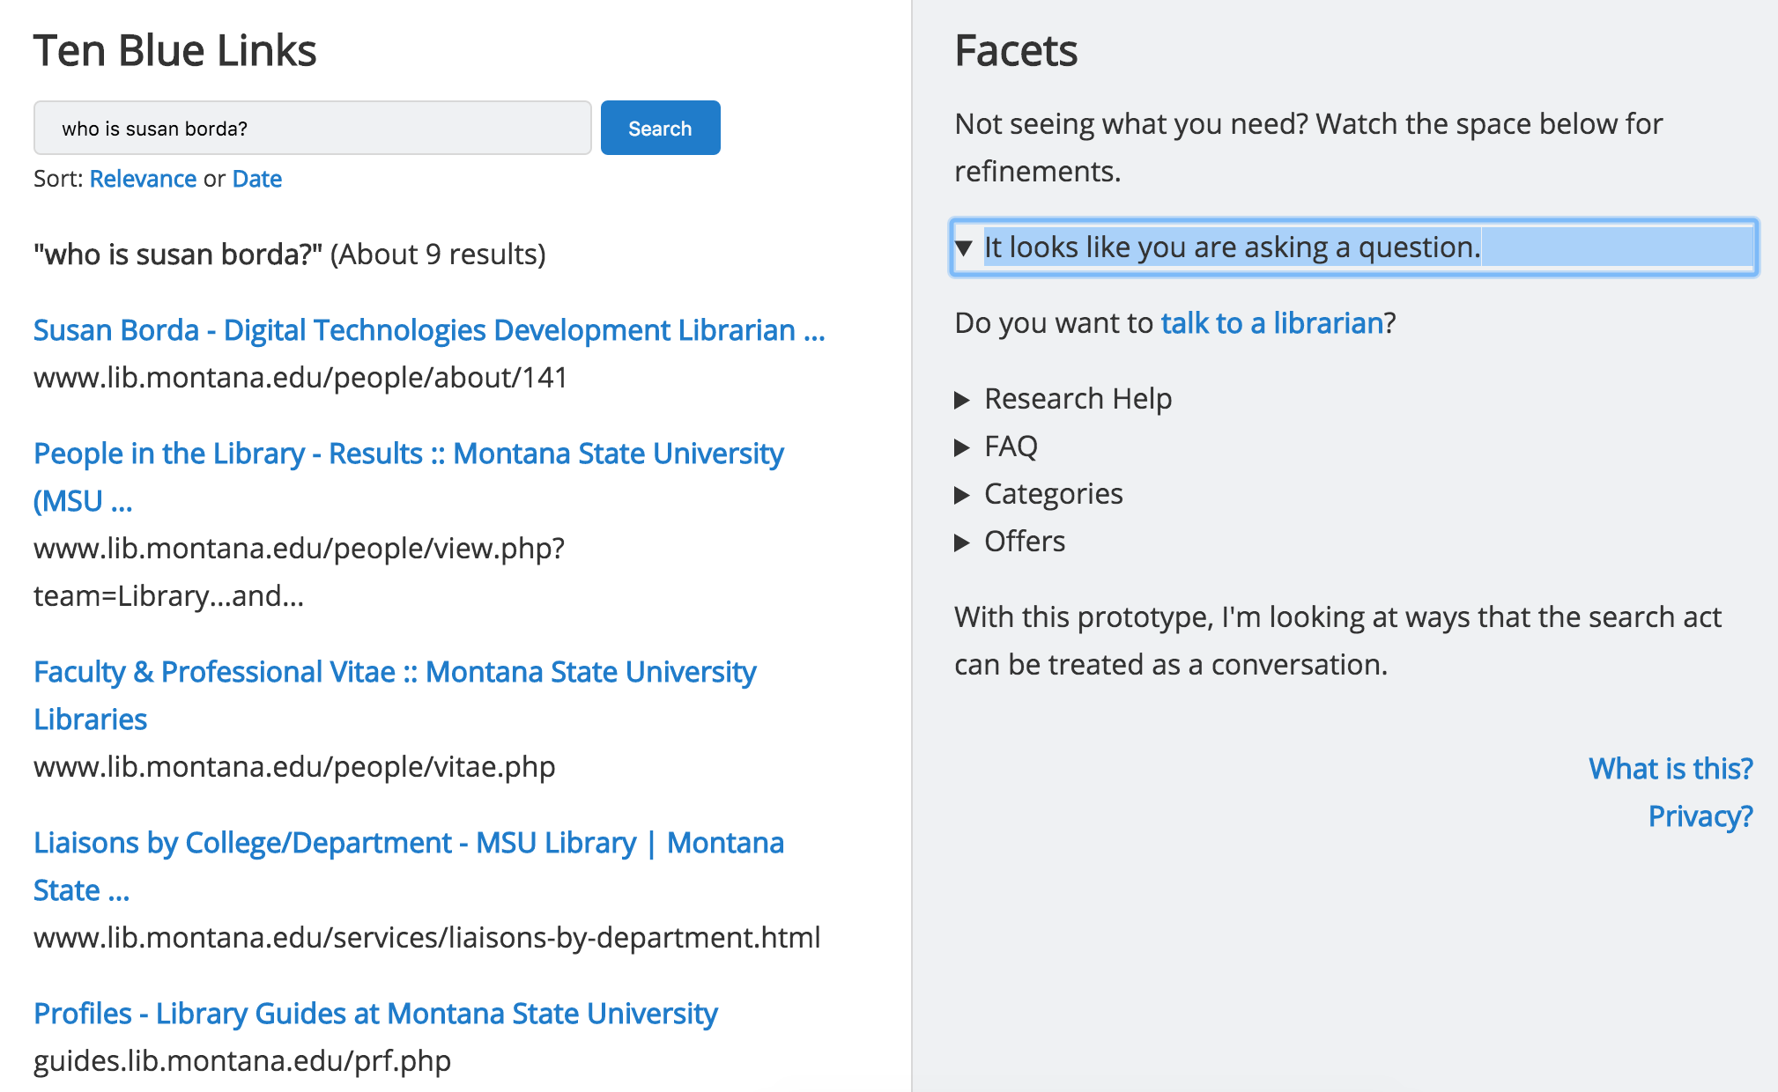
Suggestions Based on Natural Language Question

Slide 34
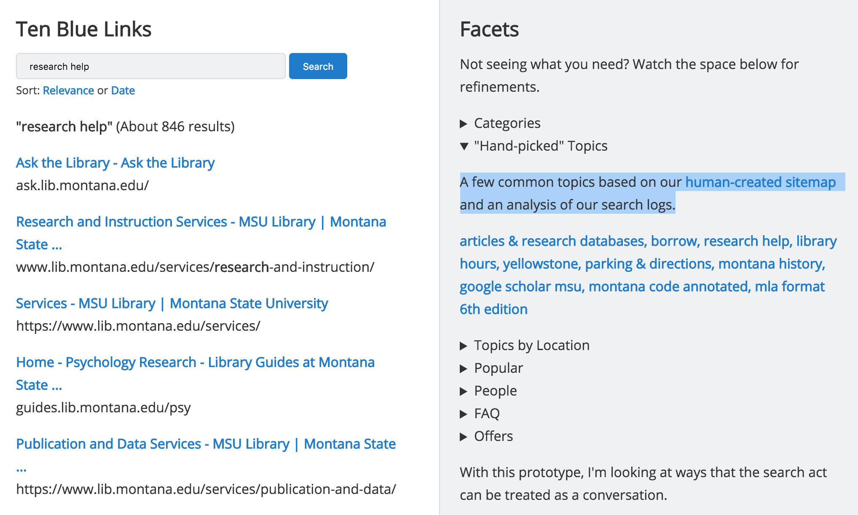
Suggestions Based on Result Set Size

Slide 35
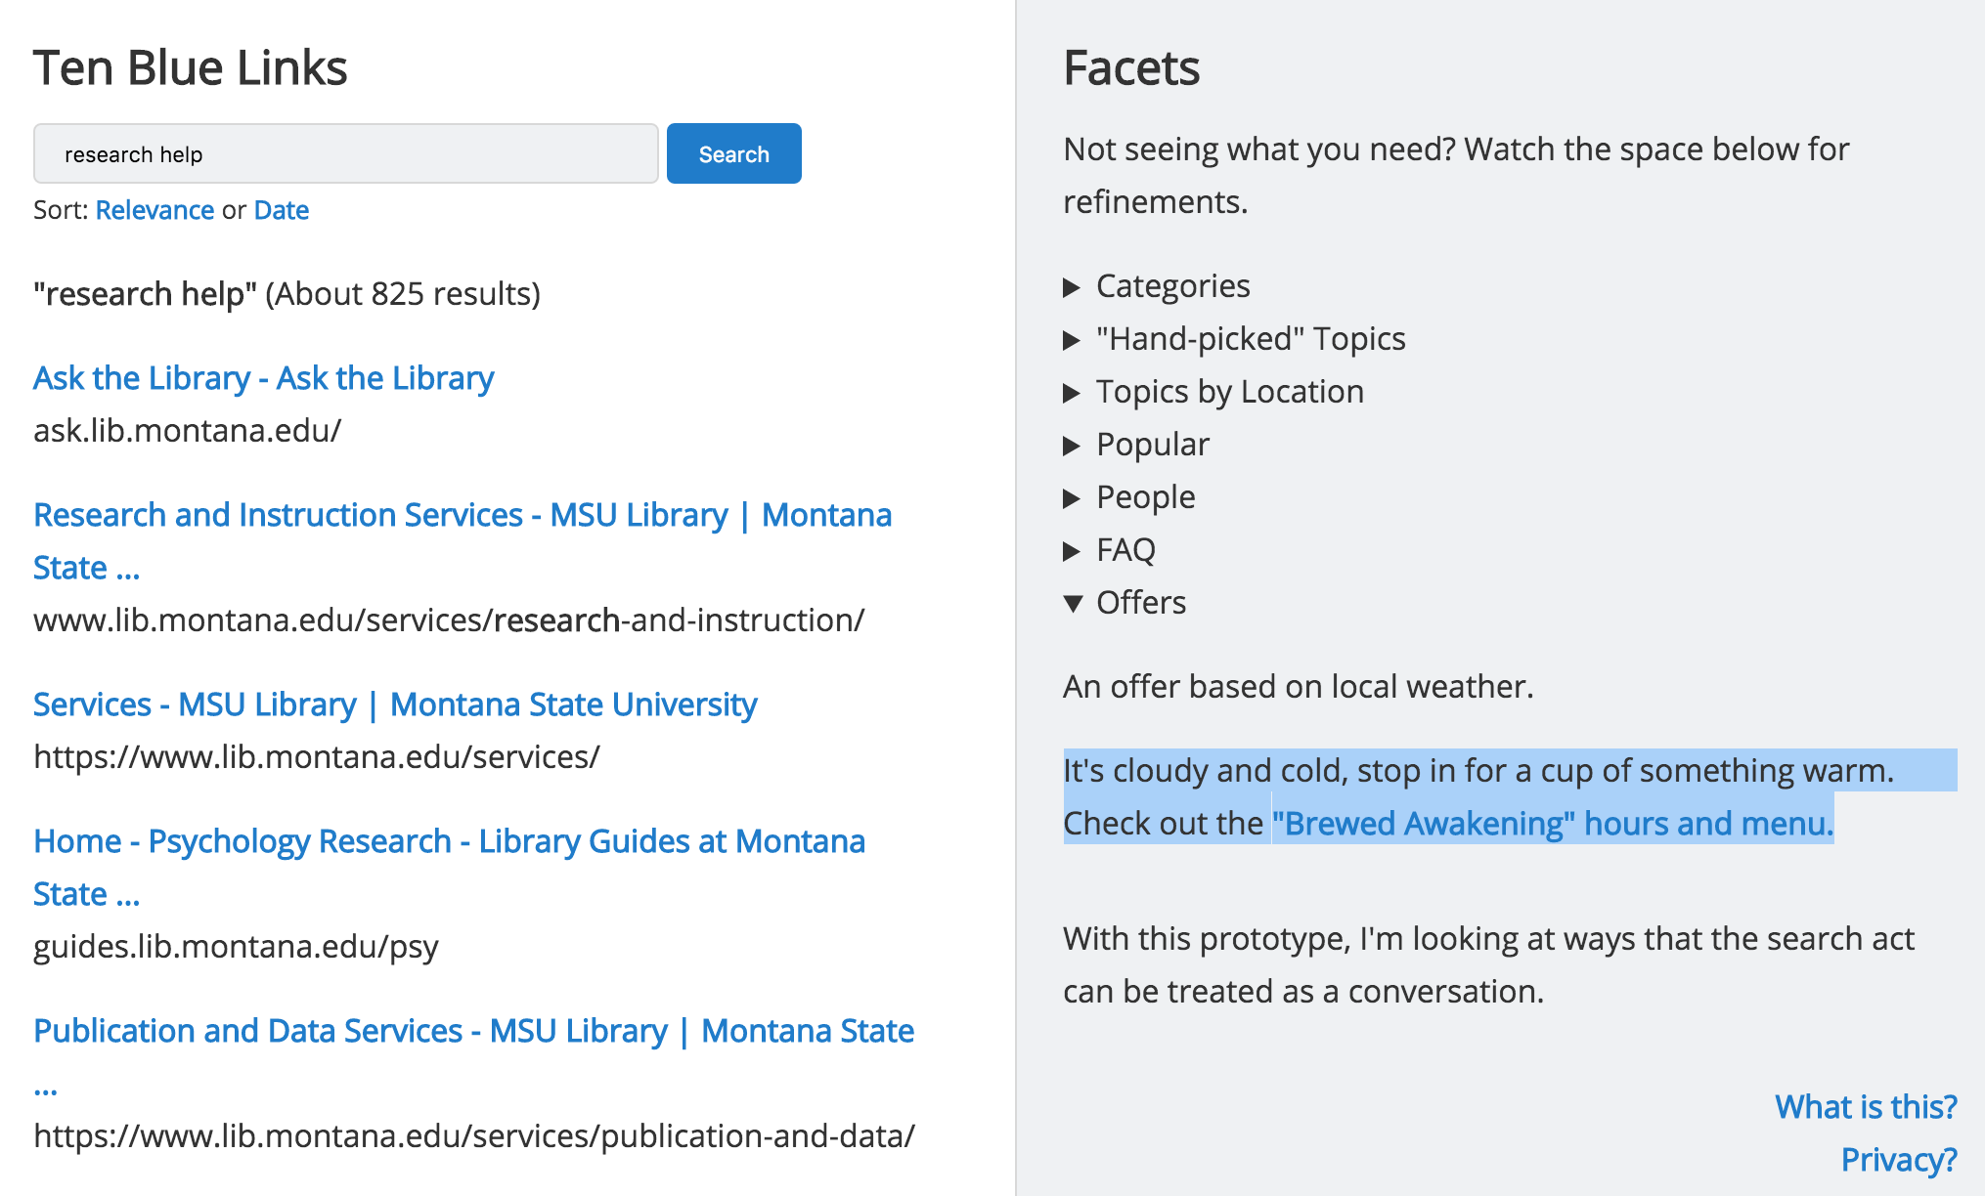
Suggestions Based on Local Context

Slide 36
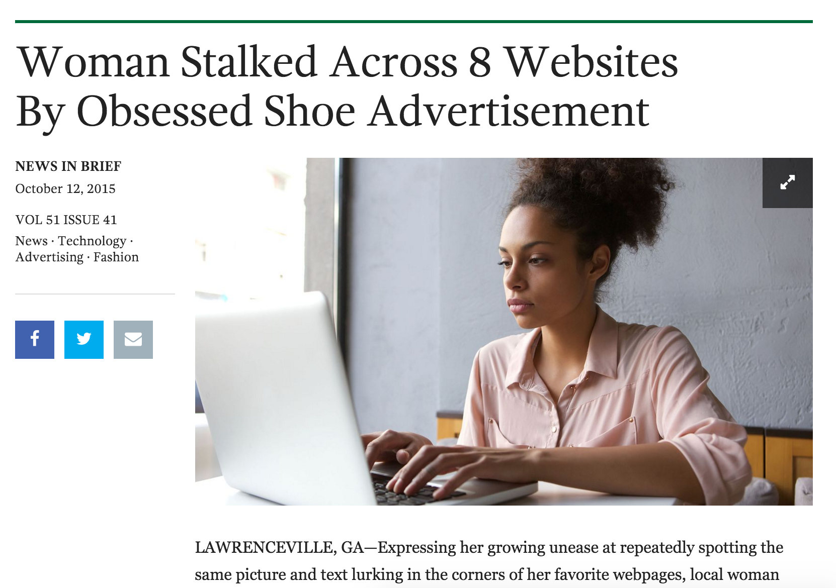
www.lib.montana.edu/~jason/files/search-ux/

Slide 37
Next Steps + Possibilities
Library Discovery Search - “Bento Box”
Speciality Search Applications
Library Digital Collections
User Testing with the Prototype

Slide 38
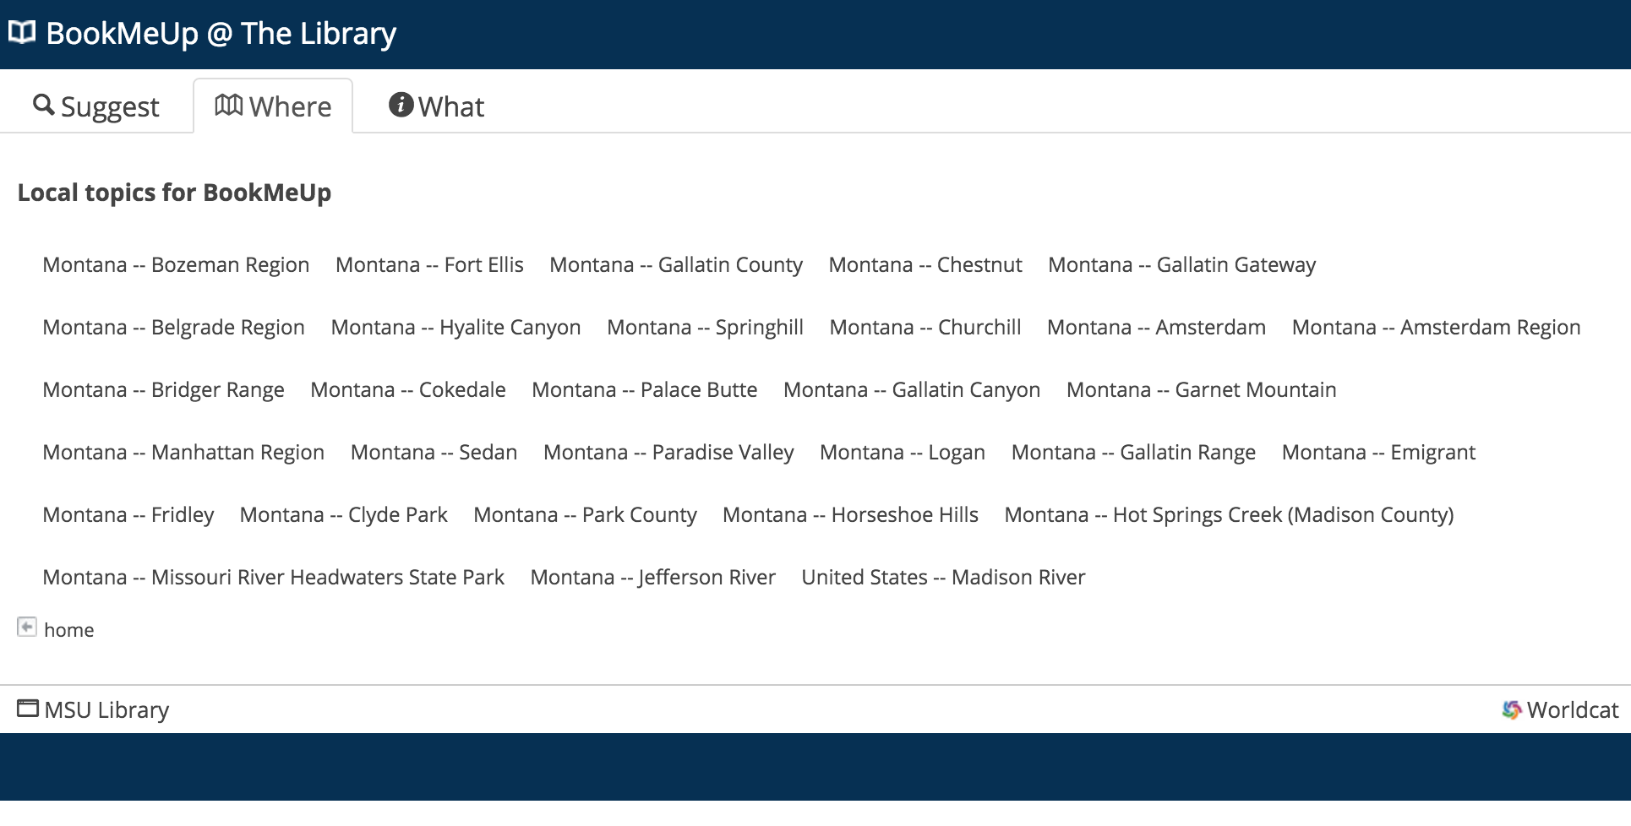
www.lib.montana.edu/beta/bookmeup/index?view=where

Slide 40
Quaero ergo sum
“I search, therefore I am”
Notes:
Speech act of a search has a fingerprint

Slide 41
There are Ghosts in the [Search] Machine.
What do we as a profession choose to do with them?
Notes:
Speech act of a search has a fingerprint

Slide 42
Questions?
twitter.com/jaclark
www.lib.montana.edu/~jason/talks.php

Slide 43
Acknowledgements
I would like to thank Montana State University and my excellent colleagues at MSU Library for supporting my research.
I am distributing this work under the Attribution-Noncommercial-Share Alike 3.0 Unported license.

Slide 44
