Slide 1
RDFa Markup, Schema.org Vocabularies, and DBpedia Topics for Digital Collections
A Closer Look at the Holy Trinity of Structured Data and their Impact on the Findability of Digital Collections

Slide 2
"Search engines continue to dominate, topping the list of electronic sources most used to find online content (93%), followed closely by Wikipedia (88%). The key difference in usage between search engines and Wikipedia is the frequency - 75% of students who use search engines do so daily, compared to 20% of those who use Wikipedia."
Perceptions of Libraries, 2010: Context and Community: a Report to the OCLC Membership. OCLC, 2011.
http://www.oclc.org/content/dam/oclc/reports/2010perceptions/2010perceptions_all_singlepage.pdf
http://www.oclc.org/content/dam/oclc/reports/2010perceptions/collegestudents.pdf
Notes:
Patrick

Slide 3
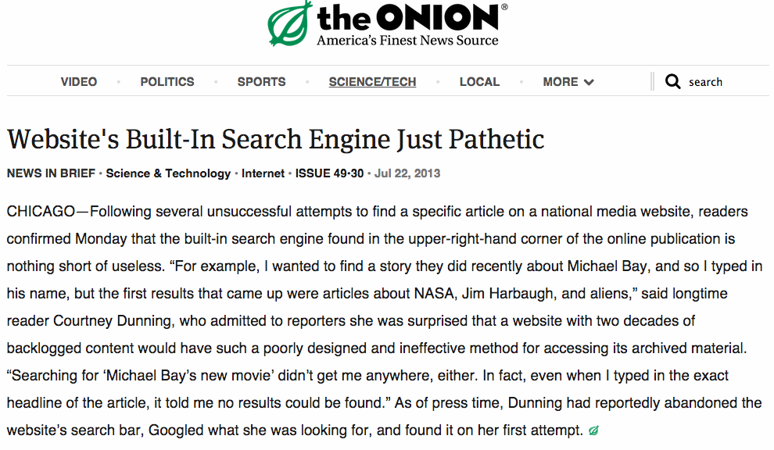

Slide 5
The Project

Slide 6
Designing Your Digital Collections for Web-Scale Search

Slide 7
Designing Your Library Collections for Web-Scale Search

Slide 8
Modeling best practices for digital collections markup
Creating metadata routines for web-scale external vocabularies
Measuring the impact of applying external vocabularies to digital collections

Slide 9
A Controlled Experiment
Two collections - 1 optimized, 1 left on its own
Similar content - photos & historical documents
Similar size - Around 800 to 1000 items
Similar date range - Mid 19th to Mid 20th century
Similar topical location - Montana
arc.lib.montana.edu/schultz-0010
arc.lib.montana.edu/brook-0771

Slide 10
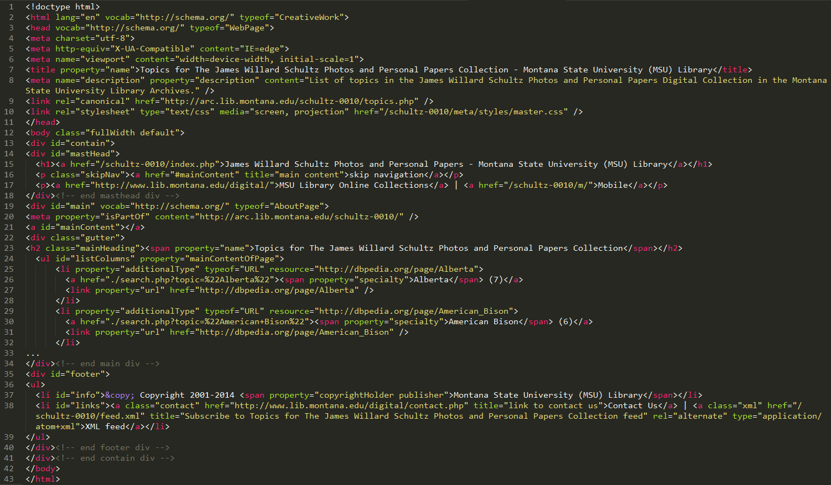

Slide 11
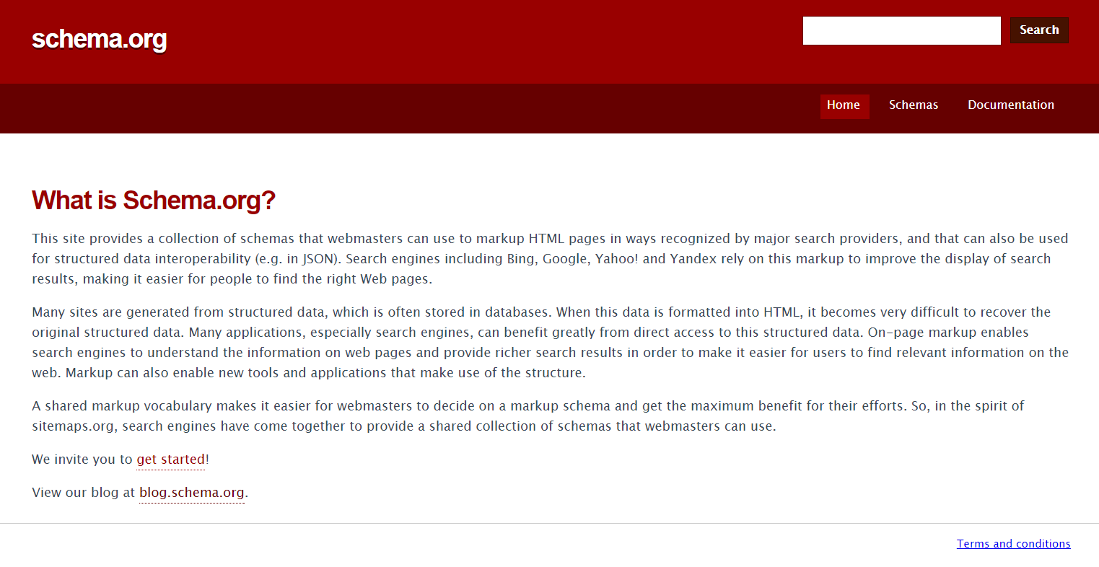

Slide 12
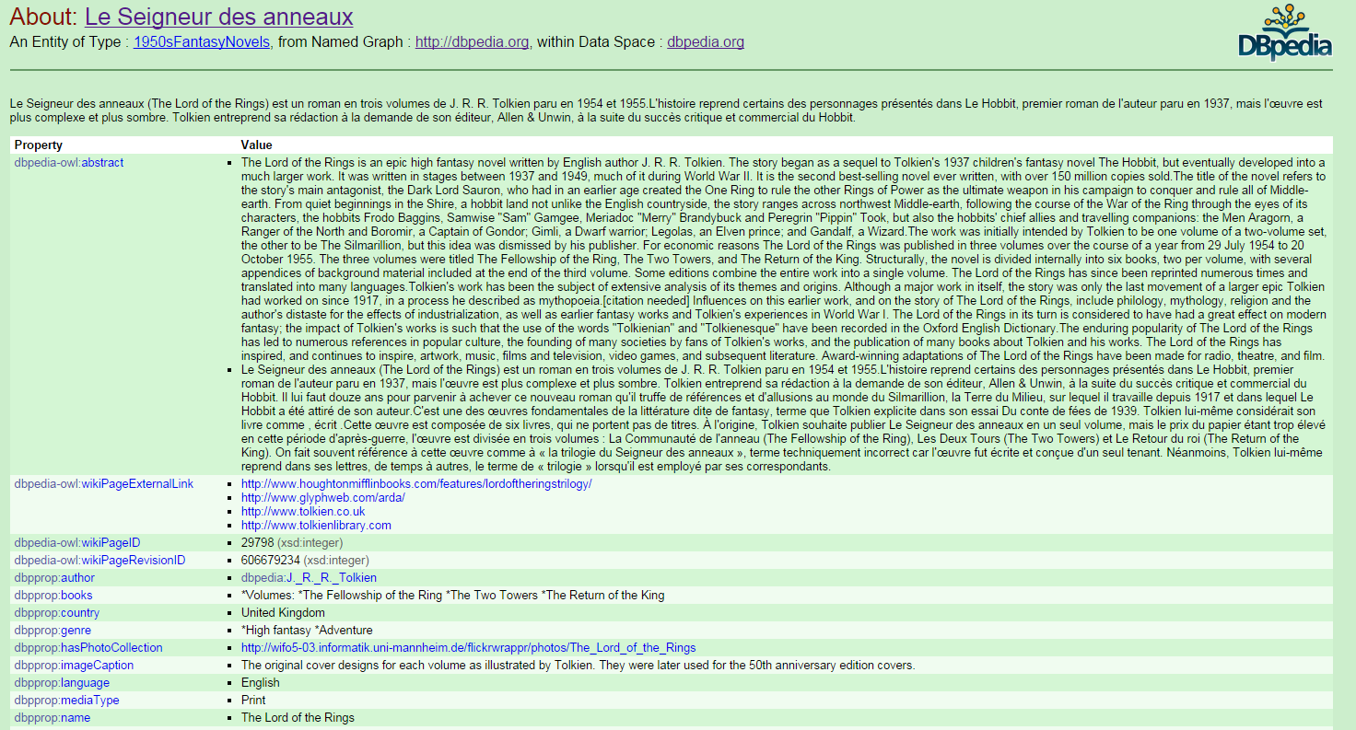

Slide 14
Wait, what… how?

Slide 15
A Revised Digital Library Architecture
Collection Page [home page]
arc.lib.montana.edu/schultz-0010/
About Pages [about page, topics page]
arc.lib.montana.edu/schultz-0010/about.php
arc.lib.montana.edu/schultz-0010/topics.php
Item Pages [individual record page]
arc.lib.montana.edu/schultz-0010/item/31
Sitemap and rel=canonical work
arc.lib.montana.edu/schultz-0010/

Slide 16
External Enumerations
"We define here some specific integration points through which selected externally maintained vocabulary can be published as part of schema.org markup"
www.w3.org/wiki/WebSchemas/ExternalEnumerations

Slide 17
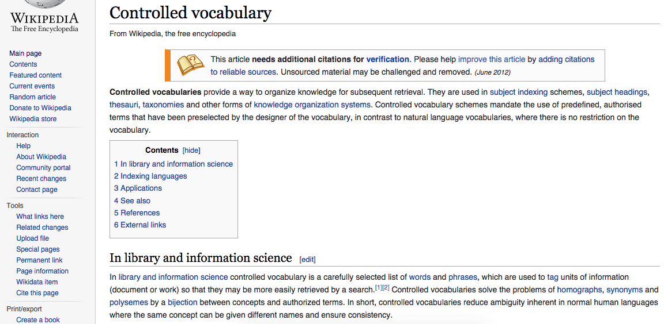
Wikipedia (DBpedia) as a Controlled Vocabulary

Slide 18
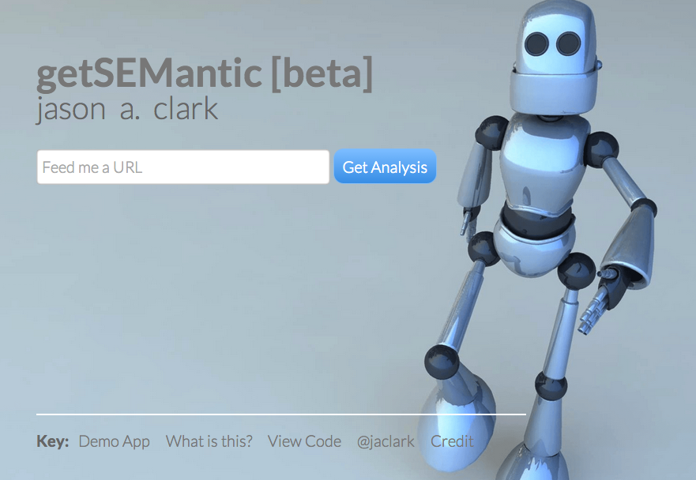
github.com/jasonclark/getsemantic

Slide 19
additionalTypes, specialty
https://schema.org/additionalType, http://schema.org/specialty

Slide 20
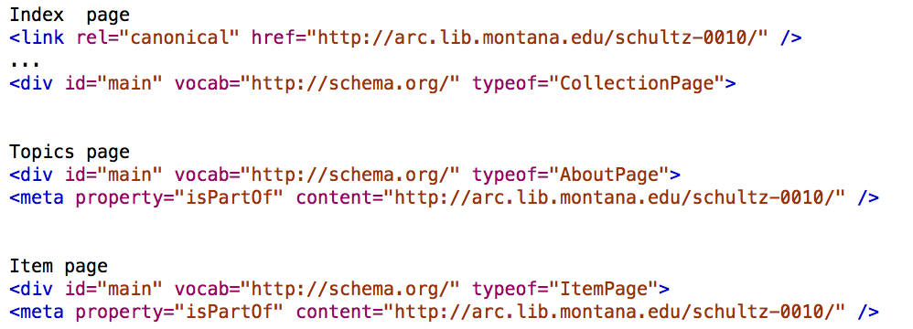
CollectionPage, AboutPage, ItemPage
https://schema.org/CollectionPage, http://schema.org/AboutPage, https://schema.org/ItemPage

Slide 21
Results

Slide 22
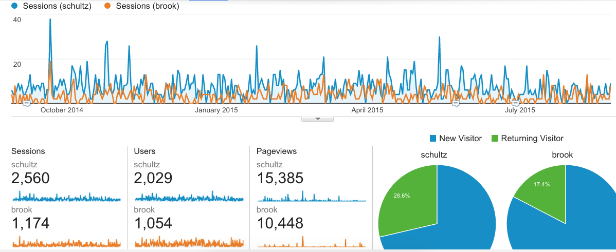

Slide 23
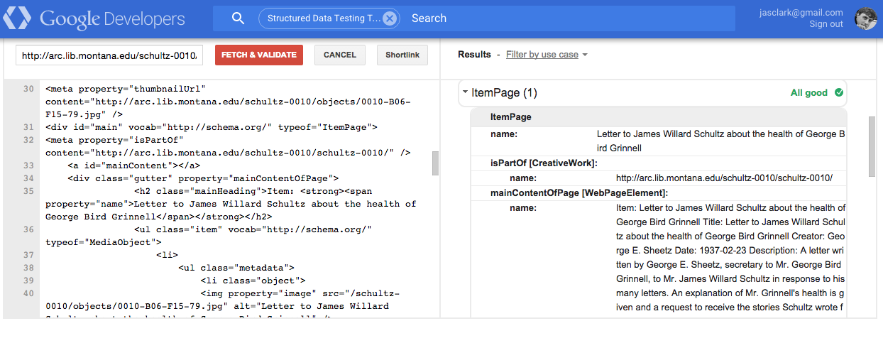

Slide 24
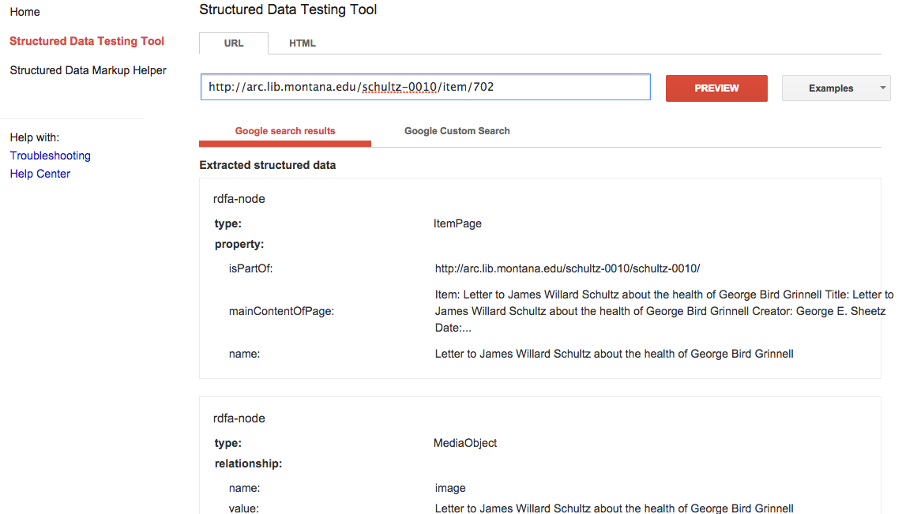

Slide 25
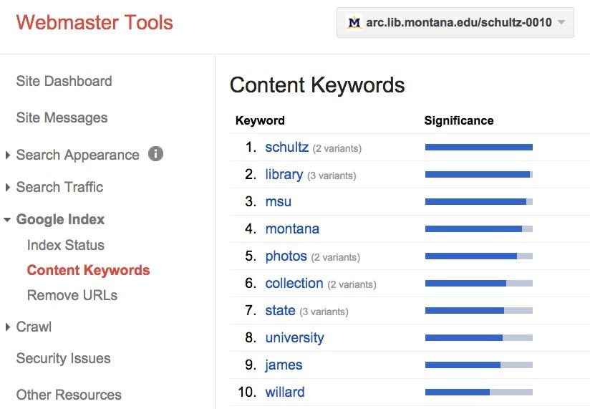
Machine Understanding

Slide 26
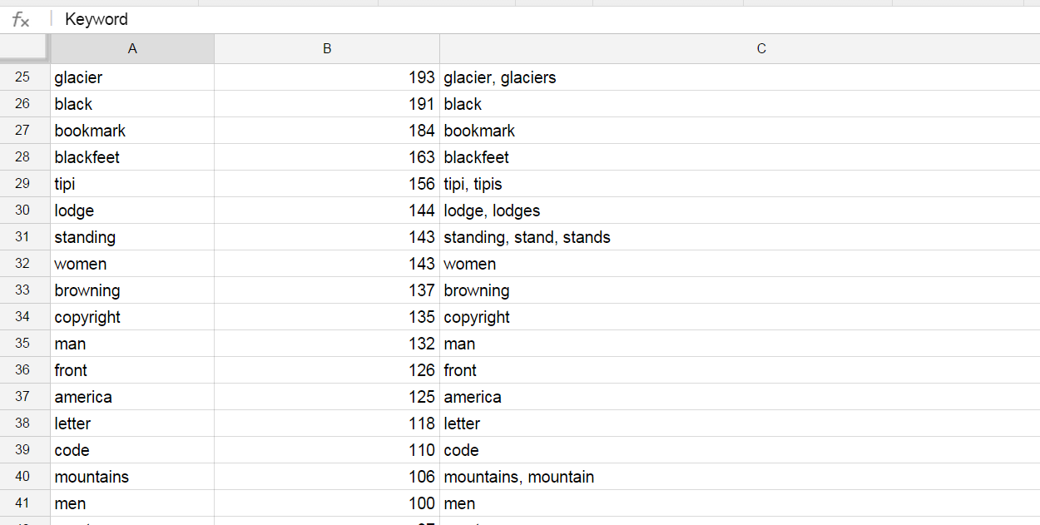
Machine Understanding

Slide 27
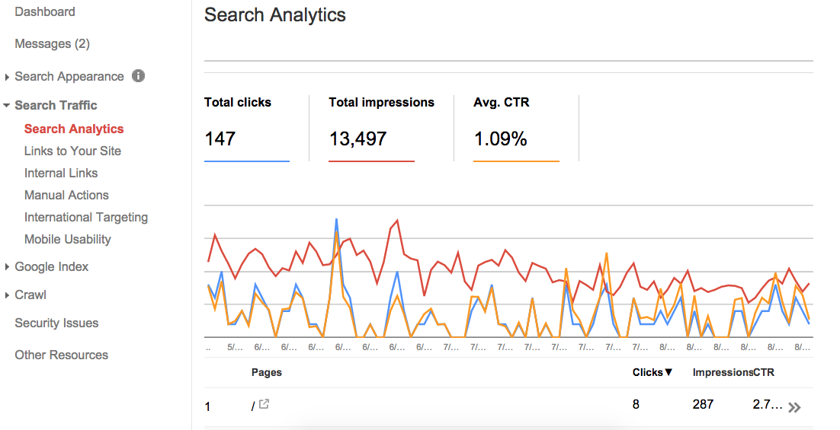
Snapshot of Search Behavior (May 26 to August 23, 2015)

Slide 28
Room for improvement based on last slide…
impressions are solid (appearance in search result)
clicks and CTR are average/low (engagement)

Slide 29
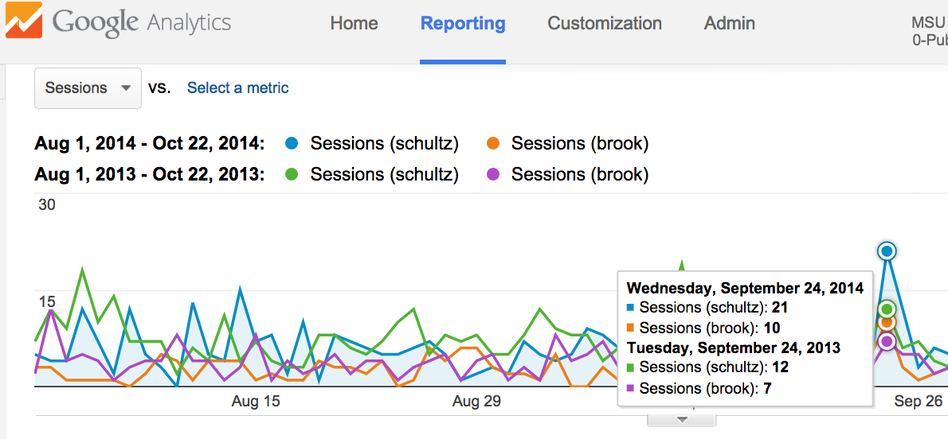

Slide 30
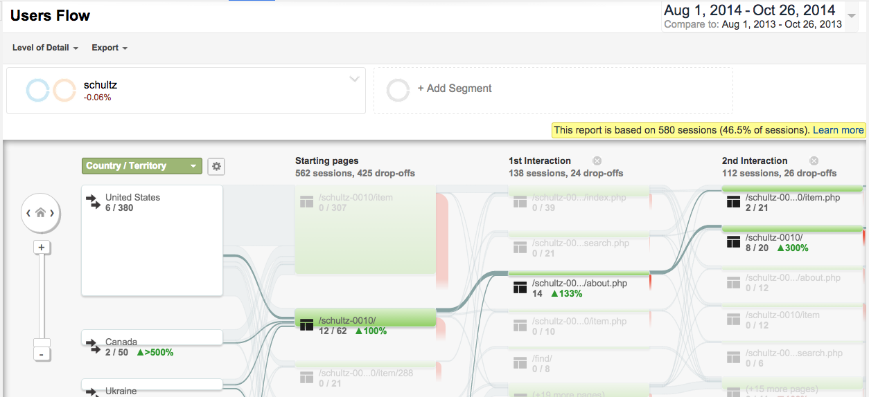

Slide 31
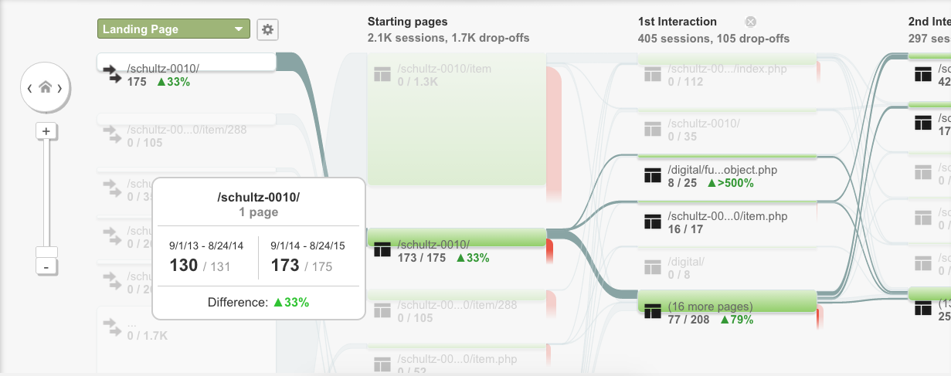

Slide 32
Future Goals

Slide 33
Set up RDFa model so that each item page can be converted to linked data triples
Streamline metadata routines and apply model to other library collections
Use longitudinal analytics data to measure impact, make improvements to model, and assess utility of the approach

Slide 34
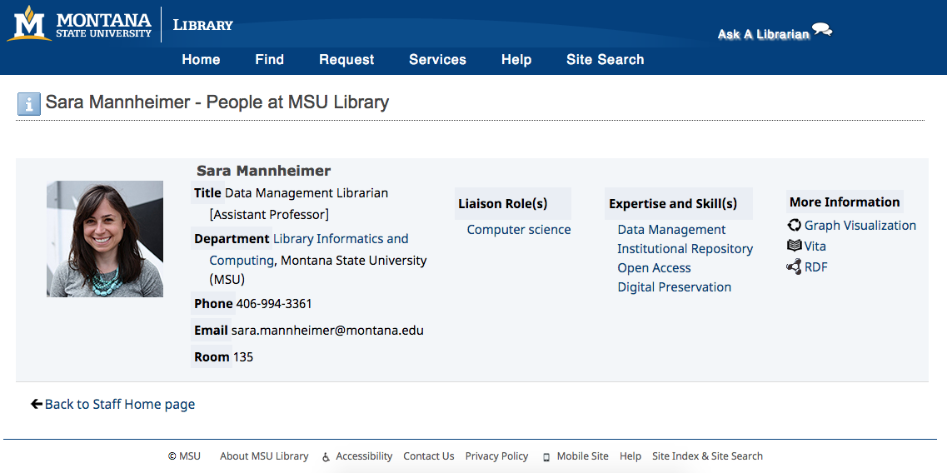

Slide 35
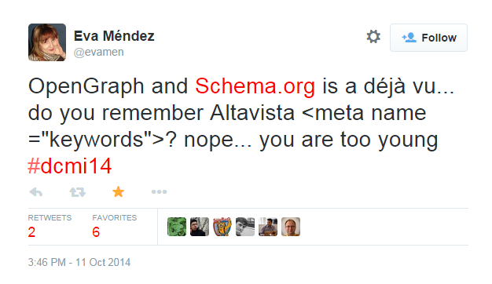

Slide 37
Questions

Slide 38
Controlled Vocabulary Work
Sounding Board

Slide 39
Semantic Web Group
Scott Young: Digital Initiatives Librarian at Montana State University Library.
@hei_scott
Jason Clark: Head of Library Informatics & Computing at Montana State University Library
@jaclark
Patrick O’Brien: Semantic Web Research Director at Montana State University Library.
@sempob
Kenning Arlitsch: Dean of the Library at Montana State University
@kenning_msu
Doralyn Rossmann: Head of Collection Development at Montana State University Library
@doralyn

Slide 40
Resources for Digital Collection Markup + Testing
https://developers.google.com/structured-data/testing-tool/
https://schema.org/AboutPage
https://schema.org/CollectionPage
https://schema.org/ItemPage
http://www.w3.org/wiki/WebSchemas/additionalTypeProposal
http://www.w3.org/wiki/WebSchemas/MultipleTypesSDO
http://www.w3.org/wiki/WebSchemas/ExternalEnumerations

Slide 41
Why do SEO?
~200 million people in the US use the Internet¹
81% of U.S. adults
95% of U.S. teens
The US submits 19+ Billion queries per month to commercial SE²
Google owns 67% of these queries
¹ Pew Research Center. “What Internet users do online: Pew Research Center’s Internet & American Life Project,” 2012. http://pewinternet.org/Trend-Data-(Adults)/Online-Activites-Total.aspx
² comScore. “comScore Releases February 2014 U.S. Search Engine Rankings,” February 18, 2014. http://www.comscore.com/Insights/Press_Releases/2014/2/comScore_Releases_January_2014_US_Search_Engine_Rankings
Notes:
Patrick

