Slide 1
Open Data and Open Libraries:
Supporting the Open Data Project in Library Services
Jason A. Clark
Associate Professor
Head of Library Informatics & Computing
Montana State University (MSU) Library
Florida Library Webinars
July 22, 2015

Slide 2
pinboard.in tag
pinboard.in/u:jasonclark/t:open/

Slide 3
twitter as channel (#hashtag)
@jaclark #opendata

Slide 4
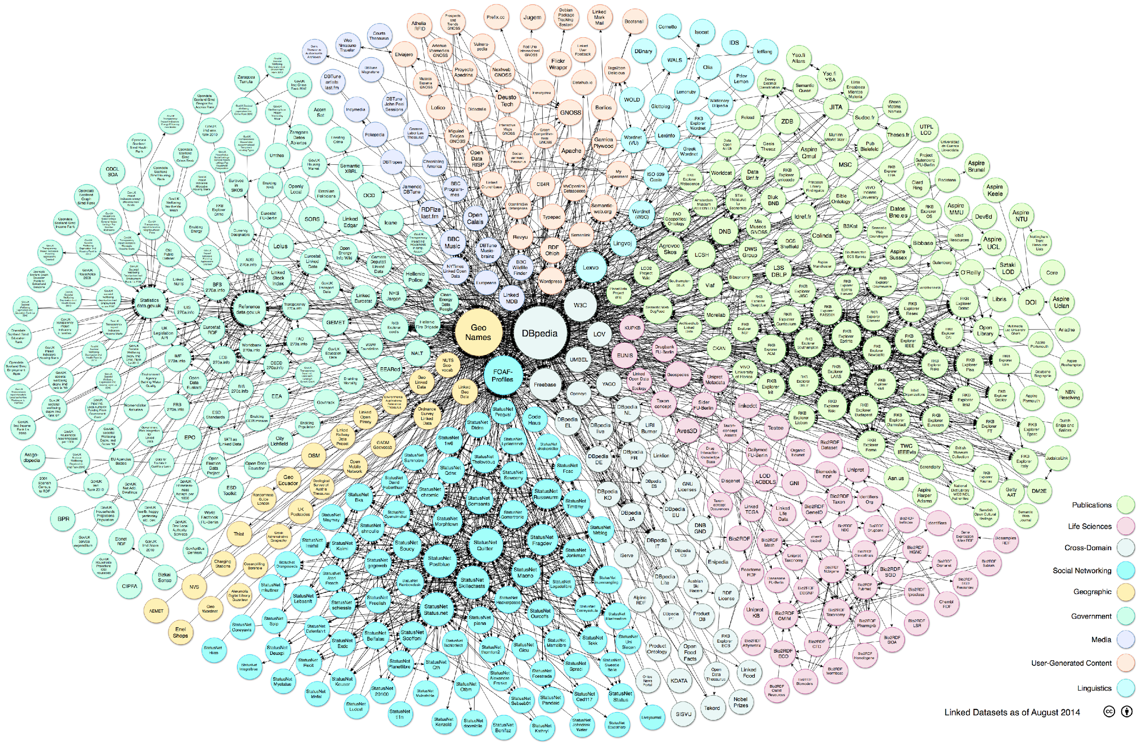
Linking Open Data cloud diagram 2014, by Max Schmachtenberg, Christian Bizer, Anja Jentzsch and Richard Cyganiak. http://lod-cloud.net/

Slide 5
Overview
Why Open Data?
Open Data in Practice
Open Data + Libraries
Open Data Processes + Tools
Questions

Slide 6
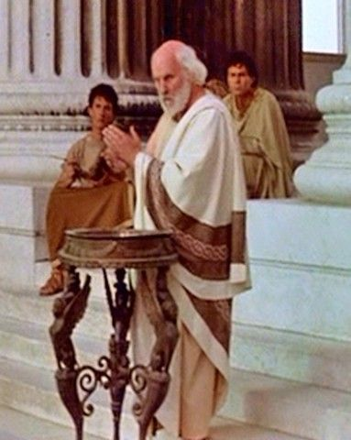
Defining Terms and Truths

Slide 7
What do you mean by “open”?
An open work must satisfy requirements around open licenses, open access, and open formats.

Slide 8
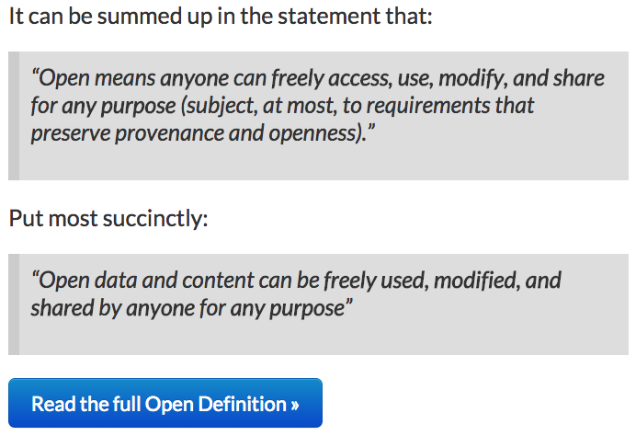
http://opendefinition.org/od/

Slide 9
“A piece of data or content is open if anyone is free to use, reuse, and redistribute it - subject only, at most, to the requirement to attribute and/or share-alike.”
http://opendefinition.org/

Slide 10
Why Open Data? Part of a Library Continuum

Slide 11
Sharing

Slide 12
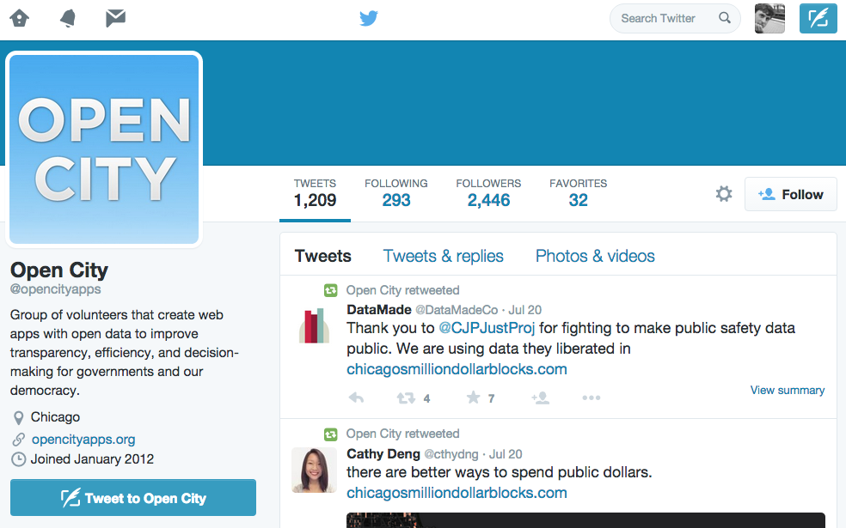
https://twitter.com/opencityapps

Slide 13
Attribution

Slide 14
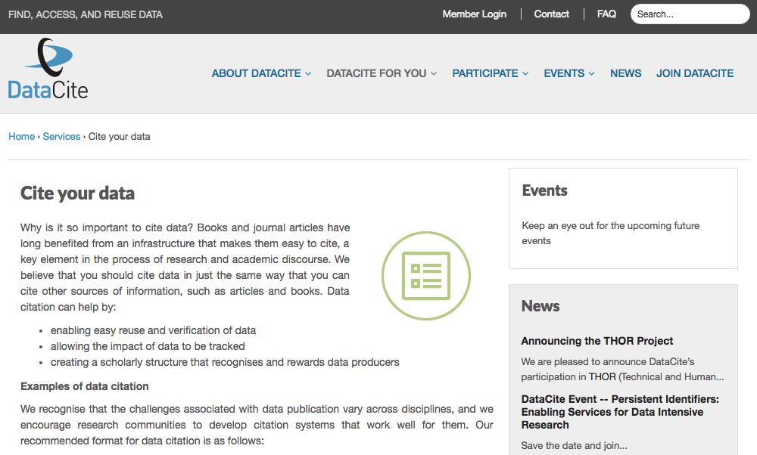
https://www.datacite.org/services/cite-your-data.html

Slide 15
Access

Slide 16
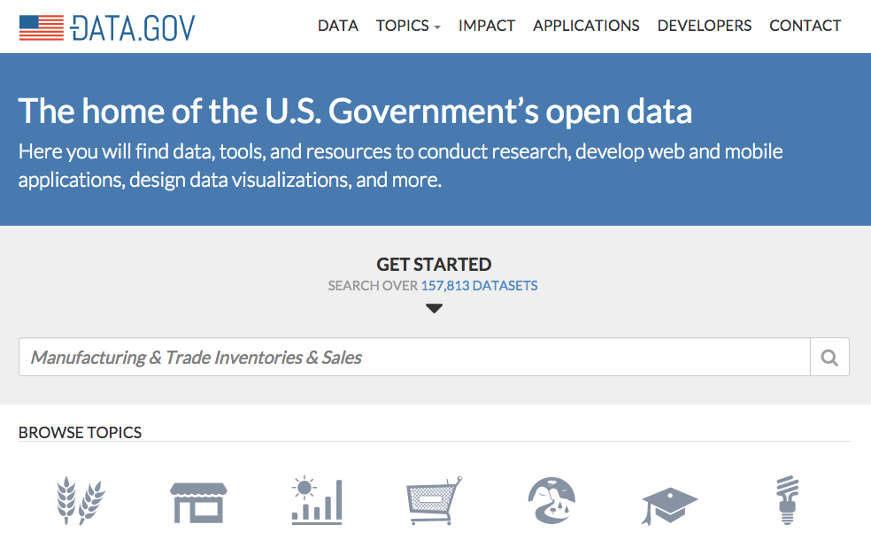
http://www.data.gov/

Slide 17
Reuse and Repurpose

Slide 18
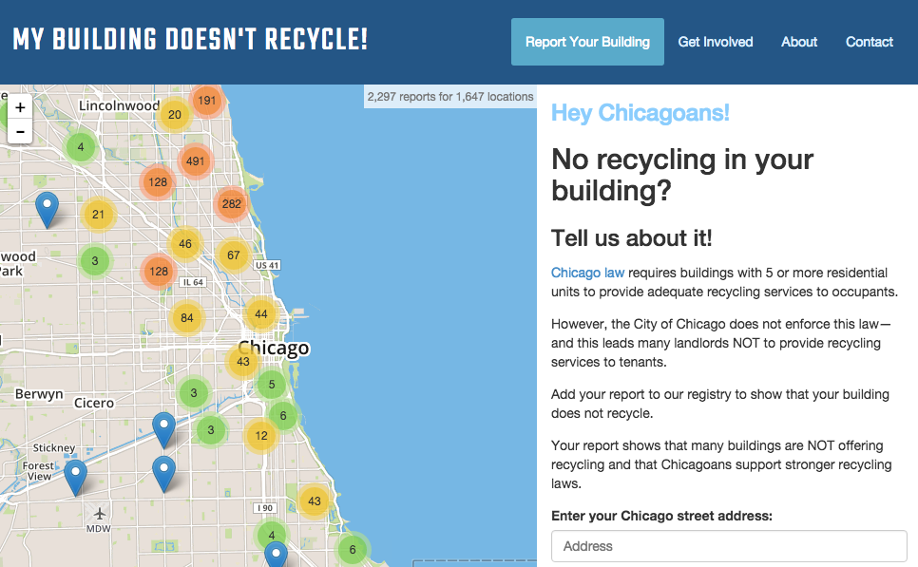
http://mybuildingdoesntrecycle.com/

Slide 19
Archive

Slide 20
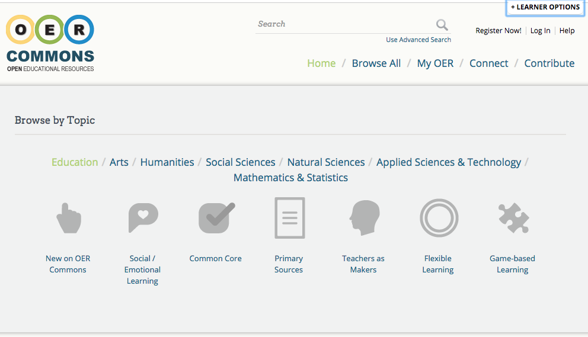
https://www.oercommons.org/

Slide 21
Open Data in Practice So what?

Slide 22
http://www.lib.montana.edu/~jason/files/oembed-this/

Slide 23
https://github.com/jasonclark/oembed-this/

Slide 24
Application Programming Interfaces (API)

Slide 25
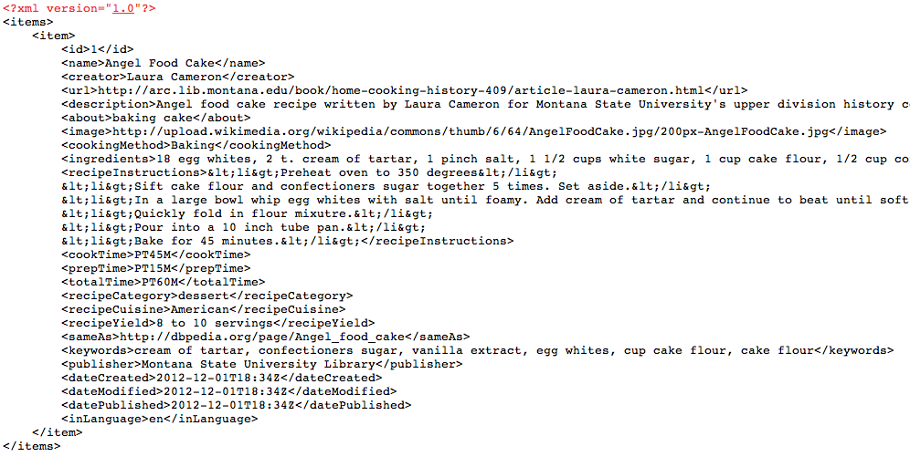
XML, JSON
/home-cooking-history-409/api.php?type=recipe&id=1&num=1&format=xml
...api?id=1&format=xml
...api?type=search&q=poetry&format=json
Notes:
http://shelf.lib.montana.edu/home-cooking-history-409/api.php?type=book&id=1&num=1&format=json
http://shelf.lib.montana.edu/home-cooking-history-409/api.php?type=recipe&id=1&num=1&format=xml
http://shelf.lib.montana.edu/home-cooking-history-409/api.php?type=search&q=lauren&num=10

Slide 26
Open Data + Libraries Where does it fit?

Slide 27
Teaching Data Science or Data Literacy Skills

Slide 28
Archiving and Packaging Data for Discovery and Reuse

Slide 29
Sponsoring Open Data Creation Moments

Slide 30
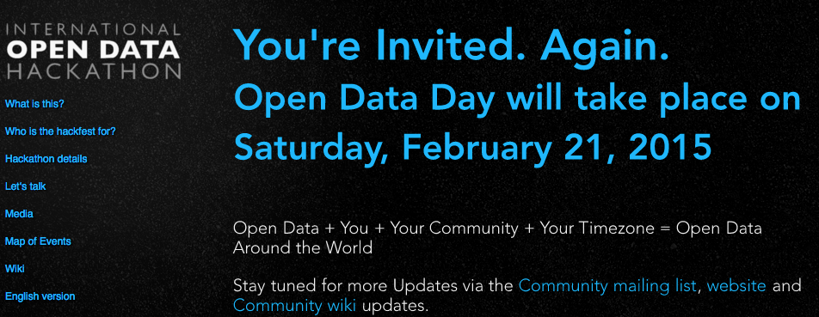
http://opendataday.org/

Slide 31
Open Data Processes + Tools Getting Started

Slide 32
Structured Data

Slide 33
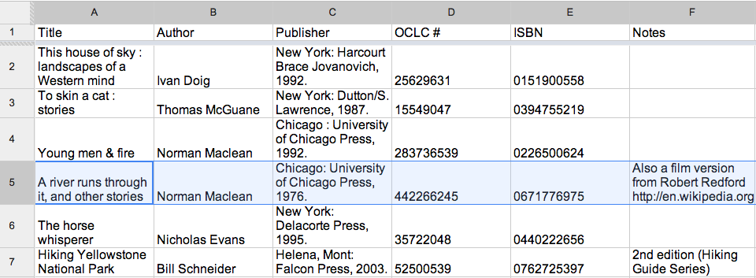

Slide 34
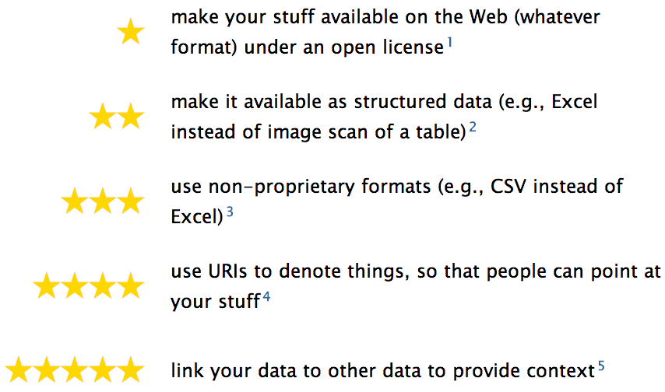
5 Star Open Data
http://5stardata.info/

Slide 35
XML, JSON
/home-cooking-history-409/api.php?type=recipe&id=1&num=1&format=xml
...api?id=1&format=xml
...api?type=search&q=poetry&format=json
Notes:
http://shelf.lib.montana.edu/home-cooking-history-409/api.php?type=book&id=1&num=1&format=json
http://shelf.lib.montana.edu/home-cooking-history-409/api.php?type=recipe&id=1&num=1&format=xml
http://shelf.lib.montana.edu/home-cooking-history-409/api.php?type=search&q=lauren&num=10

Slide 36
Minimum Viable Metadata

Slide 37
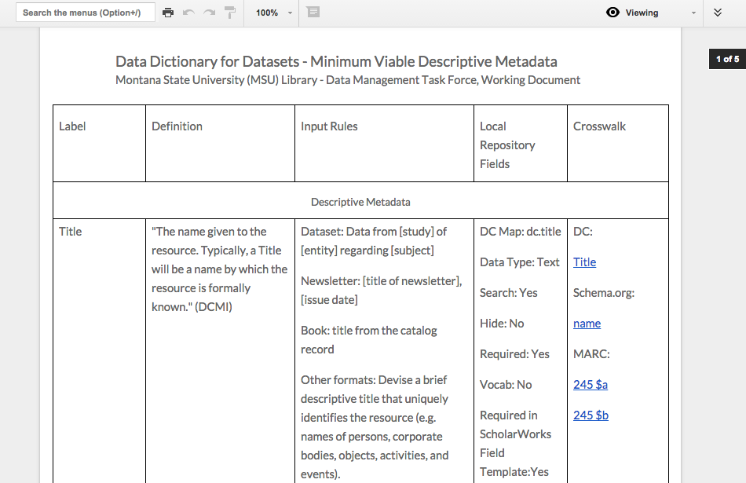
Data Dictionary for Datasets - Montana State University (MSU) Library

Slide 38
Licensing

Slide 39
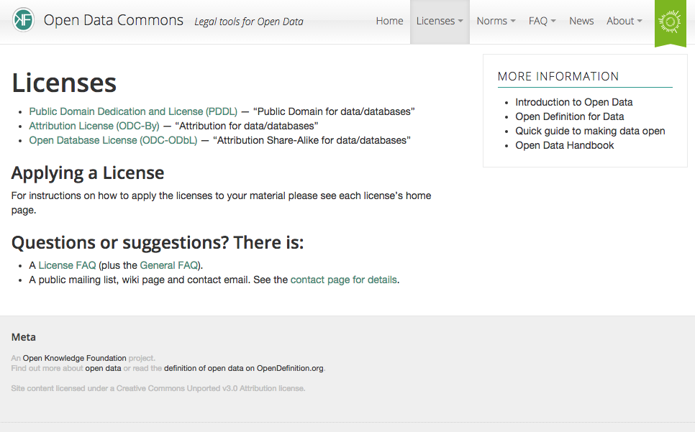
http://opendatacommons.org/licenses/

Slide 40
Tools

Slide 41
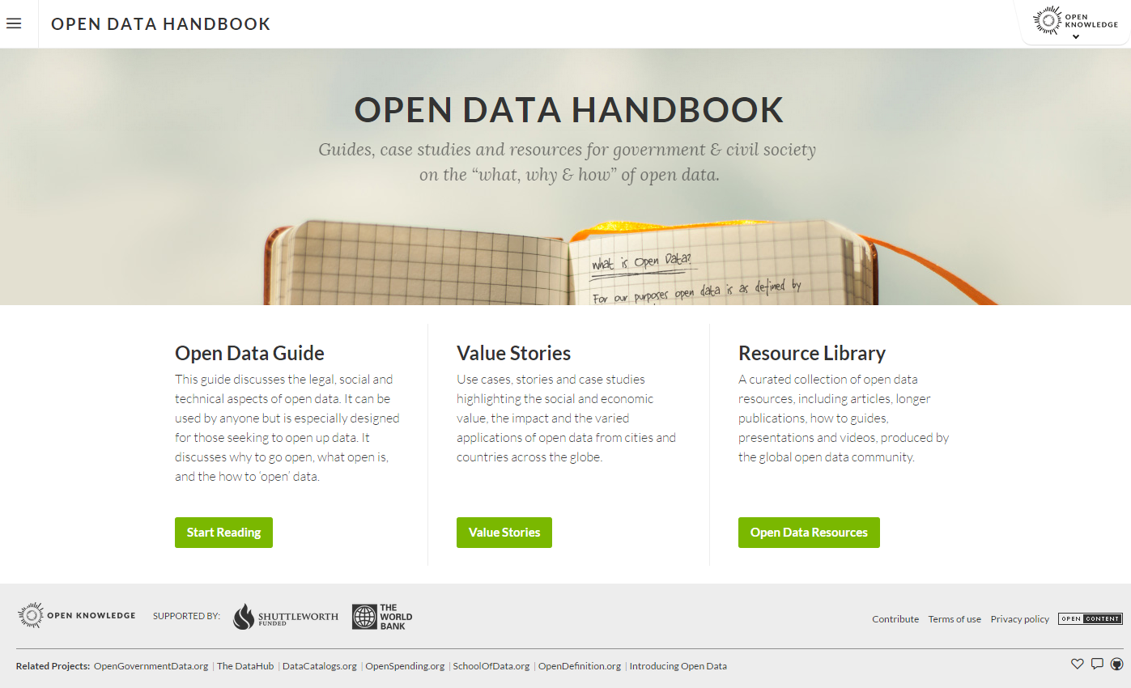
http://opendatahandbook.org/

Slide 42
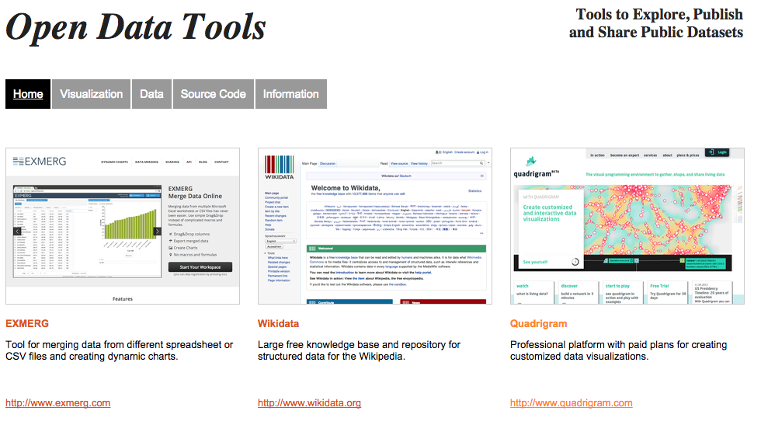
http://opendata-tools.org/en/

Slide 43
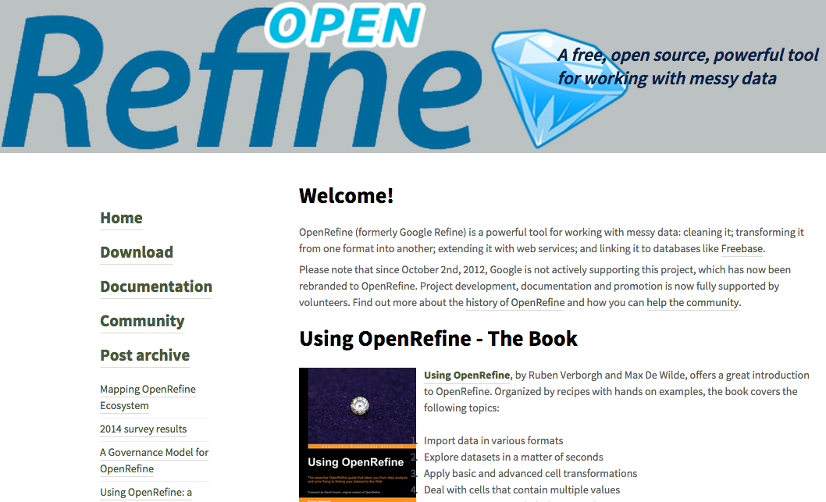
http://openrefine.org/

Slide 44
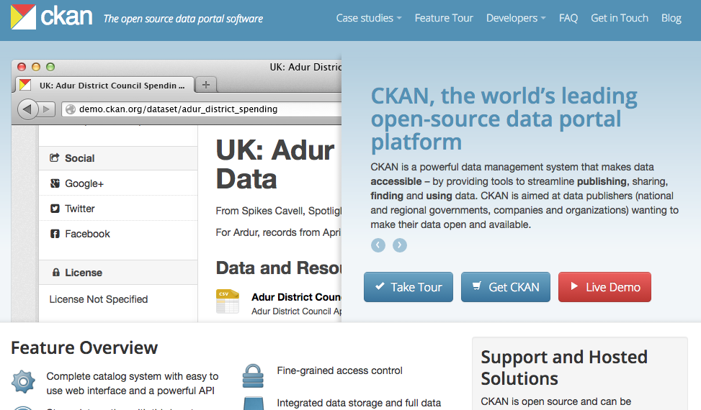
http://ckan.org/

Slide 45
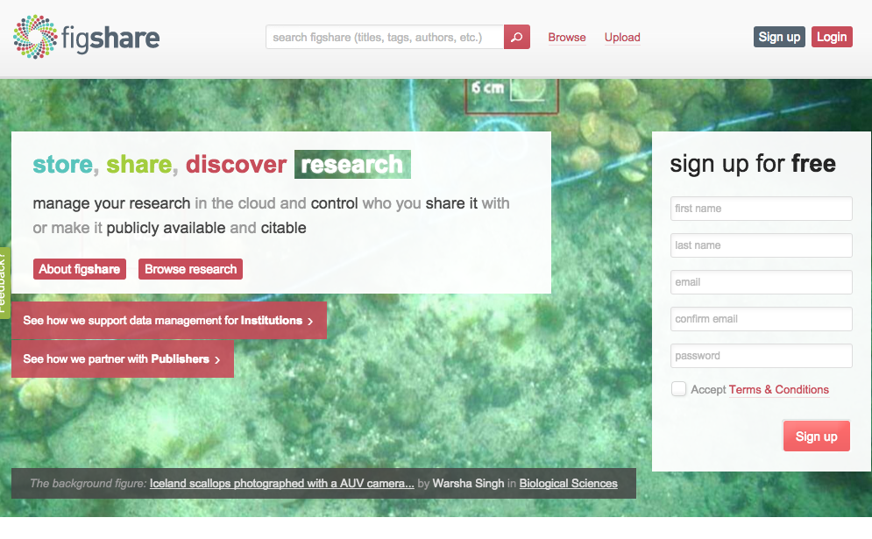
http://figshare.com/

Slide 46
Questions?
twitter.com/jaclark
www.lib.montana.edu/~jason/talks.php

