Slide 1
Building Web Applications with HTML5, CSS3, and Javascript:
An Introduction to HTML5
Jason Clark
Head of Digital Access & Web Services
Montana State University Libraries

Slide 2
pinboard.in #tag
pinboard.in/u:jasonclark/t:lita-html5/

Slide 3
twitter #hashtag
#litahtml5

Slide 4
Overview
Where does HTML5 go from here?
New Features and Functions
Demos
Getting Started
Questions

Slide 5
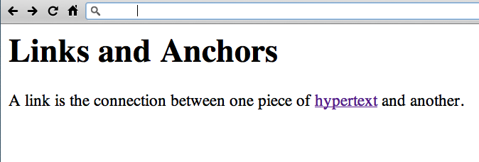
http://www.w3.org/History/19921103-hypertext/hypertext/WWW/Link.html

Slide 6
HTML5 spec from WHATWG
“The World Wide Web's markup language has always been HTML. HTML was primarily designed as a language for semantically describing scientific documents, although its general design and adaptations over the years has enabled it to be used to describe a number of other types of documents.
The main area that has not been adequately addressed by HTML is a vague subject referred to as Web Applications. This specification attempts to rectify this, while at the same time updating the HTML specifications to address issues raised in the past few years.”
www.whatwg.org/specs/web-apps/2005-09-01/#introduction

Slide 7
Future(s) of HTML5
The Web Browser as Platform

Slide 8
catalog.douglascountylibraries.org/EcontentRecord/19339/Viewer?item=3439864

Slide 9
Cross-Origin Resource Sharing
CORS (for short)
HTTP request from client to external server which required workaround (JSONP)
Create, Read, Update, Delete -> allowed
var xhr = new XMLHttpRequest();
xhr.open('GET', 'https://api.com/user1/?alt=json', true);
www.lib.montana.edu/~jason/files/web-services/html5-cors-youtube-api.html

Slide 10
Web Workers API
Run scripts in background threads
Polling of web services
Process image while user works with UI
Prefetching and/or caching data
var worker = new Worker('getFeed.js');

Slide 11
Single Page Applications
Complete web apps built within a single page where new views of data are placed
Backbone.js
Ember.js

Slide 12
Web Components
Suite of technologies: Custom Elements, Shadow DOM, HTML Templates, HTML Imports, and Decorators.
<!-- Import it: -->
<link rel="import" href="new-module.html" />
<!-- Use it: -->
<custom-module />

Slide 13
HTML Imports
Include HTML documents in other HTML documents
Load related HTML/CSS/JS
<head>
<link rel="import" href="/path/to/imports.html">
</head>

Slide 14
<template> tag
Markup is hidden DOM
Inert until activated
<section>
<template id=”result">
<img src="" alt=”thumbnail">
<div class=”query"></div>
</template>
</section>

Slide 15
Custom Elements
Define new HTML/DOM elements
Build custom functionality into a single tag
Expand HTML's existing vocabulary
<link rel="import" href="my-tabs.html">
<my-tabs>
<hgroup>
<h2>Title</h2>
...
</hgroup>
</my-tabs>

Slide 16
<srcset> attribute
Draft for responsive images solution
http://www.w3.org/html/wg/drafts/srcset/w3c-srcset/
<img alt="header logo" src="banner.jpeg"
srcset="banner-HD.jpeg 2x, banner-phone.jpeg 100w, banner-phone-HD.jpeg 100w 2x" />

Slide 17
@viewport
Specify size, zoom factor, and orientation of the viewport, similar to what's done with the viewport <meta>
@viewport {
width: device-width;
zoom: 1.0;
user-zoom: zoom;
}

Slide 18
Variables in CSS
Set global values
Syntax is still in flux
:root
{
var-mycolor: #334;
}
section {border-color: var(mycolor);}
h1 {color: var(mycolor);}
p {background-color: var(mycolor);}

Slide 19
Integration & Current Tools
Wordpress
Plugins
Themes including new markup
Frameworks

Slide 20
Integration & Current Tools
Drupal
HTML5 Initiative, Drupal Group
HTML5 Themes
Best support in Drupal 8?

Slide 21
Accessibility and HTML5
Making HTML accessible/meaningful for screen readers & other assistive devices
WAI ARIA “role” attribute
Define what an HTML element is being used for
<nav role="navigation">

Slide 22
Accessibility and HTML5
Making HTML accessible/meaningful for screen readers & other assistive devices
HTML5 global "tabindex" attribute
Set focus priority for any HTML element
<nav role="navigation">
<ul id="nav">
<li><a tabindex="1" href="#h">Home</a></li>
<li><a tabindex="2" href="#s">Search</a></li>
...

Slide 23
<main> tag
Main content of the body of a document or application (allowed once in doc/app)
<main>
<article>
<h1>My article</h1>
<p>Content</p>
</article>
<aside>
<p>More information</p>
</aside>
</main>
...

Slide 24
Web Intents (*proposal)
Framework for client-side service discovery and inter-application communication
Connect common actions:
Share, Edit, View, Pick, Subscribe, Save
<intent
action="http://webintents.org/share"
type="image/*"
href="share.html"
disposition="window|inline"
/>
* Implemented by twitter in their “web intents” service

Slide 25
Paged Media in CSS
Create paged views for print (primarily)
* Opera is testing @media -o-paged for screens
@page { size:8.5in 11in; margin:2cm; }
h1 { page-break-before:right; }
table { page-break-inside:avoid; }

Slide 26
Offline Storage - IndexedDB
My browser can haz database!
Simple key/value store within browser
NoSQL object type data store
Up to 5 MB of data storage
W3C discontinued Web SQL Database spec

Slide 27
Polyfill in action (Webshim example)
Scripts that emulate parts of the HTML5 or CSS3 specification
Webshims Lib
http://afarkas.github.com/webshim/demos/

Slide 28
Polyfill in action (Webshim example)
<!DOCTYPE html>
<html>
<head>
<title>Video including polyfill</title>
<script src="scripts/jquery-1.8.2.min.js"></script>
<script src="scripts/modernizr-custom.js"></script>
<script src="scripts/webshim/polyfiller.js"></script>
<script>
$.webshims.polyfill('mediaelement');
</script>
</head>
<body>
<video width="480" height="360" controls="controls">
<source src="Video.mp4" type="video/mp4">
<source src="Video.webm" type="video/webm">
</video>
</body>
</html>

Slide 29
HTML5 & mobile development frameworks

Slide 30
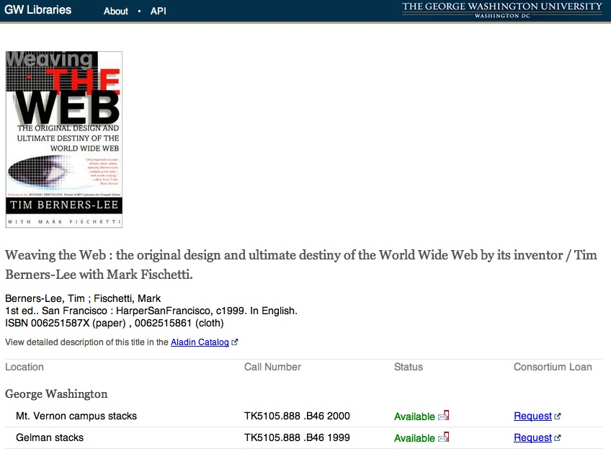
view-source:http://findit.library.gwu.edu/item/3449994

Slide 31
HTML5 right now? IE?
<!DOCTYPE html>
<html lang="en”>
<head>
<meta charset="utf-8" />
<title>HTML5 right now</title>
<!--[if IE]>
<script src="http://html5shiv.googlecode.com/svn/trunk/html5.js"></script>
<![endif]-->
<style>
article, aside, figure, footer, header, hgroup, menu, nav, section {display:block;}
</style>
</head>
<body>
<!-- ready to roll with HTML5 now -->
</body>
</html>

Slide 32
Demos & Examples
It's your call....

Slide 33
Demos
Infinite Scroll
http://warpspire.com/experiments/history-api/
Magazine Layout
http://www.html5rocks.com/en/tutorials/regions/adobe/
HTML5 Demos
http://html5demos.com/

Slide 34
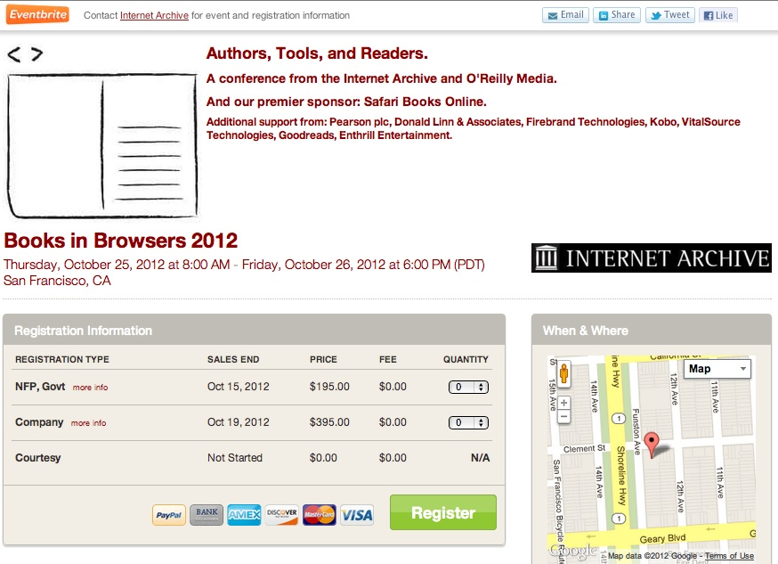
Books in Browsers - http://bib.archive.org/

Slide 35
Resources
HTML5 Validator
http://html5.validator.nu/
The HTML5 Test
http://html5test.com/
Dive into HTML5
http://diveintohtml5.info/

Slide 36
HTML5 Working Examples
HTML5 Mobile Feed Widget
www.lib.montana.edu/~jason/files/html5-mobile-feed/
BookMeUp
www.lib.montana.edu/~jason/files/bookme/
Learn more by viewing source
OR
Downloading from jasonclark.info or github.com/jasonclark

Slide 38
Questions?
twitter.com/jaclark
www.lib.montana.edu/~jason/talks.php

Slide 39
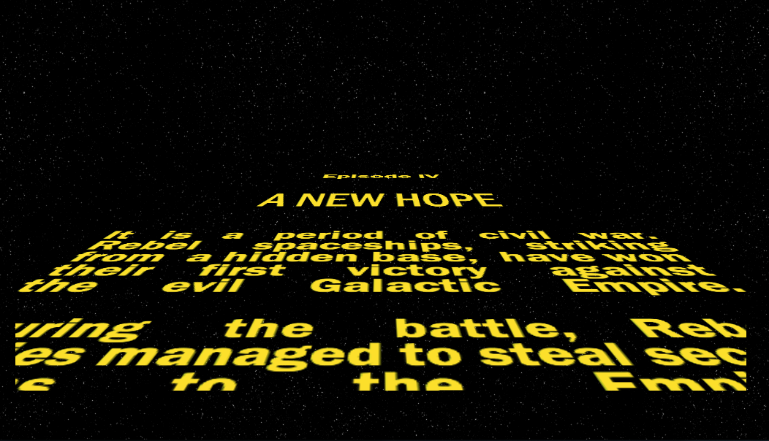
http://www.gesteves.com/experiments/starwars.html

