Slide 1
Building Web Applications with HTML5, CSS3, and Javascript:
An Introduction to HTML5
Jason Clark
Head of Digital Access & Web Services
Montana State University Libraries

Slide 2
pinboard.in #tag
pinboard.in/u:jasonclark/t:lita-html5/

Slide 3
twitter #hashtag
#litahtml5

Slide 4
Overview
New Features and Functions
Demos
Getting Started
Questions

Slide 5
Javascript APIs
Desktop programming for the web

Slide 6
Minification + Optimization
Removing unnecessary characters and spacing from code to reduce size, and optimizing the code to improve load times
Minify
http://www.minifyjavascript.com/
Optimize
http://www.jslint.com/

Slide 7
Selector APIs
Find elements by matching against a group of selectors (tags or attributes in DOM).
querySelector()
querySelectorAll()
var list = document.querySelectorAll('li.old, li.new');

Slide 8
Geolocation
w3c API
accurate
supported in Firefox 3.6, Safari 4
navigator.geolocation.getCurrentPosition();

Slide 9
File API, Drag & Drop API
Creating, reading, & uploading of files
Drag & drop API in combination with a draggable attribute

Slide 10
History API
Preserve the state of the page
Enabling back button in client-side scripts

Slide 11
Fullscreen API
Remove browser chrome
“Turn off the lights”
function launchFullScreen(element) {
if(element.requestFullScreen) {
element.requestFullScreen();
}
}
<button onclick="launchFullscreen(document.documentElement);">Go Fullscreen</button>

Slide 12
Device APIs
Allows access to video and audio input, e.g., from a webcam or microphone.
getUserMedia()

Slide 13
Page Visibility API
Check the active state of the page
React to changes in use of a page
Stop polling for data
Pause a video
document.hidden
document.visibilityState
visibilitychange Event

Slide 14
Notifications API
Display notifications to the user for given event or interactions
New emails, tweets or calendar events…
if (window.webkitNotifications)

Slide 15
Storage APIs
Keep files
Store keys/values
Local databases

Slide 16
sessionStorage
mega COOKIE
Stores key/value pairs while page is open

Slide 17
localStorage
mega COOKIE
Stores key/value pairs that persist after page and browser are closed

Slide 18
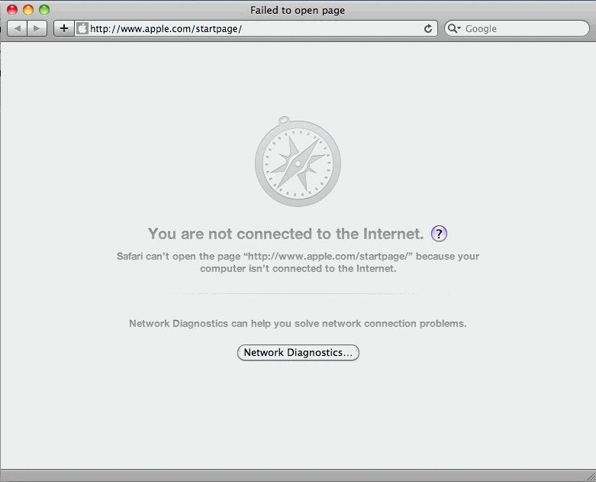

Slide 19
Offline Storage – Cache Manifest
Work without a connection
Create cache manifest file
Set server to allow for manifest file type
Link to manifest file in HTML <head>
CACHE MANIFEST
#store the files below
index.html
styles.css
images/logo.png
Scripts/global.js

Slide 20
Offline Storage - IndexedDB
My browser can haz database!
Simple key/value store within browser
Up to 5 MB of data storage
W3C discontinued Web SQL Database spec

Slide 21
Demos & Examples
It's your call....

Slide 22
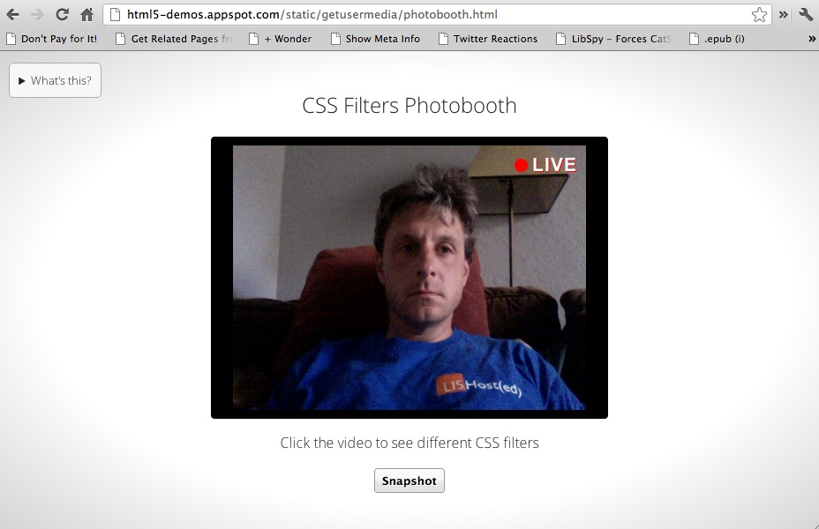
html5-demos.appspot.com/static/getusermedia/photobooth.html

Slide 23
Demos
Other possible examples:
geolocation
localStorage
IndexedDB

Slide 24
Resources
WHATWG HTML5 for Developers
http://developers.whatwg.org/
HTML5: Mozilla Developer Network
https://developer.mozilla.org/en-US/docs/HTML/HTML5
Dive into HTML5
http://diveintohtml5.info/

Slide 25
Assignment 3
Take your HTML5 Javascript template
http://www.lib.montana.edu/~jason/files/html5-mobile-feed/template.js
Add section page views
Add feed parse/display for second page view
Add geolocation showing coordinates on one of the other page views

Slide 26
Questions?
twitter.com/jaclark
www.lib.montana.edu/~jason/talks.php

Slide 27
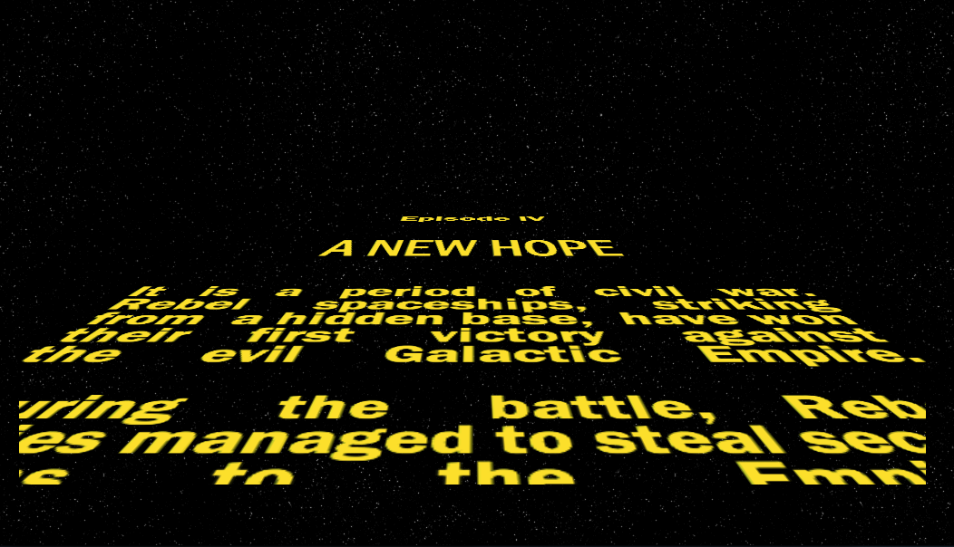
http://www.gesteves.com/experiments/starwars.html

