Slide 1
Search Engine Optimization for Libraries
"We cannot call a digital-library or electronic publishing system a success if we cannot measure and interpret its use.”
- Peterson Bishop 1998

Slide 2
Montana State University Research Team
Scott Young Digital Initiatives Librarian
Jason Clark Head of Library Informatics & Computing
Patrick OBrien Semantic Web Research Director
Kenning Arlitsch Dean of the Library

Slide 3
Agenda - Day 1
Overview
What is SEO and why do it?
Our experience
Common themes discovered
Library Organization & Strategy
Driving SEO from the strategic plan
Establishing accountability
Scalable tools and repeatable processes
Reporting and assessment
New knowledge work = new services

Slide 4
Overview

Slide 5
What is SEO?
The act of creating data that commercial search engines can find and index…
... to optimize measurable access, visibility and use of library/university content

Slide 6
SEO Major Areas
Institutional SEO
Strategic Plan
Measurement Tools
Traditional SEO
Get Indexed
Get Visible
Semantic Web SEO
Get Relevant

Slide 7
Why do SEO?
~200 million U.S. people use the Internet*
81% of U.S. adults
95% of U.S. teens
Americans submit 19+ billion queries per month to commercial SE**
Google owns 67% of these queries
* Pew Research Center. “What Internet users do online: Pew Research Center’s Internet & American Life Project,” 2012. http://pewinternet.org/Trend-Data-(Adults)/Online-Activites-Total.aspx
** comScore. “comScore Releases February 2014 U.S. Search Engine Rankings,” February 18, 2014. http://www.comscore.com/Insights/Press_Releases/2014/2/comScore_Releases_January_2014_US_Search_Engine_Rankings

Slide 8
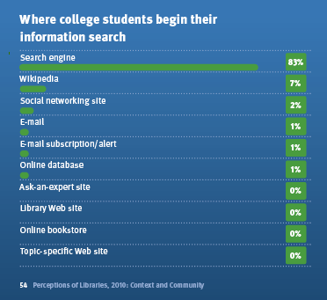
College Students Begin Research - 2010
DeRosa, Cathy, et al. “Perceptions of Libraries, 2010: Context and Community: A Report to the OCLC Membership”, OCLC, 2010.

Slide 9
More Reasons for SEO
ACRL
Funding providers want more accountability and demonstrated value*
IMLS
Identify effective museum and library services through performance monitoring**
State legislatures and local taxpayers
University administrators and donors
* ACRL Research Planning and Review Committee, “2010 top ten trends in academic libraries,” June 2010
**Institute of Museum and Library Services. 2011. “Creating a Nation of Learners; IMLS Five-Year Strategic Plan 2012–2016”
Notes:
“The IMLS assessment model will “identify effective museum and library services through performance monitoring” among other things.**

Slide 10
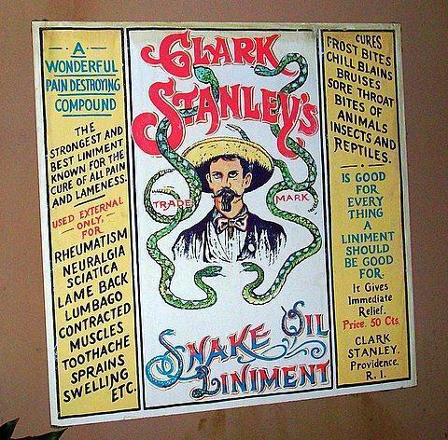
http://www.flickr.com/photos/22245459@N06/2386354917
https://en.wikipedia.org/wiki/Clark_Stanley

Slide 11
Our Experience with Traditional SEO
University of Utah digital collections in 2010
Less than 12% of collection content was accessible through Google
1% of USpace IR content was accessible through Google Scholar
Notes:
Similar situation in other MWDL partners and in spot checks across the nation

Slide 12
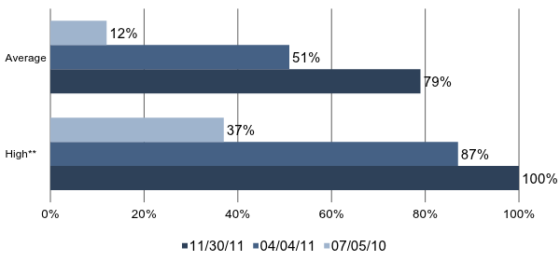
SEO improved collection accessibility in Google across the board…
Google Index Ratio - All Collections*
Notes:
* Google Index Ratio = URLs submitted / URLs Indexed by Google for about 150 collections containing ~170,00 URLs
**Highest index ratio achieved for Collections with over 500 URLs submitted to Google

Slide 13
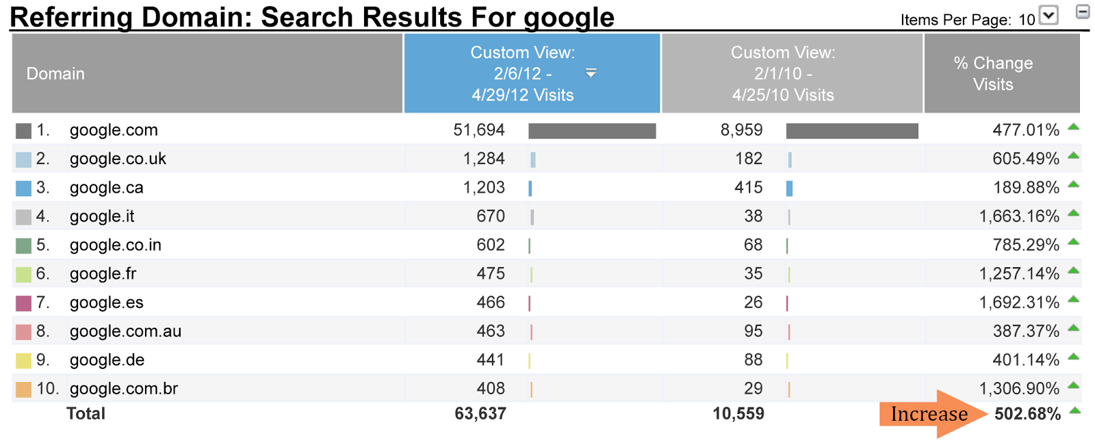
…resulting in more referrals and visitors…
12 week comparison 2010 vs. 2012

Slide 14
…producing significant increases in page views per day
Avg. Page Views / Day content.lib.utah.edu

Slide 15
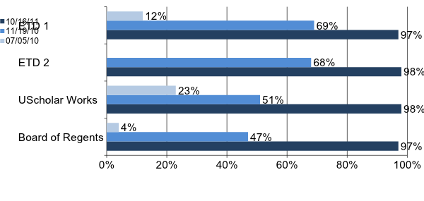
Almost 100% of USpace IR content is accessible to patrons using Google
Google Index Ratio
Google Scholar Index Ratio
0%
Weighted Average =97.8%
*October 16, 2011 Weighted Average Google Index Ratio = 97.82% (10,306/10,536).
Notes:
26% Three law journals GS Index ~ 26%
Range 14% - 38%
360 Articles
38% (68/179) Utah Law Review
14% (15/104) Journal Law & Family Studies
14% (12/81) Utah Environmental Law Review

Slide 16
IR indexing problem lay in metadata that GS couldn’t identify, parse and digest
Human Readable
Wolfinger, N. H., & McKeever, M. (2006, July). Thanks for nothing: changes in income and labor force participation for never-married mothers since 1982. In 101st American Sociological Association (ASA) Annual Meeting; 2006 Aug 11-14; Montreal, Canada (No. 2006-07-04, pp. 1-42). Institute of Public & International Affairs (IPIA), University of Utah.
Google Scholar Understandable

Slide 17
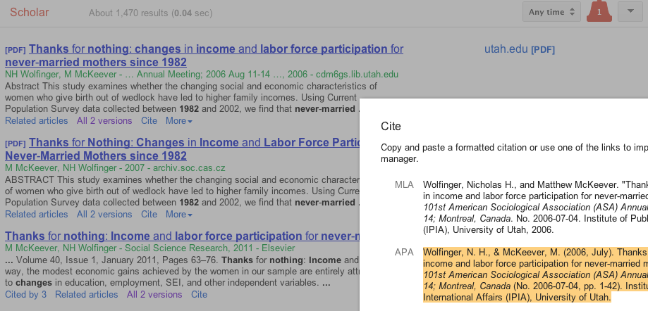
Google Scholar can read and understand!
Google Scholar

Slide 18
However, Google could not understand USpace structured data
No Schema.org = Not Understandable
No Microdata or RDFa = Not Readable

Slide 19
Semantic Web SEO
New Knowledge Work

Slide 20
Google’s Perception of MSU Lib - 2012
Notes:
Google Knowledge Graph Card

Slide 21
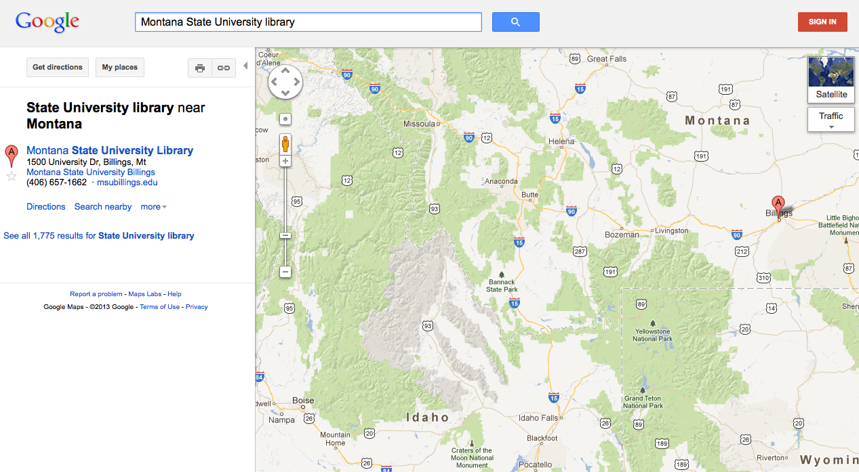
Google Maps

Slide 22
Where does Google get its information?

Slide 23
Trusted Sources for Search Engines
Wikipedia/DBpedia
No Wikipedia presence?
You don’t exist to search engines
Influences to Google’s Knowledge Graph
Google Places/Google My Business
Google+
Freebase

Slide 24
Wikipedia - 2012

Slide 25
DBpedia entry - 2012

Slide 26
Google Places - 2012

Slide 27
What’s a librarian to do?
Establish a semantic identity
Notes:
Can OCLC provide service to guide Wikipedia article creation?

Slide 28
How?
Define libraries and library concepts in Wikipedia
Beware of *pedia culture and process
Engage with other trusted data sources
Google Places/Google My Business
Google+
Freebase
Mark-up metadata with schema.org

Slide 29
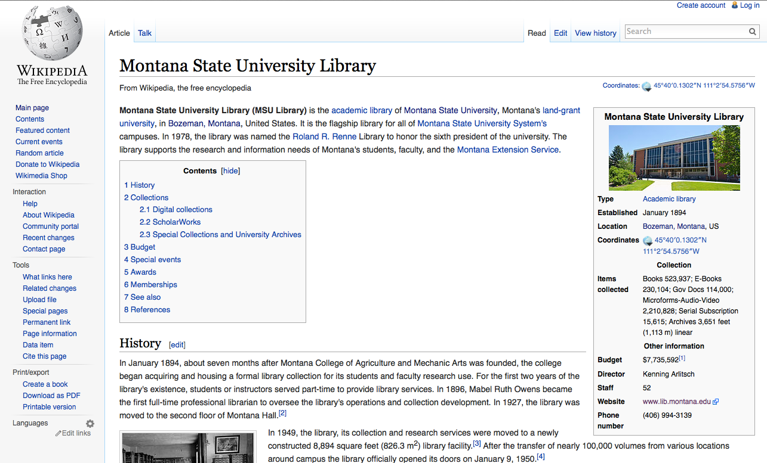

Slide 30
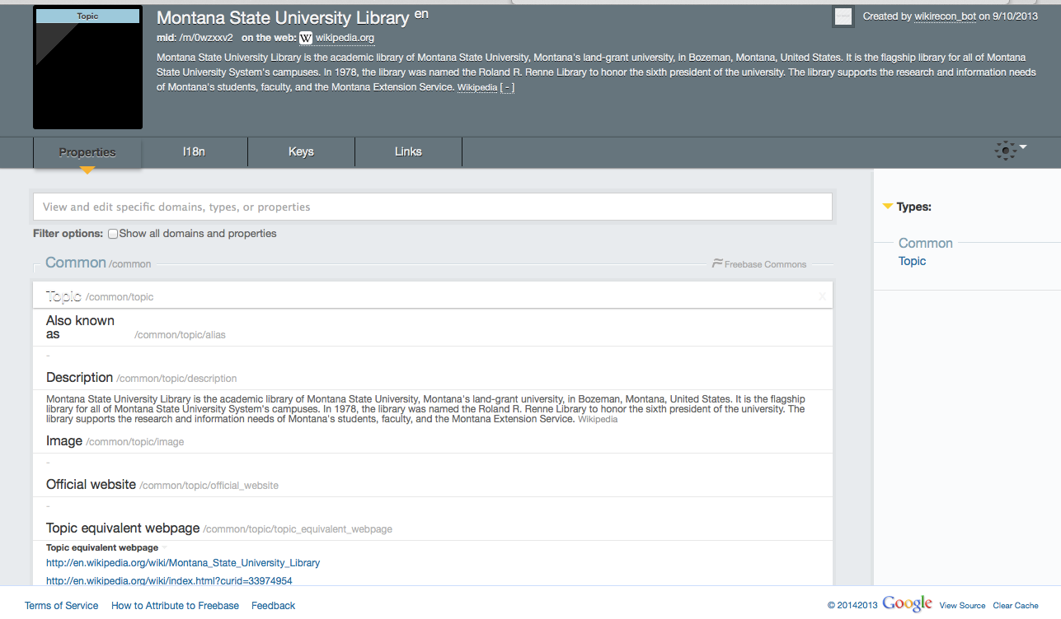
2014 Freebase entry

Slide 31
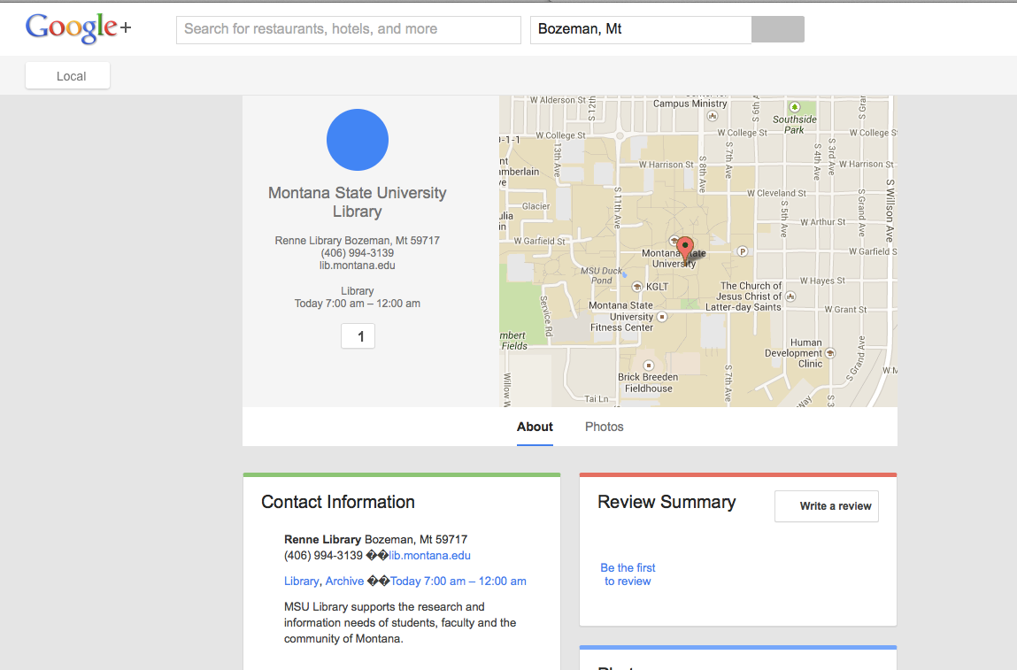
Google+

Slide 32
Google’s Perception of MSU Lib - 2012
Notes:
Google Knowledge Graph Card

Slide 33
Google’s Perception of MSU Lib - 2014

Slide 34
Themes discovered
Traditional SEO is an afterthought
Librarians think too small re potential traffic
Organizational communication is poor
Data in repositories often messy
Analytics usually poorly implemented
Vendors slow to catch on to SEO problems
Library software lacking for semantic web SEO
Libraries fail to establish semantic identities
Notes:
staff sometimes work in conflict with one another

Slide 35
Library Organization & Strategy

Slide 36
Recommendations and Priorities
Institutionalize SEO
Strategic Plan
Accurate Measurement Tools
Traditional SEO
Get Indexed = Index Ratio
Get Visible = Search Engine Results Page (SERP)
Semantic SEO
Get Relevant = Click Through Ratios (CTR)
Metadata
Linked Open Data (LOD)
Schema.org
Notes:
04/02/2013 – Zotero Work
3720 PDF
4400 Total

Slide 37
Question: Which part of the library organization is responsible for SEO?
Public Services
Information Technology
Cataloging and metadata
Administration
Special Collections
Answer: All of the above

Slide 38
University of Utah 2011 Strategic Plan
Library Strategic Plan
SEO Program Activities
Exploit the Digital and Networked Environments
Optimize Collections to Improve Visibility
Descriptions
Link Popularity
Page Elements
Metadata
Calls to Action
Develop Metrics Dashboard to monitor and improve efforts
Elevate our position and impact on campus
Improve IR Visibility and Citeability
Present program results at national and regional forums
Collaborate with the Library’s Campus Stakeholders
Diversify and increase the financial base
Apply for IMLS Grant
Improve Press website visibility and reach

Slide 39
Montana State University 2013 Strategic Plan
MSU Strategic Plan
Objective: Enhance infrastructure in support of research, discovery and creative activities
University Metric: MSU will increase grant-sponsored investment in centers, core facilities and resources to expand state of the art tools, expertise, and opportunities for research and creative activities
Develop an institutional repository of intellectual output of campus
MSU Library Strategic Plan
SEO Program Activities
Objective: Improve discovery layers and find-ability of library content
Library Metric: increase indexing rates of MSU content to improve access for researchers worldwide
Create dashboard for analytical reporting
Establish a baseline for Google’s indexing of library web content for search engine optimization
Establish baseline for Google Scholar’s indexing of ScholarWorks (IR)

Slide 40
Establishing accountability at the institutional level
Avoid the free-for-all of silos
Think institution, not department/individual
Insist on cross-organizational communication
Establish a consolidated master account
Everyone uses same baseline metrics and tools
Ex. Google Webmaster Tools, Google Analytics
Enable stakeholders for buy-in
Collection Managers
IT Personnel
Administrators

Slide 41
Set up scalable tools and repeatable process for improvement
Accessibility
SE-friendly sitemaps
Monitor via Google Webmaster Tools
Optimize server configurations
SE-friendly template viewer modifications
IR metadata transformation and reload
Use
Full capture via Google Analytics

Slide 42
Reporting and Assessment
Do you have goals?
How do you know you’re meeting them?
Tools like WT and GA can help (and they’re free!)
Reporting
Have you established baselines?
Can’t measure progress without
Monitor and measure
Balanced Scorecard for strategic plan

Slide 43
New Knowledge Work = New Services
Everyone struggles with these issues
University, colleges, departments, centers, etc.
Theory: SEO increases citations/university rankings
Develop a team
SEO skills
Repeatable processes
Show value to potential customers

Slide 44
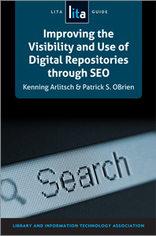
Further Reading
Arlitsch, Kenning, and Patrick S. OBrien. (2013). Improving the visibility and use of digital repositories through SEO. Chicago: ALA TechSource. ISBN-13: 978-1-55570-906-8

Slide 45
Recommendations & Priorties
Institutionalize SEO
Strategic Plan
Accurate Measurement Tools
Traditional SEO
Get Indexed = Index Ratio
Get Visible = Search Engine Results Page (SERP)
Semantic SEO
Get Relevant = Click Through Ratios (CTR)
Metadata
Linked Open Data (LOD)
Schema.org

Slide 46
Agenda - Day 1
Overview
What is SEO and why do it?
Our experience
Common Themes Discovered
Library Organization & Strategy
Recommendations and Priorities
Drive SEO from the Strategic Plan
Institutionalize SEO
Implement Accurate Measurement Tools
How to get Visibile?

Slide 47
Recommended Process Measurement & Evaluation
Single Google Account for your Institution
Establish baseline metrics
Google Analytics (gAnalytics)
Google Webmaster Tools (gMaster)
Activate Google Services
Google MyBusiness (gBusiness)
Google+ (G+)
Google AdWords (gAdWords)

Slide 48
Google Platform
Your Institution is a Thing that needs it own identity.
gAccount
msu.Lib@gmail.com
gAnalytics
gMaster
Relevant Keyword Phrases
gBusiness
G+
gAdWords
Notes:
https://accounts.google.com/SignUp?continue=https%3A%2F%2Faccounts.google.com%2FManageAccount

Slide 49
Agenda - Day 1
Overview
What is SEO and why do it?
Our experience
Common Themes Discovered
Library Organization & Strategy
Recommendations and Priorities
Drive SEO from the Strategic Plan
Institutionalize SEO
Implement Accurate Measurement Tools
How to Get Visibile?

Slide 50
Change from Strings to Things
SEO Goals are to increase access, visibility and use by patrons that value our content
Semantic Web is a framework of standards and technologies to share, integrate and represent data as concepts across different content, information and system boundaries.
Semantic Search incorporates the Semantic Web to understand the context and intent of users seeking information and the concepts contained within a document

Slide 51
Why semantic search is useful
Perfect application for research & discovery of concepts
Apple Siri
IBM Watson
Google Knowledge Graph
Making content Search Engine Readable & semantically Understandable can increase
click through rates (CTR) by 15%*
organic traffic by 30%*

Slide 52
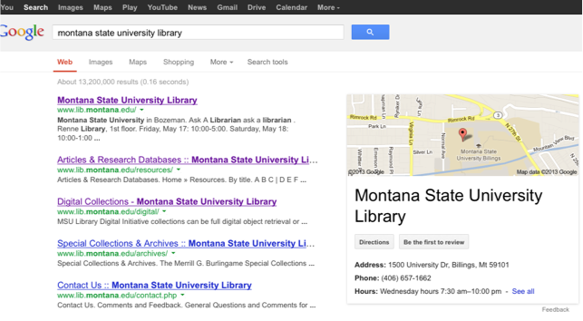
Semantic implies “meaning” or “understanding”
Notes:
Patrick

Slide 53
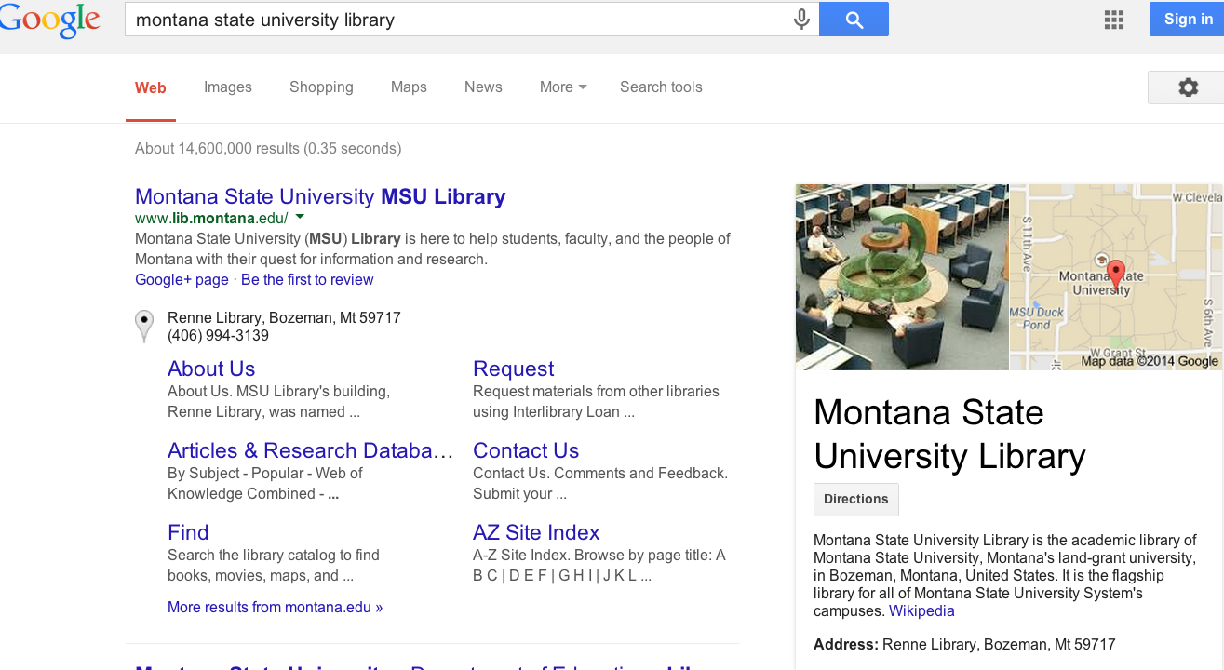
How do we help search engines get it right?
Notes:
Patrick

Slide 54
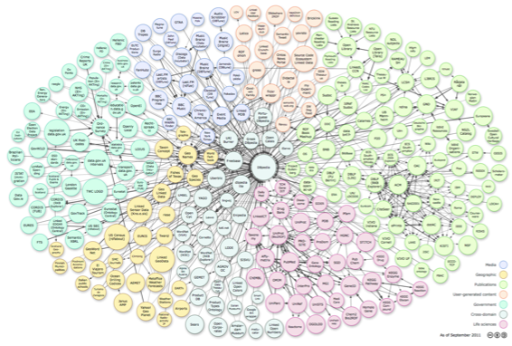
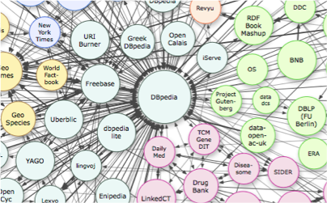
Understand where information comes

Slide 55
Know the SEO Guidelines
SE approved "Webmaster Guidelines"
Focus on improving user experience
Unique & accurate content
User relevant vocabulary & keywords
Intuitive site architecture
Build Stability & Trust
URLs
Custom 404 Pages
No Broken Links

Slide 56
Know SPAM = Banned
Using deceptive redirects
"Cloaking"
"Shadow" domains
Multiple "Doorway Pages" with poor content optimized for different keywords
"Link Schemes" trying to game the SE
"Hidden" text or links
Anything "sneaky" or untrustworthy

Slide 57
Above All: Focus on user experience
Descriptive Page Titles, anchor text, descriptions, etc.
External linking
Easy & Intuitive Site Navigation
Submit sitemaps/configure robots.txt file
Monitor & address errors
Inform staff & assign ownership
Upgrade repository software
Optimize webserver performance

Slide 58
Improve On-Page Optimization
Keyword phrase analysis
Patron relevant
Low to Moderate competition
High volume
Write / rewrite Web page
HTML <title>
<description> metatag
Ensure
all links contain descriptive "Anchor Text"
Use <H1>, <H2> HTML tags to "outline" the page around the topic (i.e. <title>)
Text is natural, easy-to-read,descriptive and relevant to the page outline (i.e., H1, H2)

Slide 59
Keyword Phrase Analysis
Focus on your audience
Broad or Specific?
High School Students
Pre-Ottoman Egypt Scholars
Can you group them by a common theme?
Person
Place
Thing
Timeperiod
What words and phrases are your target patrons using?

Slide 60
Keyword Phrase Selection
Which keyword phrase?
institutional repository
academic research
research papers
open access repository

Slide 61
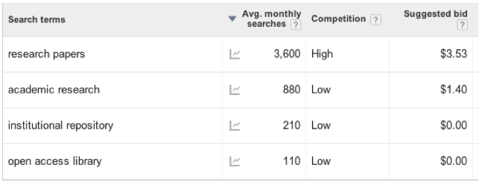
Use Google Keyword Planner Tool

Slide 62
Check Singular vs Plural

Slide 63
Digital Collection Demonstration
James Willard Schultz
Any Related Wikipedia Page(s)?
Use Google Keyword Planner for ideas
Look at linked words for specific ideas
Do we have a Collection Page?
Run Keyword Planner
Check Webmaster tools
What about an Item Page?
Notes:
hotel, lodge, lodging
http://arc.lib.montana.edu/schultz-0010/item.php?id=358

Slide 64
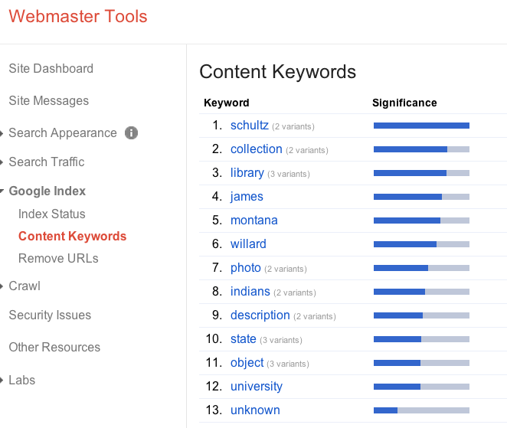
James Willard Schultz Collection

Slide 65
Things to Remember
Settings
Geographic
Negative Keywords - hotels, lodging, etc.
Broad Match = ideas
Phrase Match = 2 to 3 word natural language
Exact Match = specific competition & traffic
Dangers
Avoid "high" competition phrases / words
Too much time thinking about it
Unnatural use (i.e., keyword stuffing)

Slide 66
Writing an Item Page Title
<title> "Specific Keyword Phrase - Context"
Example: “James Willard Schultz in Buffalo Coat going home to Boonville, New York”

Slide 67
<description>
a short, declarative sentence that incorporates a page's <title> keyword phrase and context
Example:
"Photo of James Willard Schultz in Buffalo Coat returning home to Boonville, New York from Montana State University (MSU) Library Special Collections"

Slide 68
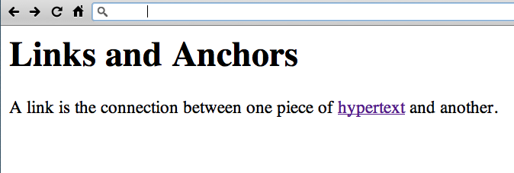
http://www.w3.org/History/19921103-hypertext/hypertext/WWW/Link.html

Slide 69
Creating Indexable Content
User intuitive hierarchy & site architecture
Short URLs containing keywords
Simple directory structure
Incorporate "Breadcrumbs"
Single URL to each page
Easy navigation between homepage and any webpage, and back
“Every page should be reachable from at least one static text link.”
https://support.google.com/webmasters/answer/35769

Slide 70
Homework
Traditional SEO
SEO Course Moodle instance
http://www.classes.ala.org/course/view.php?id=537

