Slide 1
Search Engine Optimization for Libraries
Day - 2
"We cannot call a digital-library or electronic publishing system a success if we cannot measure and interpret its use.”
- Peterson Bishop 1998

Slide 2
"Getting Found" Research Team
Scott Young Digital Initiatives Librarian at Montana State University
Jason Clark Head of Library Informatics & Computing at Montana State University Library
Patrick OBrien Semantic Web Research Director at Montana State University Library
Kenning Arlitsch Dean of the Library at Montana State University. His book, co-authored with Patrick OBrien, is titled Improving the Visibility and Use of Digital Repositories through SEO, and was published in February 2013.

Slide 3
"Getting Found: Search Engine Optimization for Digital Repositories”
- IMLS 3 Year Research Grant

Slide 4
Homework
Traditional SEO
SEO Course Moodle instance
http://www.classes.ala.org/course/view.php?id=537

Slide 5
Recommendations & Priorities
Institutionalize SEO
Strategic Plan
Accurate Measurement Tools
Traditional SEO
Get Indexed = Index Ratio
Get Visible = Search Engine Results Page (SERP)
Semantic SEO
Get Relevant = Click Through Ratios (CTR)
Metadata
Linked Open Data (LOD)
Schema.org

Slide 6
Recommended Process Measurement & Evaluation
Single Google Account for your Institution
Establish baseline metrics
Google Analytics (gAnalytics)
Google Webmaster Tools (gMaster)
Activate Google Services
Google MyBusiness (gBusiness)
Google+ (G+)
Google AdWords (gAdWords)

Slide 7
Google Platform
gAccount
gAnalytics
gMaster
gBusiness
G+
gAdWords
Key
covered today
Notes:
https://accounts.google.com/SignUp?continue=https%3A%2F%2Faccounts.google.com%2FManageAccount

Slide 8
Recommendations for Institutional gAccount
Name: founder / building name
Roland Renne
UserName: unique & easy to remember
msu.renne.seo@gmail.com
Password: considerations
Strong & Two Step Authentication
Recovery Email & Text
different Admin or an internal email list
Birthday: easy to remember ideas
18+ years old
Last Renovation, Addition, etc.

Slide 9
Google Platform
gAccount
gAnalytics
gMaster
gBusiness
G+
gAdWords
Notes:
https://accounts.google.com/SignUp?continue=https%3A%2F%2Faccounts.google.com%2FManageAccount

Slide 10
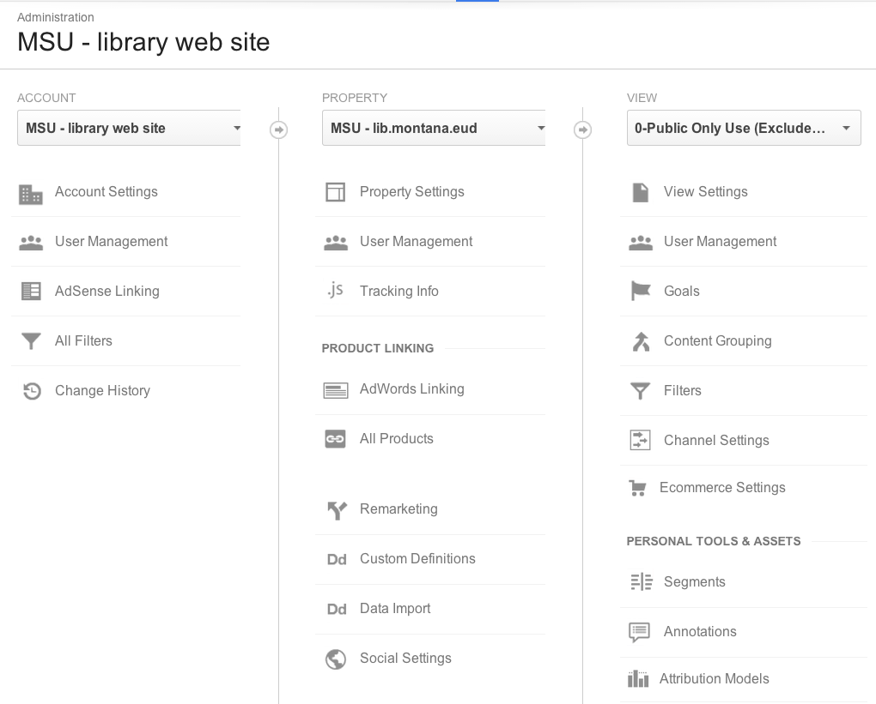
gAnalytics Key Admin Areas

Slide 11
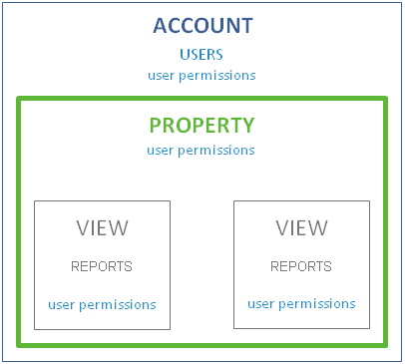
gAnalytics Key Concepts
Add Users to an Account
Users get permissions
Account
Property
View
Permissions flow down Account -> View

Slide 12
Account Filters Include or Exclude User Activity
Key Points
Built at Account level
Applied at the View level
Once applied the data can not be recovered
Recomended
Exclude Library Staff IP Address
Suggested
Campus vs Non-Campus Access via IP

Slide 13
Google Analytics Key Areas

Slide 14
Property groups information
Usually created for each domain
www.lib.montana.edu
arc.lib.montana.edu
scholarworks.montana.edu
Best-practice
Don't use the www.
lib.montana.edu aggergates
www.lib.montana.edu
arc.lib.montana.edu
guides.lib.montana.edu

Slide 15
Property Settings
Industry Category = Reference
After gAnalytics Implemented
Activate Webmaster Tools site
Consider "enhanced link attribution" for event tracking of non-HTML downloads
Privacy Issues - Do NOT Use
Enable Demographics and Interest Reports

Slide 16
.js Tracking Info
Upgrade to Universal Analytics
ga.js = legacy gAnalytics
analytics.js = Universal Analytics
Improve Privacy
Add IP Anonymization
Privacy Issues - Do NOT Use
User-ID

Slide 17
Universal Analytics js.Tracking code
<script>
Account #
Property #
ga('create', 'UA-XXXX-Y', 'auto'); // Creates a tracker.
ga('send', 'pageview'); // Sends a pageview.
ga('set', 'anonymizeIp', true);
</script>
</head>
<body>

Slide 18
Google Analytics Key Areas

Slide 19
Views are applied to a Property
Best-practice
Create 2 Views for each Property
Raw Data - no filters - Admin Access Only
Public Only Use (Excludes staff computers)
Site search Tracking = On
0-Public Only Use (Excludes staff computers)
Apply "Exclue Staff IP Filter" to View

Slide 20
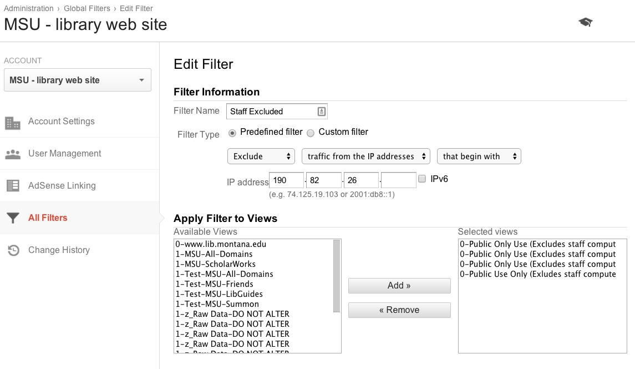

Slide 21
Google Platform
gAccount
gAnalytics
gMaster
gBusiness
G+
gAdWords
Notes:
https://accounts.google.com/SignUp?continue=https%3A%2F%2Faccounts.google.com%2FManageAccount

Slide 22
Above All: Focus on user experience
Descriptive Page Titles, anchor text, descriptions, etc.
External linking
Easy & Intuitive Site Navigation
Submit sitemaps/configure robots.txt file
Monitor & address errors
Inform staff & assign ownership
Upgrade repository software
Optimize web server performance

Slide 23
gMaster
Activate gMaster via gAnalytics Verification
Add / remove users to the gMaster account
Focus on
Eliminating Crawl Errors
Improving Crawler Efficiency

Slide 24
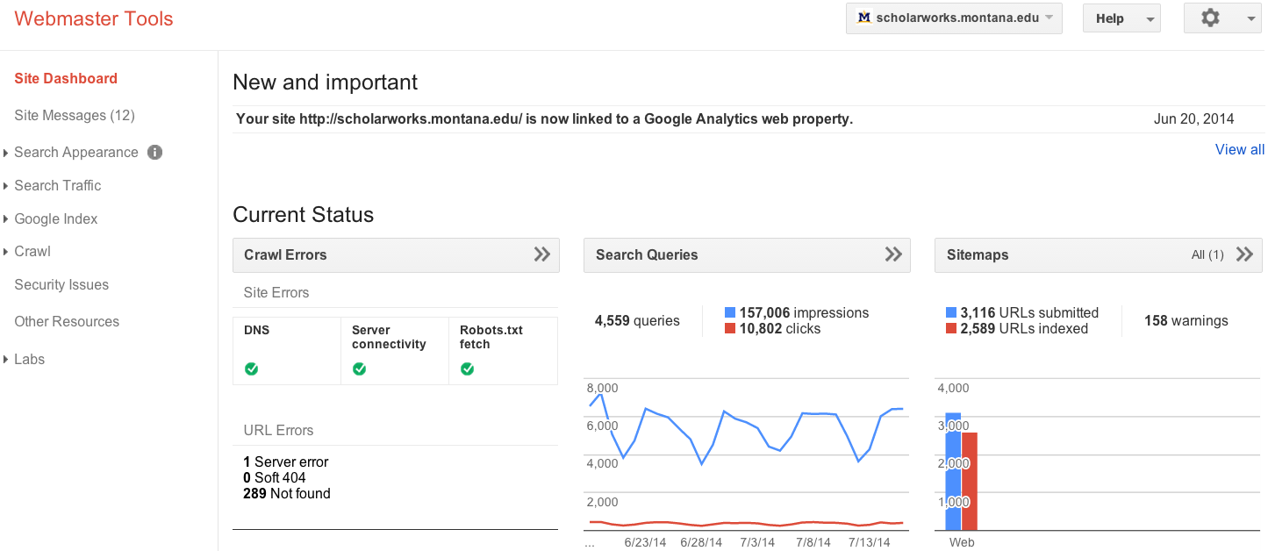
gMaster Dashboard

Slide 25
Eliminate Crawl Errors
Server Errors
See HTTP 5XX
Page Not found
HTTP 404
Provide a useful 404 Page
Use 301 Redirects
Soft 404

Slide 26
gMaster Dashboard

Slide 27
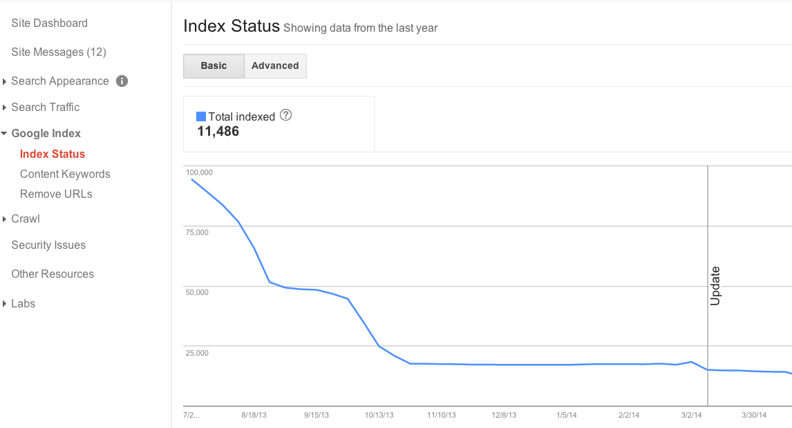
Does your Index Status Make Sense?

Slide 28
Sitemaps Provide Inclusion Guidance
Link a human readable HTML sitemap from homepage
Implement machine-readable XML file(s) to provide SE content inclusion direction
"sitemapindex"
"sitemap" file(s)
“Google adheres to Sitemap Protocol 0.9 as defined by sitemaps.org.”

Slide 29
Robots.txt provide crawlers guidance to reduce Index "noise"
Text file at top level / root of web site
Provides SE exclusion guidance
Test your robots.txt file
Disallow: /staff/
#allow primary mobile page
Allow: /finding-aids/m/index.php
Allow: /finding-aids/m/$

Slide 30
Canonicalization & HTML directive markup helps reduce duplicate content
HTML <head> tags
Reduce duplication <link rel="canonical" href="http://arc.lib.montana.edu/finding-aids/item/23" />
Page Level Crawler Guidance <meta name="robots" content="nofollow,noindex" />
HTML <body> tags
Improve Crawler Efficiency <a rel="nofollow" href="http://www..lib.montana.edu/login.html">User Login</a>

Slide 31
Google Platform
gAccount
gAnalytics
gMaster
gBusiness
G+
gAdWords
Notes:
https://accounts.google.com/SignUp?continue=https%3A%2F%2Faccounts.google.com%2FManageAccount

Slide 32
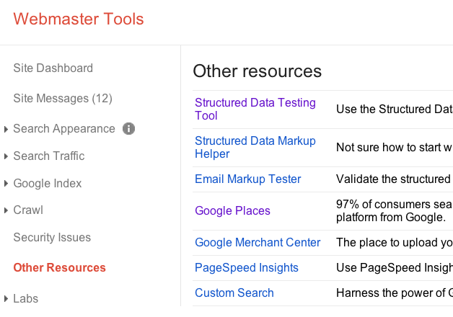
One way of getting to gBusiness
A.K.A.
Google Business
Google MyBusiness

Slide 33
Claim, consolidate and standardize listings
Create list for all variations
Name of library
Name of library building
All library phone numbers
Search
gMaps
gBusiness
G+
Notes:
Patrick

Slide 34
Claim, consolidate and standardize listings
Login gBusiness
Use Institutional gAccount
Claim ownership every variation found
Review each gBusiness listing
Find G+ "pre-approved custom URL"
Consolidate under gBusiness w/ "pre-approved custom URL"
Notes:
Patrick

Slide 35
Complete and standardize consolidated gBusiness and G+ profiles
Name
Address
Phone Number(s)
Notes:
Patrick

Slide 36
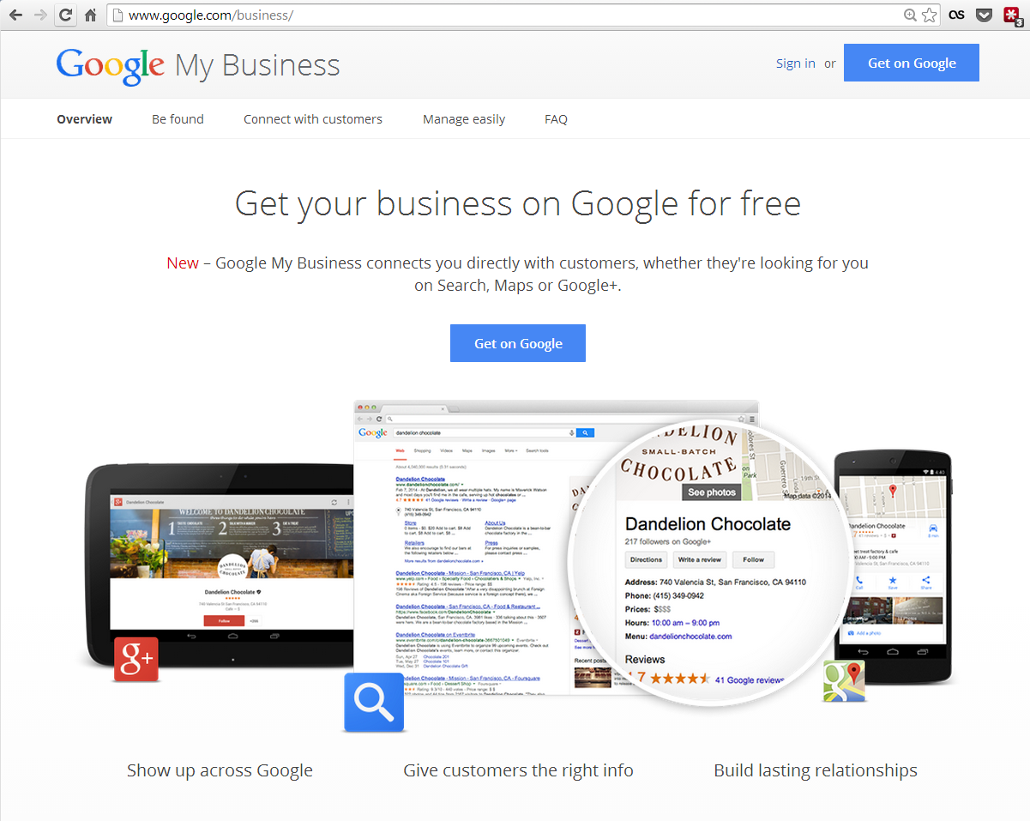

Slide 37
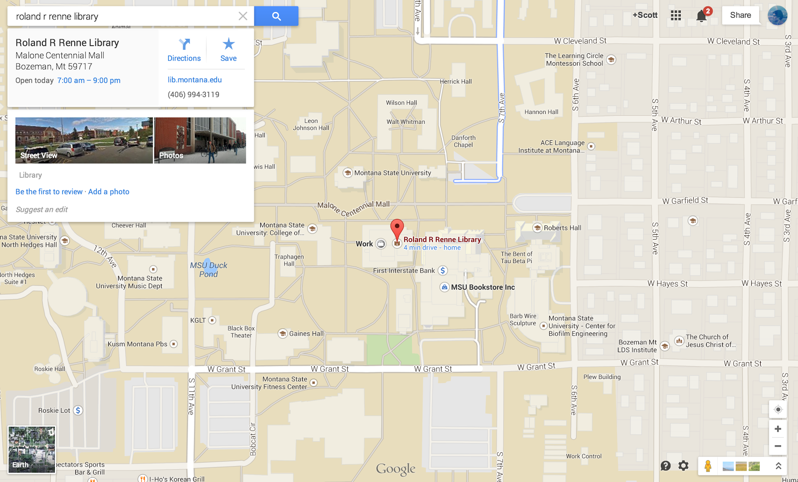

Slide 38
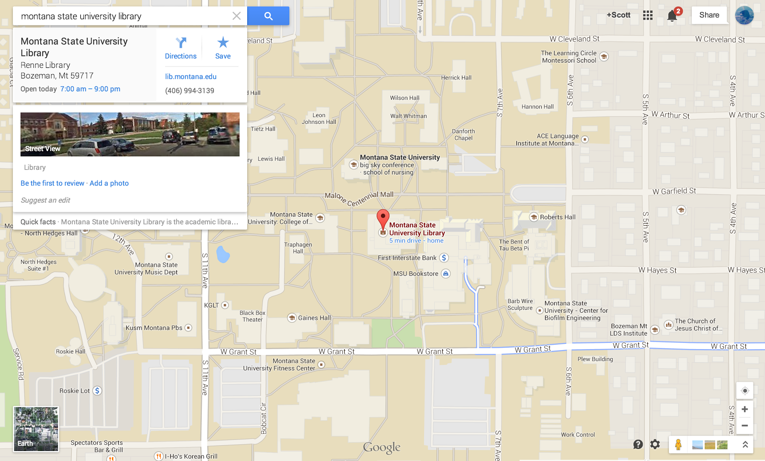

Slide 39
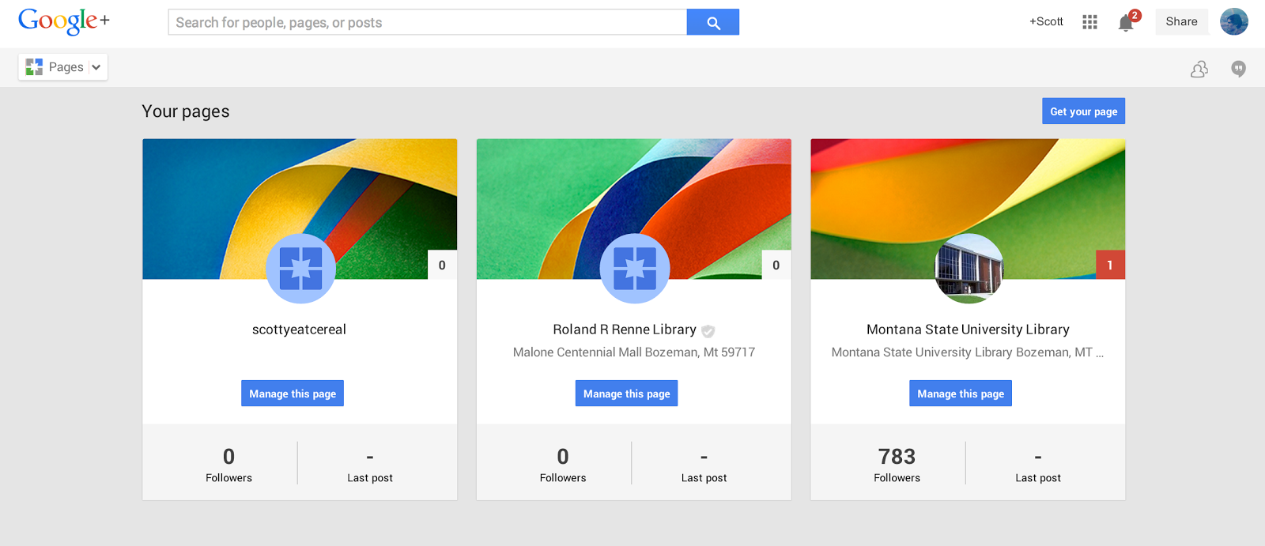

Slide 40
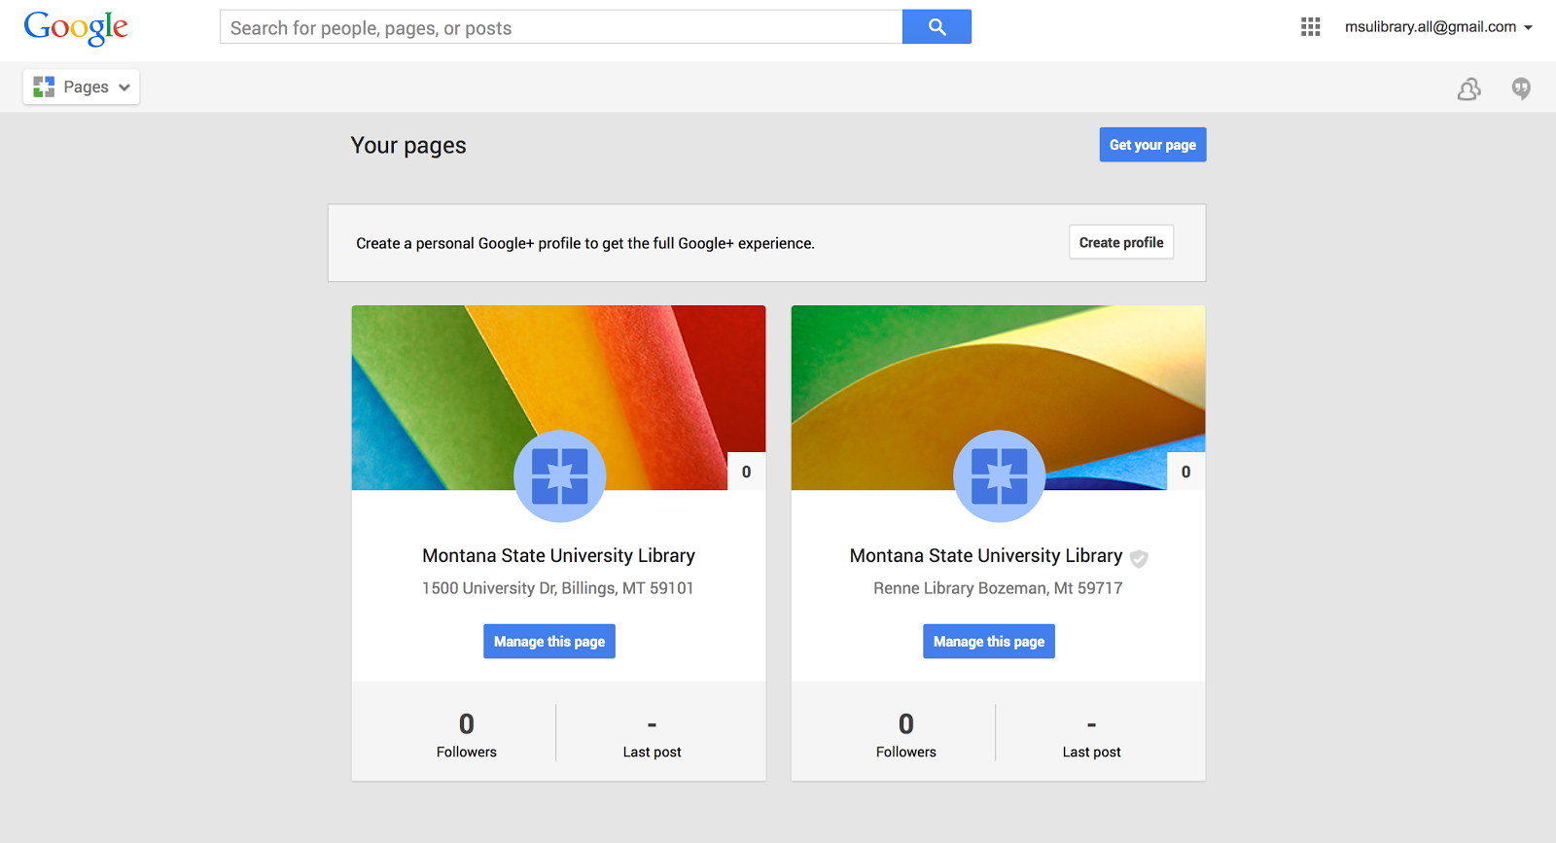

Slide 41
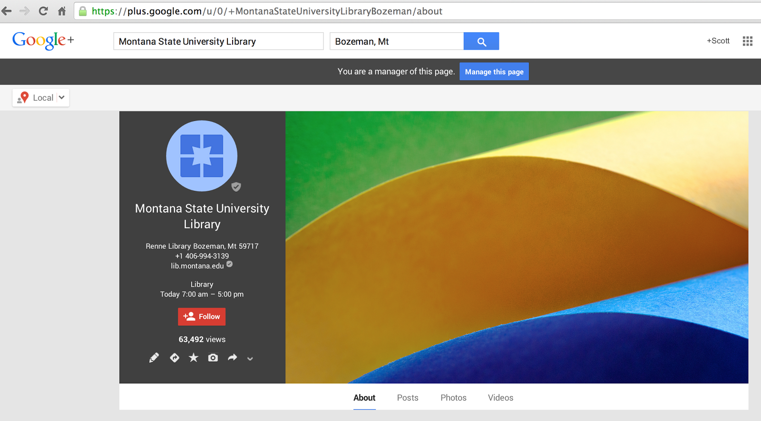

Slide 42
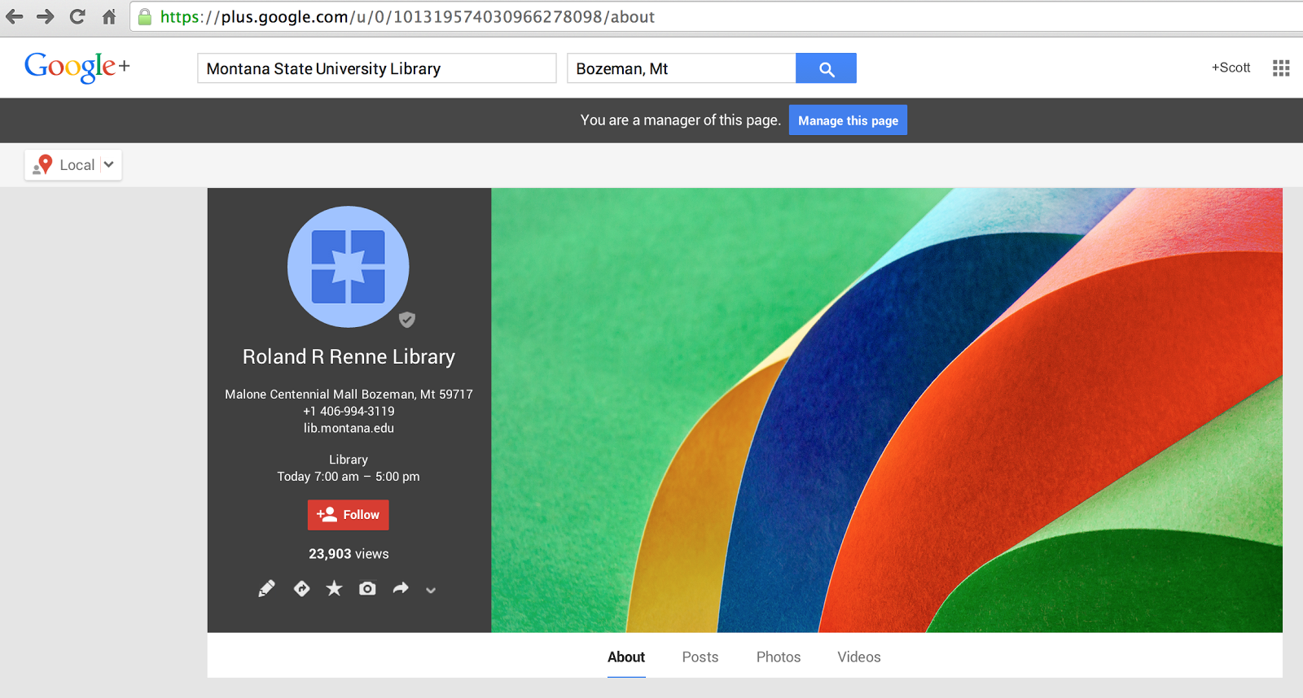

Slide 43
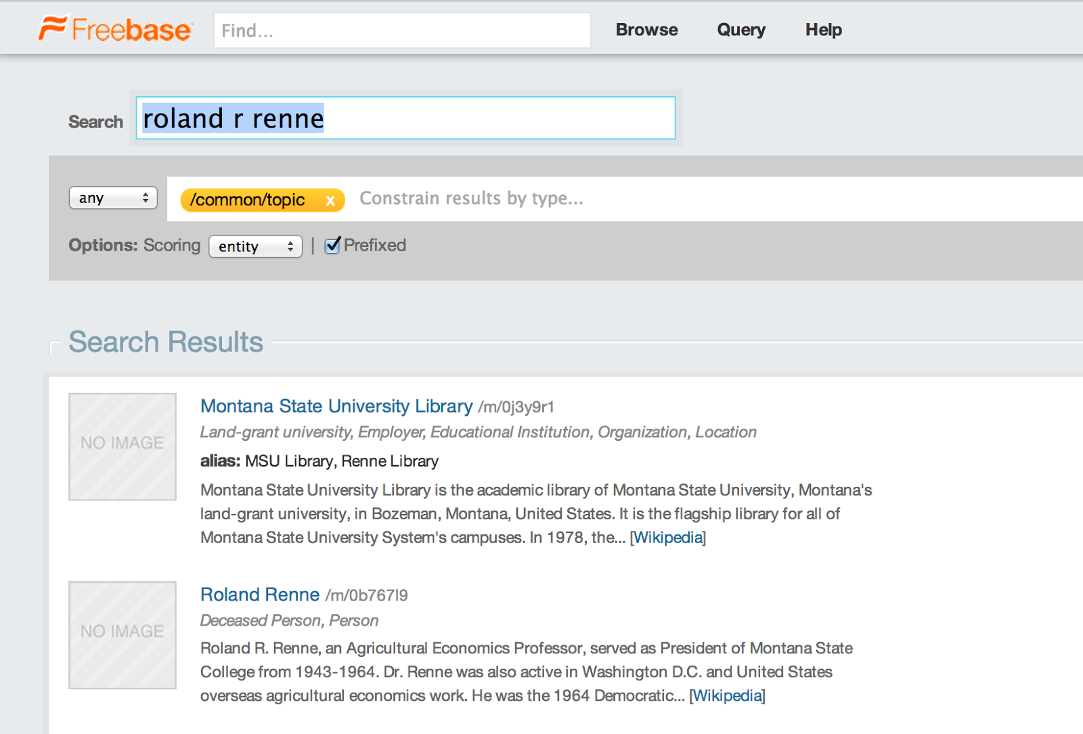

Slide 44
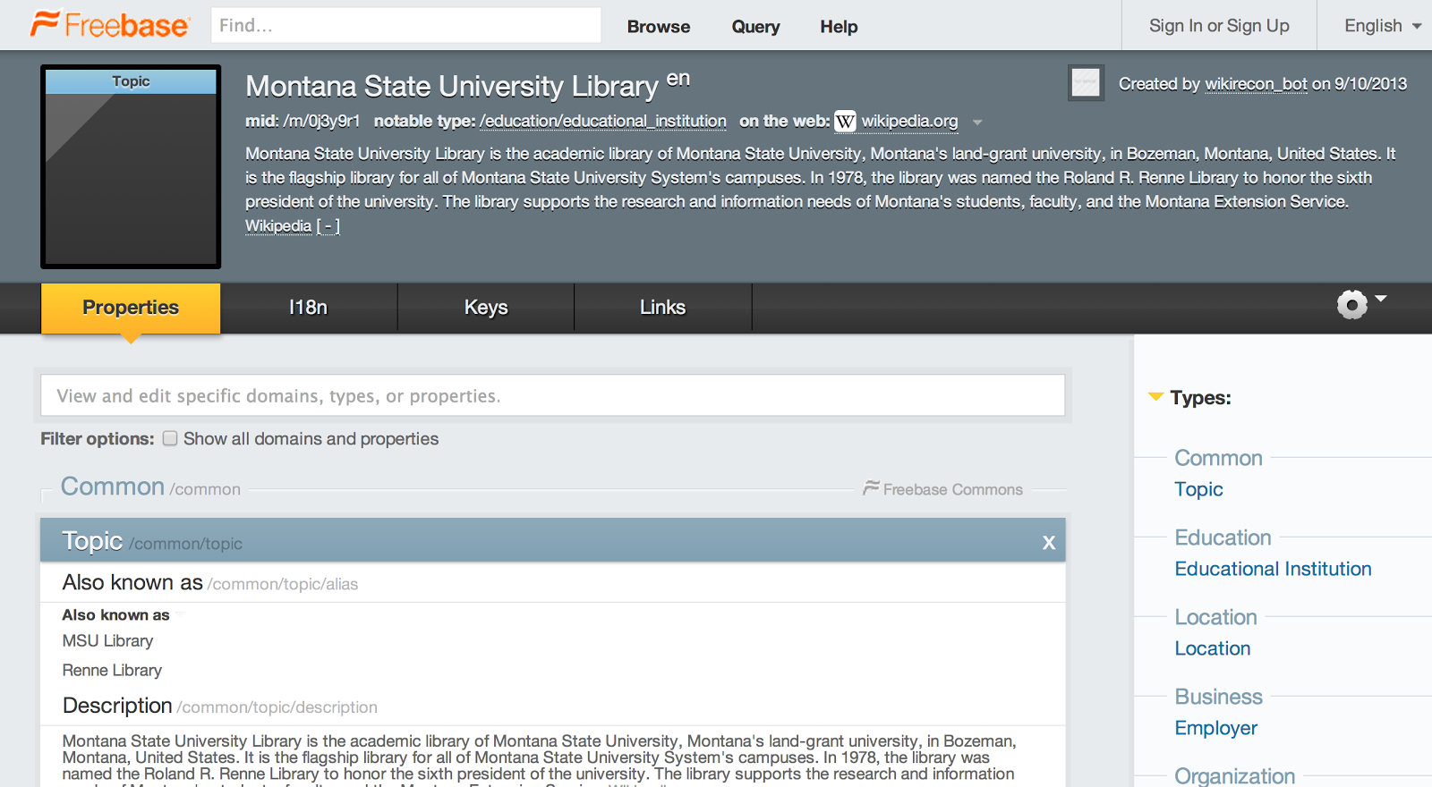

Slide 45
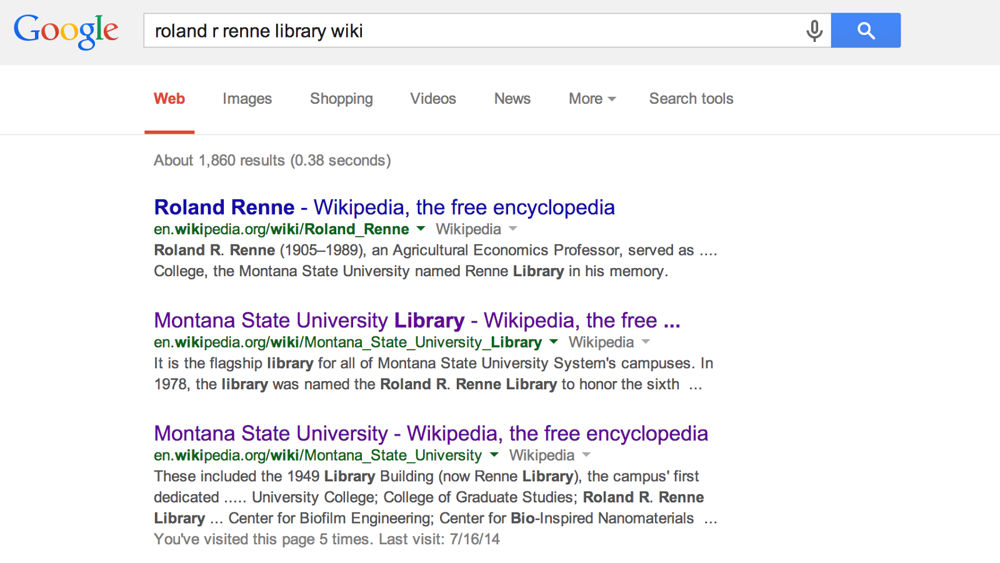

Slide 46
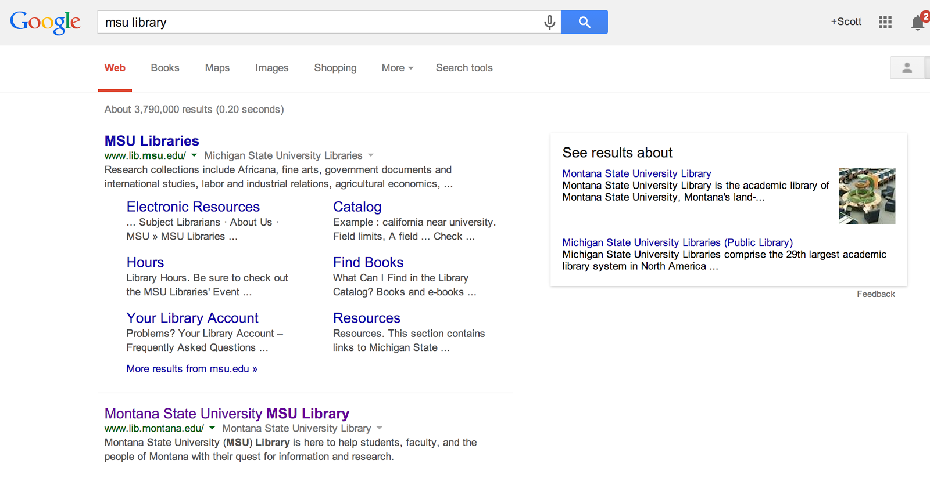

Slide 47
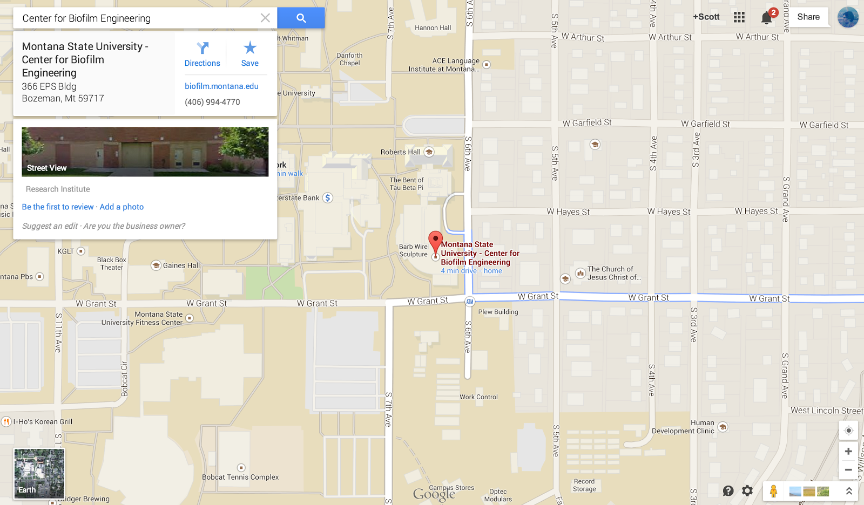

Slide 48
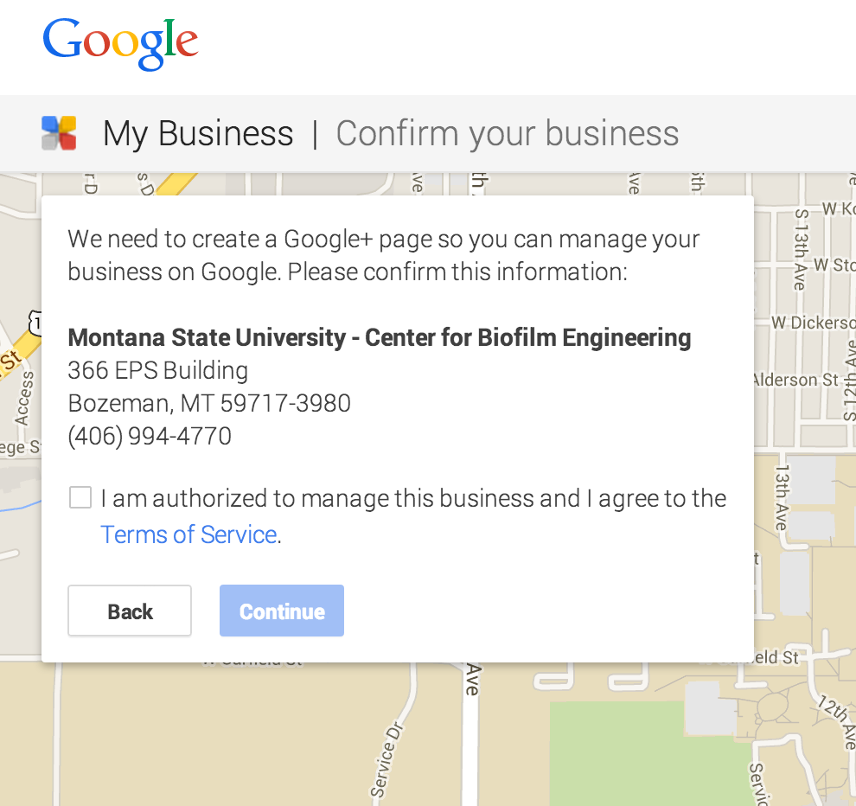

Slide 49
Homework
Institutional Setup & Identity
https://docs.google.com/document/d/1HWVOkPn9UJXLeY3CV14cEPQKQtvgh6yA6T6uXK6-iAw/edit
SEO Course Moodle instance
http://www.classes.ala.org/course/view.php?id=537

