Slide 1
Search Engine Optimization for Libraries
"We cannot call a digital-library or electronic publishing system a success if we cannot measure and interpret its use.”
- Peterson Bishop 1998

Slide 2
Research Team
Scott Young Digital Initiatives Librarian at Montana State University
Jason Clark Head of Library Informatics & Computing at Montana State University Library
Patrick OBrien Semantic Web Research Director at Montana State University Library
Kenning Arlitsch Dean of the Library at Montana State University. His book, co-authored with Patrick OBrien, is titled Improving the Visibility and Use of Digital Repositories through SEO, and was published in February 2013.

Slide 3
"Getting Found: Search Engine Optimization for Digital Repositories”
- IMLS 3 Year Research Grant

Slide 4
pinboard.in tag
pinboard.in/u:jasonclark/t:lita-seo/

Slide 5
Agenda - Day 3
What is Structured Data?
New Markup Practices
Creating/Refining the Searchable Index
Impact of these Semantic SEO techniques
Questions
Resources

Slide 6
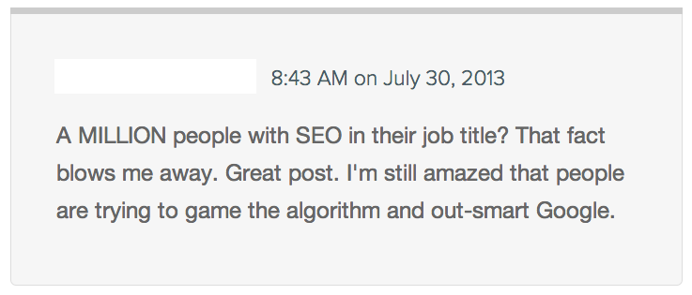
Black Hat SEO

Slide 7
White Hat SEO
SE approved "Webmaster Guidelines"
Focus on improving user experience
Unique & accurate content
User relevant vocabulary & keywords
Intuitive site architecture
Build Stability & Trust

Slide 8
Homework
Traditional SEO
https://docs.google.com/document/d/1L8lbQTFBdFkgHCv0bz7pqV5tpMxdFT_Ljaz9fcC-O1o/edit?usp=sharing
SEO Course Moodle instance
http://www.classes.ala.org/course/view.php?id=537

Slide 9
Writing an Item Page Title
<title> "Specific Keyword Phrase - Context"
Example: “James Willard Schultz in Buffalo Coat going home to Boonville, New York”

Slide 10
<description>
a short, declarative sentence that incorporates a page's <title> keyword phrase and context
Example:
"Photo of James Willard Schultz in Buffalo Coat returning home to Boonville, New York from Montana State University (MSU) Library Special Collections"

Slide 11
Introducing Semantic Markup
HTML5 semantic tags and schema.org vocabularies that help classify page types and identify content on the page
“If Google understands the content on your pages, we can create rich snippets—detailed information intended to help users with specific queries.”
https://support.google.com/webmasters/answer/99170?hl=en&ref_topic=1088472

Slide 12
Semantic & Functional Markup
header footer main nav section aside | figure figcaption article menu …. contenteditable attribute
www.whatwg.org/specs/web-apps/current-work/

Slide 13
Link Relations
Explain why you're pointing to another page.
"I'm pointing to this other page because..."
<link rel="stylesheet" href="template.css"/>
rel=alternate rel=archives rel=author rel=external rel=icon rel=license | rel=canonical rel=prefetch rel=search rel=sidebar rel=tag ...

Slide 14
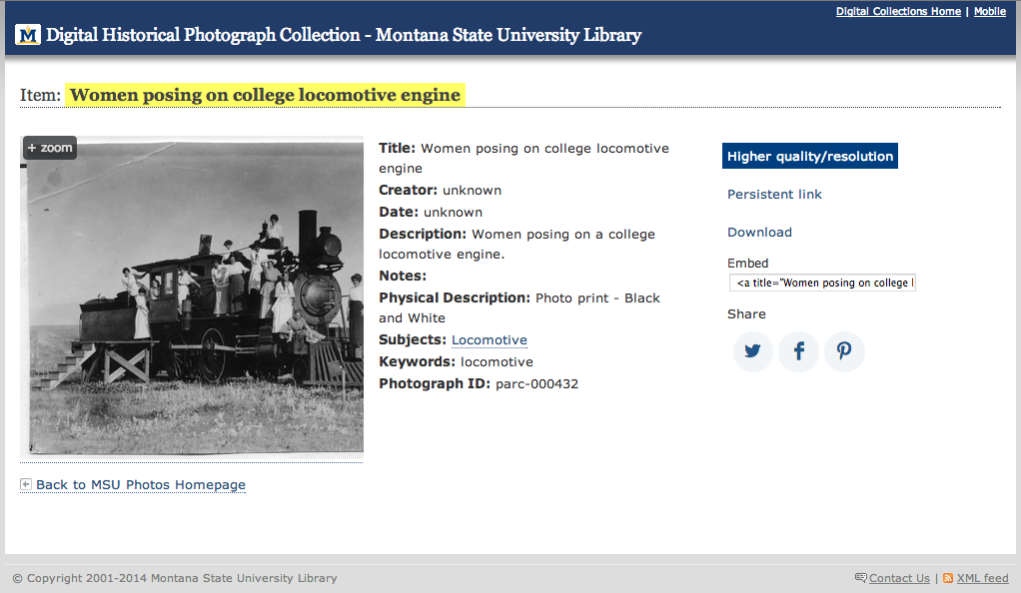
Before Schema.org markup

Slide 15
After Schema.org markup

Slide 16
<div id="main">
<meta content="http://arc.lib.montana.edu/msu-photos/objects/thumb-parc-000432.jpg" />
...
<h2 class="mainHeading">Item: <strong>Women posing on college locomotive engine</strong></h2>
<ul class="item">
<li>
<ul class="metadata">
<li class="object">
<a title="zoom &amp; scan view - Women posing on college locomotive engine" href="/msu-photos/viewer.php?id=432" alt="Women posing on college locomotive engine"><img src="/msu-photos/objects/parc-000432.jpg" alt="Women posing on college locomotive engine" />
<span>&#43; zoom</span>
</a>
</li>
<li class="describe">
<p><strong>Title:</strong> Women posing on college locomotive engine</p>
<p><strong>Creator:</strong> unknown</p>
<p><strong>Date:</strong> 1931-05-15</p>
<p><strong>Description:</strong> Women posing on a college locomotive engine.</p>
...
<p><strong>Physical Description:</strong> Photo print - Black and White</p>
...
<p><strong>Keywords:</strong> locomotive</p>
<p><strong>Photograph ID:</strong> parc-000432</p>
</li>
</ul><!-- end metadata <ul> -->
</li>
</ul><!-- end item <ul> -->
</div>

Slide 17
<div id="main" vocab="http://schema.org/" typeof="ItemPage" >
<meta property="thumbnailUrl" content="http://arc.lib.montana.edu/msu-photos/objects/thumb-parc-000432.jpg" />
...
<h2 class="mainHeading">Item: <strong><span property="name">Women posing on college locomotive engine</span></strong></h2>
<ul class="item">
<li>
<ul class="metadata">
<li class="object">
<a title="zoom &amp; scan view - Women posing on college locomotive engine" href="/msu-photos/viewer.php?id=432" alt="Women posing on college locomotive engine"><img property="about image primaryImageOfPage" src="/msu-photos/objects/parc-000432.jpg" alt="Women posing on college locomotive engine" />
<span>&#43; zoom</span>
</a>
</li>
<li class="describe" vocab="http://schema.org/" typeof="Photograph">
<p><strong>Title:</strong> <span property="name">Women posing on college locomotive engine</span></p>
<p><strong>Creator:</strong> <span property="author">unknown</span></p>
<p><strong>Date:</strong> <span property="dateCreated">1931-05-15</span></p>
<p><strong>Description:</strong> <span property="description">Women posing on a college locomotive engine.</span></p>
...
<p><strong>Physical Description:</strong> <span property="genre">Photo print - Black and White</span></p>
...
<p><strong>Keywords:</strong> <span property="keywords">locomotive</span></p>
<p><strong>Photograph ID:</strong> parc-000432</p>
</li>
</ul><!-- end metadata <ul> -->
</li>
</ul><!-- end item <ul> -->
</div>

Slide 18
<dl>
<dt>Title</dt>
<dd>A River Runs Through It and Other Stories</dd>
<dt>Author</dt>
<dd>Norman Maclean</dd>
<dt>Publication date</dt>
<dd>October 1, 2001</dd>
<dt>ID</dt>
<dd>0226500667</dd>
</dl>

Slide 19
<dl itemscope itemtype="http://schema.org/Book">
<dt>Title</dt>
<dd itemprop="title">A River Runs Through It and Other Stories</dd>
<dt>Author</dt>
<dd itemprop="author">Norman Maclean</dd>
<dt>Publication date</dt>
<dd itemprop="pubdate">October 1, 2001</dd>
<dt>ID</dt>
<dd itemprop="isbn">0226500667</dd>
</dl>

Slide 20
Schema.org
A lingua franca for web classification and markup
Google, Bing, Yahoo, Yandex

Slide 21
Why Schema.org?
Libraries as publishers in Web of Data
Machines understanding our data = Significance
Can improve findability in search engines (search engine optimization)
Can create efficiencies in our own indexing (e.g., digital collections search)

Slide 22
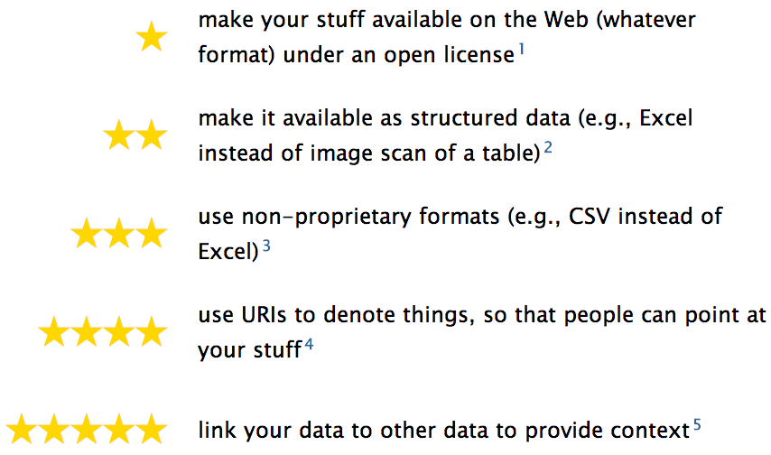
5 Star Linked Open Data

Slide 23
Creative Work - Schema.org
Thing > CreativeWork > ?
“The most generic kind of creative work, including books, movies, photographs, software programs, etc.”
http://schema.org/CreativeWork
has property
http://schema.org/Creator
Notes:
Property inherited from most generic type of item: Thing

Slide 24
Web Page - Schema.org
Thing > CreativeWork > WebPage
“A web page. Every web page is implicitly assumed to be declared to be of type WebPage...”
http://schema.org/WebPage
has property
http://schema.org/isPartOf
Notes:
Property inherited from most generic type of item: Thing

Slide 25
Web Page - Schema.org
Thing > CreativeWork > WebPage > ?
AboutPage
CheckoutPage
CollectionPage
ContactPage
ItemPage
MedicalWebPage
ProfilePage
QAPage
SearchResultsPage
Notes:
Property inherited from most generic type of item: Thing

Slide 26
sameAs - Schema.org
“URL of a reference Web page that unambiguously indicates the item's identity.”
http://schema.org/Thing
has property
http://schema.org/sameAs
Notes:
Property inherited from most generic type of item: Thing

Slide 27
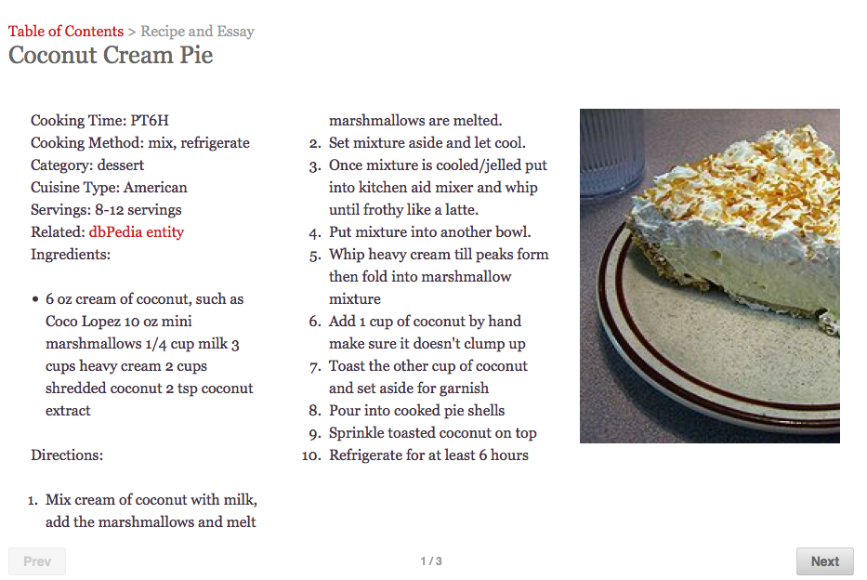
arc.lib.montana.edu/book/home-cooking-history-409/item-13

Slide 28
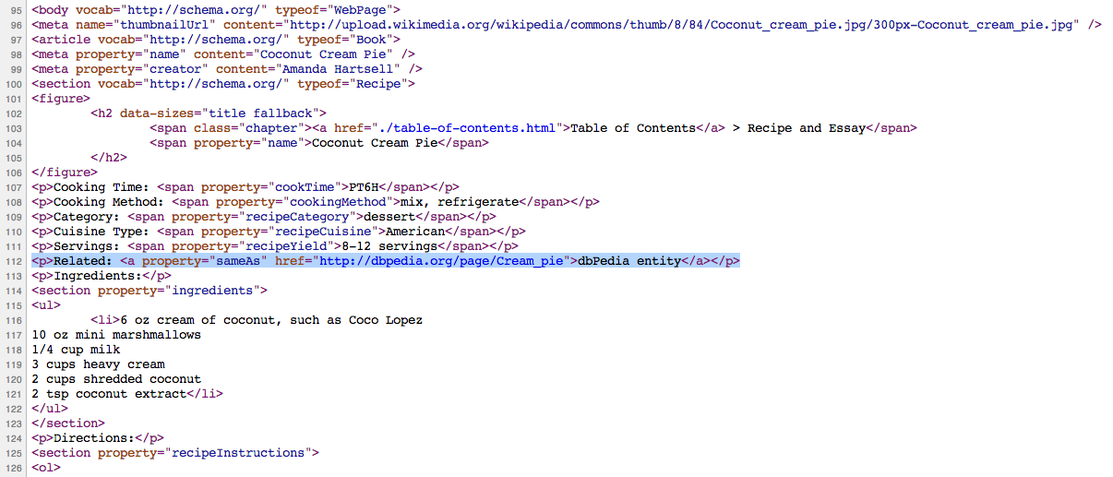
arc.lib.montana.edu/book/home-cooking-history-409/item-13

Slide 29
Role - Schema.org
“Represents additional information about a relationship or property. For example, a Role can be used to say that a Person's 'actor' role in a Movie was for some particular characterName.”
http://schema.org/Thing
has property
https://schema.org/Role
Notes:
Property inherited from most generic type of item: Thing

Slide 30
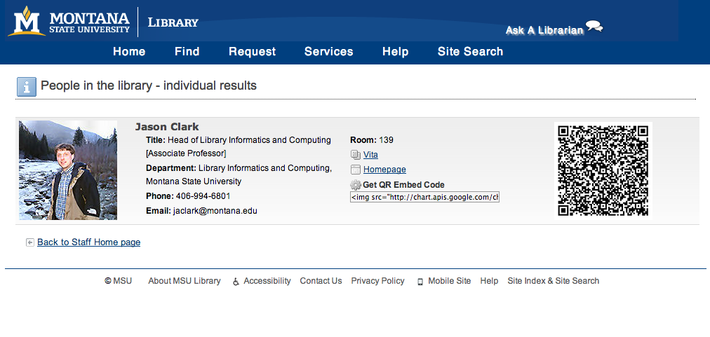
www.lib.montana.edu/people/about?id=23

Slide 31
www.lib.montana.edu/people/about?id=23

Slide 32
Action - Schema.org
“An action performed by a direct agent and indirect participants upon a direct object.”
http://schema.org/Thing
has property
https://schema.org/Action
or
https://schema.org/potentialAction
Notes:
Property inherited from most generic type of item: Thing

Slide 33
<script type="application/ld+json">
{
"@context": "http://schema.org",
"@type": "Organization",
"name": "Montana State University (MSU) Library",
"sameAs": "http://www.freebase.com/m/0j3y9r1",
"potentialAction": {
"@type": "ViewAction",
"target": [
"http://www.lib.montana.edu",
{
"@type": "EntryPoint",
"urlTemplate": "http://www.lib.montana.edu",
"contentType": "text/html"
}
]
}
}
</script>
Notes:
Wait, what happened to HTML? This is JSON-LD another format for encoding schema props
Not limited here… Jenn Riley wrote a book about McGill University Digital Libraries

Slide 34
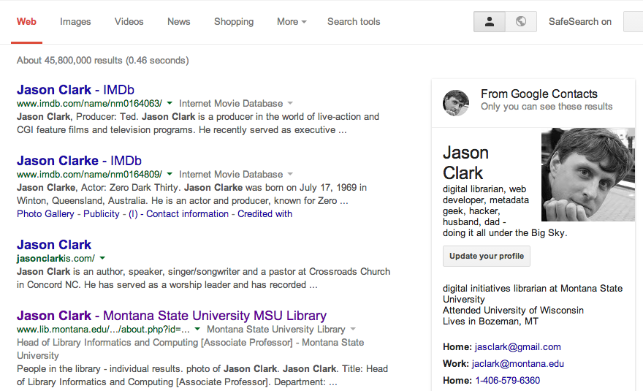
*Tentative results for SEO - This is a personal result set.

Slide 35
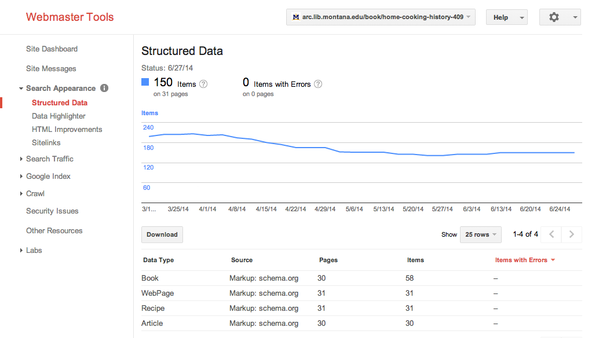
Structured Data in Your Index
www.google.com/webmasters/tools/
Notes:
Using a local data store, an about page, and a sitemap

Slide 36
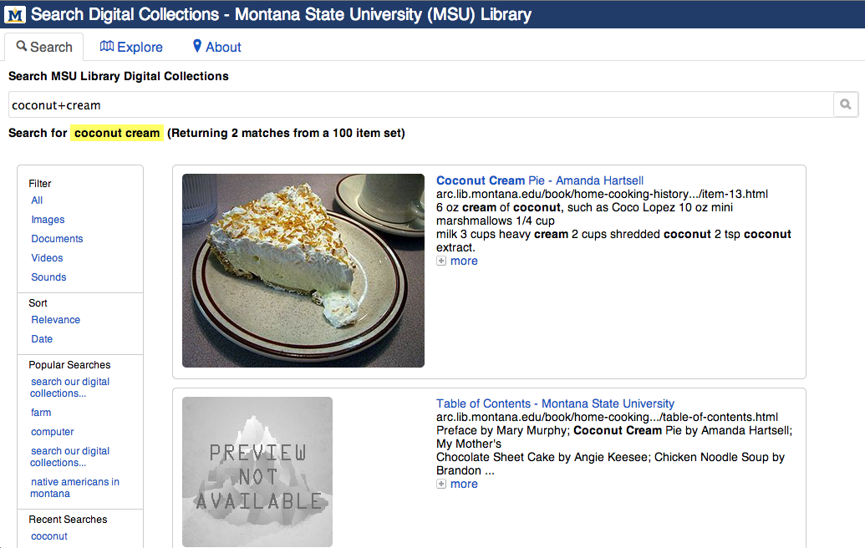
arc.lib.montana.edu/digital-collections/index.php?q=coconut+cream

Slide 37
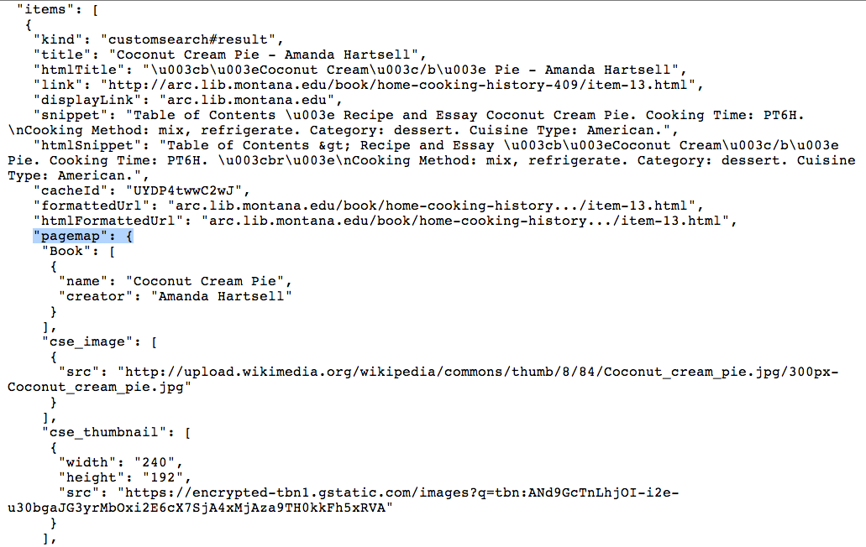
Google Custom Search Engine JSON API Result

Slide 38
Getting Started
Think about entities you want to surface - type of web page, organization, person, etc.
Find those entities in schema.org vocabulary
Draft your new markup
Use Google Structure Data Markup Helper Tool
Test your markup in Google Structured Data Testing Tool
Publish it on the web.

Slide 39
Structured Data Testing Tool
Test and validate your Schema.org markup
http://www.google.com/webmasters/tools/richsnippets
Notes:
Property inherited from most generic type of item: Thing

Slide 40
Creating/Refining the Searchable Index
Identify “Noise” and unnecessary pages
Apply some directives and refining techniques
Techniques:
robots.txt directives
meta tag & link relations (index directive markup)
sitemaps

Slide 41
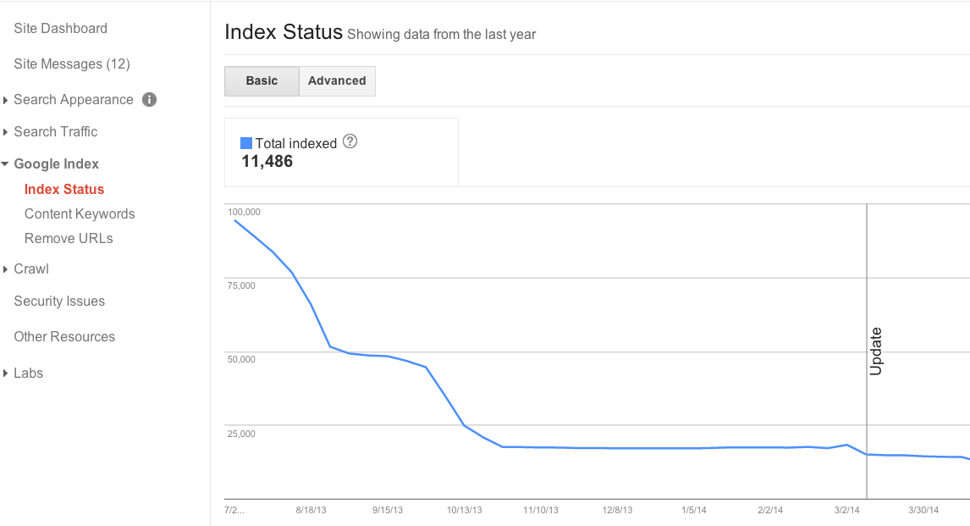
Does your Index Status Make Sense?

Slide 42
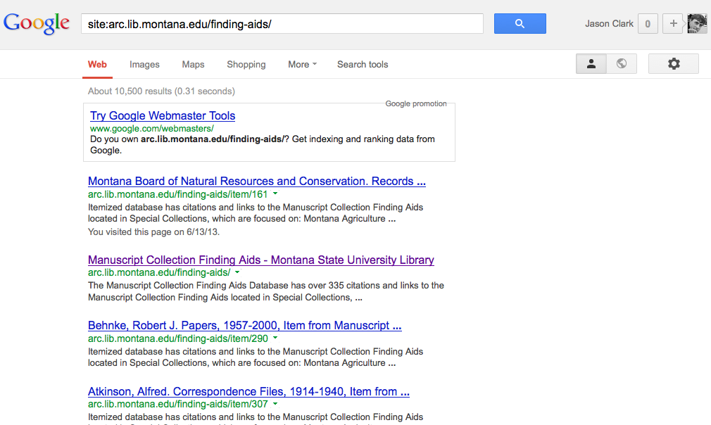

Slide 43
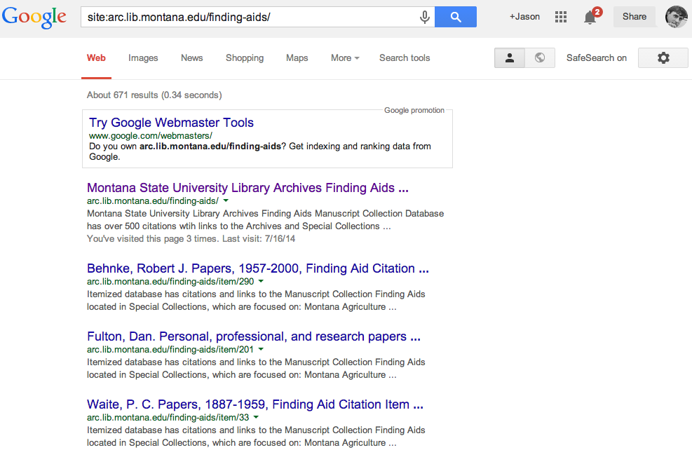

Slide 44
Optimization and Directives
Screenshot 1 - June 28, 2013
10,500 results for arc.lib.montana.edu/finding-aids/
Screenshot 2 - July 21, 2013
671 results for arc.lib.montana.edu/finding-aids/

Slide 45
Avoid Diluting PageRank
http://searchenginewatch.com/article/2316757/Matt-Cutts-on-Linking-Guidelines-How-Many-Links-on-a-Page

Slide 46
Creating Indexable Content
User intuitive hierarchy & site architecture
Short URLs containing keywords
Simple directory structure
Incorporate "Breadcrumbs"
Single URL to each page
Easy navigation between homepage and any webpage, and back
“Every page should be reachable from at least one static text link.”
https://support.google.com/webmasters/answer/35769

Slide 47
Reduce “Noise” in the Index
Implement robots.txt
text file at top level / root of web site
Provides SE content exclusion rules
Disallow: /staff/
#allow primary mobile page
Allow: /finding-aids/m/index.php
Allow: /finding-aids/m/$

Slide 48
Robots.txt provide crawlers guidance to reduce Index "noise"
Test your robots.txt file
Disallow: /staff/
Disallow: /admin/
Disallow: /search.php
#allow primary mobile page
Allow: /finding-aids/m/index.php
Allow: /finding-aids/m/$

Slide 49
Reduce “Noise” in the Index
Eliminate duplicate content
Dynamic pages, search result pages
Ensure every page is unique
Techniques:
robots.txt directives
meta tag & link relations (index directive markup)
sitemaps

Slide 50
Reduce “Noise” in the Index
Link relations and index directive markup
HTML page <head> markup that provides canonicalization and index exclusion rules
<link rel="canonical" href="http://arc.lib.montana.edu/finding-aids/item/23" />
<a rel="nofollow" href="http://www..lib.montana.edu/login.html">User Login</a>
<meta name="robots" content="nofollow,noindex" />

Slide 51
Reduce “Noise” in the Index
Eliminate duplicate content
Prescribe and define your searchable index
Techniques:
robots.txt directives
meta tag & link relations (index directive markup)
sitemaps

Slide 52
Creating Indexable Content
Link a human readable HTML sitemap from homepage
Implement machine-readable XML file(s) to provide SE content inclusion direction
"sitemap index"
"sitemap" file(s)

Slide 53
<?xml version="1.0" encoding="utf-8"?>
<urlset xmlns="http://www.sitemaps.org/schemas/sitemap/0.9">
<url>
<loc>http://arc.lib.montana.edu/finding-aids/index.php</loc>
<lastmod>2014-07-21</lastmod>
<changefreq>weekly</changefreq>
<priority>1.0</priority>
</url>
<url>
<loc>http://arc.lib.montana.edu/finding-aids/about.php</loc>
<lastmod>2014-07-21</lastmod>
<changefreq>monthly</changefreq>
<priority>1.0</priority>
</url>
<url>
<loc>http://arc.lib.montana.edu/finding-aids/item/1</loc>
<lastmod>2014-07-21</lastmod>
<changefreq>weekly</changefreq>
<priority>0.8</priority>
</url>
<url>
<loc>http://arc.lib.montana.edu/finding-aids/item/2</loc>
<lastmod>2014-07-21</lastmod>
<changefreq>weekly</changefreq>
<priority>0.8</priority>
</url>
...
</url>
</urlset>

Slide 54
Sitemaps Provide Inclusion Guidance
Link a human readable HTML sitemap from homepage
Implement machine-readable XML file(s) to provide SE content inclusion direction
"sitemapindex"
"sitemap" file(s)
“Google adheres to Sitemap Protocol 0.9 as defined by sitemaps.org.”

Slide 55
Homework
Semantically Clarify Your Library & Define Your Site Index
https://docs.google.com/document/d/1wJqe5h6aS-Fc4KGBOaJSTpcMw3_GvjncitjujNFEgQ8/edit?usp=sharing
SEO Course Moodle instance
http://www.classes.ala.org/course/view.php?id=537

Slide 56
Questions?
twitter.com/jaclark
www.lib.montana.edu/~jason/talks.php

