Slide 1
Search Engine Optimization for Libraries
"We cannot call a digital-library or electronic publishing system a success if we cannot measure and interpret its use.”
- Peterson Bishop 1998

Slide 2
Research Team
Scott Young Digital Initiatives Librarian at Montana State University
Jason Clark Head of Library Informatics & Computing at Montana State University Library
Patrick OBrien Semantic Web Research Director at Montana State University Library
Kenning Arlitsch Dean of the Library at Montana State University. His book, co-authored with Patrick OBrien, is titled Improving the Visibility and Use of Digital Repositories through SEO, and was published in February 2013.

Slide 3
"Getting Found: Search Engine Optimization for Digital Repositories”
- IMLS 3 Year Research Grant

Slide 4
Agenda - Day 4
Semantic Web SEO
Using Semantic Web Practices for SEO
Web Development Practices and SEO
Social Media Optimization (SMO)
Resources
Questions

Slide 5
Homework - Day 2
Institutional Setup & Identity
https://docs.google.com/document/d/1HWVOkPn9UJXLeY3CV14cEPQKQtvgh6yA6T6uXK6-iAw/edit
SEO Course Moodle instance
http://www.classes.ala.org/course/view.php?id=537

Slide 6
Homework - Day 3
Semantically Clarify Your Library & Define Your Site Index
https://docs.google.com/document/d/1wJqe5h6aS-Fc4KGBOaJSTpcMw3_GvjncitjujNFEgQ8/edit?usp=sharing
SEO Course Moodle instance
http://www.classes.ala.org/course/view.php?id=537

Slide 7
Recommendations & Priorities
Institutionalize SEO
Strategic Plan
Accurate Measurement Tools
Traditional SEO
Get Indexed = Index Ratio
Get Visible = Search Engine Results Page (SERP)
Semantic SEO
Get Relevant = Click Through Ratios (CTR)
Metadata
Linked Open Data (LOD)
Schema.org

Slide 8
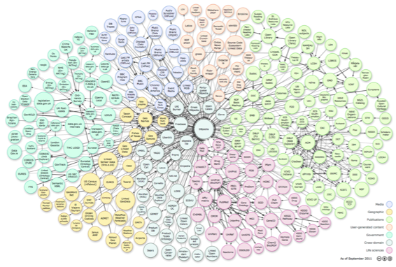
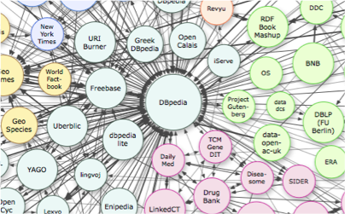
Linked Open Data cloud diagram

Slide 9
What is Linked Open Data?
Practice of publishing structured, machine actionable data with an open license for sharing and reuse.

Slide 10
Why use Linked Open Data?
Source for disambiguation
Provides machine definition of entity (a person, place, thing, subject, etc.) using a unique identifier (e.g., URL)
Enables understanding vs. indexing of data

Slide 11
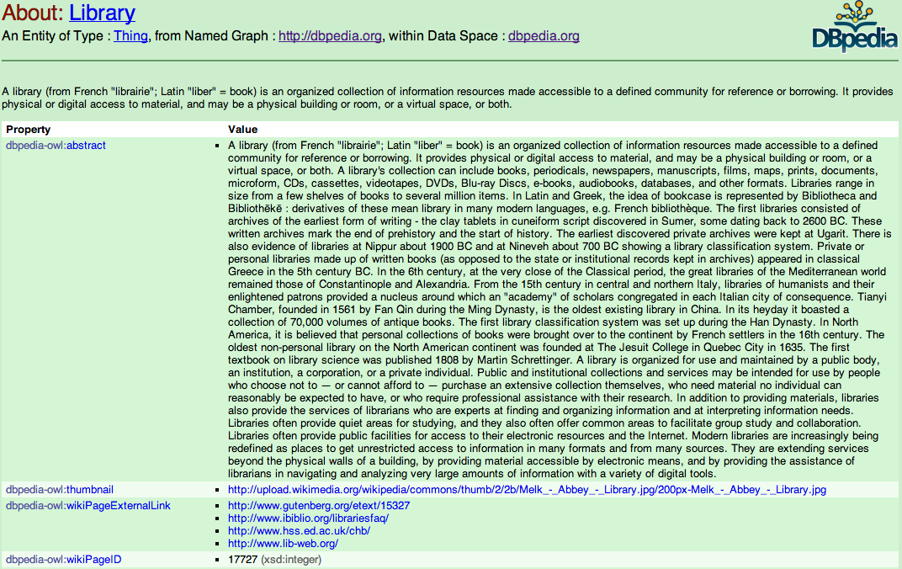
http://dbpedia.org/page/Library

Slide 12
Semantic Data Sources
Topic Identification
Freebase
DBpedia
Library of Congress Linked Data Service
Identity Disambiguation
Orcid
VIAF

Slide 13
Design Expectations for LOD
Use URIs as names for things
Use HTTP URIs so that people can look up those names.
When someone looks up a URI, provide useful information, using the standards (RDF*, SPARQL)
Include links to other URIs so that they can discover more things.
- Tim Berners Lee
http://www.w3.org/DesignIssues/LinkedData.html

Slide 14
Expressing and Encoding LOD
The data model of RDF is based on the idea of a triple.
A triple is a simple statement with three distinct parts:
a subject
a predicate
an object

Slide 15
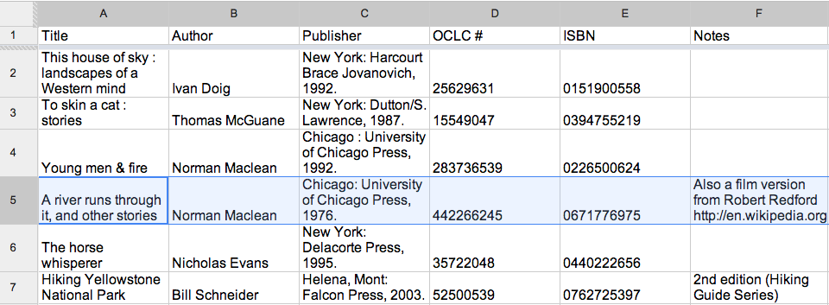

Slide 16
#5 “has author” Norman Maclean
(subject) (predicate) (object)

Slide 17
Design Expectations for LOD
Use URIs as names for things
Use HTTP URIs so that people can look up those names.
When someone looks up a URI, provide useful information, using the standards (RDF*, SPARQL)
Include links to other URIs so that they can discover more things.
- Tim Berners Lee
http://www.w3.org/DesignIssues/LinkedData.html

Slide 18
Expressing and Encoding LOD
Resource Description Framework (RDF)
A structured data format for expressing relationships (descriptions) between things (resources).
http://www.xml.com/pub/a/2001/01/24/rdf.html

Slide 19
Expressing and Encoding LOD
The data model of RDF is based on the idea of a triple.
A triple is a simple statement with three distinct parts:
a subject
a predicate
an object

Slide 20
Use URIs as names for things

Slide 21
http://www.worldcat.org/oclc/1733412 (subject)
http://purl.org/dc/terms/creator (predicate)
http://dbpedia.org/page/Norman_Maclean (object)

Slide 22
<?xml version="1.0"?>
<!DOCTYPE rdf:RDF PUBLIC "-//DUBLIN CORE//DCMES DTD 2002/07/31//EN"
"http://dublincore.org/documents/2002/07/31/dcmes-xml/dcmes-xml-dtd.dtd">
<rdf:RDF xmlns:rdf="http://www.w3.org/1999/02/22-rdf-syntax-ns#"
xmlns:dc ="http://purl.org/dc/elements/1.1/">
<rdf:Description rdf:about="http://www.worldcat.org/oclc/1733412">
<dc:creator rdf:resource="http://dbpedia.org/page/Norman_Maclean"/>
<dc:identifier>ISBN 0671776975</dc:identifier>
</rdf:Description>
</rdf:RDF>

Slide 23
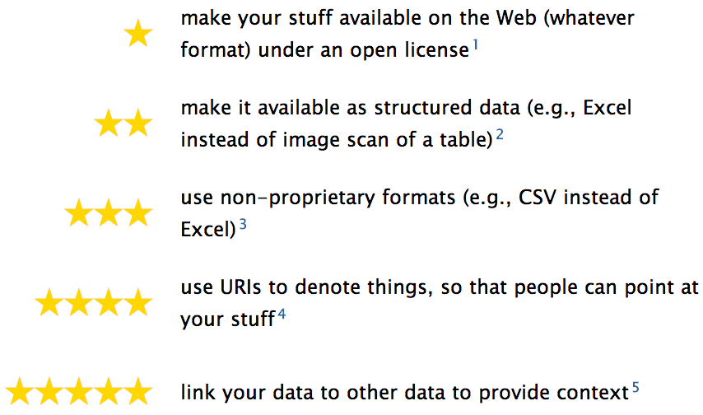
5 Star Linked Open Data
http://5stardata.info/

Slide 24
LOD Resources
Harper, Corey. Library linked data: tuning library metadata for the semantic web. An ALCTS webcast, March 16. 2011. (open access) http://www.ala.org/alcts/confevents/upcoming/webinar/cat/031611

Berners-Lee, Tim. The next web. A TED talk, February 2009. (open access) http://www.ted.com/talks/tim_berners_lee_on_the_next_web
Koster, Lukas (2011) Brief Introduction to Linked Data (open access) https://docs.google.com/document/d/1W6UOCLgxTyM0BlPfd5hs58dh4k6CUdLW354AjjtnJfk/edit
*See also LODLAM - Linked Open Data in Libraries, Archives &amp; Museums at http://lodlam.net/

Slide 25
Enhancing Your Identity

Slide 26
Reinforce your Semantic Identity
Website Organization Schema.org
logo
sameAs
branchOf
location
Wikipedia
Organization
Description

Slide 27
Schema.org Organization to Home Page
Type = http://schema.org/Library
Property
name
alternateName
description
logo
telephone

Slide 28
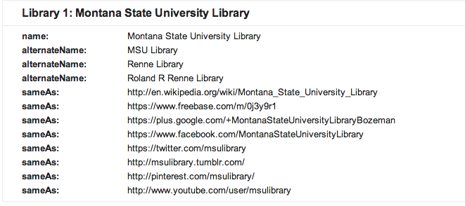
Schema.org Organization to Home Page
Type = http://schema.org/Library
Property
sameAs
URI
Wikipedia
Freebase
G+
Facebook
Twitter
Tumblr
Pinterest
YouTube

Slide 29
Schema.org Organization to Home Page
Type = http://schema.org/Library
Property
branchOf
http://schema.org/CollegeOrUniversity

Slide 30
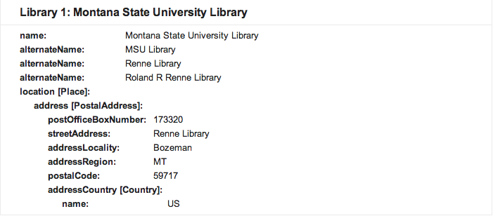
Schema.org Location to Home, Contact Us, or both pages
Type = http://schema.org/Library
Property
location
http://schema.org/Place
Property
address
http://schema.org/PostalAddress

Slide 31
Reinforce your Semantic Identity
Website Organization Schema.org
logo
sameAs
branchOf
location
Wikipedia
Organization
Description

Slide 32
Setup your organizational relationships
Locate parent organization
Identify where you belong
Academic Departments
Join Wikipedia
Create article stub in sandbox
Provide Facts with verifiable references
Include Library InfoBox for DBpedia
Work with OCLC Wikipedia Visiting Scholars to publish and the Wikipedia Library program - Do NOT self-publish

Slide 33
Web Development Practices for SEO
Responsive Web Design (RWD)
Speed and Website Performance

Slide 34
Responsive Web Design = 3 techniques
Media Queries
A Fluid Grid
Flexible Images or Media Objects

Slide 35
Responsive Web Design and SEO
Using a single URL for a piece of content prioritizes and allows amplification of link
No redirection is needed to avoid indexing complications
Saves resources for crawlers and users (1 bot indexes 1 site)

Slide 36
Website Performance and SEO
PageSpeed Insights
Understanding Critical Loading of Web Page Resources
Images and File Compression
Time to First Byte
Page Size
Source:
Using Site Speed in Web Search Ranking
Matt Cutts, Principal Engineer, Google Search Quality Team
http://googlewebmastercentral.blogspot.com/2010/04/using-site-speed-in-web-search-ranking.html

Slide 37
Search Engine Optimization
Findability
Social Media Optimization
Shareability

Slide 38
SMO - What is it?
Practices that help make web content easily shared through social networks
A way to help start and sustain conversation about the Library
Resources
Services
People
Topics of interest to libraries
Info Lit
Scholarly Communication
Reading

Slide 39
SMO - How
Consistent identity across social media platforms
Coordinating the social web with the semantic web
Social Media Tagging

Slide 40
Consistent identity across social media platforms

Slide 42
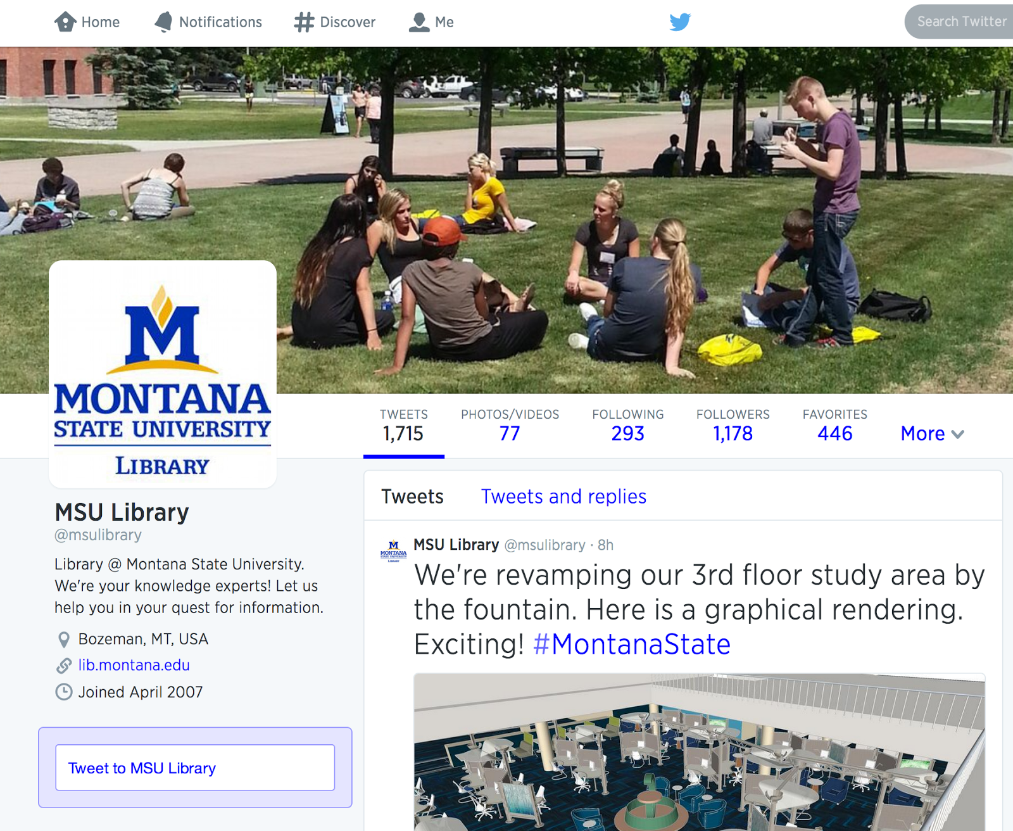

Slide 44
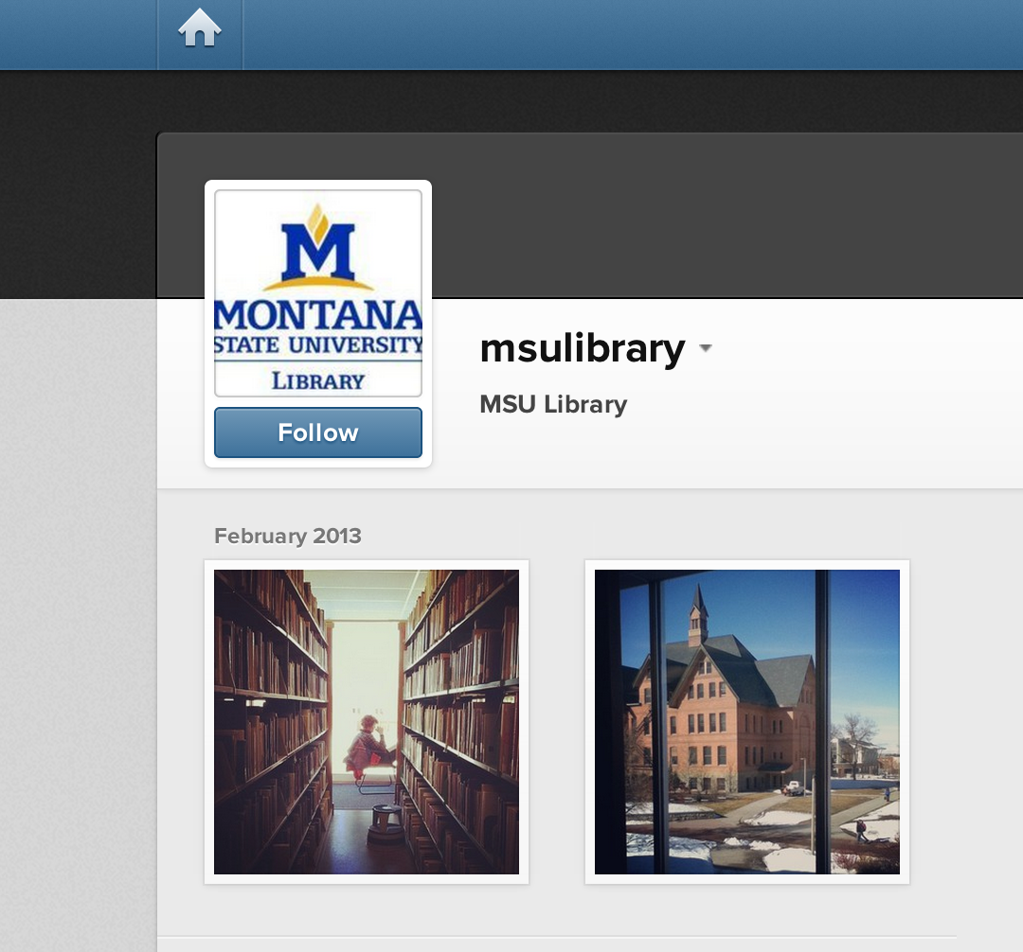

Slide 45
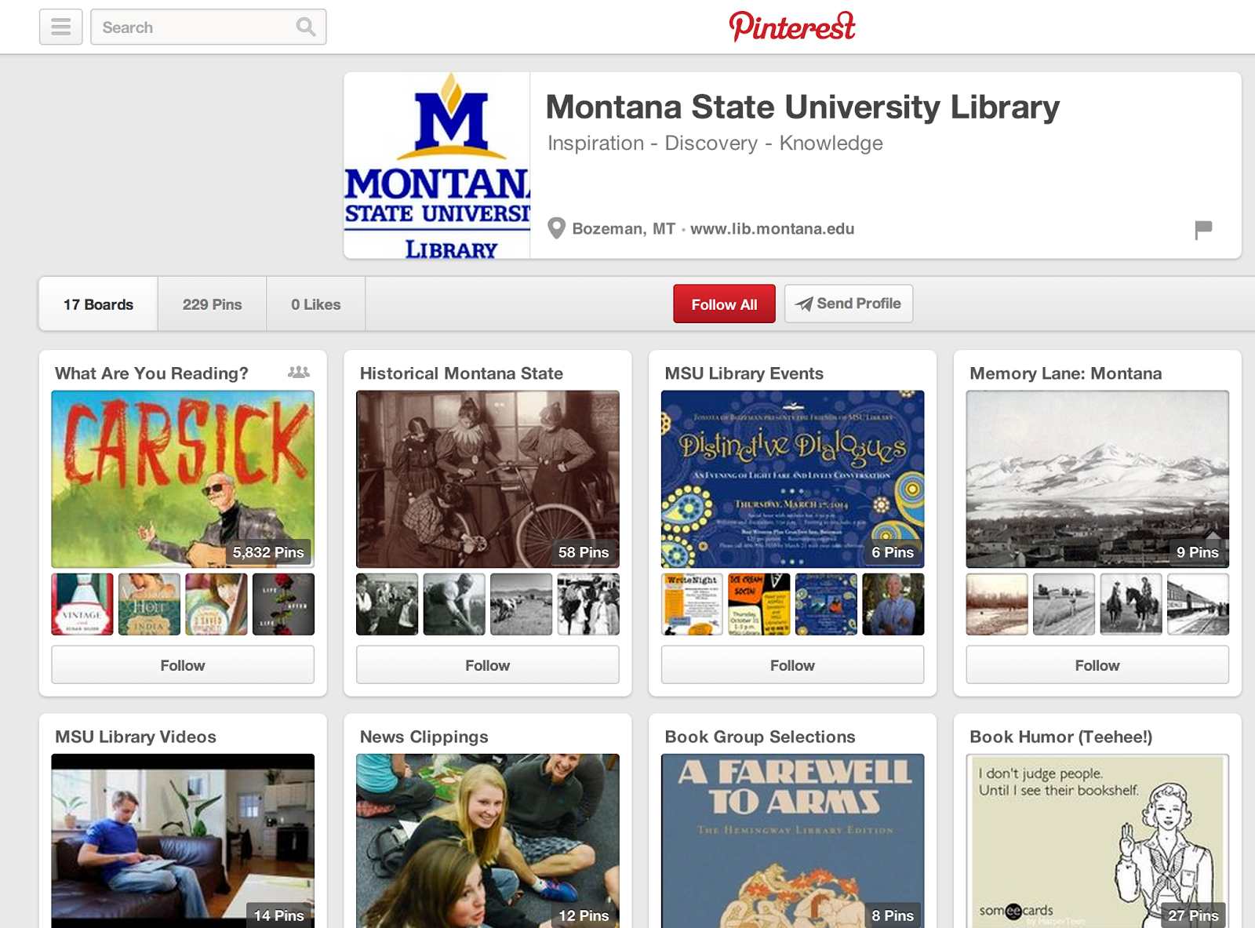

Slide 46
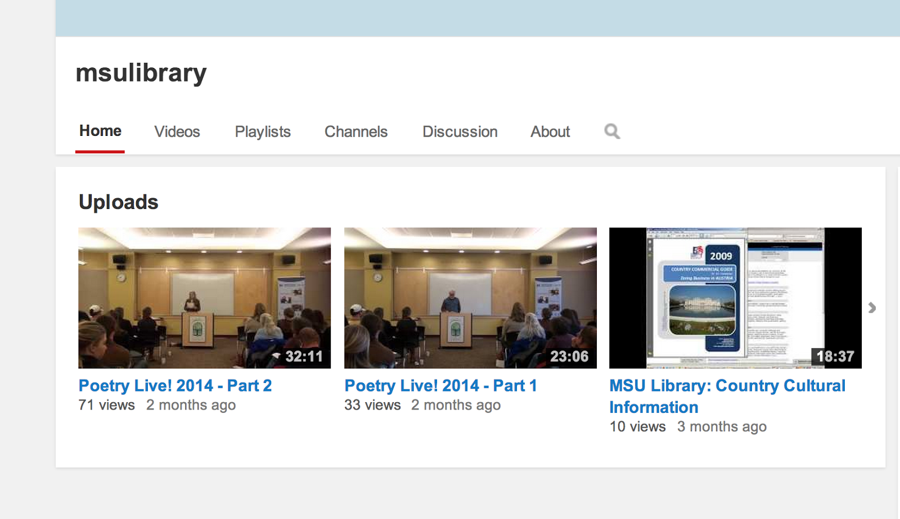

Slide 47
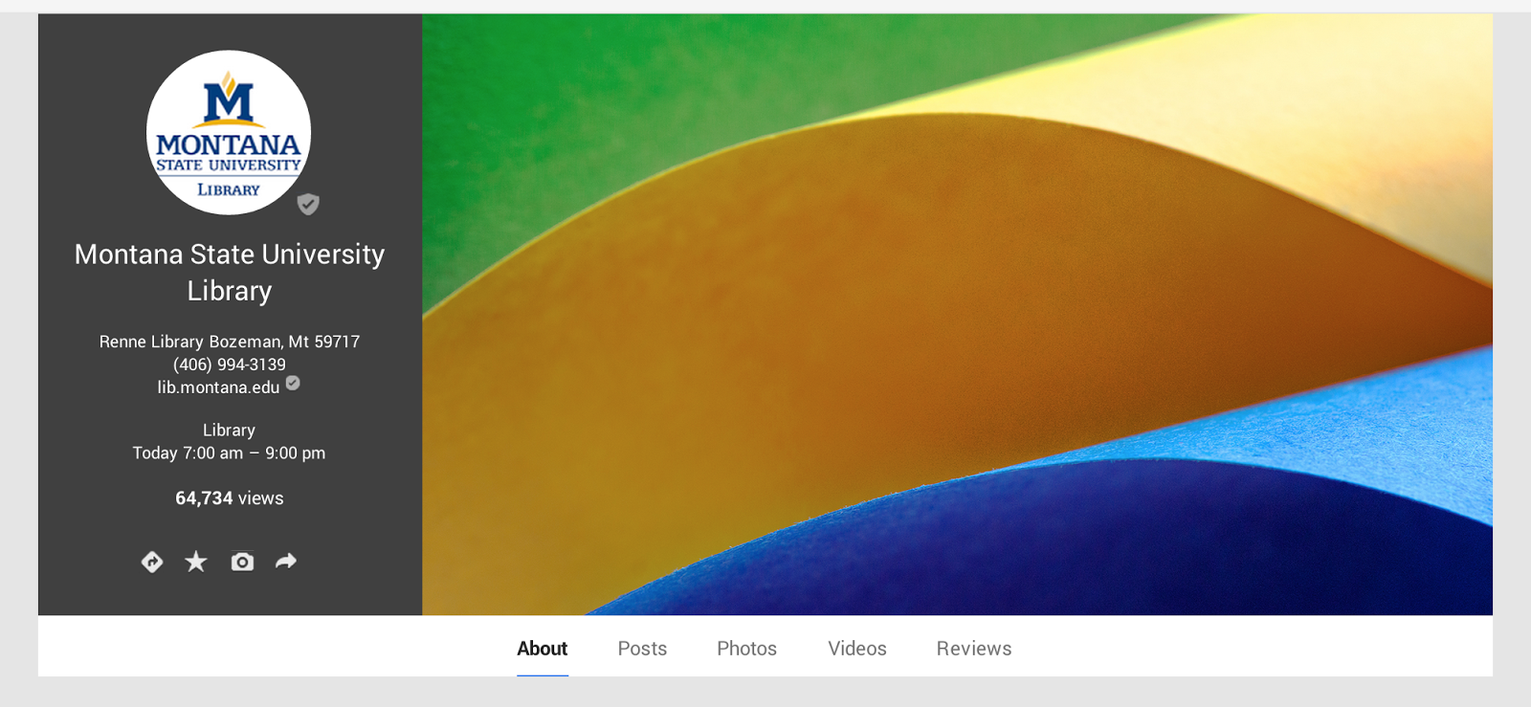

Slide 48
Coordinating the social web with the semantic web

Slide 49
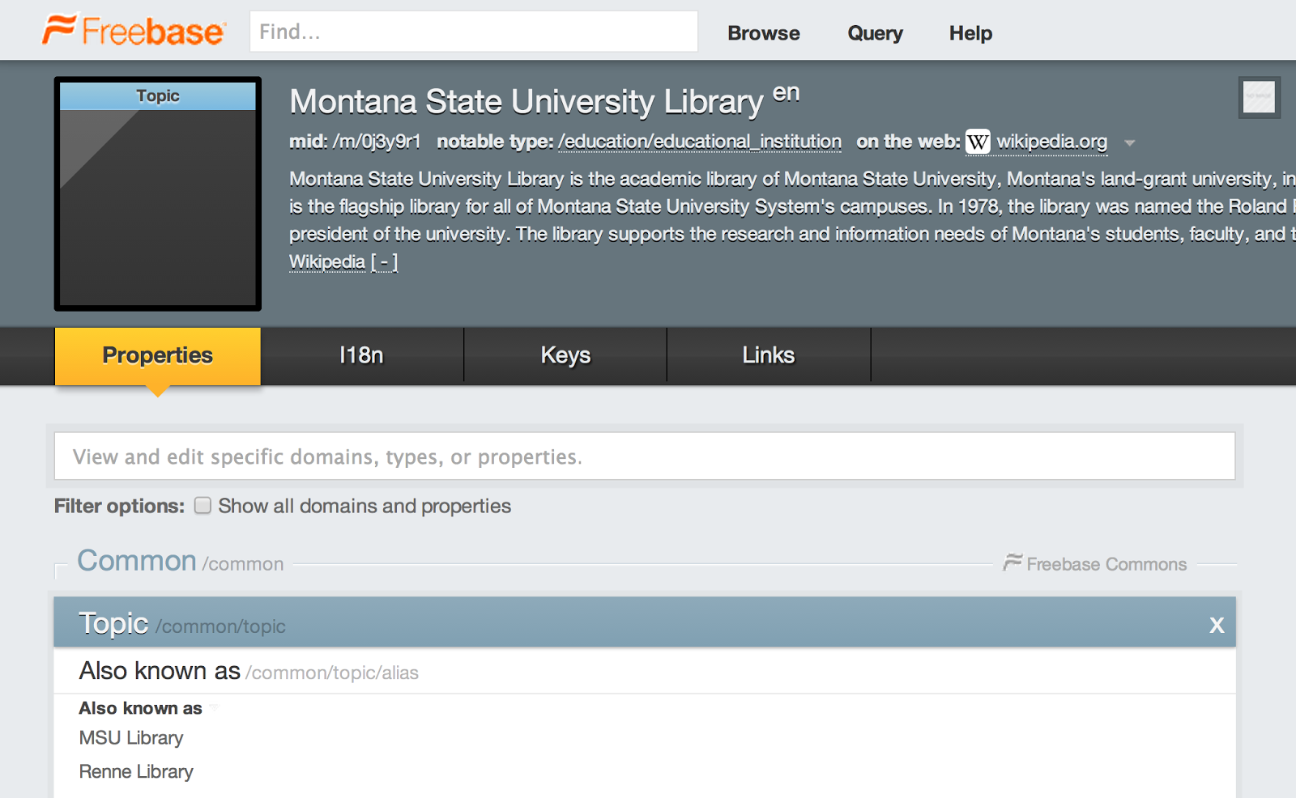

Slide 50
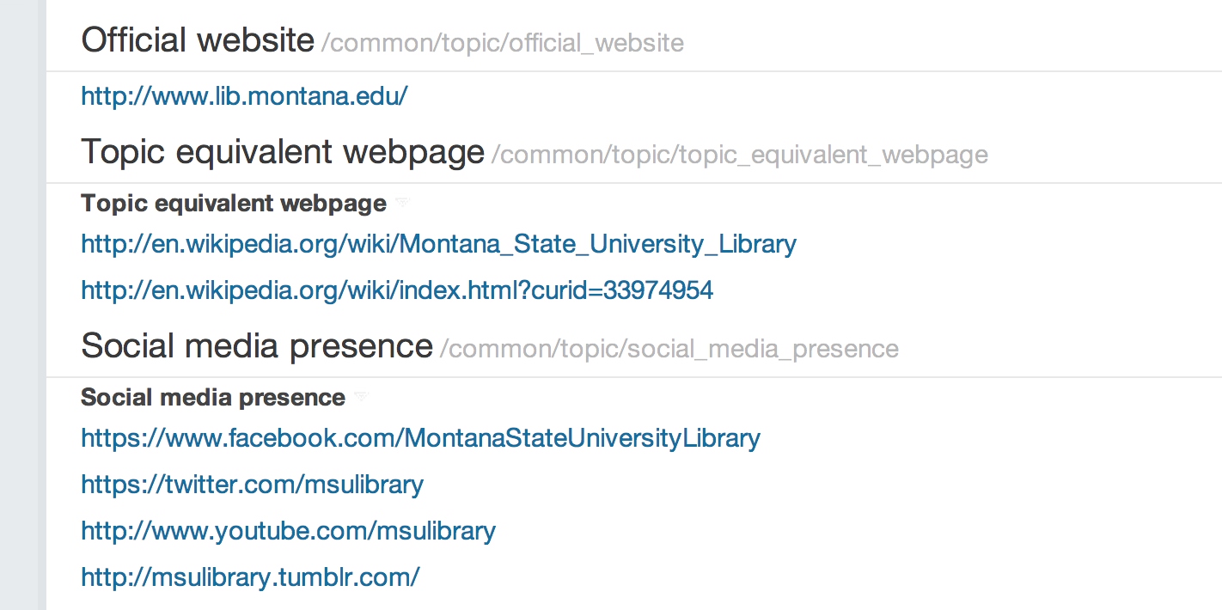

Slide 51
Social Media Tagging

Slide 52
Gearing Up Your Sites for Sharing with Twitter & Facebook Meta Tags
http://acrl.ala.org/techconnect/?p=4062

Slide 53
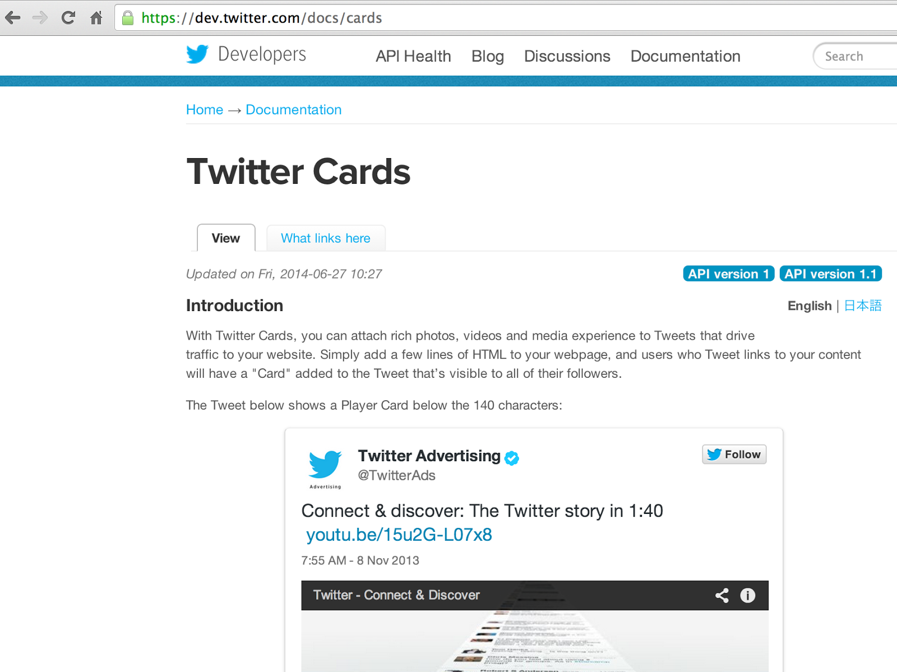

Slide 54
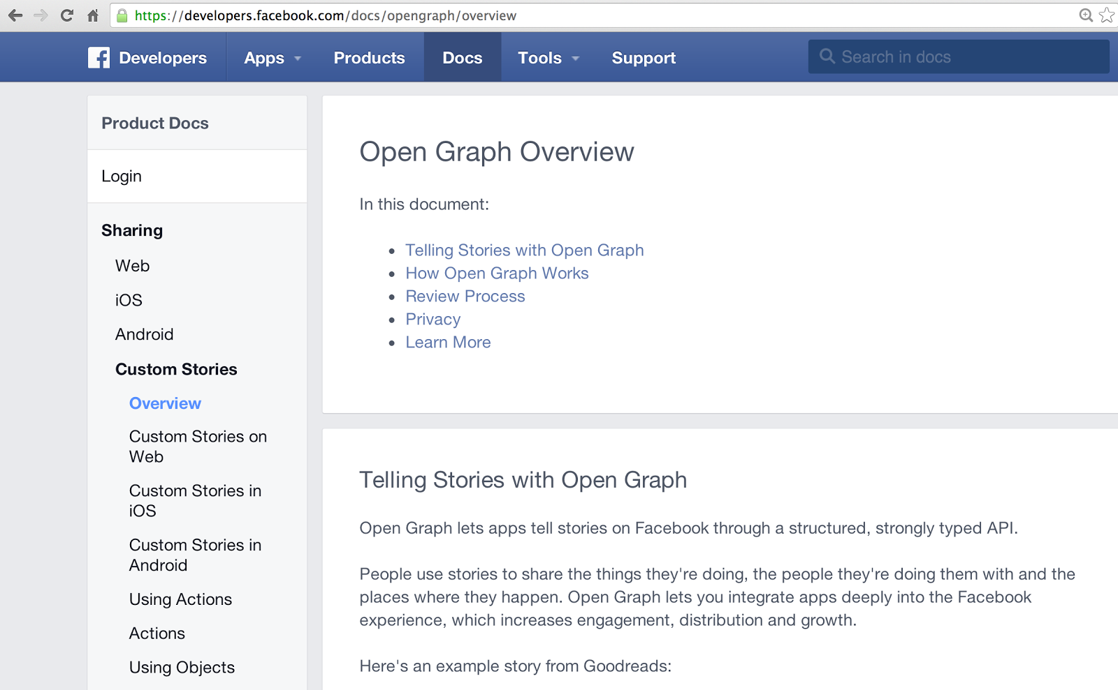

Slide 55
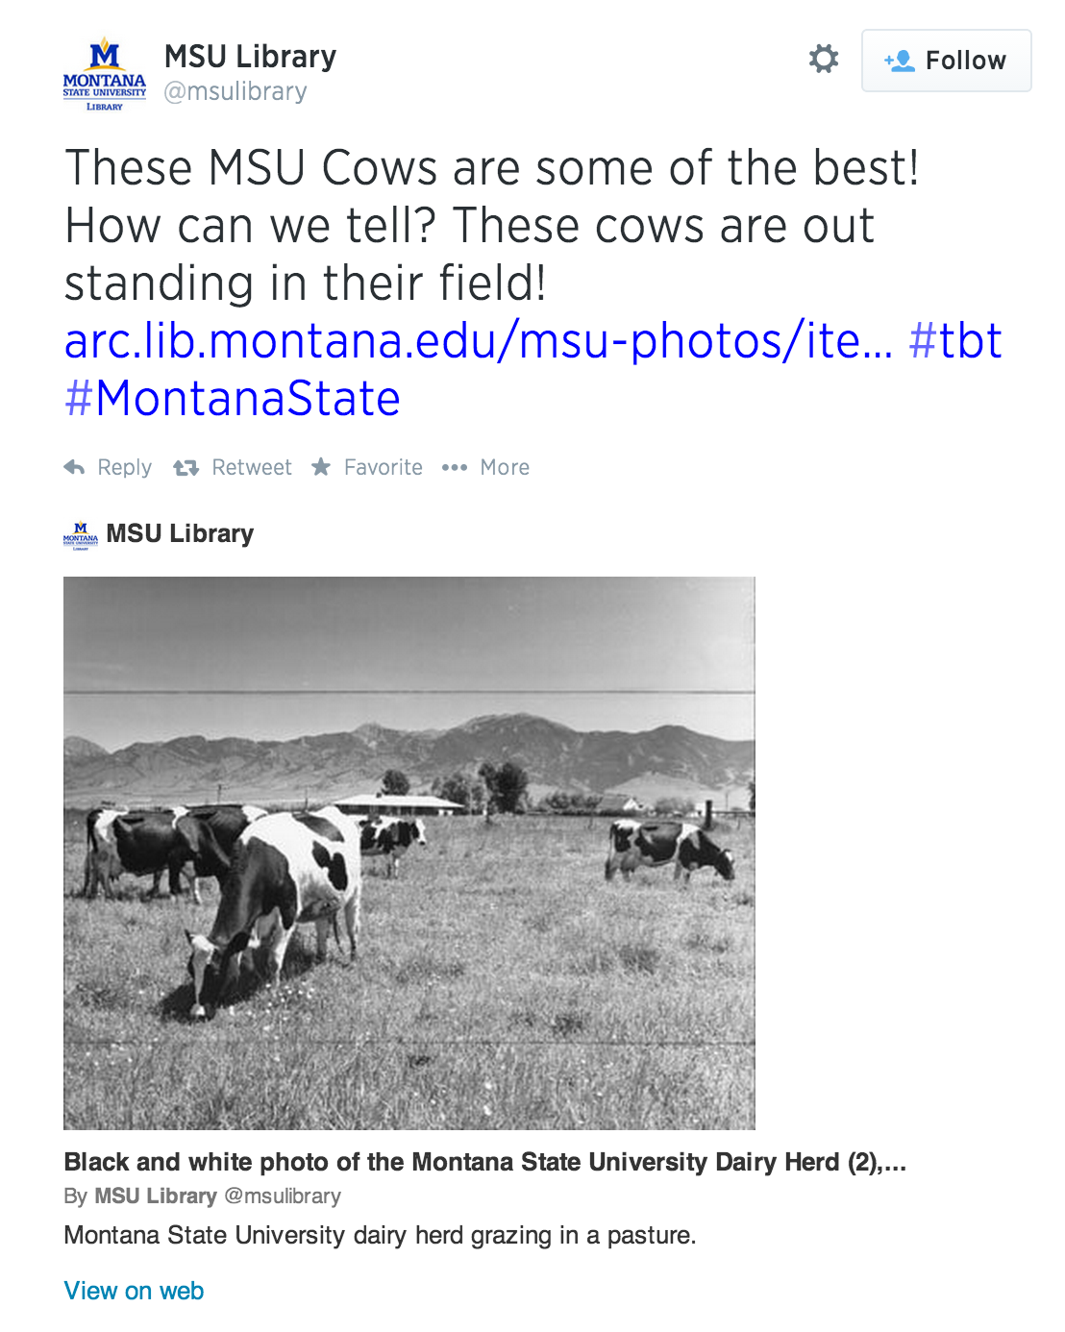

Slide 59
Questions?

Slide 60
Themes discovered
Traditional SEO is an afterthought
Librarians need to think bigger re potential traffic
Organizational communication can be improved
Data in repositories often messy
Analytics usually poorly implemented
Vendors slow to catch on to SEO problems
Library software lacking for semantic web SEO
Libraries fail to establish semantic identities
Notes:
staff sometimes work in conflict with one another

Slide 61
New Knowledge Work = New Services
Everyone struggles with these issues
University, colleges, departments, centers, etc.
Theory: SEO increases citations/university rankings
Develop a team
SEO skills
Repeatable processes
Show value to users, stakeholders, and potential customers

