Slide 1
Exploring Ethics
in Data and Technology Research
MSU Library
Sara Mannheimer
Scott W. H. Young
Jason Clark
Justin Shanks
Computer Science Seminar Series
February 22, 2016

Slide 2
1. Twitter Sentiment Analysis
2. Personalized Web Search
3. Semantic Web Identities

Slide 3
Can vs. should
Personalized services vs. user privacy
Who benefits?
Ethical Questions
Notes:
Tensions of data-driven research

Slide 4
Twitter Sentiment Analysis

Slide 5
Sentiment Analysis + Data Sharing
Identify researchers in 16 disciplines
Pull data from Twitter API
Isolate data-related tweets
Code sentiment using Mechanical Turk

Slide 6
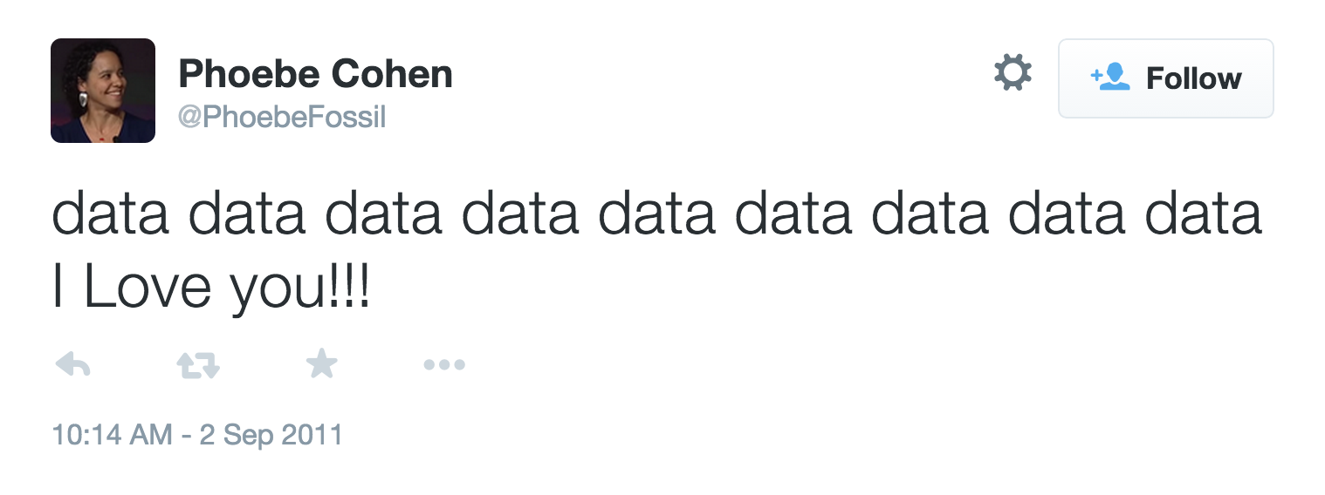

Slide 7
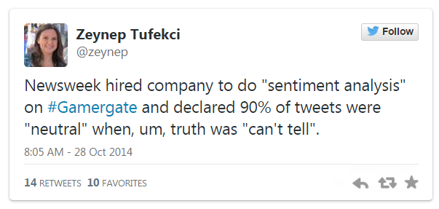
Notes:
Gamergate: conversation around sexism in videogame culture

Slide 8
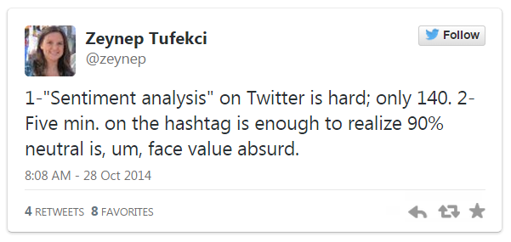

Slide 9
Notes:
Newsweek was looking for insight into the gamergate conversation by doing big data analysis

Slide 10
“The ability to harvest the wealth of information contained in biomedical
Big Data will advance our understanding of human health and disease.”
— NIH Big Data to Knowledge
Notes:
all of this big data seems like it has a lot of potential

Slide 11
“Numbers are seductive because they look like answers.”
— Nathan Jurgenson
Notes:
in the case of big data, lots of numbers can look like lots of answers

Slide 12
Ethical concerns for social media (big) data research
Perceived Publics
Informed Consent
Digital Labor

Slide 13
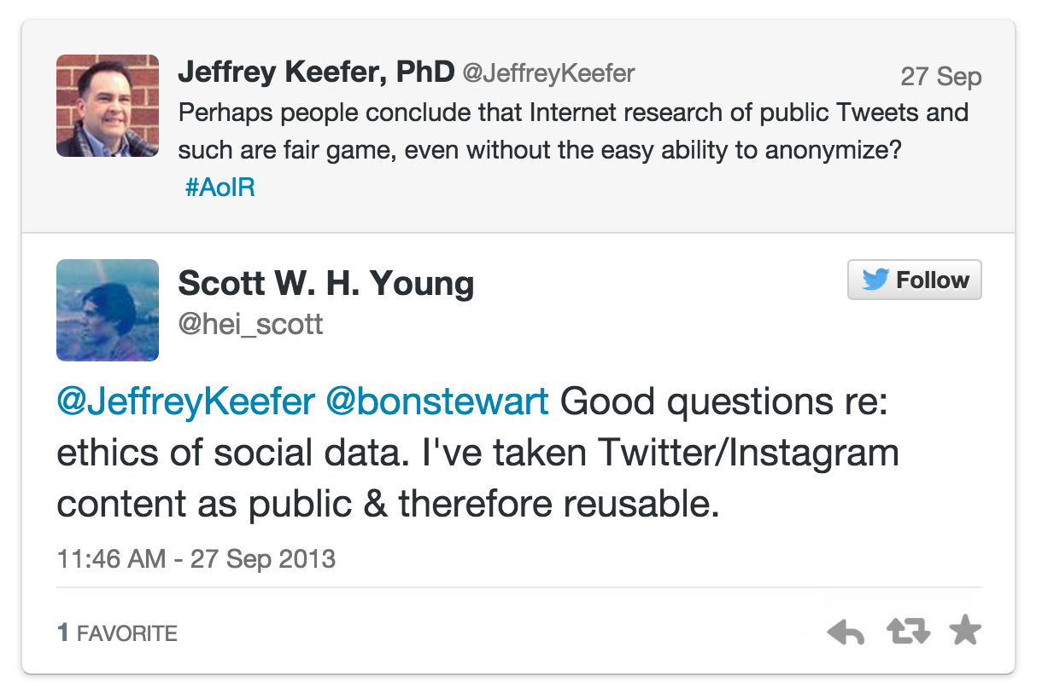

Slide 14
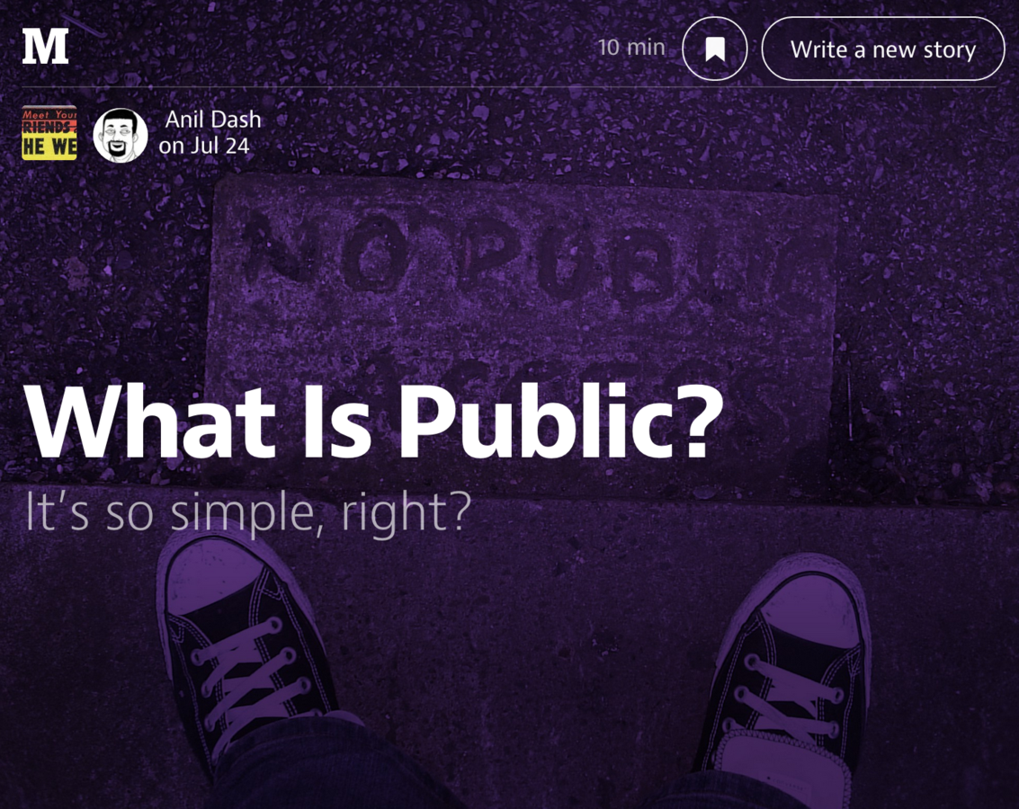

Slide 15
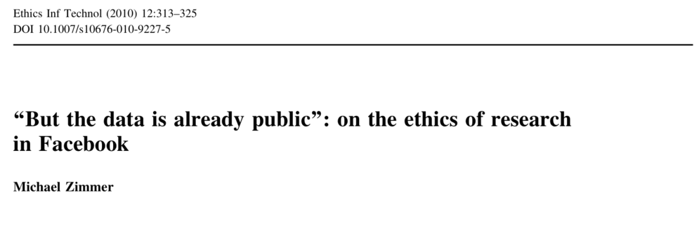

Slide 16
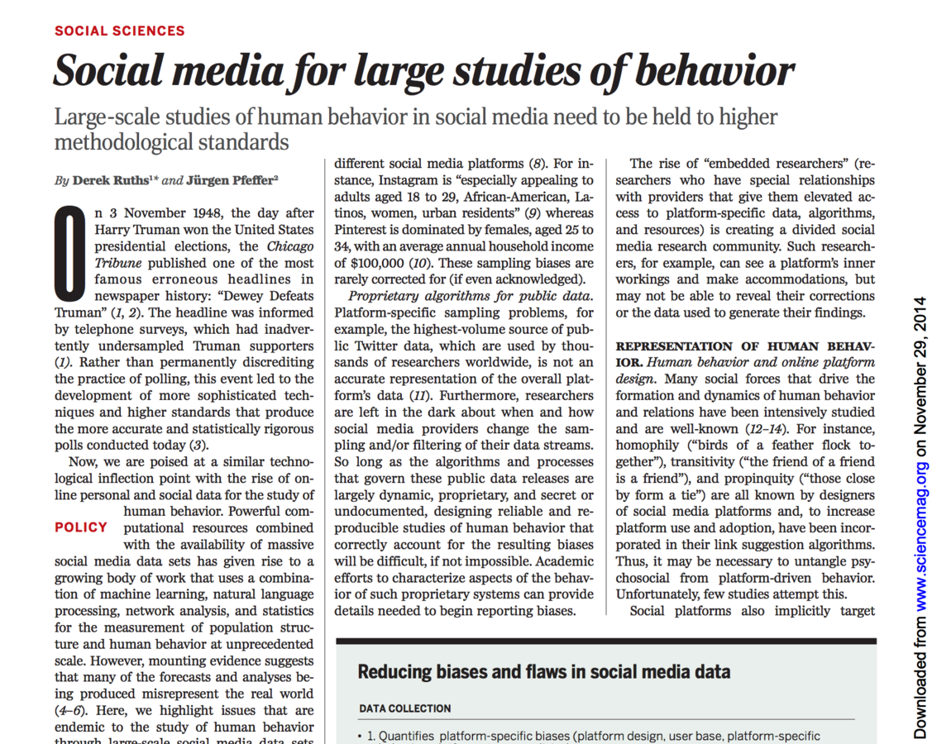

Slide 17
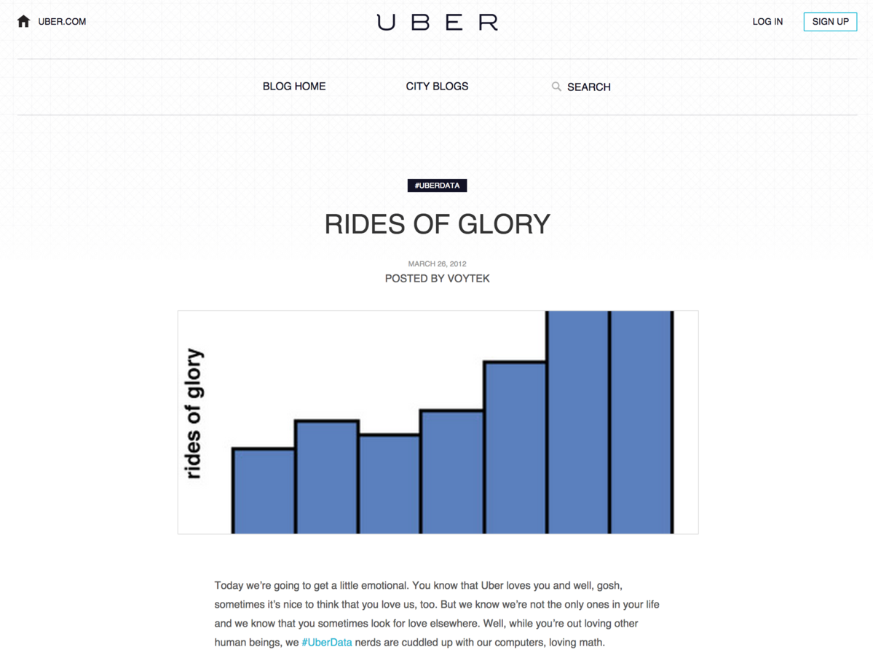

Slide 18
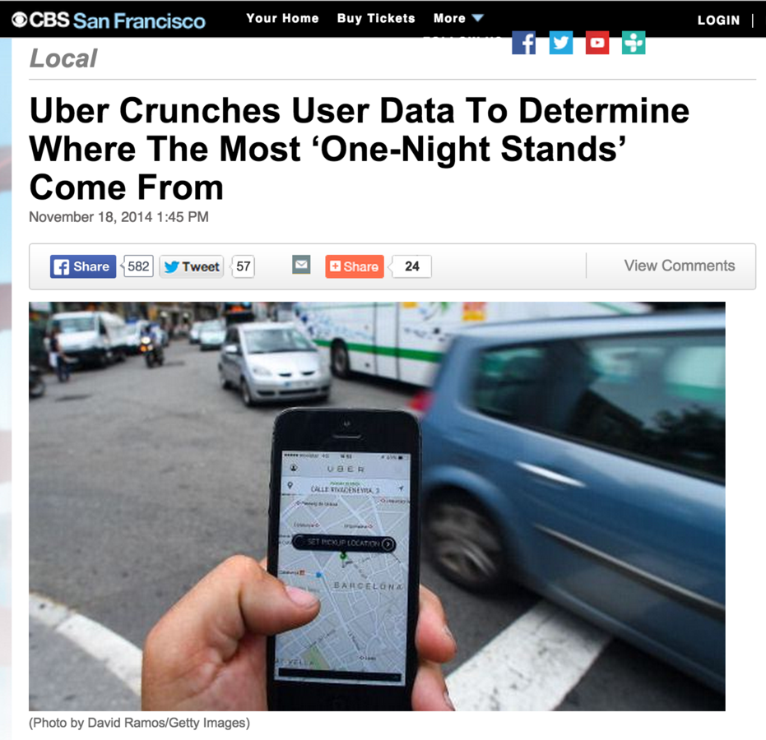

Slide 21
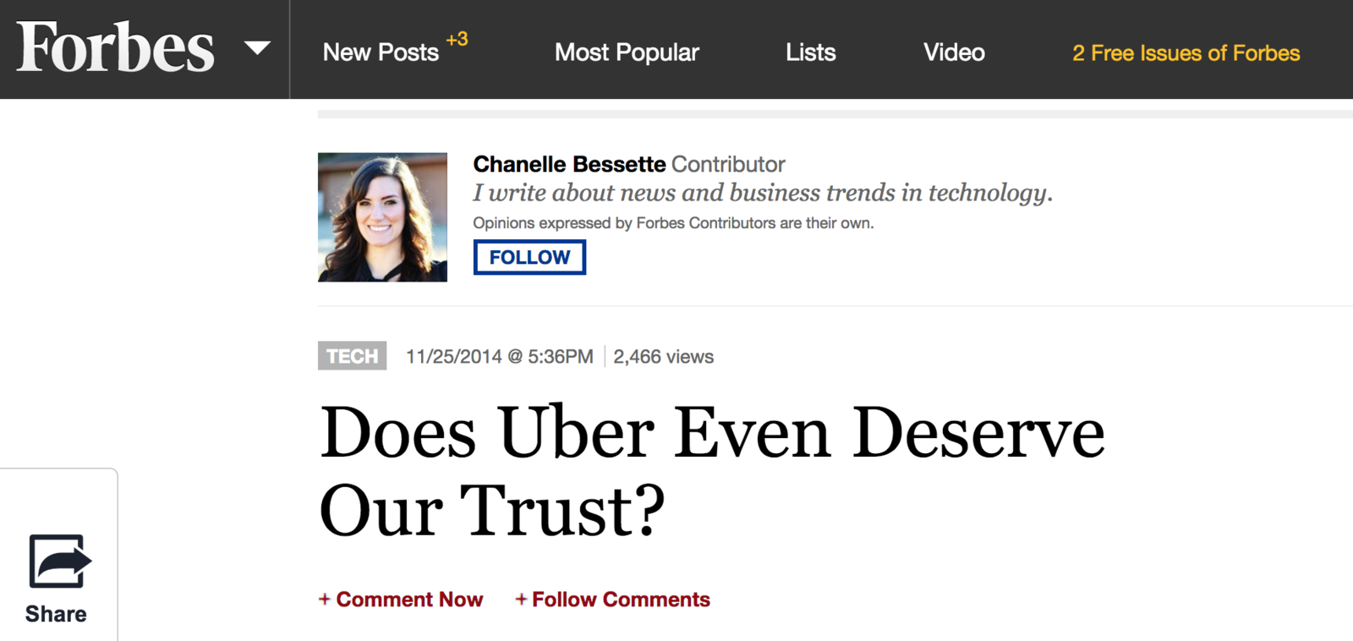

Slide 22
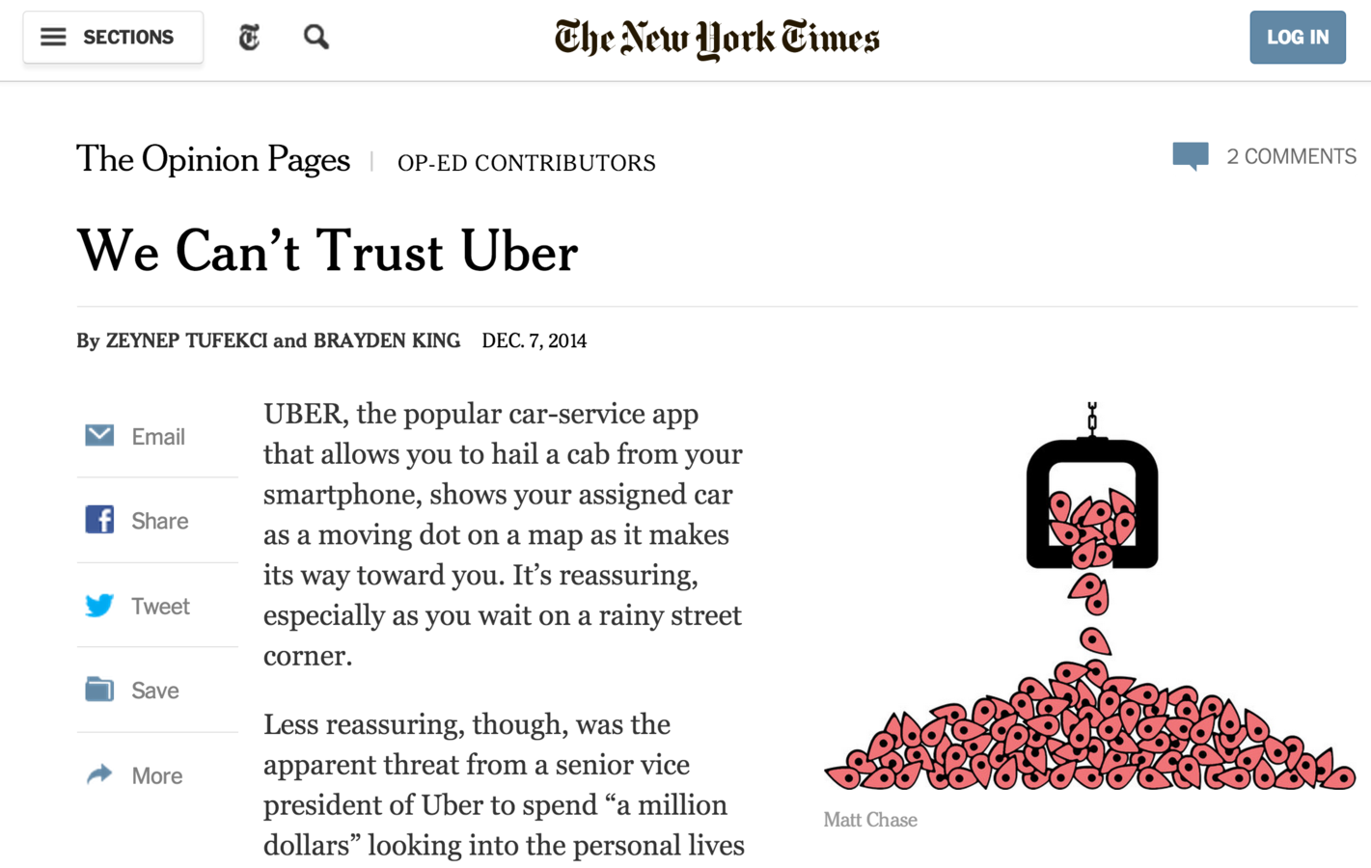

Slide 23
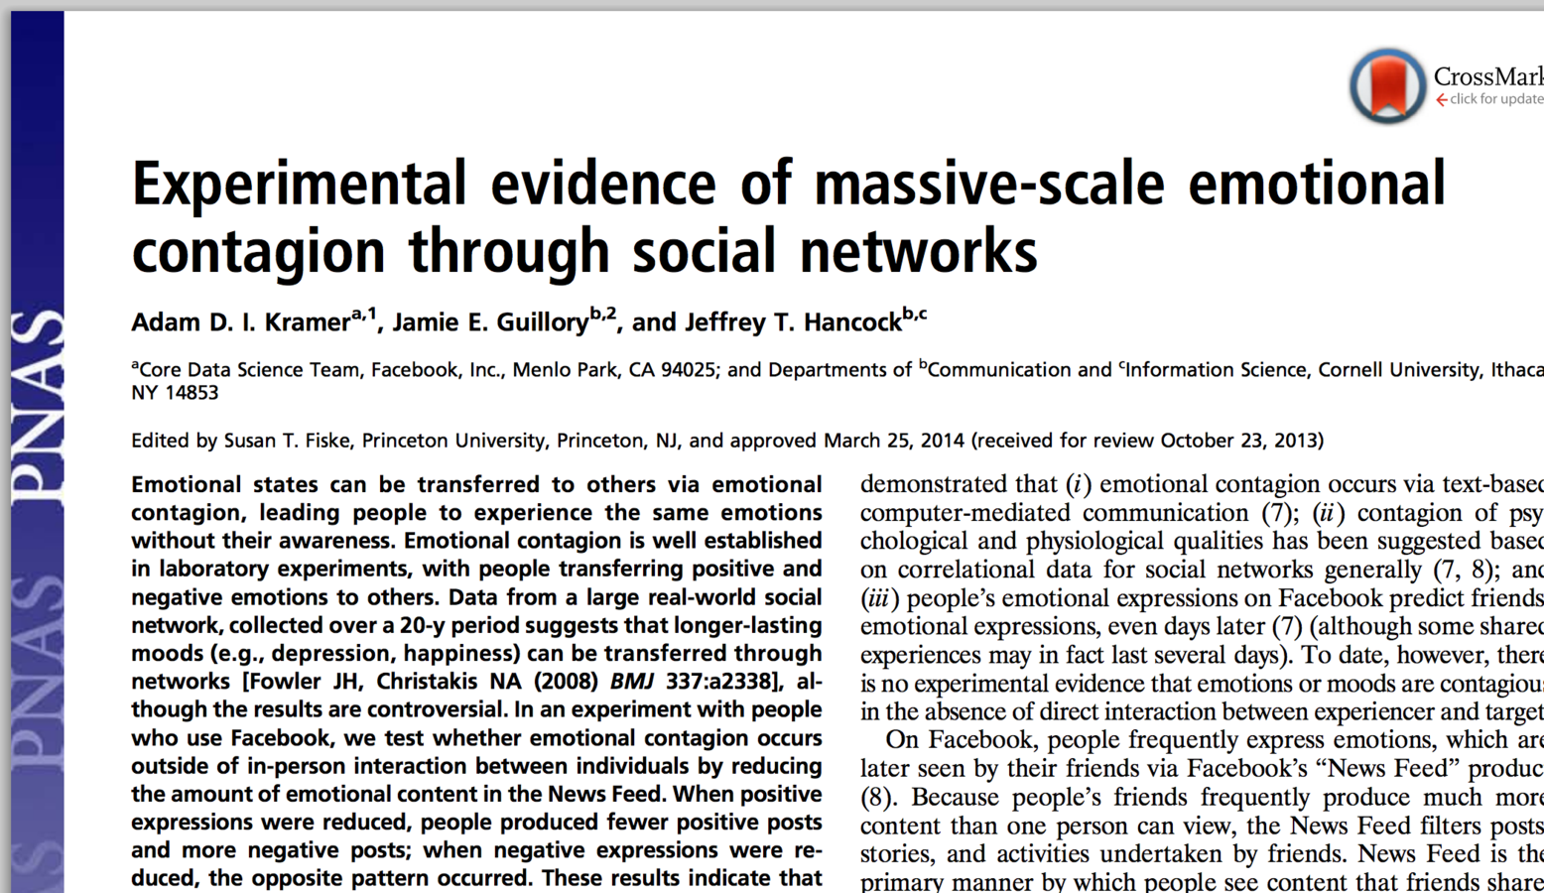

Slide 25
“[The work] was consistent with Facebook’s Data Use Policy, to which all users agree prior to creating an account on Facebook, constituting informed consent for this research.”
— Authors of the Facebook Emotional Contagion Study

Slide 26
“This study is a scandal because it brought Facebook’s troubling practices into a realm—academia—where we still have standards of treating people with dignity and serving the common good.”
— James Grimmelmann

Slide 27
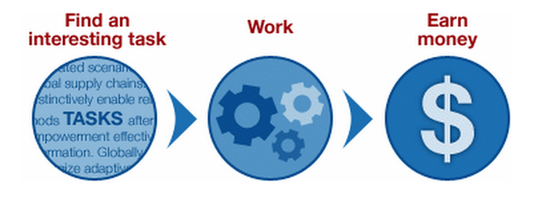

Slide 28
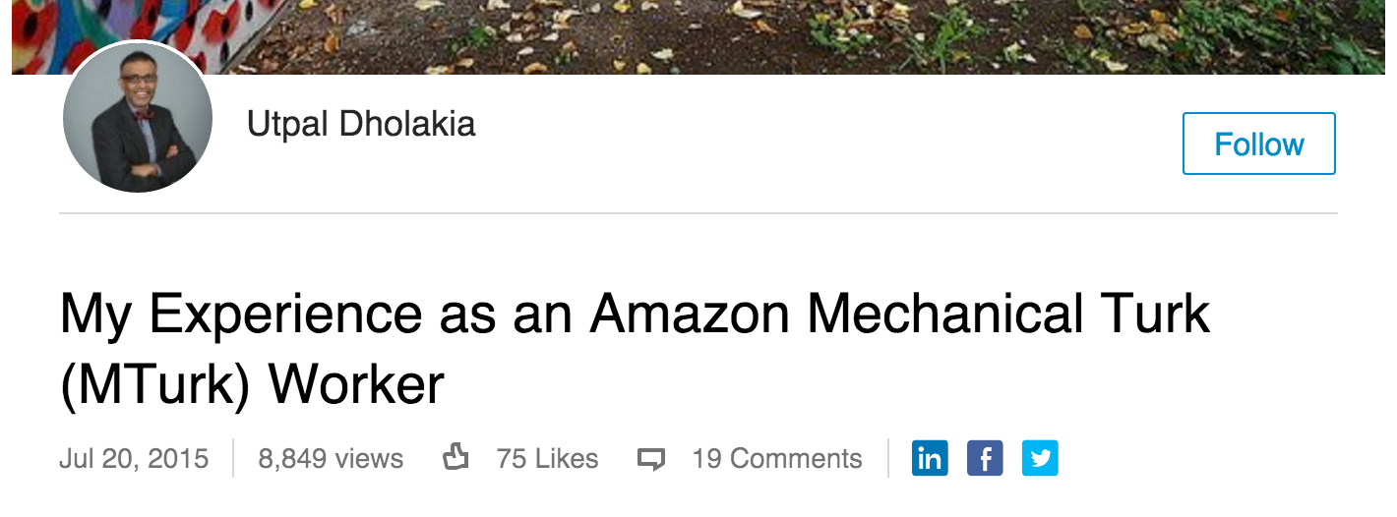

Slide 29
“In most crowdsourcing platforms, fragmentation of tasks disenfranchises cognitive workers by disconnecting them from the final intellectual work.”
—Ayhan Aytes

Slide 30
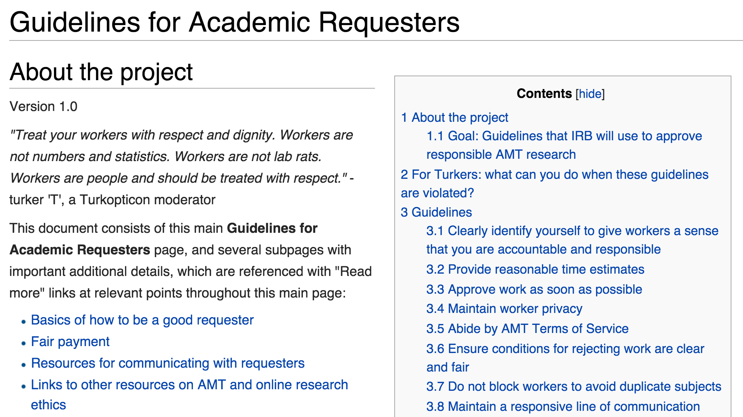
http://wiki.wearedynamo.org/index.php/Guidelines_for_Academic_Requesters

Slide 31
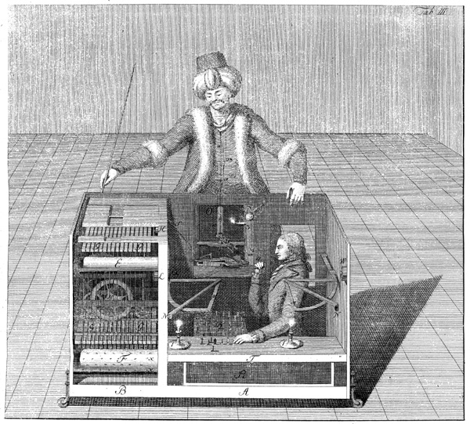

Slide 32
Is there a Ghost in the [Search] Machine?
Improving Search UX using Query Analysis and Machine Cues
Jason A. Clark
Associate Professor
Head, Library Informatics & Computing
Montana State University (MSU) Library

Slide 33
Overview
What are the “ghosts” of the search act?
Applying context and intention to Search UX
Intention mining and anticipatory design in a search prototype
Questions

Slide 34
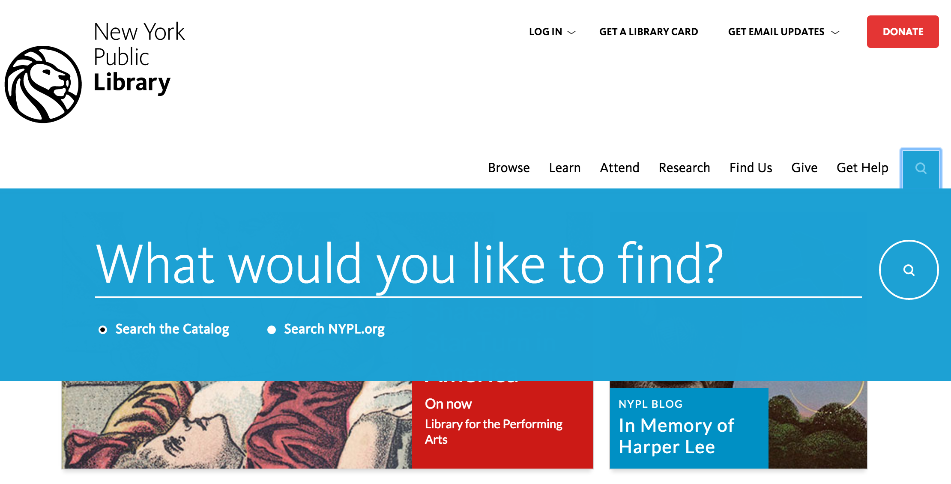

Slide 35
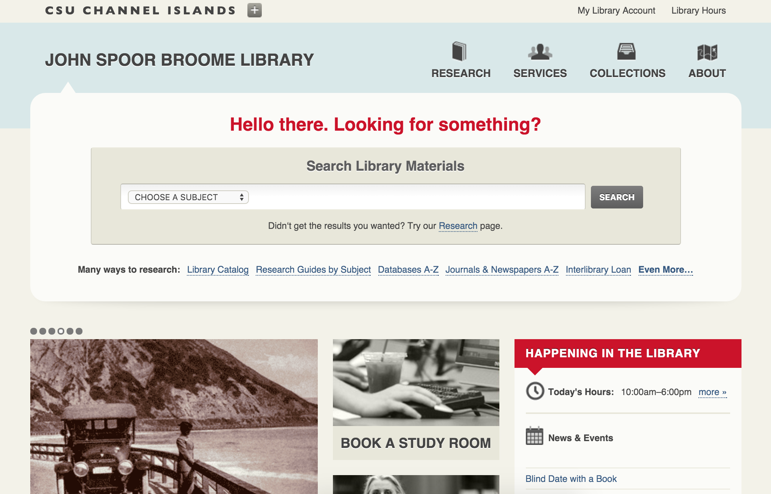

Slide 36
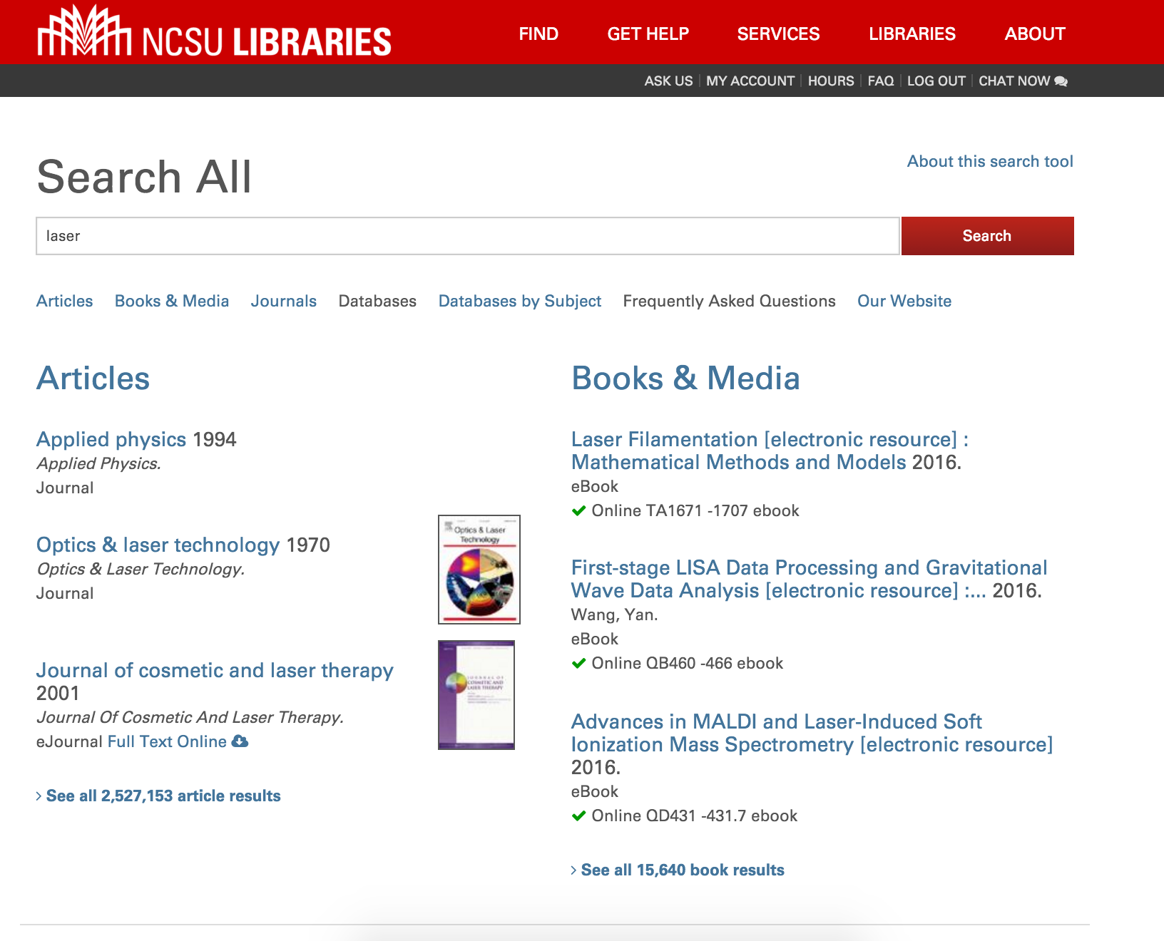

Slide 37
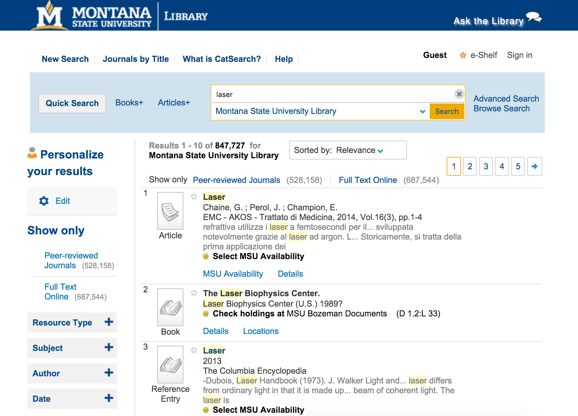

Slide 39
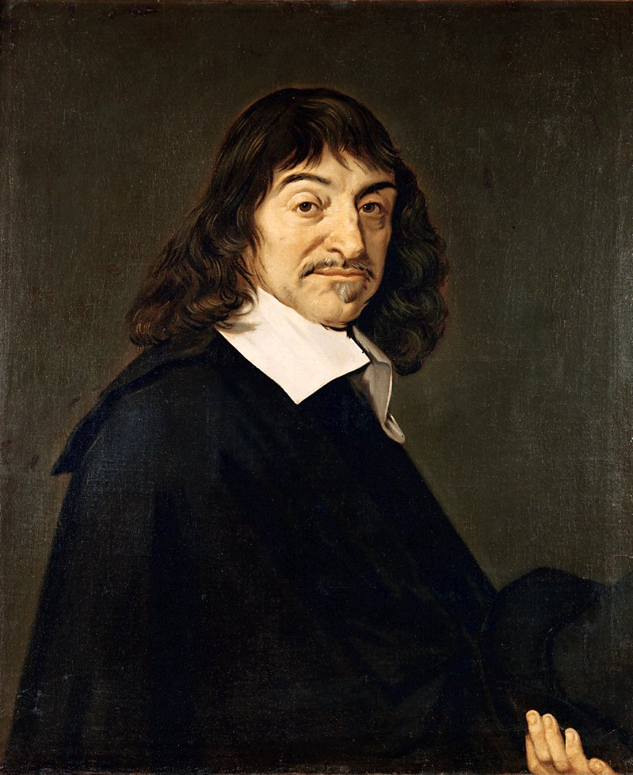

Slide 40
MIND | BODY

Slide 42
“Such in outline is the official theory. I shall often speak of it, with deliberate abusiveness, as "the dogma of the Ghost in the Machine." I hope to prove that it is entirely false, and false not in detail but in principle. It is not merely an assemblage of particular mistakes. It is one big mistake and a mistake of a special kind. It is, namely, a category mistake.”
Ryle, Gilbert, "Descartes' Myth," in The Concept of Mind, Hutchinson, London, 1949

Slide 43
search query =
literal aspect + inferred aspect

Slide 44
“yellowstone national park”
[search query]
“yellowstone national park”
[literal aspect]
iPhone user, on MT highway
[tacit, inferred aspect]

Slide 45
Search Act => Context + Intention

Slide 46
What are the Ghosts in the Search Act?

Slide 47
How do we enhance services and keep privacy in place?

Slide 48
Cues from the “live” Query

Slide 49
$cueWords = array( "about", "above", "across", "after", "afterwards", "again", "against", "all", "almost", "alone", "became", "because", "become", "becomes", "becoming", "been", "before", "beforehand", "behind", "being", "below", "beside", "besides", "between", "beyond", "by", "call", "can", "cannot", "cant", "could", "couldnt", "cry", "describe", "do", "either", "except", "few", "fill", "find", "found", "from", "front", "full", "further", "get", "give", "go", "had", "has", "hasnt", "have", "how", "however", "hundred", "if", "in", "indeed", "interest", "into", "is", "keep", "might", "mine", "more", "moreover", "most", "mostly", "move", "much", "must", "my", "myself", "name", "never", "nevertheless", "nor", "not", "nothing", "now", "nowhere", "of", "off", "often", "on", "once", "one", "only", "onto", "or", "other", "others", "otherwise", "our", "ours", "ourselves", "out", "over", "own", "part", "per", "perhaps", "please", "put", "rather", "see", "seem", "seemed", "seeming", "seems", "should", "show", "side", "since", "so", "some", "somehow", "someone", "something", "sometime", "sometimes", "somewhere", "still", "such", "system", "take", “temp”, “temperature”, "than", "that", "the", "their", "them", "themselves", "then", "thence", "there", "thereafter", "thereby", "therefore", "therein", "thereupon", "these", "they", "this", "those", "though", "three", "through", "throughout", "thru", "thus", "to", "together", "too", "top", "toward", "towards", "under", "until", "up", "upon", "us", "very", "time", "were", “weather”, "what", "whatever", "when", "whence", "whenever", "where", "whereafter", "whereas", "whereby", "wherein", "whereupon", "wherever", "whether", "which", "while", "whither", "who", "whoever", "whole", "whom", "whose", "why", "will", "with", "within", "without", "would", "yet", "you", "your", "yours", "yourself", "yourselves");

Slide 50
cueWords = ["about", "above", ... , "can", ...]
query = 'Can I get research help?';
if (in_array(strtolower($query), $cueWords)) {
echo "Here are some people to talk to: ";
}
OR
# python example
cueWords = ["about", "above", ... , "can", ...]
query = 'Can I get research help?'
query.lower()
if query in cueWords:
print Here are some people to talk to:

Slide 51
Cues from the Machine

Slide 52
HTTP Headers
+
Global Server Variables
en.wikipedia.org/wiki/List_of_HTTP_header_fields

Slide 53
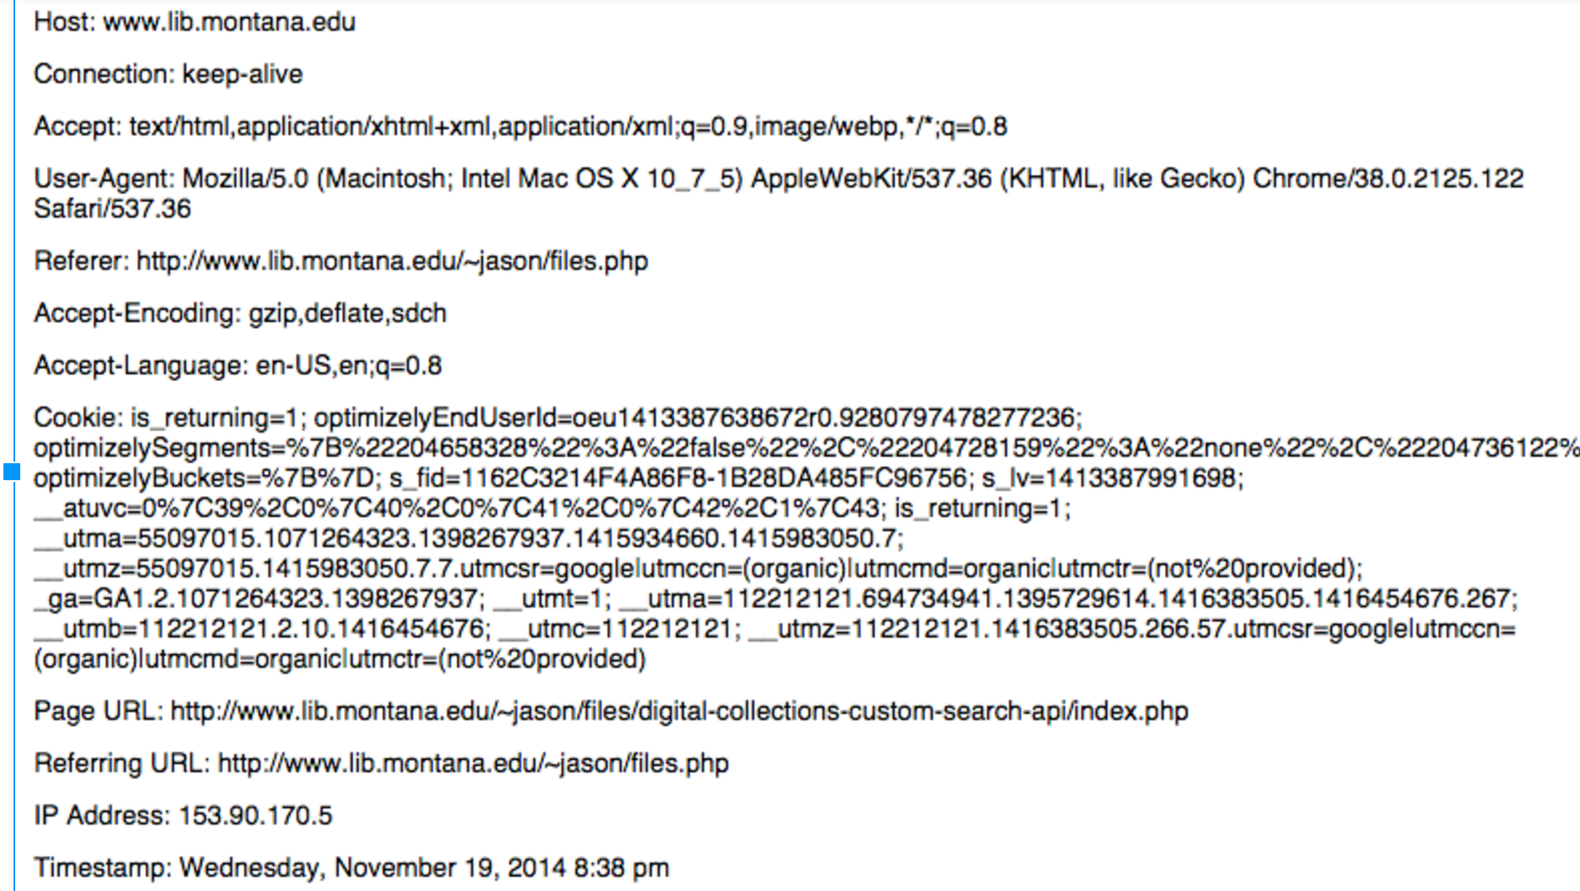

Slide 54
Location from the Browser or Network Info

Slide 55
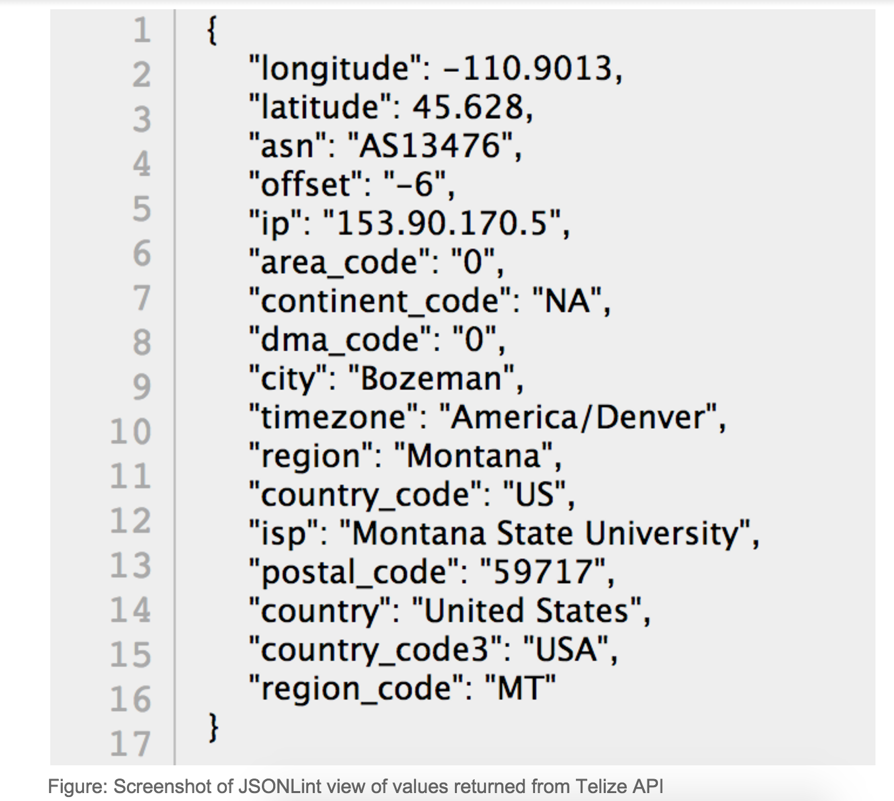

Slide 56
Javascript variables from the Browser Load

Slide 57
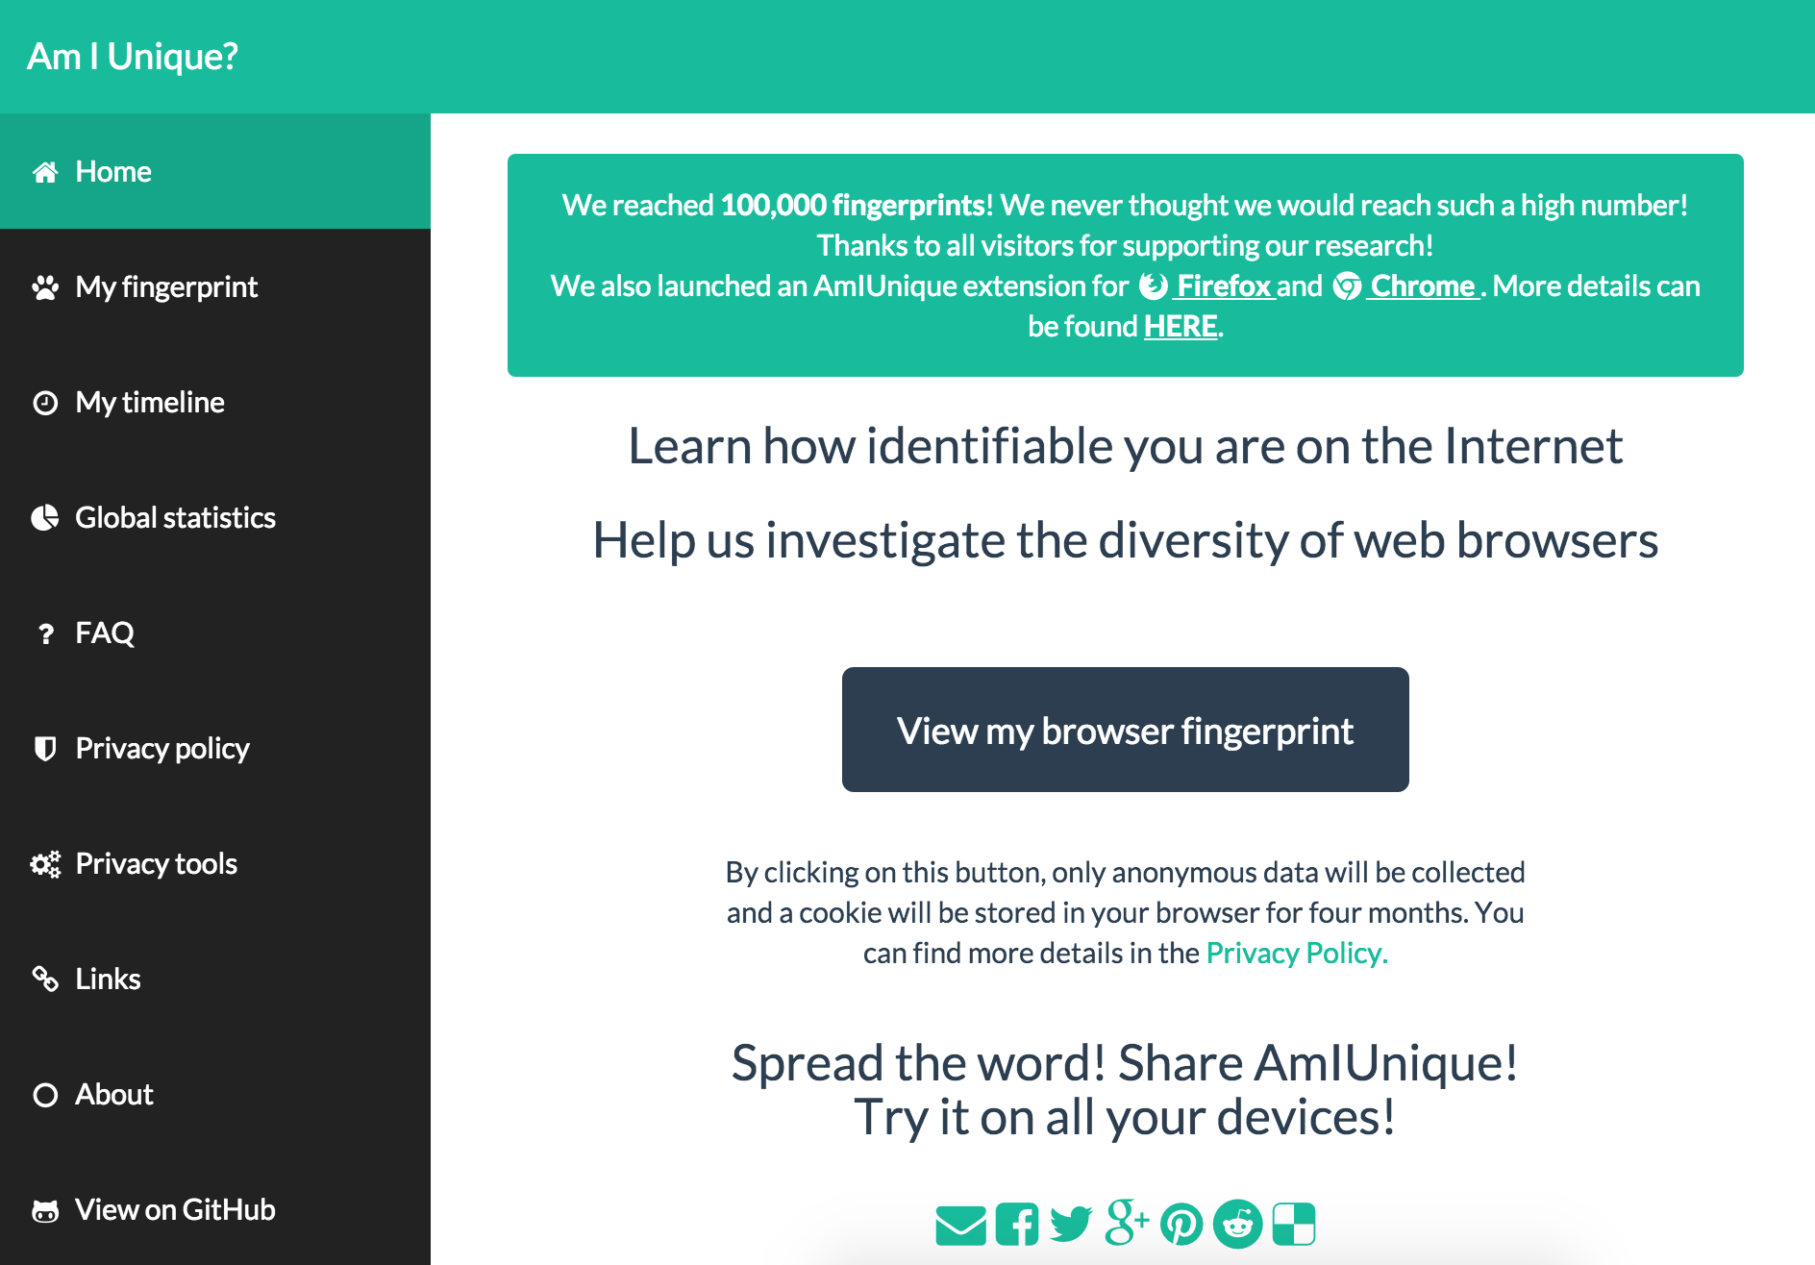

Slide 58
Javascript functions:
window.navigator.plugins
window.navigator.platform
window.navigator.cookieEnabled
window.navigator.doNotTrack
new Date().getTimezoneOffset()
window.screen.height
window.screen.width
window.screen.colorDepth

Slide 59
Cues from Analytics Logs

Slide 60
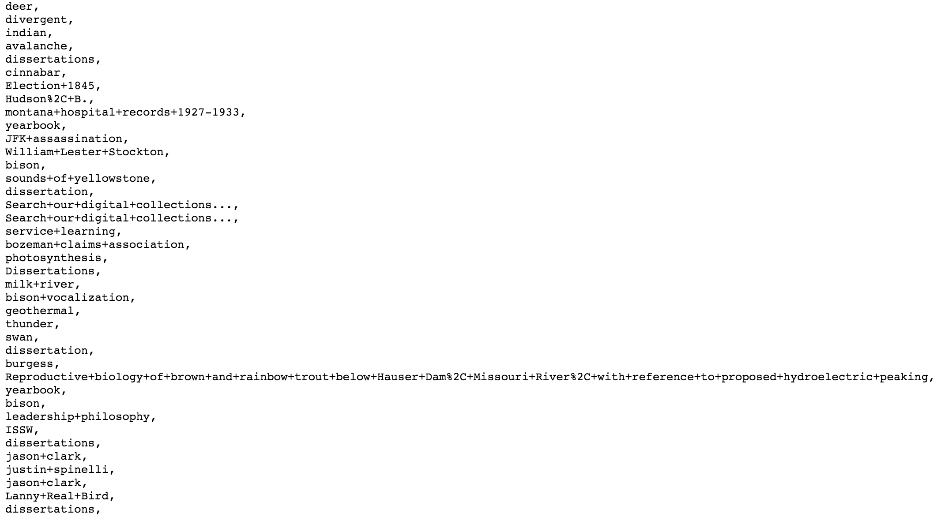
arc.lib.montana.edu/digital-collections/search-log.txt

Slide 61
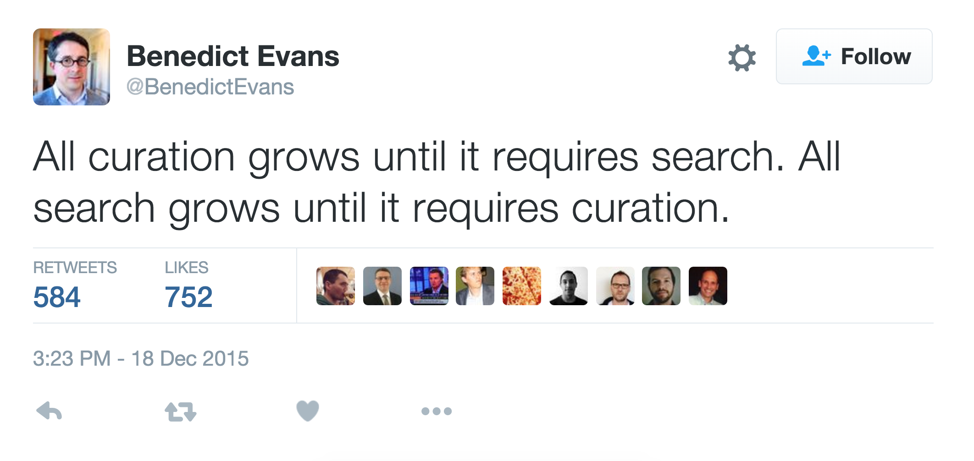
https://twitter.com/BenedictEvans/status/677977465373896704

Slide 62
Applying Contextual and Intentional Cues

Slide 63
Use these cues to show different parts of search index and additional context

Slide 64
This is anticipatory design.
www.smashingmagazine.com/2015/09/anticipatory-design/

Slide 65
This is intention mining.
www.smashingmagazine.com/2015/09/anticipatory-design/

Slide 66
Search Prototype
Demo
www.lib.montana.edu/~jason/files/search-ux/
Code
github.com/jasonclark/search-ux

Slide 67
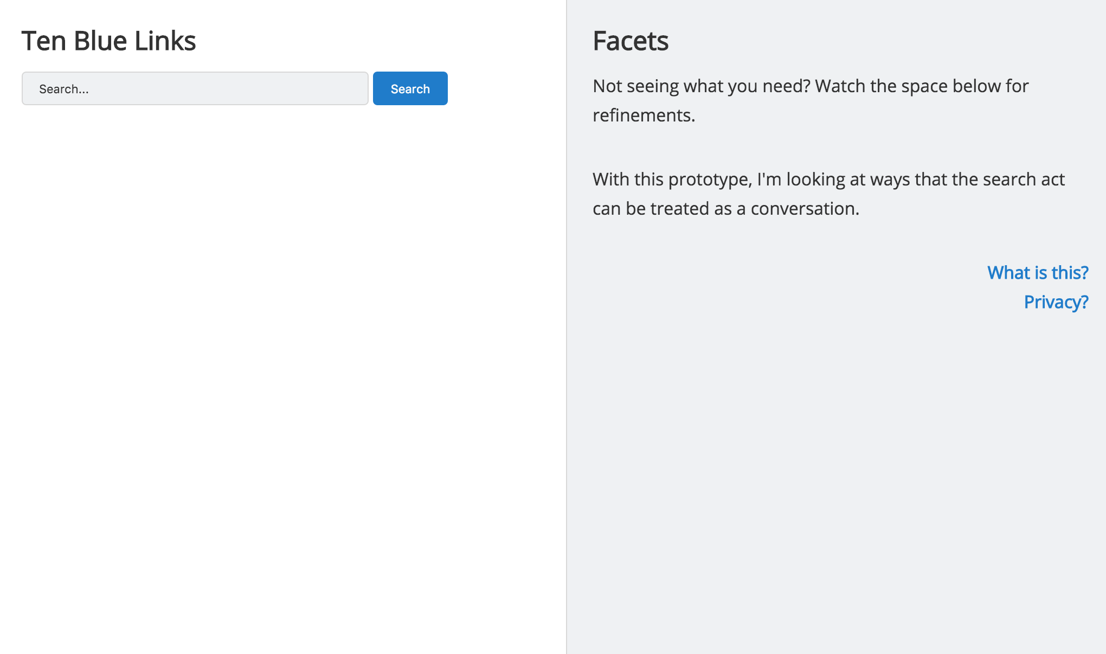
Initial Search Landing Page

Slide 68
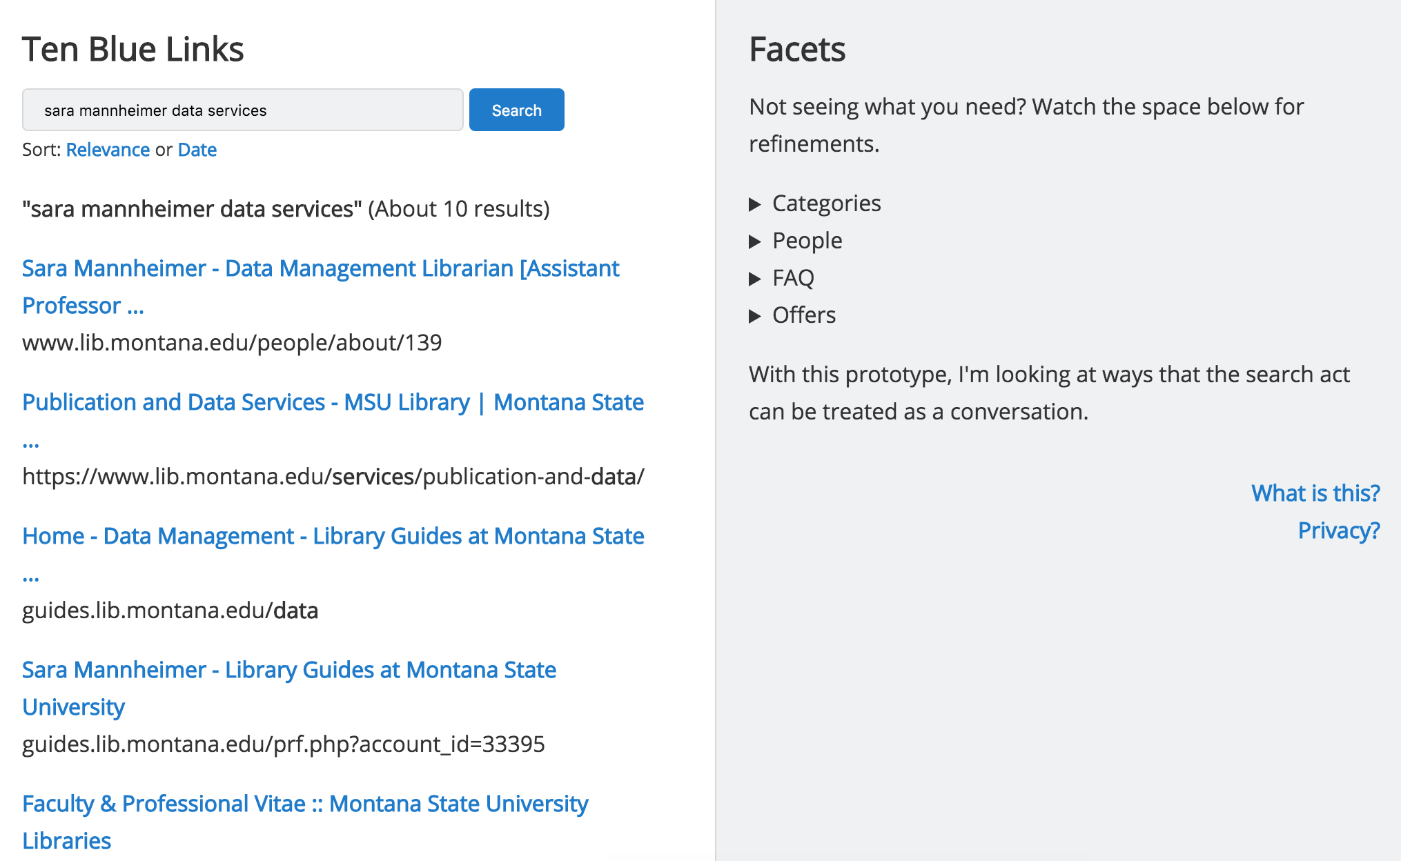
Small Result Set ( < 30 results)

Slide 69
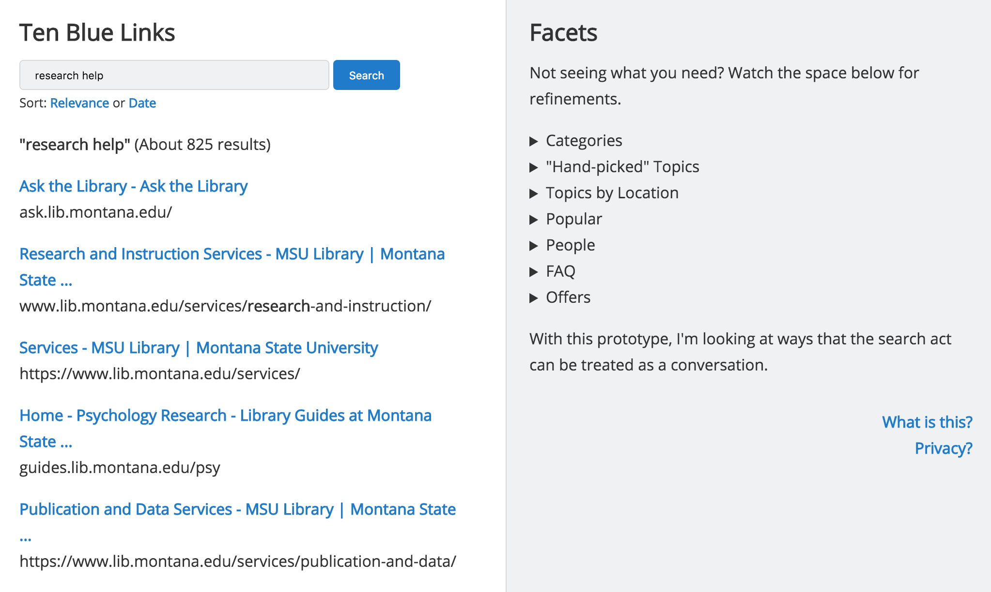
Large Result Set ( > 30 results)

Slide 70
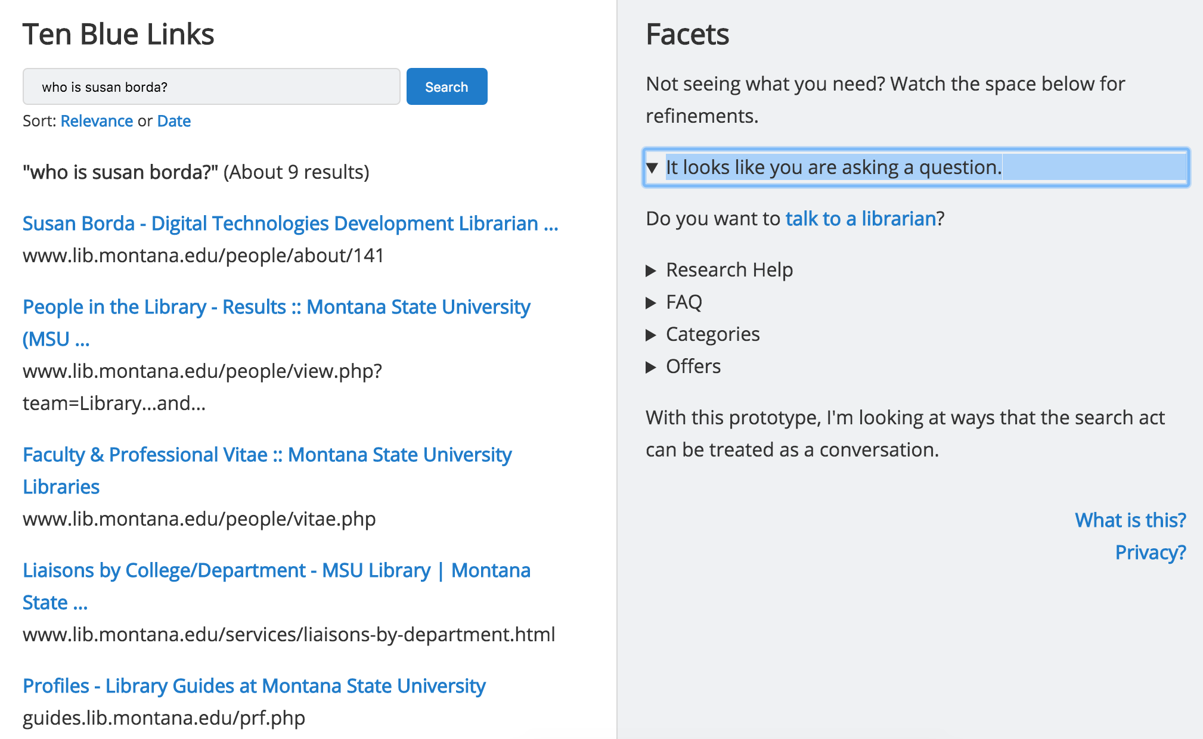
Suggestions Based on Natural Language Question

Slide 71
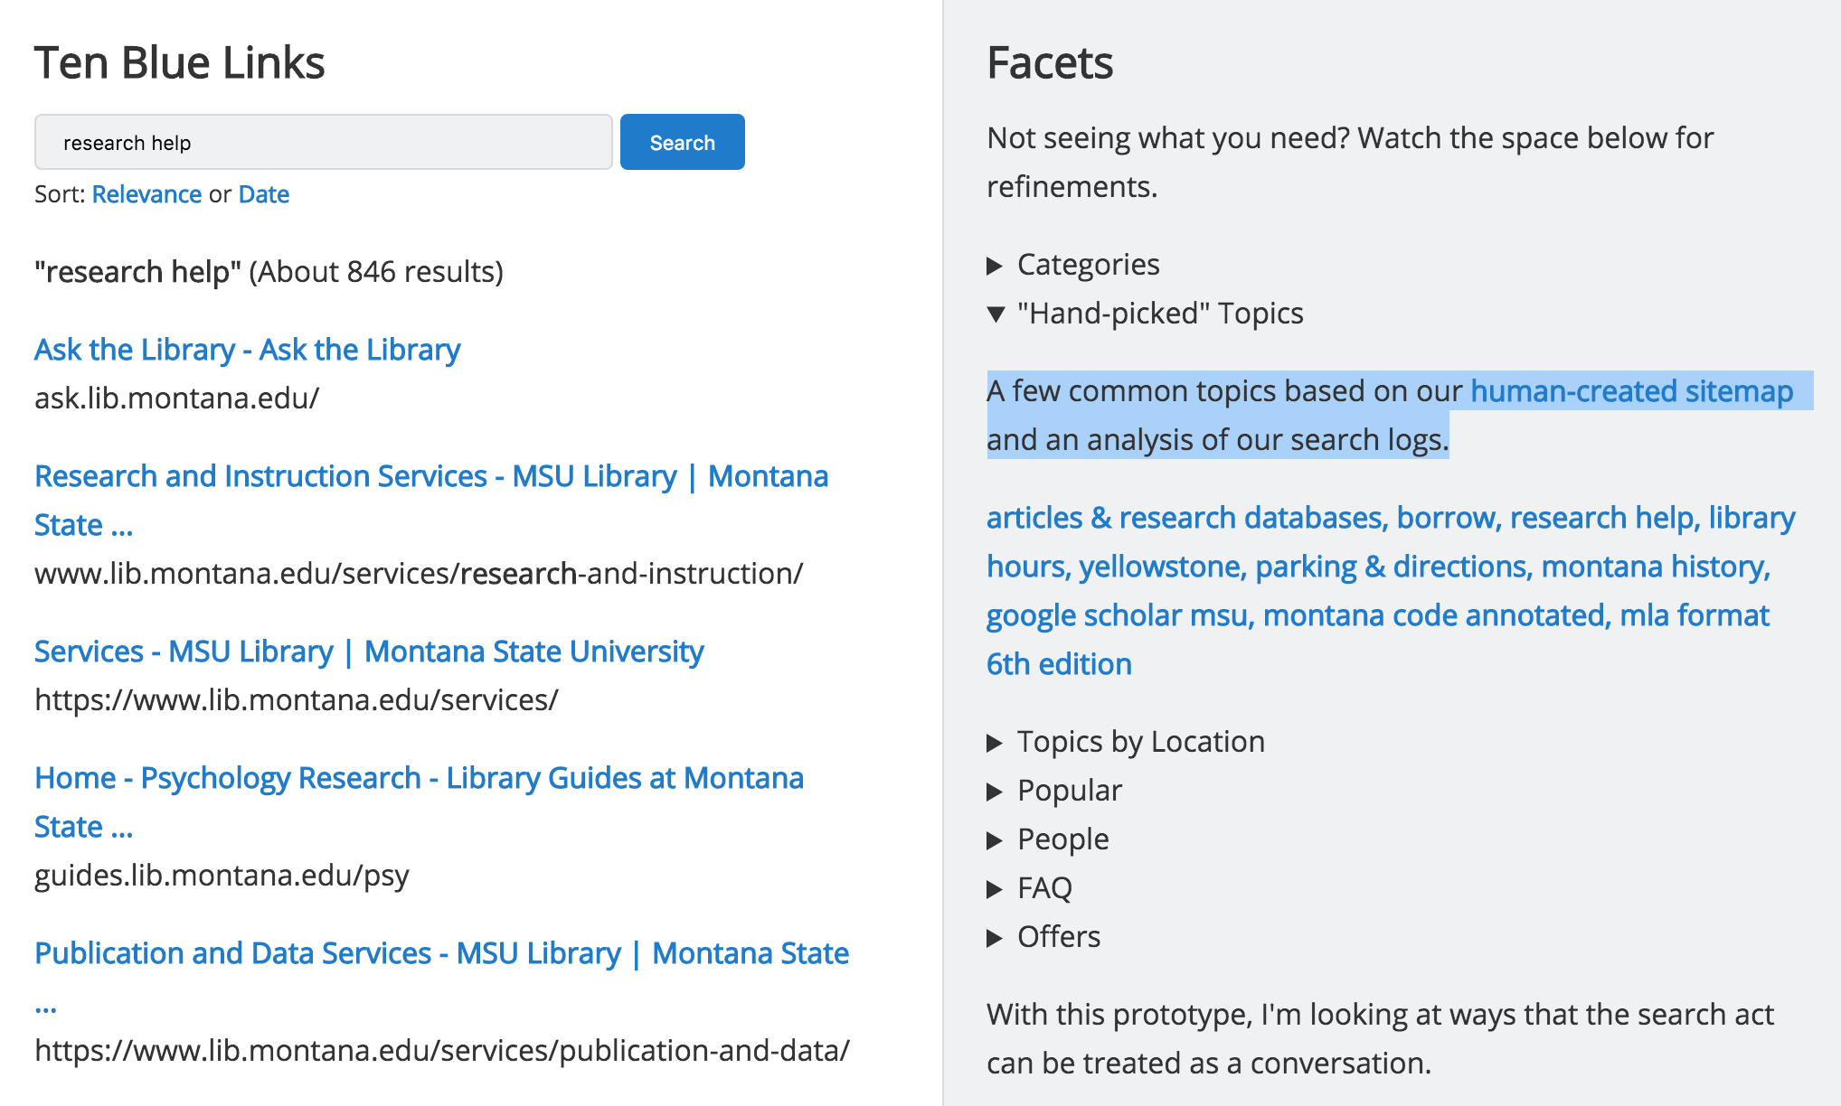
Suggestions Based on Result Set Size

Slide 72
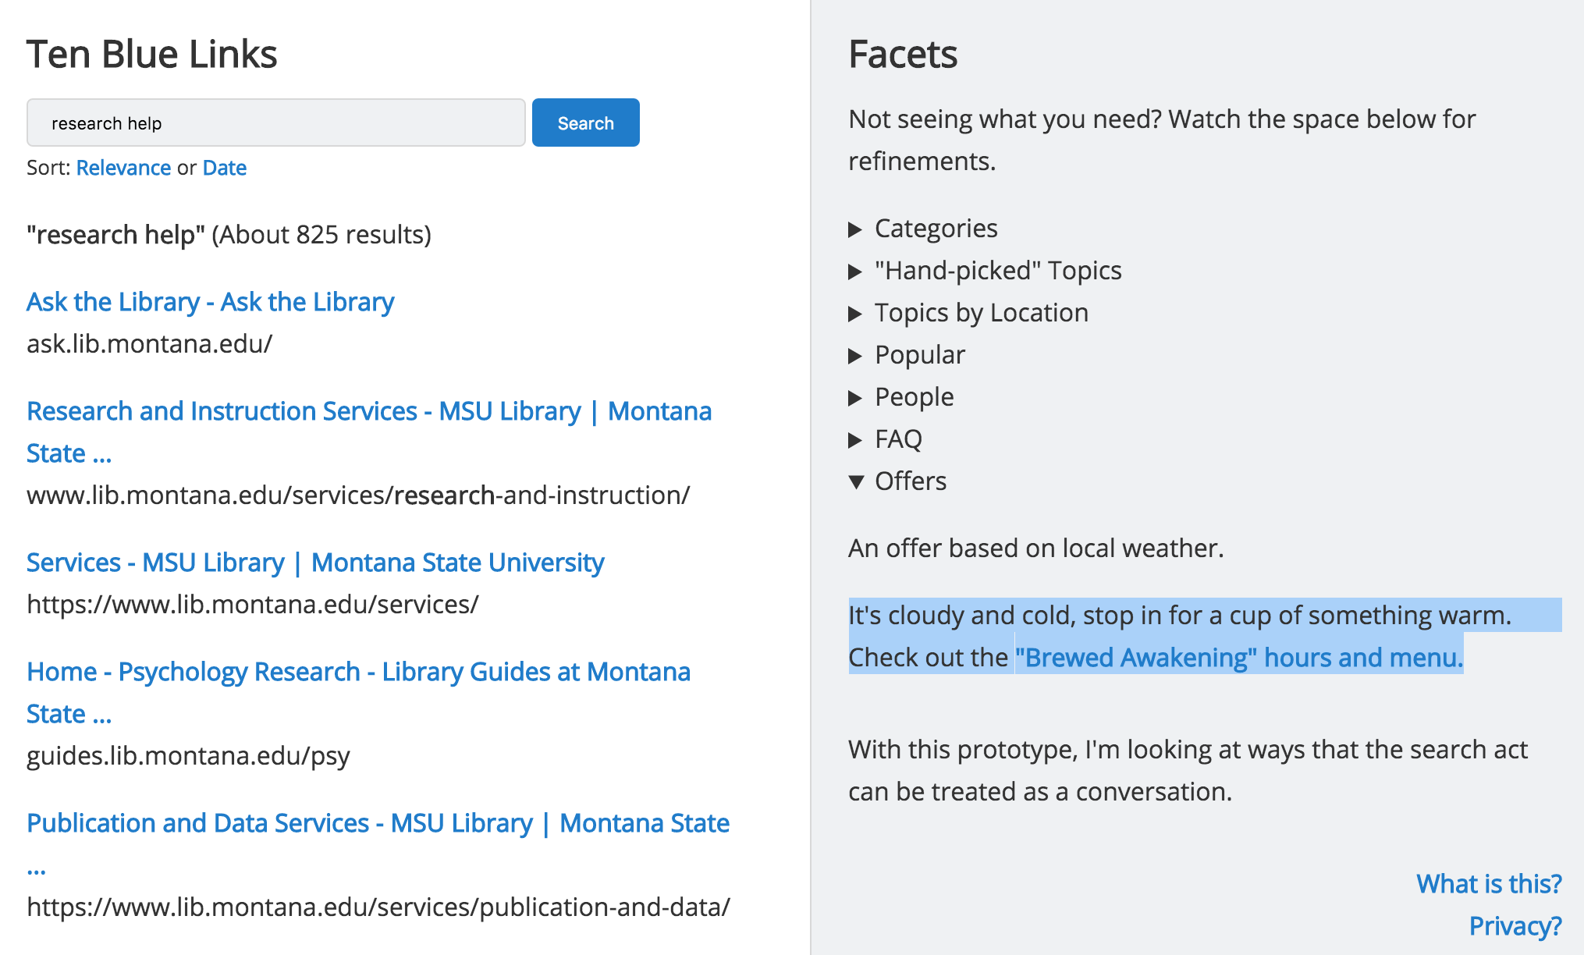
Suggestions Based on Local Context

Slide 73
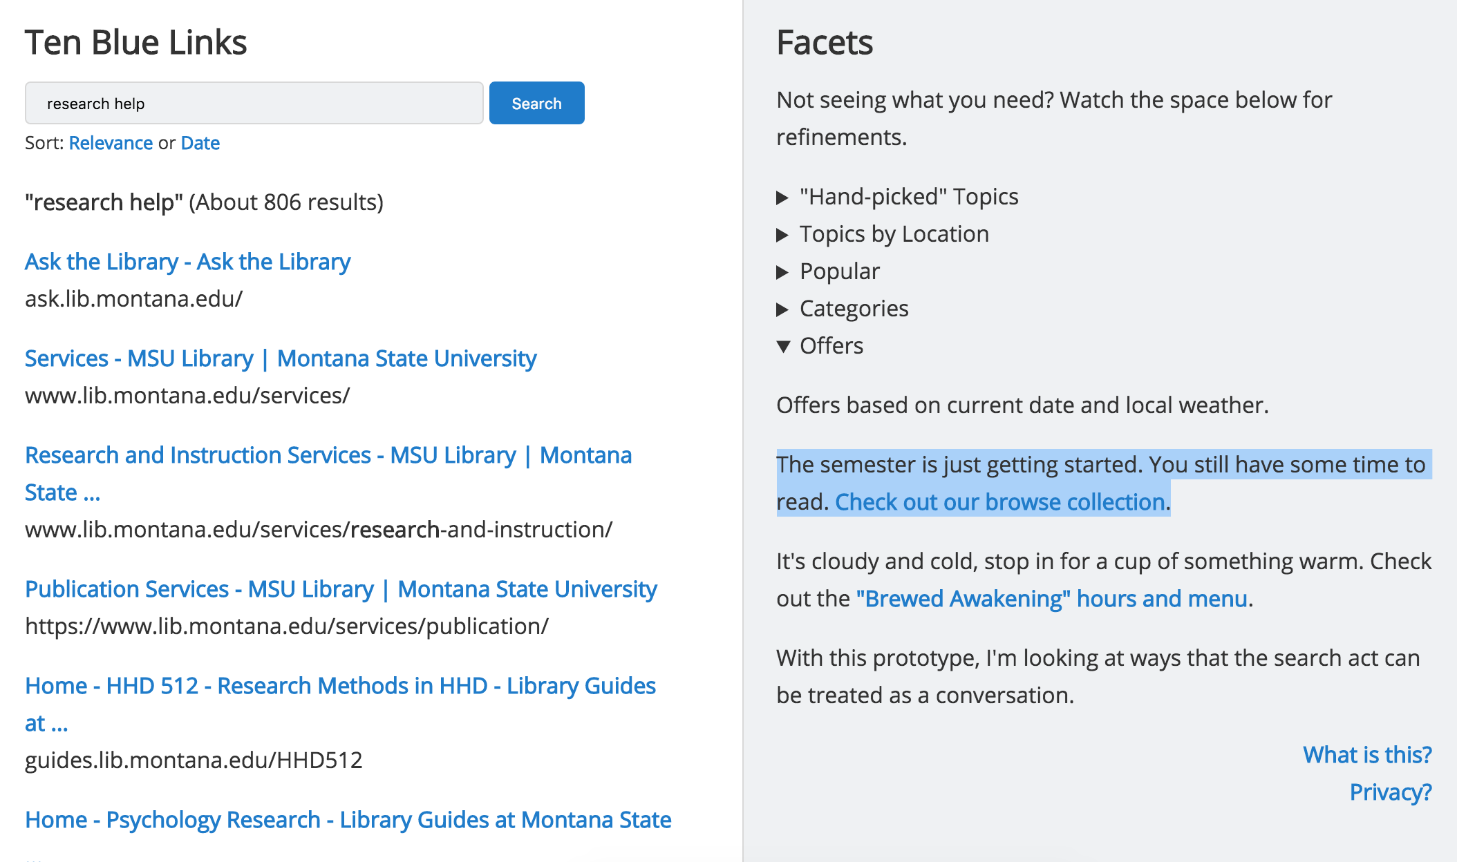
Suggestions Based on Time and Date

Slide 74
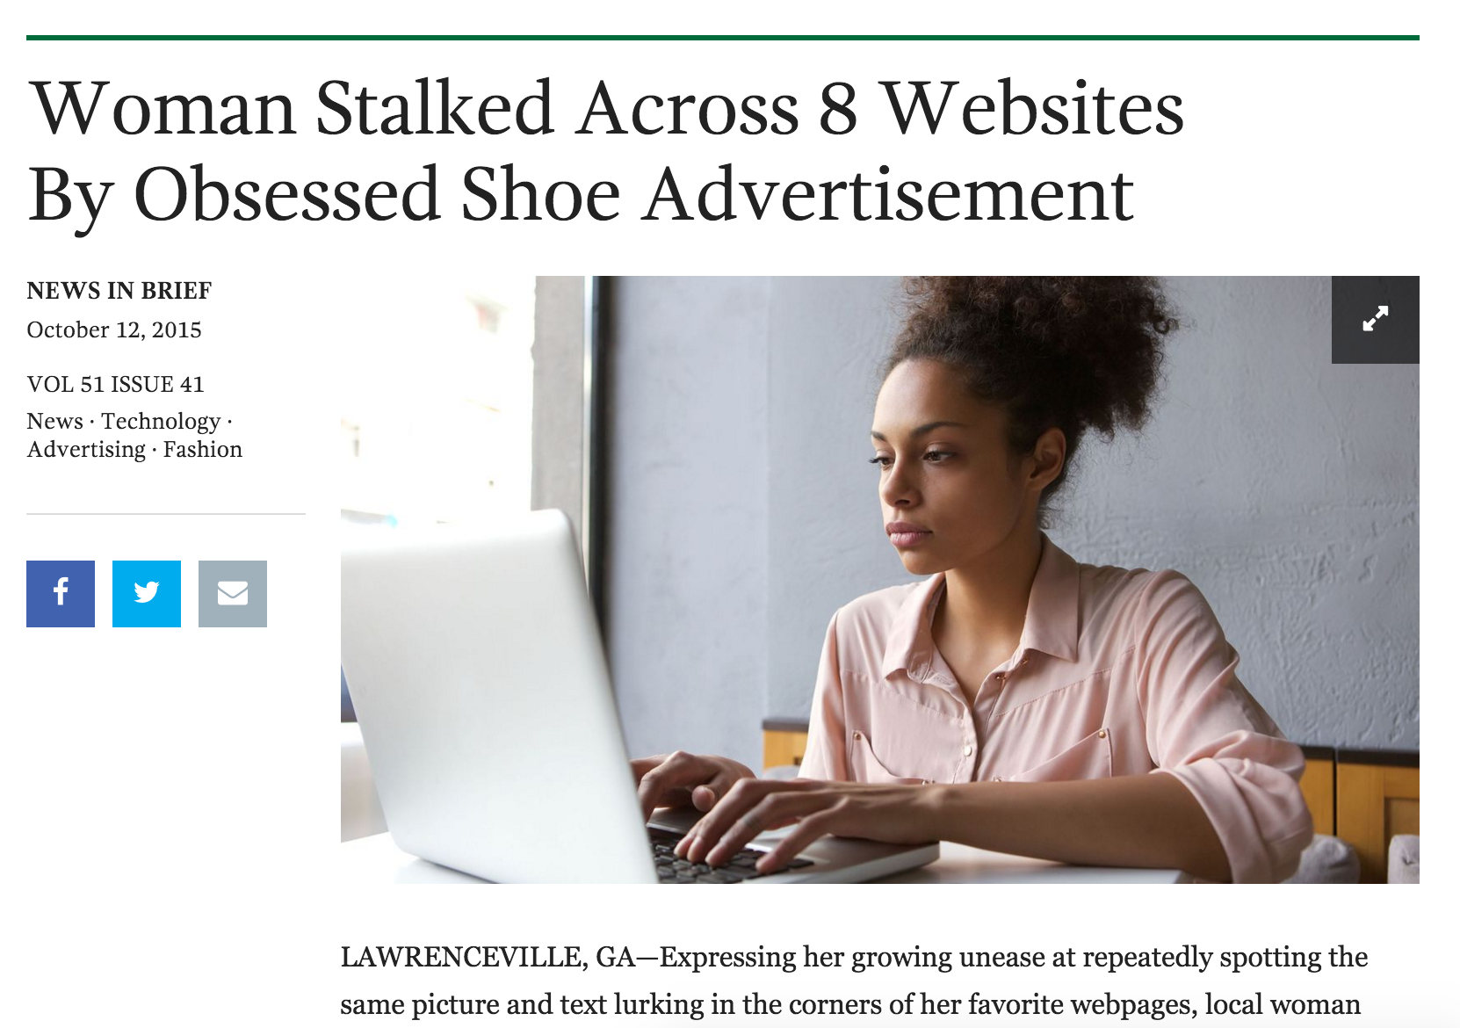

Slide 75
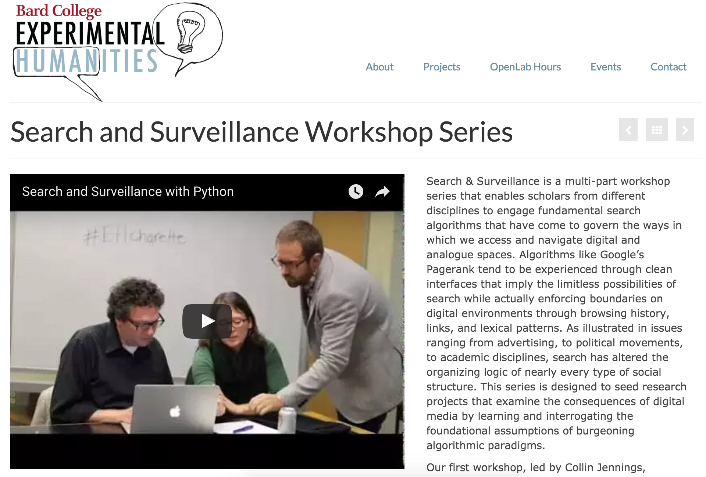

Slide 77
Quaero ergo sum
“I search, therefore I am”
Notes:
Speech act of a search has a fingerprint

Slide 78
There are Ghosts in the [Search] Machine.
What do we as a profession choose to do with them?
Notes:
Speech act of a search has a fingerprint

Slide 79
Search Surveillance Engine

Slide 80
Research - Next Steps
Systems design with domain experts (research librarians)
Testing users with eye toward where tolerance for added value and privacy coincide

Slide 81
Semantics of Ethics
or
Ethics of Semantics

Slide 82
Notes:
data is everywhere
1’s and 0’s, but also not just 1’s and 0’s

Slide 83
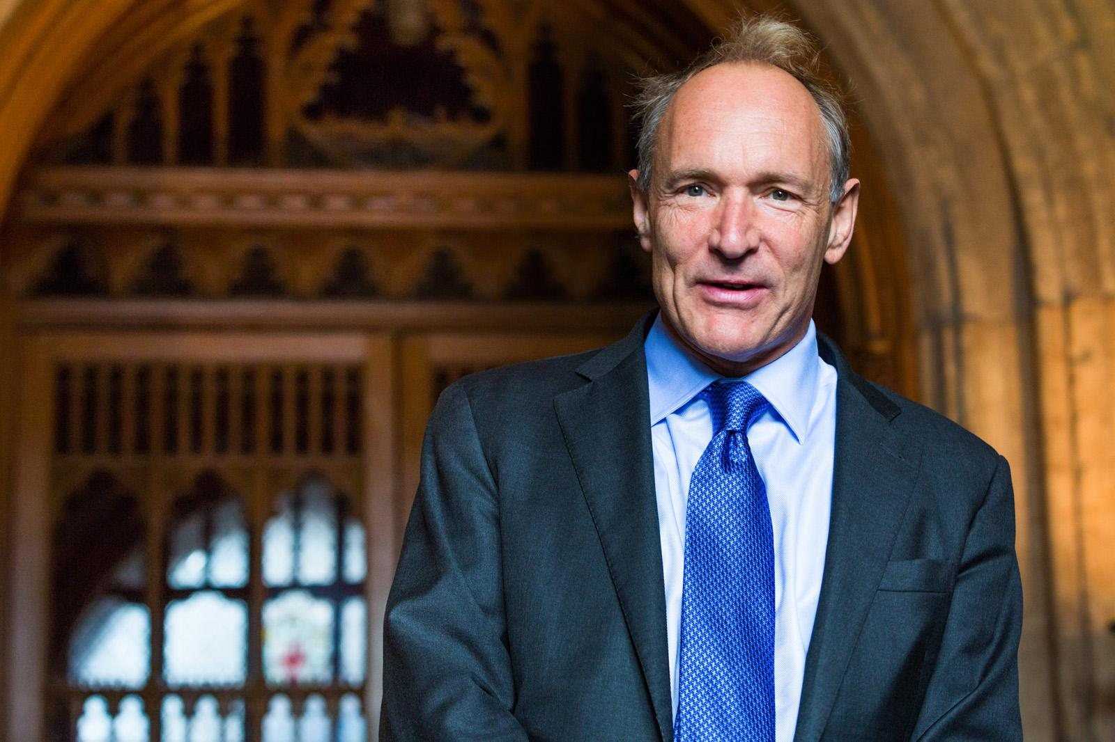
Notes:
enable machines to comprehend semantic documents and data not human speech and writings
Properly designed, the Semantic Web can assist the evolution of human knowledge as a whole

Slide 84
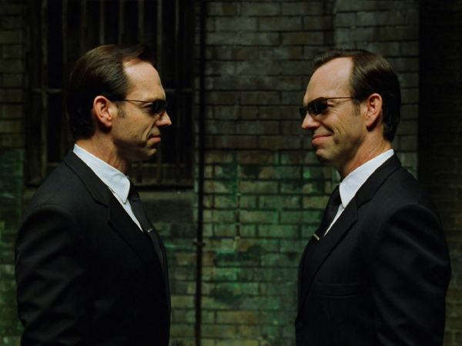
Sir Timothy John Berners-Lee
b. 1955
Software Agents
Notes:
enable machines to comprehend semantic documents and data not human speech and writings
in 2001 when TBL proposed the Semantic Web, most Web content was designed for humans to read, not for computer programs to “manipulate meaningfully”
in short, computers had no way of processing the semantics (aka meaning) of web content
the Semantic Web was suggested as a way to provide meaningful structure to web content and create an environment “software agents” roam from page to page to carry out sophisticated tasks for users
this all works provided that page content is encoded by human agents
so, in order to create
Semantic Web is an extension of the existing web architecture
provides information with well-defined meaning
better enabling computers and people to work in cooperation

Slide 85
“Properly designed, the Semantic Web can assist the evolution of human knowledge as a whole.”
~TBL, 2001
Notes:
“The Semantic Web”, Scientific American, 2001
“a new form of Web content that is meaningful to computers will unleash a revolution of new possibilities”
enable machines to comprehend semantic documents and data not human speech and writings
“Properly designed, the Semantic Web can assist the evolution of human knowledge as a whole”

Slide 86
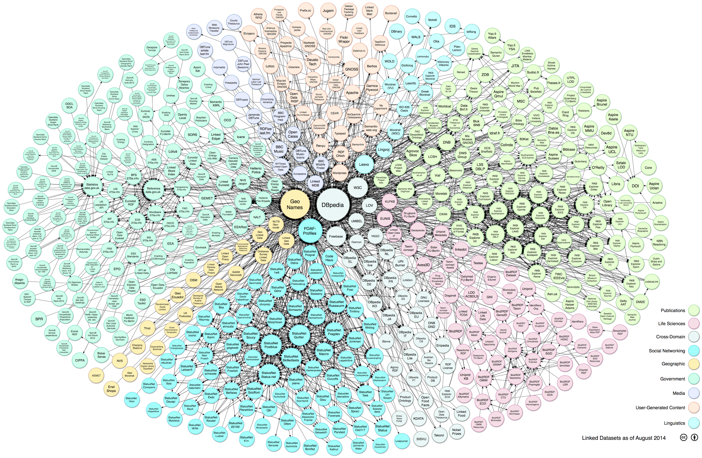
Notes:
the foundation of the Semantic Web is Linked Data
Linked Data empowers people that publish and use information on the Web.
way to create a network of standards-based, machine-readable data across Web sites.
allows an application to start at one piece of Linked Data, and follow embedded links to other pieces of Linked Data that are hosted on different sites across the Web.
from documents to data and information

Slide 87
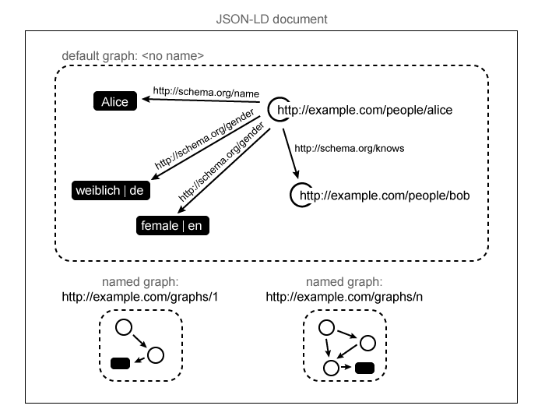
JSON-LD data model courtesy of W3C @ goo.gl/AVRjWq
Notes:
recall earlier when I mentioned that machine learning relies upon semantic encoding performed by humans
as such, machine learning is a reflection of human decisions
the choices we make when encode something
how human define something/someone semantically can have huge implications
what happens when you make choices about something/someone
hinges on human actors
understanding content in context
JSON-LD is a lightweight Linked Data format.
easy for humans to read and write.
based on the already successful JSON format
provides a way to help JSON data interoperate at Web-scale
JSON-LD is a lightweight syntax to serialize Linked Data in JSON [RFC4627]. Its design allows existing JSON to be interpreted as Linked Data with minimal changes. JSON-LD is primarily intended to be a way to use Linked Data in Web-based programming environments, to build interoperable Web services, and to store Linked Data in JSON-based storage engines. Since JSON-LD is 100% compatible with JSON, the large number of JSON parsers and libraries available today can be reused. In addition to all the features JSON provides, JSON-LD introduces:
a universal identifier mechanism for JSON objects via the use of IRIs,
a way to disambiguate keys shared among different JSON documents by mapping them to IRIs via a context,
a mechanism in which a value in a JSON object may refer to a JSON object on a different site on the Web,
the ability to annotate strings with their language,
a way to associate datatypes with values such as dates and times,
and a facility to express one or more directed graphs, such as a social network, in a single document.

Slide 88
Notes:
machine learning and meaning making
Interoperability - property of a product or system, whose interfaces are completely understood, to work with other products or systems, present or future, without any restricted access or implementation
Discoverability - readily findable
Visibility - prominence across various platforms, channels, etc., but with attention to DATA -- making data visible and available to various nodes within the web architecture
Authority - knowing the entity we are looking at is the entity we are searching for

Slide 89
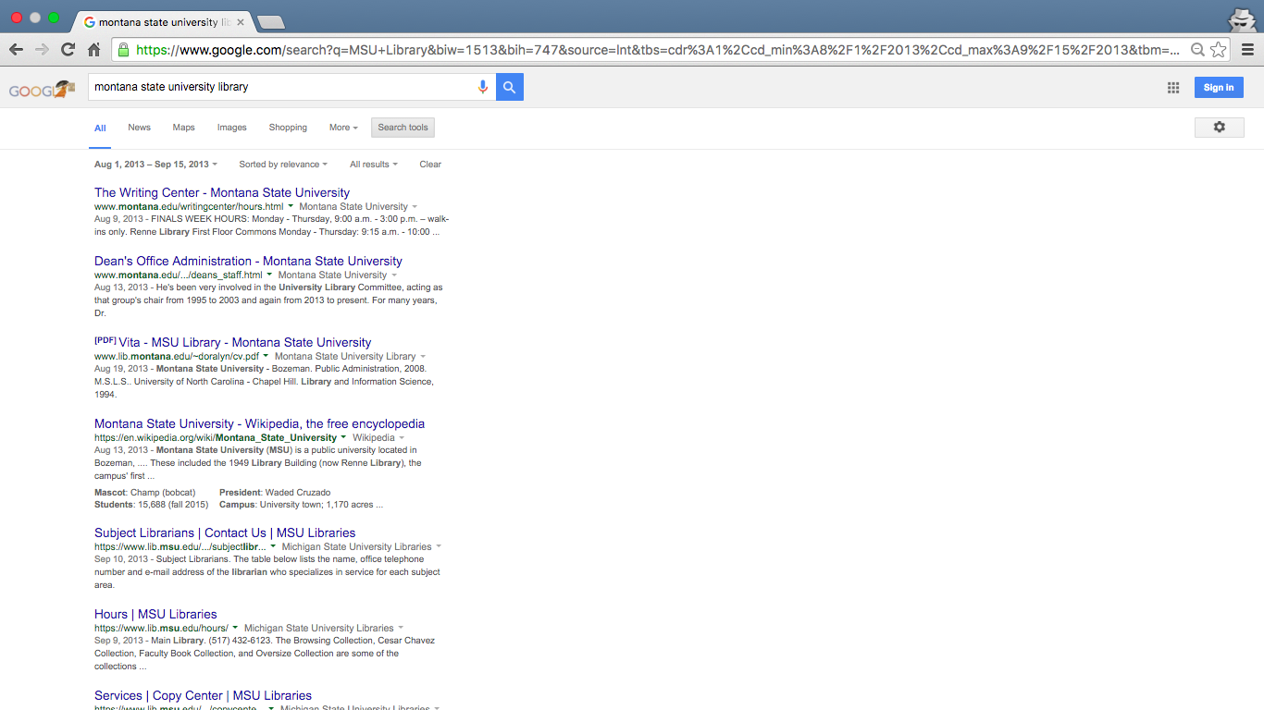

Slide 90
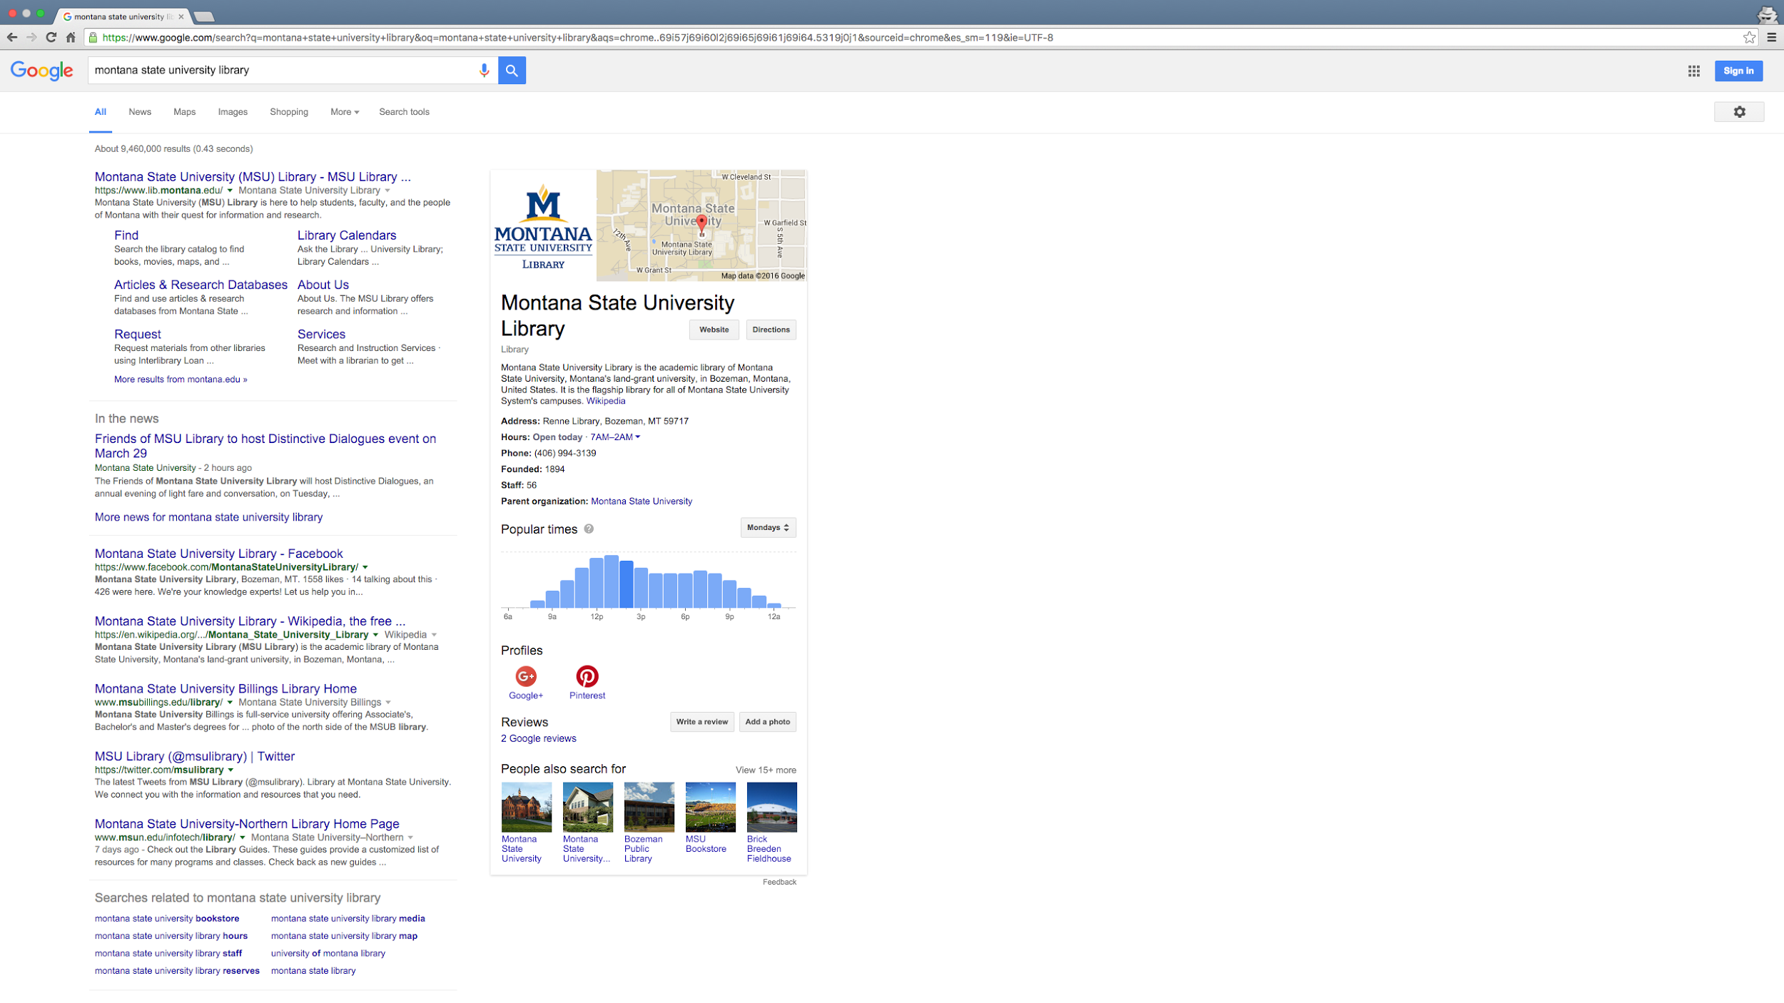
Notes:
After Semantic Web Optimization
Web Location with sitemapping
Physical Location
Pertinent business information
And for that matter, the type of business
Description of entity pulled in from Wikipedia
Verified Social Media profiles
oh, and some not-yet-verified (by Google) Social Media profiles
link to the full Wikipedia entry
and, just in case you mistyped or are looking for something else but couldn’t quite recall the name, here are some contextually appropriate entities you may be searching for
similar in some ways to Jason’s example of personalized web search and inference, the suggestions provided here are not based upon browser history but rather on the relationships between the various entities. in short, linked data and machine learning

Slide 91
Interoperability.
Discoverability.
Visibility.
Authority.
Notes:
machine learning and meaning making
Interoperability - property of a product or system, whose interfaces are completely understood, to work with other products or systems, present or future, without any restricted access or implementation
Discoverability - readily findable
Visibility - prominence across various platforms, channels, etc., but with attention to DATA -- making data visible and available to various nodes within the web architecture
Authority - knowing the entity we are looking at is the entity we are searching for

Slide 92
More is better. Always.
Right?
Notes:
21st century librarians take for granted the importance of findability, perceived visibility
discovery, access, open access
concerns of availability
exploring emerging ethical questions/concerns

Slide 93
The Reflective Moment
Notes:
take a step back
broaden our field of vision
pause to consider how we arrived at this particular moment
what choices were made that led us to this particular moment
unintended consequences? unexpected benefits? looming worries?
essentially the old adage encouraging us to understand history so we are not doomed to repeat its mistakes

Slide 94
Sociotechnical Considerations
Notes:
one framework for an multifaceted reflection
consider how social, political, and cultural values affect scientific research and technological innovation, and how these, in turn, affect society, politics and culture.
the interaction between society's complex infrastructures and human behavior

Slide 95
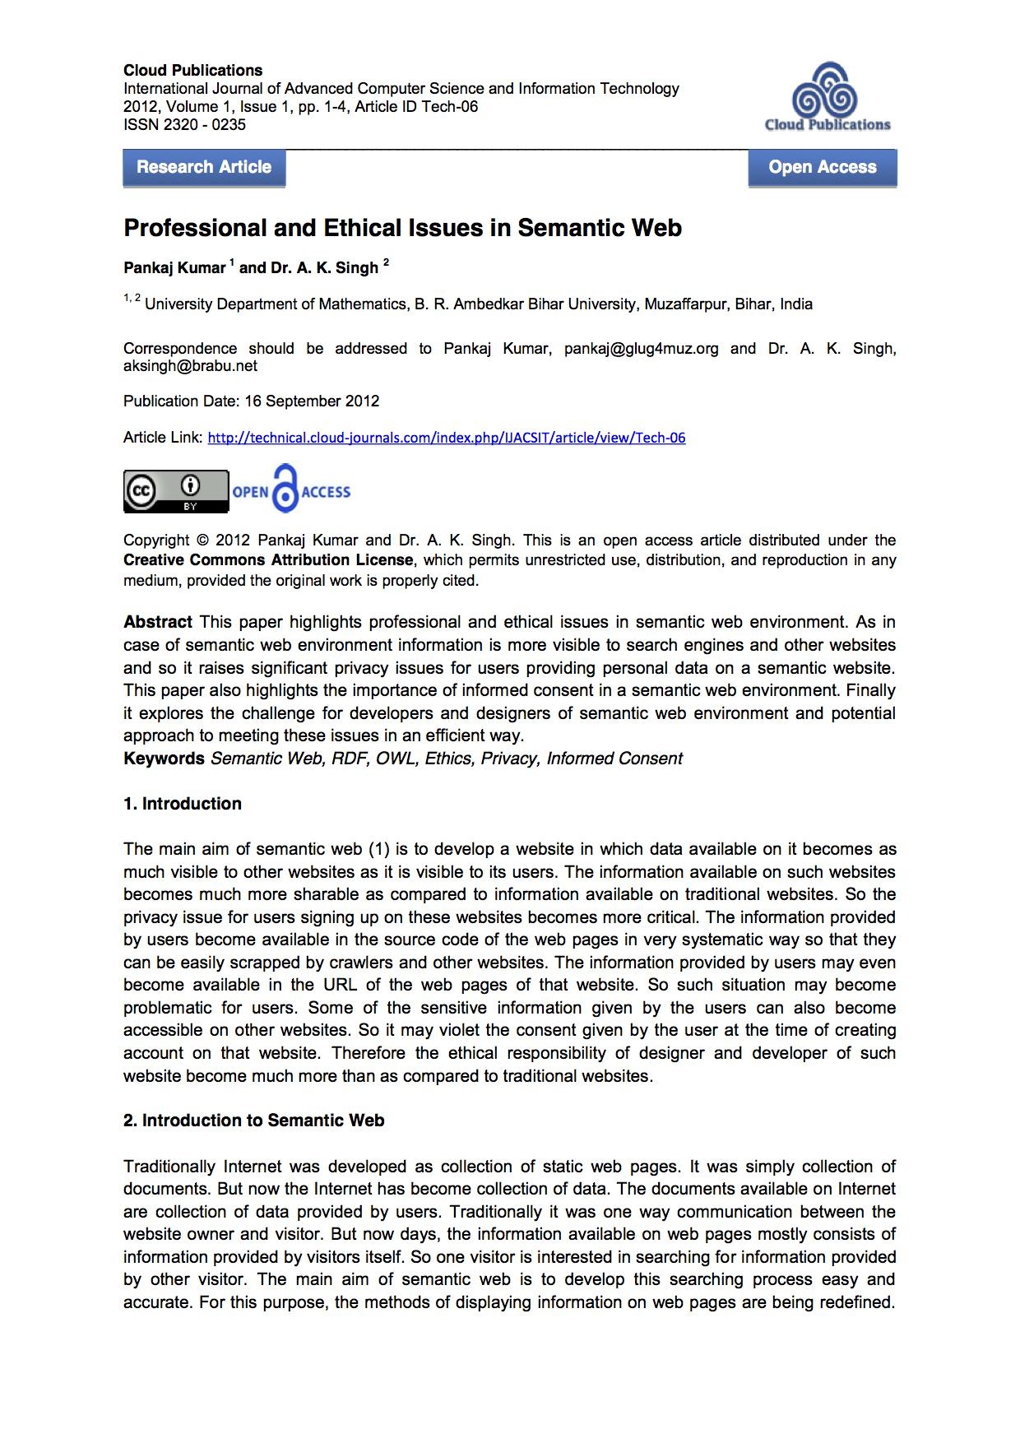
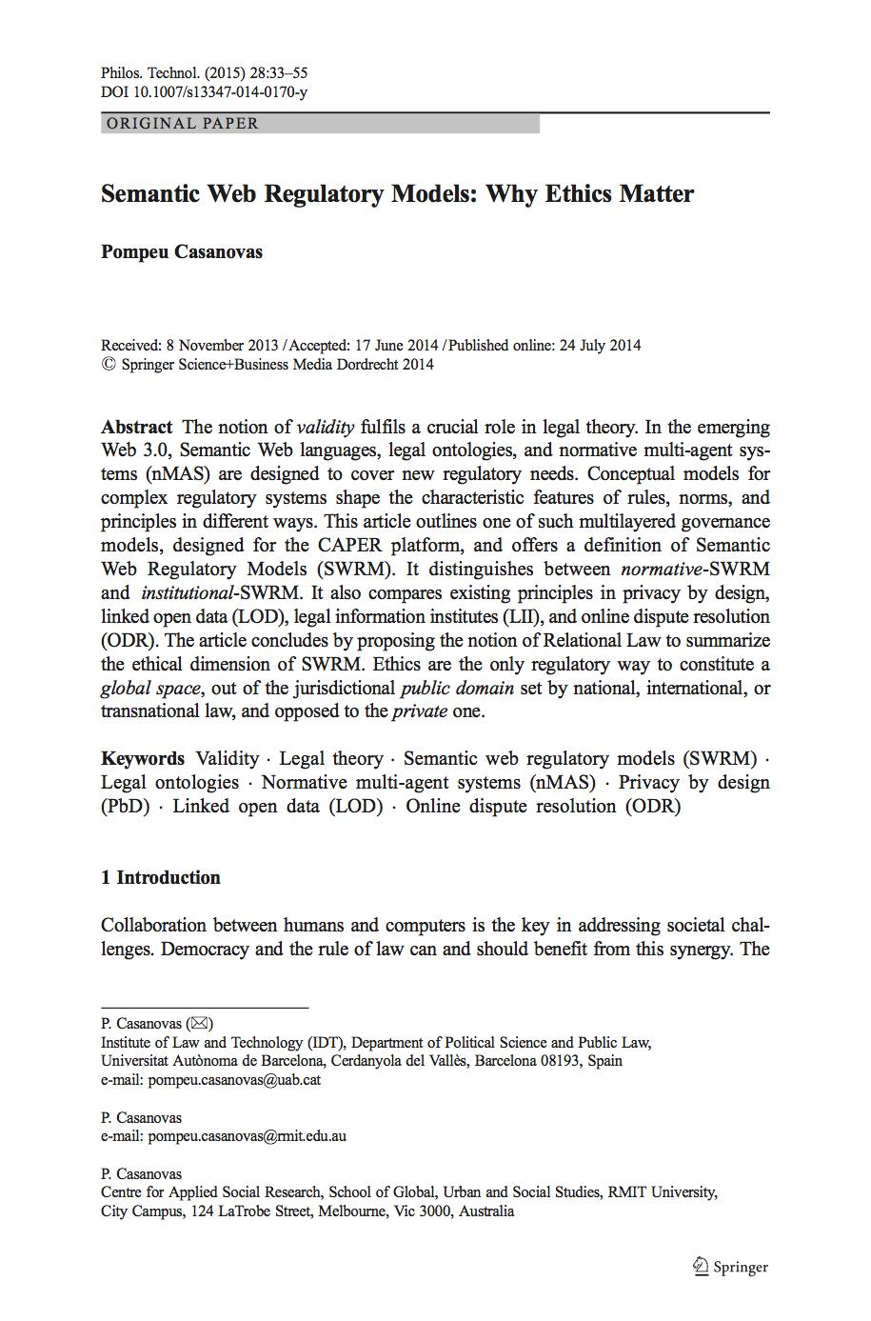
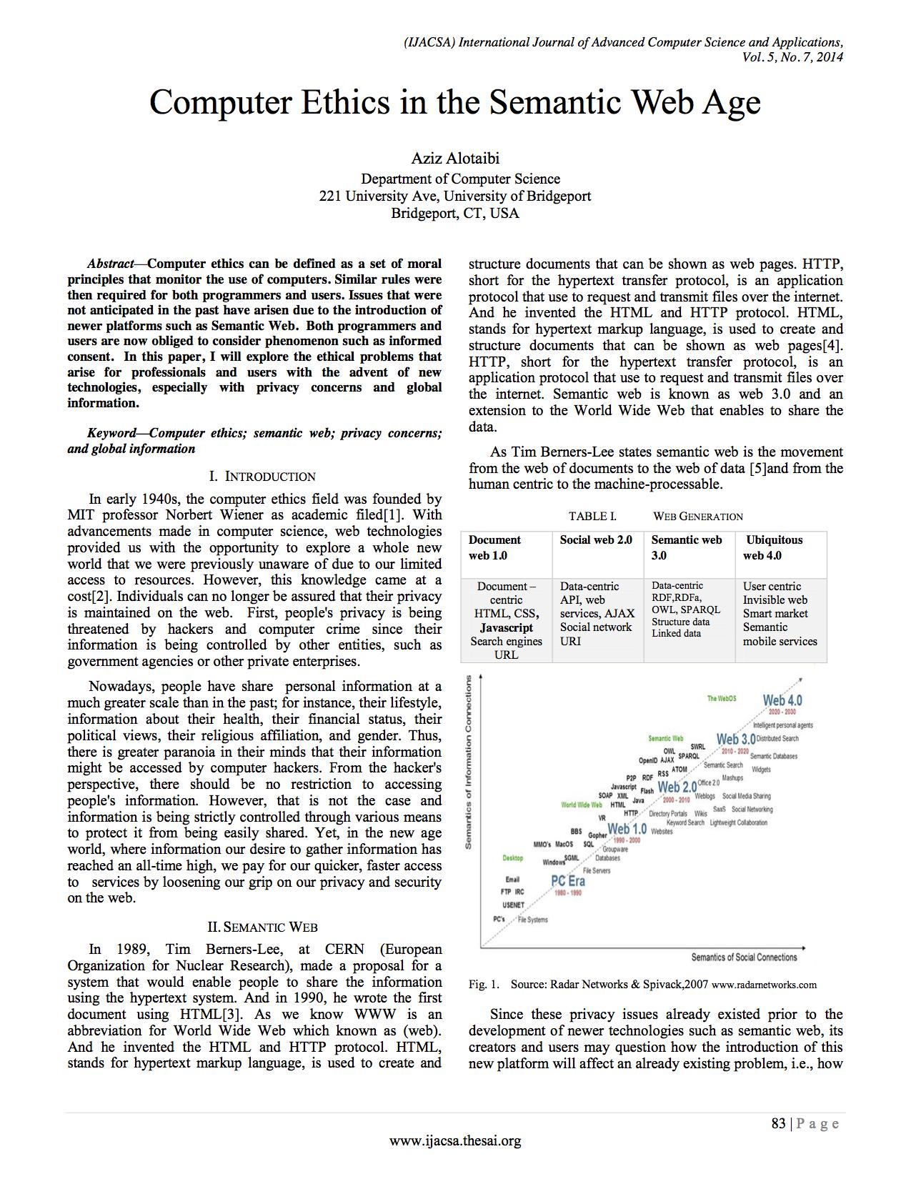
Notes:
beginning to see

Slide 96
Informed Consent.
Data Persistence.
Privacy.
Programmers and Users.
¿and?
¿or?
¿versus?
Notes:
informed consent
data persistence
privacy

Slide 97
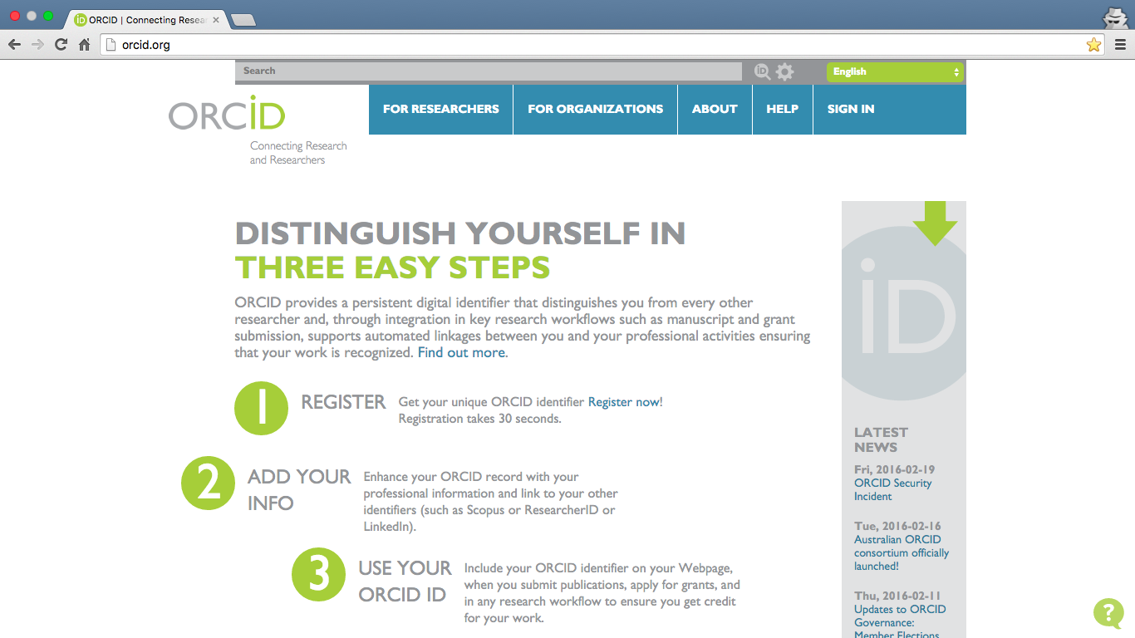
Notes:
Noble and worthwhile goals
“The surnames Kim, Lee, and Park account for nearly one-half of all Koreans (Ghosh, 2013). “Nguyen” is a surname held by 40% of the Vietnamese population, far more common than “Smith” or “Jones” in European and American populations (Enserink,111 2009). Given such ambiguity, the ability to track citations for researchers is severely hampered without unique identifiers.”
Services vs. Privacy?
Commercialization?
Monetization?

Slide 98
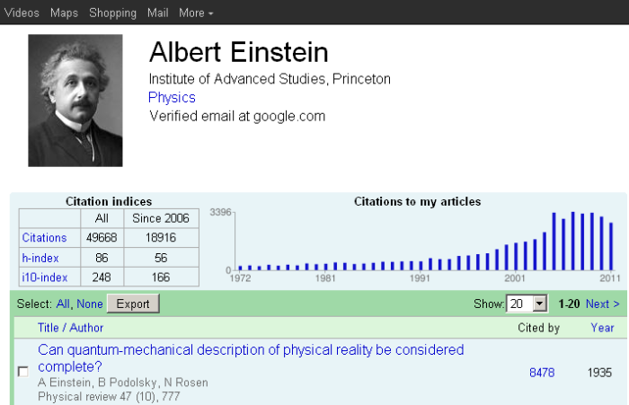
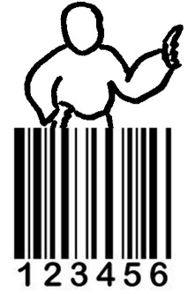
Notes:
There are various services that address issues of author ambiguity, scholarly visibility, research discoverability, etc.
Noble and worthwhile goals
Services vs. Privacy?
Commercialization?
Monetization?

Slide 99
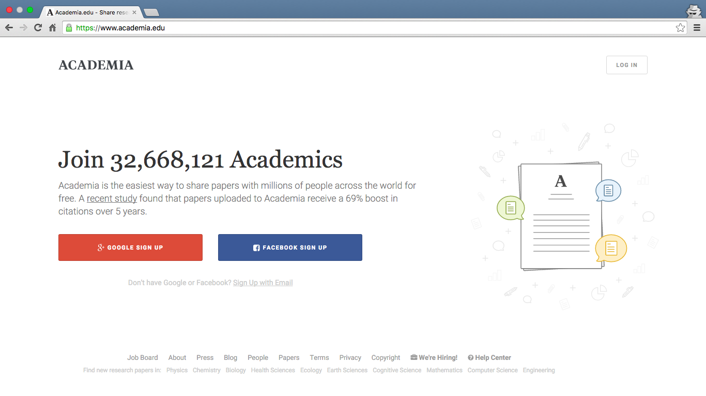
Notes:
But...i want to focus on one service and its unexpected (and perhaps undesired) accession within the
privately held company based in SF
launched in September 2008
32+ million users
over 8 million uploaded texts
platform for academics to share research, monitor deep analytics around the impact of their research, and track the research of academics they follow.
The company's mission is to accelerate the world's research.
often referred to as Facebook for academics
create networks
follow other academics
There are various services that address issues of author ambiguity, scholarly visibility, research discoverability, etc.
Noble and worthwhile goals
Services vs. Privacy?
Commercialization?
Monetization?

Slide 100
#deleteacademiaedu
Notes:
In late January 2016, outraged academics encouraged colleagues to delete their Academia.edu accounts after an email suggested the scholarly social network was considering charging users a fee to have their work considered for a recommendation.
News of the idea to charge members spread across the internet after a handful of users received an email from Adnan Akil, a product developer at Academia.edu.
In the email, Akil said he wanted to gauge users’ interest in "paying a small fee to submit any upcoming papers to our board of editors to be considered for recommendation."

Slide 101
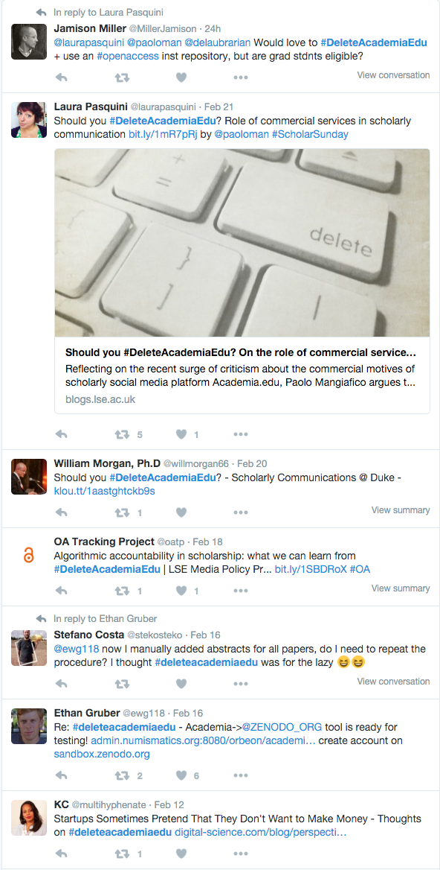
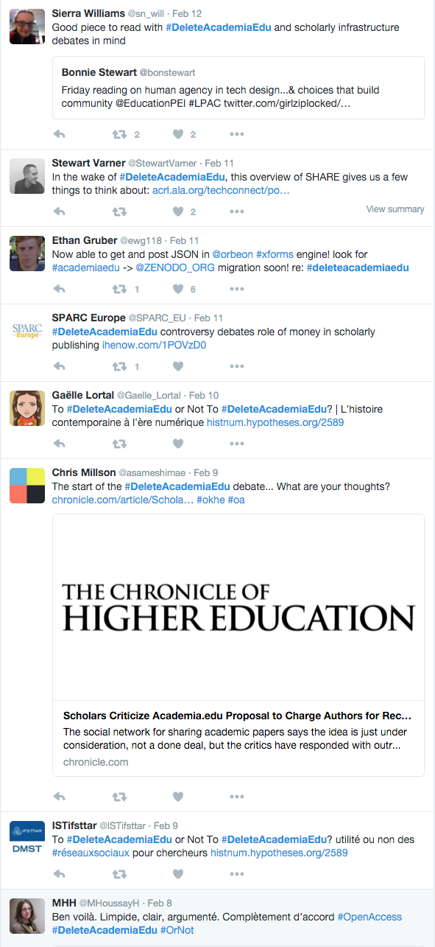
Notes:
In late January 2016, outraged academics encouraged colleagues to delete their Academia.edu accounts after an email suggested the scholarly social network was considering charging users a fee to have their work considered for a recommendation.
News of the idea to charge members spread across the internet after a handful of users received an email from Adnan Akil, a product developer at Academia.edu.
In the email, Akil said he wanted to gauge users’ interest in "paying a small fee to submit any upcoming papers to our board of editors to be considered for recommendation."

Slide 102
Notes:
In late January 2016, outraged academics encouraged colleagues to delete their Academia.edu accounts after an email suggested the scholarly social network was considering charging users a fee to have their work considered for a recommendation.
News of the idea to charge members spread across the internet after a handful of users received an email from Adnan Akil, a product developer at Academia.edu.
In the email, Akil said he wanted to gauge users’ interest in "paying a small fee to submit any upcoming papers to our board of editors to be considered for recommendation."

Slide 103
Notes:
CONTEXT MATTERS
Scott F. Johnson, assistant professor of classics and letters at the University of Oklahoma tweeted a screenshot of an email he received from Adnan Akil (product director from Academia.edu)
Academia.edu runs an editor program open to users with doctorates or professorships in specific fields and experience with publishing and peer review.
Users who are given editor status gain access to a "Recommend" button, which they can use to promote research.
Academia.edu has since dismissed the idea as one of many the website is debating, but the brief controversy has raised awareness among many academics about the economics of scholarly publishing. Some have called for colleges to build an open-access alternative to the website.
He compared it to the gold open-access publishing model, where authors (or their institutions) assume the cost of funding scholarly publishing by paying an article processing charge.
in short Academia.edu suggests the “pay-for-recommendation-consideration” is comparable for a
Academia.edu users seem to believe their participation in the social networking site is more
“pay-for-recommendation-consideration” runs counter to their understanding of social networks, open access, etc.
Many academics state that paying for recommendations would force them to choose between promoting their research and maintaining their integrity
trade-offs
wider visibility
greater discoverability
stronger authority
“pay-for-recommendation-consideration”
“publishers” vs. authors
programmers vs. users
Academia.edu is motivating academics to upload profile data and publications
What happens to that information once it’s there?
Looking at terms of service, no other uses can be made of what you’ve put there – it’s up to Academia.edu to decide what you can and can’t do with the information you’ve given them, and they’re not likely to make it easy for alternative methods of access (why would they?).
There doesn’t appear to be a public API, and you need to be logged in to do most of the useful things on the site (even as a casual reader).
Is Academia.edu an unethical company?

Slide 104
Were Adnan’s intentions ethical?
Is academia.edu an ethical company?
How can we know?
Notes:
Not new questions.
Answering is not the end goal.
Rather sitting with questions and considering implications in digital endeavors

Slide 105
Notes:
Not new questions.
Answering is not the end goal.
Rather sitting with questions and considering implications in digital endeavors

Slide 106
Categorical Imperative
immoral to use another person merely
as a means to an end
a posteriori
justification relies upon experience;
thus, such propositions are logically contingent
Immanuel Kant
1724 - 1804
Notes:
means and ends
where are you heading?
why are you heading there?
how are you getting there?
what is motivating you?
who is harmed? who benefits?
Not new questions.
Answering is not the end goal.
Rather sitting with questions and considering implications in digital endeavors

Slide 107
Remember...
Not new questions.
Answering is not the end goal.
Sit with questions.
Consider implications in digital endeavors.

Slide 108
Framework for Ethical Inquiry
Context
Expectation
Value Analysis
Mannheimer S, Young SWH, Rossmann D (2016) On the Ethics of Social Network Research in Libraries. Journal of Information, Communication, and Ethics in Society 14(2) (forthcoming). http://scholarworks.montana.edu/xmlui/handle/1/9470

Slide 109
Context
What are the data privacy norms and policies in your culture or context?

Slide 110
Expectation
What are your expectations as a researcher conducting your research?
What are users’ expectations of data reuse?

Slide 111
Value Analysis
Consider the balance between privacy risks/potential ethical breaches and potential research gains.
Consult with an ethicist, when appropriate and feasible.

Slide 112
How can ethical inquiry impact
design and development?
Privacy statements
User testing to confirm expectations
Transparency about how algorithms work
Development that ends if privacy is threatened
Analytical work that ends if exploitation becomes apparent
Notes:
Asking ethics questions is a start, not an end in itself.
"what do we do with the question of ethics in data research or software development?"
These considerations provide a framework for evaluating/considering ethics.
Applying an ethical framework into design, development, etc. has the potential to change how, why, and to what ends products/software/etc. are created
For example: user testing to confirm attitudes, privacy statements and explanations of how the algorithm works (transparency), development that ends when privacy is threatened; analytical work that ends when exploitation becomes apparent (mechanical turk example), etc.

