Slide 1
Libraries in Search Engines
Search Engine Optimization (SEO) for Libraries
NCompass Live
Nebraska Library Commission
September 18, 2013
Jason Clark
Head of Digital Access & Web Services
Montana State University Library

Slide 2
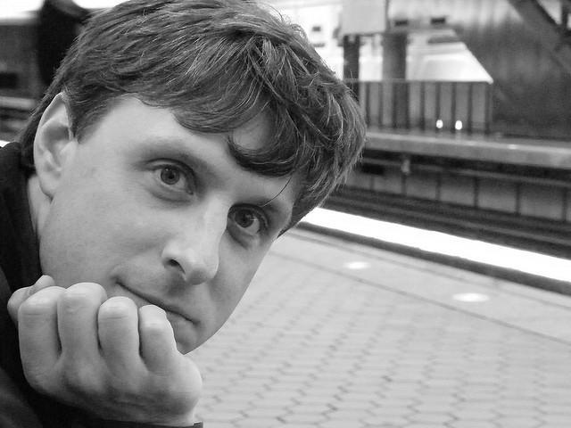

Slide 3
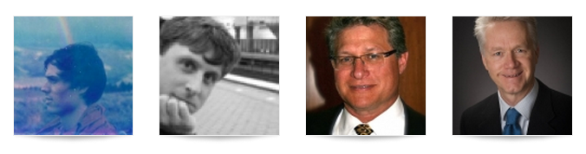
A Research Team Effort
Scott Young: Digital Initiatives Librarian at Montana State University. Scott works to make information more open and accessible through front-end web development, semantic web development, user experience research, and social media. Catch up with him on Twitter @hello_scott_.
Jason Clark: Head of Digital Access and Web Services at Montana State University Library
Patrick O’Brien: Semantic Web Research Director at Montana State University Library.
Kenning Arlitsch: Dean of the Library at Montana State University. His book, co-authored with Patrick OBrien is titled Improving the Visibility and Use of Digital Repositories through SEO, and was published in February 2013. He occasionally tweets from @kenning_msu.

Slide 4
pinboard.in tag
pinboard.in/u:jasonclark/t:libseo/

Slide 5
twitter as channel (#hashtag)
  @jaclark #libseo

Slide 6
Overview
What is Search Engine Optimization (SEO)?
Black Hat vs. White Hat SEO
Why do SEO?
Baseline SEO techniques
Questions

Slide 7
Search Engine Optimization
The act of creating indexable and crawlable content for commercial search engine robots
SEO

Slide 8
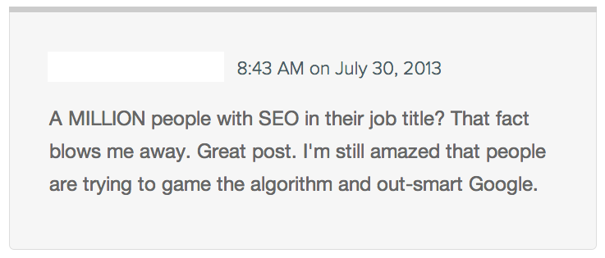
Black Hat SEO

Slide 9
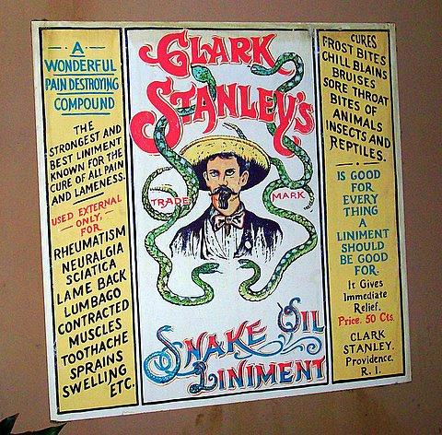
http://www.flickr.com/photos/22245459@N06/2386354917
https://en.wikipedia.org/wiki/Clark_Stanley

Slide 10
Black Hat SEO
Creation of "shadow" domains that funnel users to a site by using deceptive redirects.
"Doorway" pages loaded with keywords
Link “farms” - pages without real content
Hidden markup stuffed with keywords

Slide 11
White Hat SEO
Approved SEO techniques
Based on search engine guidelines and documentation for indexing
Align with user’s expectations for a search result

Slide 12
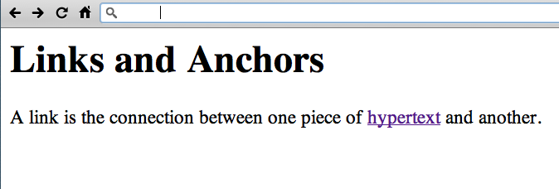
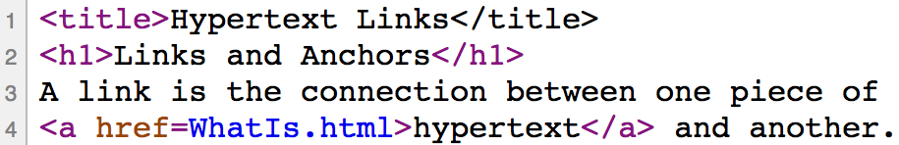
http://www.w3.org/History/19921103-hypertext/hypertext/WWW/Link.html

Slide 13
Terms: HTML + CSS
Does everybody know what these elements are?
CSS
- style rules for HTML documents
HTML
- markup tags that structure docs
- browsers read them and display according to rules

Slide 14
"Discovery happens elsewhere."
- Lorcan Dempsey (in 2007)
Vice President and Chief Strategist of the Online Computer Library Center (OCLC)
http://orweblog.oclc.org/archives/001430.html

Slide 15
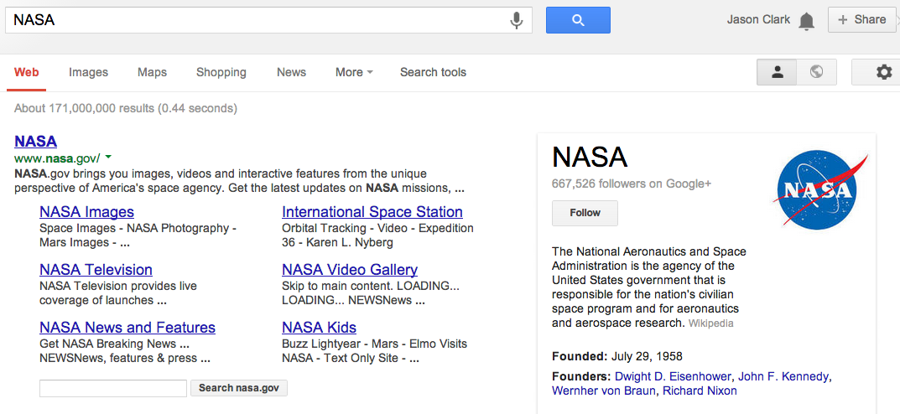

Slide 16
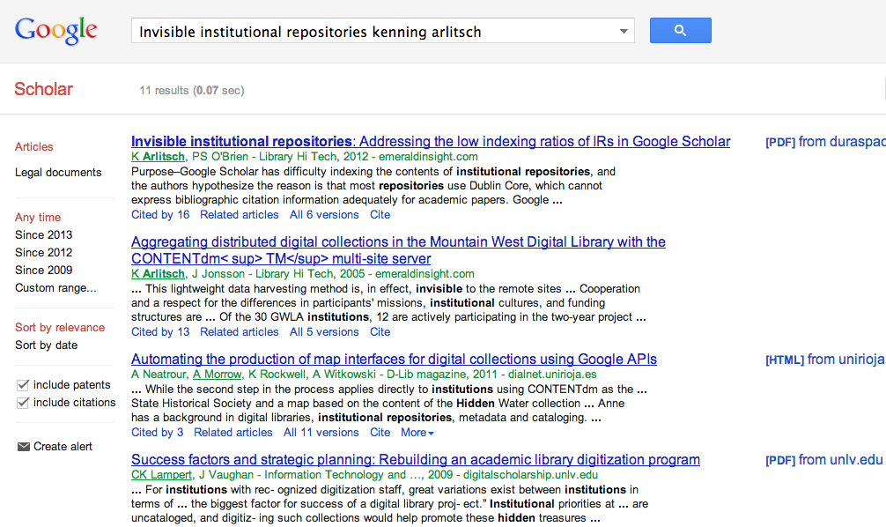

Slide 17
"Search engines continue to dominate, topping the list of electronic sources most used to find online content (93%), followed closely by Wikipedia (88%). The key difference in usage between search engines and Wikipedia is the frequency - 75% of students who use search engines do so daily, compared to 20% of those who use Wikipedia."
Perceptions of Libraries, 2010: Context and Community: a Report to the OCLC Membership. OCLC, 2011.
http://www.oclc.org/content/dam/oclc/reports/2010perceptions/2010perceptions_all_singlepage.pdf
http://www.oclc.org/content/dam/oclc/reports/2010perceptions/collegestudents.pdf

Slide 18
SEO - Baseline Techniques
Keyword analysis
Writing titles and descriptions
Creating indexable content
  - sitemaps, linked architecture
Reduce noise in the index
  - rel canonical, noindex nofollow
Introduce semantic markup

Slide 19
Keyword Analysis
Research your market
Write or rewrite your web copy, titles, descriptions based on this research
Set up Google Adwords Account
  Keyword Planner

Slide 20
Writing Titles and Descriptions
Writing web copy for the robot and the human
  <title></title>
  <meta name=”description” />

Slide 21
Writing Titles and Descriptions
Title
"Keyword Phrase | Context"
Example:
“Staff Directory and People Listing: Montana State University MSU Library”

Slide 22
Writing Titles and Descriptions
Description
a short, declarative sentence that incorporates your keywords, as you laid it out in your page title
Example:
"A listing of staff employed at Montana State University MSU Library including library departments, roles, job titles, phone numbers and contact information."

Slide 23
Creating Indexable Content
Clear hierarchy and site architecture
  Directory in URL shows hierarchy
  Breadcrumb links
“Every page should be reachable from at least one static text link.”
https://support.google.com/webmasters/answer/35769

Slide 24
Creating Indexable Content
Set up machine-readable sitemap
    Listing all pages that you want to be indexed and indexing priorities for those pages
“Google adheres to Sitemap Protocol 0.9 as defined by sitemaps.org.”
https://support.google.com/webmasters/answer/156184

Slide 25
Creating Indexable Content
Set up machine-readable sitemap
    Listing all pages that you want to be indexed and indexing priorities for those pages
“Google adheres to Sitemap Protocol 0.9 as defined by sitemaps.org.”
https://support.google.com/webmasters/answer/156184

Slide 26
Reduce “Noise” in the Index
Redundant content
Dynamic pages, search result pages
Not every page is unique
Techniques:
robots.txt directives
link relations and index directive markup

Slide 27
Reduce “Noise” in the Index
robots.txt
set of commands in text file at top level of your site
Disallow: /staff/
#allow primary mobile page
Allow: /finding-aids/m/index.php
Allow: /finding-aids/m/$

Slide 28
Reduce “Noise” in the Index
Link relations and index directive markup
markup that identifies canonicalization or whether to index a page
<link rel="canonical" href="http://arc.lib.montana.edu/finding-aids/item/23" />
<a rel="nofollow" href="http://arc.lib.montana.edu/finding-aids/item/23"></a>
<meta name="robots" content="nofollow,noindex" />

Slide 29
Introducing Semantic Markup
HTML5 semantic tags and microdata that helps classify page types and types of content on the page
“If Google understands the content on your pages, we can create rich snippets—detailed information intended to help users with specific queries.”
https://support.google.com/webmasters/answer/99170?hl=en&ref_topic=1088472

Slide 30
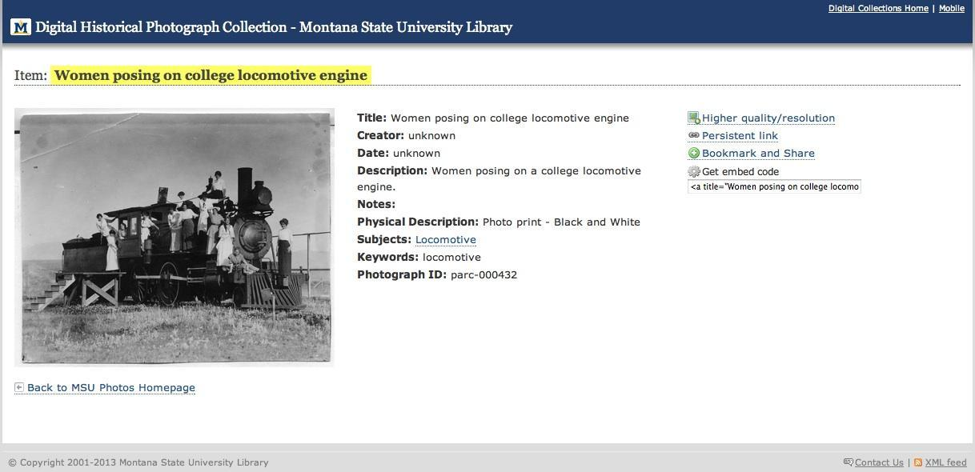
BM (Before Microdata)

Slide 31
AM (After Microdata)

Slide 32
<dl>
<dt>Title</dt>
<dd>A River Runs Through It and Other Stories</dd>
<dt>Author</dt>
<dd>Norman Maclean</dd>
<dt>Publication date</dt>
<dd>October 1, 2001</dd>
<dt>ID</dt>
<dd>0226500667</dd>
</dl>

Slide 33
<dl itemscope itemtype="http://schema.org/Book">
<dt>Title</dt>
<dd itemprop="title">A River Runs Through It and Other Stories</dd>
<dt>Author</dt>
<dd itemprop="author">Norman Maclean</dd>
<dt>Publication date</dt>
<dd itemprop="pubdate">October 1, 2001</dd>
<dt>ID</dt>
<dd itemprop="isbn">0226500667</dd>
</dl>

Slide 34
Schema.org
A lingua franca for web classification and markup
Google, Bing, Yahoo

Slide 35
SEO in Libraries
Arlitsch, Kenning, and Patrick S. O'Brien. "Invisible institutional repositories: Addressing the low indexing ratios of IRs in Google Scholar." Library Hi Tech 30.1 (2012): 60-81.
Onaifo, Daniel, and Diane Rasmussen. "Increasing libraries' content findability on the web with search engine optimization." Library Hi Tech 31.1 (2013): 87-108.

Slide 36
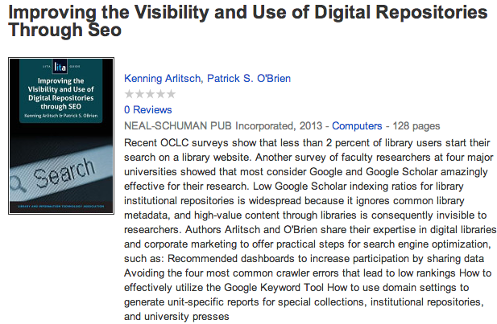
Arlitsch, Kenning, and Patrick S. O'Brien. Improving the Visibility and Use of Digital Repositories Through Seo: A Lita Guide. Chicago: ALA TechSource, 2013. Print.

Slide 37
Questions?
twitter.com/jaclark
www.lib.montana.edu/~jason/talks.php

