Slide 1
Building Smarter Books in Browsers with RDFa, Schema.org, & Linked Data: Leveraging Standards & Tools in the Creation of Semantically-Enhanced Reading Systems
#nisonfais
Jason A. Clark
@jaclark
Notes:
We are from Montana State

Slide 2
Book as Platform:
Linking Data to Build a Better Book
Notes:
We are from Montana State

Slide 4
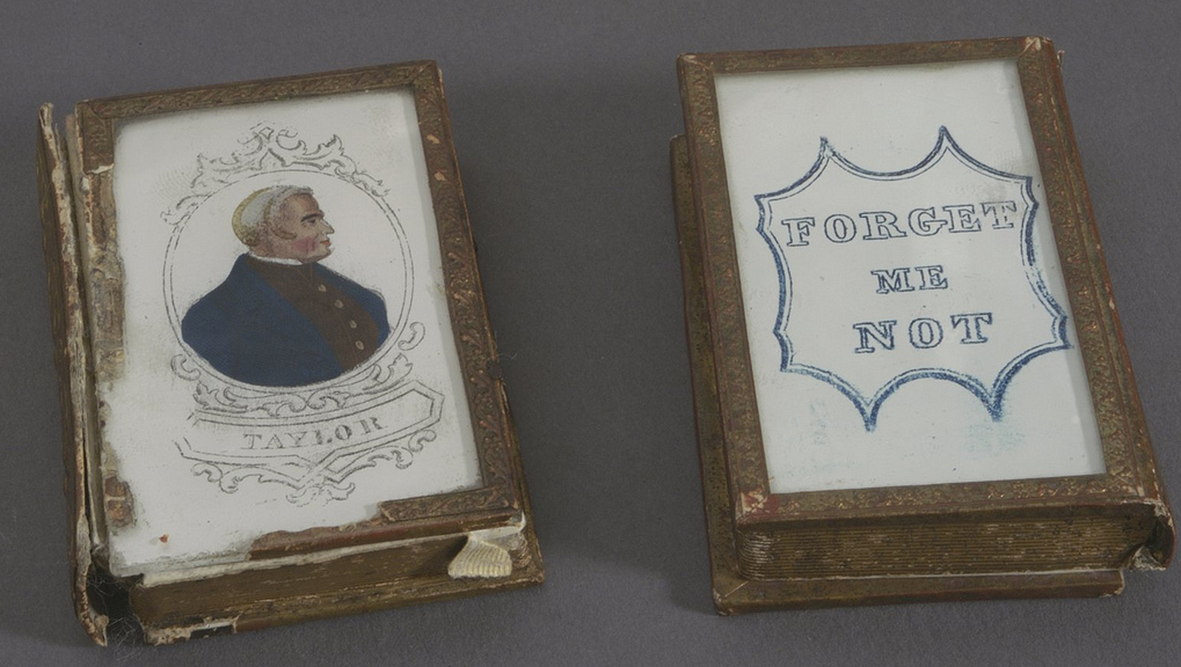
Notes:
http://library24.library.cornell.edu:8280/luna/servlet/detail/CORNELL~9~1~78423~3615

Slide 7
Every Book its [machine] Reader
Apologies to Ranganathan
Notes:
It’s as easy to access a book page as it is a web page

Slide 8
What if?
Books were machine indexed
for semantic discovery
Journal articles were semantically tagged
at the page level
Notes:
It’s as easy to access a book page as it is a web page

Slide 9
A “Book” in a Browser
Atomizable, Analyzable, Linkable, Reusable

Slide 10
Book as Software
Software Development
Data Storage and Archiving
Metadata
Discovery and Analytics
API Access

Slide 11
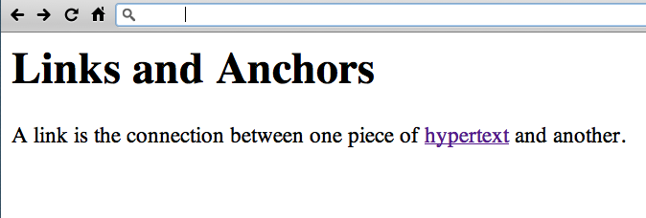
www.w3.org/History/19921103-hypertext/hypertext/WWW/Link.html

Slide 12
The Research
Institute of Museum and Library Services
Sparks Ignition Grant

Slide 13
Web Book Prototyping

Slide 14
Our Initial Project
Digital Book for History Class
MS Word -> Static HTML -> Dynamic HTML
API driven and Linked Data

Slide 15
Book 1
demo: arc.lib.montana.edu/book/home-cooking-history-409
code: github.com/jasonclark/bib-template
Book 2
demo: arc.lib.montana.edu/book/opsis
code: github.com/msulibrary/bib-template-fiction

Slide 16
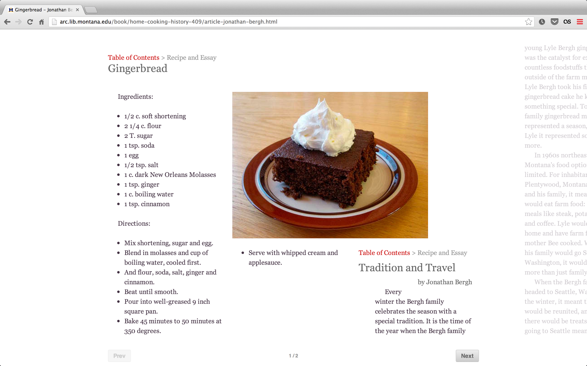

Slide 17
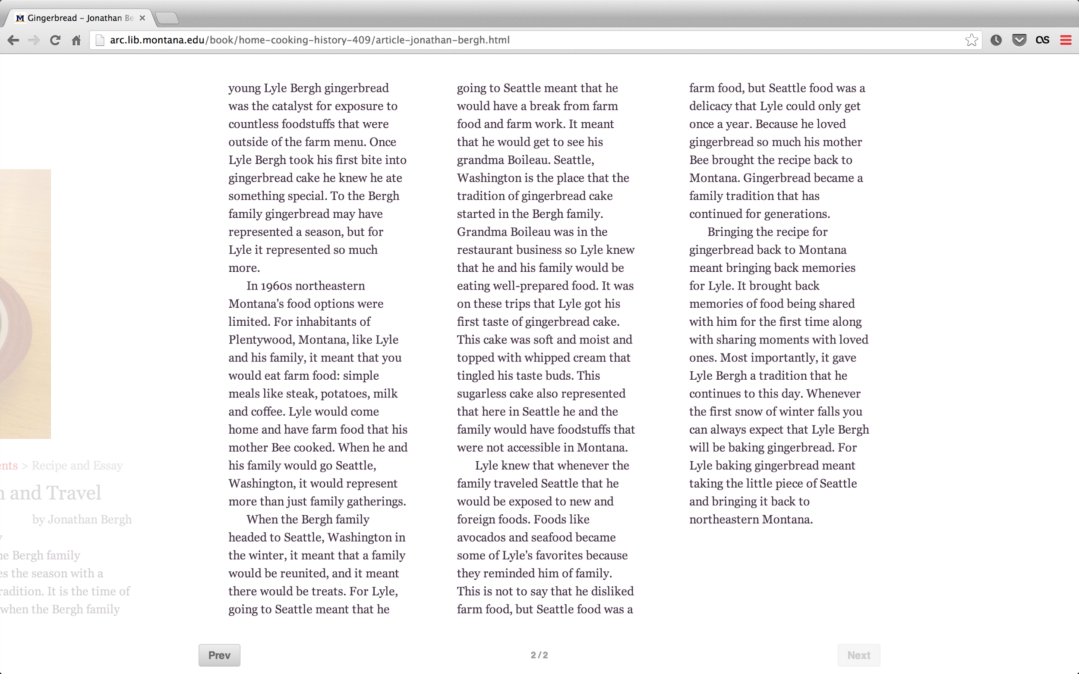

Slide 18
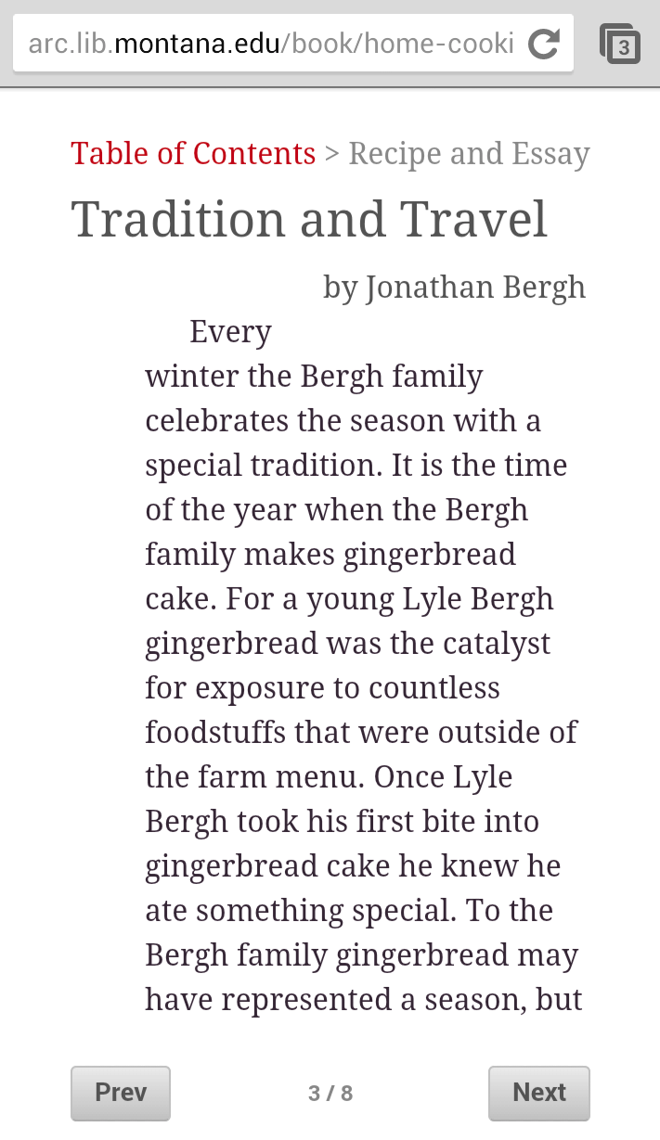

Slide 19
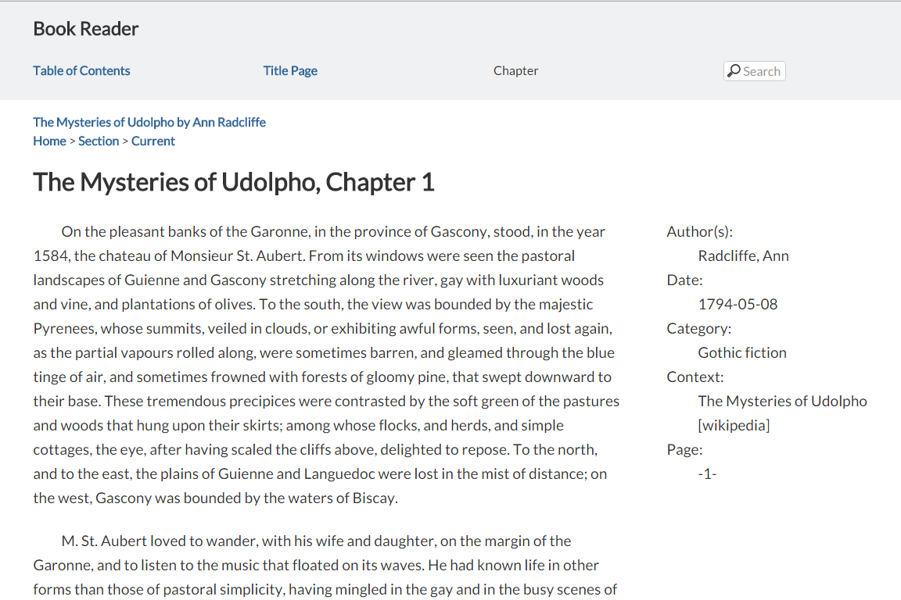

Slide 20
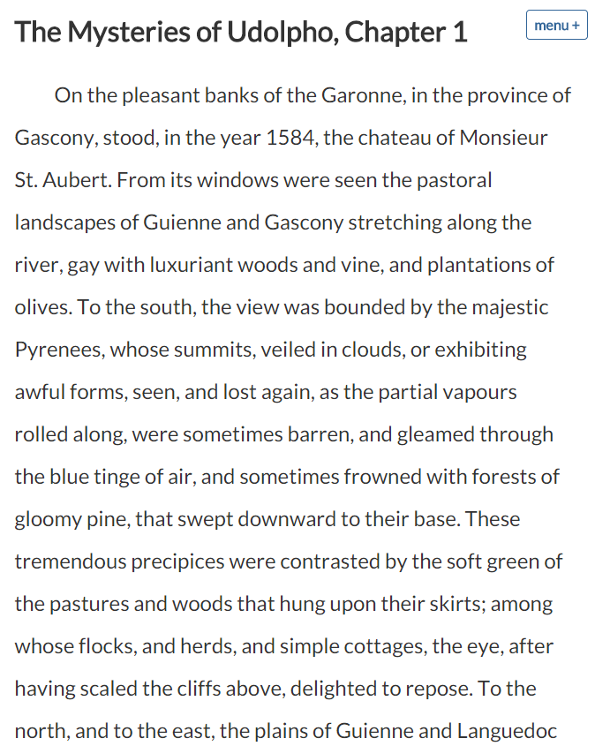

Slide 21
Web Book Dev Stack
HTML
CSS
Javascript
MySQL
PHP
schema.org
RDFa

Slide 22
Disruption?
New Roles for Publisher

Slide 23
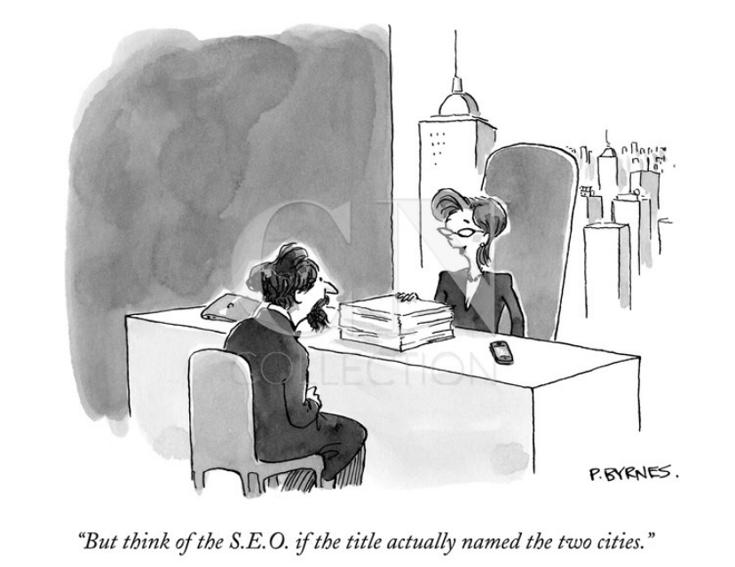

Slide 24
Old Roles
Validating
Editing
Typesetting
Promotion
Sales

Slide 25
New Roles
Archiving
Metadata [structured]
Discovery
Analytics + Metrics
Sharing + Reuse

Slide 26
Structured Data
Data Model + Machine Readability

Slide 27
Schema.org
controlled vocabulary

Slide 28
CREATE TABLE IF NOT EXISTS `bodymatter` (
`id` int(11) NOT NULL AUTO_INCREMENT,
`name` varchar(255) DEFAULT NULL,
`creator` varchar(255) DEFAULT NULL,
`url` varchar(255) DEFAULT NULL,
`description` text,
`about` text,
`image` varchar(140) DEFAULT NULL,
`articleBody` text COMMENT 'http://schema.org/Article',
`articleSection` text COMMENT 'http://schema.org/Article',
`publicationType` varchar(255) NOT NULL COMMENT 'http://schema.org/MedicalScholarlyArticle',
`additionalType` varchar(255) DEFAULT NULL,
`additionalType2` varchar(255) DEFAULT NULL,
`isbn` varchar(40) DEFAULT NULL,
`genre` varchar(140) DEFAULT NULL,
`keywords` varchar(255) DEFAULT NULL,
`publisher` varchar(255) DEFAULT NULL,
`dateCreated` varchar(255) DEFAULT NULL,
`dateModified` timestamp NULL DEFAULT CURRENT_TIMESTAMP ON UPDATE CURRENT_TIMESTAMP,
`datePublished` varchar(255) DEFAULT NULL,
`version` varchar(140) DEFAULT NULL,
`learningResourceType` varchar(140) DEFAULT NULL,
`inLanguage` varchar(5) DEFAULT NULL,
PRIMARY KEY (`id`),
FULLTEXT KEY `search` (`name`,`creator`,`description`,`genre`,`keywords`,`dateCreated`)
) ENGINE=MyISAM DEFAULT CHARSET=utf8;

Slide 29
epub:type
semantic divisions...

Slide 30
<html …
xmlns:epub="http://www.idpf.org/2007/ops">
…
<section epub:type="bodymatter">
…
</section>
…
</html>

Slide 32
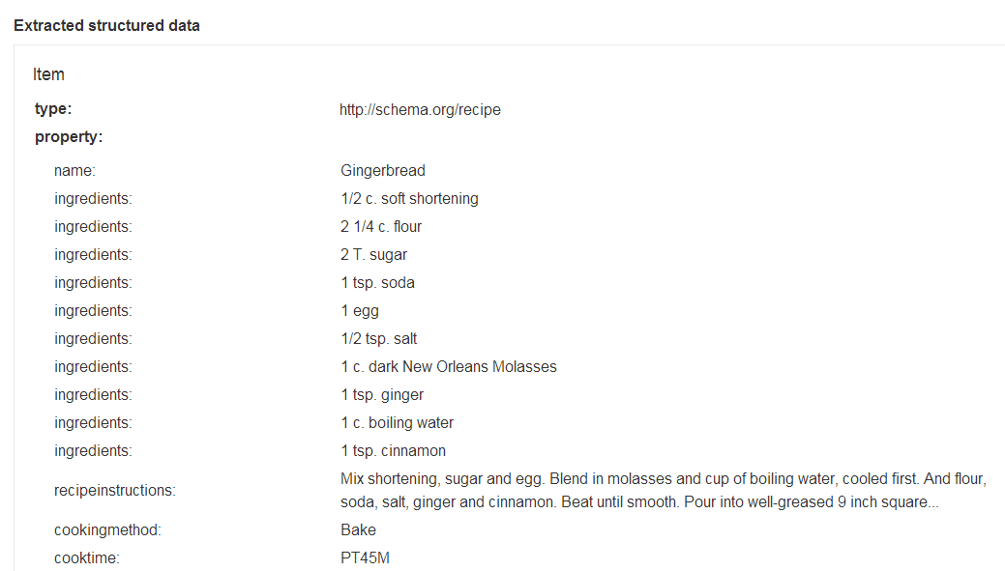

Slide 33
Discovery
RDFa
JSON-LD
Linked Data Topics
Notes:
https://developers.google.com/webmasters/structured-data/testing-tool/

Slide 35
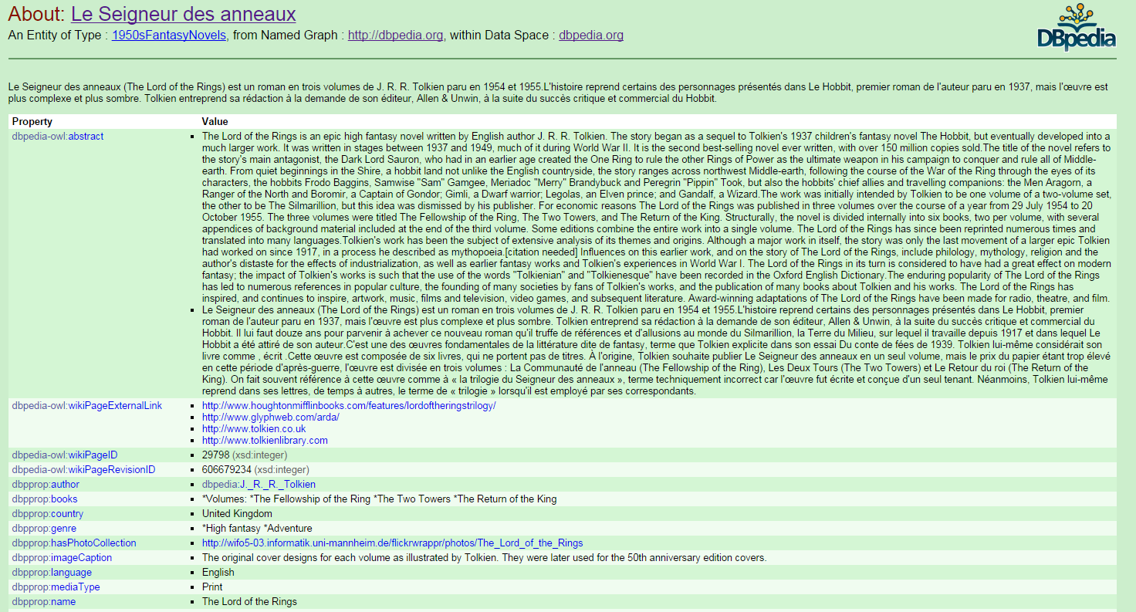

Slide 36
<script type="application/ld+json">
{
"@context" : "http://schema.org",
"@type": "CreativeWork",
"name": "Opsis: Literary Arts Journal at Montana State University (MSU)",
"description": "Opsis is the literature and arts magazine of Montana State University",
"image": "http://arc.lib.montana.edu/book/opsis/meta/img/opsis.png",
"datePublished": "2015-02-02T01:43:19Z",
"inLanguage" : "en",
"genre" : "Journals (Publications)",
"learningResourceType" : "Student literary journal",
"creator": {
"@type": "Person",
"name": "Multiple Authors"
},
"Article": {
"@type": "Article",
"name": "The Shore As She",
"author": {
"@type": "Person",
"name": "Leslie Staven"
},
"articleBody": "The sand softens shifts ...",
"url": "http://arc.lib.montana.edu/book/opsis/item/7",
"datePublished": "2015-02-02T01:43:19Z",
"publisher": {
"@type": "Organization",
"name": "Montana State University (MSU)"
},
"additionalType": "http://dbpedia.org/resource/Poetry",
"additionalType": "http://dbpedia.org/resource/Memory"
},
...

Slide 37
CIP Data
Cataloging in Publication
www.loc.gov/publish/cip/techinfo/cipdata.html

Slide 38
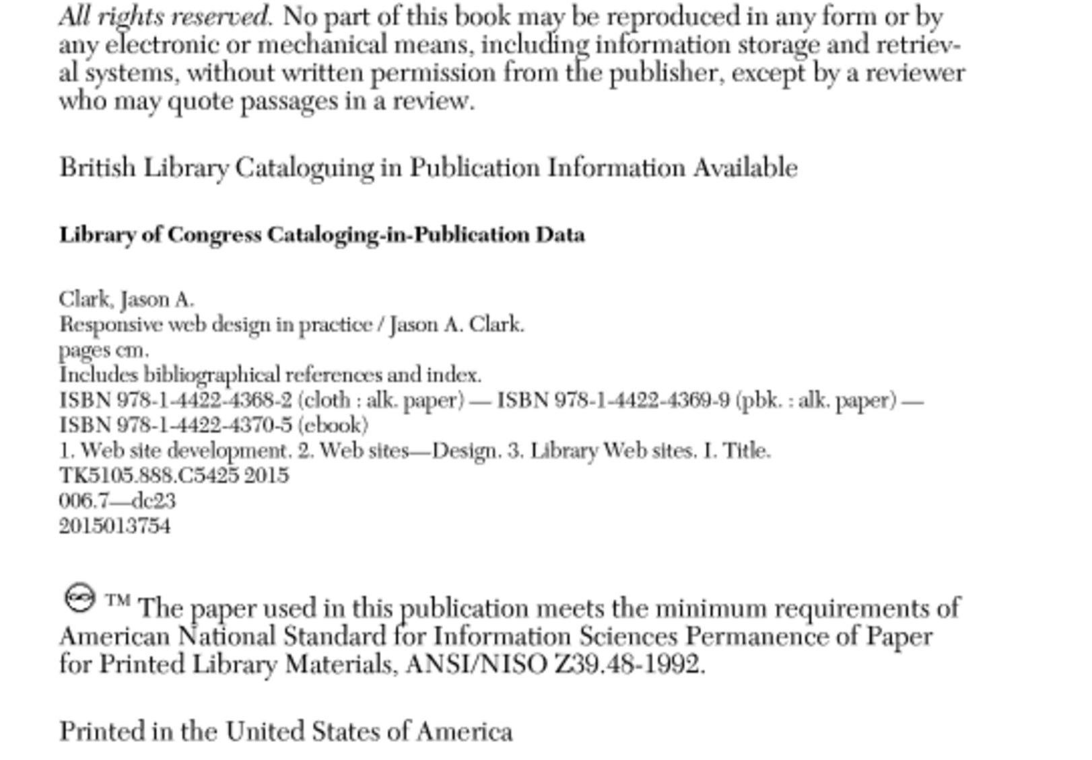

Slide 39
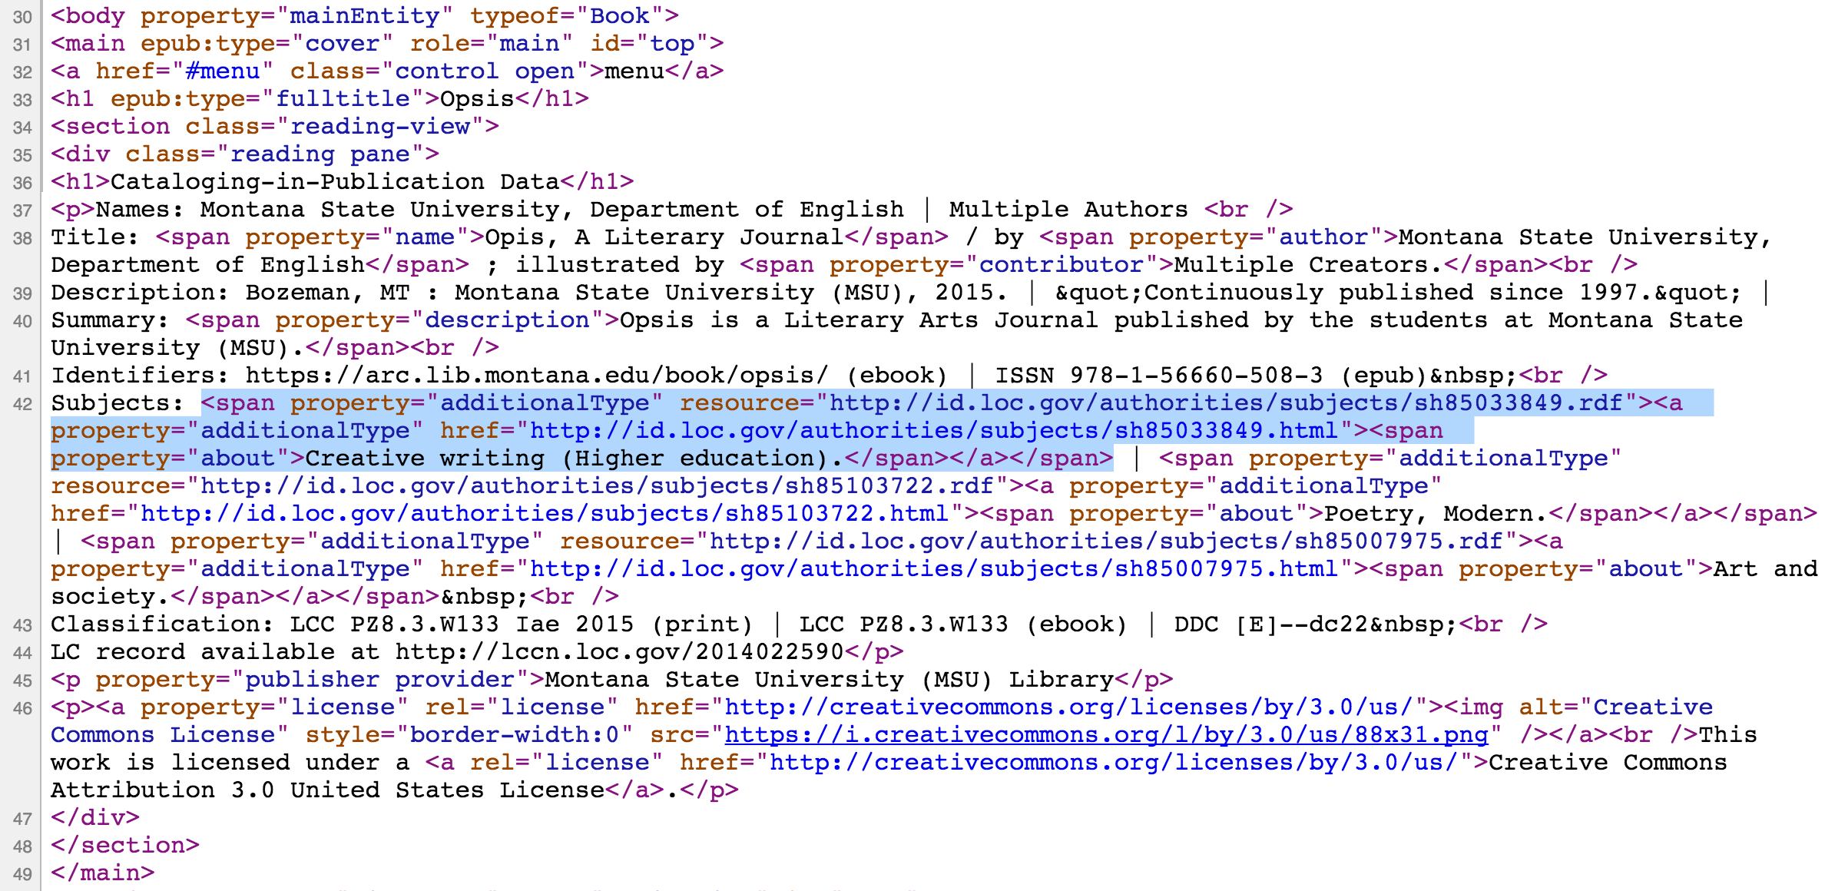

Slide 40
Analytics + Metrics
Web Analytics, UX

Slide 41
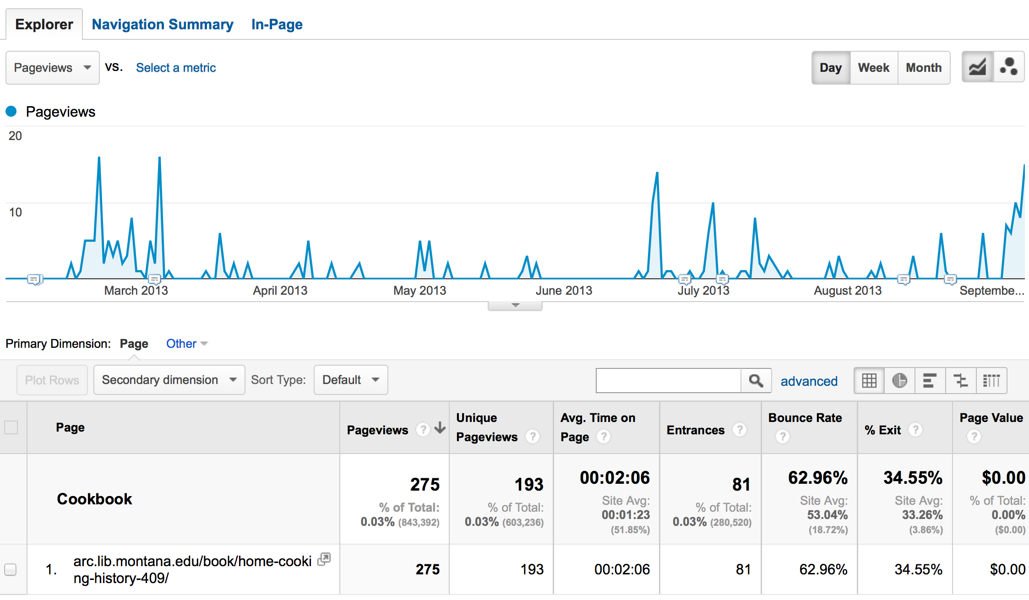

Slide 42
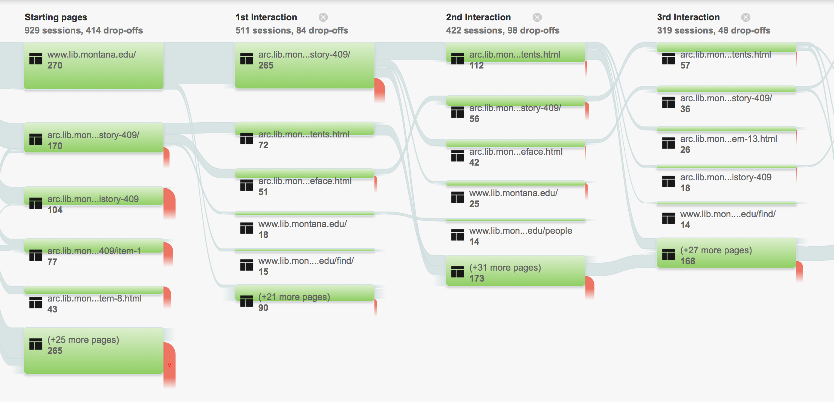
Notes:
- GA allows us to see how people are moving through the book
- we can see how they interact with each page

Slide 43
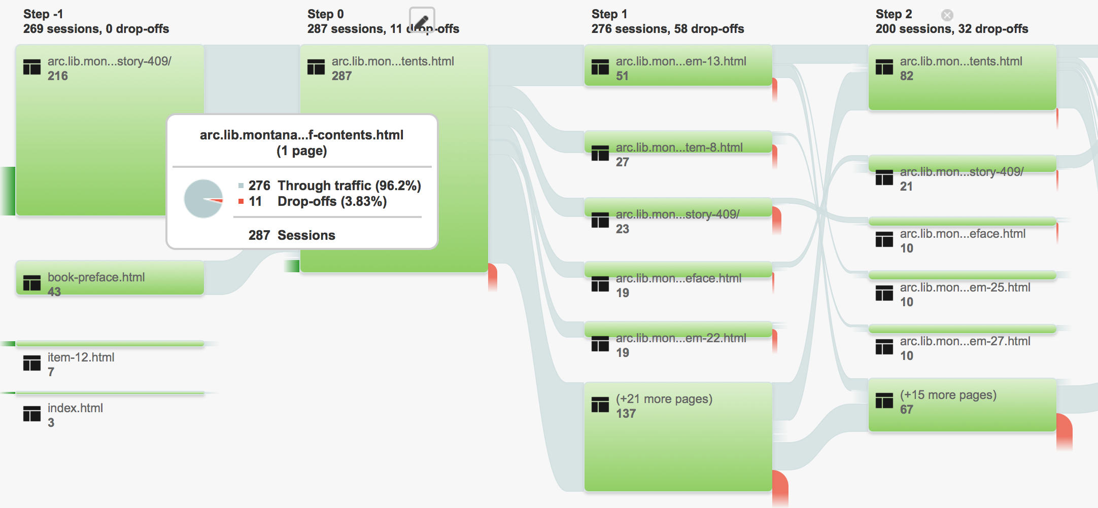

Slide 44
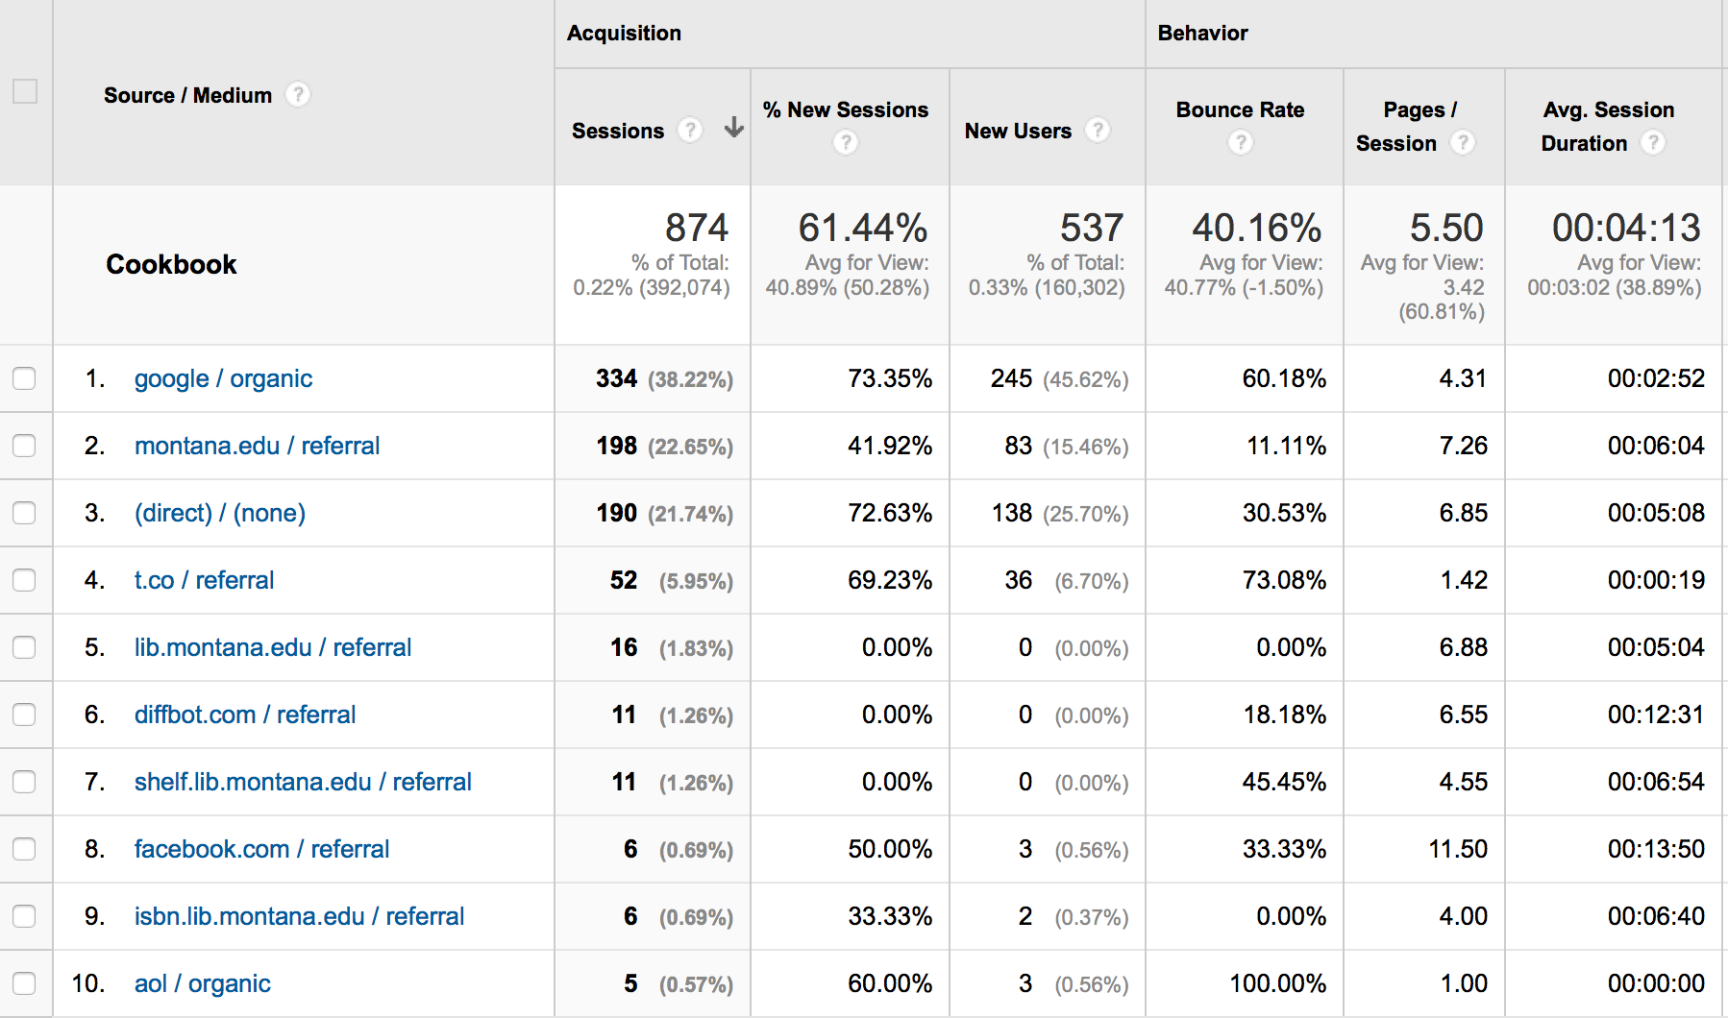

Slide 45
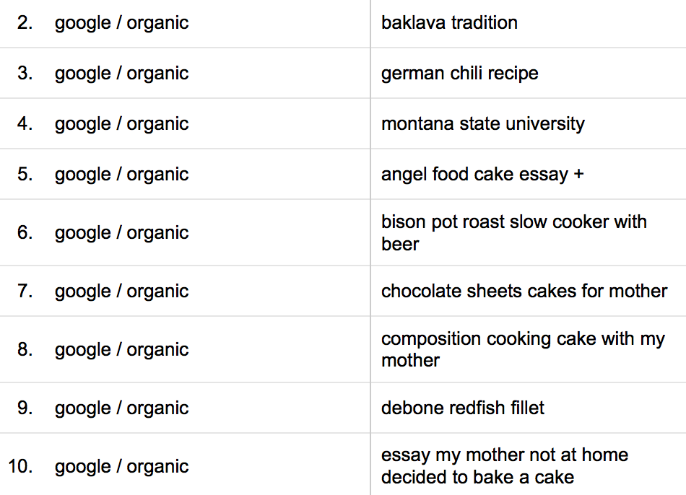

Slide 46
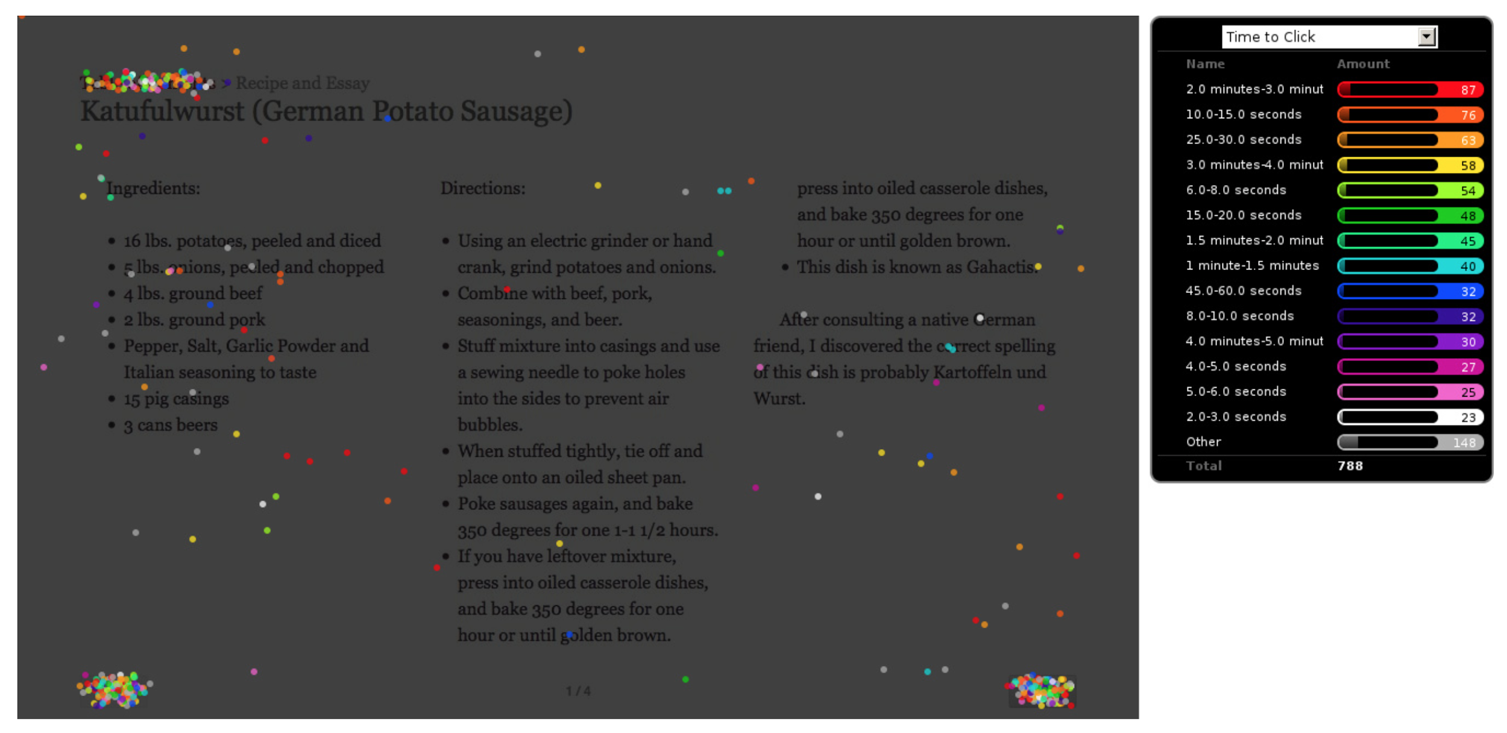

Slide 47
Sharing + Reuse
Web Services + API
Social Sharing
Deep Linking

Slide 48
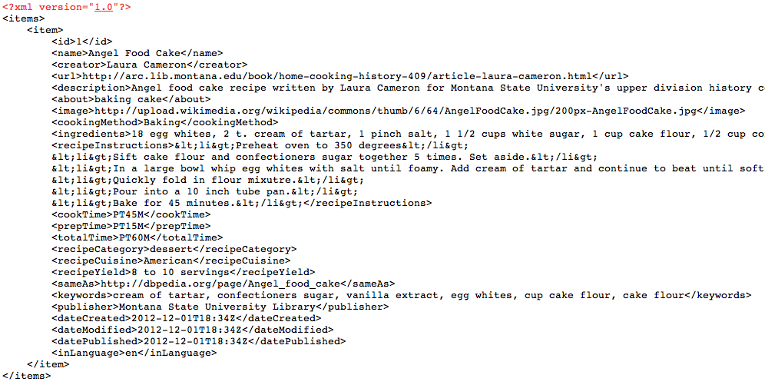
XML, JSON
/home-cooking-history-409/api.php?type=recipe&id=1&num=1&format=xml
...api?id=1&format=xml
...api?type=search&q=poetry&format=json
Notes:
http://shelf.lib.montana.edu/home-cooking-history-409/api.php?type=book&id=1&num=1&format=json
http://shelf.lib.montana.edu/home-cooking-history-409/api.php?type=recipe&id=1&num=1&format=xml
http://shelf.lib.montana.edu/home-cooking-history-409/api.php?type=search&q=lauren&num=10

Slide 49
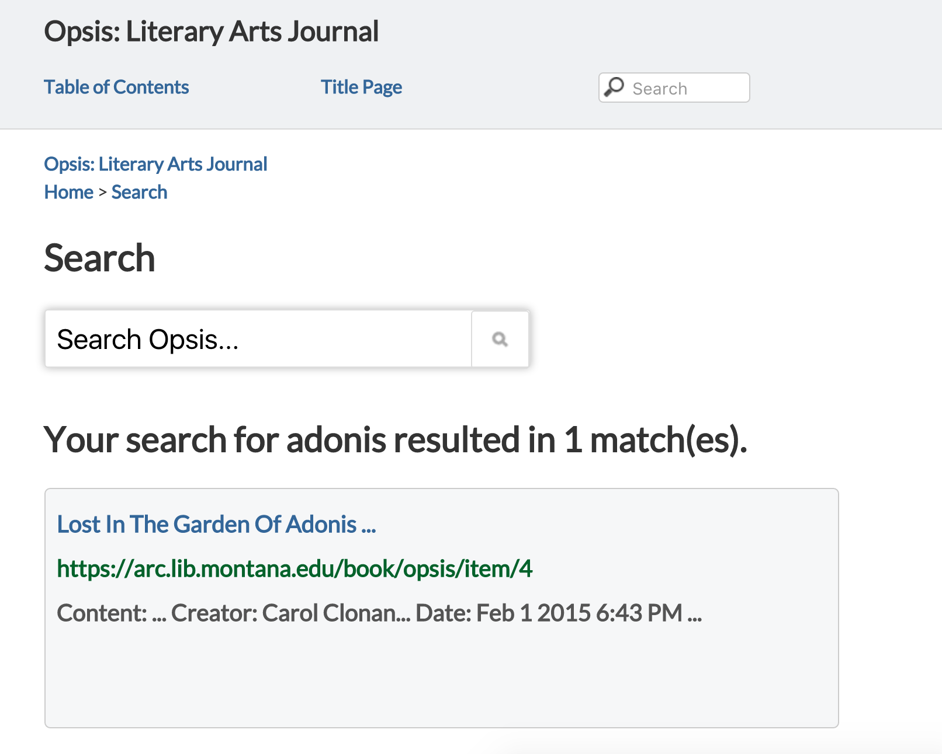

Slide 52
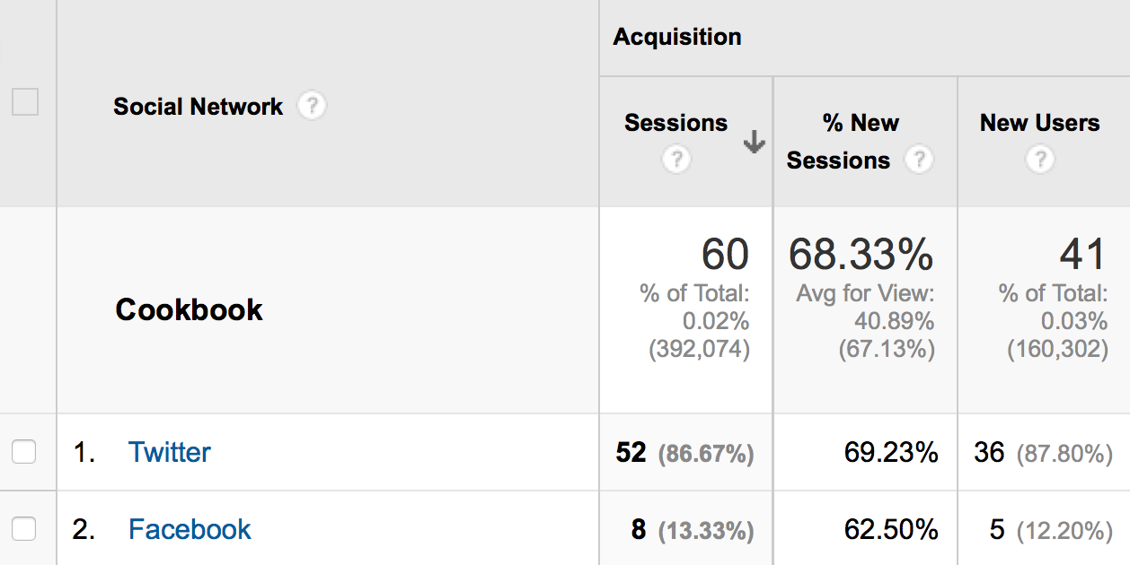

Slide 53
Deep-linking the book
HTTP + URL
Notes:
- harness the HTTP and the URL: one of the design purposes of the Web is to allow authors to link to any published document on another site
- share individual pages

Slide 54
http://arc.lib.montana.edu/book/opsis/item/21
http://arc.lib.montana.edu/book/opsis/table-of-contents.html
Notes:
The book in a browser is networked and therefore findable and shareable

Slide 55
Ongoing Research
Semantic Classification
Genres - textbook, journal
UX of Reading
Real-time Analytics
Annotations
Offline

Slide 56
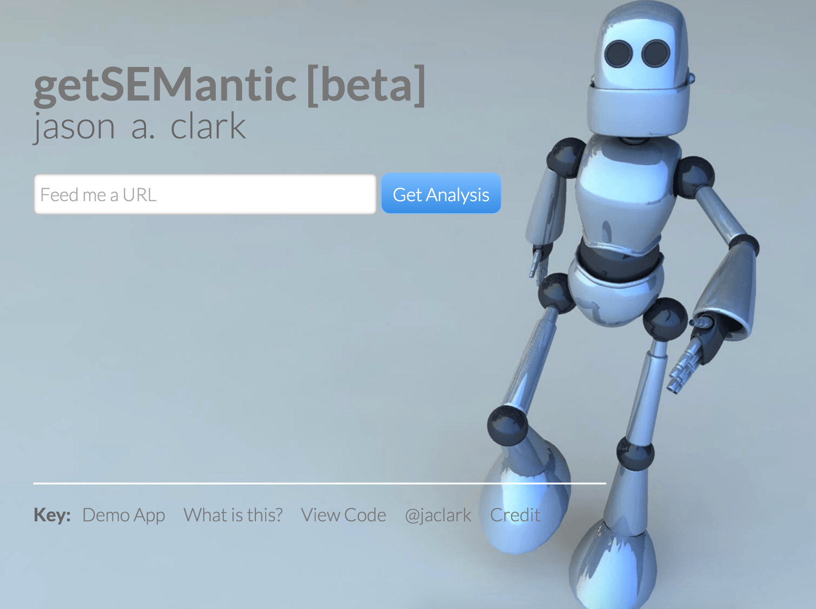

Slide 58
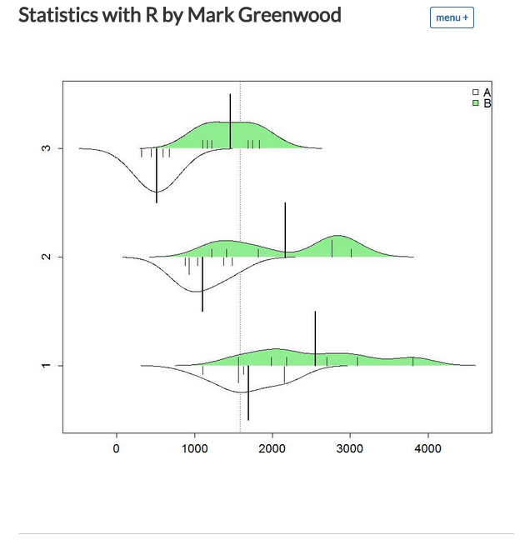

Slide 59
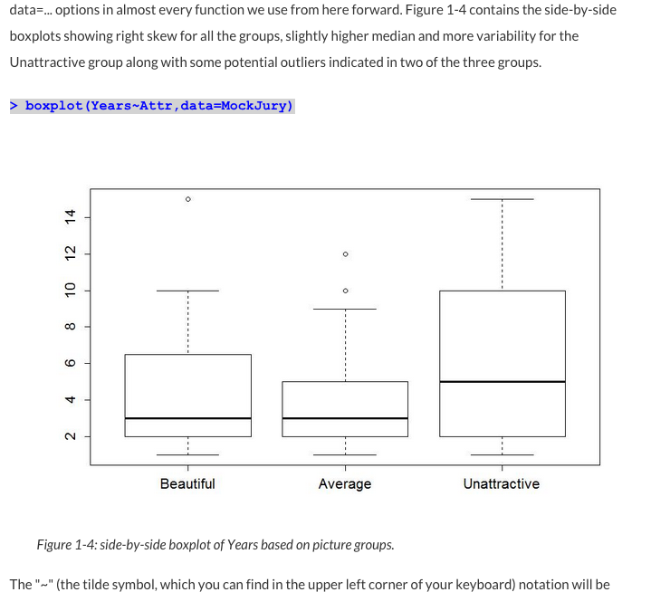

Slide 60
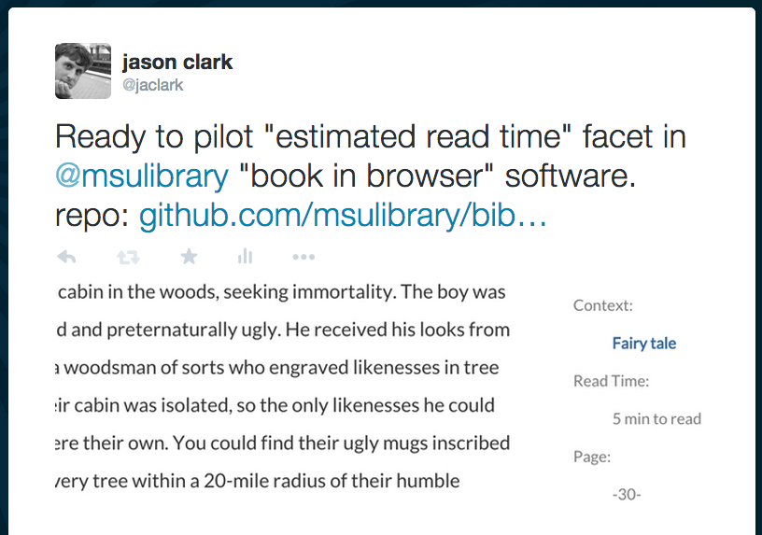

Slide 61
The “Book” in a Network
http://arc.lib.montana.edu/book/
Designed for the bot’s experience
Designed for the reader’s experience
Notes:
Connected, Shareable

Slide 62
Survey of the Field
HTMLBook
https://github.com/oreillymedia/HTMLBook
Leanpub
https://leanpub.com/
GitBook
https://www.gitbook.com/
Penflip
https://www.penflip.com/
gitenberg
https://gitenberg.github.io/
Book in Browser Conference
http://booksinbrowsers.org/
Library Publishing Coalition
http://www.librarypublishing.org/
Notes:
http://www.kickstarter.com/projects/1371597318/the-peoples-e-book

Slide 63
w3c Groups
Schema.org Community Group
https://www.w3.org/community/schemaorg/
Digital Publishing Interest Group
http://www.w3.org/dpub/
Semantic Web Interest Group
http://www.w3.org/2001/sw/interest/
Web Annotation Working Group
http://www.w3.org/annotation/
Data on the Web Best Practices Working Group
http://www.w3.org/2013/dwbp/wiki/Main_Page
Notes:
http://www.kickstarter.com/projects/1371597318/the-peoples-e-book

Slide 64
A Research Team Effort
Scott Young
Digital Initiatives Librarian
Jason A. Clark
Head, Library Informatics & Computing
Michelle Gollehon
Digital Production Operations Manager
Jan Zauha
Outreach Librarian

Slide 65
Thanks!
Jason A. Clark
Head, Library Informatics & Computing
Montana State University Library
@jaclark
Scott Young
Digital Initiatives Librarian
Montana State University Library
@hei_scott

