Slide 1
Working with Javascript
Building Responsive Library Apps
Florida Library Webinars
Novare Library Services
July 31, 2013
Jason Clark
Head of Digital Access & Web Services
Montana State University Library

Slide 2


Slide 3
pinboard.in tag
pinboard.in/u:jasonclark/t:jscript/

Slide 4
twitter as channel (#hashtag)
  @jaclark #jscript

Slide 5
Overview
Why Javascript?
Smart Design and Markup
Progressive Enhancement
Ajax and User Interfaces
Code Libraries - jQuery
Demos and Code
  UX Problems and Solutions
Questions

Slide 6
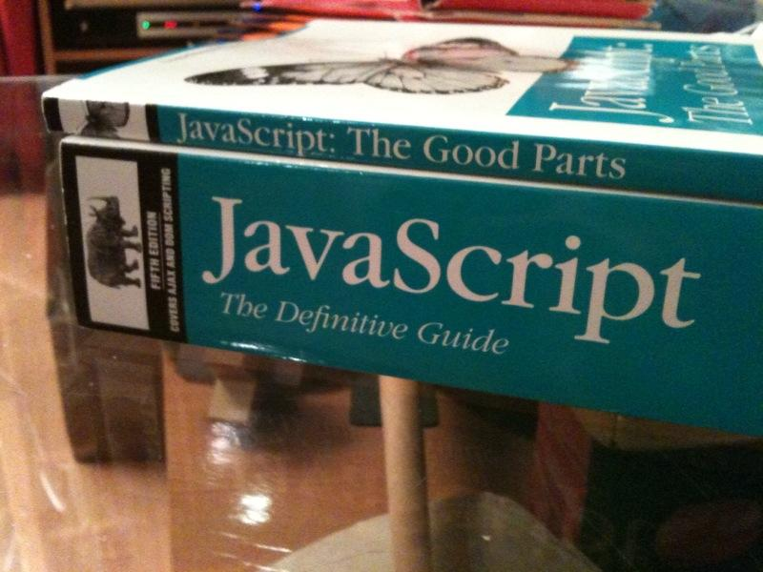
From alikins' photostream (http://www.flickr.com/photos/alikins/4439062727/)

Slide 7
Why Javascript?
client-side scripting FTW

Slide 8
Why Javascript?
Want to make your applications more interactive
Want to incorporate data from external Web Services
Don’t want your users to have to download a plugin
Simplest form of dynamic functionality on a web page

Slide 9
Javascript App Components
HTML and CSS
These familiar Web standards are used for styling the look and feel of a page and to markup those areas on a page that will be targeted for data updates.
DOM (document object model)
The DOM is used to manipulate dynamic page views for data and to walkthrough documents to “cherrypick” data. The DOM enables certain pieces of an Ajax page to be transformed and updated with data.
XML, JSON (Javascript Object Notation), HTML, or plain text
Any of these standards are used to provide structure to the data it passes to and from a page.
XMLHttpRequest object
The heavy lifter for Ajax: It’s a javascript object embedded in most modern browsers that sets up data request/response pipelines between client and server.
Client-side Scripting (Javascript)
Lightweight programming language that used for instructions to bind all of the components together

Slide 10
Client versus Server
Client-side scripting
  Web browser does all the work
Server-side Scripting
  Web server does all the work
Ajax leverages both client and server side scripting

Slide 11
Smart Design and Markup
Think semantically, code hooks

Slide 12
Coding for App Functionality
Place hooks using ids and classes
Create semantic divisions
Document can be recognized by human

Slide 13
Markup sample...
<dd class="toggle">

Slide 14
Progressive Enhancement
Failing gracefully...

Slide 15
Progressive Enhancement
Strategy for web design and development
Adding functionality for user's with most current browsers.
Graceful Degradation
Building apps that still work with older browsers and clients
Finding the BALANCE...
See Progressive Enhancement:
http://www.smashingmagazine.com/2009/04/22/progressive-enhancement-what-it-is-and-how-to-use-it/

Slide 16
Ajax and User Interfaces
Desktop functionality in the browser

Slide 17
What is Ajax?
Asynchronous Javascript and XML
  Not all AJAX apps involve XML
Combination of technologies
  HTML, CSS, DOM
  XML, JavaScript
Some server scripting language
A method for building more responsive and interactive applications

Slide 18
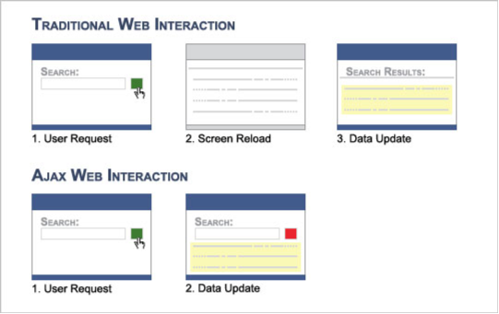
How Ajax Works...

Slide 19
Ajax is Ubiquitous
Google Maps
Flickr
Facebook
Twitter

Slide 20
Code Libraries - jQuery
Makin' it easier for all of us

Slide 21
Why Use a Code Library?
Cross Browser Troubleshooting = DONE
Access to high level functions
Cleaner code
Plugin architecture

Slide 22
Which Code Library?
jQuery
  jquery.com
MooTools
  mootools.net
Prototype
  www.prototypejs.org

Slide 23
Demos and Code
Learning & building from examples

Slide 24
UX Problem
Need to load data into page without reloading page

Slide 25
Solution
Use Ajax to load pieces of data when user makes request
People @ Your Library (Ajax)
www.lib.montana.edu/~jason/files/javascript/showpeople/

Slide 26
UX Problem
Want to use data from outside your site to enhance site content

Slide 27
Solution
Use a call to web service and process response client-side
Flickr API - Display Photos (Javascript)
www.lib.montana.edu/~jason/files/javascript/flickr/

Slide 28
UX Problem
You have a long list of information and you want to present pieces of list to a user only when requested

Slide 29
Solution
Use jQuery to hide/display information when clicked
Dynamic Definition List
(toggle with jQuery)
www.lib.montana.edu/~jason/files/javascript/togglelist/

Slide 30
UX Problem
Have sets of data that users have to scroll and scroll to see

Slide 31
Solution
Use jQuery to create a search/browse filter interface
Livesearch of a Department and Subject List (jQuery)
www.lib.montana.edu/~jason/files/javascript/livesearch/

Slide 32
UX Problem
Have essential user interface elements to include, but can't clutter interface

Slide 33
Solution
Show and hide search interface based on user's request (click)
Toggle Search Form (Javascript)
www.lib.montana.edu/~jason/files/javascript/togglesearch/

Slide 34
Final thoughts - What's Next?
Consider Javascript advantages and disadvantages
Fundamentals of method are there
Keep practicing and learning

Slide 35
Questions?
twitter.com/jaclark
www.lib.montana.edu/~jason/talks.php

