Slide 1
HTML5 and CSS3:
New Markup & Styles for the Emerging Web
Florida Library Webinars
Novare Library Services
June 12, 2013
Jason Clark
Head of Digital Access & Web Services
Montana State University Libraries

Slide 3
pinboard.in #tag
pinboard.in/u:jasonclark/t:nls-html5/

Slide 4
twitter #hashtag
#nlshtml5

Slide 5
Overview
Revolution or Evolution?
New Features and Functions
Demos
Getting Started
Questions

Slide 6
Terms: HTML, CSS, API
Does everybody know what these elements are?
CSS
- style rules for HTML documents
HTML
- markup tags that structure docs
- browsers read them and display according to rules
API (application programming interface)
- set of routines, protocols, and tools for building software applications

Slide 7
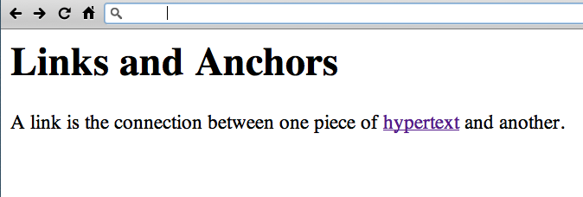
http://www.w3.org/History/19921103-hypertext/hypertext/WWW/Link.html

Slide 8
Chrome Experiments
Arcade Fire - The Wilderness Downtown
http://www.chromeexperiments.com/arcadefire/

Slide 9
HTML5 Working Examples
HTML5 Mobile Feed Widget
www.lib.montana.edu/~jason/files/html5-mobile-feed/
BookMeUp
www.lib.montana.edu/beta/bookme/
Learn more by viewing source
OR
Downloading from jasonclark.info or github.com/jasonclark

Slide 10
HTML5 as "umbrella" Term
Changes to HTML spec
New Javascript APIs
Additions to CSS spec

Slide 11
Evolution into HTML5
Reacting to how the web is used

Slide 12
A Minimal HTML5 Document
<!DOCTYPE html>
<html lang="en">
<head>
<meta charset="utf-8">
<title>title</title>
<link rel="stylesheet" href="style.css">
<script src="script.js"></script>
</head>
<body>
<!-- page content -->
</body>
</html>

Slide 13
Semantic & Functional Markup
header
footer
nav
section
article
figure
aside
mark
menu
contenteditable attribute

Slide 14
Microdata
Markup for making HTML machine-readable
itemscope
itemtype
itemprop

Slide 15
Microdata – Book Example
<dl itemscope
itemtype="http://vocab.example.net/book"
itemid="urn:isbn:0226500667"
<dt>Title</dt>
<dd itemprop="title">A River Runs Through It and Other Stories</dd>
<dt>Author</dt>
<dd itemprop="author">Norman Maclean</dd>
<dt>Publication date</dt>
<dd itemprop="pubdate">October 1, 2001</dd>
</dl>

Slide 16
Native Video and Audio
simple markup
no plugin!
limited vid formats: .ogv, .mp4, webm
<video width="320" height="240 controls="controls">
<source src="film.mp4" type="video/mp4" />
Your browser doesn’t support the video tag.
</video>

Slide 17
Forms <form>
field types - email, date
validation
regular expressions
still need to watch for security/hacks

Slide 18
<form> Markup
<input type="email" required>
<input type="date">
<input type="url">
<input type="email" required autofocus>

Slide 19
Javascript APIs
Desktop programming for the web

Slide 20
Minification + Optimization
Removing unnecessary characters and spacing from code to reduce size, and optimizing the code to improve load times
Minify
http://www.minifyjavascript.com/
Optimize
http://www.jslint.com/

Slide 21
Selector APIs
Find elements by matching against a group of selectors (tags or attributes in DOM).
querySelector()
querySelectorAll()
var matchList = document.querySelectorAll('li.old, li.new');

Slide 22
Geolocation
w3c API
accurate
supported in Firefox 3.6, Safari 4
navigator.geolocation.getCurrentPosition();

Slide 23
File API, Drag & Drop API
Uploading of files
Drag & drop API in combination with a draggable attribute

Slide 24
History API
Preserve the state of the page
Enabling back button in client-side scripts

Slide 25
Fullscreen API
Remove browser chrome
“Turn off the lights”
function launchFullScreen(element) {
if(element.requestFullScreen) {
element.requestFullScreen();
}
}
<button onclick="launchFullscreen(document.documentElement);">Go Fullscreen</button>

Slide 26
Storage APIs
Keep files
Store keys/values
Local databases

Slide 27
sessionStorage
mega COOKIE
Stores key/value pairs while page is open

Slide 28
localStorage
mega COOKIE
Stores key/value pairs that persist after page and browser are closed

Slide 29
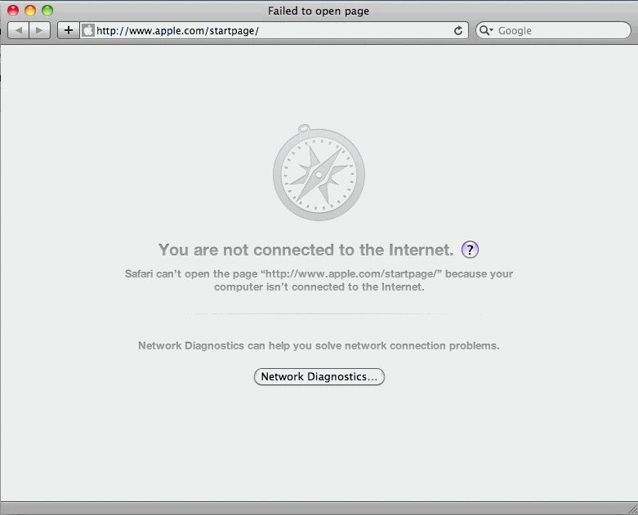

Slide 30
Offline Storage – Cache Manifest
Work without a connection
Create cache manifest file
Set server to allow for manifest file type
Link to manifest file in HTML <head>
CACHE MANIFEST
#store the files below
index.html
styles.css
images/logo.png
Scripts/global.js

Slide 31
Offline Storage - IndexedDB
My browser can haz database!
Simple key/value store within browser
Up to 5 MB of data storage
W3C discontinued Web SQL Database spec

Slide 32
HTML5 right now? IE?
<!DOCTYPE html>
<html lang="en”>
<head>
<meta charset="utf-8" />
<title>HTML5 right now</title>
<!--[if IE]>
<script src="http://html5shiv.googlecode.com/svn/trunk/html5.js"></script>
<![endif]-->
<style>
article, aside, figure, footer, header, hgroup, menu, nav, section {display:block;}
</style>
</head>
<body>
<!-- ready to roll with HTML5 now -->
</body>
</html>

Slide 33
Evolution into CSS3
Rethinking web displays and styles

Slide 34
Vendor Prefixes
Add support for emerging parts of CSS spec
Android: -webkit-
Chrome: -webkit-
Firefox: -moz-
Internet Explorer: -ms-
iOS: -webkit-
Opera: -o-
Safari: -webkit-

Slide 35
Box Sizing
Set how the browser calculates the width of an element to include (or not include) padding, borders, and margins
div.doc {
width: 200px;
padding: 0 30px;
-webkit-box-sizing: border-box;
-moz-box-sizing: border-box;
box-sizing: border-box;
}

Slide 36
Rounded Elements
border-radius declaration
smooth out your interfaces
button effects
-moz-border-radius: 10px 5px;
-webkit-border-top-left-radius: 10px;
-webkit-border-top-right-radius: 5px;
-webkit-border-bottom-right-radius: 10px;
-webkit-border-bottom-left-radius: 5px;
border-radius: 10px 5px;

Slide 37
Gradients/Opacity
no more background images
transparency

Slide 38
Selectors
Target specific elements or markup in a series
div[attr] and a[href$=pdf]
Attribute selector (starts with, ends with, contains)
ul > li
Immediate descendant (child) selector
td:last-child {border-right:0 none;}
li:nth-child(n+6) {color: grey;}

Slide 39
Transitions
Animation behavior
Scaling, fading, easing, etc.
body {
-o-transition:all .2s linear;
-moz-transition:all .2s linear;
-webkit-transition:all .2s linear;
transition:all .2s linear;
}

Slide 40
Columns and Grids
Layout and page structure
Goodbye, float?
ul#content {
-webkit-column-count: 3;
-webkit-column-rule: 1px solid #eee;
-webkit-column-gap: 1em;
-moz-column-count: 3;
-moz-column-rule: 1px solid #eee;
-moz-column-gap: 1em;
column-count: 3;
column-rule: 1px solid #eee;
column-gap: 1em;
display: block;
}

Slide 41
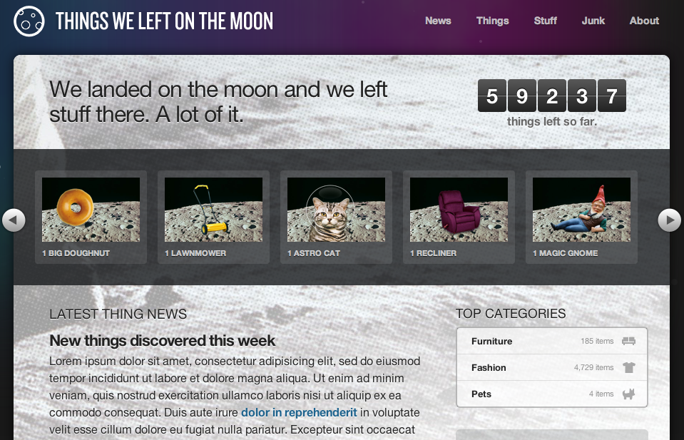
CSS3 example - http://css3exp.com/moon/

Slide 42
Media Queries
switch stylesheets based on width and height of viewport
same content, new view depending on device
@media screen and (max-device-width:480px) {… mobile styles here… }

Slide 43
Media Queries in Action
<link rel="stylesheet" type="text/css” media="screen and (max-device-width:480px) and (resolution: 163dpi)” href="shetland.css" />
Responsive Web Design, Ethan Marcotte
http://www.alistapart.com/articles/responsive-web-design

Slide 44
@Font-Face
bring in fonts
use any licensed TrueType (.ttf) or OpenType (.otf) font
independent of machine it's being rendered on...

Slide 45
Demos & Examples
It's your call....

Slide 46
catalog.douglascountylibraries.org/EcontentRecord/19339/Viewer?item=3439864

Slide 47
Demos
YouTube HTML5 demo
http://www.youtube.com/html5
24 ways CSS3 demo
http://24ways.org/
HTML5 Demos
http://html5demos.com/
Other possible examples:
geolocation
localStorage

Slide 48
What Type of Support?
see "When can I use…"
http://a.deveria.com/caniuse/
Mobile browsers leading the way
Modernizr
http://www.modernizr.com/
HTML5 enabling script
http://remysharp.com/2009/01/07/html5-enabling-script/

Slide 49
Resources
HTML5 Tag Reference (W3Schools)
w3schools.com/html5/html5_reference.asp
Cross Browser Support Tables
www.findmebyip.com/litmus/
HTML5 Doctor
html5doctor.com/
CSS3 Previews (CSS3.info)
www.css3.info/preview/
HTML5 & CSS3 Cheat Sheets
webresourcesdepot.com/html-5-and-css3-cheat-sheets-collection/

Slide 50
Resources (cont.)
HTML5 Boilerplate
http://html5boilerplate.com/
HTML5rocks
html5rocks.com
HTML5 Please
html5please.com/#use

Slide 51
Questions?
twitter.com/jaclark
www.lib.montana.edu/~jason/talks.php

Slide 52
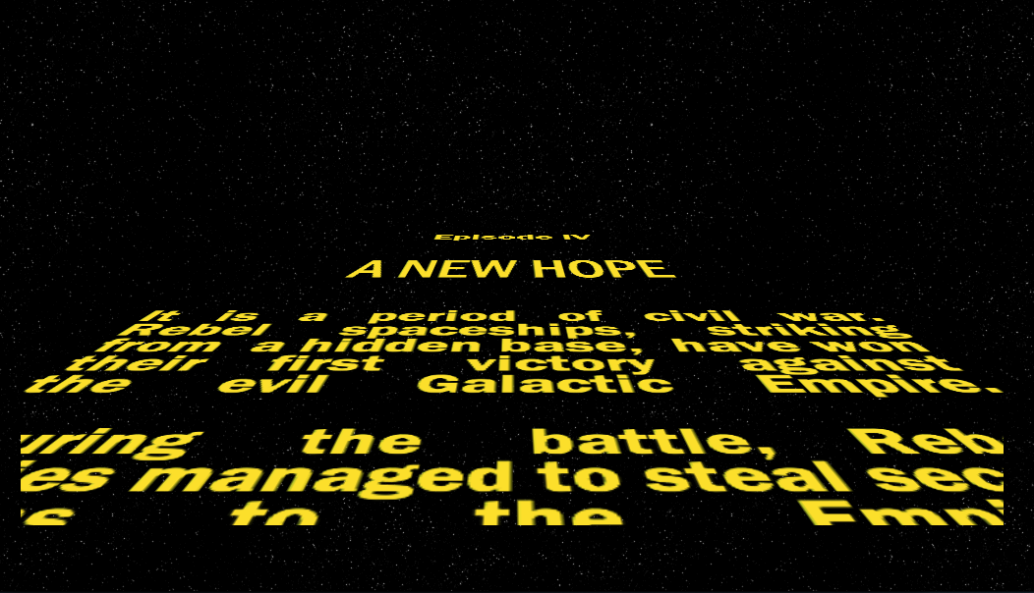
http://www.gesteves.com/experiments/starwars.html

