Slide 1
Web Services Bootcamp:
Adding Value to Library Apps & Services
Jason A. Clark
Head of Digital Access and Web Services
Montana State University Libraries

Slide 3
A quick look ahead…
Why web services for libraries?
What do we gain in the move to "mashup"?
Define the major terms of web services
Resources for learning: wizard and tools (Yahoo Pipes, Google Code Playground)
Code samples for downloading and practicing

Slide 4
Questions?
Ask anytime during the presentation
This can be heady stuff
twitter.com/jaclark or email

Slide 5
Web as Platform
Tim O'Reilly's concept for Web 2.0
oreilly.com/web2/archive/what-is-web-20.html
software written above level of single device
lightweight programming models
small pieces, loosely joined

Slide 6
Web as Platform
Examples
www.lib.montana.edu/channel/
www.lib.montana.edu/beta/bookme/

Slide 7
Terms: API
What is an API? An application programming interface (or API) is a way for developers to access parts of a remote web site and integrate it with their own site. MSU Libraries "lofiAPI"www.lib.montana.edu/~jason/files/api/lofi/

Slide 8
Terms: Web Service
What is a Web Service?
Broader term
Public interface (API)
Provides access to data and/or procedures
On a remote/external system (usually)
Use structured data for data exchange (often XML)

Slide 9
Terms: Mashup
What is a mashup? A Web application that uses and/or combines data from multiple sources within a single tool.Trendsmaptrendsmap.com

Slide 10
Terms: Structured Data
Structured data = XML and JSON
Extensible Mark-up Language and Javascript Object Notation
Flexible mark-up languages
Lightweight and easy to parse
Allow communication between disparate systems

Slide 11
Terms: POST and GET
Two primary verbs for web services actions
POST data to a web service
GET data from a web service
Read and Write actions

Slide 12
Why use Web Services?
Access to content/data stores you could not otherwise provide (zip codes, news, pictures, reviews, etc.)
Enhance site with a service that is not feasible for you to provide (maps, search, products, etc.)
Combine these services into a seamless service you provide (mashups)

Slide 13
Provide Web Services?
You have a service that benefits your users best if they can get to their data from outside the application
You want others to use your data store in their applications

Slide 14
Available Web Services
Google
Yahoo!
Amazon
eBay
Flickr, Instagram
New York Times
Google App Engine (code.google.com/appengine/)
Netflix
iTunes
YouTube
pinboard.in
Many more...

Slide 15
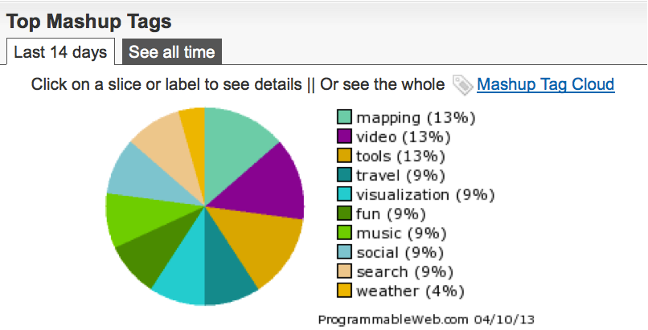
Top Mashup Types - recent

Slide 16
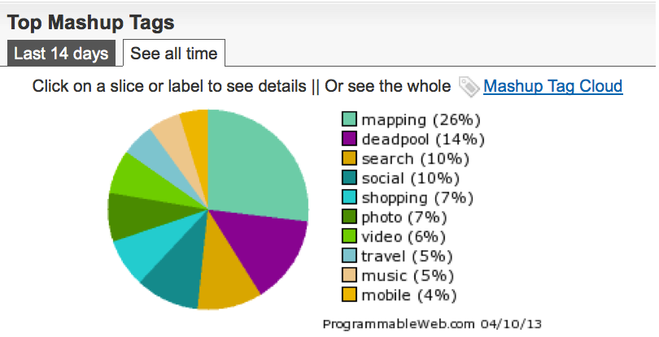
Top Mashup Types

Slide 17
You'd be surprised...
AllCDCovers.com http://www.allcdcovers.com/api
ISBNdb.com http://isbndb.com/docs/api/index.html
OpenDOAR http://www.opendoar.org/tools/api.html
arXiv.org http://export.arxiv.org/api_help/
Google Book Search APIs - http:code.google.com/apis/books
LibraryThing APIs - http://www.librarything.com/services
WorldCat Search API - http://www.worldcat.org/devet/wiki/SearchAPIDetails
Open Library API - http://openlibrary.org/dev/docs/api
* See ProgrammableWeb http://www.programmableweb.com/apis/directory

Slide 18
Types of Web Services
SOAP
XML-RPC
REST

Slide 19
What is SOAP?
An acronym for Simple Object Access Protocol
Version 1.2 of the W3C recommendation
dropped the acronym
Specification maintained at w3.org
There's nothing simple about SOAP!

Slide 20
Using SOAP
Send a message specifying an action to take, including data for the action
Receive a return value from the action
Most SOAP services provide a WSDL file to describe the actions provided by the service

Slide 21
What's WSDL?
Web Services Description Language
XML mark-up for describing the functionality provided by a SOAP service

Slide 22
SOAP Example
EBAY wsdl http://api.google.com/GoogleSearch.wsdl<?xml version="1.0" encoding="UTF-8"?><SOAP-ENV:Envelope xmlns:SOAP-ENV="http://schemas.xmlsoap.org/soap/envelope/"xmlns:ns1="urn:ebay:apis:eBLBaseComponents"><SOAP-ENV:Header> ...</SOAP-ENV:Header><SOAP-ENV:Body><ns1:GetSearchResultsRequest><ns1:Version>425</ns1:Version><ns1:Query>*</ns1:Query><ns1:TotalOnly>true</ns1:TotalOnly></ns1:GetSearchResultsRequest></SOAP-ENV:Body></SOAP-ENV:Envelope>

Slide 23
SOAP: Final Thoughts
Complex
Messaging and Data mingled
Usually seen in software APIs, but many scripting languages have libraries
Google API has moved away from it

Slide 24
What is XML-RPC
XML Remote Procedure Call
Specification maintained at xmlrpc.com
Provides a means to call methods/procedures on a remote server and make changes and/or retrieve data
An early specification

Slide 25
Using XML-RPC
Most common implementation of XML-RPC used today is that of blog ping services
Technorati, Flickr, FeedBurner, others?

Slide 26
XML-RPC: Final Thoughts
An updating protocol
Early adoption, but little recent development

Slide 27
What is REST?
The greatest thing since sliced...
Representational State Transfer
Unique data resources with addresses

Slide 28
Theory of REST
Focus on diversity of resources (nouns), not actions (verbs)
Every resource is uniquely addressable
All resources share the same constrained interface for transfer of state (actions)
Must be stateless, cacheable, and layered

Slide 29
REST = Web Protocol
Web As Prime Example
URLs uniquely address resources
HTTP methods (GET, POST, HEAD, etc.) and content types provide a constrained interface
All transactions are atomic
HTTP provides cache control

Slide 30
REST: Final Thoughts
Similarity to web - easy to understand
URL is the method
Most popular type of web service

Slide 31
Formats for Data from Web Services
XML
Lots of different formats
Can use a particular standard
MARC XML
Dublin Core
RSS
Atom
Or may be a proprietary format
JSON (Javascript Object Notation)
very popular
easy to use with Javascript
can be simpler to work with
HTML

Slide 32
Web Services in Libraries
Vendors: LibGuides, Serial Solutions, ExLibris
Repository66: mash-up of OpenDOAR data with Google Maps and repository growth charts from ROAR, developed by Stuart Lewis of the University of Aberystwyth, Wales http://maps.repository66.org/
lofiAPI: MSU Libraries (ETD, RMT)
MSU Library Lifestream: RSS services (Twitter, del.icio.us, last.fm, MSU Library Blog)
Bento Box Search Interface at NCSU Libraries
www.lib.ncsu.edu/search/?q=laser

Slide 33
Web Services in Libraries
Web Services from OCLC
WorldCat Search API
xISBN
xISSN
WorldCat Registry (Registry Search and Registry Detail)
WorldCat Identities
Virtual International Authority File
Terminology Services
LibraryThing API
Google Book API
Open Library API

Slide 34
Under the hood...
Making the examples work... a closer look at the web services handout.
Which examples do you want to talk about?
- Yahoo Pipes
- Google Code Playground
- Basic API examples

Slide 35
What I've Learned
Web services are closed source software
Documentation and online support is vital
Debugging can be hard
Similarities to common protocols are important
Practice and finding your development kit is essential

Slide 37
jsFiddle
Can edit javascript and jquery scripts without a web server
Can share code examples
http://jsfiddle.net/libdevel/4HbhB/7/

Slide 38
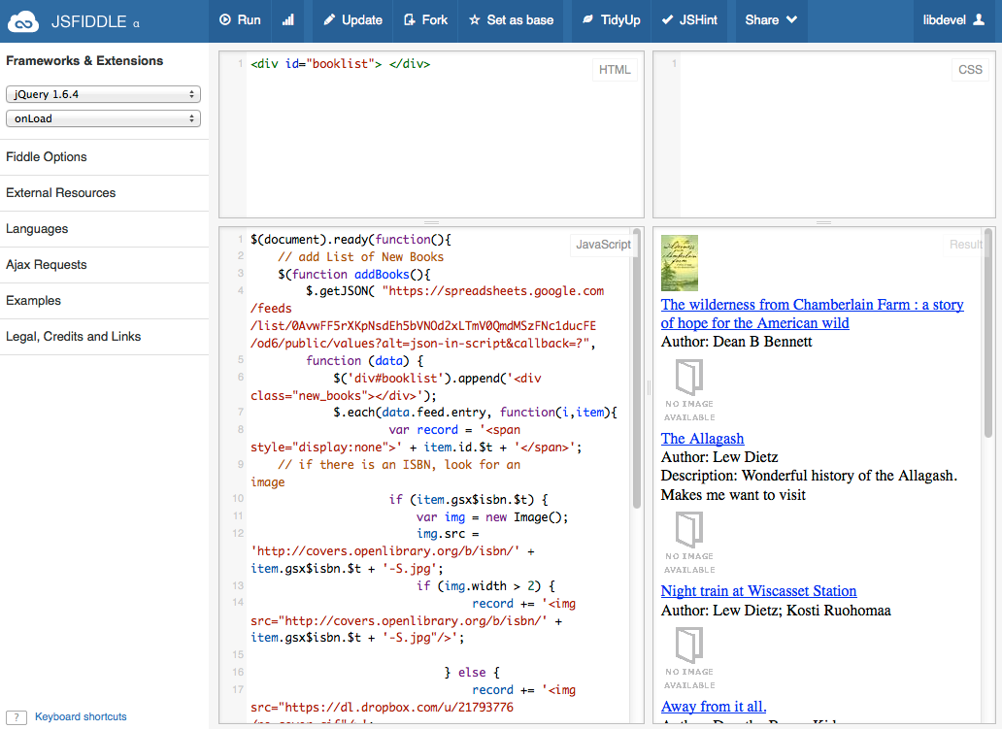

Slide 39
Last thoughts...
This stuff is becoming mature.
Digital Library Federation API recommendation
Library mashups are here - WorldCat widget for Wordpress

Slide 40
Contact Information
Jason A. Clark
Head of Digital Access and Web Services
Montana State University Libraries
jaclark@montana.edu
www.jasonclark.info
twitter.com/jaclark
406-994-6801

