Slide 1
Where are You?
Surveying and Building Location-Aware Library Apps
Jason Clark
Head of Library Informatics & Computing
Montana State University Library
Florida Library Webinars
Novare Library Services
April 30, 2014

Slide 2
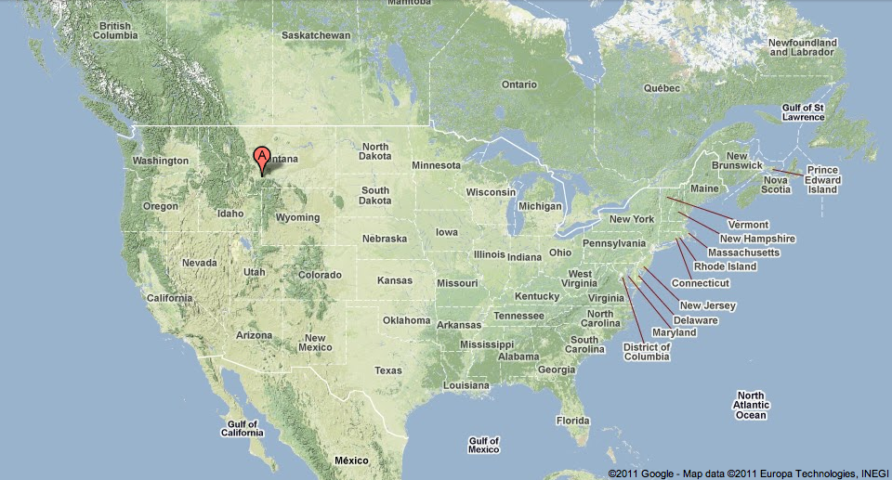

Slide 3
Twitter #hashtag
#libgeoapp

Slide 4
pinboard.in URL (get links)
pinboard.in/u:jasonclark/t:libgeoapp

Slide 5
Overview
Does location matter?
Library Apps and Demos
Getting Started
Questions

Slide 6
What?

Slide 7
“Context is King”
For Real?

Slide 8
“About half of the queries on Google have a geographic component.”
Source: Andrew Foster, product manager at Google
http://www.guardian.co.uk/technology/2010/jun/16/google-maps-property-finder

Slide 9
“74% of adult smartphone owners ages 18 and older say they use their phone to get directions or other information based on their current location.”
Source: Pew Research Report: Location-Based Services (September 12, 2013)
http://www.pewinternet.org/2013/09/12/location-based-services/

Slide 10
Location is a metric for interest.
Can libraries apply this?

Slide 11
Temporality is a metric for interest.
Can libraries use presence?

Slide 13
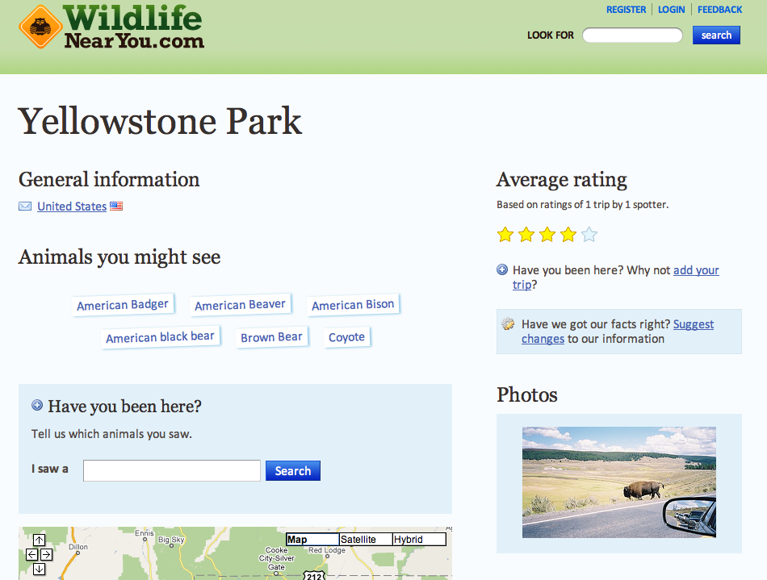
www.wildlifenearyou.com

Slide 14
Library Applications
Mapping Data
Check-in Services
Crowdsourcing Geo Information
Local Interest Apps

Slide 15
Mapping Data
Montana State University Research Locations
UNC Digital Collections Map Browse
www.lib.unc.edu/dc/geobrowse/
TAMU Geological Atlas, United States
repository.tamu.edu/handle/1969.1/2490
Geography becomes a browse point

Slide 16
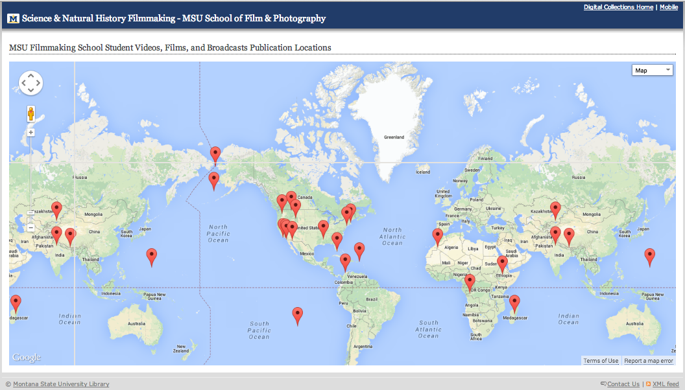
http://arc.lib.montana.edu/msu-film-archive/locations

Slide 17
Check-in Services
Darien Library (Connecticut)
Enoch Pratt Free Library (Maryland)
US National Archives
foursquare.com/usnatarchives
Participate and get badges or gifts

Slide 18
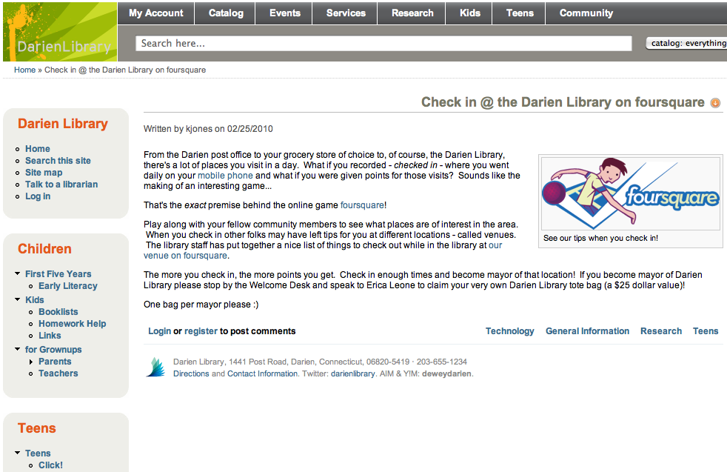
http://www.darienlibrary.org/2010/03/1/foursquare

Slide 19
Crowdsourcing Geo
New York Public Library
maps.nypl.org
Historical Overlays
Help us create better geographic data

Slide 20
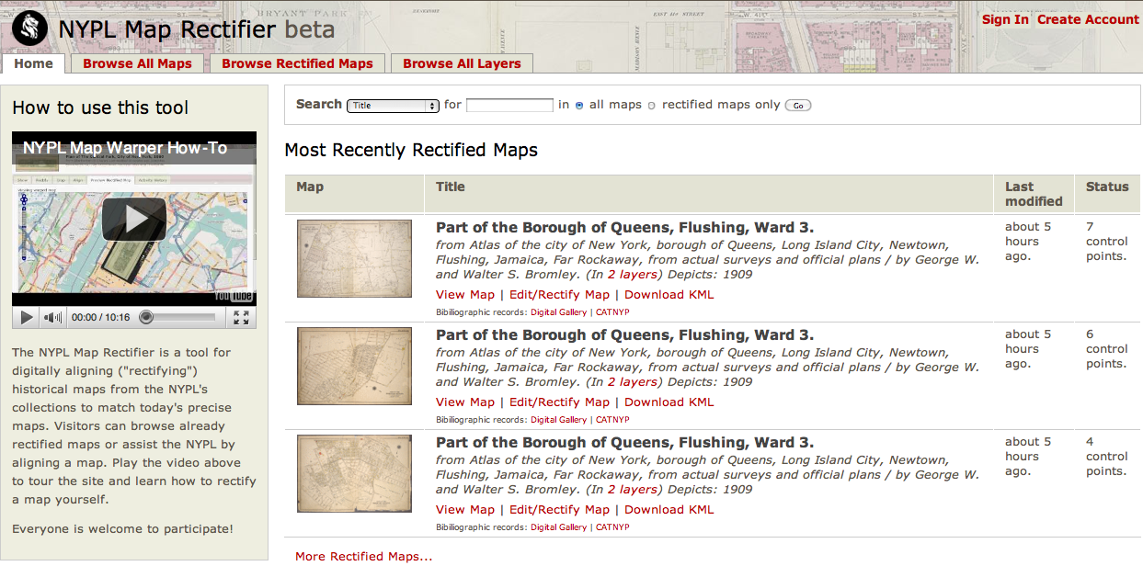
http://maps.nypl.org/warper/

Slide 21
Local Interest Apps
NCSU Wolf Walk
San Jose Public Library
Augmented Reality Historical Walking Tours (in beta… )
Location-based Learning Opportunities

Slide 22
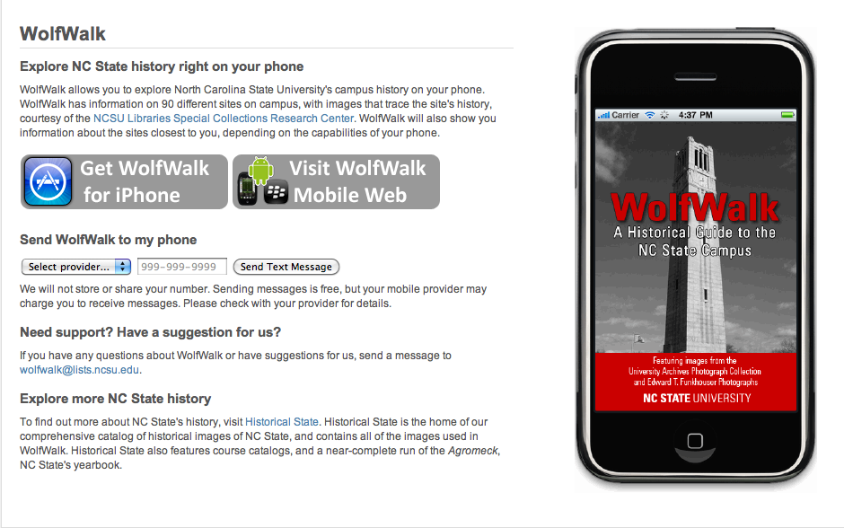
http://www.lib.ncsu.edu/wolfwalk/

Slide 23
Geolocation (options)
w3c Geolocation API
accurate
supported in Firefox 3.6, Safari 4
Javascript functionality
Yahoo Query Language Location Tables
Web Services, REST API
Server-side and/or Client-side scripting
These are just two of the options…

Slide 24
Getting Started
Choose data with location interest
Record latitude/longitude
“Reverse Geocode” to get text values
code.google.com/apis/maps/documentation/geocoding/#ReverseGeocoding

Slide 25
Going Offline
HTML5 Offline Database Storage
www.html5rocks.com/features/offline
HTML5 Local Session Storage
Record values in physical - QR codes
HTML5 Local caching - cache manifest file
Download GeoNames Datasets
www.geonames.org

Slide 26
BooksnStuffNearby
A Beta App
http://www.google.com/search?q=jason+clark+code

Slide 27
HTML5 Geolocation API, Worldcat Search API, Forecast.io API, etc.
Building blocks for a service

Slide 28
Resources
Symposium on Location-Based Services
www.lbs2014.org
Journal of Location-Based Services
www.tandfonline.com/loi/tlbs20
Geolocation API - diveintohtml5
diveintohtml5.org/geolocation.html
Leaflet.js - Javascript Geo/Mapping Library
leafletjs.com

Slide 29
Code Examples
Google Static Maps + Geolocation
www.lib.montana.edu/~jason/files/web-services/google-static-maps-geolocate.html
OCLC MapFast Subject Headings
www.lib.montana.edu/~jason/files/web-services/html5-geolocation-mapfast.html
re:This Place (aka BooksnStuffNearby)
www.lib.montana.edu/~jason/files/geolocate/

Slide 30
pinboard.in URL (get links)
pinboard.in/u:jasonclark/t:libgeoapp

Slide 31
Questions?
twitter.com/jaclark
www.jasonclark.info

