Slide 1
Intro to Web Development
Building a web site for the desktop, tablet and smartphone
Florida Library Webinars
Novare Library Services
April 30, 2014
Jason Clark
Head of Library Informatics & Computing
Montana State University Library

Slide 2
First Principles
Responsive Web Design
Search Engine Optimization
Information Architecture
Analytics and Statistics

Slide 4
pinboard.in tag
pinboard.in/u:jasonclark/t:rwd/

Slide 5
twitter as channel (#hashtag)
@jaclark #rwd

Slide 6
Overview
What is Responsive Web Design?
RWD Principles
Live RWD Redesign
Getting Started
Questions

Slide 7
Terms: HTML + CSS
Does everybody know what these elements are?
CSS
- style rules for HTML documents
HTML
- markup tags that structure docs
- browsers read them and display according to rules

Slide 8
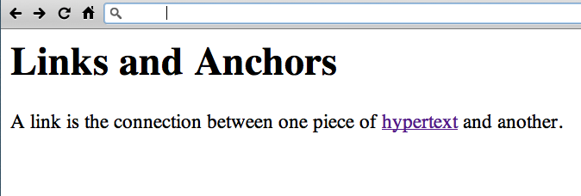
http://www.w3.org/History/19921103-hypertext/hypertext/WWW/Link.html

Slide 9
Responsive design = 3 techniques
Media Queries
A Fluid Grid
Flexible Images or Media Objects

Slide 10
RWD Working Examples
HTML5 Mobile Feed Widget
www.lib.montana.edu/~jason/files/html5-mobile-feed/
Mobilize Your Site with CSS (Responsive Design)
www.lib.montana.edu/~jason/files/responsive-design/
www.lib.montana.edu/~jason/files/responsive-design.zip
Learn more by viewing source
OR
Download from jasonclark.info & github.com/jasonclark

Slide 11
Media Queries
switch stylesheets based on width and height of viewport
same content, new view depending on device
@media screen and (max-device-width:480px) {… mobile styles here… }
* note “em” measurements based on base sizing of main body font are becoming standard (not pixels)

Slide 12
Media Queries in Action
<link rel="stylesheet" type="text/css” media="screen and (max-device-width:480px) and (resolution: 163dpi)” href="shetland.css" />
Responsive Web Design, Ethan Marcotte
http://www.alistapart.com/articles/responsive-web-design

Slide 13
Define the Breakpoints
3 major breaks
480 / 768 / 1024

Slide 14
Define the Breakpoints
3 major media query rules
< 480
< 768
> 768

Slide 15
A Fluid Grid
Create Flexible Layouts with Relative Sizing
| 200 px | 300 px | 800 px |
| 15.38% | 23.07% | 61.5384% |

Slide 16
Box Sizing
Set how the browser calculates the width of an element to include (or not include) padding, borders, and margins
div.doc {
width: 200px;
padding: 0 30px;
-webkit-box-sizing: border-box;
-moz-box-sizing: border-box;
box-sizing: border-box;
}

Slide 17
Flexible Images & Media
Adaptive Sizing
img{width:100%;min-width:250px;}

Slide 18
Flexible Images & Media ...
Adaptive Sizing
<div class="video-container">
<iframe src="http://player.vimeo.com/video/6284199?title=0&byline=0&portrait=0" width="800" height="450" frameborder="0"></iframe>
</div>
.video-container {position:relative;padding-bottom:56.25%;padding-top: 30px;height:0;overflow:hidden;}
.video-container iframe {position:absolute;top:0;left:0;width:100%;height: 100%;}

Slide 19
Ensure Device Screen Size
meta viewport tag in <head>
<meta name="viewport" content="width=device-width, initial-scale=1">

Slide 20
Linearize Layout for Mobile
Turn all block level elements into full width to create single column layout
width -> 100%

Slide 21
Hide Non-Essential Content
As screen sizes shrink, remove elements from view
Apply a .hide class
@media screen and (max-width:480) {
.hide {display:none;}
}

Slide 22
RWD Gotchas
Hidden page weights
Be lean with your markup
Minify if performance bottleneck

Slide 23
Minification + Optimization
Removing unnecessary characters and spacing from code to reduce size, and optimizing the code to improve load times
Minify
www.cleancss.com
Optimize
csstidyonline.com
stidyonline.com/

Slide 24
What Type of Support?
see "When can I use…"
http://a.deveria.com/caniuse/
Mobile browsers leading the way
Modernizr
http://www.modernizr.com/
HTML5 enabling script
http://remysharp.com/2009/01/07/html5-enabling-script/

Slide 25
RWD Tools
Twitter Bootstrap
twitter.github.io/bootstrap/
Responsify
responsify.it/
960 Grid System
http://960.gs/

Slide 26
Resources
HTML5 & CSS3 Cheat Sheets
webresourcesdepot.com/html-5-and-css3-cheat-sheets-collection/
HTML5 Boilerplate
http://html5boilerplate.com/
HTML5rocks
html5rocks.com
HTML5 Please
html5please.com/#use

Slide 27
Next version of RWD = Flexbox
A flexible box model?
body>div#main {
display: -webkit-flexbox;
display: -moz-flexbox;
display: -ms-flexbox;
display: -o-flexbox;
height: 500px;
padding: 1em;
background-color: gray;
}

Slide 28
RWD in Libraries
Matthew Reidsma
matthew.reidsrow.com
@mreidsma
Brad Czerniak
brad.hawidu.com
@ao5357

Slide 29
Search Engine Optimization
Engineering Findability...

Slide 30
pinboard.in tag
pinboard.in/u:jasonclark/t:libseo/

Slide 31
Search Engine Optimization
The act of creating indexable and crawlable content for commercial search engine robots
SEO

Slide 32
Best Practices and SEO
Approved SEO techniques
Based on search engine guidelines and documentation for indexing
Align with user’s expectations for a search result

Slide 33
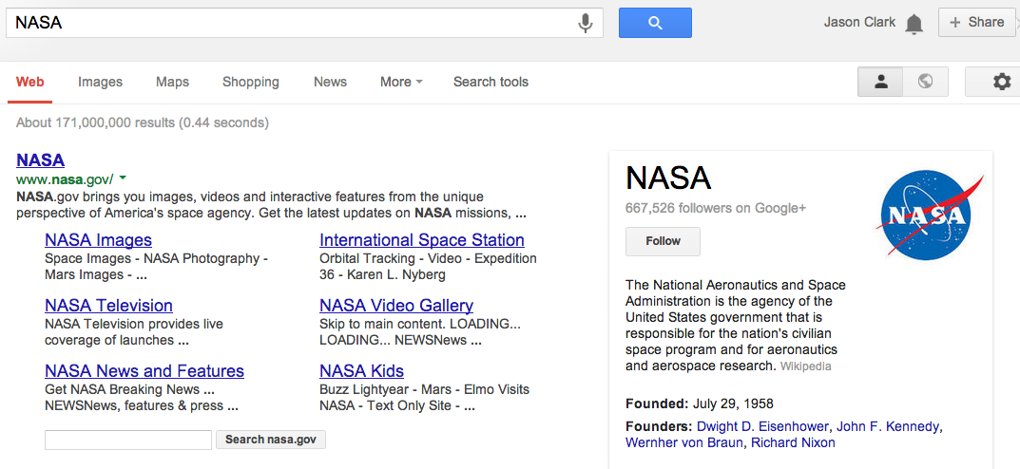

Slide 34
SEO - Baseline Techniques
Keyword analysis
Writing titles and descriptions
Creating indexable content
- sitemaps, linked architecture
Reduce noise in the index
- rel canonical, noindex nofollow
Introduce semantic markup

Slide 35
Keyword Analysis
Research your market
Write or rewrite your web copy, titles, descriptions based on this research
Set up Google Adwords Account
Keyword Planner

Slide 36
Writing Titles and Descriptions
Writing web copy for the robot and the human
<title></title>
<meta name=”description” />

Slide 37
Writing Titles and Descriptions
Title
"Keyword Phrase | Context"
Example:
“Staff Directory and People Listing: Montana State University MSU Library”

Slide 38
Writing Titles and Descriptions
Description
a short, declarative sentence that incorporates your keywords, as you laid it out in your page title
Example:
"A listing of staff employed at Montana State University MSU Library including library departments, roles, job titles, phone numbers and contact information."

Slide 39
Creating Indexable Content
Clear hierarchy and site architecture
Directory in URL shows hierarchy
Breadcrumb links
“Every page should be reachable from at least one static text link.”
https://support.google.com/webmasters/answer/35769

Slide 40
Creating Indexable Content
Set up machine-readable sitemap
Listing all pages that you want to be indexed and indexing priorities for those pages
“Google adheres to Sitemap Protocol 0.9 as defined by sitemaps.org.”
https://support.google.com/webmasters/answer/156184

Slide 41
Creating Indexable Content
Set up machine-readable sitemap
Listing all pages that you want to be indexed and indexing priorities for those pages
“Google adheres to Sitemap Protocol 0.9 as defined by sitemaps.org.”
https://support.google.com/webmasters/answer/156184

Slide 42
Reduce “Noise” in the Index
Redundant content
Dynamic pages, search result pages
Not every page is unique
Techniques:
robots.txt directives
link relations and index directive markup

Slide 43
Reduce “Noise” in the Index
robots.txt
set of commands in text file at top level of your site
Disallow: /staff/
#allow primary mobile page
Allow: /finding-aids/m/index.php
Allow: /finding-aids/m/$

Slide 44
Reduce “Noise” in the Index
Link relations and index directive markup
markup that identifies canonicalization or whether to index a page
<link rel="canonical" href="http://arc.lib.montana.edu/finding-aids/item/23" />
<a rel="nofollow" href="http://arc.lib.montana.edu/finding-aids/item/23"></a>
<meta name="robots" content="nofollow,noindex" />

Slide 45
Introducing Semantic Markup
HTML5 semantic tags and microdata that helps classify page types and types of content on the page
“If Google understands the content on your pages, we can create rich snippets—detailed information intended to help users with specific queries.”
https://support.google.com/webmasters/answer/99170?hl=en&ref_topic=1088472

Slide 46
BM (Before Microdata)

Slide 47
AM (After Microdata)

Slide 48
<dl>
<dt>Title</dt>
<dd>A River Runs Through It and Other Stories</dd>
<dt>Author</dt>
<dd>Norman Maclean</dd>
<dt>Publication date</dt>
<dd>October 1, 2001</dd>
<dt>ID</dt>
<dd>0226500667</dd>
</dl>

Slide 49
<dl itemscope itemtype="http://schema.org/Book">
<dt>Title</dt>
<dd itemprop="title">A River Runs Through It and Other Stories</dd>
<dt>Author</dt>
<dd itemprop="author">Norman Maclean</dd>
<dt>Publication date</dt>
<dd itemprop="pubdate">October 1, 2001</dd>
<dt>ID</dt>
<dd itemprop="isbn">0226500667</dd>
</dl>

Slide 50
Analytics and Statistics
Know your Users...

Slide 51
Recording Web site usage
Create a Google Analytics account
Create a Google Webmaster Tools Account
Connect the accounts
https://support.google.com/webmasters/answer/1120006

Slide 52
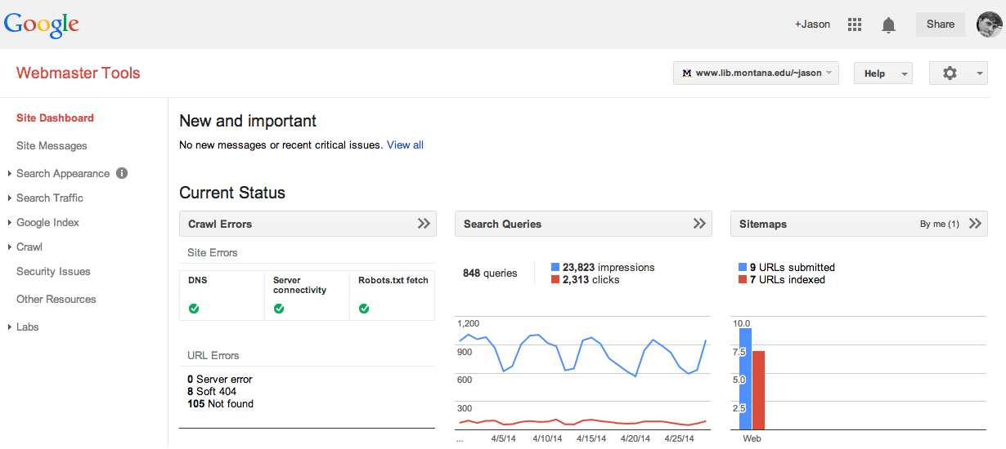

Slide 54
Questions?
twitter.com/jaclark
www.lib.montana.edu/~jason/talks.php

