Slide 1
Why You Should Care About Linked Data and Open Data
Linked Open Data (LOD) in Libraries
Florida Library Webinars
Novare Library Services
May 30, 2014
Jason Clark
Head of Library Informatics & Computing
Montana State University Library

Slide 3
pinboard.in tag
pinboard.in/u:jasonclark/t:lod/

Slide 4
twitter as channel (#hashtag)
@jaclark #lodlib

Slide 5
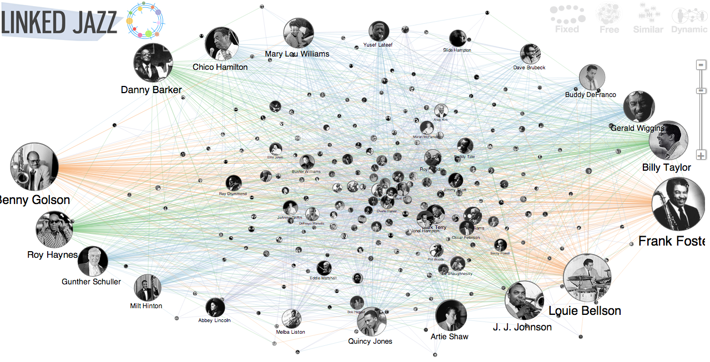
http://linkedjazz.org/

Slide 6
Overview
What is Linked Open Data (LOD)?
LOD in Practice
Build a sample RDF
LOD in Libraries
Questions

Slide 7
What is Linked Open Data?
Practice of publishing structured, machine actionable data with an open license for sharing and reuse.

Slide 8
What is Linked Data?
“a method of publishing structured data so that it can be interlinked and become more useful. It builds upon standard Web technologies such as HTTP, RDF and URIs, but rather than using them to serve web pages for human readers, it extends them to share information in a way that can be read automatically by computers. This enables data from different sources to be connected and queried.”
http://en.wikipedia.org/wiki/Linked_data

Slide 9
What is Open Data?
“A piece of data or content is open if anyone is free to use, reuse, and redistribute it - subject only, at most, to the requirement to attribute and/or share-alike.”
http://opendefinition.org/

Slide 10
LOD in Practice
Design Expectations for LOD
Expressing and Encoding LOD
Principles of Publishing LOD

Slide 11
Design Expectations for LOD
Use URIs as names for things
Use HTTP URIs so that people can look up those names.
When someone looks up a URI, provide useful information, using the standards (RDF*, SPARQL)
Include links to other URIs so that they can discover more things.
- Tim Berners Lee
http://www.w3.org/DesignIssues/LinkedData.html

Slide 12
Expressing and Encoding LOD
Resource Description Framework (RDF)
A structured data format for expressing relationships (descriptions) between things (resources).
http://www.xml.com/pub/a/2001/01/24/rdf.html

Slide 13
Expressing and Encoding LOD
The data model of RDF is based on the idea of a triple.
A triple is a simple statement with three distinct parts:
a subject
a predicate
an object

Slide 14
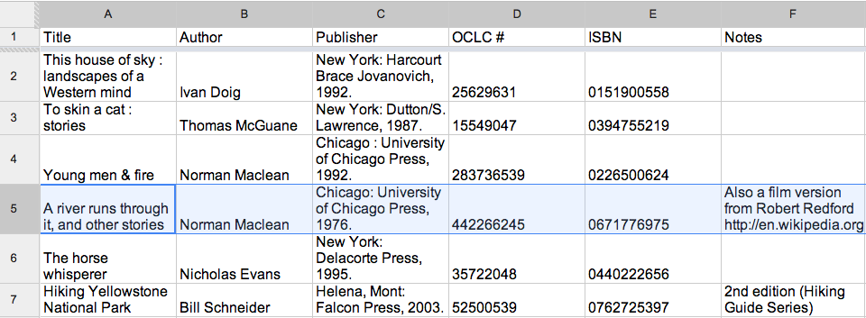

Slide 15
#5 “has ISBN” 0671776975
(subject) (predicate) (object)

Slide 16
#5 “has author” Norman Maclean
(subject) (predicate) (object)

Slide 17
Use URIs as names for things

Slide 18
http://www.worldcat.org/oclc/1733412 (subject)
http://purl.org/dc/terms/creator (predicate)
http://dbpedia.org/page/Norman_Maclean (object)

Slide 19
<?xml version="1.0"?>
<!DOCTYPE rdf:RDF PUBLIC "-//DUBLIN CORE//DCMES DTD 2002/07/31//EN"
"http://dublincore.org/documents/2002/07/31/dcmes-xml/dcmes-xml-dtd.dtd">
<rdf:RDF xmlns:rdf="http://www.w3.org/1999/02/22-rdf-syntax-ns#"
xmlns:dc ="http://purl.org/dc/elements/1.1/">
<rdf:Description rdf:about="http://www.worldcat.org/oclc/1733412">
<dc:creator rdf:resource="http://dbpedia.org/page/Norman_Maclean"/>
<dc:identifier>ISBN 0671776975</dc:identifier>
</rdf:Description>
</rdf:RDF>

Slide 20
LOD Ontologies & Vocabularies
URIs link to:
Reputable machine-readable endpoints
E.g., Worldcat, VIAF, or DbPedia
Open Ontologies & Vocabularies
E.g., Dublin Core Terms, Library of Congress Subject Headings
* See Linked Open Vocabularies (LOV) for a list of possible ontologies and vocabularies. http://lov.okfn.org/dataset/lov/

Slide 21
Principles of Publishing LOD
Use URIs for description
Make structured data available on WWW
Allow for machine-actionability and sharing through common ontologies
* machine-actionable is a term used by Karen Coyle to mean readable and interpretable by computers or software agents. See her Library Technology Report on Understanding the Semantic Web at http://www.metapress.com/content/g212v1783607/

Slide 22
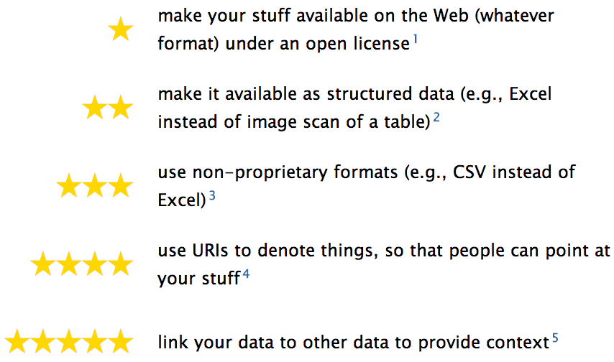
5 Star Linked Open Data
http://5stardata.info/

Slide 23
Build a sample RDF
Go to Maya Angelou’s Wikipedia page
http://en.wikipedia.org/wiki/Maya_angelou
Come up with 2 statements that can expressed as triples

Slide 24
Build a sample RDF
What are some triples you identified?
Final step:
Place a triple into RDF and test in W3C RDF Validation Service

Slide 25
A Graph Database
A series of RDF triples that can be queried
Expressions provide links between triples
Non-hierarchical, arbitrary object relations

Slide 26
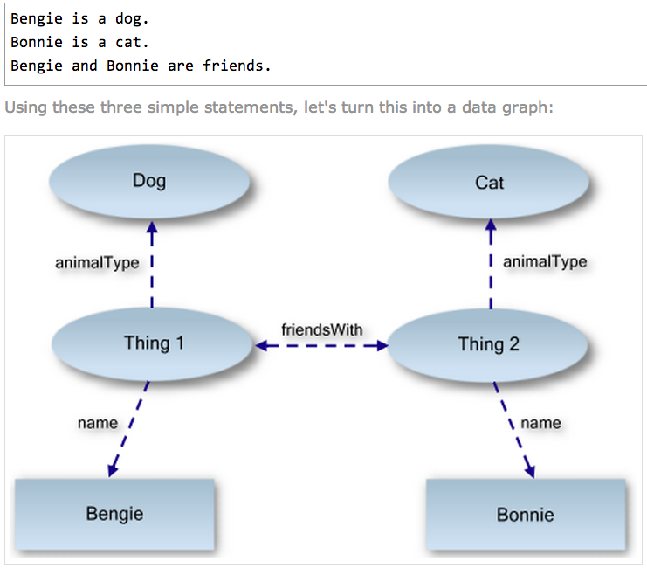
http://www.linkeddatatools.com/introducing-rdf

Slide 27
Why LOD?
Libraries as publishers in Web of Data
Reuse of our data = Significance
Can improve findability in search engines (search engine optimization)
Levels of description in LOD enable entirely new applications

Slide 28
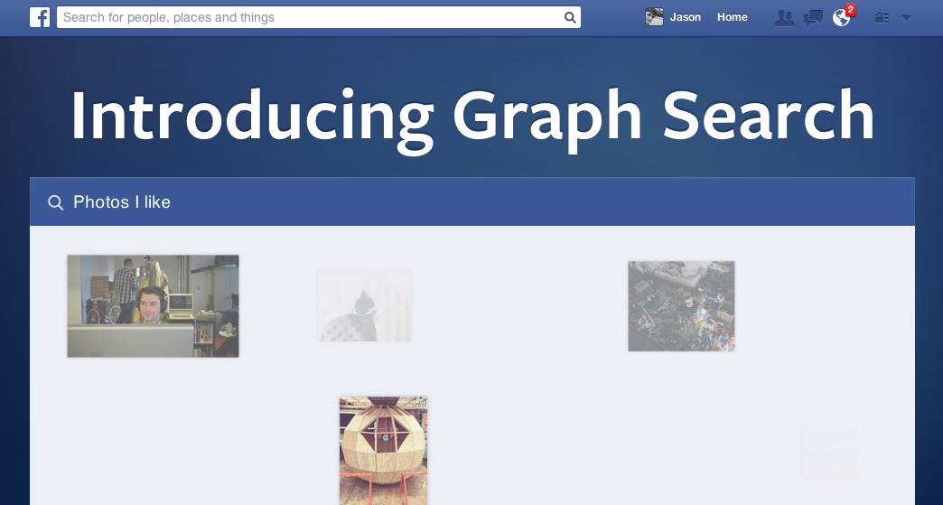
https://www.facebook.com/about/graphsearch

Slide 29
LOD in Libraries
UNLV Linked Data Project
http://www.library.unlv.edu/linked-data
Worldcat
http://www.oclc.org/data.en.html
Europeana Linked Open Data
http://labs.europeana.eu/api/linked-open-data/introduction/

Slide 30
LOD in Libraries - Use Cases
Web Scale Cataloging
Library of Congress BIBFRAME Initiative
http://www.loc.gov/bibframe/
Annotated Texts and Books
http://arc.lib.montana.edu/book/home-cooking-history-409/
Recommendation Systems
http://linkedjazz.org/network/

Slide 31
Introducing Semantic Markup
HTML5 semantic tags and RDFa that helps classify page types and types of content on the page
“If Google understands the content on your pages, we can create rich snippets—detailed information intended to help users with specific queries.”
https://support.google.com/webmasters/answer/99170?hl=en&ref_topic=1088472

Slide 32
BM (Before Microdata)

Slide 33
AM (After Microdata)

Slide 34
<dl>
<dt>Title</dt>
<dd>A River Runs Through It and Other Stories</dd>
<dt>Author</dt>
<dd>Norman Maclean</dd>
<dt>Publication date</dt>
<dd>October 1, 2001</dd>
<dt>ID</dt>
<dd>0226500667</dd>
</dl>

Slide 35
<dl itemscope itemtype="http://schema.org/Book">
<dt>Title</dt>
<dd itemprop="title">A River Runs Through It and Other Stories</dd>
<dt>Author</dt>
<dd itemprop="author">Norman Maclean</dd>
<dt>Publication date</dt>
<dd itemprop="pubdate">October 1, 2001</dd>
<dt>ID</dt>
<dd itemprop="isbn">0226500667</dd>
</dl>

Slide 36
Resources
Harper, Corey. Library linked data: tuning library metadata for the semantic web. An ALCTS webcast, March 16. 2011. (open access) http://www.ala.org/alcts/confevents/upcoming/webinar/cat/031611

Berners-Lee, Tim. The next web. A TED talk, February 2009. (open access) http://www.ted.com/talks/tim_berners_lee_on_the_next_web
Koster, Lukas (2011) Brief Introduction to Linked Data (open access) https://docs.google.com/document/d/1W6UOCLgxTyM0BlPfd5hs58dh4k6CUdLW354AjjtnJfk/edit
*See also LODLAM - Linked Open Data in Libraries, Archives &amp; Museums at http://lodlam.net/

Slide 37
Acknowledgements
I would like to thank Alison Hitchens for her excellent work in explaining and teaching these linked data concepts and definitions.
http://www.accessola2.com/olita/insideolita/wordpress/?p=60029
She was also gracious enough to distribute her work under the Attribution-Noncommercial-Share Alike 3.0 Unported license. And I am doing the same.

Slide 39
Questions?
twitter.com/jaclark
www.lib.montana.edu/~jason/talks.php

