Slide 1
Libraries in Search Engines
Search Engine Optimization (SEO) for Libraries
Florida Library Webinars
Novare Library Services
April 2, 2014
Patrick OBrien+
Semantic Web Research Director
Montana State University Library
Jason Clark
Head of Library Informatics & Computing
Montana State University Library
@jaclark #libseo

Slide 2
A Research Team Effort
Scott Young
Digital Initiatives Librarian at Montana State University
Jason Clark
Head of Library Informatics & Computing at Montana State University Library
Patrick OBrien
Semantic Web Research Director at Montana State University Library
Kenning Arlitsch
Dean of the Library at Montana State University. His book, co-authored with Patrick OBrien is titled Improving the Visibility and Use of Digital Repositories through SEO, and was published in February 2013.

Slide 3
Today's Agenda
What is Search Engine Optimization (SEO)?
Why do SEO?
Black Hat vs. White Hat SEO
Recommendations
Key SEO techniques
Resources
Questions

Slide 4
What is SEO for Libraries?
The act of creating indexable content for commercial search engines (SE)...
... to increase access, visibility and use of library content and resources ...
...by patrons that value it
Notes:
Patrick

Slide 5
Why do SEO?
~200 million people in the US use the Internet¹
81% of U.S. adults
95% of U.S. teens
The US submits 19+ Billion queries per month to commercial SE²
Google owns 67% of these queries
¹ Pew Research Center. “What Internet users do online: Pew Research Center’s Internet & American Life Project,” 2012. http://pewinternet.org/Trend-Data-(Adults)/Online-Activites-Total.aspx
² comScore. “comScore Releases February 2014 U.S. Search Engine Rankings,” February 18, 2014. http://www.comscore.com/Insights/Press_Releases/2014/2/comScore_Releases_January_2014_US_Search_Engine_Rankings
Notes:
Patrick

Slide 6
"Search engines continue to dominate, topping the list of electronic sources most used to find online content (93%), followed closely by Wikipedia (88%). The key difference in usage between search engines and Wikipedia is the frequency - 75% of students who use search engines do so daily, compared to 20% of those who use Wikipedia."
Perceptions of Libraries, 2010: Context and Community: a Report to the OCLC Membership. OCLC, 2011.
http://www.oclc.org/content/dam/oclc/reports/2010perceptions/2010perceptions_all_singlepage.pdf
http://www.oclc.org/content/dam/oclc/reports/2010perceptions/collegestudents.pdf
Notes:
Patrick

Slide 7
"Discovery happens elsewhere."
- Lorcan Dempsey (in 2007)
Vice President and Chief StrategistOnline Computer Library Center (OCLC)
http://orweblog.oclc.org/archives/001430.html

Slide 8
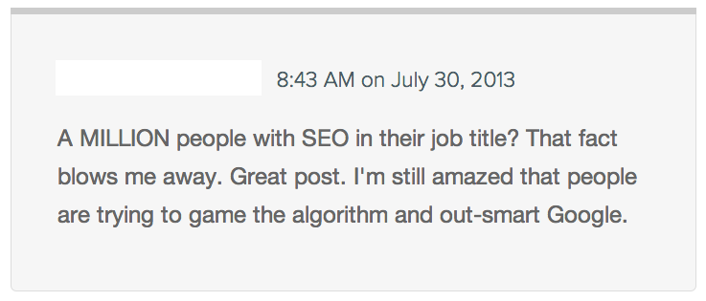
Black Hat SEO

Slide 9
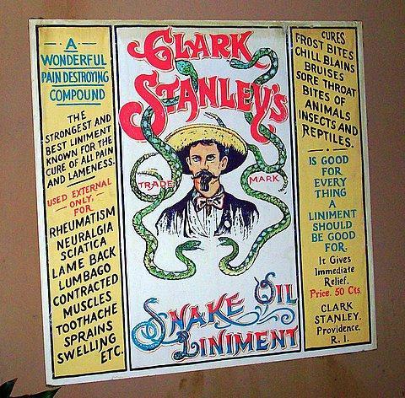
http://www.flickr.com/photos/22245459@N06/2386354917
https://en.wikipedia.org/wiki/Clark_Stanley

Slide 10
Black Hat SEO = Banned
Using deceptive redirects
"Cloaking"
"Shadow" domains
Multiple "Doorway Pages" with poor content optimized for different keywords
"Link Schemes" trying to game the SE
"Hidden" text or links
Anything "sneaky" or untrustworthy

Slide 11
White Hat SEO
SE approved "Webmaster Guidelines"
Focus on improving user experience
Unique & accurate content
User relevant vocabulary & keywords
Intuitive site architecture
Build Stability & Trust

Slide 12
Recommended Library Process
Institutionalize SEO
Accurate Measurement Tools
Strategic Plan
Traditional SEO
Get Indexed
Get Visible
Semantic SEO
Get Relevant
Notes:
Patrick

Slide 13
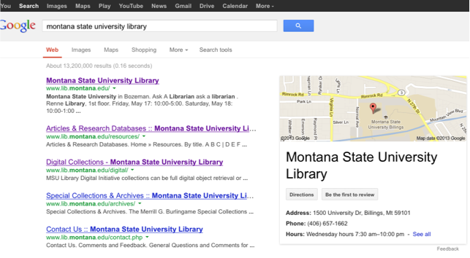
Google – Baseline May 15 2013
Notes:
Patrick

Slide 14
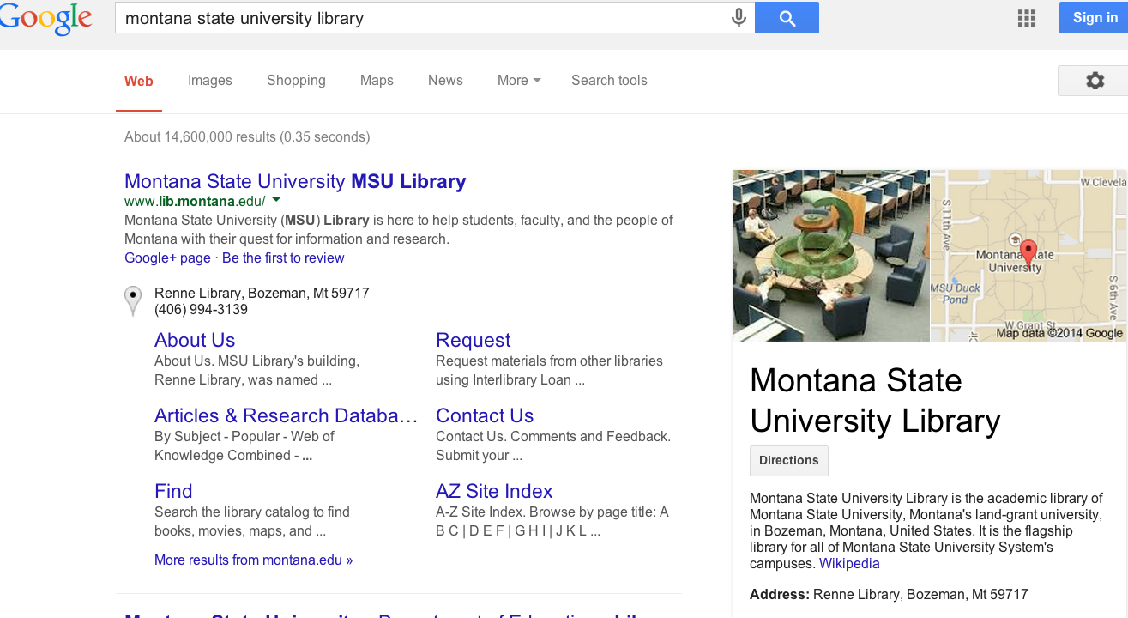
Google – April 2, 2014
Notes:
Patrick

Slide 15
Setup Measurement & Evaluation
Associate a single Google Account with your Institution
(e.g., msuseo@gmail.com)
Establish baseline metrics
Google Analytics (gAnalytics)
Google Webmaster Tools (gMaster)
Activate Google Services
Google Places for Business (gPlaces)
Google+ (G+)
Google AdWords (gAdWords)
Notes:
Patrick

Slide 16
Make Improvements
Address gWebmaster "errors"
Ensure content is indexable
Reduce Index noise
Claim, consolidate and standardize all listings
gPlaces
Google Maps (gMaps)
G+
Improve On-Page Optimization
Notes:
Patrick

Slide 17
Creating Indexable Content
User intuitive hierarchy & site architecture
Short URLs containing keywords
Simple directory structure
Incorporate "Breadcrumbs"
Single URL to each page
Easy navigation between homepage and any webpage, and back
“Every page should be reachable from at least one static text link.”
https://support.google.com/webmasters/answer/35769

Slide 18
Creating Indexable Content
Link a human readable HTML sitemap from homepage
Implement machine-readable XML file(s) to provide SE content inclusion direction
"sitemap index"
"sitemap" file(s)
“Google adheres to Sitemap Protocol 0.9 as defined by sitemaps.org.”
https://support.google.com/webmasters/answer/156184

Slide 19
Reduce “Noise” in the Index
Implement robots.txt
text file at top level / root of web site
Provides SE content exclusion rules
Disallow: /staff/
#allow primary mobile page
Allow: /finding-aids/m/index.php
Allow: /finding-aids/m/$

Slide 20
Reduce “Noise” in the Index
Eliminate duplicate content
Dynamic pages, search result pages
Ensure every page is unique
Techniques:
robots.txt directives
link relations and index directive markup

Slide 21
Reduce “Noise” in the Index
Link relations and index directive markup
HTML page <head> markup that provides canonicalization and index exclusion rules
<link rel="canonical" href="http://arc.lib.montana.edu/finding-aids/item/23" />
<a rel="nofollow" href="http://www..lib.montana.edu/login.html">User Login</a>
<meta name="robots" content="nofollow,noindex" />

Slide 22
Claim, consolidate and standardize listings
Search gMaps and G+ for all variations
Name of library
Name of library building
All library phone numbers
Login gPlaces with Institutional Google Account
Search gPlaces & claim ownership of all variations from step 1
Notes:
Patrick

Slide 23
Claim, consolidate and standardize listings
Identify gPlaces variation with G+ "pre-approved custom URL"
Consolidate under gPlaces variation with G+ "pre-approved custom URL"
Complete and standardize consolidated gPlaces and G+ profiles
Name
Address
Phone Number(s)
Notes:
Patrick

Slide 24
Improve On-Page Optimization
Keyword phrase analysis
Patron relevant
Low to Moderate competition
High volume
Write / rewrite Web page
HTML <title>
<description> metatag
Ensure
all links contain descriptive "Anchor Text"
Use <H1>, <H2> HTML tags to "outline" the page around the topic (i.e. <title>)
Text is natural, easy-to-read and relevant to the page outline
Notes:
Patrick

Slide 25
Keyword Phrase Analysis
Use the vocabulary of your patrons
Which keyword phrase?
institutional repository
academic research
research papers
open access library

Slide 26
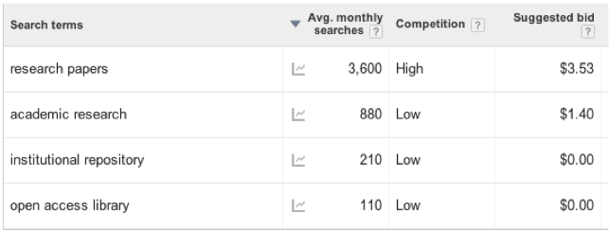
Keyword Phrase Analysis
Use Google AdWords

Slide 27
Keyword Phrase Analysis
Check Singular vs Plural

Slide 28
Writing Titles and Descriptions
Writing web copy for the robot and the human
<title></title>
<meta name=”description” />

Slide 29
Writing Titles and Descriptions
<title>
"Keyword Phrase Topic - Context"
Example:
“Staff Directory - Contact Information - Montana State University (MSU) Library”

Slide 30
Writing Titles and Descriptions
<description>
a short, declarative sentence that incorporates a reversal of the page's <title> keyword phrase topic and context
Example:
"Montana State University (MSU) Library staff directory and employee contact information that includes library departments, roles, job titles, and phone numbers."

Slide 31
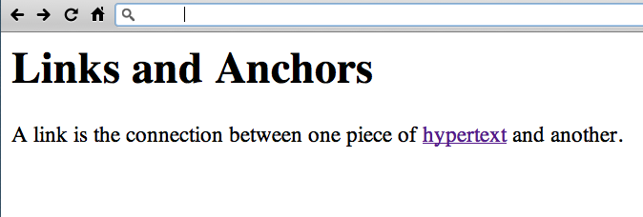
http://www.w3.org/History/19921103-hypertext/hypertext/WWW/Link.html

Slide 32
Introducing Semantic Markup
HTML5 semantic tags and microdata that helps classify page types and types of content on the page
“If Google understands the content on your pages, we can create rich snippets—detailed information intended to help users with specific queries.”
https://support.google.com/webmasters/answer/99170?hl=en&ref_topic=1088472

Slide 33
BM (Before Microdata)

Slide 34
AM (After Microdata)

Slide 35
<div id="main">
<meta content="http://arc.lib.montana.edu/msu-photos/objects/thumb-parc-000432.jpg" />
...
<h2 class="mainHeading">Item: <strong>Women posing on college locomotive engine</strong></h2>
<ul class="item">
<li>
<ul class="metadata">
<li class="object">
<a title="zoom &amp; scan view - Women posing on college locomotive engine" href="/msu-photos/viewer.php?id=432" alt="Women posing on college locomotive engine"><img src="/msu-photos/objects/parc-000432.jpg" alt="Women posing on college locomotive engine" />
<span>&#43; zoom</span>
</a>
</li>
<li class="describe">
<p><strong>Title:</strong> Women posing on college locomotive engine</p>
<p><strong>Creator:</strong> unknown</p>
<p><strong>Date:</strong> 1931-05-15</p>
<p><strong>Description:</strong> Women posing on a college locomotive engine.</p>
...
<p><strong>Physical Description:</strong> Photo print - Black and White</p>
...
<p><strong>Keywords:</strong> locomotive</p>
<p><strong>Photograph ID:</strong> parc-000432</p>
</li>
</ul><!-- end metadata <ul> -->
</li>
</ul><!-- end item <ul> -->
</div>

Slide 36
<div id="main" vocab="http://schema.org/" typeof="ItemPage" >
<meta property="thumbnailUrl" content="http://arc.lib.montana.edu/msu-photos/objects/thumb-parc-000432.jpg" />
...
<h2 class="mainHeading">Item: <strong><span property="name">Women posing on college locomotive engine</span></strong></h2>
<ul class="item">
<li>
<ul class="metadata">
<li class="object">
<a title="zoom &amp; scan view - Women posing on college locomotive engine" href="/msu-photos/viewer.php?id=432" alt="Women posing on college locomotive engine"><img property="about image primaryImageOfPage" src="/msu-photos/objects/parc-000432.jpg" alt="Women posing on college locomotive engine" />
<span>&#43; zoom</span>
</a>
</li>
<li class="describe" vocab="http://schema.org/" typeof="Photograph">
<p><strong>Title:</strong> <span property="name">Women posing on college locomotive engine</span></p>
<p><strong>Creator:</strong> <span property="author">unknown</span></p>
<p><strong>Date:</strong> <span property="dateCreated">1931-05-15</span></p>
<p><strong>Description:</strong> <span property="description">Women posing on a college locomotive engine.</span></p>
...
<p><strong>Physical Description:</strong> <span property="genre">Photo print - Black and White</span></p>
...
<p><strong>Keywords:</strong> <span property="keywords">locomotive</span></p>
<p><strong>Photograph ID:</strong> parc-000432</p>
</li>
</ul><!-- end metadata <ul> -->
</li>
</ul><!-- end item <ul> -->
</div>

Slide 37
Schema.org
A lingua franca for web classification and markup
Google, Bing, Yahoo, Yandex

Slide 38
SEO in Libraries
Arlitsch, Kenning, and Patrick S. O'Brien. Improving the Visibility and Use of Digital Repositories Through Seo: A Lita Guide. Chicago: ALA TechSource, 2013. Print.
Arlitsch, Kenning, and Patrick S. O'Brien. "Invisible institutional repositories: Addressing the low indexing ratios of IRs in Google Scholar." Library Hi Tech 30.1 (2012): 60-81.
Onaifo, Daniel, and Diane Rasmussen. "Increasing libraries' content findability on the web with search engine optimization." Library Hi Tech 31.1 (2013): 87-108.

Slide 39
pinboard.in tag
pinboard.in/u:jasonclark/t:libseo/

Slide 40
Questions?

