Slide 1
Collections as/are Data[sets]: Connecting Research Data Management to Digital Collections
Jason A. Clark @jaclark
Montana State University
Research Data Access and Preservation Summit 2020

Slide 2
Collections as/are Dataset[s]
Outline
Datasets + Collection Worldviews
Collections are data
Benefits
Standards + Prototypes
Implications

Slide 3
Research
Motivation

Slide 4
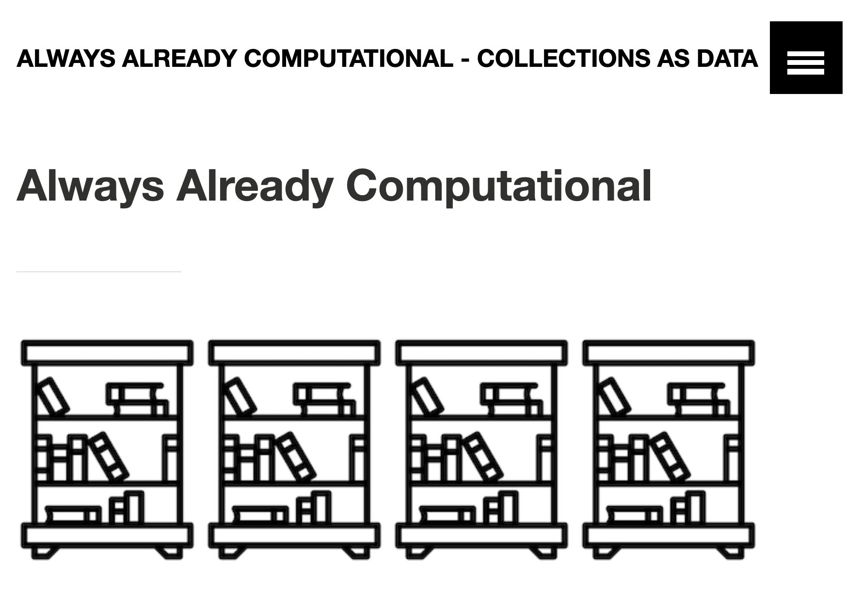
Research Motivation - Collections as/are Dataset[s]
Thomas Padilla
@thomasgpadilla

Slide 5
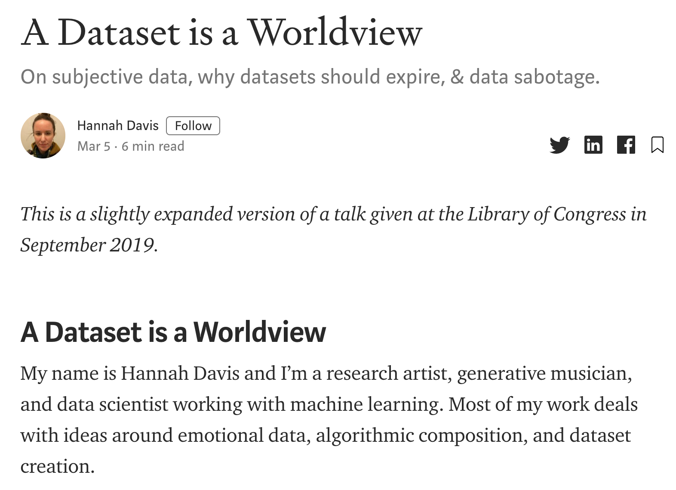
Research Motivation - Collections as/are Dataset[s]
Hannah Davis
@ahandvanish

Slide 6
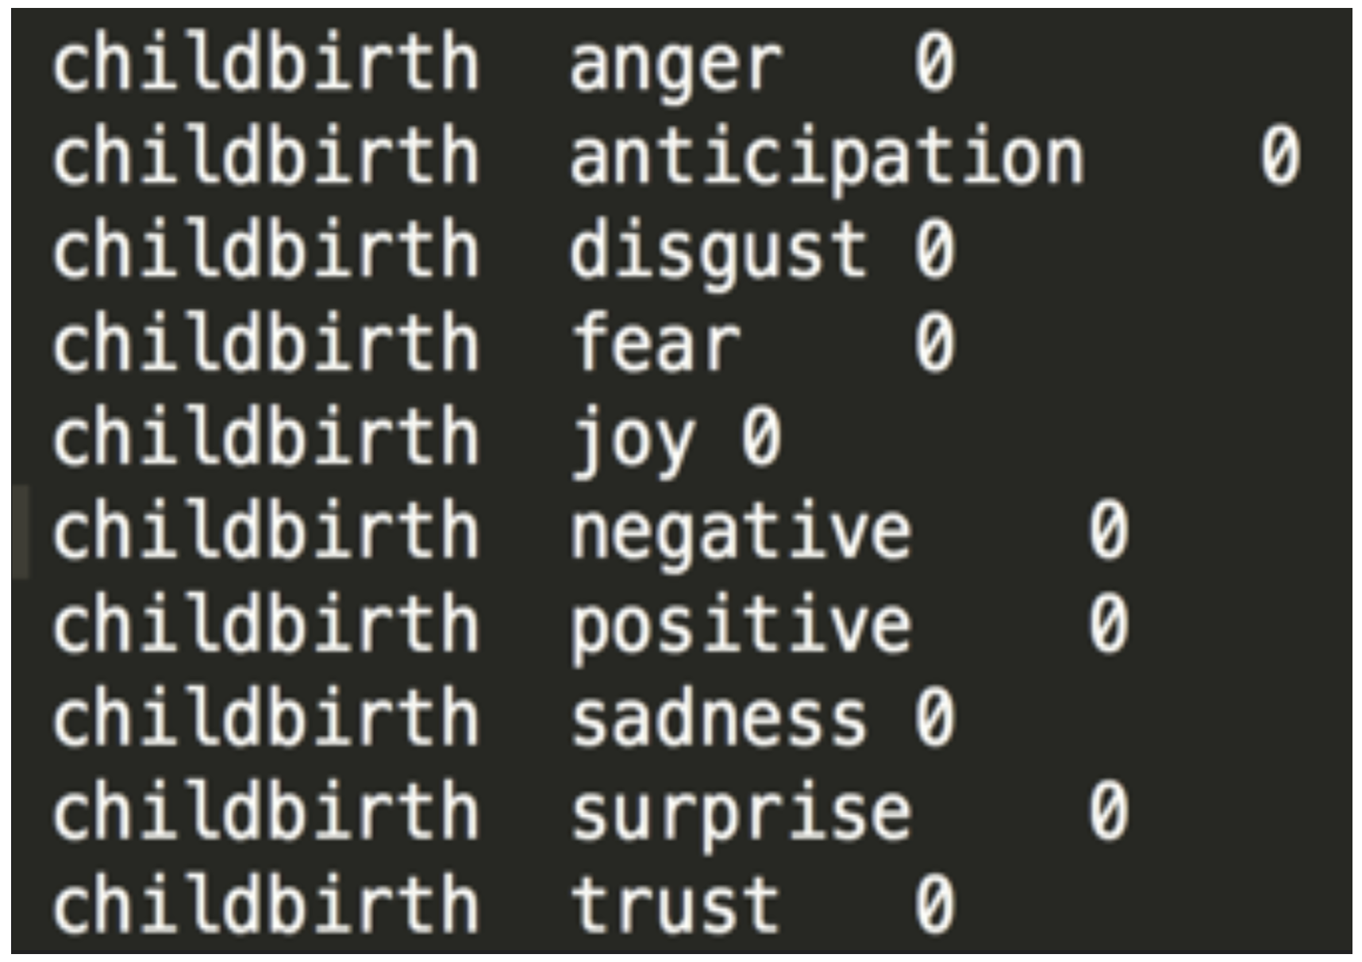
Research Motivation - Collections as/are Dataset[s]
The word "childbirth" had been tagged as being completely unemotional.

Slide 7
Research Motivation - Collections as/are Dataset[s]
“This led to a perspective that has informed all of my work since: a dataset is a worldview. It encompasses the worldview of the people who scrape and collect the data, whether they’re researchers, artists, or companies. It encompasses the worldview of the labelers, whether they labeled the data manually, unknowingly, or through a third party service like Mechanical Turk, which comes with its own demographic biases.”
Hannah Davis (2019)
https://towardsdatascience.com/a-dataset-is-a-worldview-5328216dd44d

Slide 8
Connecting Worldviews

Slide 9
Collections as/are Dataset[s]
Collections Worldview
Findability
Discovery
Inventory
Linkable
Datasets Worldview
Reproducibility
Sharing + Reuse
Preservation
Citeable

Slide 10
Collections as/are Dataset[s]
Connecting digital collection worldviews to dataset worldviews helps us realize that collections are datasets.

Slide 11
Benefits?

Slide 12
Collections as/are Dataset[s]
Benefits
Manifest for search engines
Metadata
Reuse
Preservation
Citeable

Slide 13
Standards + Prototypes

Slide 14
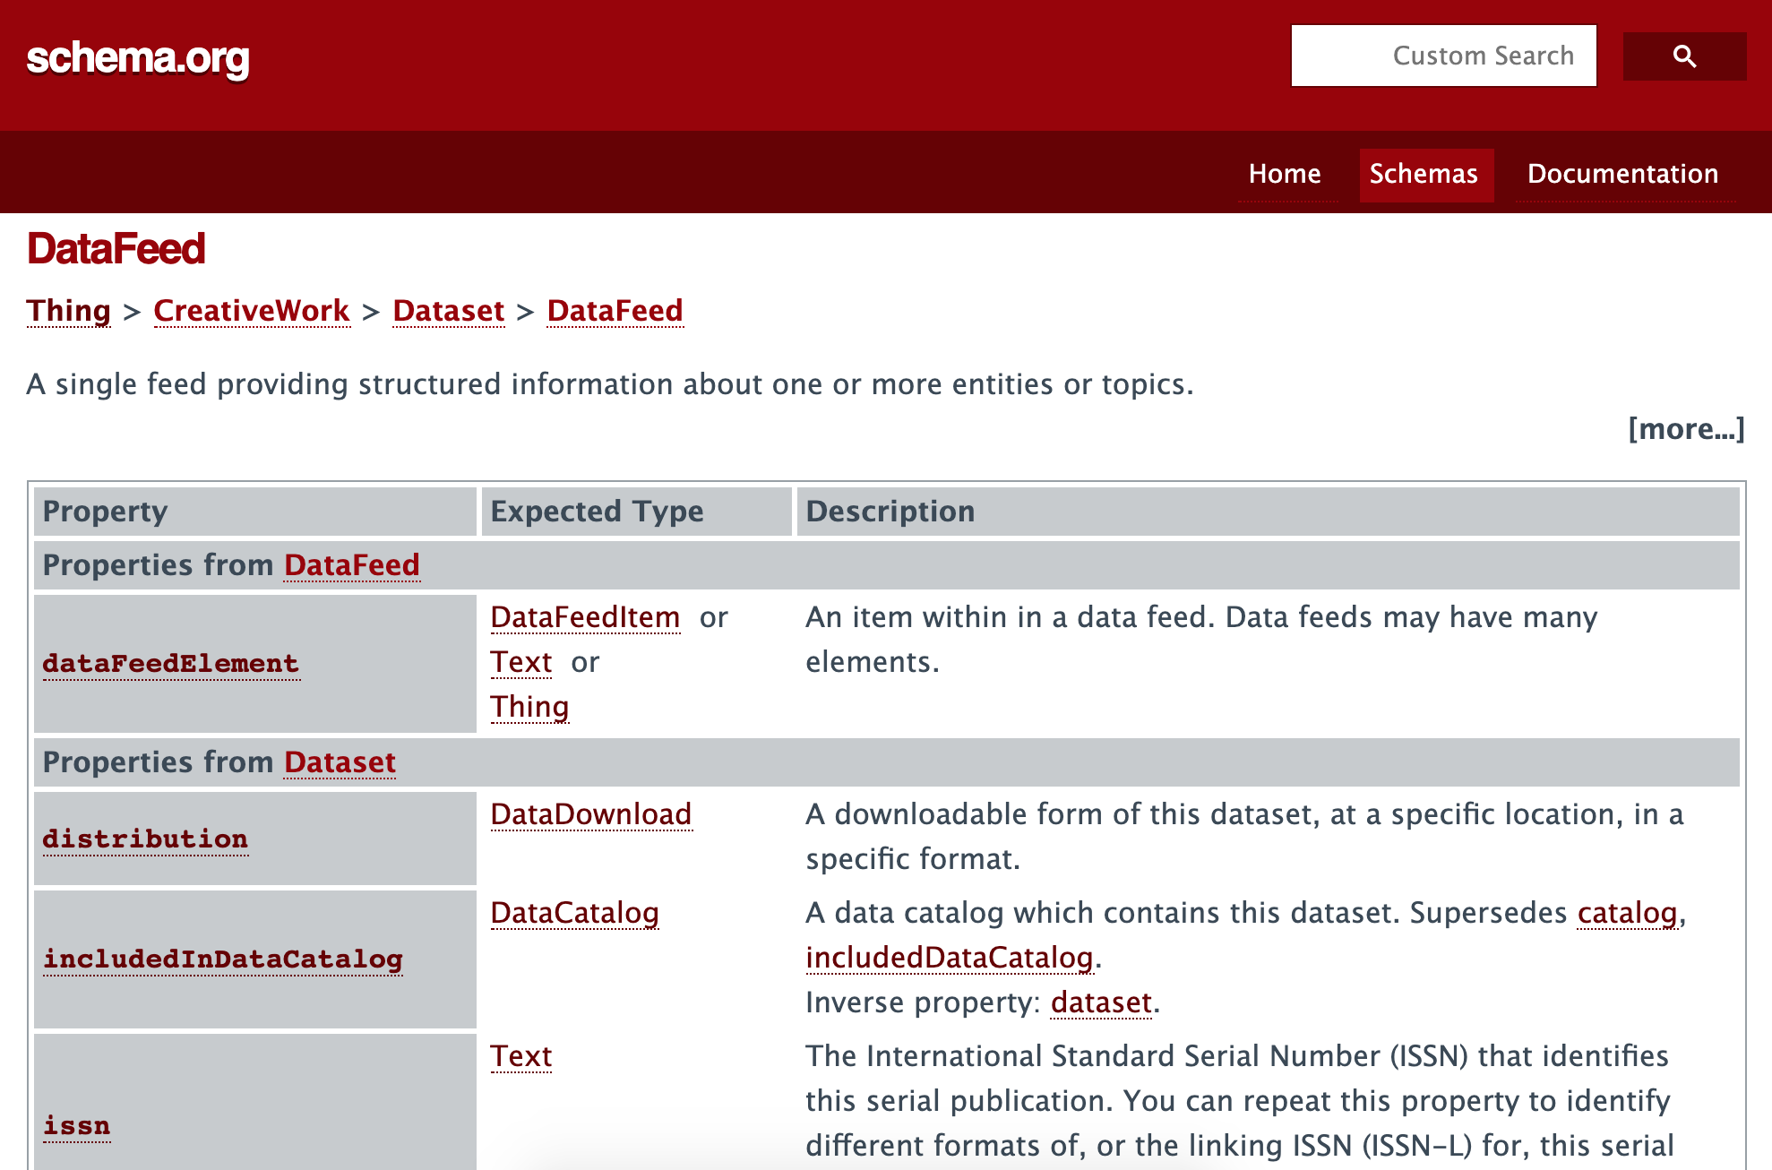
Standards - Schema.org
https://schema.org/Dataset
https://schema.org/DataFeed

Slide 15
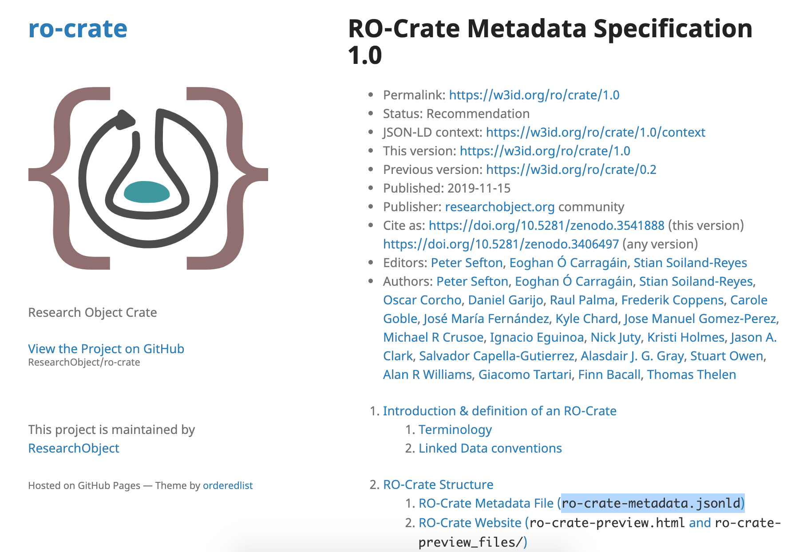
Standards - Research Object Crate (RO-Crate)
a lightweight approach to packaging research data with their metadata
https://w3id.org/ro/crate/1.0
#digital-library-and-repository-content

Slide 16
Prototype - Digital Collections Application Programming Interface
Collections API as DataFeed
Application Programming Interface

Slide 17
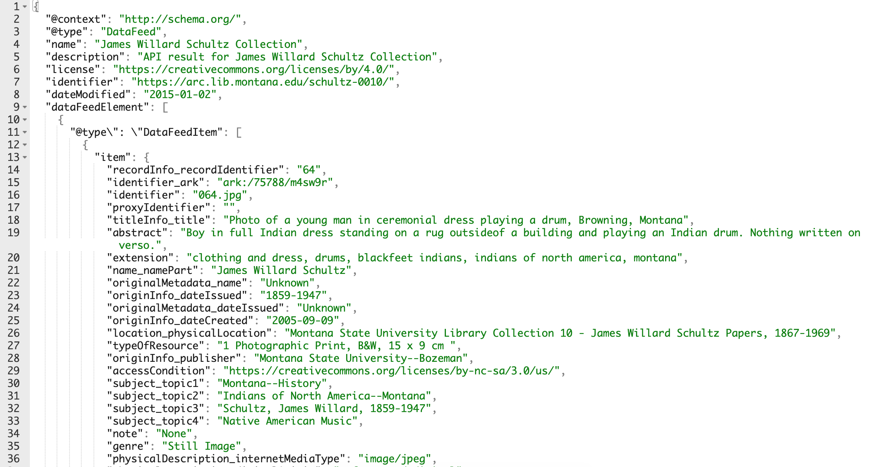
API Payload as a DataFeed (.jsonld)
https://arc.lib.montana.edu/schultz-0010/api.php?v=1&type=search&q=boy&limit=10&format=json

Slide 18
Prototype - Progressive Web App (PWA)
James Willard Schultz
Progressive Web App (PWA) built using DataFeed and RO-Crate standards as datastore (.jsonld)

Slide 19
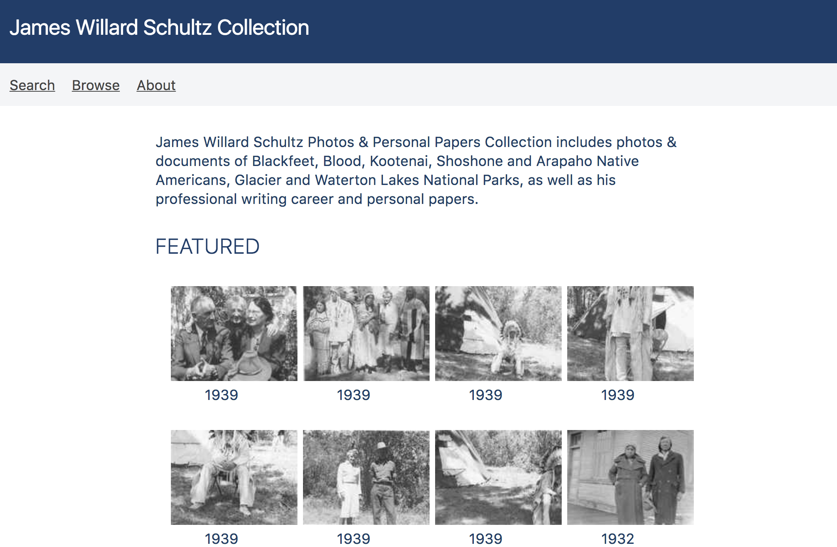
Prototype

Slide 20
Prototype

Slide 21
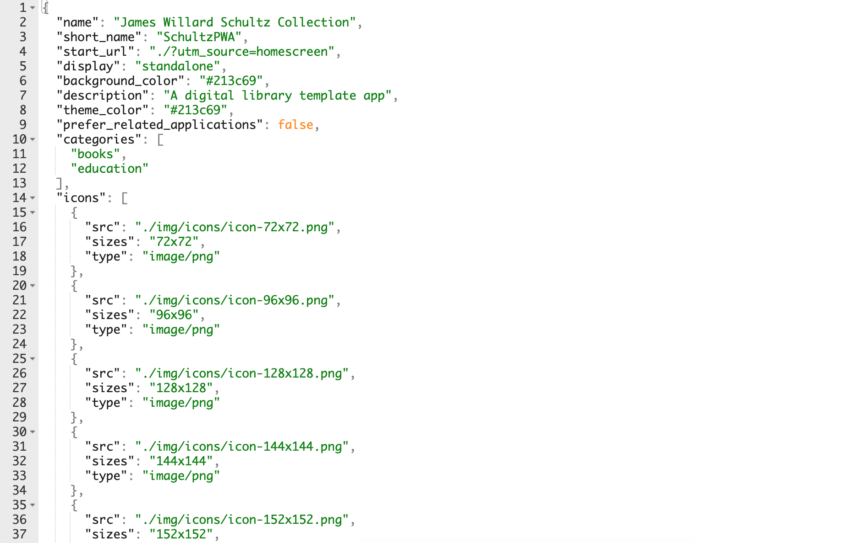
Manifest (.json)

Slide 22
Items (.jsonld)

Slide 23
Implications for
Research Data Practice

Slide 24
Collections as/are Dataset[s]
Implications
Identifying collections as datasets
Encoding collections as datasets
Prioritizing reuse
Prioritizing reproducibility
Connecting research data metadata practices to collections metadata

Slide 25
Research Implication
Collections are datasets.
- emulatable and preservable
- set up for indexing and metadata (manifest file)
- static “databases” that can be reused/redeployed

Slide 26
Research Implication
How can we continue to connect our worldviews?
- Cross-departmental appointments
- Recognition of emerging dataset standards
- Release our collections as datasets

Slide 27
**Thank you**
Jason A. Clark
@jaclark

